Slide 1

Hacking Your Facebook Data
Bernease Herman
@bernease
github.com/bernease

Slide 2
What is Machine Learning?
Machine Learning vs. Data Mining
Machine learning focuses on prediction, based on known properties learned from the training data.
Data mining (which is the analysis step of Knowledge Discovery in Databases) focuses on the discovery of (previously) unknown properties on the data.
“Machine learning” Wikipedia, accessed April 1, 2013
Machine Learning vs. Big Data
Information architecture, parallel computing, different kind of clustering
Myth: “It’s not the size of the data, but the way you use it.”

Slide 3
Defining the Problem
Feature set: known characteristics/facts about event/item, independent variables
Label: description of event/item, dependent variable
Supervised Learning: training set with labeled data
Semi-supervised Learning: small amount of labeled data, mixture of supervised and unsupervised
Unsupervised Learning: no labeled data, e.g. clustering

Slide 4
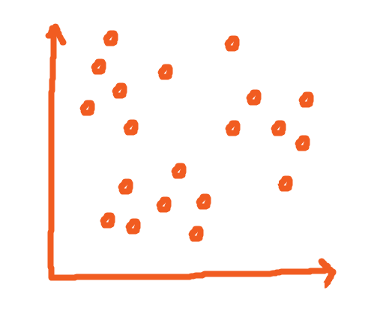
Clustering Method

Slide 5
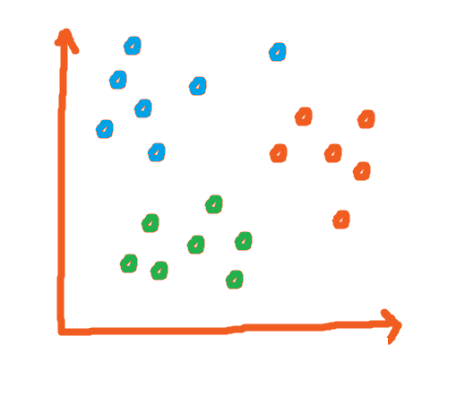
Clustering Method

Slide 6
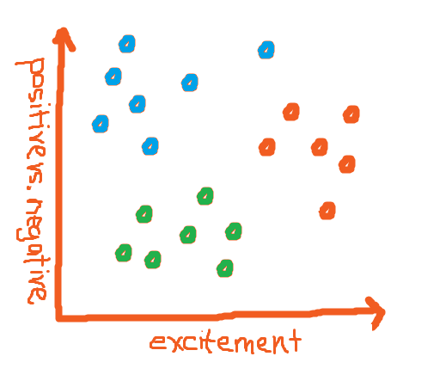
Clustering Method

Slide 7
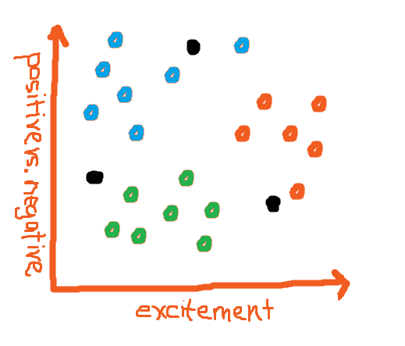
Clustering Method

Slide 8
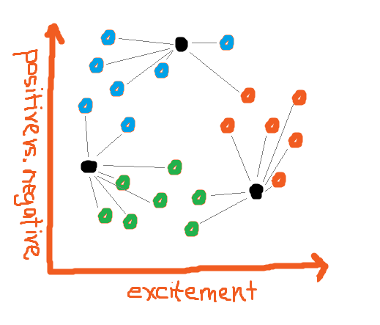
Clustering Method

Slide 9
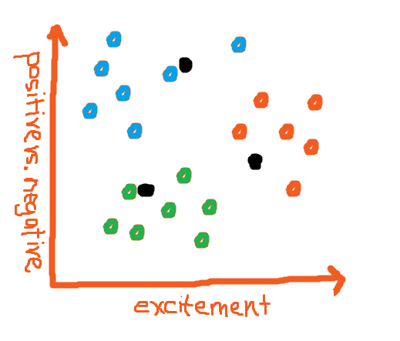
Clustering Method

Slide 10
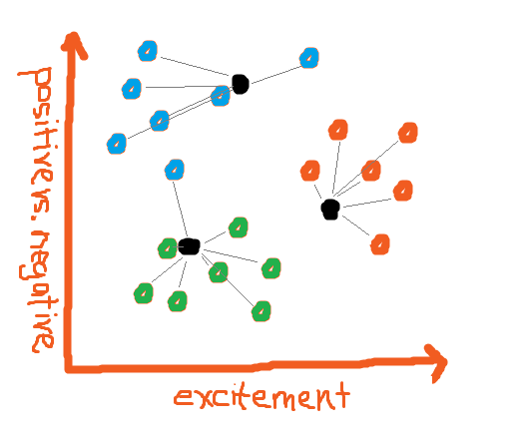
Clustering Method

Slide 11
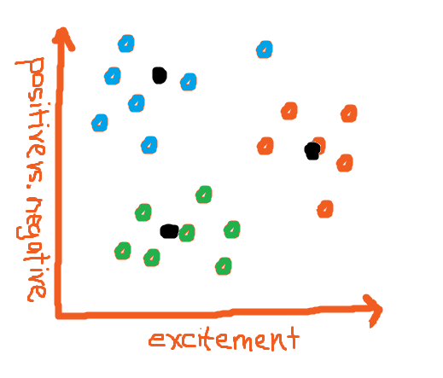
Clustering Method

Slide 12

Clustering Method

Slide 13
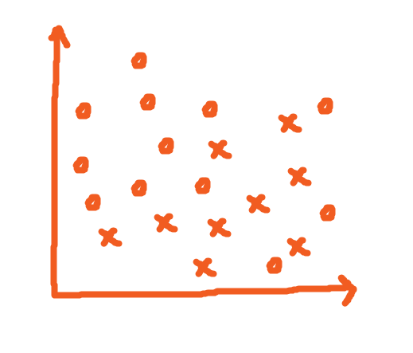
Classification Method

Slide 14
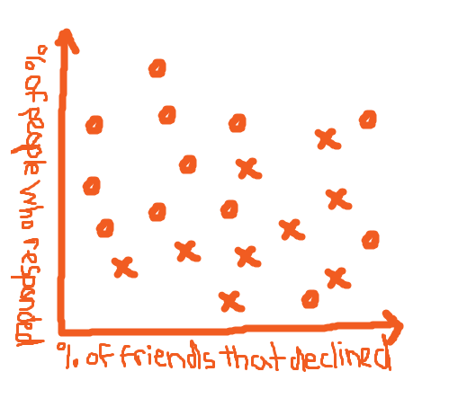
Classification Method

Slide 15
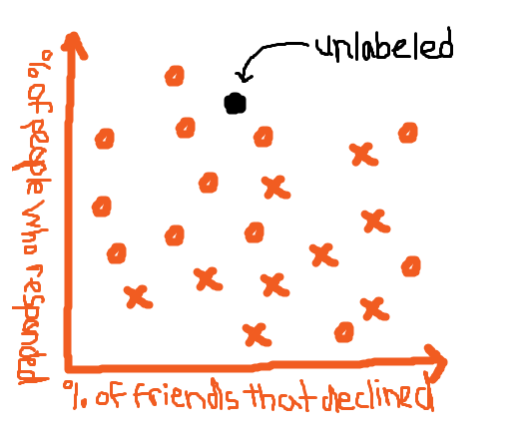
Classification Method

Slide 16
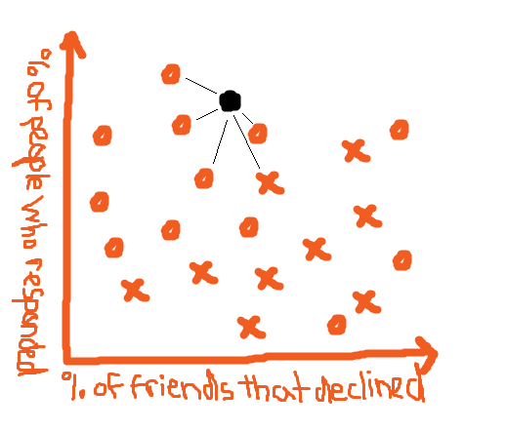
Classification Method

Slide 17

Classification Method

Slide 18
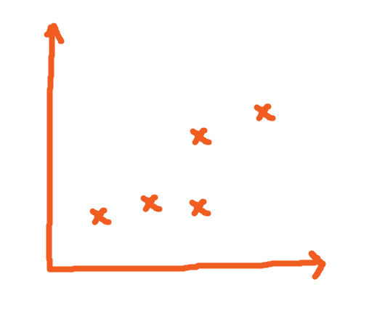
Collaborative Filtering Method

Slide 19
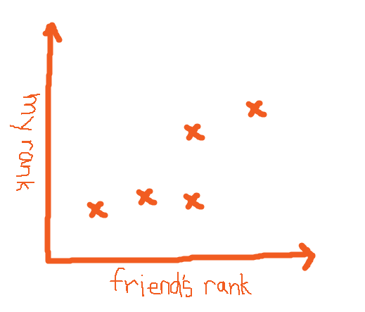
Collaborative Filtering Method

Slide 20
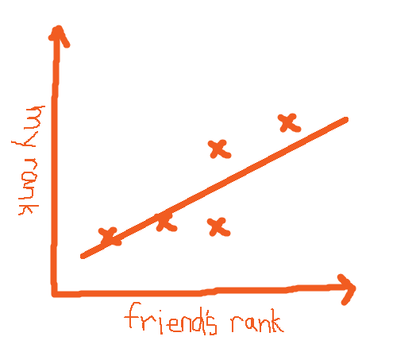
Collaborative Filtering Method

Slide 21
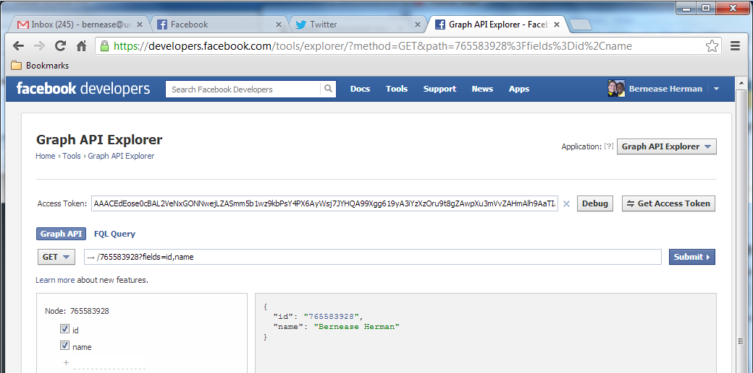
Getting Your Data
https://developers.facebook.com/tools/explorer/

Slide 22
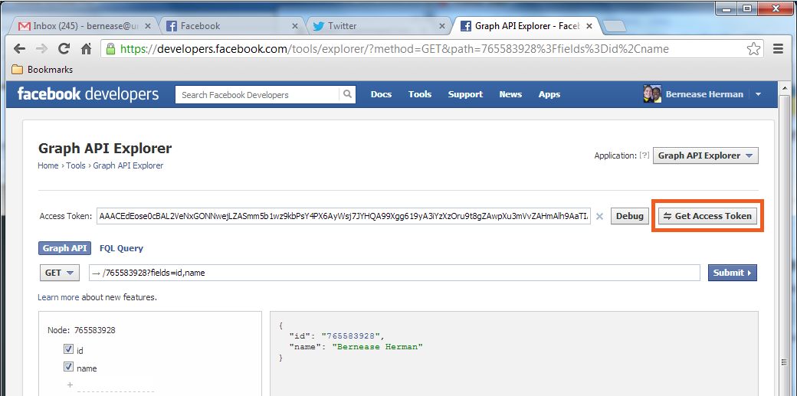
Getting Your Data
https://developers.facebook.com/tools/explorer/

Slide 23
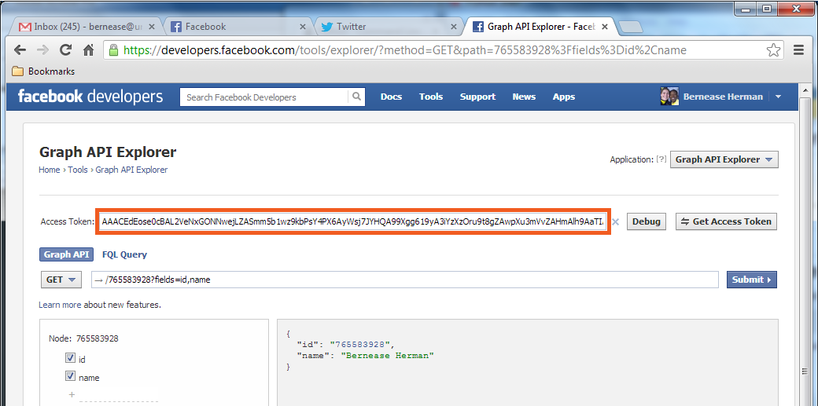
Getting Your Data
https://developers.facebook.com/tools/explorer/

Slide 24
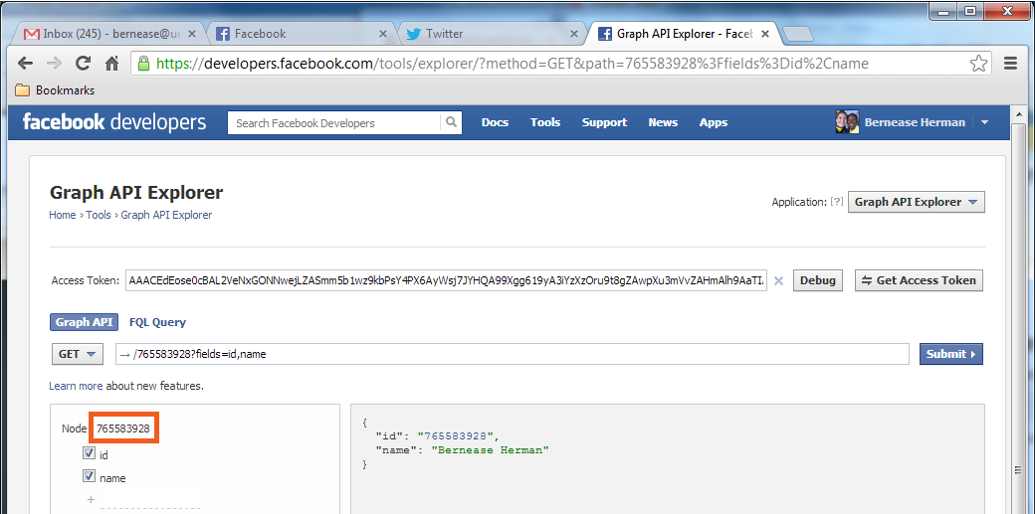
Getting Your Data
https://developers.facebook.com/tools/explorer/

Slide 25
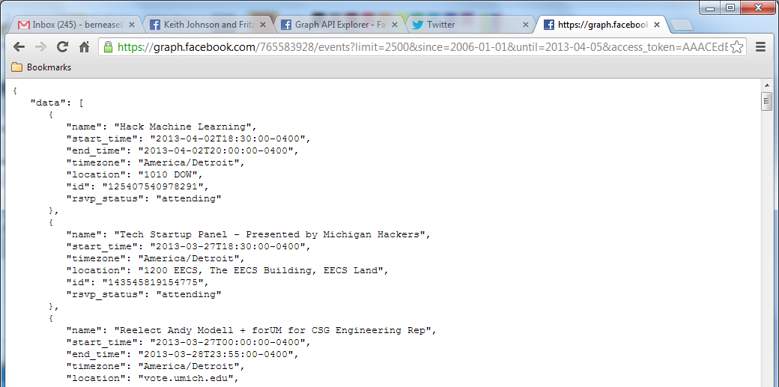
Getting Your Data

Slide 26

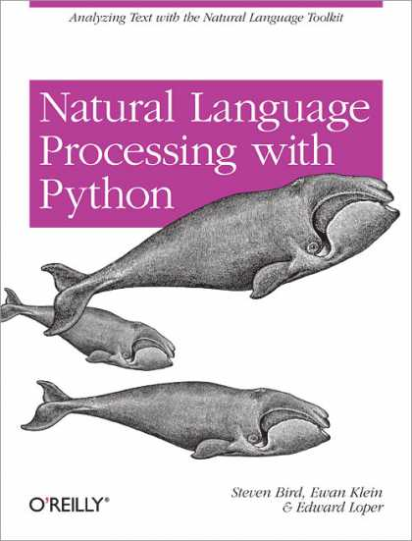
Books to Check Out

