Slide 1
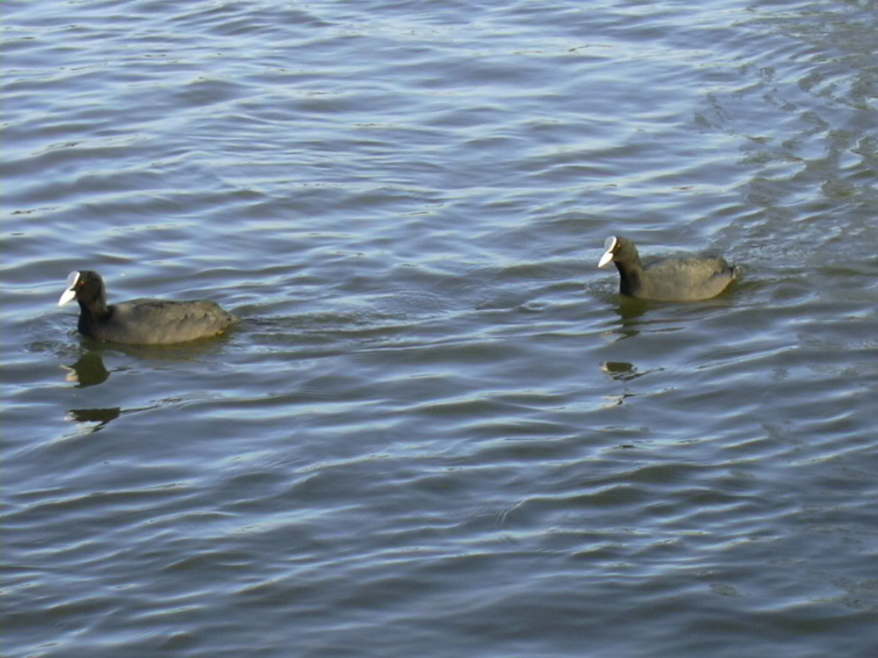
Common Coot
(Fulica atra)

Slide 2
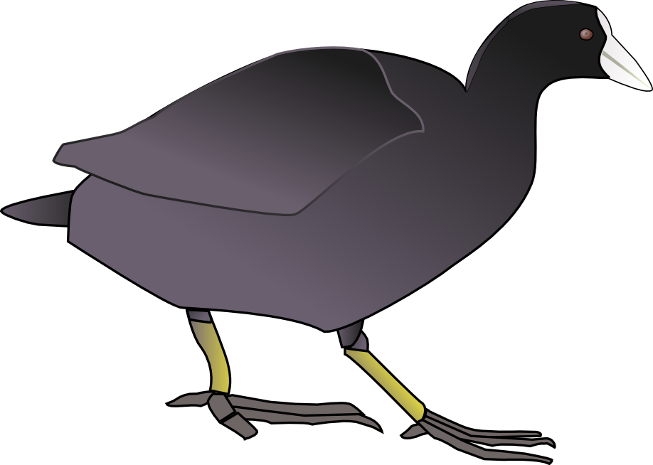
Model Building
An Introduction to Coot
Bernhard Lohkamp
Karolinska Institutet, Sweden
Lund June 20221

Slide 3



Model-Building
Place protein atoms in (best) electron density
Automated model building
e.g. buccaneer, ARP/wARP, resolve
Data/map
“Manual”(*) model building
e.g. Coot
(*) rather interactive real-space refinement
Notes:
Lowest res 6; Resolution for phase 1.5A

Slide 4
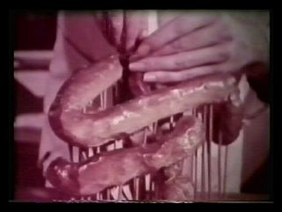
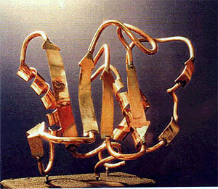
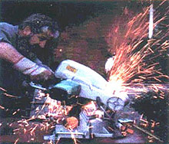
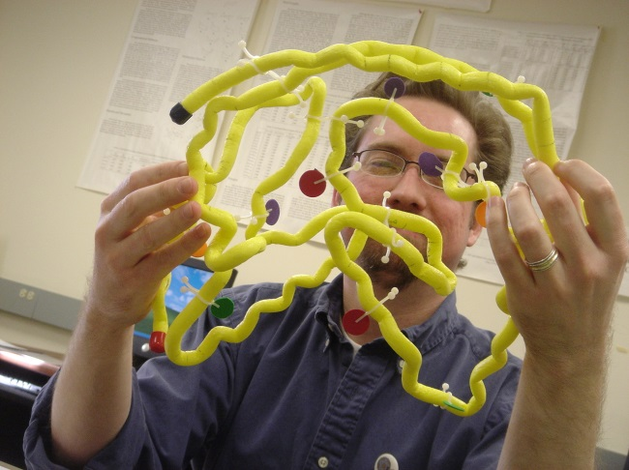
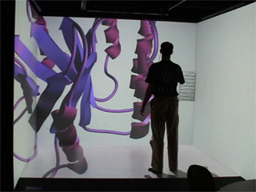
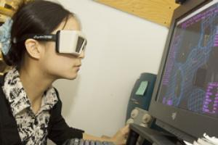
Model-Building
Kendrew (1957)
Rubin

Slide 5
… but why bother?
In the days of Automation
  why build something Interactive?
Automated model-building for complete models is still impossible
  It takes a brain to validate
Concerted correction/improvement of a model is difficult on the larger scale
Coot is built with Novice users in mind
  (but not exclusively)
It's fun!!!

Slide 6


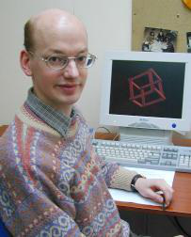
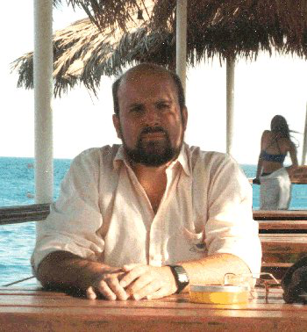
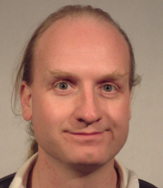


Coot Collaborators
Paul Emsley
Bernhard
Lohkamp
Kevin
Cowtan
Eugene Krissinel
Stuart
McNicholas
Martin
Noble
Alexei
Vagin

Slide 7
Coot
Molecular Graphics application
  Protein crystallographic(*) model-building tools (Crystallographic Object-Oriented Toolkit)
  Aims:
    Model building, completion, validation
    “Slick and powerful” interface to CCP4
Interface to other programs: SHELXL, Refmac, AceDrg, Probe&Reduce (MolProbity), EBI, EDS, Povray, Raster3D, PHENIX, ...
Several model-building and validation tools
(*) EM tools now too

Slide 8
(some) Coot features
displays maps and atomic macromolecular models
allows model manipulation, e.g.
  structure idealization & real space refinement
  manual rotation/translation, rigid body fitting & rotamer selection
  ligand search, solvation, mutations
  Ramachandran plots, non-crystallographic symmetry (NCS)…
interfaced to other programs
  Refinement
  Phasing
  Model validation and analysis

Slide 9
Feature Integration
Refinement
External
Internal
Validation
e.g. REFMAC
Internal
External
e.g. MolProbity
Validation, Model Building and Refinement should be used together

Slide 10
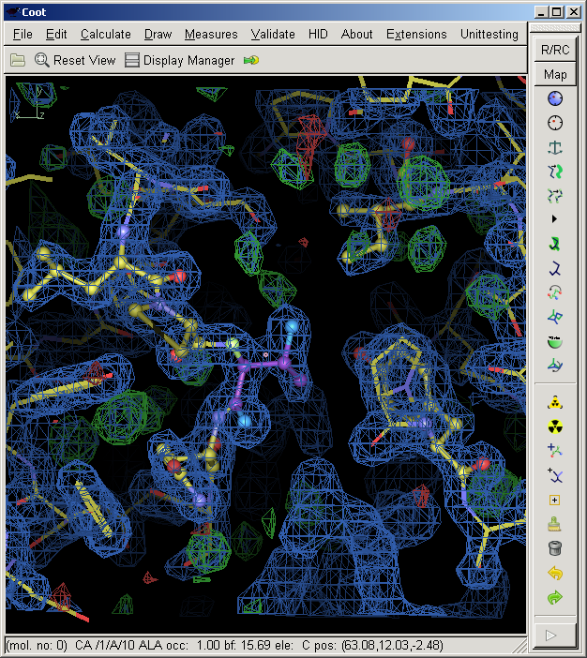
Menus
Main toolbar
(customizable)
Model/fit/refine
Toolbar
(access to main
functions)

Slide 11
What is “Refinement”?
The adjustment of model parameters (coordinates) so that the calculated structure factors match the observations (map) as nearly as possible
  In “one-shot” real-space refinement, such as in Coot, this translates to:
    move the atoms into as high density as possible while minimizing geometrical distortions

Slide 12
Refinement real vs reciprocal space
Real Space
  Refinement against electron density (map; E_{map})
Reciprocal Space
  Refinement against structure factors (E_{xray})
Minimize:

Slide 13
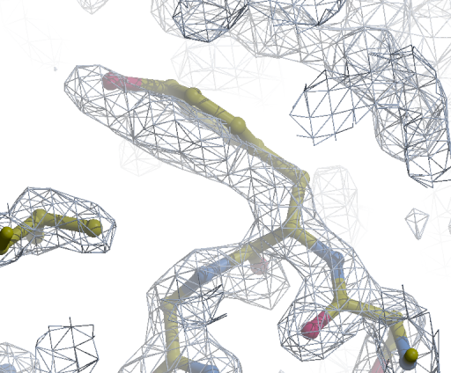
Distorted Geometry Pre-Refinement

Slide 14
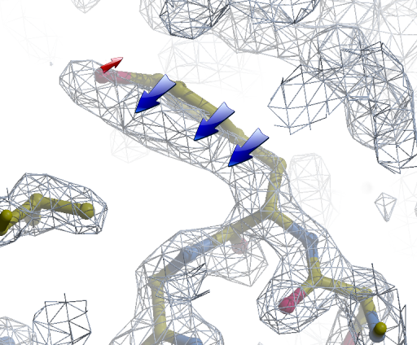
Refinement Gradients

Slide 15
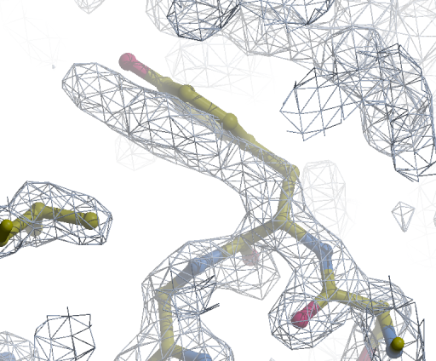
Refinement: Cycle 3

Slide 16
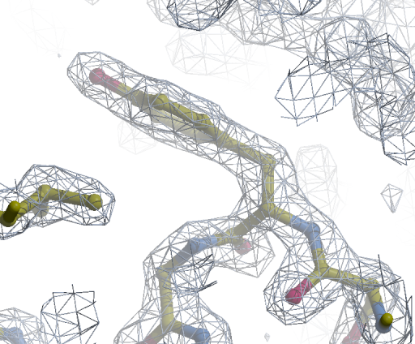
Refinement Cycle 200: Minimized

Slide 17
Real Space Refinement
Diamond, R. (1971). Acta Cryst. A
27, 436-452.
Major feature of Coot
  Gradient minimizer (BFGS derivative)
  Based on mmCIF standard dictionary
  Minimizing bonds, angles, planes, non-bonded contacts, torsions, [chiral volumes, Ramachandran]
Provides “interactive refinement”
  Atom positions can be moved after refinement (white)
Chi squares (easy evaluation of result)
Threaded (0.9 onwards):
  Target function and derivative evaluation, model and map all happen simultaneously now
  => more atoms, smoother updates and/or closer to the minimum
Fast & Animated

Slide 18
Which map to use?
Direct maps
  Calculated from experimental amplitudes and phases inferred from diffraction or model
  2Fo-Fc, density modified map (experimentally phased, MR or refinement), usually blue
  Covers the model (if Fo≈Fc => Fo)
Difference map
  Highlight errors in model
  Fo-Fc, usually red (negative, i.e. too much model, Fc>Fo) and green (positive, i.e. not enough model, Fo>Fc)
Composite map
  Combination of above
  e.g. 3Fo-2Fc ≈ 2Fo-Fc + Fo-Fc

Slide 19
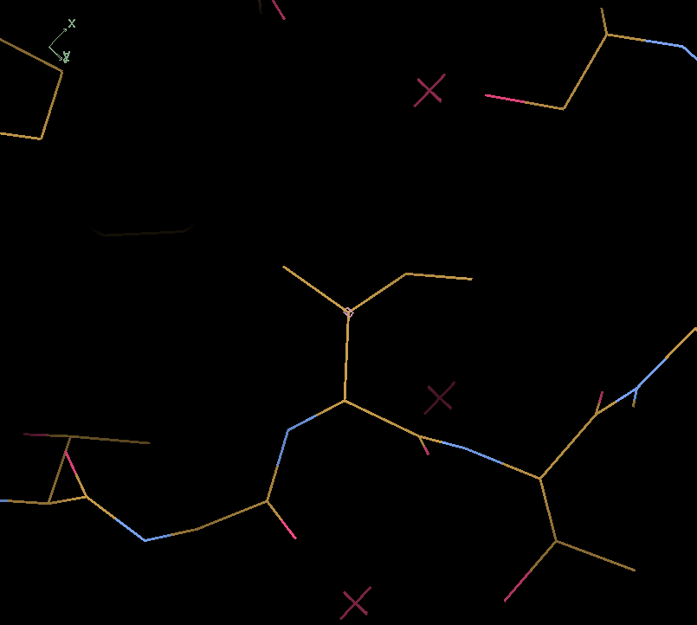
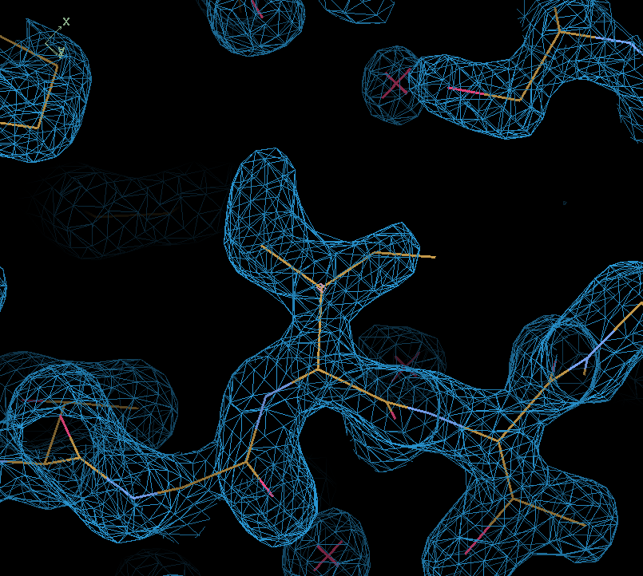
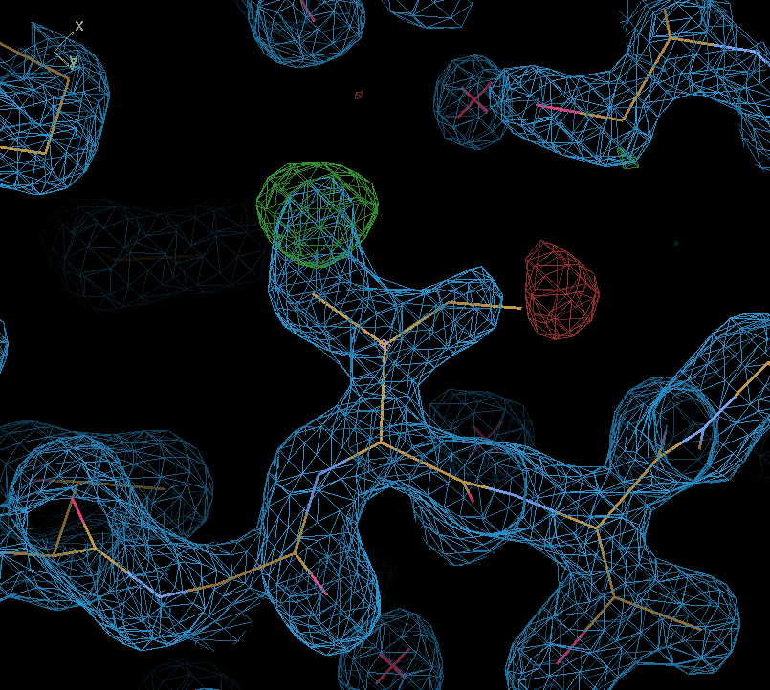
Green: Positive Level
Red: Negative Level

Slide 20
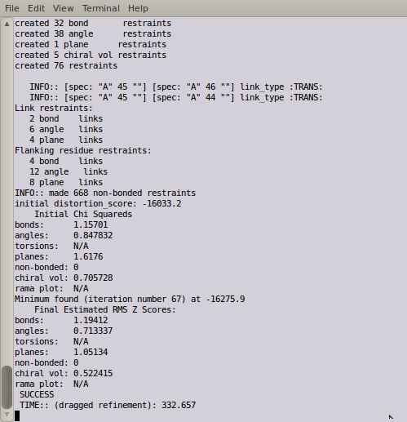
Representation of Refinement Results:
The first attempt
Student Reaction:
“Oh, I don't look at that window...”

Slide 21
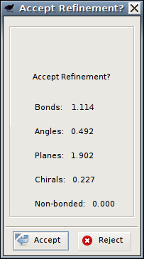
Representation of Refinement Results:
Second attempt...
Student Reaction:
“Oh, box of meaningless numbers.
Go away”

Slide 22
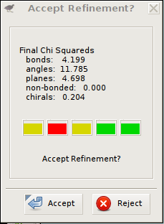
Refinement “Traffic Lights”
“Traffic Lights” represent the
chi-squared values for each of the refined geometry types
e.g. bonds length (b):

Slide 23
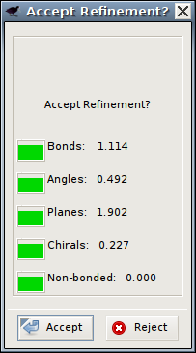
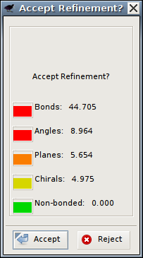
Representation of Results: “Traffic Lights”
“Traffic Lights” represent the chi-squared values for each of the refined geometry types
Good refinement
Bad refinement

Slide 24
Refinement Techniques
Single-Atom Drag
Key-bindings:
  Triple Refine
  Single Residue Refine with Auto-accept
Ramachandran Refinement
Sphere refinement
Crankshaft Peptide Optimisation
Coming at some point..?
  VR (Hamish Todd)
  AR

Slide 25
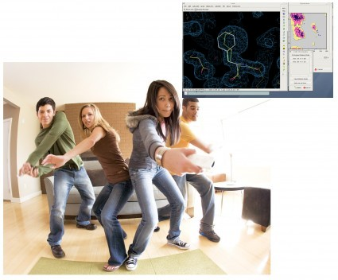
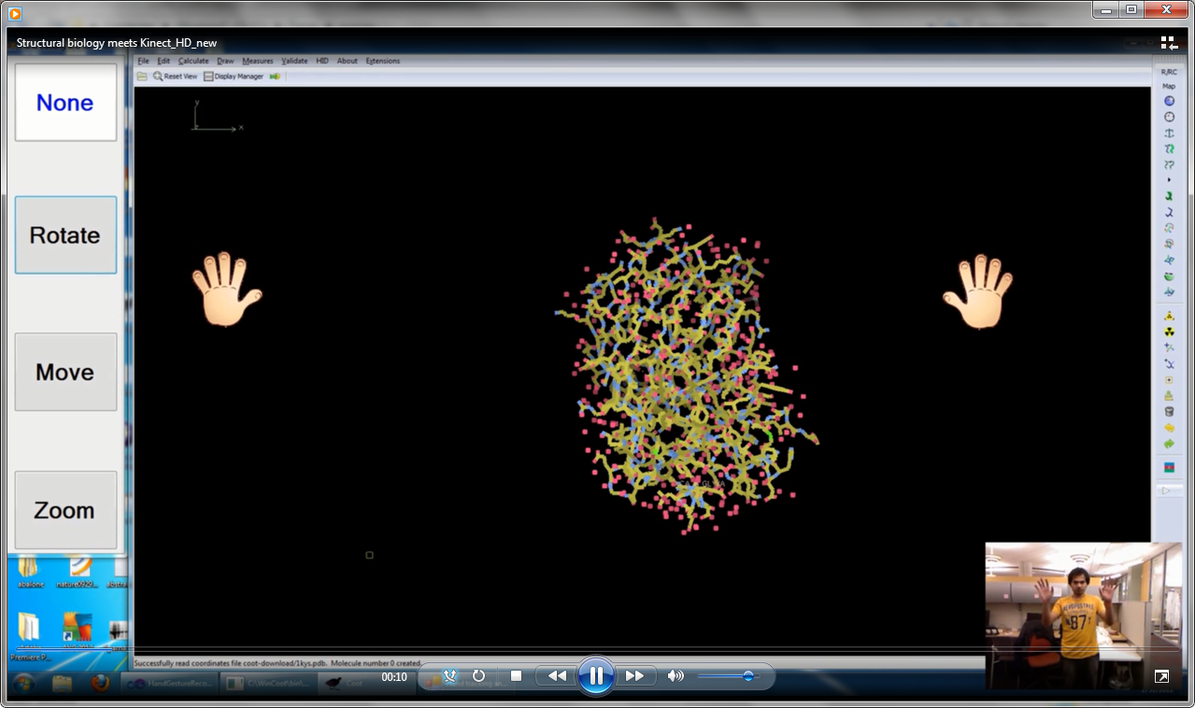
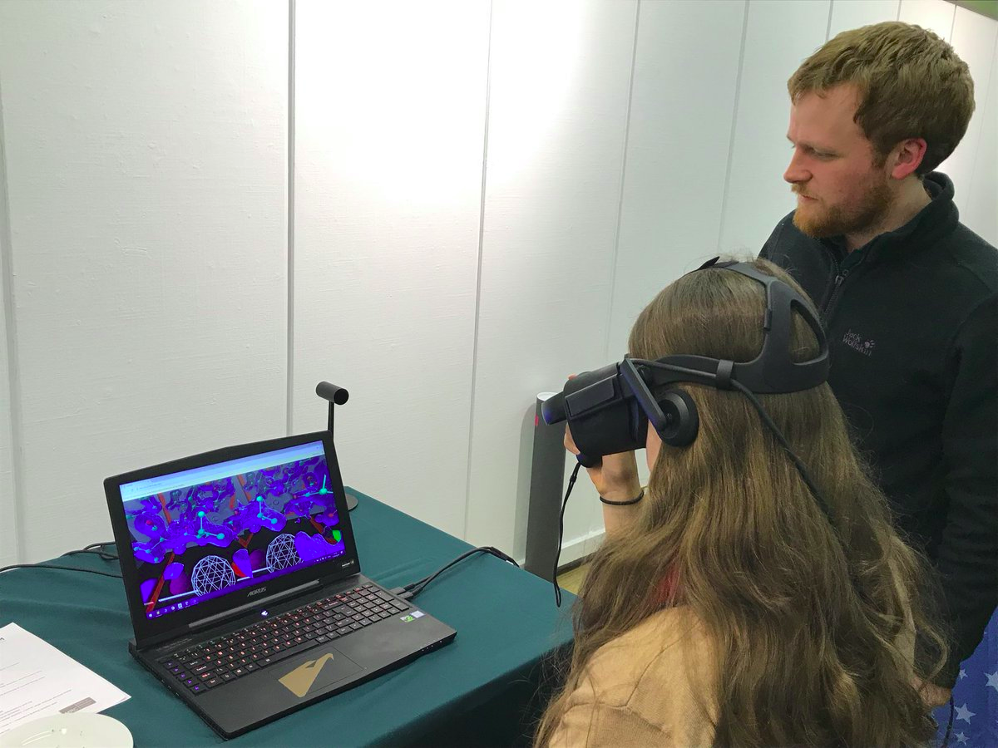
Wii/VR Refinement?

Slide 26
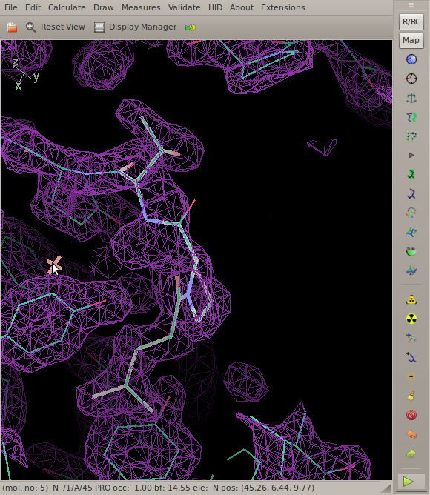
Single-drag
(Ctrl-left mouse)
(over dragging – out of density: not required any more usually)

Slide 27
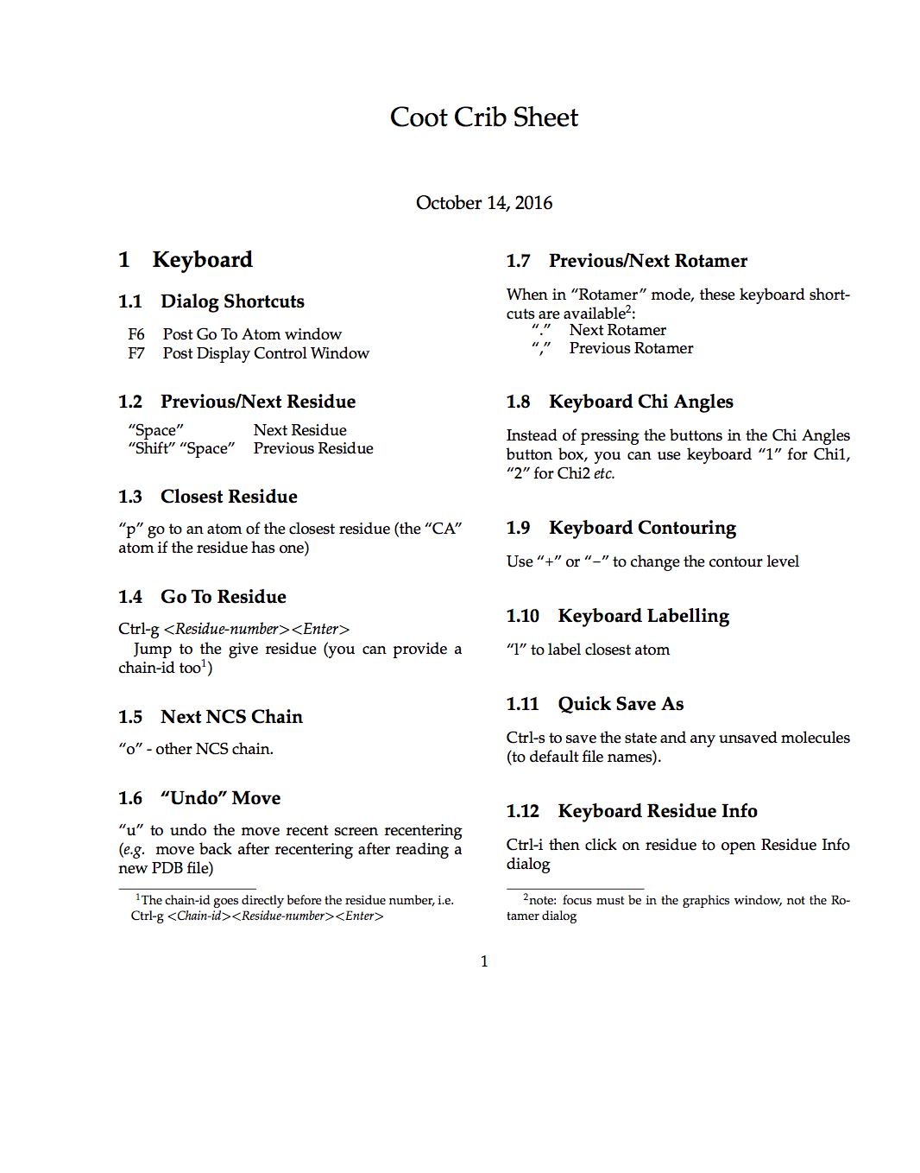
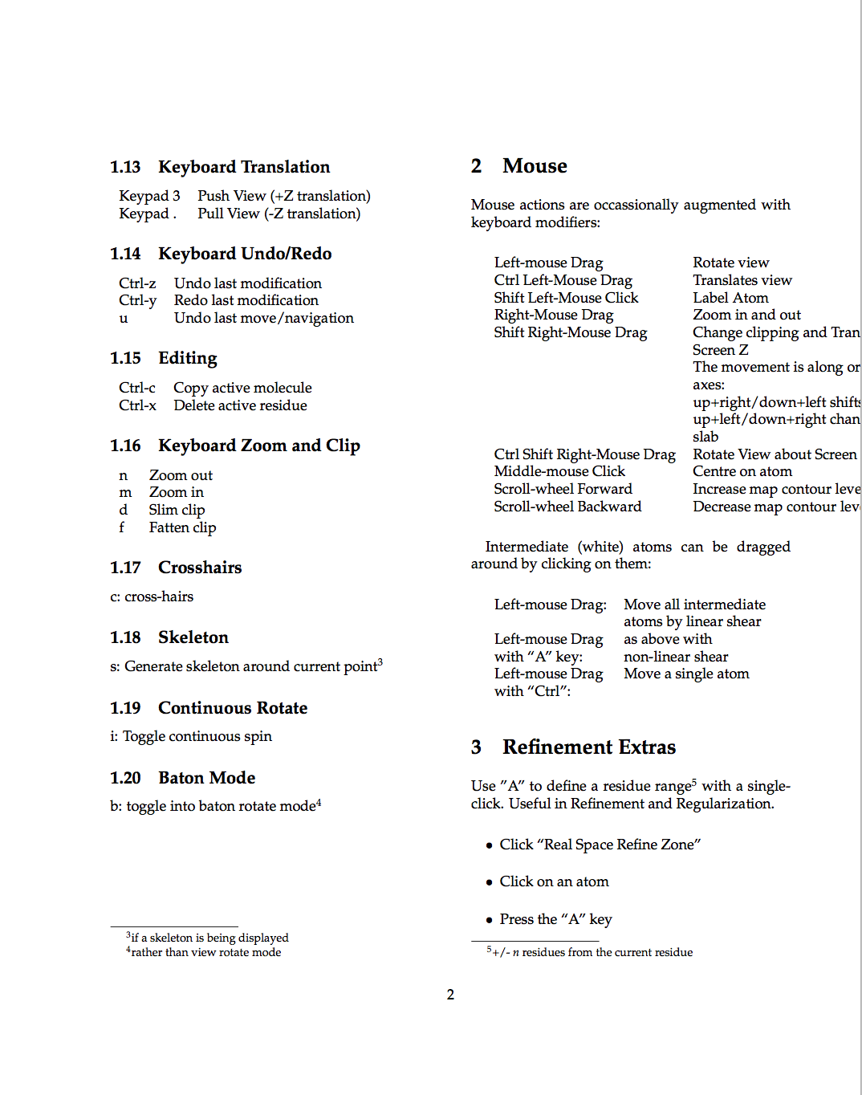
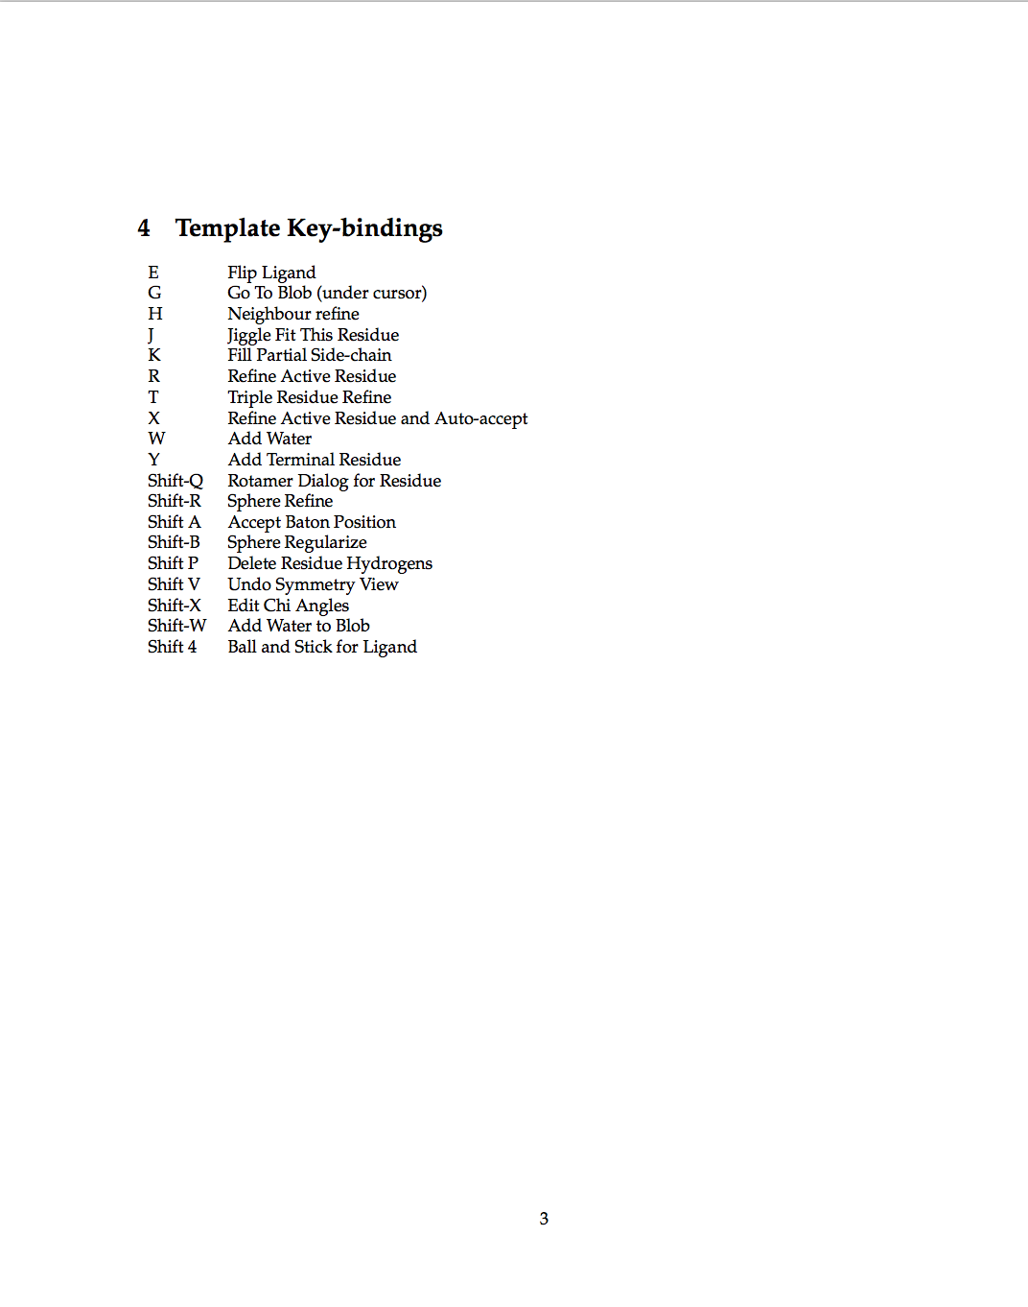
Coot Key-binding Crib-Sheet

Slide 28
“Sphere” Refinement
Given an “Active”* Residues*
  Define a sphere of residues around it and use them all for refinement
    NOT just a linear selection
  Residues from different chains (or different parts of the same chain) interact
  Make CYS-CYS or glycosylation links as you find them
    Use the group and link_list chem_link in the dictionary
* Active residue = residue closest to the screen centre

Slide 29
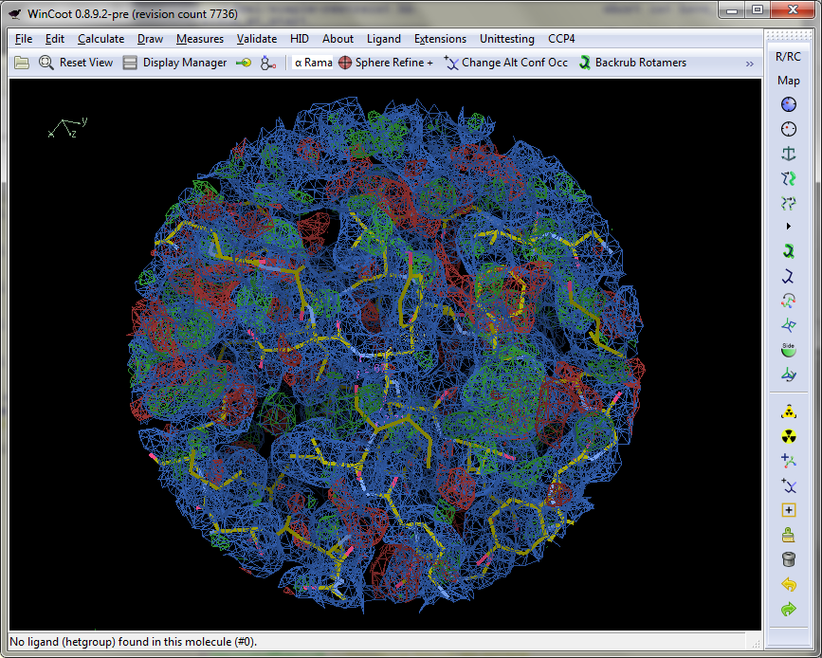
Limit model and map display
Map
  Sphere
  Use Preferences to set radius
Coordinates
  All
  Within radius
  Symmetry...

Slide 30
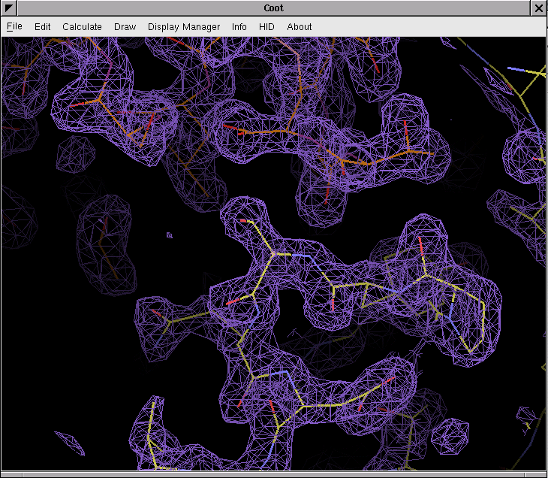
Electron Density: “Continuous Crystal”

Slide 31
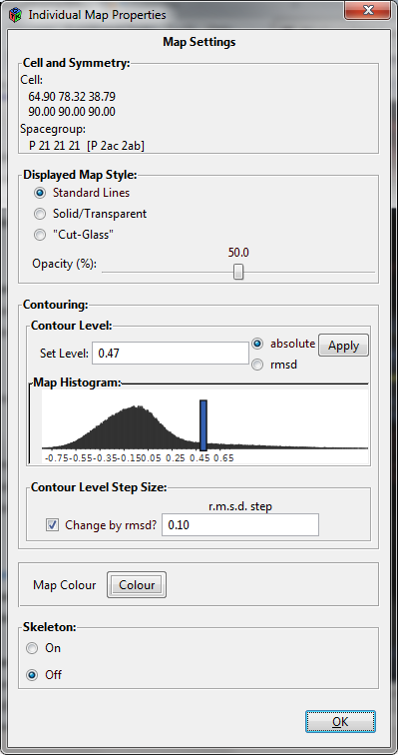
Map properties
Different display styles
  Standard
  Solid
  Cut-glass
Histogram (interactive)

Slide 32
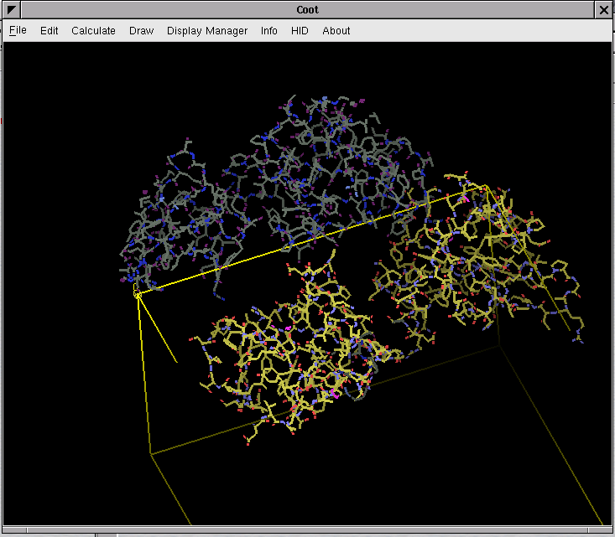
Symmetry
Display
  crystallographic symmetry copies
  Unit cell
Investigate crystal packing (voids?)
Helps tracing/model building

Slide 33

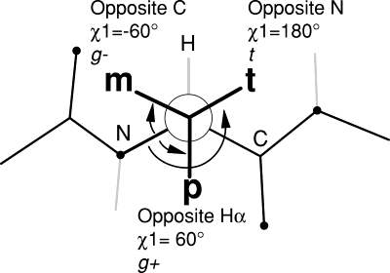
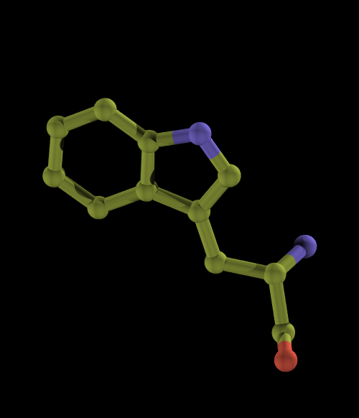
Side-chain Rotamers
Rotamers are preferred configurations of a side-chains rotatable bonds
“preferred” means these configurations occur more frequently in a set of reference protein structures
“preferred” because they are low-energy conformations (staggered rather than eclipsed)
Several Rotamer “databases” exist
chi2
chi1

Slide 34
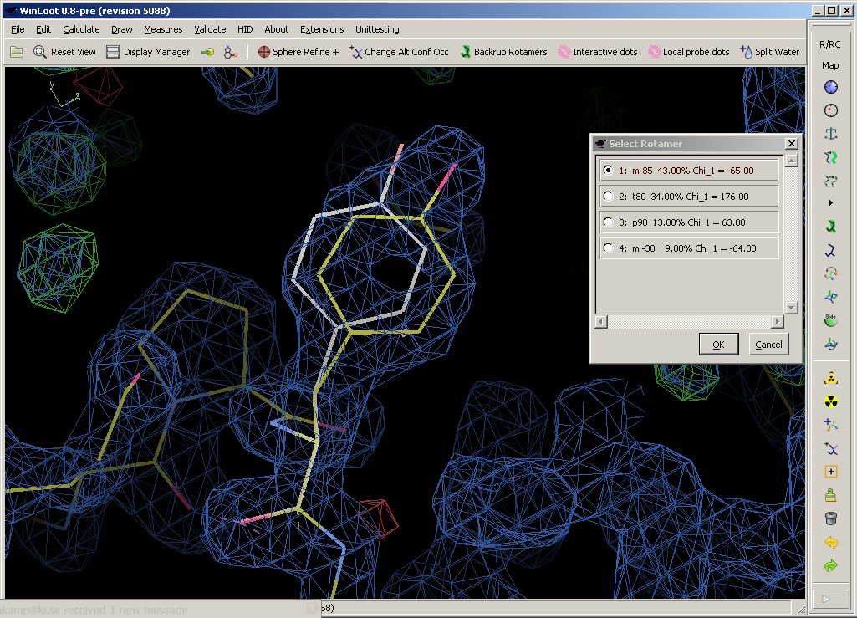
Rotamer Database Molprobity Option

Slide 35
Some more Coot Tools…
Add Terminal Residue
  ϕ,ψ hypothesis scoring
Alternate Conformations
Ligand fitting/search
Rigid-body Fitting
  Steepest Descent
  Simplex (slower but better)
“Move Molecule Here”
Water Search
Fill-partial-residues (after MR)
Dots, ball&stick representation

Slide 36
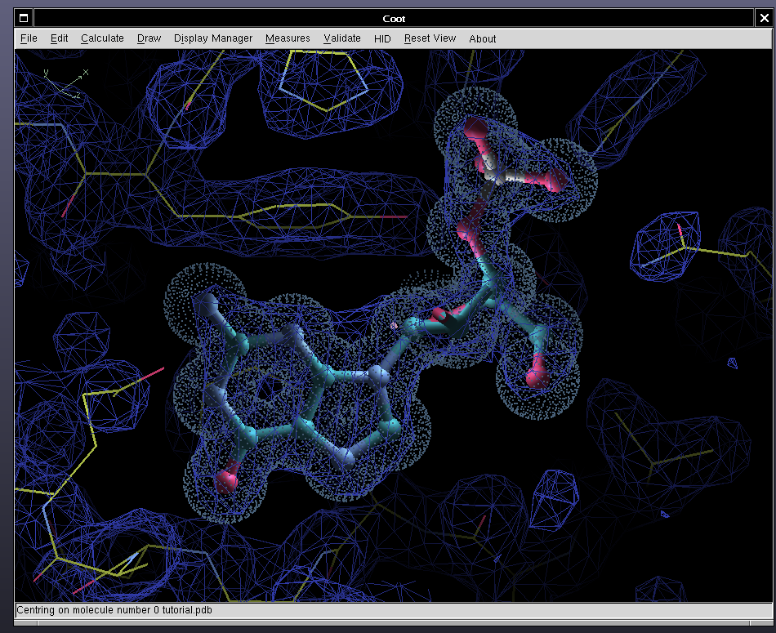

Slide 37
Low Resolution/Extra Tools

Slide 38
Extra Restraints....

Slide 39
Extra Restraints....
Ramachandran restraints
Secondary structure restraints
Remove degree of freedom
  Torsion angle restraints
  Backrub rotamers
Manually add restraints
Map sharpening
[Jiggle fit]
[Morphing]

Slide 40
Ramachandran Restraints
Scenario:
  I have a loop, with poor density, I know the atoms are there somewhere and I want to provide a “reasonable” model
Controversial Feature?
  Ramachandran Plots have been used for “validation” - but here we are deliberately optimizing them
Ramachandran Plots can be added to the geometry target function

Slide 41
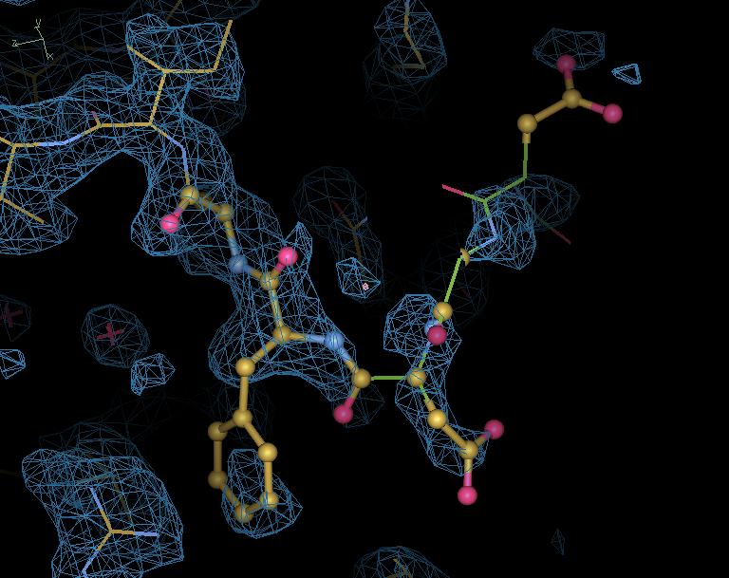

Slide 42
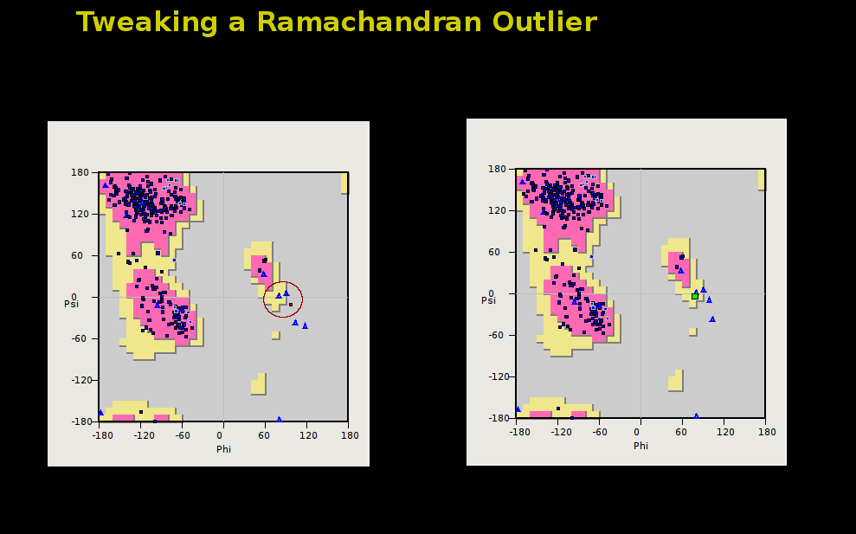

Slide 43
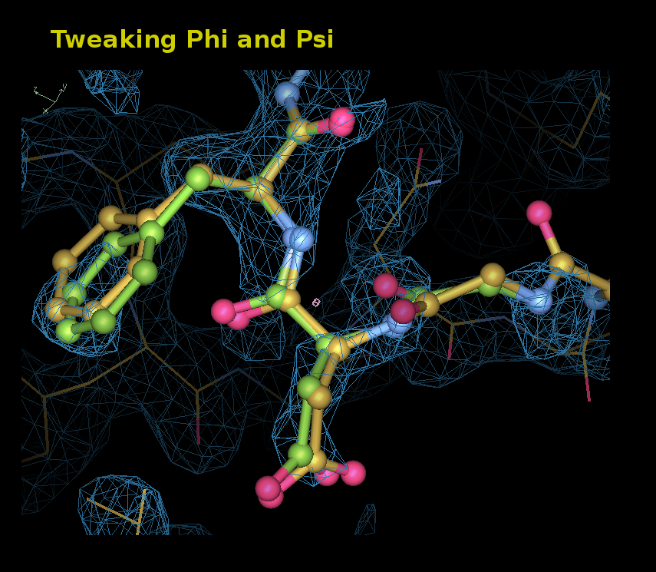

Slide 44
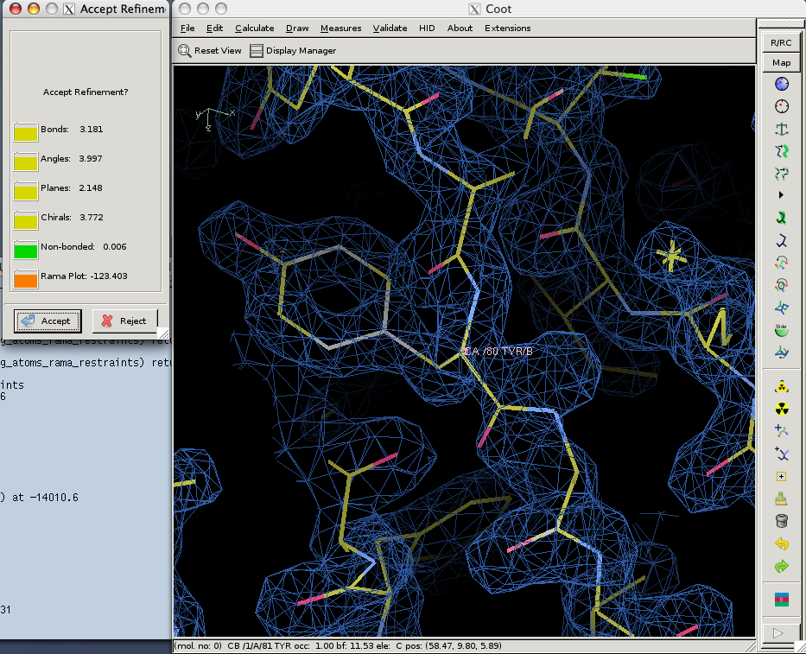

Slide 45
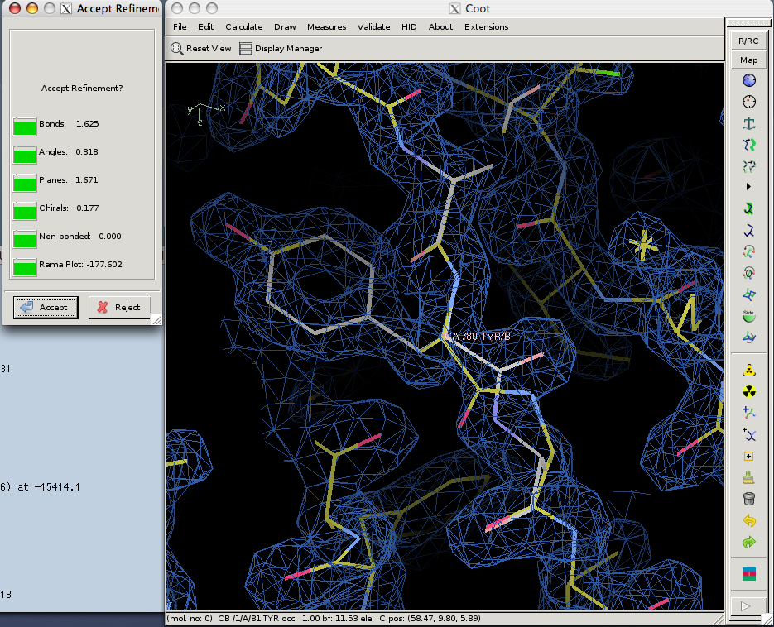

Slide 46
Ramachandran Restraints
Controversial?
  “... the Ramachandran Plot is one of the simplest and most sensitive means for assessing the quality of a protein model...”
    Gerard Kleywegt & Alwyn Jones (1996)
But to quote Jane Richardson:
  Do you want a better structure – or a better idea of the quality of your structure?

Slide 47

Adding Torsion Angle Restraints
Torsion angle refinement is slow (relatively)
  Simple addition of these restraints to the geometry target function
    often makes the region “stuck and unsatisfied”
    i.e. trapped in local minimum
Add Pseudo-bonds

Slide 48
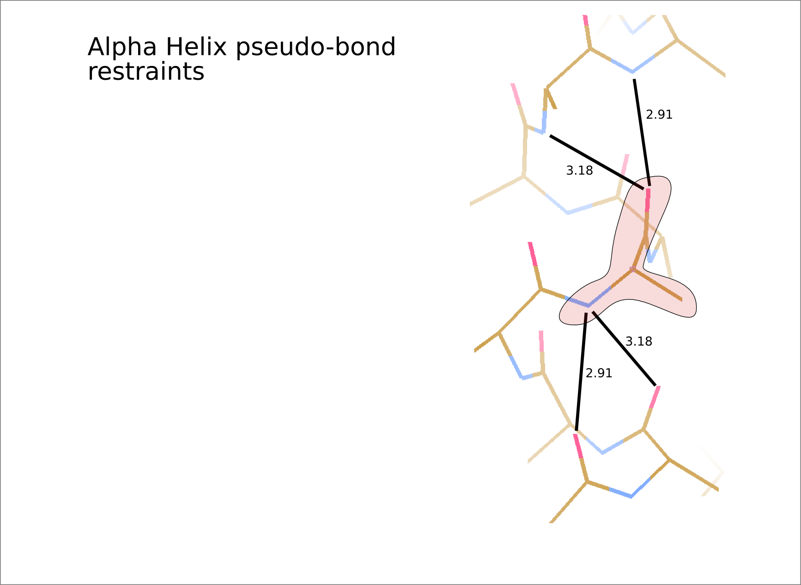
Restrain the Hydrogen-bonding
atom distances

Slide 49
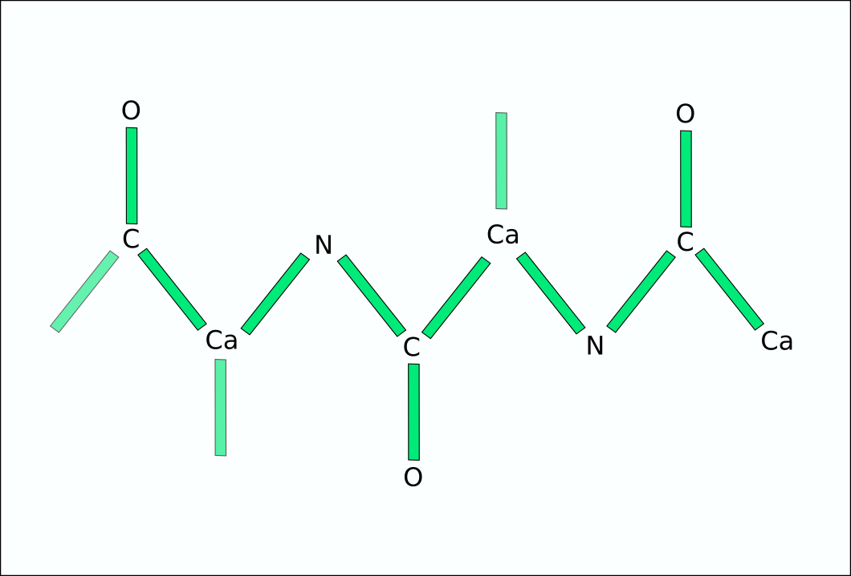

Slide 50
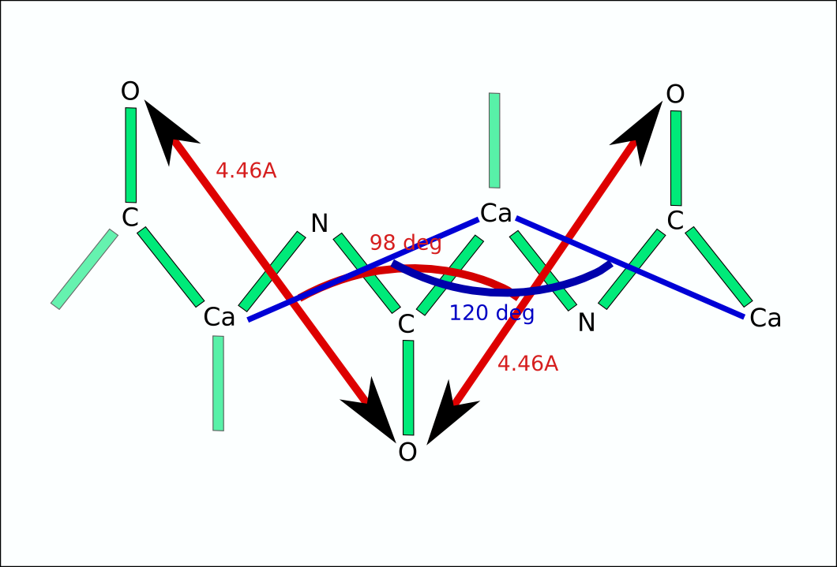

Slide 51
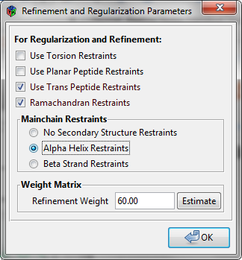
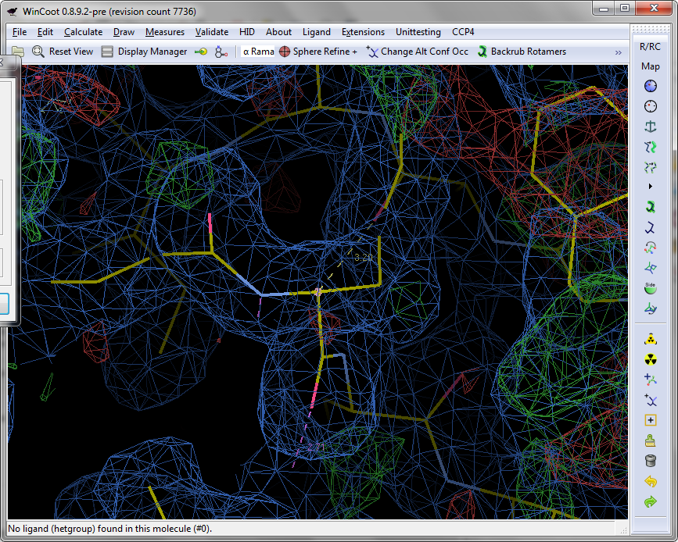
Activate restraints
start here
indicator
Refinement weight,
the smaller
the tighter geometry

Slide 52
”Backrub Rotamers”
High probability models with low resolution data

Slide 53
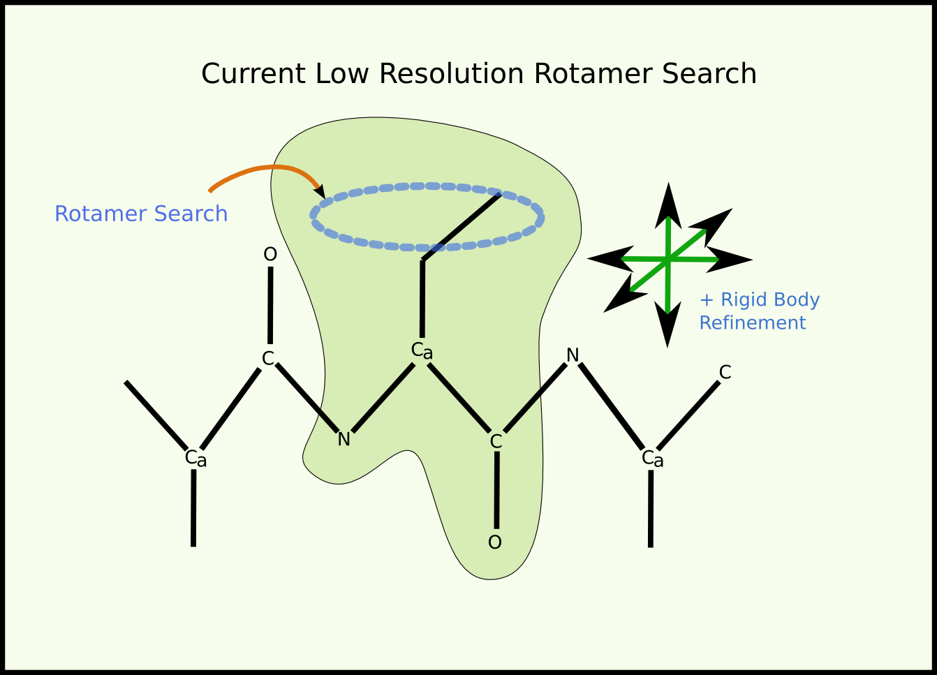
Previous

Slide 54


Slide 55


Slide 56


Slide 59


Slide 60


Slide 61

Traditional
Backrub

Slide 62
To turn it on...
automatically for resolution > 2.9Å
via
  Extensions → Modelling → Rotamer Search
  scripting:
    guile: (ROTAMERSEARCHLOWRES)
    python: set_rotamer_search_mode(ROTAMERSEARCHLOWRES)
  toolbutton

Slide 63
Map Sharpening
Which B-factor shall I use to get the
most interpretable map?
Interactively adjust the structure
factor amplitudes and re-generate
the map with FFT and recontouring…
Try to optimise using map kurtosis
Notes:
Kurtosis: measure of map sharpness

Slide 64



Slide 65

2XGJ: Mtr4 (Wier et al., 2010)

Slide 66

2XGJ: Mtr4, Weir et al. (2010)

Slide 67
Secondary structure building

Slide 68
Alpha Helix Placement
Scenario: Looking at a new map, not built with automatic tools:
  “I can see that there’s a helix here - build it for me!”
From a given point:
  Move to local averaged maximum
  Do a 2D MR-style orientation search on a cylinder of electron density
  Build a helix (both directions)
  1D Rotation search to find best fit
  Score based on density at CB positions
  Trim ‘n Grow

Slide 69


Slide 70


Slide 71

Strand Placement
Similar but unlike Helices, Strands have to be treated as non-idealized
  Repeating a single phi/psi value doesn't make a structure that fits “real-world” density
Curvature of strands should be taken into account
  Use selections from a “database” of good structures

Slide 72


Slide 73

Automated Fast
Secondary Structure Search

Slide 74
Loop fitting
Simple loop fitting
  Add residue by residue (from both termini)
DB loop
  Fitting fragments from database

Slide 75

Loop fitting

Slide 76



Slide 77

cis-Peptides
Now replaced by trans-peptide
pseudo-bond centre distance
restraints

Slide 78

cis-Peptides

Slide 79

cis-peptide Representation
Pre-PRO
Twisted-trans
Non-pre-PRO

Slide 80
Jiggle Fit
How do I rotate and translate these atoms to fit the density?
  6-dimensional problem
Originally used to fit simple ligands/solvent molecules to blobs of density
Now extended to fit arbitrary atom selections
  e.g. by Chain

Slide 81
Jiggle Fit: How it Works
Loop 1000 times:
  Generate random angles and translations
  Transform atom selection by these rotations and translation
  Score and store the fit to density
Rank density fit scores,
  Pick top 20 solution, for each of them
    Rigid body fit and score solutions
    Pick the highest scoring solution if it's better than the starting model)
Radius of Convergence is larger when using a low-pass map

Slide 82


Slide 83


Slide 84


Slide 85
Model Morphing:
How it Works
For each residue in a chain, we ask:
  where does a small fragment centred on this residue want to go?
  (Robust) average the transformations and apply them on a per-residue basis
Repeat

Slide 86

Model Morphing:
Generating the Raw RTs

Slide 87

Model Morphing: Example

Slide 88
Model Morphing:
Robust Averaging
What are the residues in the environment of a residue?
  What are their RTs?
  Create a metric 'distance', sort on that
  Discard the top and bottom 20%
  Use remaining RTs to generate average
  ...which is then applied to central residue
Repeat for all residues
Larger environment radii make the shifts smaller/more conservative
  More cycles needed

Slide 89


Slide 90


Slide 91


Slide 92


Slide 93


Slide 94

Model Morphing

Slide 95

CURLEW:
Coot Utilities and Refinement Library Extention Wranger
Easy access to ”interesting” Coot scripts

Slide 96
A Few Tools More...
More restraints
  ProSMART
  User defined
  Planes, DNA (libg) etc.
Carbohydrate-fitting
  N-linked glycosylation
Use of NCS
  Copy chains
Scripting

Slide 97
Ligands in Coot
Ligand fitting
Importing and building ligand from scratch
  AceDRG, PRODRG, pyrogen, LIBCHECK
Validation
Representation
  Surfaces
Analysis
  Molprobity, LIDIA

Slide 98
Ligand building

Slide 99


Cocktail Examples

Slide 100


Ligand search in Coot
Which ligand (flexibility?)
Which map
What to do with the protein (mask)
Where to search
How many sites to find
  Acceptance levels
Map level
No of conformers
Real space refine

Slide 101


2D Ligand Builder
Free sketch
AceDRG (PRODRG)
Notes:
Stamp out fragments, change atom types, and has interactive SMILES string

Slide 102


Ligand Validation
Mogul plugin in Coot (distortions can be shown without)
  Run mogul, graphical display of results
  Update restraints (target and esds for bonds and angles)
  Ligand distortion can be analysed without Mogul

Slide 103

Interactive:
Mouse over interacting residues =>
Highlighted in structure

Slide 104


Slide 105
A bit of validation and blobology
Validation of model only
Ramachandran Plot
  Kleywegt Plot (NCS differences)
Geometry Analysis
Peptide  Analysis
Temperature Factor Analysis
Rotamer Analysis
Clashes
Validation of model fit to density
Density Fit Analysis
Difference Map Peaks
  Variance analysis at water positions
Unmodelled blobs

Slide 106



Validation tools in Coot

Slide 107

New
Ramachandran plot
Smooth outline
Outliers only
Selection only
Save pdf
Stand-alone
Quick change to Kleywegt plot (incl. chains)

Slide 108

Interactive plots
-red/large = “bad”
-small/green = “good”

Slide 109


Blobology
What can be there?
  Crystallisation solution
  Protein buffer
  Purification buffers
  Medium (and metabolites)
Can it be there? i.e. do we have sensible interactions
Distance? (use pointer or environment distance
Correct chemistry?
Check symmetry
Accept that not everything can be modelled but provide the best possible model

Slide 110


Coot Present, and Futures…
Aim:
  Slick, easy to use
  Powerful
  Smooth interface to external applications
Under Development
  Interesting things move quickly
  There may be bugs
  Python 3, GTK3 – Coot 1.0

Slide 111
Further information
Coot WIKI
  http://strucbio.biologie.uni-konstanz.de/ccp4wiki/index.php/Coot
Coot BB (mailing list)
  http://www.jiscmail.ac.uk/lists/coot.html
Coot documentation
  http://www2.mrc-lmb.cam.ac.uk/personal/pemsley/coot/web/docs/
YouTube
  Various tutorial
  https://www.youtube.com/c/PaulEmsley

Slide 112
Acknowledgements
http://www2.mrc-lmb.cam.ac.uk/personal/pemsley/coot/
or
Google: Coot
or for WinCoot
https://github.com/bernhardcl/coot
Paul Emsley
Kevin Cowtan
Eleanor Dodson
Keith Wilson
Libraries, dictionaries
  Alexei Vagin, Eugene Krissinel, Stuart McNicholas
  Dunbrack, Richardsons
Coot Builders and Testers
  William Scott, Ezra Peisach
  York YSBL, Dundee, Glasgow (early adopters)
  Coot Mailing List subscribers
Funding
BBSRC, CCP4, MRC, RÅC

Slide 113
Which map to use?
Which contour level?
Coot defaults:
  Direct maps: 1.5 rmsd
  Difference maps: 3 rmsd
Adjust contour level with mouse wheel so that there is no noise!?
  Use solvent region for decision making
  Often 1-1.2 rmsd is more appropriate
  May be locally different

Slide 114
How do we get the atoms into the density?
Which atoms (groups) are placed?
  Single atoms
  Amino acids/nucleic acid
  Secondary structure elements
  Backbone (baton)
How to place?
  Manual move
  Computational fit (refinement)
  Both, interactive
  All atoms are “blue”, no distinction between the “heavy” atoms (unless atomic resolution)

Slide 115
Side chain density what to do if there isn’t any?
Lower the contour level, maybe something shows up
Possible “solutions”
Mutate to Ala:
  Doesnt reflect the truth
  PDB will complain that there is a sequence mismatch
Stub the residue (i.e. remove all atoms beyond Cβ)
  Again, not reality
  PDB will complain about missing atoms
Set occupancies to 0 (or low value)
  May be deceiving (0 occ not always clear)
  Possible “distorted” side chains

Slide 116
Side chain density what to do if there isn’t any?
Keep all atoms (and let refinement inflate B-factors)
  Use a “fitting” (not clashing) high probable rotamer
  Suggests a fixed position (unless you check B-factors)
Multiple conformations
  Data may not justify this (resolution)
  Confusing (?), which rotamers and how many

Slide 117
Crankshaft Peptide Optimisation
Rotation around Cα-Cα vectors creates new positions for C and N atoms, leading to new {φi,ψi}i=1-3 angles and positions in the Ramachandran Plot
  1 neighbour each side → 3 residue
  2 neighbours each side → 5 residue
Pertsemlidis et al. (2007) Statistical Applications in Genetics and Molecular Biology, 4(1), 35
Useful discussions: Z. Otwinowski

Slide 118
Crankshaft Peptide Optimisation
By rotation of the peptide atoms around a Cα-Cα vector for a number of residue pairs, choose solutions for which ϕ,ψ most probable
  cis→trans conversion (if needed) is the first step
  a number of local-minima solutions are generated
  each of which are (simultaneously) evaluated by real-space refinement
  and assessed by posterior model distortion (model probability)
  fit to map (likelihood) is used but has little discriminatory power for cryo-EM maps

Slide 119
Restraints Editing in Coot
Distance Restraints:
  Alpha helices, A-form RNA, B-form DNA
Add and delete individual restraints
  User-selectable sigma
Select 2 residues for range
User-defined torsion restraints
Input from ProSMART (ProSMART interface)
Output to Refmac
[planar restraints]

Slide 120



Slide 121


Slide 122


Slide 123


Slide 124
ProSMART Interface
Use previous-solved “template” structures to inform the refinement of the (low resolution) target protein
Conformation-independent structural comparison/superposition
and restraint generation

Slide 125


Slide 126


Slide 127


Slide 128


Slide 129
Scripting
Python or scheme
100s of functions are scriptable
Accessed via:
  the command line: --script
  the GUI: Calculate -> Run Script...
  Interactive: Calculate -> Scripting
Use –-no-graphics for “batch mode”

Slide 130
SSM Overlay by Scripting
(superpose-with-atom-selection imol1 mol2 atom-selection-string-1 atom-selection-string-2 move-copy-flag)
e.g. in scheme (superpose-with-atom-selection 0 1 “//A/20-120” “//B/30-130” 0)
e.g. in Python superpose_with_atom_selection(0, 1, “//A/20-120”, “//B/30-130”, 0)
General command:
  Scheme: (scheme-command arg1 arg2 ...)
  Python: python_command(arg1, arg2, ..)

Slide 131
More on Scripting
If something is boring, stop it
  Write a script
  Or get someone to do it for you
    me?
Scripting available in Python or Scheme (lisp)
Scripting example available on the mailing list
  and the Coot Wiki

Slide 132
Some key bindings
Any function can be bound to a key
  Allows for personalization/customization
Here's how you do it:
Makes Coot easy to use
  (but harder to learn)
http://www2.mrc-lmb.cam.ac.uk/personal/pemsley/coot/web/docs/coot-keys-and-buttons.pdf
(add-key-binding "x" (lambda () (refine-active-residue)))

Slide 133
Handling NCS...

Slide 134

What is Non-Crystallographic Symmetry (NCS)?
2 or more copies of a molecule in the unit cell not related by crystallographic symmetry
NCS related molecules provide different representations of the same molecule

Slide 135
Non-crystallographic symmetry
Crystallographic
Non-crystallograpic
Aligned
2-fold
Unaligned
2-fold
What are the problems?
  Molecules are different
  How to allow for differences, but minimize unnecessary rebuilding?

Slide 136
Handling NCS
Typical Scenario:
I have done an LSQ overlap of my NCS-related molecules and from the graph, have seen significant deviations in the positions of some side-chains.
Why are they different?

Slide 137

...or NCS Differences graph

Slide 138

…or Kleywegt Plots[*]
[*] Named by George Sheldrick

Slide 139


Slide 140


Slide 141


Slide 142
NCS Model-modification Tools
Automatic detection of NCS
  And their operators
Copy Master NCS molecule to others
  Applies NCS transformation
Copy NCS Master residue-range
Change NCS Master chain
NCS Skipping ('o' key)

