Slide 1
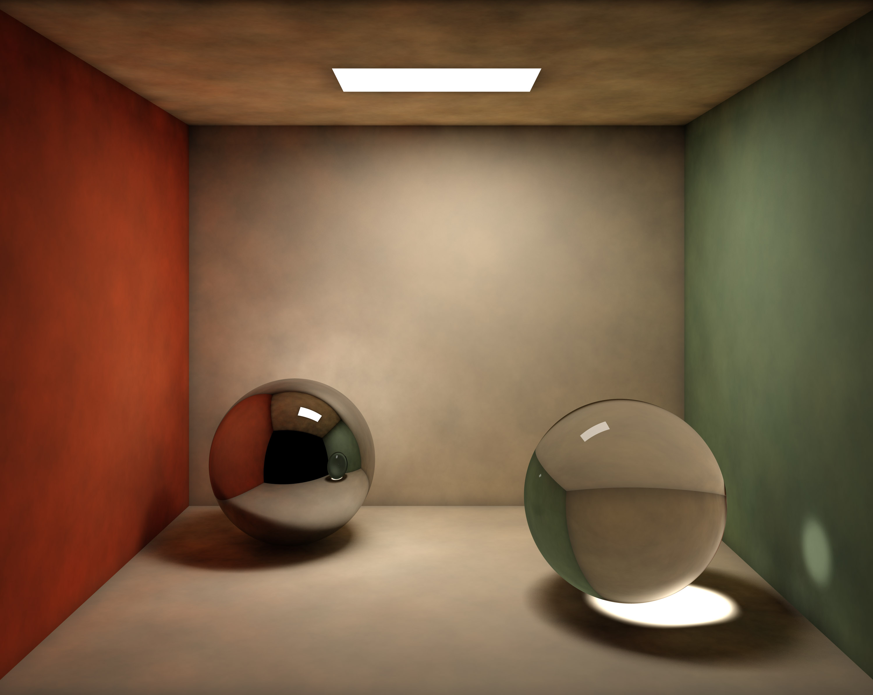
Photon Mapper
Final project presentation
Presented by: Bernhard FRITZ
Mathias HÖLZL
Florian TISCHLER
Supervisor: Univ.-Prof. Dr. Matthias Harders
Group: Interactive Graphics and Simulation

Slide 2
Problem description
Path tracing does not produce significant caustics in a reasonable amount of time
Small probability that a ray starting from camera, hits a surface that actually reflects incoming rays directly through a transparent object to the light source

Slide 3
Solution
Collect additional information about light photons being emitted from the light source
Photons carry energy which can be transmitted whenever an object is hit
The process of storing photon→object interactions is called photon mapping

Slide 4
How does photon mapping work?
Photon mapping is a two pass technique
Photon tracing
Follow photons from light into scene
Save photons when colliding with diffuse objects
Photon gathering
Determine intersection point with e.g. raytracing
Collect photons nearby to estimate incident flux

Slide 5
Implementation details
Enhanced path tracer
Photon mapping for handling indirect lighting
Shadow rays for direct lighting
Recursive ray tracing for specularity/transmission
Multithreaded photon map creation and ray casting
Per object Kd-tree for storing photons

Slide 6
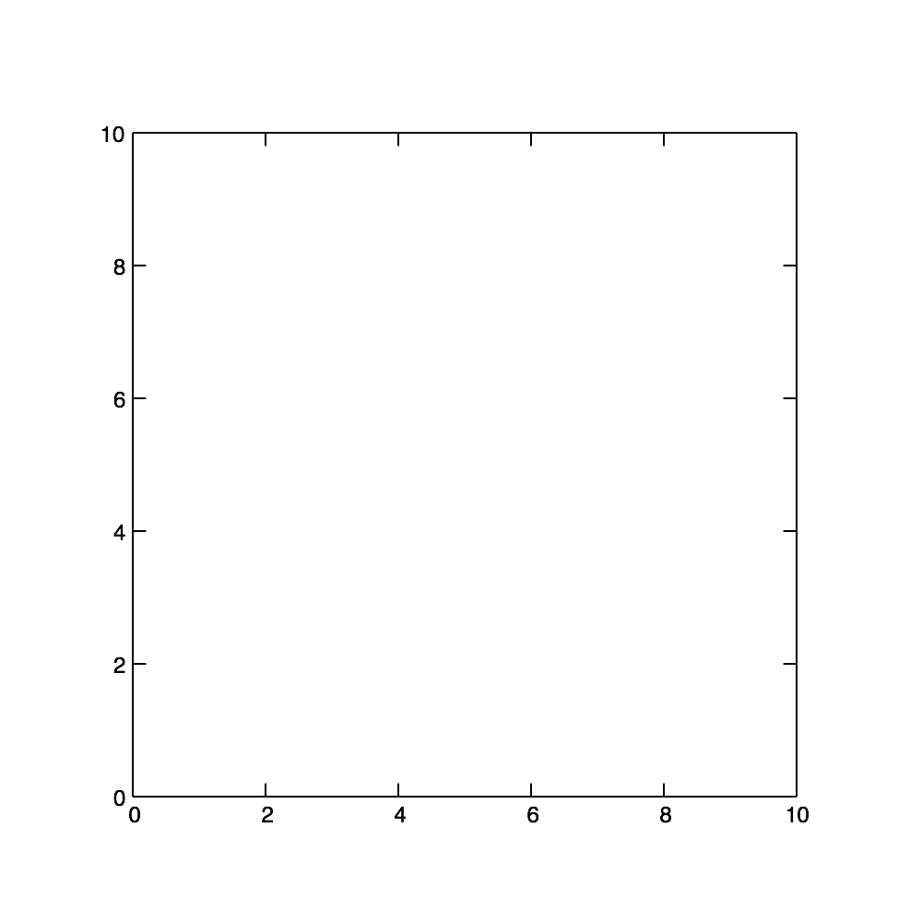
Kd-tree
Inserting 2D (x,y) coordinates: (7,2) (5,4) (2,3) (9,6) (4,7) (8,1)

Slide 7
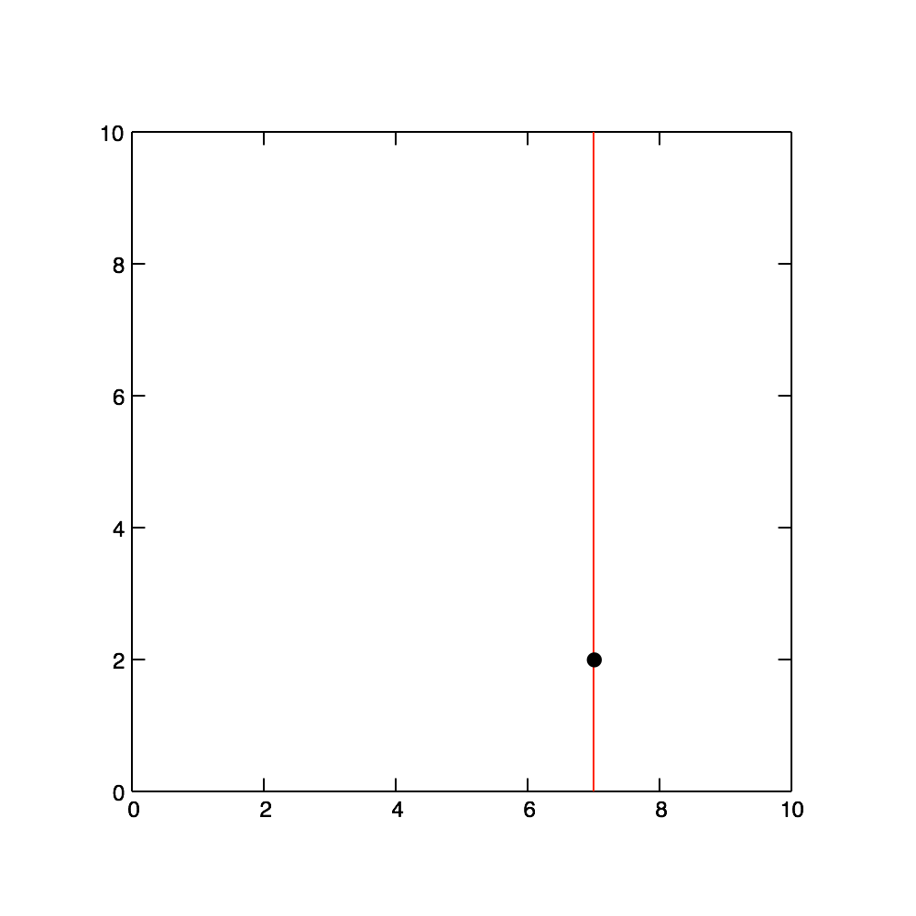
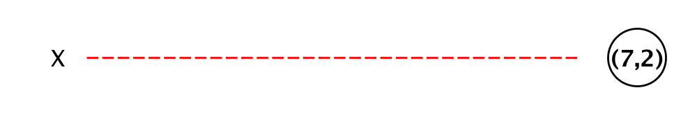
Kd-tree
Inserting 2D (x,y) coordinates: (7,2) (5,4) (2,3) (9,6) (4,7) (8,1)

Slide 8
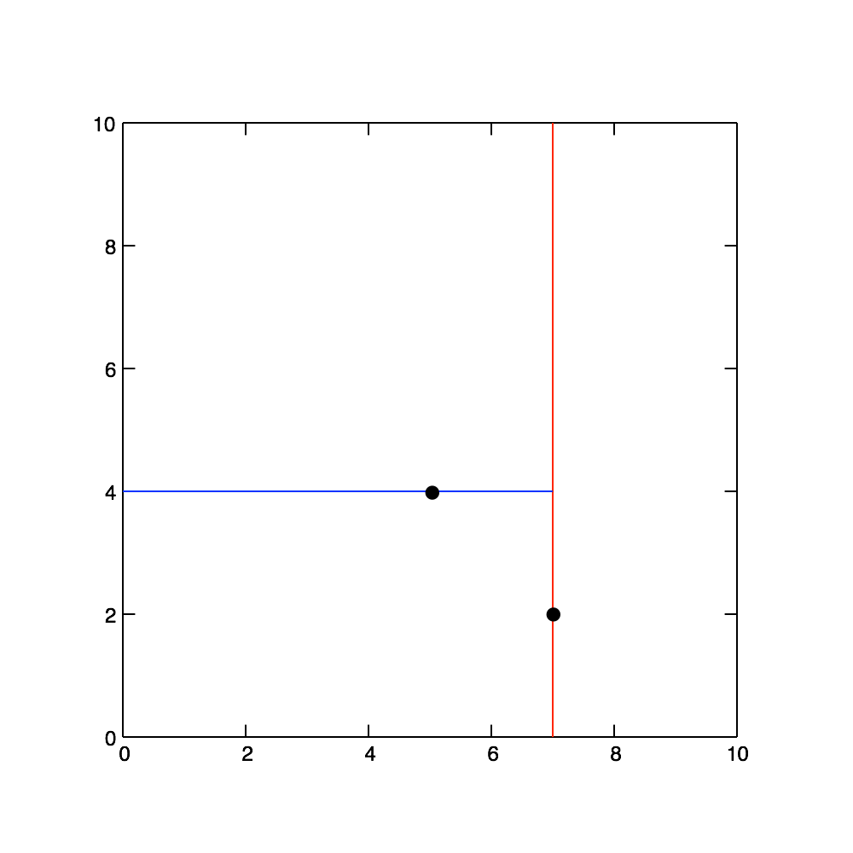
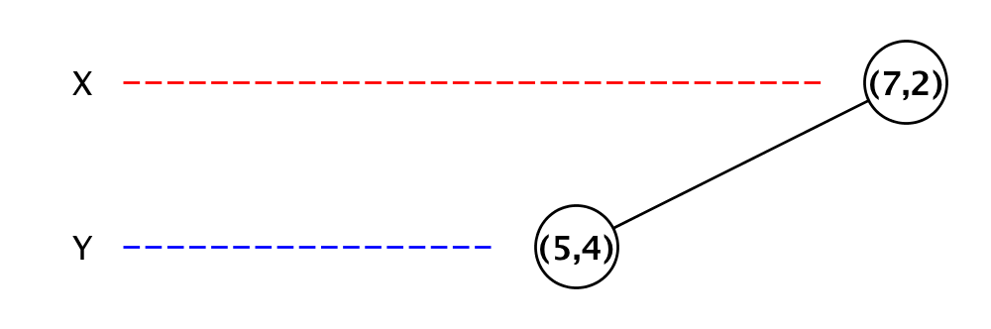
Kd-tree
Inserting 2D (x,y) coordinates: (7,2) (5,4) (2,3) (9,6) (4,7) (8,1)

Slide 9
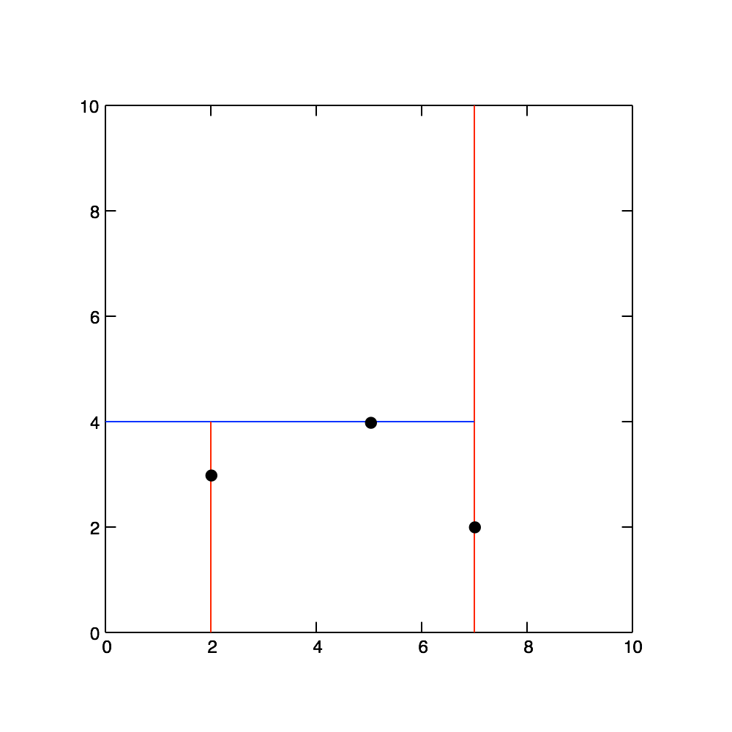
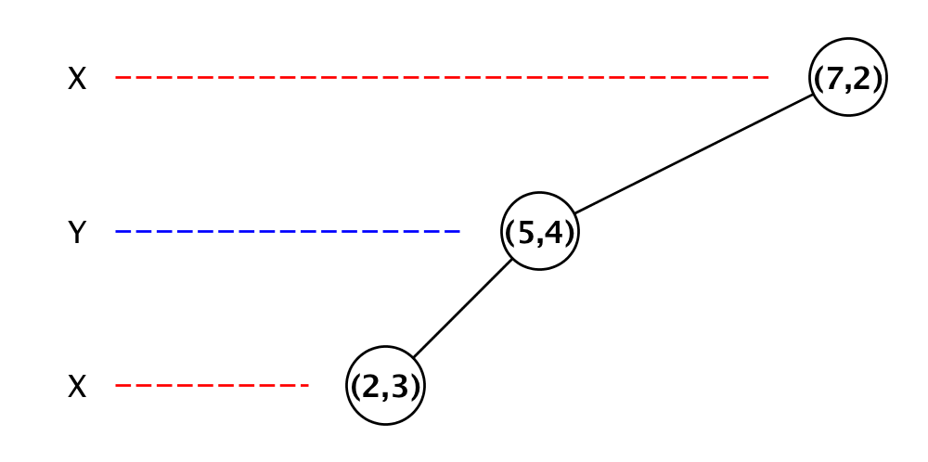
Kd-tree
Inserting 2D (x,y) coordinates: (7,2) (5,4) (2,3) (9,6) (4,7) (8,1)

Slide 10
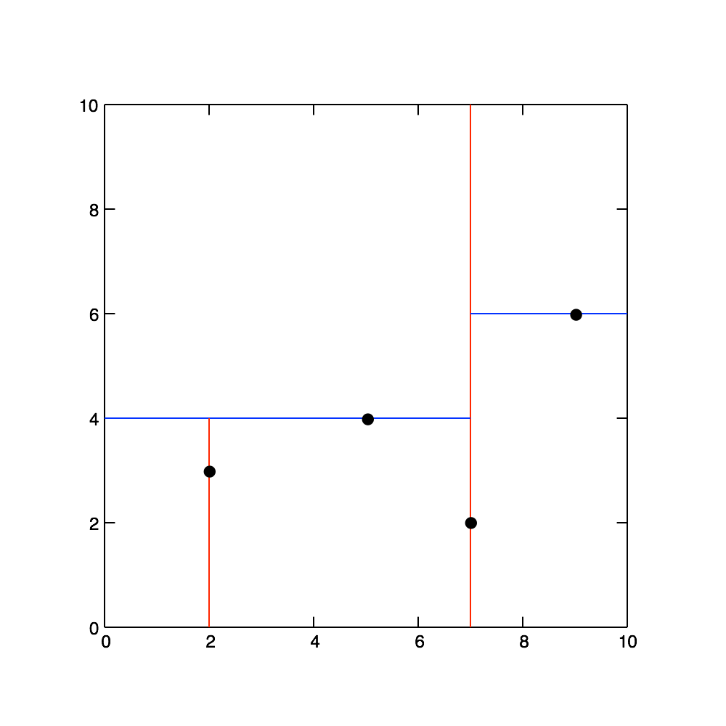
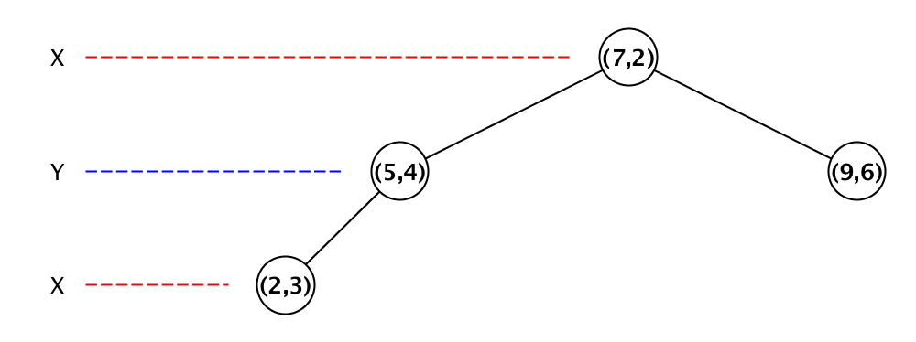
Kd-tree
Inserting 2D (x,y) coordinates: (7,2) (5,4) (2,3) (9,6) (4,7) (8,1)

Slide 11
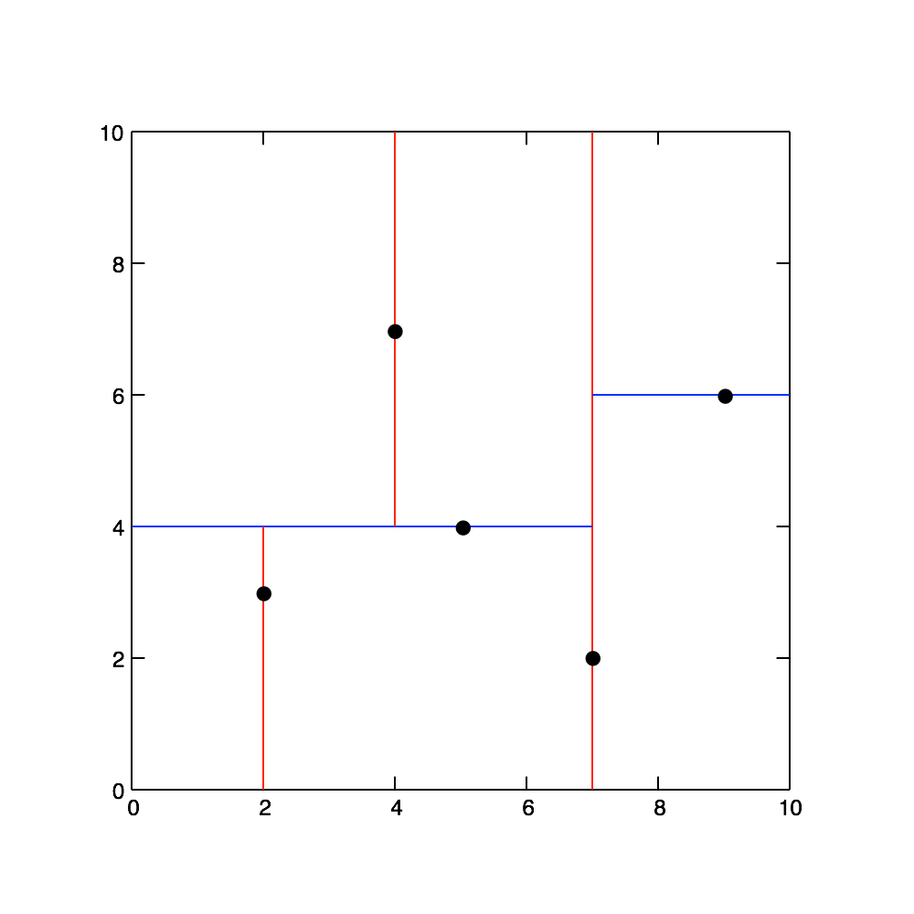
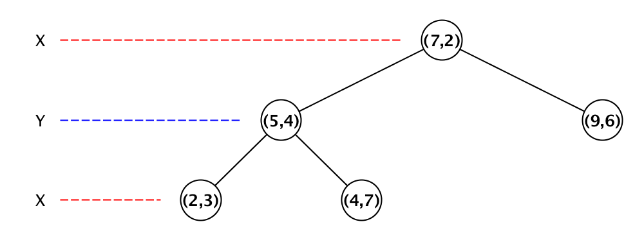
Kd-tree
Inserting 2D (x,y) coordinates: (7,2) (5,4) (2,3) (9,6) (4,7) (8,1)

Slide 12
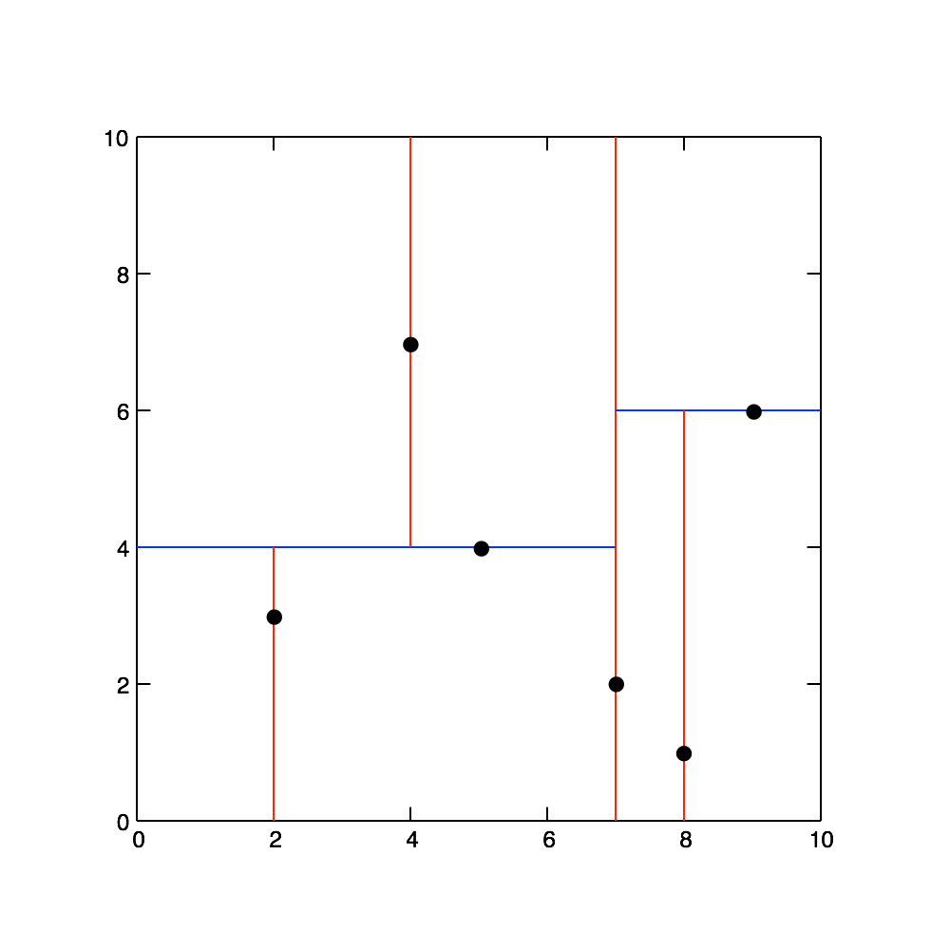
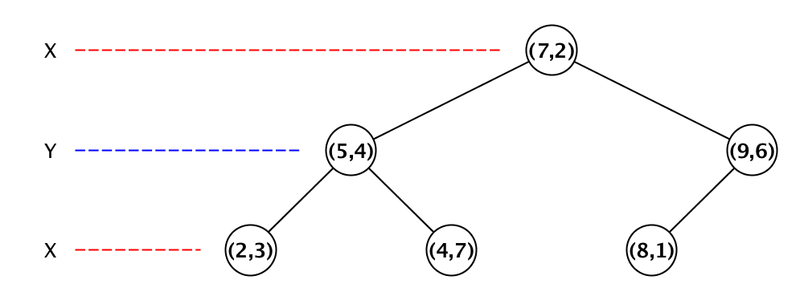
Kd-tree
Inserting 2D (x,y) coordinates: (7,2) (5,4) (2,3) (9,6) (4,7) (8,1)

Slide 13
Kd-tree
Inserting 2D (x,y) coordinates: (7,2) (5,4) (2,3) (9,6) (4,7) (8,1)

Slide 14
Libraries and resources to be mentioned
GLM
OpenGL
Glut
NanoFlann (Kd-tree)

Slide 15
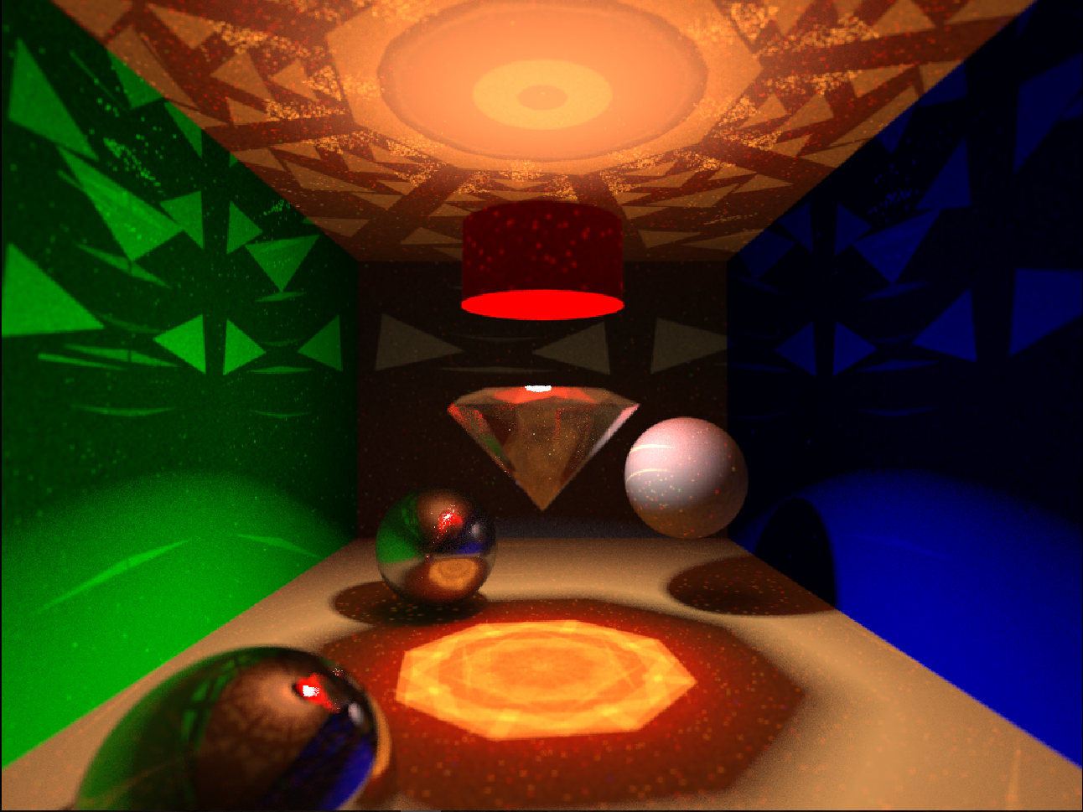
Result

Slide 16
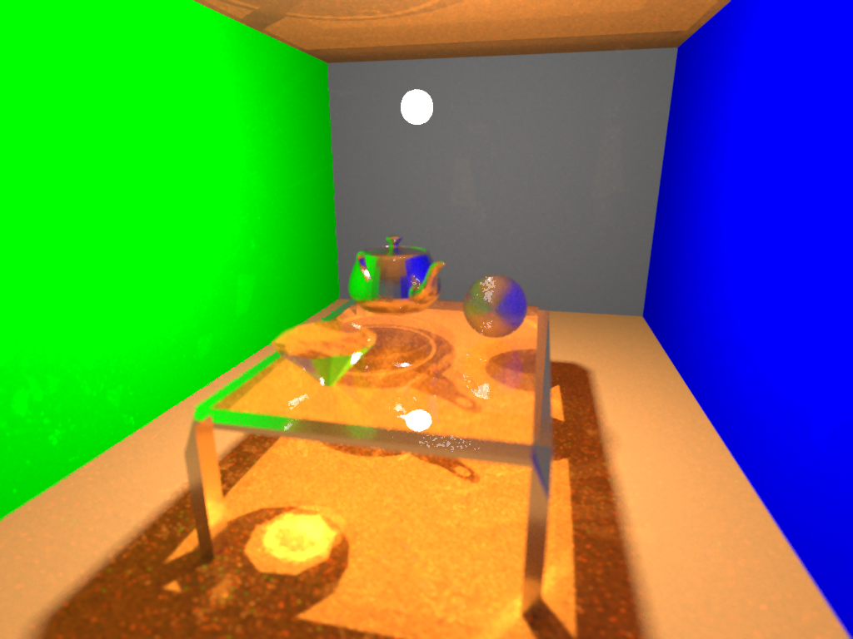
Result

