Slide 1
Photon Mapper
Final project presentation
Presented by: Bernhard FRITZ
Mathias HÖLZL
Florian TISCHLER
Supervisor: Univ.-Prof. Dr. Matthias Harders
Group: Interactive Graphics and Simulation

Slide 2
What is a photon mapper?

Slide 3
How does photon mapping work?

Slide 4
Difference between previous renderers?

Slide 5
Implementation details

Slide 6
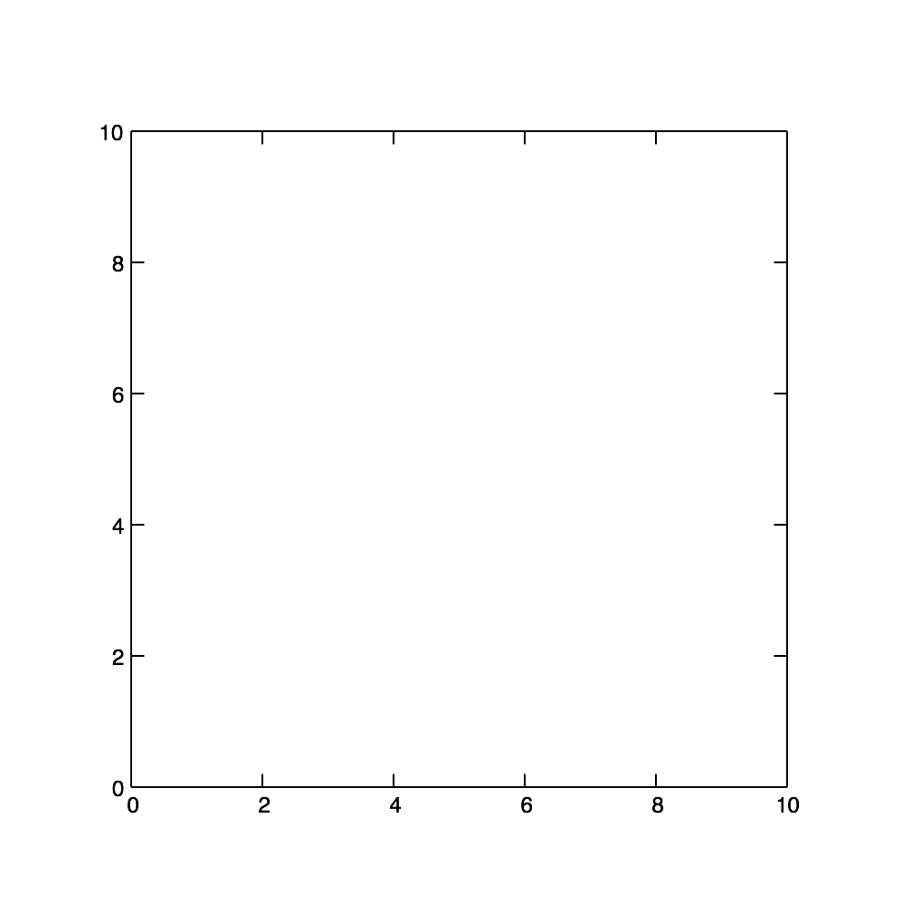
KD-Tree
Inserting 2D (x,y) coordinates: (7,2) (5,4) (2,3) (9,6) (4,7) (8,1)

Slide 7
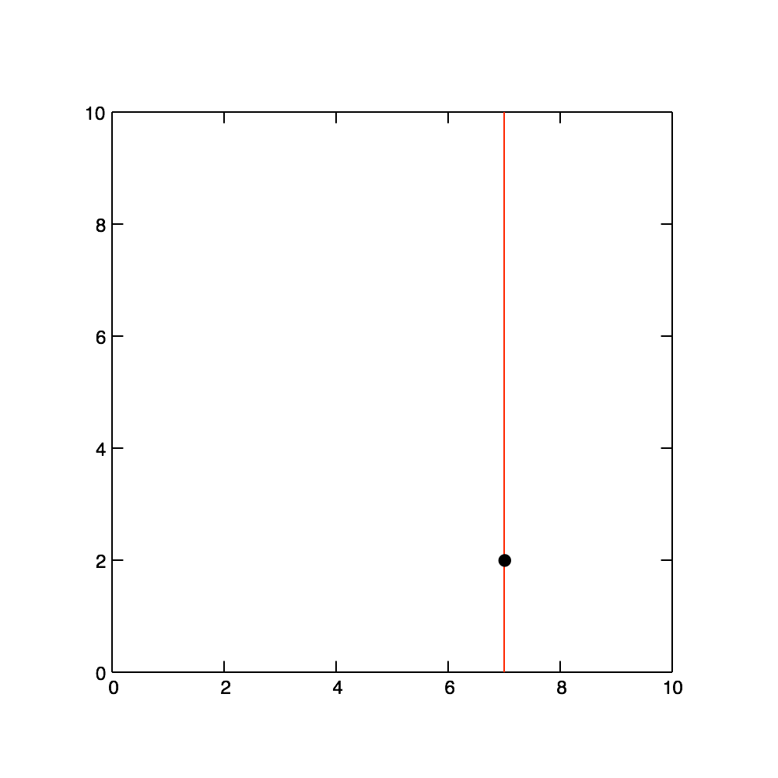
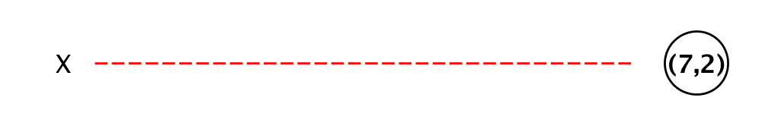
KD-Tree
Inserting 2D (x,y) coordinates: (7,2) (5,4) (2,3) (9,6) (4,7) (8,1)

Slide 8
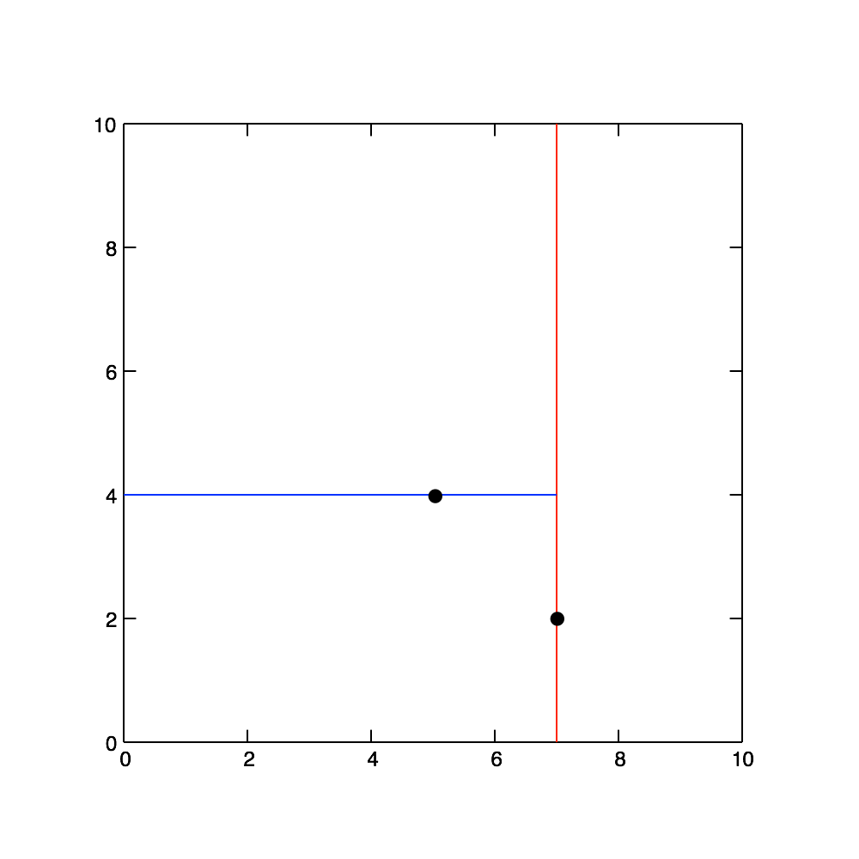
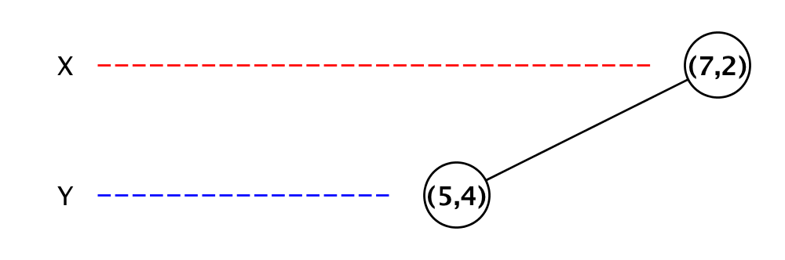
KD-Tree
Inserting 2D (x,y) coordinates: (7,2) (5,4) (2,3) (9,6) (4,7) (8,1)

Slide 9
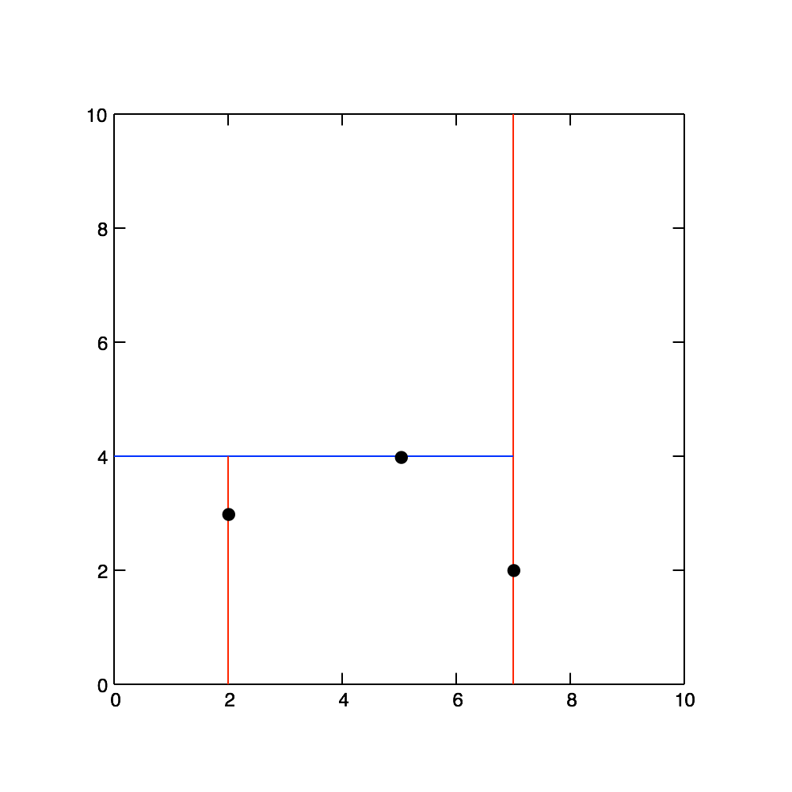
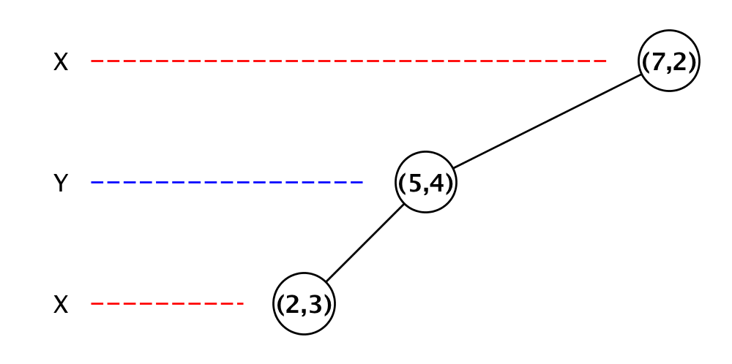
KD-Tree
Inserting 2D (x,y) coordinates: (7,2) (5,4) (2,3) (9,6) (4,7) (8,1)

Slide 10
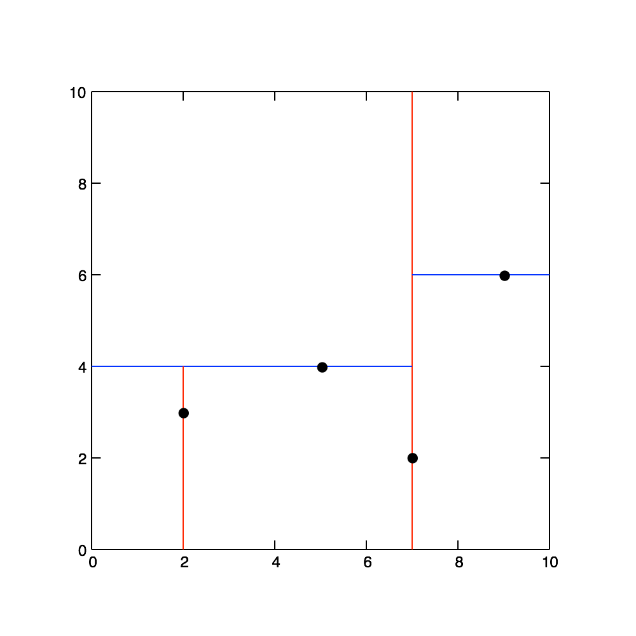
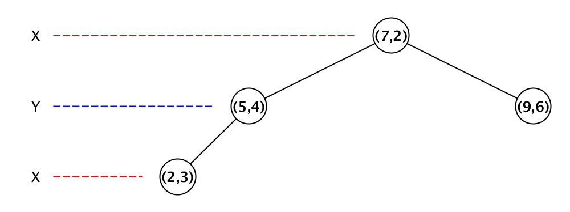
KD-Tree
Inserting 2D (x,y) coordinates: (7,2) (5,4) (2,3) (9,6) (4,7) (8,1)

Slide 11
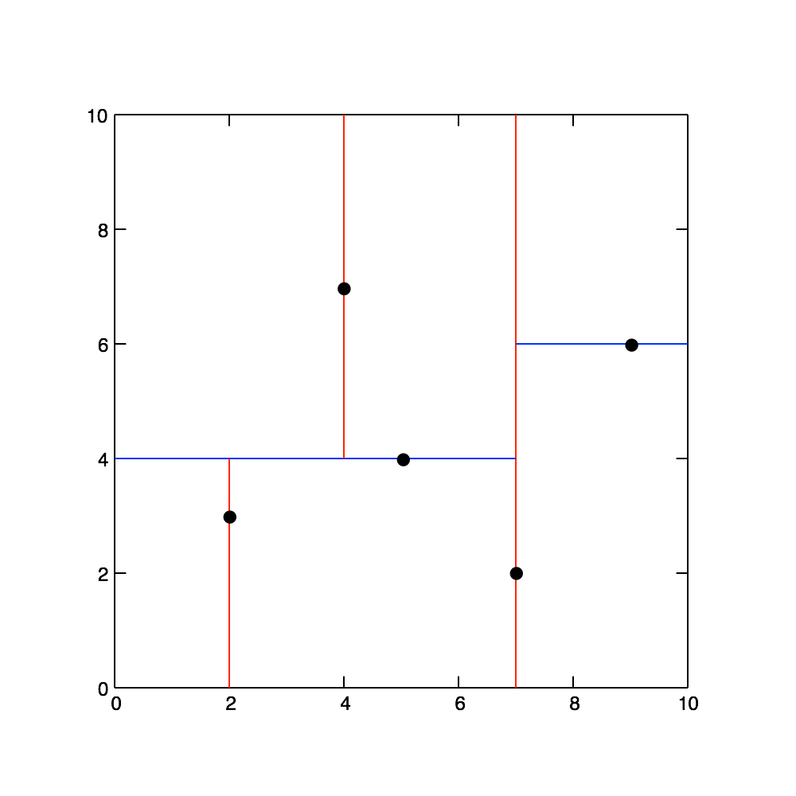
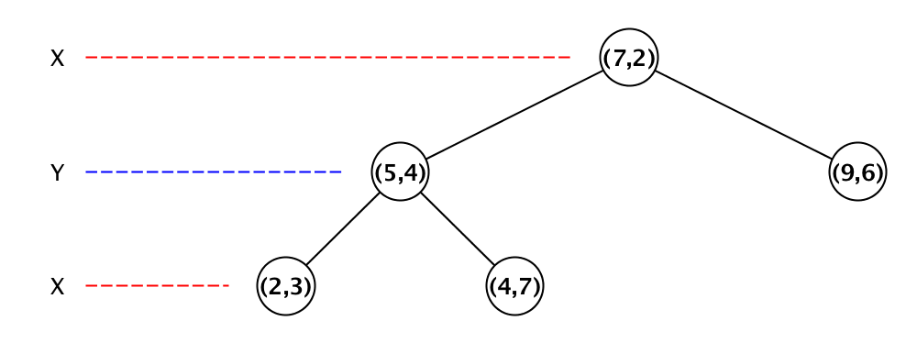
KD-Tree
Inserting 2D (x,y) coordinates: (7,2) (5,4) (2,3) (9,6) (4,7) (8,1)

Slide 12
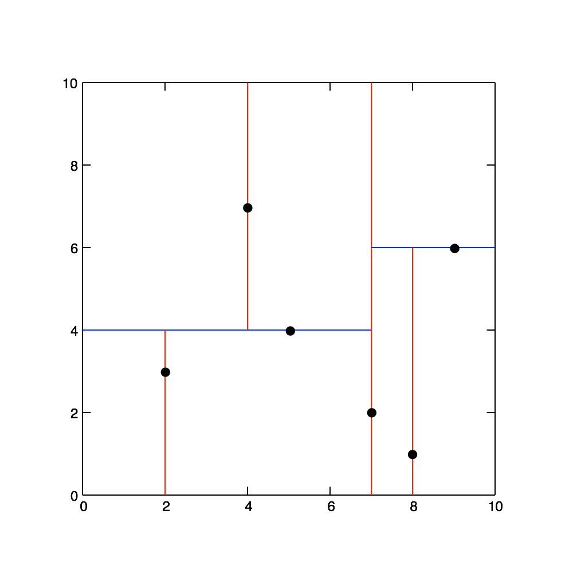
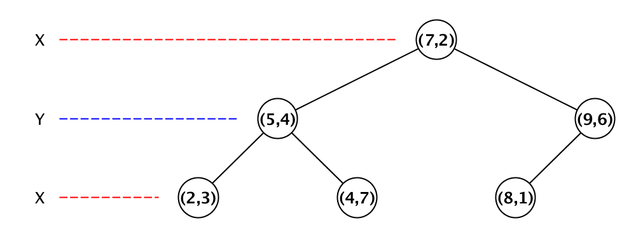
KD-Tree
Inserting 2D (x,y) coordinates: (7,2) (5,4) (2,3) (9,6) (4,7) (8,1)

Slide 13
KD-Tree
Inserting 2D (x,y) coordinates: (7,2) (5,4) (2,3) (9,6) (4,7) (8,1)

Slide 14
Appropriate parallelization of algorithms

Slide 15
Libraries and resources to be mentioned

Slide 16
Result

