Slide 1
Photon Mapper
Final project presentation
Presented by: Bernhard FRITZ
Mathias HÖLZL
Florian TISCHLER
Supervisor: Univ.-Prof. Dr. Matthias Harders
Group: Interactive Graphics and Simulation

Slide 2
Problem description
Path tracing does not produce significant caustics in a reasonable amount of time
Small probability that a ray starting from camera, hits a surface that actually reflects incoming rays directly through a transparent object to the light source

Slide 3
Solution
Collect additional information about light photons being emitted from the light source
Photons carry energy which can be transmitted whenever an object is hit
The process of storing photon→object interactions is called photon mapping

Slide 4
How does photon mapping work?
Basically there are 2 steps involved:
Construction of the photon map
Rendering

Slide 5
Construction of the photon map
Shooting photons from light in all directions
Whenever a photon intersects with a surface, save intersection point and incoming direction in photon map
Decide if photon gets reflected, transmitted or absorbed by chance
The photon will not be traced any further once it has been absorbed

Slide 6
Rendering
Conventional photon mappers use ray tracing to determine direct illumination and extend it by adding indirect illumination on top
At each intersection point that results from a ray hitting a surface during ray tracing, the nearest N photons will be determined
Summing up the direct and indirect portions of illumination at all intersection points results in a globally illuminated scene

Slide 7
Implementation details

Slide 8
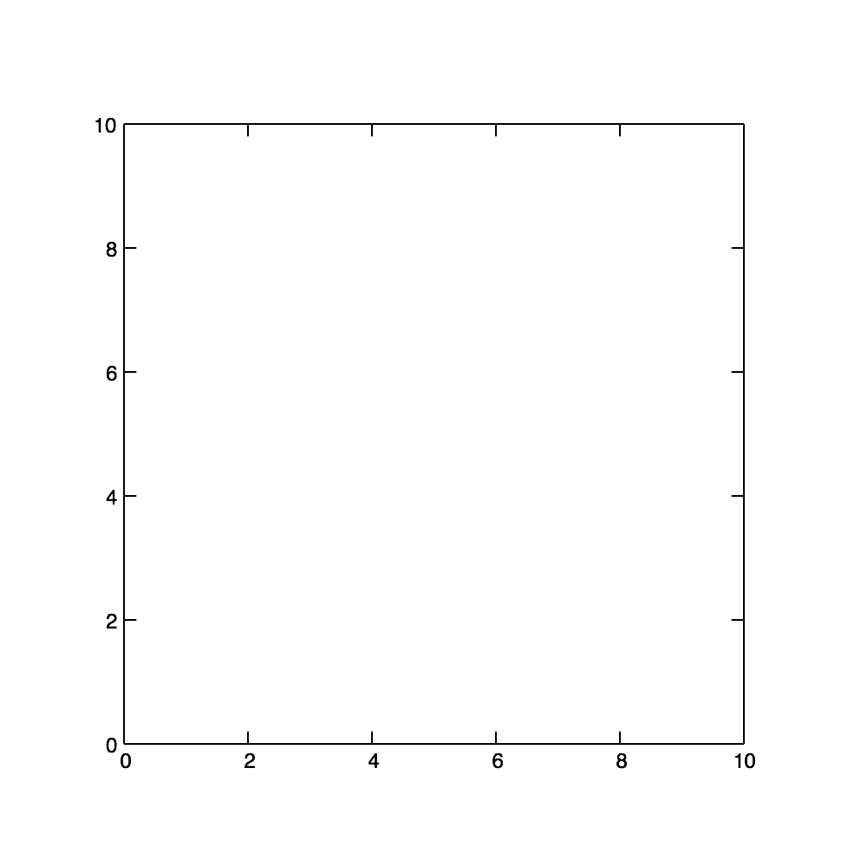
KD-Tree
Inserting 2D (x,y) coordinates: (7,2) (5,4) (2,3) (9,6) (4,7) (8,1)

Slide 9
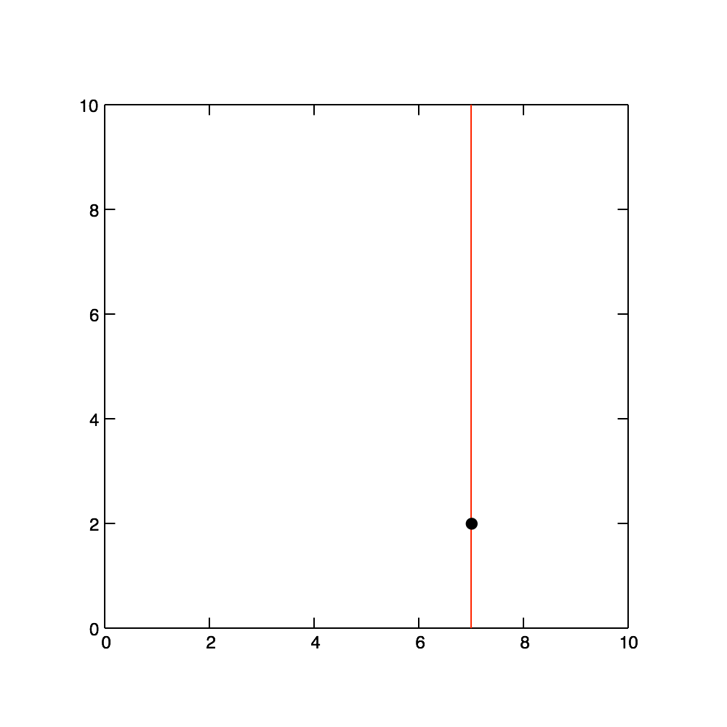
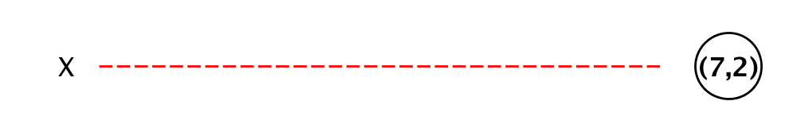
KD-Tree
Inserting 2D (x,y) coordinates: (7,2) (5,4) (2,3) (9,6) (4,7) (8,1)

Slide 10
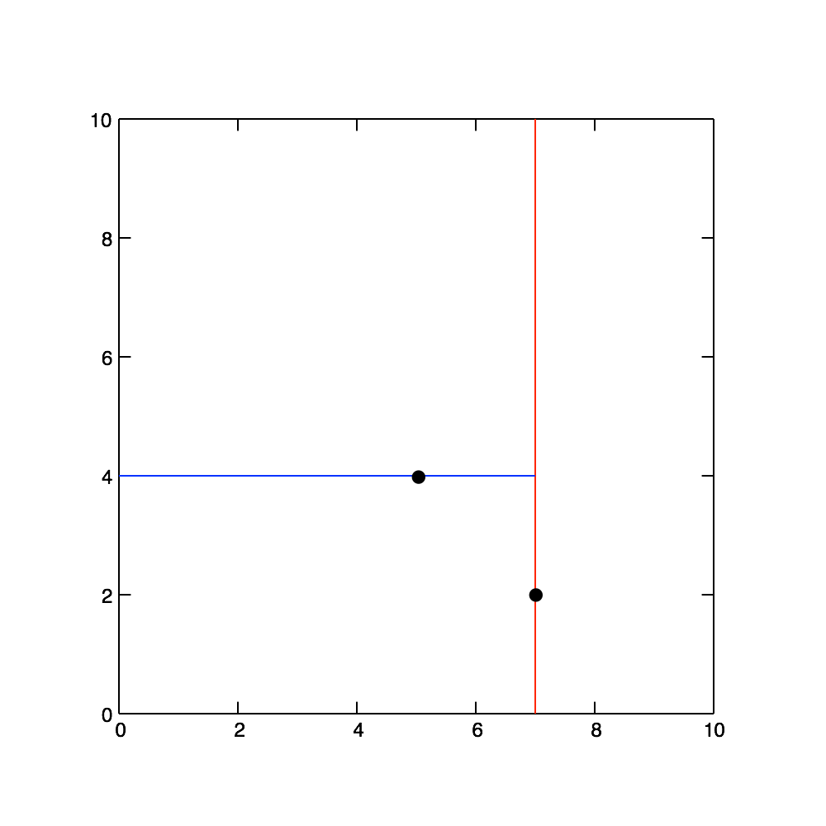
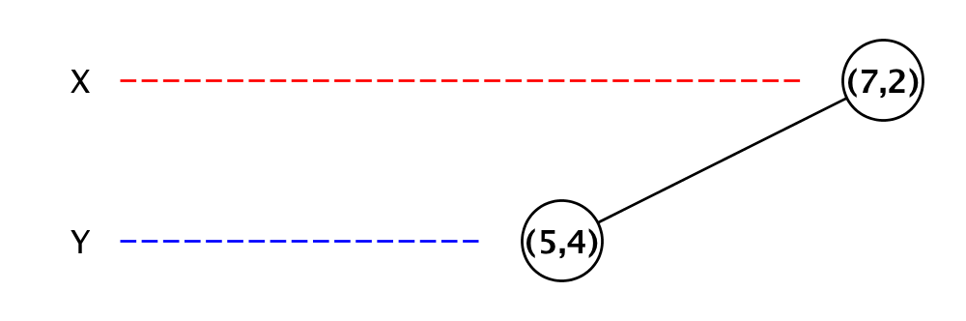
KD-Tree
Inserting 2D (x,y) coordinates: (7,2) (5,4) (2,3) (9,6) (4,7) (8,1)

Slide 11
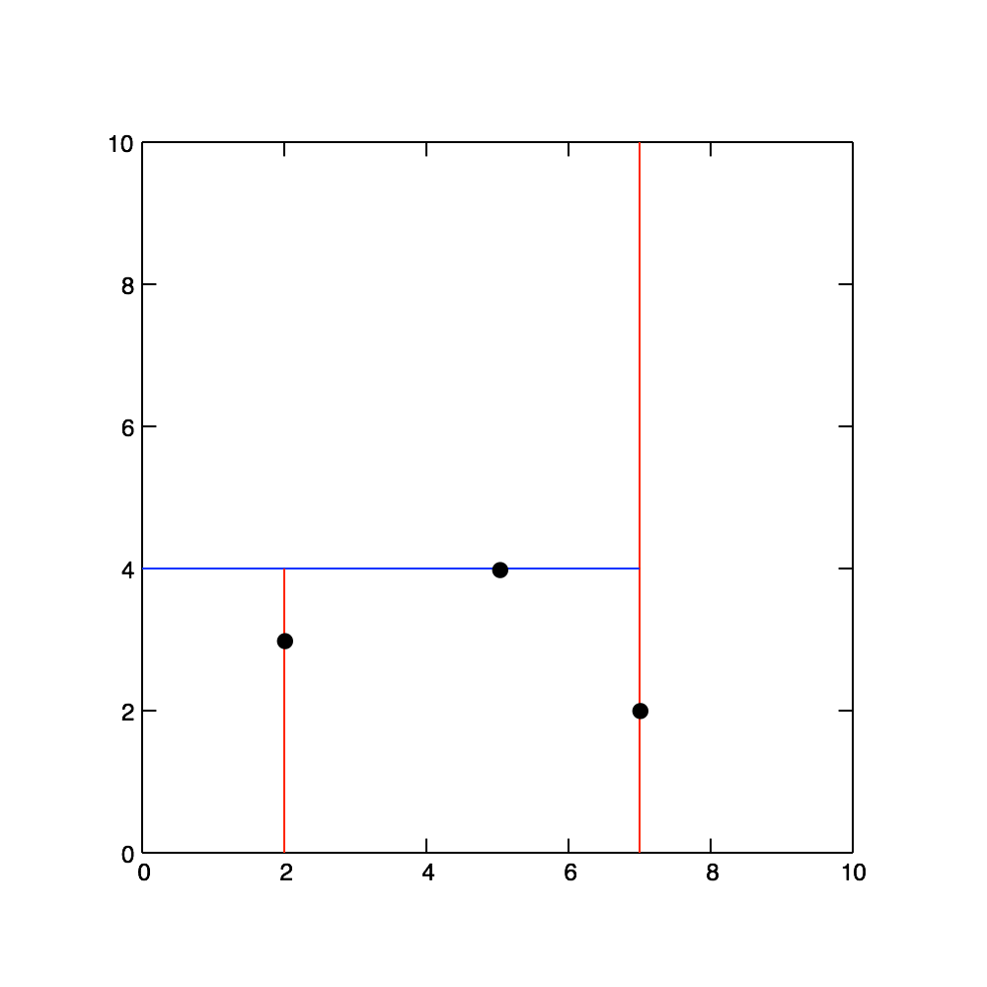
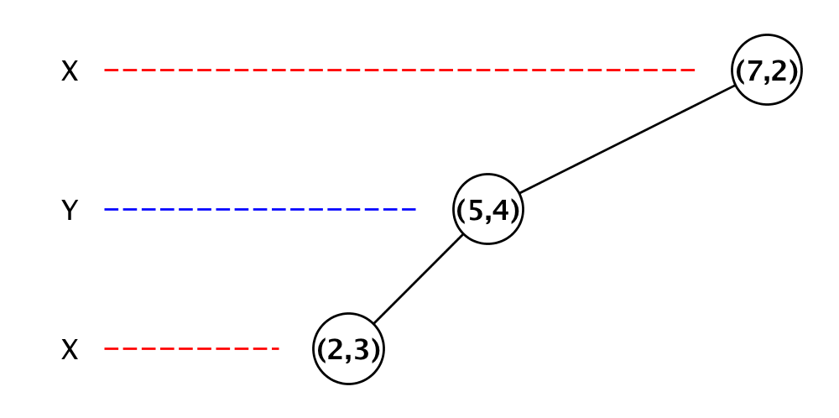
KD-Tree
Inserting 2D (x,y) coordinates: (7,2) (5,4) (2,3) (9,6) (4,7) (8,1)

Slide 12
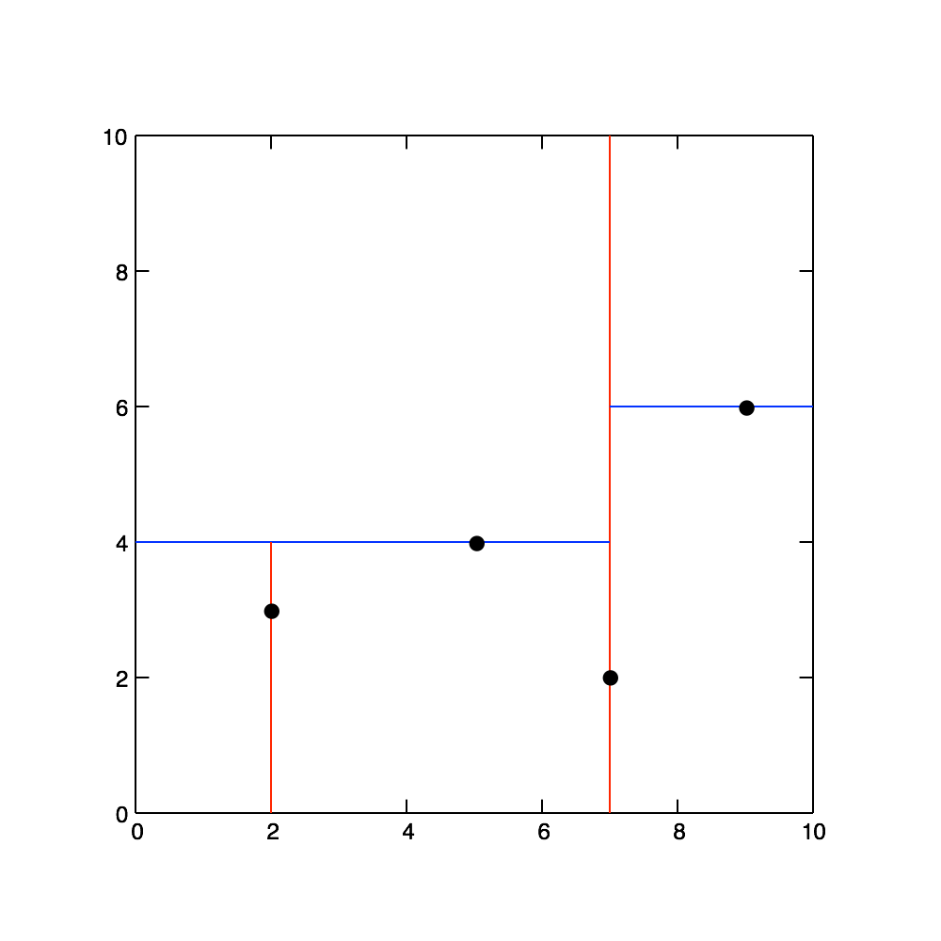
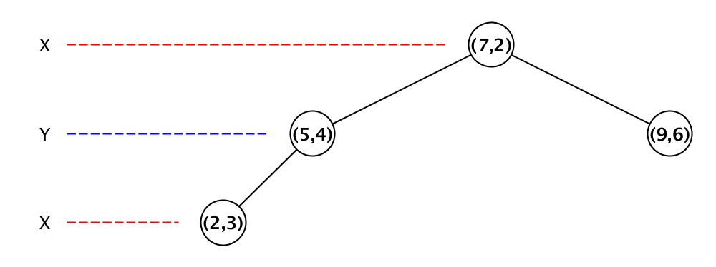
KD-Tree
Inserting 2D (x,y) coordinates: (7,2) (5,4) (2,3) (9,6) (4,7) (8,1)

Slide 13
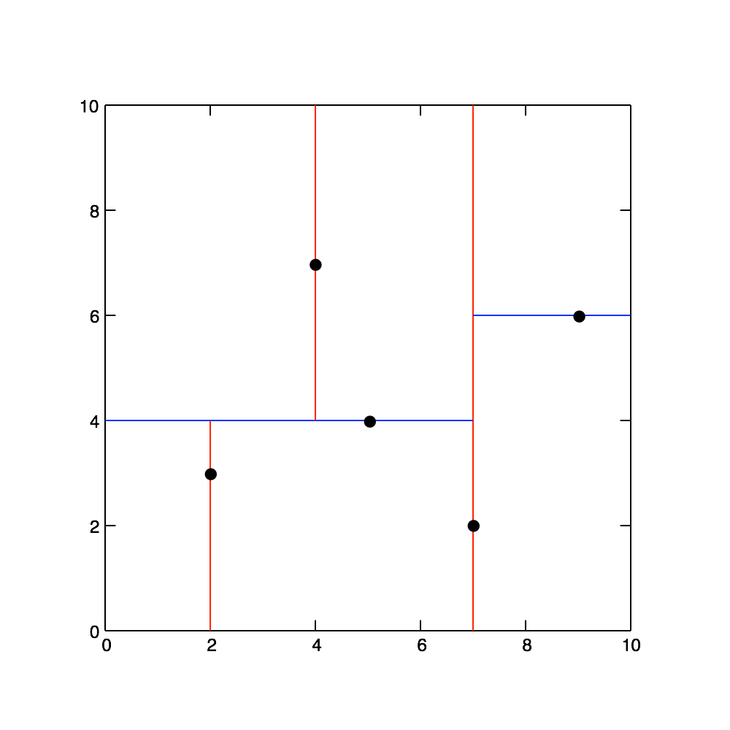
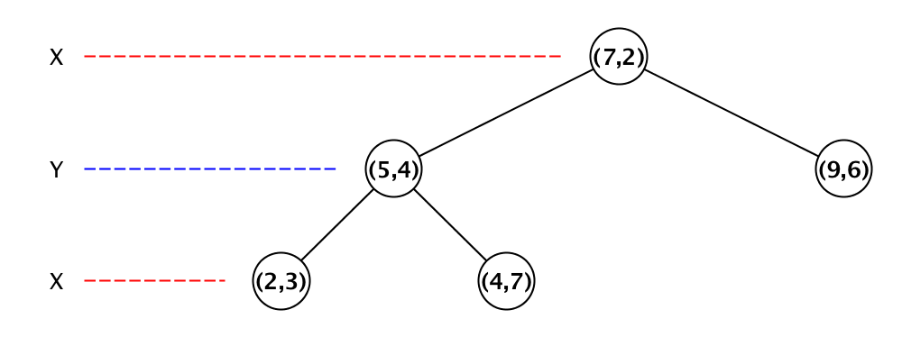
KD-Tree
Inserting 2D (x,y) coordinates: (7,2) (5,4) (2,3) (9,6) (4,7) (8,1)

Slide 14
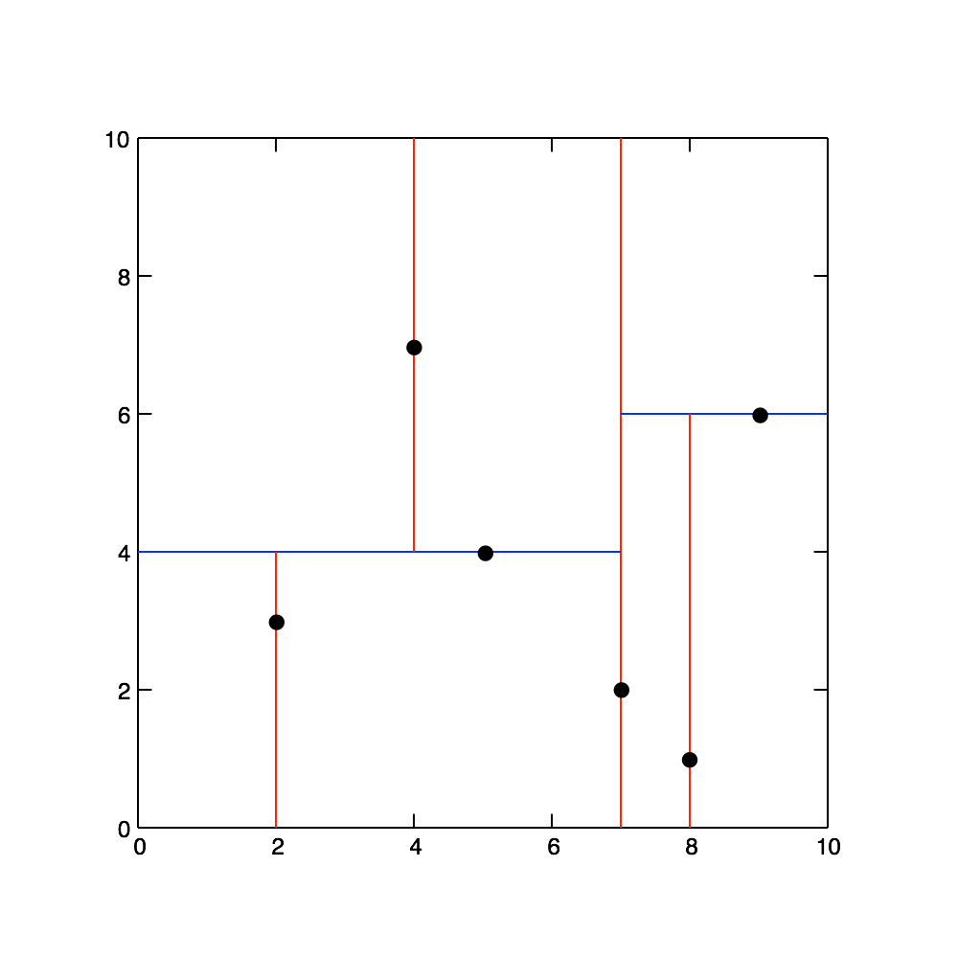
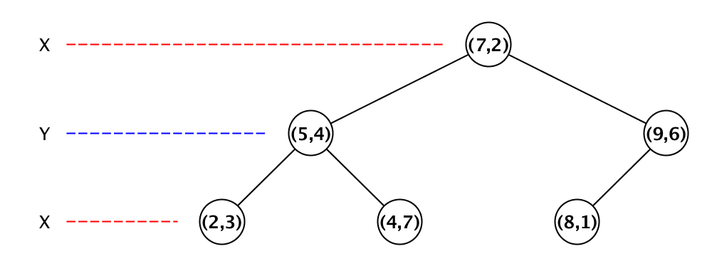
KD-Tree
Inserting 2D (x,y) coordinates: (7,2) (5,4) (2,3) (9,6) (4,7) (8,1)

Slide 15
KD-Tree
Inserting 2D (x,y) coordinates: (7,2) (5,4) (2,3) (9,6) (4,7) (8,1)

Slide 16
Appropriate parallelization of algorithms

Slide 17
Libraries and resources to be mentioned

Slide 18
Result

