Slide 1
Photon Mapping
Final project presentation
Bernhard FRITZ
Mathias HÖLZL
Florian TISCHLER
Supervisor
Univ.-Prof. Dr. Matthias Harders
Interactive Graphics and Simulation

Slide 2
What is photon mapping?
Extension for raytracing based rendering approaches
Enables caustics and indirect lighting
Improves rendering performance

Slide 3
How does photon mapping work?
Photon mapping is a two pass technique
Photon tracing
Follow photons from light into the scene
Save photons when colliding with diffuse objects
Photon gathering
Determine intersection point with e.g. raytracing
Collect photons nearby to estimate incidend flux

Slide 4
Implementation details
Enhanced Path tracer
Photon mapping for handling indirect lighting
Shadow rays for direct lighting
Recursive ray tracing for specularity/transmission
Multithreaded photon map creation and ray casting
Per object Kd – tree for storing photons

Slide 5
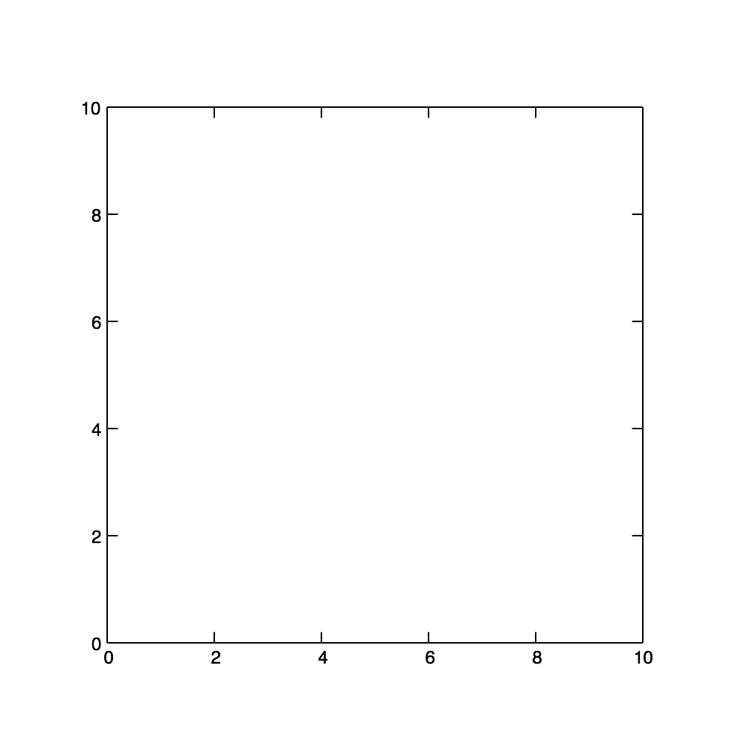
KD-Tree
Inserting 2D (x,y) coordinates: (7,2) (5,4) (2,3) (9,6) (4,7) (8,1)

Slide 6
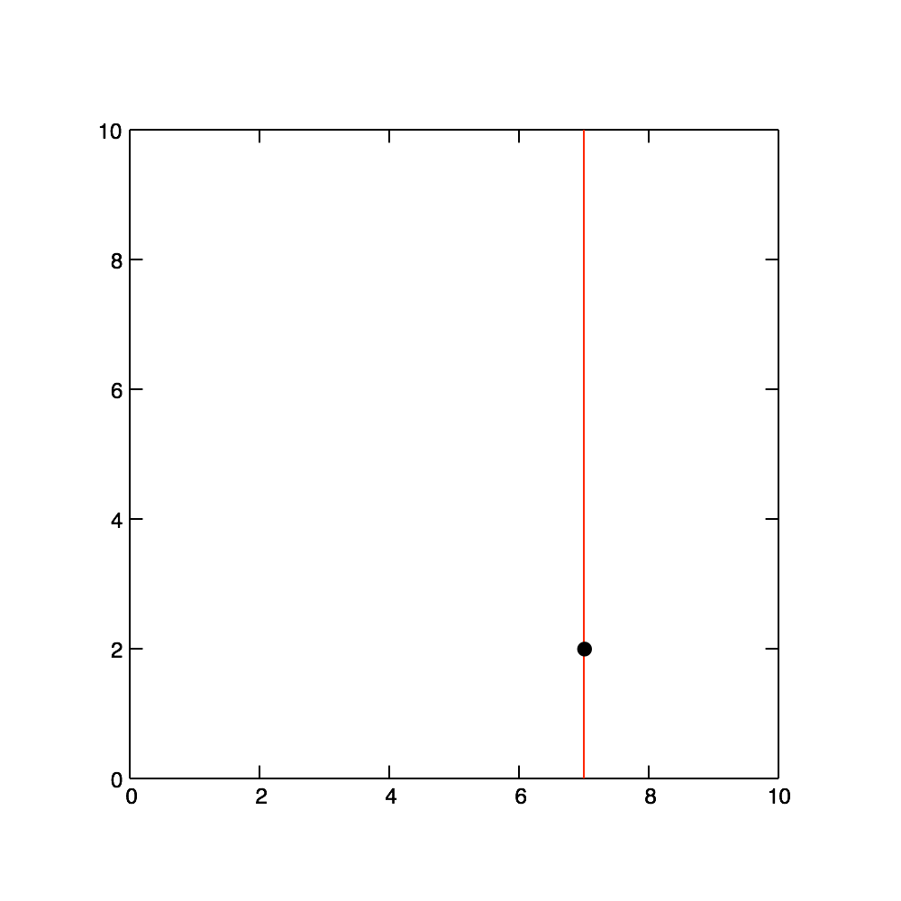
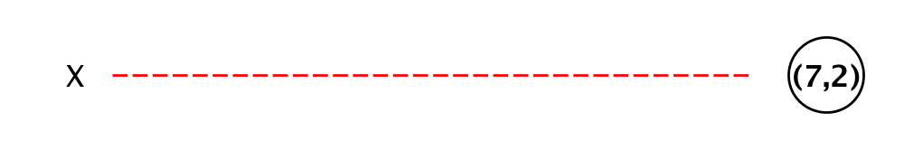
KD-Tree
Inserting 2D (x,y) coordinates: (7,2) (5,4) (2,3) (9,6) (4,7) (8,1)

Slide 7
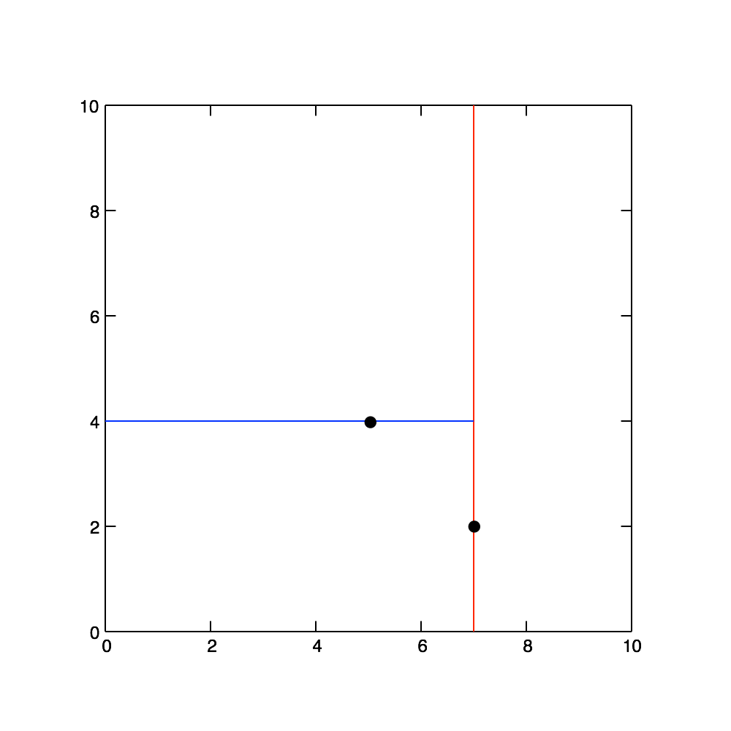
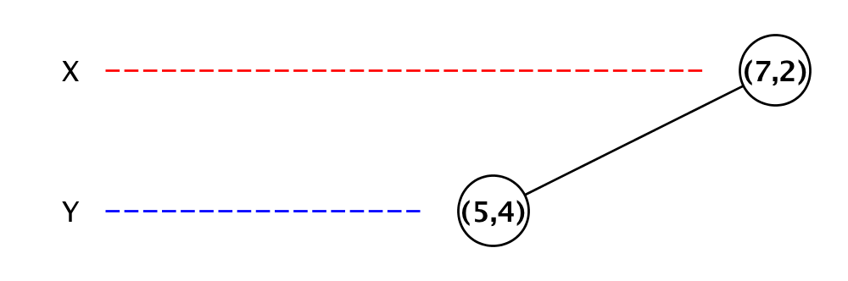
KD-Tree
Inserting 2D (x,y) coordinates: (7,2) (5,4) (2,3) (9,6) (4,7) (8,1)

Slide 8
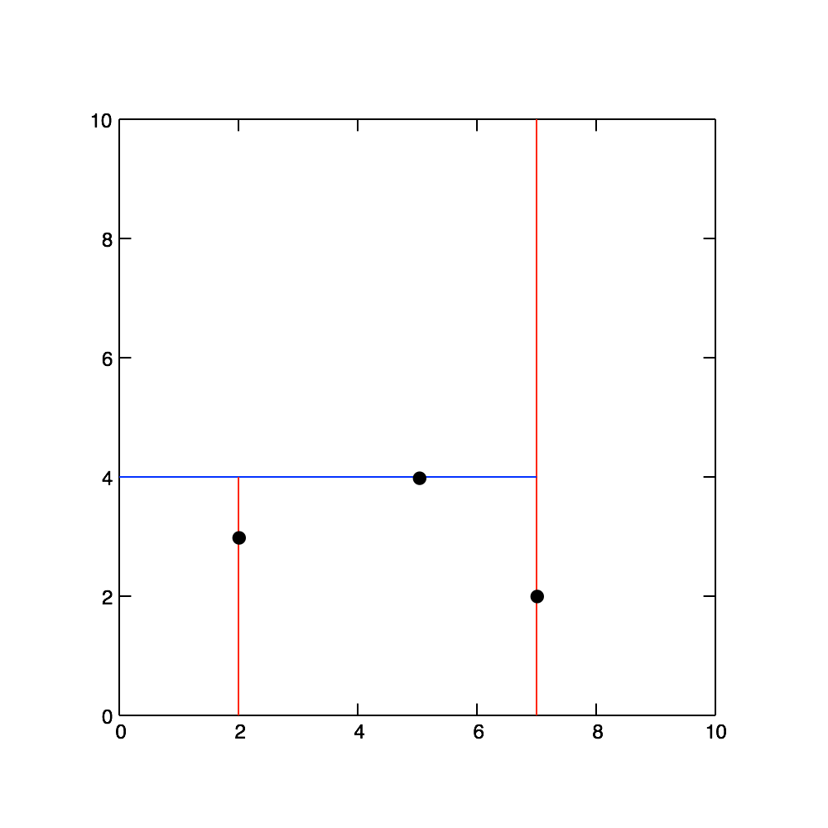
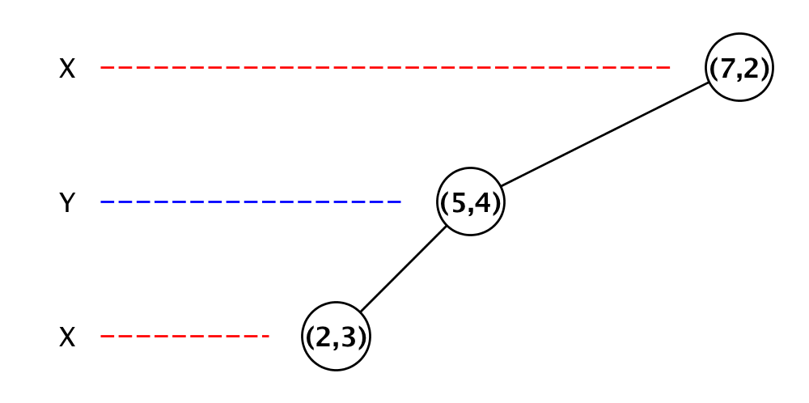
KD-Tree
Inserting 2D (x,y) coordinates: (7,2) (5,4) (2,3) (9,6) (4,7) (8,1)

Slide 9
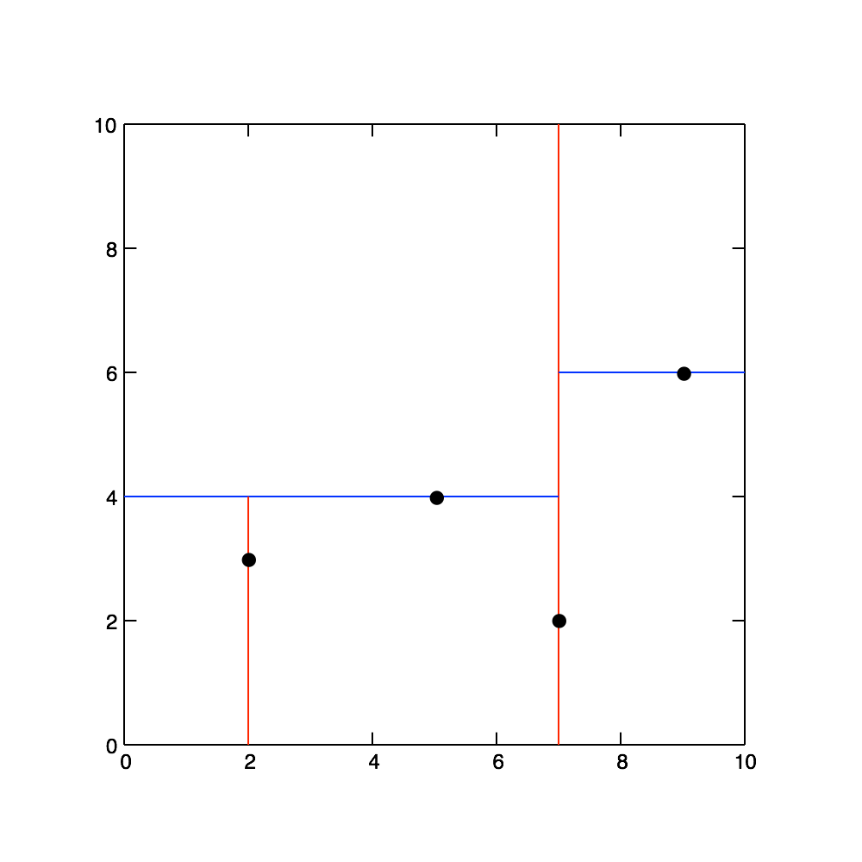
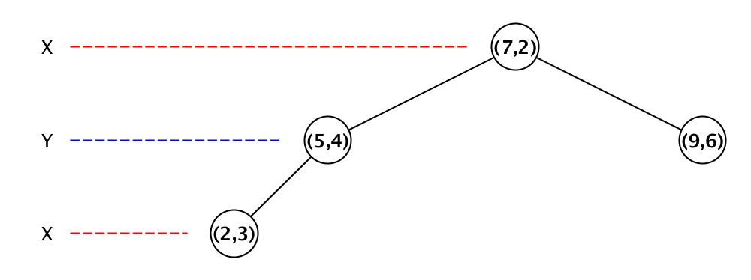
KD-Tree
Inserting 2D (x,y) coordinates: (7,2) (5,4) (2,3) (9,6) (4,7) (8,1)

Slide 10
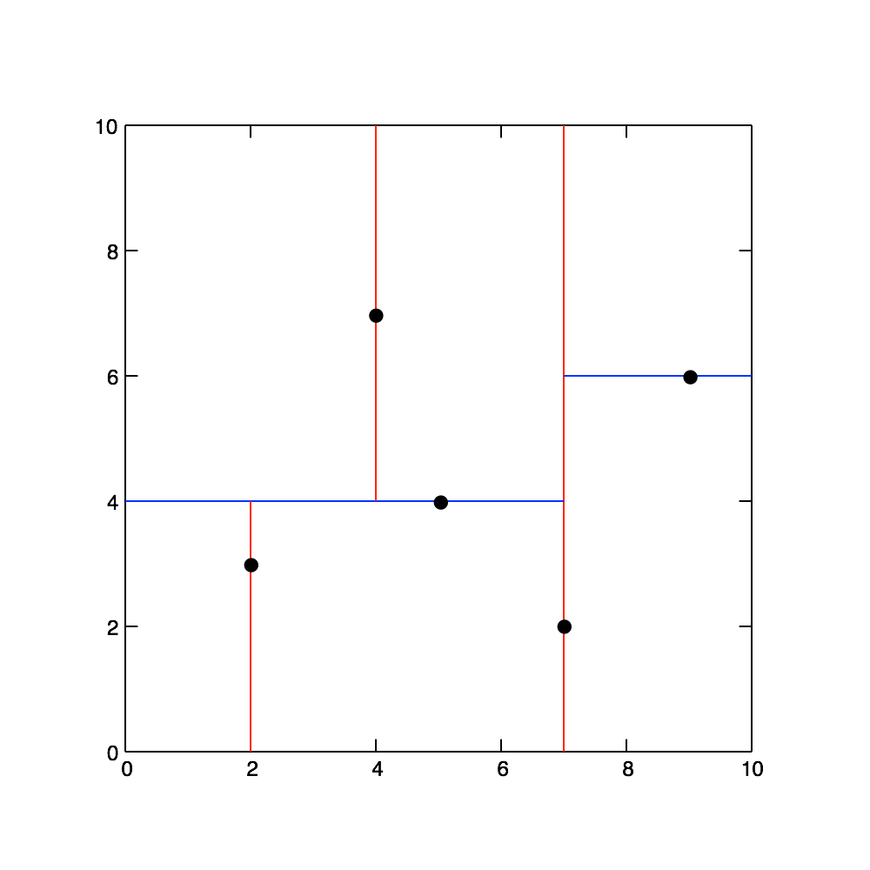
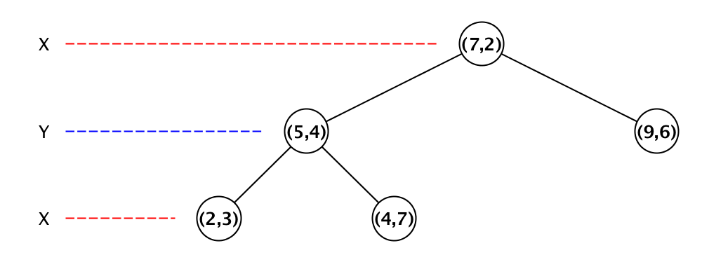
KD-Tree
Inserting 2D (x,y) coordinates: (7,2) (5,4) (2,3) (9,6) (4,7) (8,1)

Slide 11
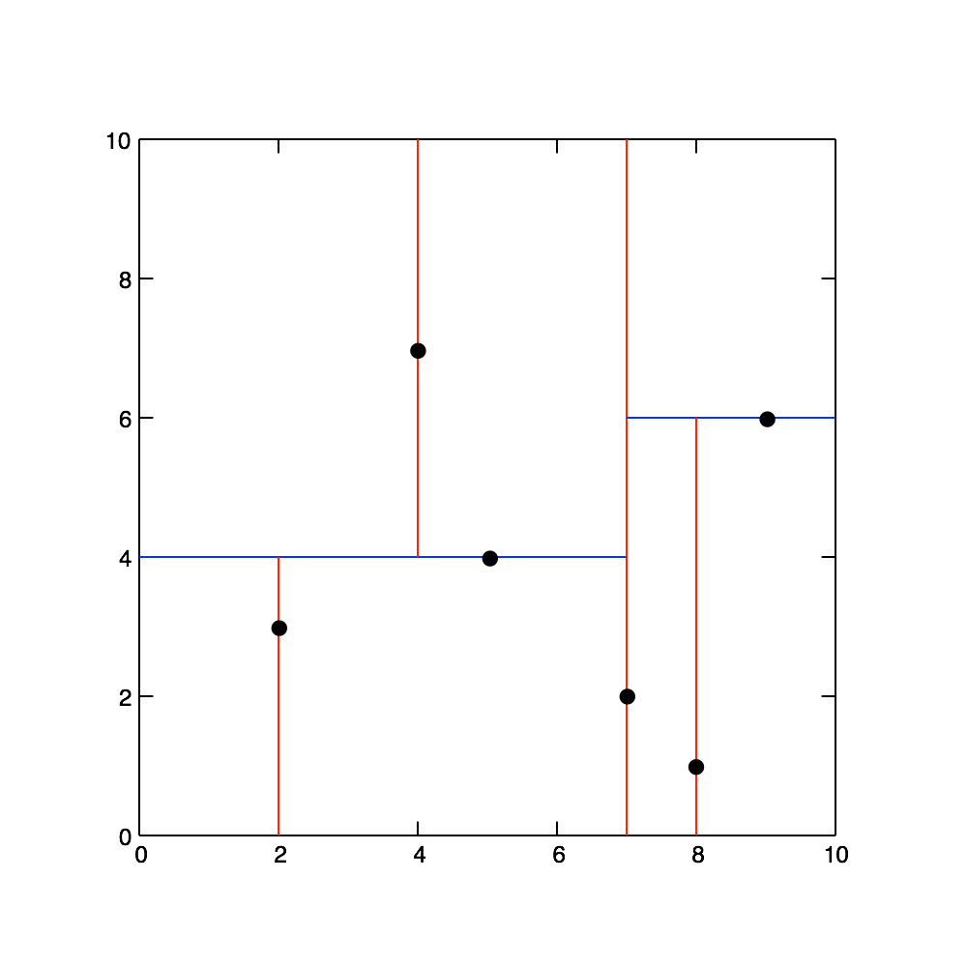
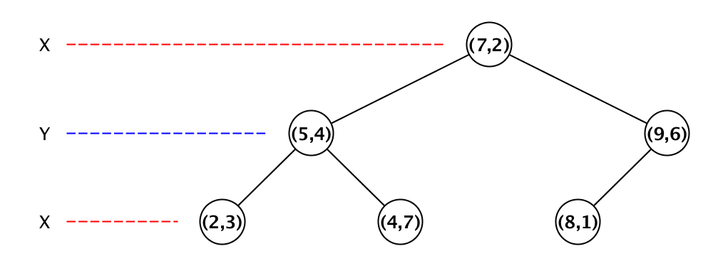
KD-Tree
Inserting 2D (x,y) coordinates: (7,2) (5,4) (2,3) (9,6) (4,7) (8,1)

Slide 12
KD-Tree
Inserting 2D (x,y) coordinates: (7,2) (5,4) (2,3) (9,6) (4,7) (8,1)

Slide 13
Libraries and resources to be mentioned
GLM
OpenGL
Glut
NanoFlann (Kd-Tree)

Slide 14
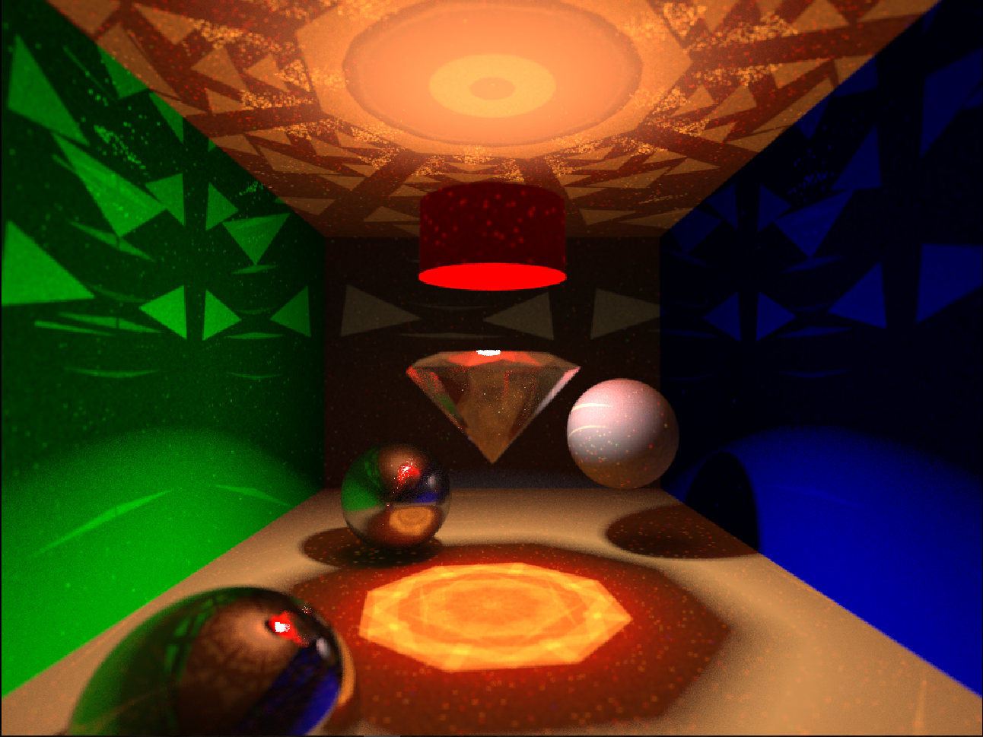
Result

