Slide 2
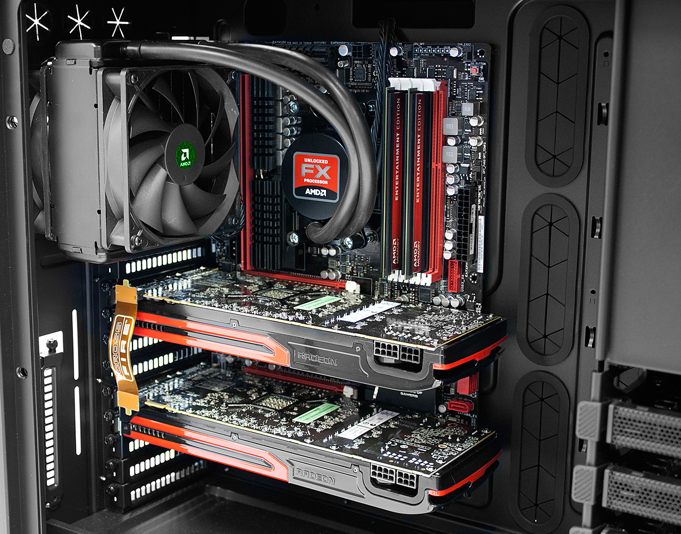
CPU
Applications
??
GPU
http://blogs.amd.com/play/2012/05/01/building-on-amd-hardware/
Notes:
Hello guys.
Ok, first things first: This presentation will be in English, because this is also the language I have chosen for my bachelor thesis.
The topic description of my bachelor thesis is actually quite long, as most of you know probably know from the topic catalogue we got last year. Therefore I'll start with a simple picture.
This picture shows the major components of a computer but the two most important ones [CLICK] are the CPU and the GPU.
Most people know about the CPU. [CLICK] It runs basically all our applications. But what does the GPU do?

Slide 3
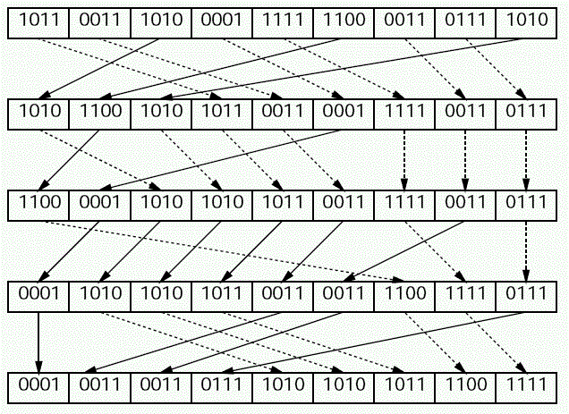
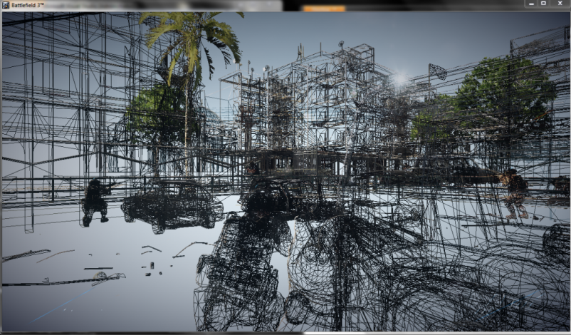
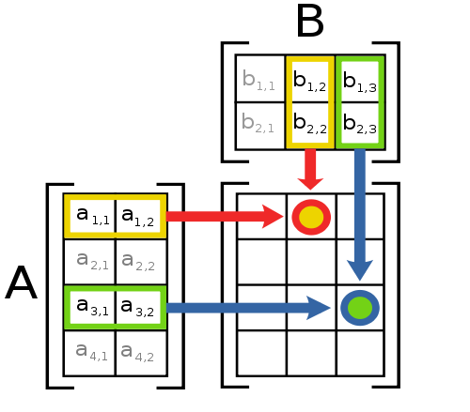



General purpose
Graphics Processing Unit
GPGPU
http://en.wikipedia.org/wiki/File:Matrix_multiplication_diagram_2.svg http://www2.gssm.otsuka.tsukuba.ac.jp/staff/kuno/csr08/hint-05.html http://blog.allenthinks.com http://www.geforce.com/games-applications/pc-games/battlefield-3

Slide 4

GPU Hardware
OpenCL Driver
OpenCL API
OpenCL C Compiler
Application
OpenCL Kernels

Slide 5
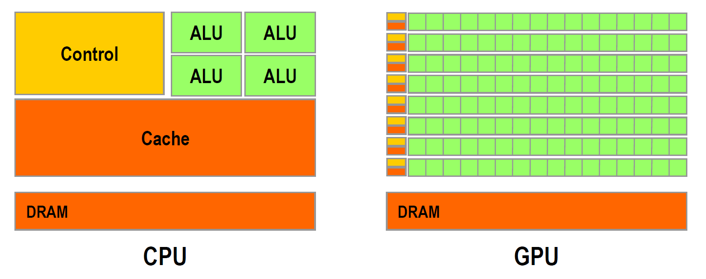
Hardware
http://gpgpu.org/static/sc2007/SC07_CUDA_1_Introduction_Luebke.pdf/
Notes:
This is a very, very abstract view of a CPU and a GPU.

Slide 6
Algorithms
Matrix mult.
Scan
Sort
Notes:
The major focus of my bachelor thesis will be the implementation and benchmark of several standard algorithms. These include algorithms for sorting, scanning and matrix multiplication. I have chosen this algorithms because they often form fundamental blocks for various applications.

Slide 7
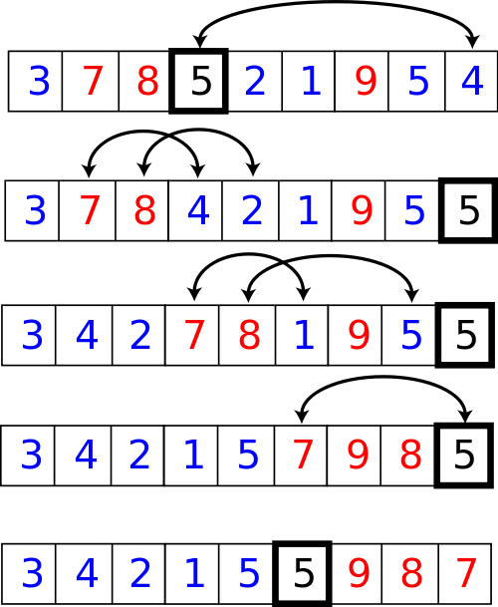
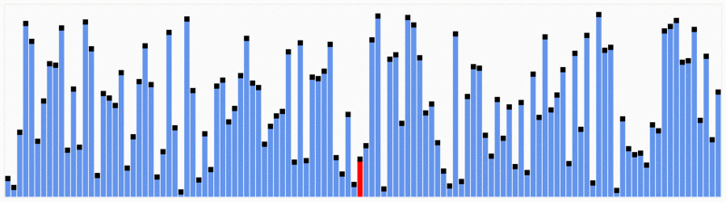
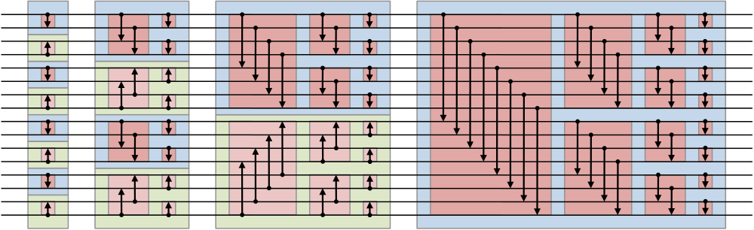
Sort
Quicksort
n log(n)
n²
Bitonic sorting network
http://en.wikipedia.org/wiki/File:Partition_example.svg http://en.wikipedia.org/wiki/File:Quicksort.gif http://en.wikipedia.org/w/index.php?title=File:BitonicSort1.svg&page=1

Slide 8
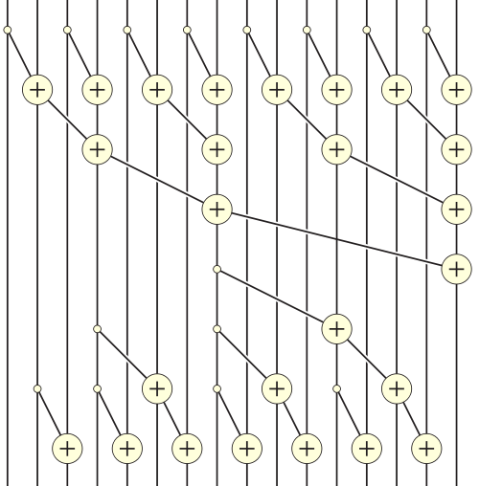
Scan
sum[0] = arr[0];
for(int i = 1; i < len(arr); i++)
sum[i] = sum[i - 1] + arr[i];
n
arr | 5 | 1 | 3 | 4 | 2 | 8 | 0 | 4 | 7
sum | 5 | 6 | 9 | 13 | 15 | 23 | 23 | 27 | 34
http://en.wikipedia.org/wiki/File:Prefix_sum_16.svg

Slide 9
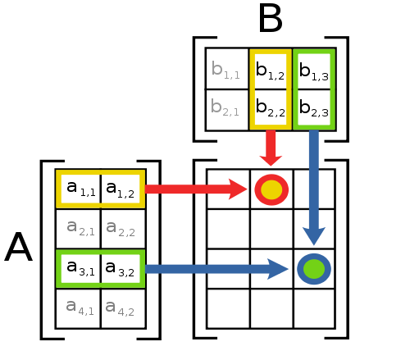
Matrix mult.
n³
http://en.wikipedia.org/wiki/File:Matrix_multiplication_diagram_2.svg

Slide 10
Statistics
Code
Conclusions
Results?

