Slide 2
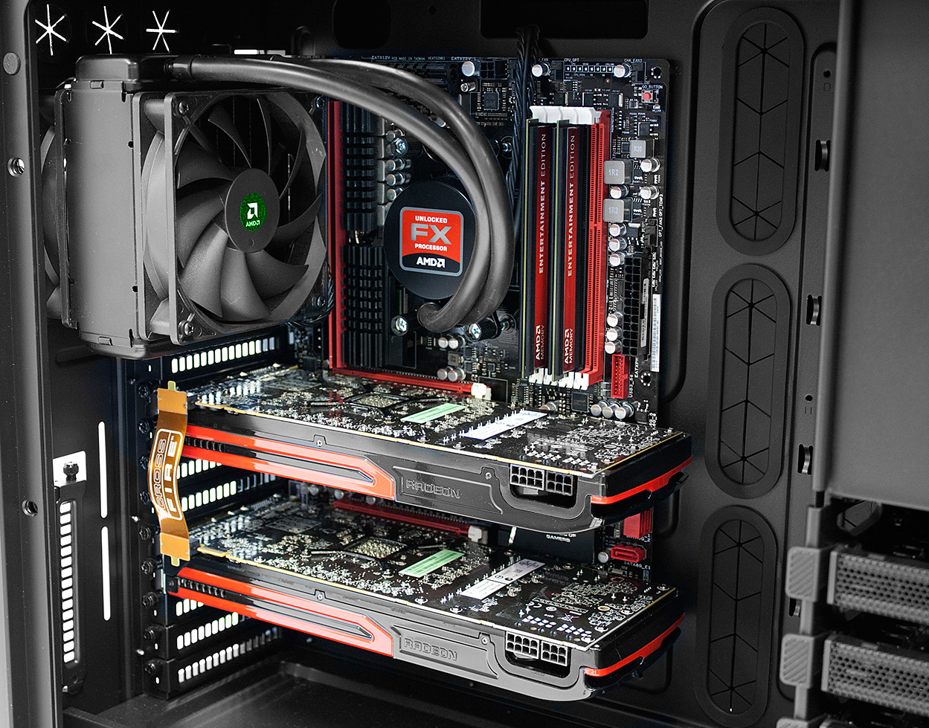
CPU
Applications
??
GPU
http://blogs.amd.com/play/2012/05/01/building-on-amd-hardware/
Notes:
Hello guys.
Ok, first things first: This presentation will be in English, because this is also the language I have chosen for my bachelor thesis.
The topic description of my bachelor thesis is actually quite long, as most of you know probably know from the topic catalogue we got last year. Therefore I'll start with a simple picture.
This picture shows the major components of a computer but the two most important ones [CLICK] are the CPU and the GPU.
Most people know about the CPU. [CLICK] It runs basically all our applications. But what does the GPU do?

Slide 3
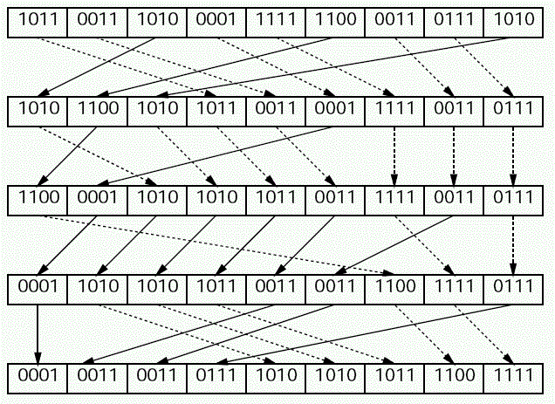
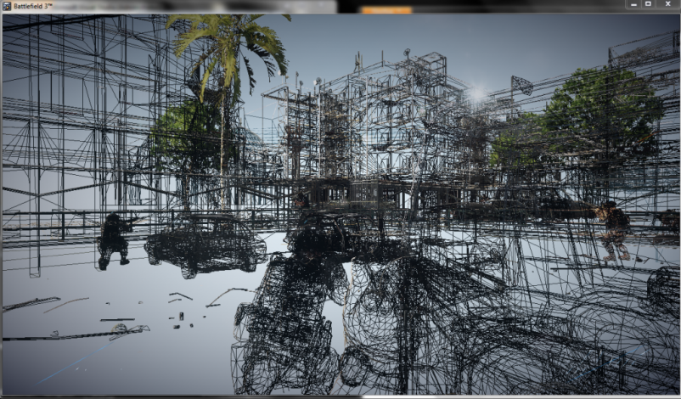
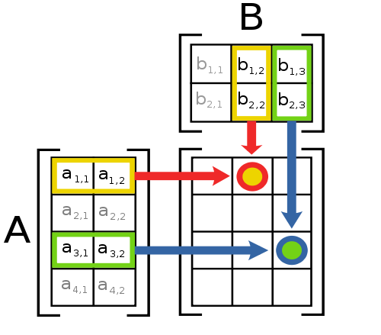



General purpose
Graphics Processing Unit
GPGPU
http://en.wikipedia.org/wiki/File:Matrix_multiplication_diagram_2.svg http://www2.gssm.otsuka.tsukuba.ac.jp/staff/kuno/csr08/hint-05.html http://blog.allenthinks.com http://www.geforce.com/games-applications/pc-games/battlefield-3
Notes:
The GPU, the Graphics Processing Unit, is usually used to process graphics and calculate geometry.
Favourite game, shadows, textures, lot's of triangles
BUT: The GPU can nowadays not only be used for graphics. In fact it is sometimes very suitable for boring [CLICK] general purpose calculations, like sorting arrays or multiplying matrixes. But the question is not only about what boring things I can do with my graphics card, the question is how i can do it.

Slide 4

GPU Hardware
OpenCL Driver
OpenCL API
OpenCL C Compiler
Application
OpenCL Kernels
CPU Hardware
Notes:
And this is where OpenCL comes into play. OpenCL will form the first part of my bachelor thesis, because building an application for the GPU using OpenCL is not as straightforward as writing an application for the CPU. Let's look what is different [CLICK].
Like most other languages OpenCL has a compiler, that compiles OpenCL programs, the kernels. But the difference is, that is program cannot be run. It needs a so called host application, that moves this OpenCL program through the driver to the GPU. The host application running on the CPU then communicates with the OpenCL kernel through the OpenCL API and driver.
But OpenCL is not only limitted to GPUs. OpenCL runs on the CPU as well [CLICK]. (Why should we do that? Because OpenCL does also do a great job utilizing multicore CPUs. In fact, it can even run a program on the CPU and GPU at the same time.) Therefore, OpenCL has several concepts to abstract the hardware to the programmer and these concepts and the corresponding APIs form a main part of my bachelor thesis.

Slide 5
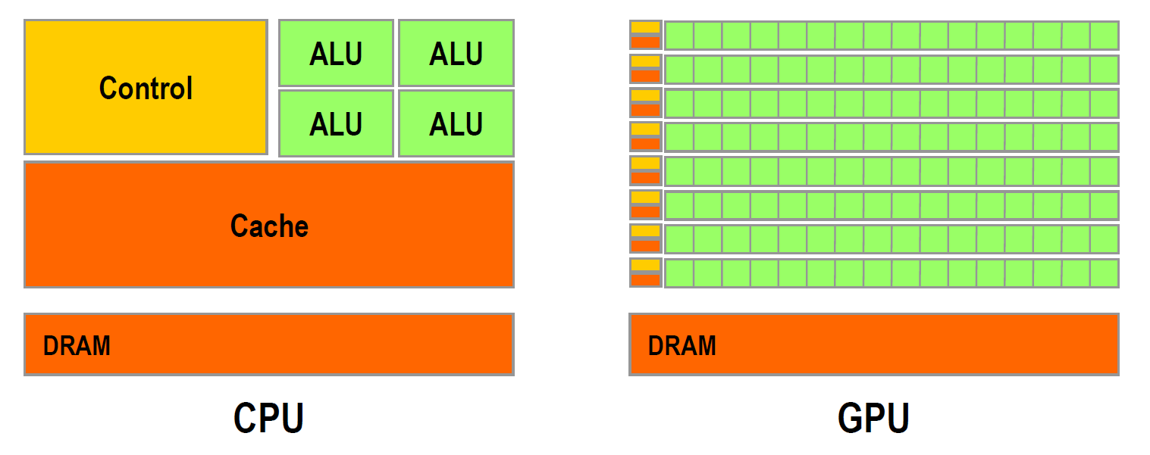
Hardware
http://gpgpu.org/static/sc2007/SC07_CUDA_1_Introduction_Luebke.pdf/
Notes:
As important as how OpenCL handles the hardware is how the hardware actually looks like. So here is a very, very abstract view of a CPU and a GPU. The obvious difference is the number of cores. A typical CPU has around 4 independent cores while a typical GPU has several hundreds of cores grouped together in so-called multi processors. This difference in hardware architecture has a huge impact on the kind of algorithms that can be run efficiently on the GPU and on the problems we will encounter during the implementation. So the second big chapter in my thesis will be about the hardware architectures OpenCL supports.

Slide 6
Algorithms
Matrix mult.
Scan
Sort
Notes:
After a profound introduction to OpenCL and hardware, the second focus of my bachelor thesis will be the implementation and benchmark of several standard algorithms. These include algorithms for sorting, scanning and matrix multiplication. I have chosen this algorithms because they often form fundamental blocks for various applications.

Slide 7
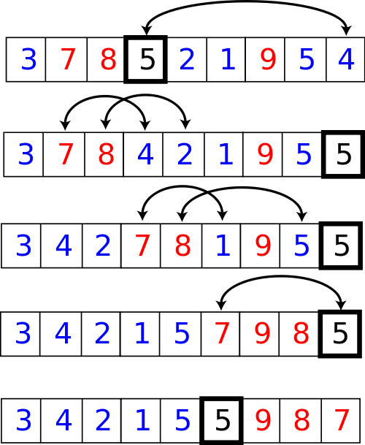
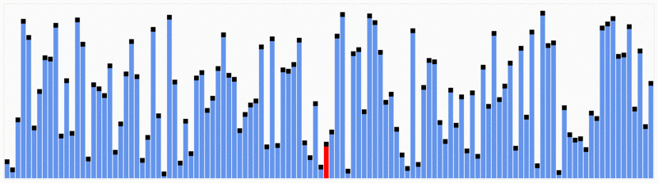
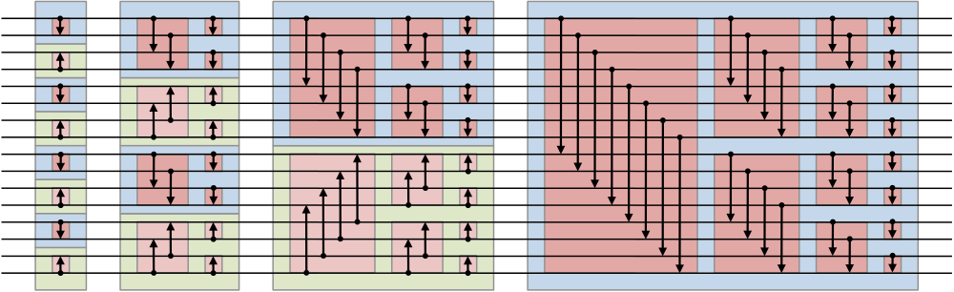
Sort
Quicksort
n log(n)
n log²(n)
Bitonic sorting network
http://en.wikipedia.org/wiki/File:Partition_example.svg http://en.wikipedia.org/wiki/File:Quicksort.gif http://en.wikipedia.org/w/index.php?title=File:BitonicSort1.svg&page=1
Notes:
The first and probably my most complex class of algorithms are sorting algorithms. Everybody knows sorting algorithms, like quicksort. Most sorting algorithms rely on some kind of comparing and swapping of two elements one after each other. This works perfectly on a single core, but on several hundred cores only one core would be used at a time. Therefore different approaches are necessary like the bitonic sorting network, which has a worse runtime complexity than a quicksort, but allows many operations to run parallel.

Slide 8
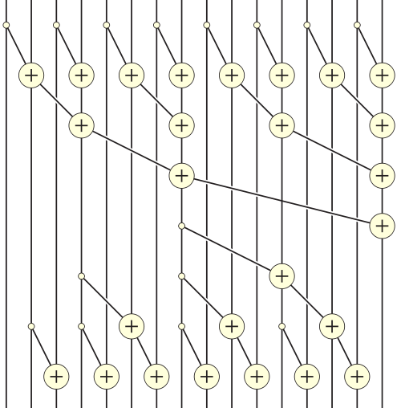
Scan
sum[0] = arr[0];
for(int i = 1; i < len(arr); i++)
sum[i] = sum[i - 1] + arr[i];
n
arr | 5 | 1 | 3 | 4 | 2 | 8 | 0 | 4 | 7
sum | 5 | 6 | 9 | 13 | 15 | 23 | 23 | 27 | 34
http://en.wikipedia.org/wiki/File:Prefix_sum_16.svg
Notes:
Another basic algorithm is the so-called scan. The scan operation simply loops over an array and sums up the previous values plus the current value. The implementation for a CPU looks very simple. But as the algorithm is linear, it is very hard to be ported to a GPU. One method would be to use such a tree based addition system.

Slide 9
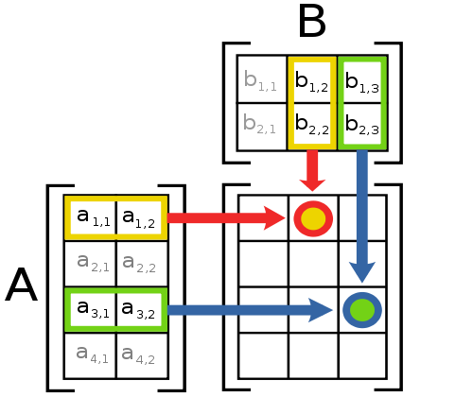
Matrix mult.
n³
http://en.wikipedia.org/wiki/File:Matrix_multiplication_diagram_2.svg
Notes:
The final algorithm I want to cover in my bachelor thesis is the matrix multiplication. It has a very bad runtime complexity, needs a lot of floating point operations and is highly parallelizable. As a result the matrix multiplication, at least for large matrixes, should perform a lot better on a GPU. The question will be how large has the matrix to be for the GPU to be faster than the CPU and how much faster will the GPU be?

Slide 10
Statistics
Code
Conclusions
Results?
Notes:
So what are the final results of my bachelor thesis? The first step after the theoretical part will be the implementation of these three kinds of algorithms I have shown you. Then I will run some benchmarks and create statistics. And from this statistics I will try to draw some conclusions to answere the final question "Is it profitable to use OpenCL for my application or not?"
Thanks for listening and see you guys in January with some results.

