Slide 1
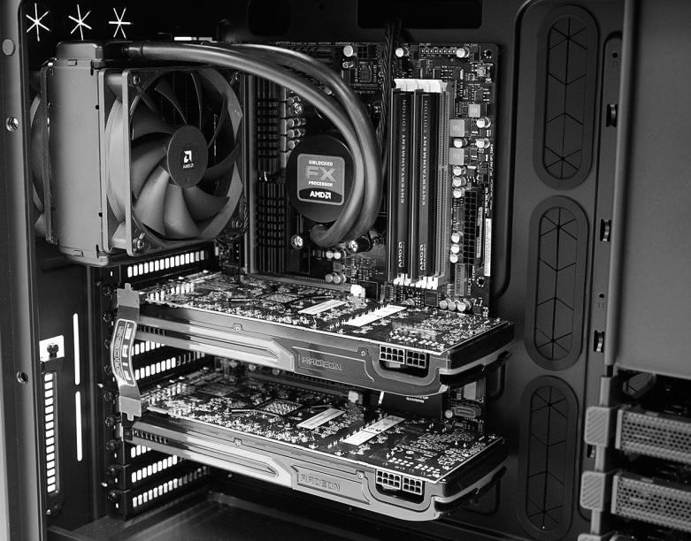

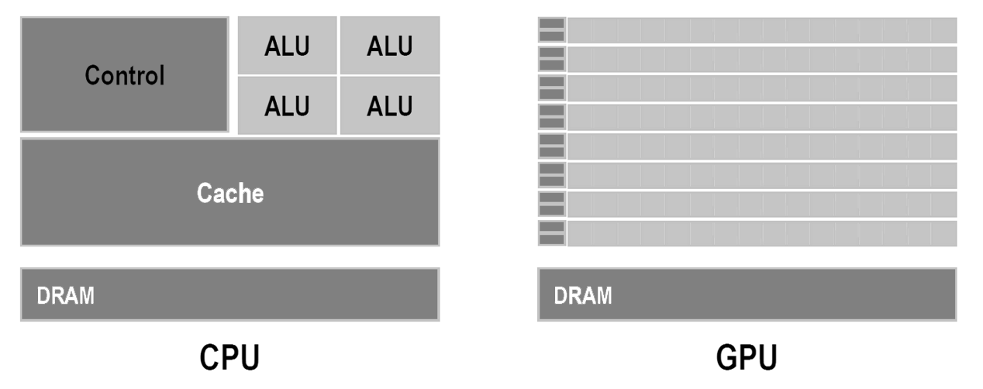
Matrix mult.
Scan
Sort
CPU
GPU
Notes:
And this is where OpenCL comes into play. OpenCL will form the first part of my bachelor thesis, because building an application for the GPU using OpenCL is not as straightforward as writing an application for the CPU. Let's look what is different [CLICK].
Like most other languages OpenCL has a compiler, that compiles OpenCL programs, the kernels. But the difference is, that is program cannot be run. It needs a so called host application, that moves this OpenCL program through the driver to the GPU. The host application running on the CPU then communicates with the OpenCL kernel through the OpenCL API and driver.
But OpenCL is not limitted to GPUs. OpenCL runs on the CPU as well [CLICK]. Therefore, OpenCL has several concepts to abstract the hardware to the programmer and these concepts and the corresponding APIs form a main part of my bachelor thesis.

Slide 2
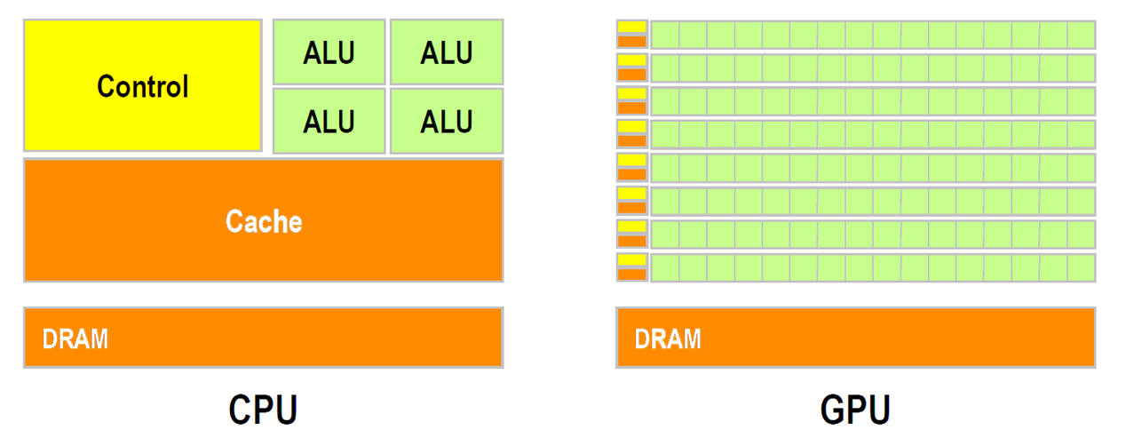
Compute Units
http://gpgpu.org/static/sc2007/SC07_CUDA_1_Introduction_Luebke.pdf/
Notes:
As important as how OpenCL handles the hardware is how the hardware actually looks like. So here is a very, very abstract view of a CPU and a GPU. The obvious difference is the number of cores. A typical CPU has around 4 independent cores while a typical GPU has several hundreds of cores grouped together in so-called multi processors. This difference in hardware architecture has a huge impact on the kind of algorithms that can be run efficiently on the GPU and on the problems we will encounter during the implementation. So the second big chapter in my thesis will be about the hardware architectures OpenCL supports.

Slide 3
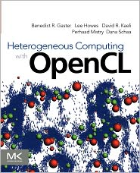
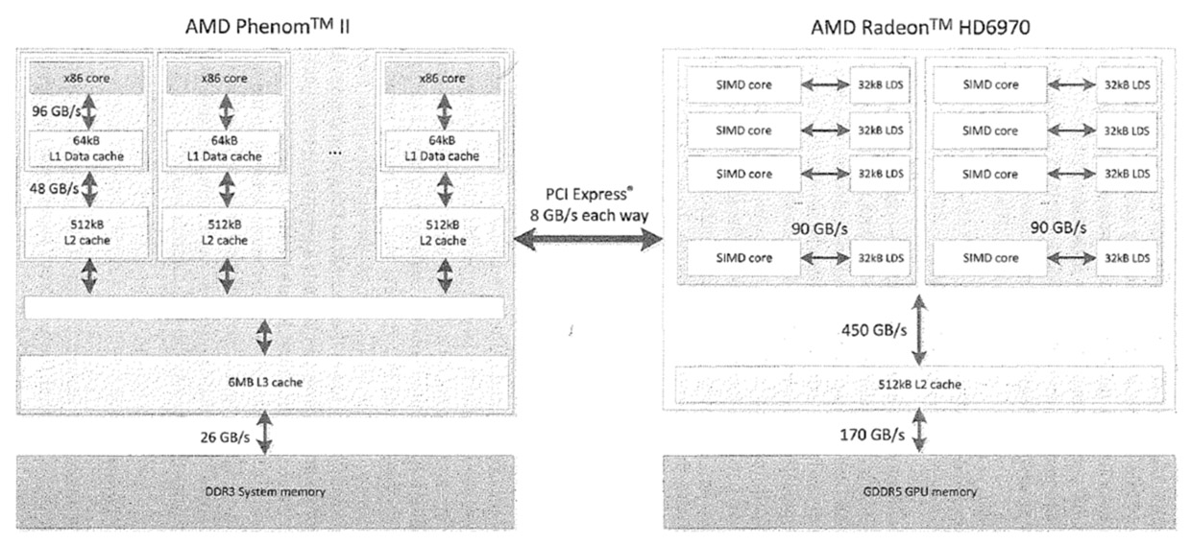
Memory bandwidth
From:
CPU
GPU

Slide 4
Algorithms
Matrix mult.
Scan
Sort
Notes:
After a profound introduction to OpenCL and hardware, the second focus of my bachelor thesis will be the implementation and benchmark of several standard algorithms. These include algorithms for sorting, scanning and matrix multiplication. I have chosen this algorithms because they often form fundamental blocks for various applications.

Slide 5
CPU
Scan
sum[0] = arr[0];
for(int i = 1; i < len(arr); i++)
sum[i] = sum[i - 1] + arr[i];
n
arr | 5 | 1 | 3 | 4 | 2 | 8 | 0 | 4 | 7
sum | 5 | 6 | 9 | 13 | 15 | 23 | 23 | 27 | 34
Notes:
Another basic algorithm is the so-called scan. The scan operation simply loops over an array and sums up the previous values plus the current value. The implementation for a CPU looks very simple. But as the algorithm is linear, it is very hard to be ported to a GPU. One method would be to use such a tree based addition system.

Slide 6
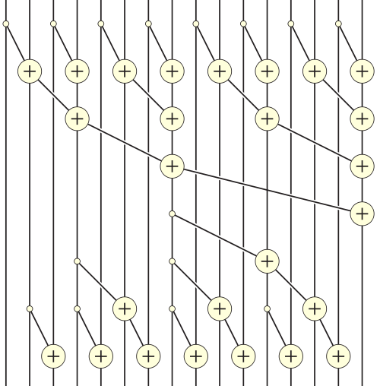
GPU
16 Elements
Scan
5 | 1 | 3 | 4 | 2 | 8 | 0 | 4 | 7 | 7 | 4 | 3 | 0 | 3 | 9 | 4
n log(n)
7 Passes
5 | 6 | 9 | . | . | . | . | . | . | . | . | . | . | . | . | .
http://en.wikipedia.org/wiki/Prefix_sum

Slide 7
Benchmark

Slide 8
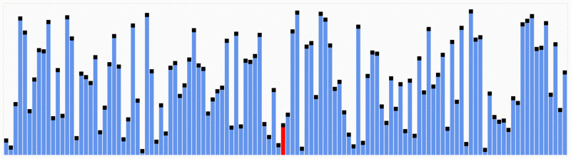
CPU
Sort
Quicksort
n log(n)
http://en.wikipedia.org/wiki/File:Partition_example.svg http://en.wikipedia.org/wiki/File:Quicksort.gif
Notes:
The first and probably my most complex class of algorithms are sorting algorithms. Everybody knows sorting algorithms, like quicksort. Most sorting algorithms rely on some kind of comparing and swapping of two elements one after each other. This works perfectly on a single core, but on several hundred cores only one core would be used at a time. Therefore different approaches are necessary like the bitonic sorting network, which has a worse runtime complexity than a quicksort, but allows many operations to run parallel.

Slide 9
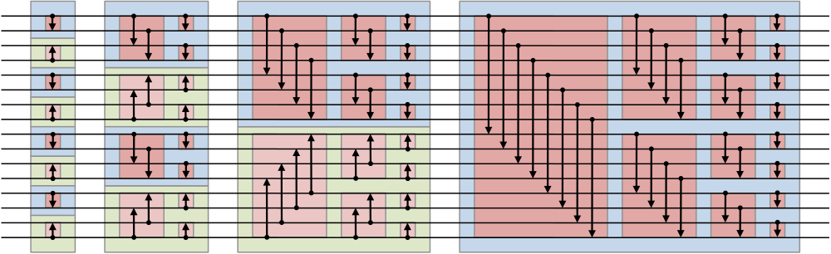
GPU
Sort
Bitonic sort
n log²(n)
16 Elements
10 Passes
http://en.wikipedia.org/wiki/Bitonic_sorter

Slide 10
Benchmark

Slide 11
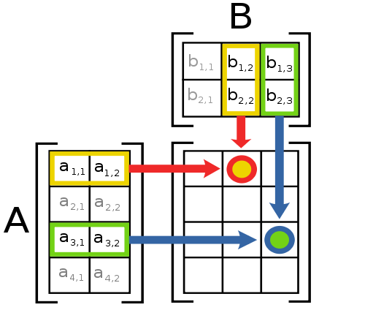
CPU
GPU
Matrix mult.
n³
http://en.wikipedia.org/wiki/File:Matrix_multiplication_diagram_2.svg
Notes:
The final algorithm I want to cover in my bachelor thesis is the matrix multiplication. It has a very bad runtime complexity, needs a lot of floating point operations and is highly parallelizable.

Slide 12
Benchmark
74,5s
36,7s
5,6s

Slide 13
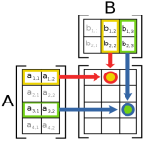
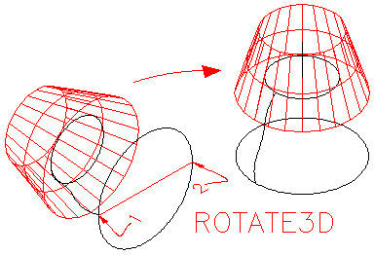
CPU
Lots of
GPU
…
Matrix mult.
~n
http://www.we-r-here.com/cad_05/tutorials/level_3/3-8.htm http://en.wikipedia.org/wiki/File:Matrix_multiplication_diagram_2.svg

Slide 14
Benchmark

Slide 15
Memory transfer

Slide 16
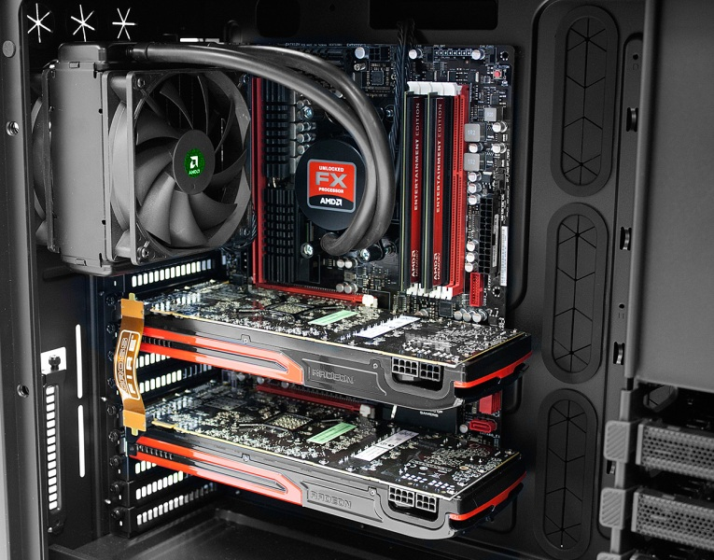
Conclusion
GPUs are awesome, if …
CPU
Highly parallelizable
Small, independent pieces
Arithemitically intensive
Less memory transfer
GPU

