Slide 1
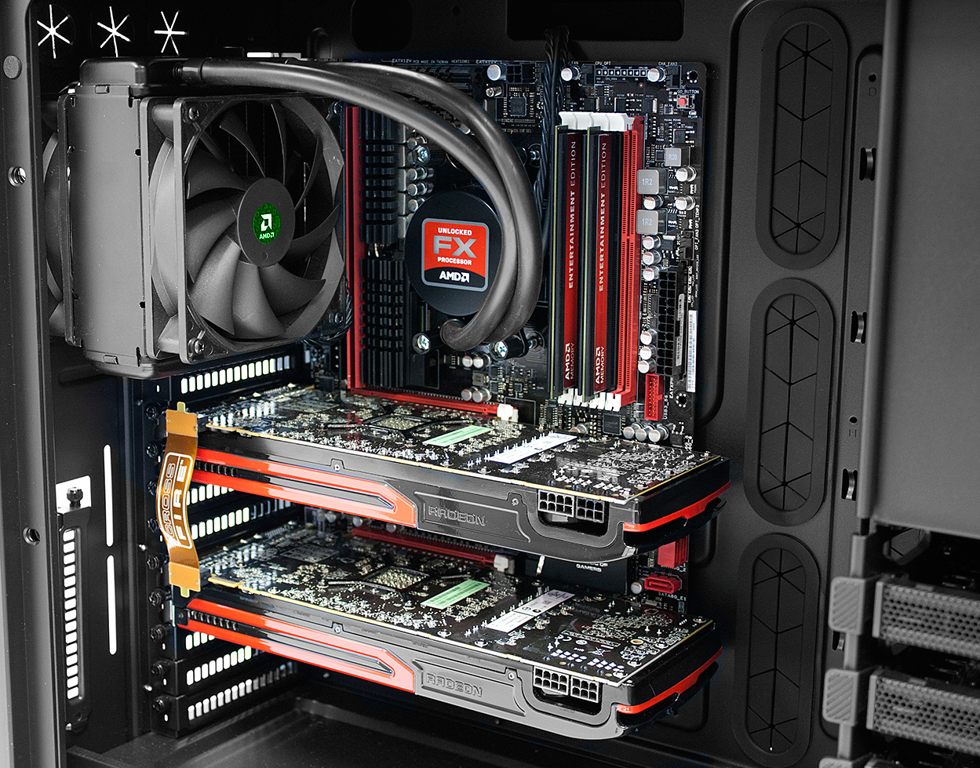
CPU
Applications
??
GPU
http://blogs.amd.com/play/2012/05/01/building-on-amd-hardware/
Notes:
Hello guys.
Ok, first things first: This presentation will be in English, because this is also the language I have chosen for my bachelor thesis.
The topic description of my bachelor thesis is actually quite long, as most of you know probably know from the topic catalogue we got last year. Therefore I'll start with a simple picture.
This picture shows the major components of a computer but the two most important ones [CLICK] are the CPU and the GPU.
Most people know about the CPU. [CLICK] It runs basically all our applications. But what does the GPU do?

Slide 2
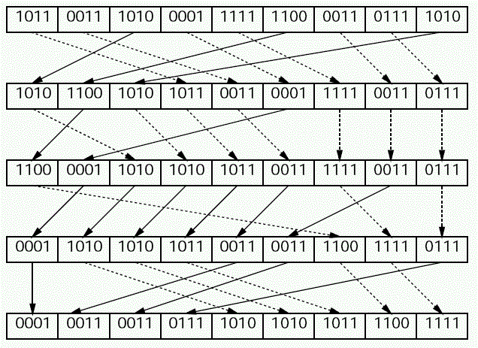
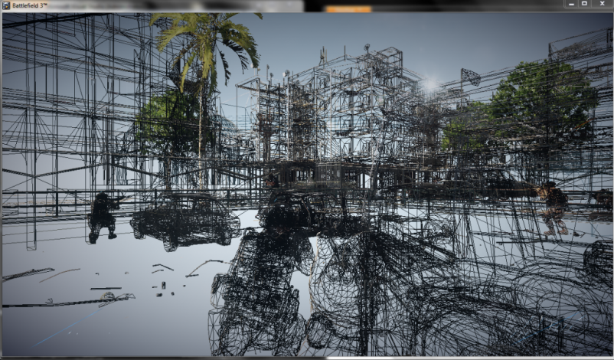
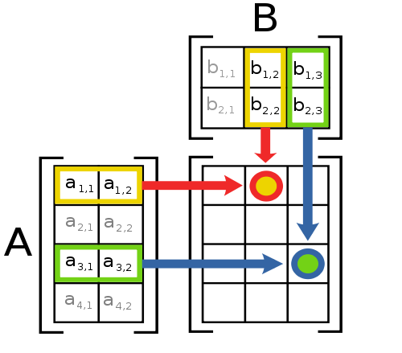
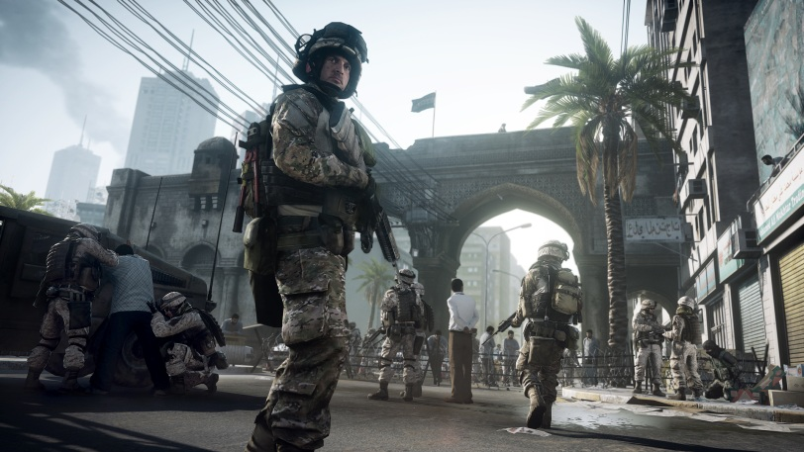


General purpose
Graphics Processing Unit
GPGPU
http://en.wikipedia.org/wiki/File:Matrix_multiplication_diagram_2.svg http://www2.gssm.otsuka.tsukuba.ac.jp/staff/kuno/csr08/hint-05.html http://blog.allenthinks.com http://www.geforce.com/games-applications/pc-games/battlefield-3

Slide 3


Slide 4
Hardware

Slide 5
Algorithms
Sort
Scan
Matrix multiplication

Slide 6
Sort

Slide 7
Scan

Slide 8
Matrix multiplication (large)

Slide 9
Matrix multiplication (many)

