Slide 1
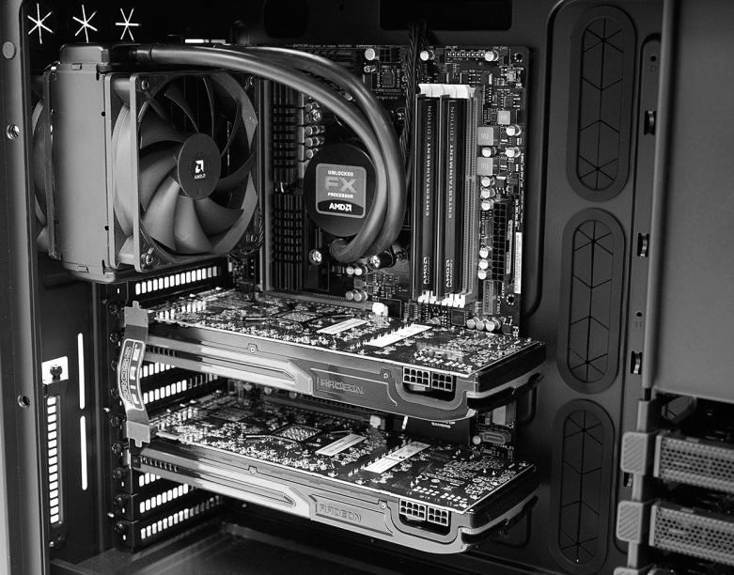

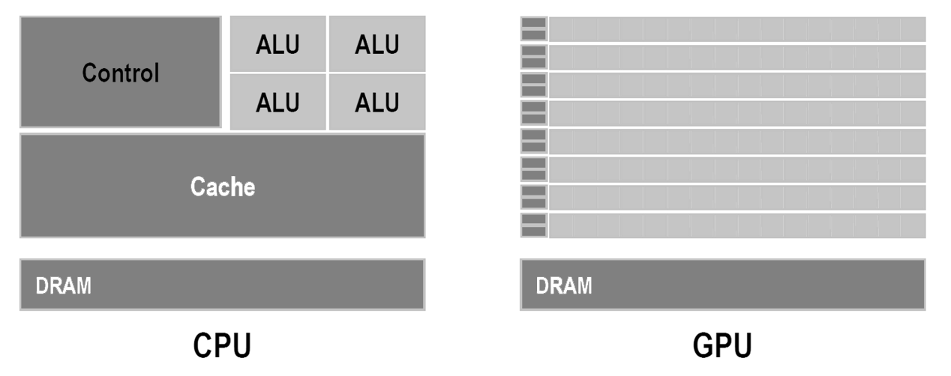
Matrix mult.
Scan
Sort
CPU
GPU
Notes:
Welcome to my second presentation about OpenCL, about the Open Computing Language.
I will start with a short flashback about what I have presented last time.
We talked about what a GPU is and what the differences between a CPU and GPU are.
In the second part, I covered the algorithms I wanted to implement.
Today we will take a short look onto the hardware again and then continue with some concrete concepts about how we can implement those algorithms for a GPU.

Slide 2
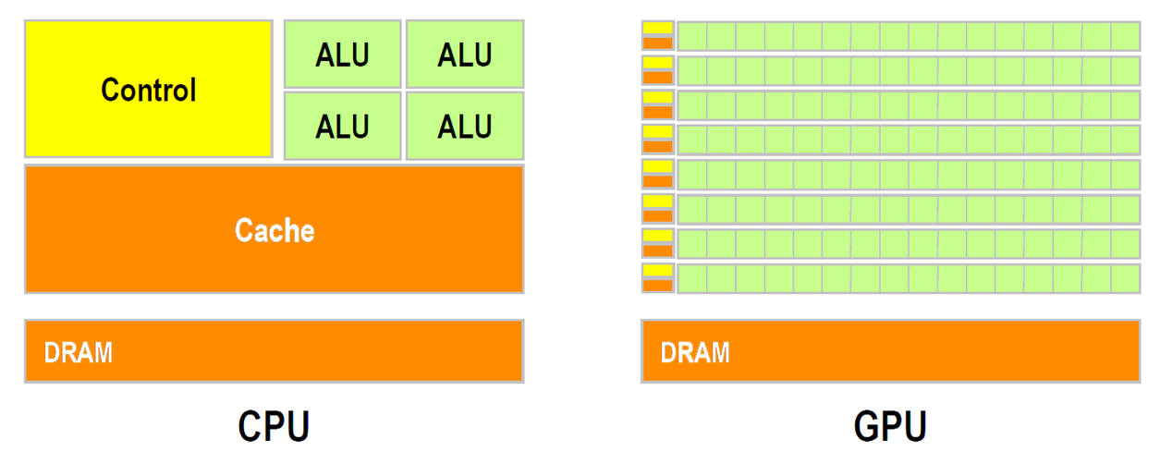
Compute Units
http://gpgpu.org/static/sc2007/SC07_CUDA_1_Introduction_Luebke.pdf/
Notes:
We already know this image, but I want to quickly restate the important difference between a CPU and a GPU.
A typical CPU has around 4 independent cores. We can run threads on them and we can do all that stuff with synchronization like locks, critical seconds and so on.
On a GPU we have several hundreds of cores which run basically independent.

Slide 3
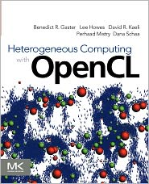
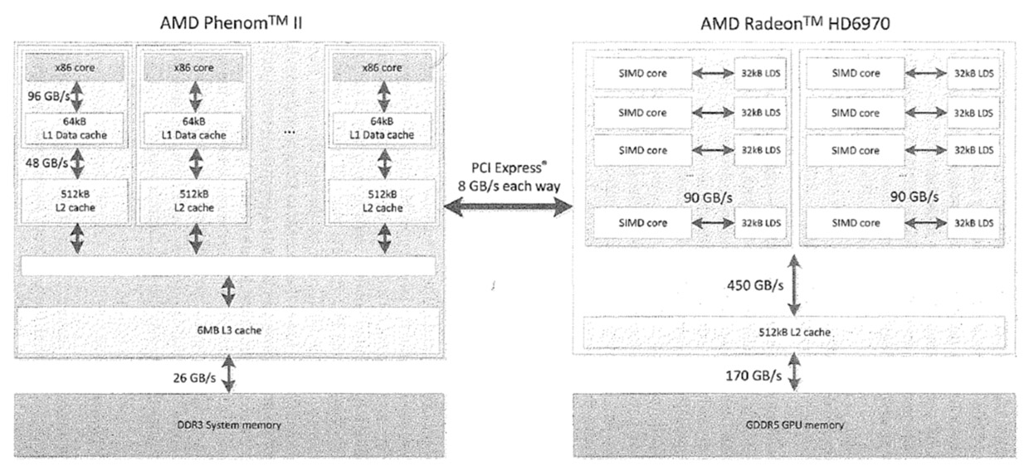
Memory bandwidth
From:
CPU
GPU
Notes:
Another graphic I want to show you is from the book Heterogenous Computing with OpenCL. It shows the memory transfer rates between some hardware compontents.
We can see a lot of high numbers inside the CPU, even higher numbers inside the GPU.
BUT, the big bottle neck is PCI bus between the CPU and the GPU, which is very slow compared to the others. We will see an example later on, why this plays an important role.

Slide 4
Algorithms
Matrix mult.
Scan
Sort
Notes:
Now let's look into some algorithms.

Slide 5
CPU
Scan
sum[0] = arr[0];
for(int i = 1; i < len(arr); i++)
sum[i] = sum[i - 1] + arr[i];
n
arr | 5 | 1 | 3 | 4 | 2 | 8 | 0 | 4 | 7
sum | 5 | 6 | 9 | 13 | 15 | 23 | 23 | 27 | 34
Notes:
We also already know this slide. It is about the scan, a very simple operation running in linear time.
The scan takes an input array and sums up all preceding elements and the value itself for each element in the input.
This is very easy on a CPU, but how can be parallelize something like this?

Slide 6
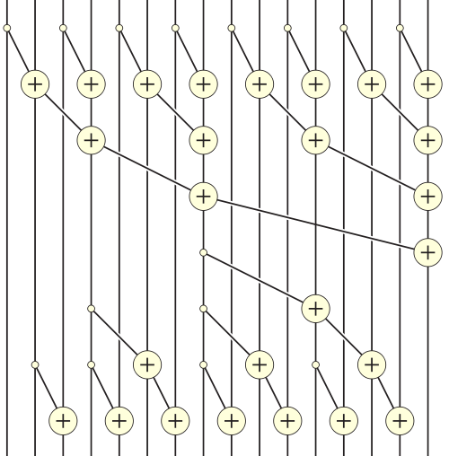
GPU
16 Elements
Scan
5 | 1 | 3 | 4 | 2 | 8 | 0 | 4 | 7 | 7 | 4 | 3 | 0 | 3 | 9 | 4
n log(n)
7 Passes
26 Additions
5 | 6 | 9 | . | . | . | . | . | . | . | . | . | . | . | . | .
http://en.wikipedia.org/wiki/Prefix_sum
Notes:
A common approach is to use trees and to divide the problem into several steps, called passes.
Each pass contains only operations that can run in parallel.
Although we need more additions and get a worse runtime complexitiy, it only takes 7 steps for the GPU instead of 16 for the CPU.
Let's look how this turns out.

Slide 7
Benchmark

Slide 8
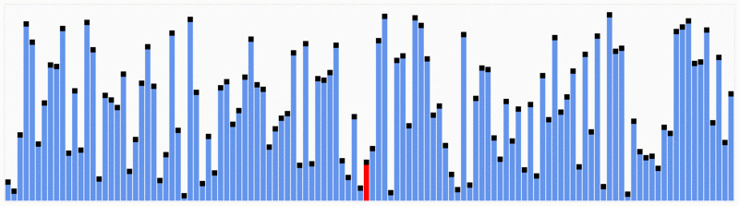
CPU
Sort
Quicksort
n log(n)
http://en.wikipedia.org/wiki/File:Partition_example.svg http://en.wikipedia.org/wiki/File:Quicksort.gif
Notes:
The second problem I want to try on a GPU is sorting. We already talked about quicksort last time, a good sorting algorithm for a CPU. But it is hard to port it on a GPU because of the permutation step at the beginning of each recursion.
So which alternatives do we have?

Slide 9
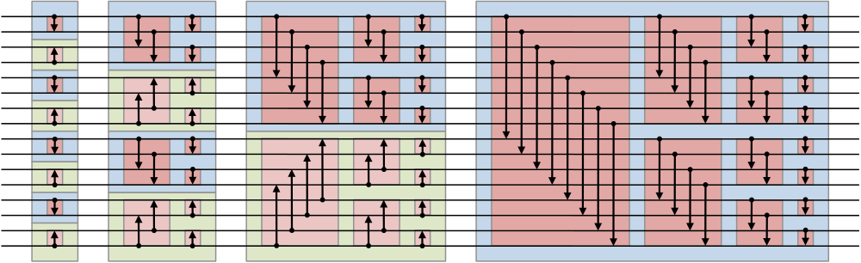
GPU
Sort
Bitonic sort
n log²(n)
16 Elements
10 Passes
http://en.wikipedia.org/wiki/Bitonic_sorter
Notes:
A often used solution is to use sorting networks and the bitonic sorter is one of these networks. A sorting network consists of wires, where the values travel along, and comperators which compare and swap them.
So we basically attach an input array to the left side and let it travel through the network. The output is a sorted array at the right side.
The parallelization of the bitonic sorter is also bought on behalf of runtime complexity. What are the results?

Slide 10
Benchmark

Slide 11
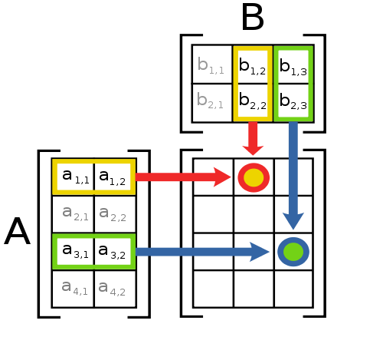
CPU
GPU
Matrix mult.
n³
http://en.wikipedia.org/wiki/File:Matrix_multiplication_diagram_2.svg
Notes:
The final problem I tried was the matrix multiplication. The beauty of this problem is that each output element is computed completely independently of each other element. This means, that calculating the result matrix should be very fast and easy to implement on a GPU, as we can simply assign each separate output element to a different GPU core.

Slide 12
Benchmark
74,5s
36,7s
5,6s
Notes:
The results are amazing.

Slide 13
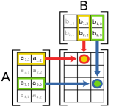
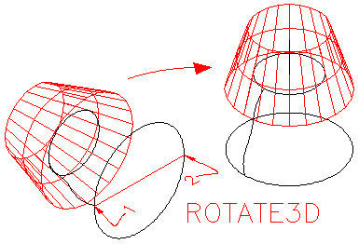
CPU
Lots of
GPU
…
Matrix mult.
~n
http://www.we-r-here.com/cad_05/tutorials/level_3/3-8.htm http://en.wikipedia.org/wiki/File:Matrix_multiplication_diagram_2.svg
Notes:
But why take one matrix multiplication, when we can have lots of multiplications in parallel. This is often used in 3D geometry, when the vertices of a 3D model have to be transformed by a matrix.
My guess was that this should also run very fast an the GPU. But the results where different … totally different …

Slide 14
Benchmark
Notes:
As it turns out, a multithreaded CPU implementation using OpenMP runs faster than the GPU implementation.
How is this possible? The single matrix multiplication was so amazingly fast.
And this is where memory transfer comes into play …

Slide 15
Memory transfer
Notes:
In fact, the GPU was way faster than the CPU. But, the time needed to copy all the input data to the graphics card and download it again after the calculation is so big, that the GPU loses the fight agains the CPU.
Memory transfere is still a big trouble in many GPU implementations. But fortunately, hardware venors are already experimenting with a solution to the problem by placing the GPUs on the same chip as the CPU. Examples of this try would be Intel's Sandy Bridge and Ivy Bridge.

Slide 16
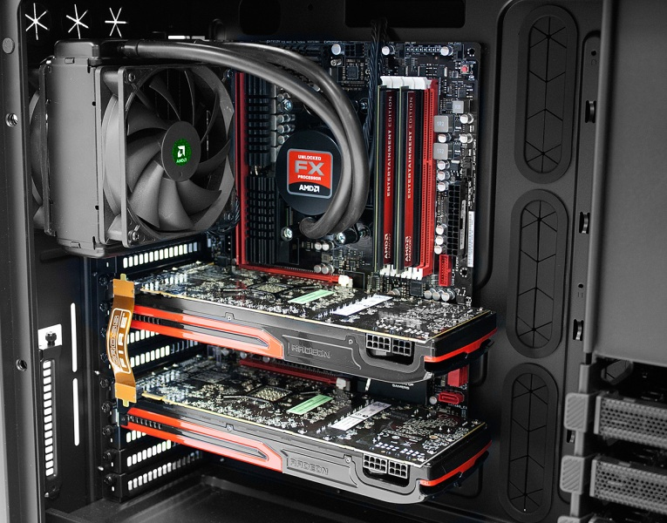
Conclusion
GPUs are awesome, if …
CPU
Highly parallelizable
Small, independent pieces
Arithemitically intensive
Less memory transfer
GPU
Notes:
The conclusion that we can draw from these results is that GPUs are awesome!
IF, the problem is …
Otherwise it is the better idea to develop for a CPU, as this is usually much easier.
Thank you for listening. Are there any questions?

