Slide 1
Graph Databases
Philipp Fleck, Bernhard Manfred Gruber

Slide 2
Contents
Big Data – Big Files – Big Problems
Graph-DB Concepts
Example (Wikipedia)
Neo4j vs MS-SQL
Queries
Performance
Conclusion

Slide 3

Big Data – Big Files – Big Problems

Slide 4
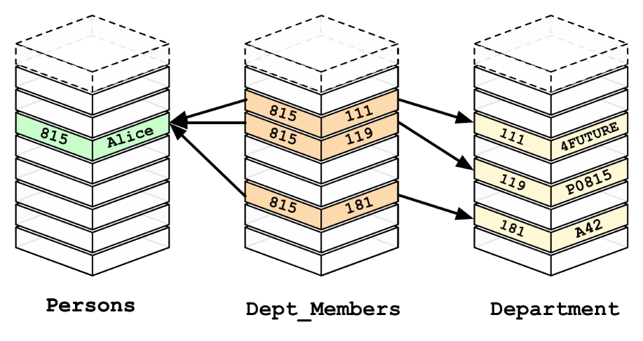
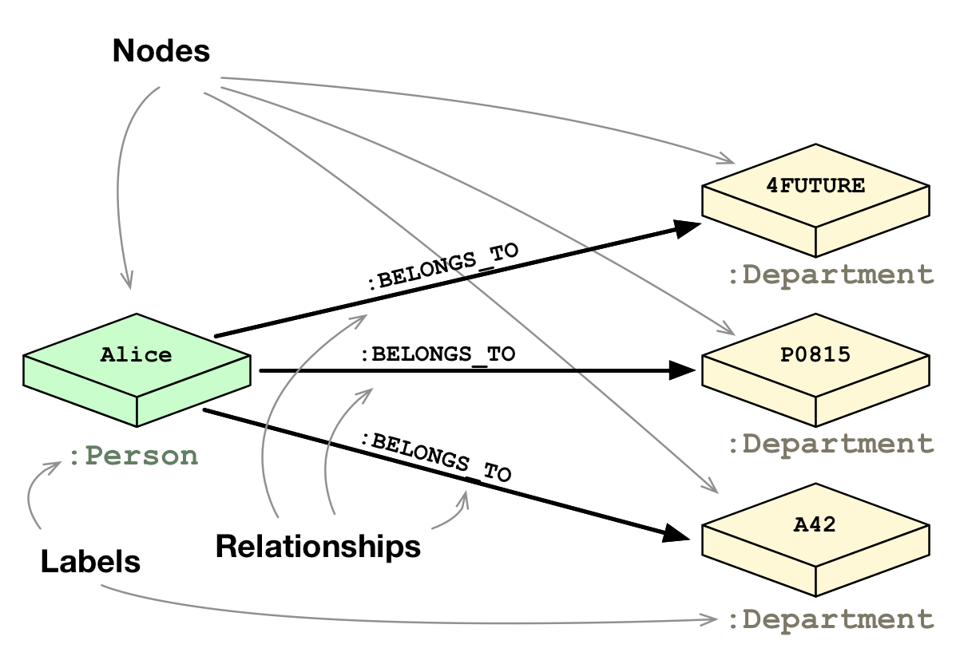
Graph-DB Concepts
Ideas
RDBMS: Slow Joins
Natural Relations
Graph Theory (math)
Components
Nodes (Entities)
Edges (Relationships)
Properties (Data)

Slide 5
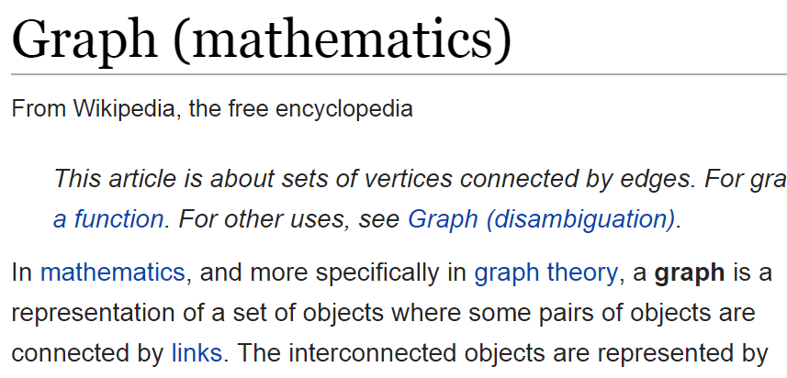
Example Wikipedia
Wikipedia Plattdüütsch
31814 Articles
299032 Links
21993 First-Links
Philosophy-Game
WikiGame
First-Link
Links
Notes:
Page {id, title, ctitle, length, text}
links_to {srd, dst}
first_links_to {src, dst}

Slide 6
Neo4j vs SQL (Basics Queries)
CREATE (p:Page {id:1, title:"Philosophy"}) CREATE (l:Page {id:2, title:"Logic"}) CREATE (l)-[:links_to]->(p);
MATCH (p:Page {title:"Philosophy"}) SET p.text="Hello Graph";
MATCH (p:Page {title:"Philosophy"}) DELETE p;
MATCH (p:Page {title:"Philosophy"}) MATCH (p)<-[:links_to]-(a) RETURN a;
INSERT INTO Pages (id, title) VALUES (1, 'Philosophy'), (2, 'Logic'); INSERT INTO Links VALUES (2, 1);
UPDATE Pages SET text='Hello Graph‚ WHERE title='Philosophy';
DELETE FROM Pages WHERE title='Philosophy';
SELECT a.* FROM Pages p JOIN Links l ON p.id=l.dst JOIN Pages a ON a.id=l.src WHERE p.title='Philosophy';

Slide 7

Neo4j vs SQL (Advanced Queries)
MATCH (p:Page {title:"Philosophy"}) MATCH (p)<-[:first_links_to*1..3]-(a) RETURN DISTINCT a;
MATCH (p:Page {title:"Philosophy"}) MATCH (p)<-[:first_links_to*]-(a) RETURN DISTINCT a;
MATCH path=shortestPath( (p:Page {title:"Philosophy"}) <-[:first_links_to*]- (g:Page {title:"Graph"}) ) RETURN path;
Dijkstra, A*
JOIN UNION JOIN UNION JOIN ...
Recursive Join ☺ CONNECT BY / Common Table Expression
WITH temp (id) AS ( SELECT p.id FROM Page p WHERE p.title='Philosophy' UNION ALL SELECT fl.src FROM FirstLink fl JOIN temp t ON fl.dst=t.id ) SELECT a.* FROM Page a JOIN temp t ON a.id=t.id;

Slide 8
Neo4j vs SQL (Performance)
Operation |  | Neo4j | SQL
Insert | All | 3m30s | 12m45s
 | Pages (31.841) | 4,7s | 4,6s
 | Links (299.032) | 3m15s | 12m
 | First Links (21.993) | 11,3s | 42s
Find First Links to Philosophy (33) |  | 53ms | <0s
Find Sources of Philosophy (all links) |  | (only COUNT) | (all data)
 | 1 Hopp (166) | 30-35ms | <0s
 | 2 Hopps (2.057) | 38-42ms | <0s
 | 3 Hopps (14.240) | 330-370ms | <0s
 | 4 Hopps (25.558) | 25-30s +7GB RAM | 8s
Notes:
Insert
Pages
Links
Delete?
Find 1 Page by Title
Find Sources of Philosophy
1-4 Hops

