Slide 1
Graph Databases
Philipp Fleck, Bernhard Manfred Gruber

Slide 2
Contents
Big Data – Big Files – Big Problems
Graph-DB Concepts
Example (Wikipedia)
Neo4j vs MS-SQL
Queries
Performance
Conclusion

Slide 3
Big Data – Big Files – Big Problems

Slide 4
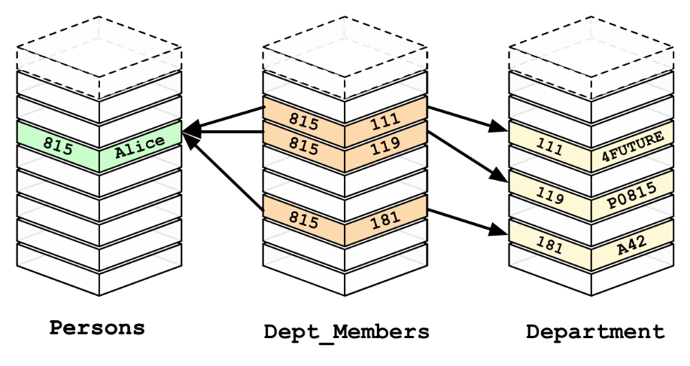
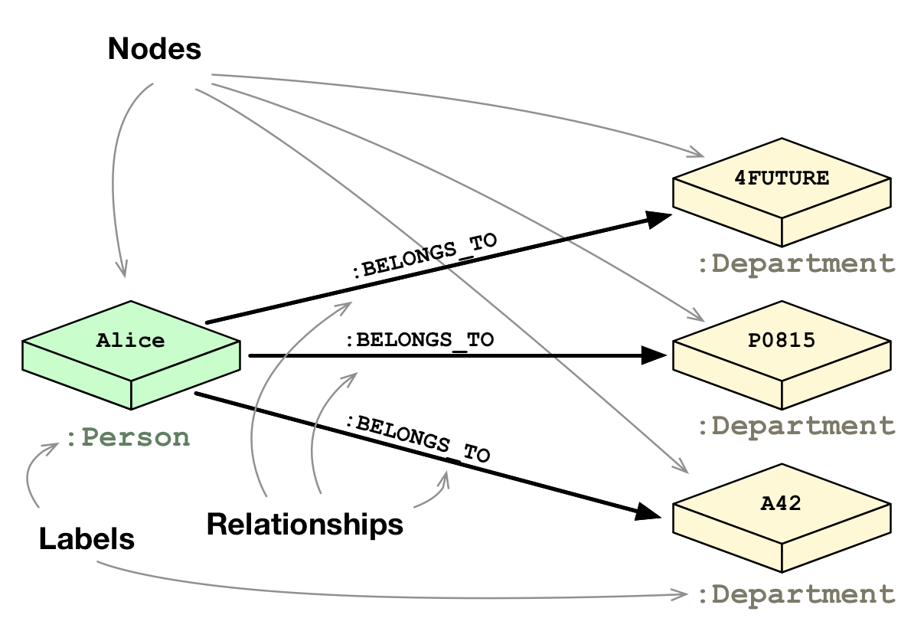
Graph-DB Concepts
Ideas
RDBMS: Slow Joins
Natural Relations
Graph Theory (math)
Components
Nodes (Entities)
Edges (Relationships)
Properties (Data)

Slide 5
Neo4j vs SQL (Basics)
CREATE (phi:Page {id:1, title:”Philosophy”}) CREATE (log:Page {id:2, title:”Logic”}) CREATE (log)-[:links_to]->(phi)
MATCH (p:Page {title:”Philosophy”}) SET p.text=“Hello Graph”;
MATCH (p:Page {title:”Philosophy”}) DELETE p;
MATCH (p:Page {title:”Philosophy”}) MATCH (p)<-[:links_to]-(any) RETURN p, any
INSERT INTO Pages (id, title) VALUES (1, “Philosophy”), (2, “Logic”); INSERT INTO Pages_links_to VALUES (2, 1)
UPDATE Pages SET text=“Hello Graph” WHERE title=“Philosophy”
DELETE FROM Pages WHERE title=“Philosophy”
SELECT p.*, any.* FROM Pages p JOIN Pages_links_to l ON p.id=l.id1 JOIN Pages any ON any.id=l.id2 WHERE p.title="Philosophy"

Slide 6

Neo4j vs SQL (Advanced)
MATCH (p:Page {title:”Philosophy”}) MATCH (p)<-[:links_to*1..5]-(any) RETURN DISTINCT p, any;
MATCH (p:Page {title:”Philosophy”}) MATCH (p)<-[:links_to*]-(any) RETURN DISTINCT p, any;
MATCH path=shortestPath( (p:Page {title:”Philosophy”}) -[*]- (g:Page {title:”Graph”}) ) RETURN path;
JOIN JOIN JOIN JOIN JOIN JOIN
Recursive Join ☺
CONNECT BY / Common Table Expression
WITH temp AS ( SELECT p.* FROM Pages p WHERE p.title=“Philosophy” UNION ALL SELECT any.* FROM Pages any JOIN Pages_links_to l ON any.id=l.id2 JOIN )SELECT * FROM temp;
Notes:
MATCH (g:Page {title:”Graph”}) MATCH OPTIONAL (g)-[:first_link_to]->(target) RETURN g, target
SELECT g.*, target.* FROM Pages g JOIN Pages_first_links_to l ON g.id=l.id1 LEFT JOIN Pages target ON target.id=l.id2 WHERE g.title=“Graph"

