Slide 1
Graph Databases
Philipp Fleck, Bernhard Manfred Gruber

Slide 2
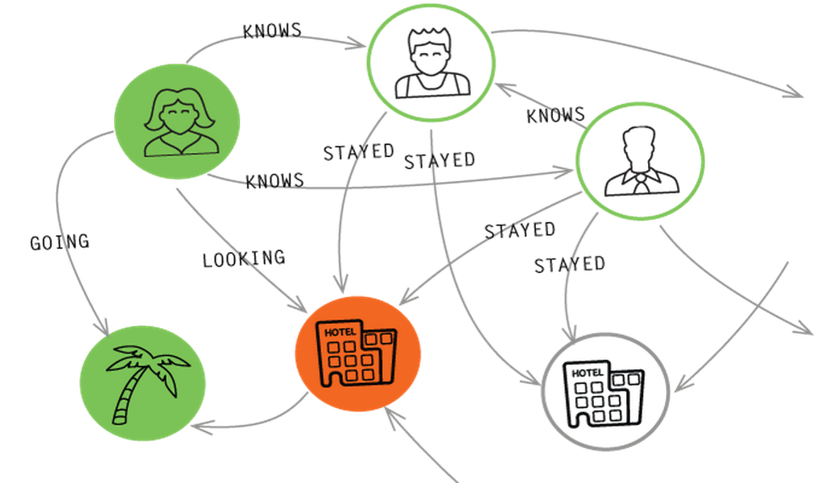
Overview
Big files, Unicode and CSV
Example (Wikipedia)
Graph-DB Concepts
Neo4j vs MS-SQL
Queries
Performance
Conclusion

Slide 3
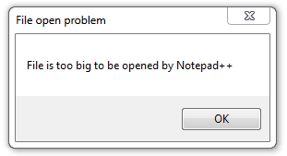
Big Data – Big Files – Big Problems
What if ...
you have a file with 49 GiB?
you have a file with 164,379,808 lines?
your editor search&replaces 27 lines/s
a line is longer than a String can hold?
String.Split() fails to allocate enough memory?
a regular expression runs 12 minutes ... on a single item?
your file parser spends only 20% on disk IO?
each line is an INSERT statement and your DB runs only 1000 queries/s?
LocalDB cannot store tables larger than 10 GiB?
you have to compute your primary keys yourself?
Notes:
Use intelligent text editor -> often very limited features
Process file line by line using a specially coded program
Even commercial editors fail
Read file in chunks -> how to deal with regex?
Implement Split() lazyly
Use compiled regex
Paralellize intensive code (e.g. Regex), lock on output
Use bulk insert and CSV files
Must use full DB
Impossibru

Slide 4

Unicode and CSV
What‘s wrong with this code? var t = page.Text.Substring(0, 100); writer.WriteLine(t);
Varchar vs. nvarchar
MS SQL Server: no UTF-8 Neo4j: only UTF-8
MS SQL CSV: no enquoted fields, no field interpretation Neo4j CSV: enquoting optional, requires escapting quotes
String equality WHERE str1 = str2 COLLATE ..._BIN
Notes:
Unicode surrogates

Slide 5
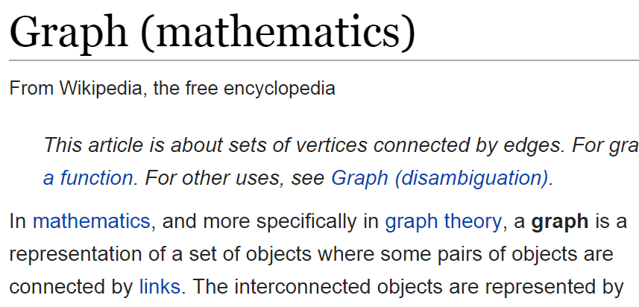
Example Wikipedia
Article
Wikipedia English
15,113,788 articles
164,379,808 links
Wikipedia Plattdüütsch
31,814 articles
299,032 links
21,993 first-links
Philosophy-Game
5-clicks-to-Jesus
First-Link
Links
Notes:
“Shema”
Page {id, title, ctitle, length, text}
links_to {id1, id2}
first_links_to {id1, id2}

Slide 6
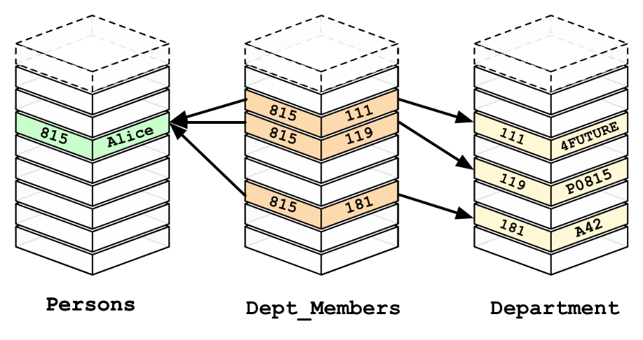
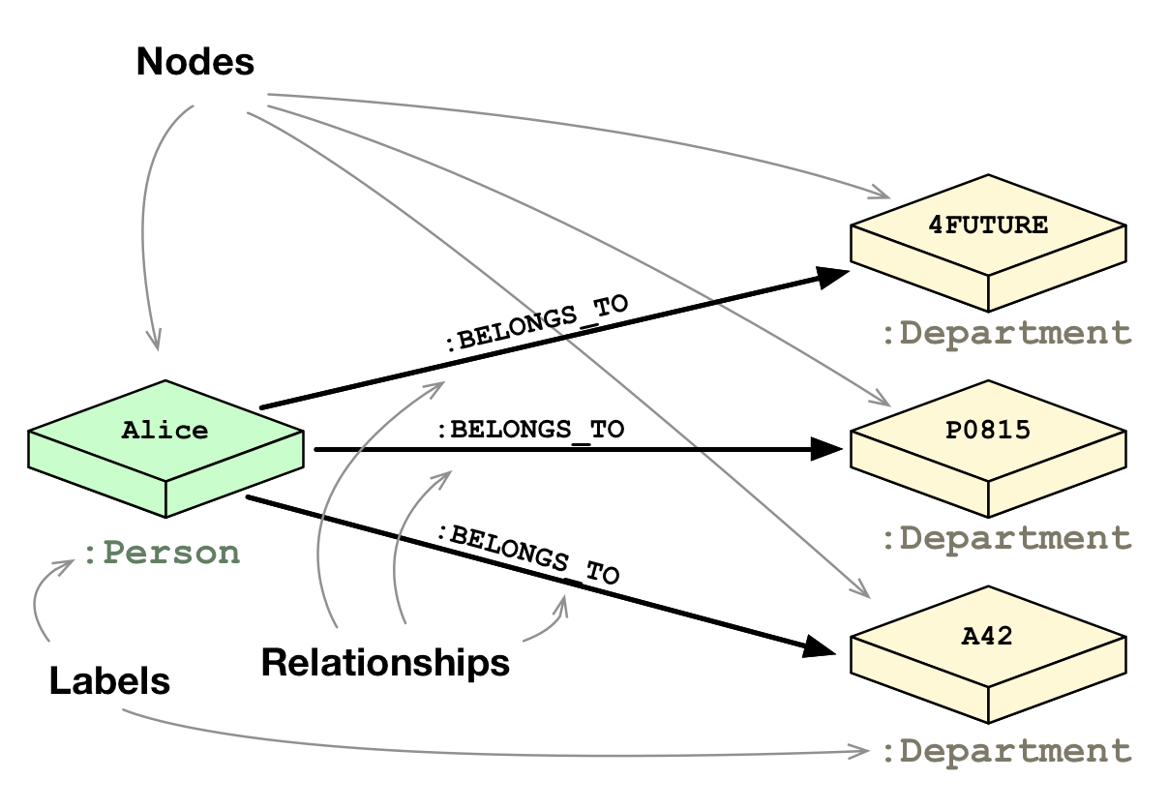
Graph-DB Concepts
Ideas
RDBMS: Slow Joins
Natural Relations
Graph Theory (math)
Components
Nodes (Entities)
Edges (Relationships)
Properties (Data)

Slide 7
Neo4j vs SQL (Basics Queries)
CREATE (p:Page {id:1, title:"Philosophy"}) CREATE (l:Page {id:2, title:"Logic"}) CREATE (l)-[:links_to]->(p);
MATCH (p:Page {title:"Philosophy"}) SET p.text="Hello Graph";
MATCH (p:Page {title:"Philosophy"}) DELETE p;
MATCH (p:Page {title:"Philosophy"}) MATCH (p)<-[:links_to]-(a) RETURN a;
INSERT INTO Pages (id, title) VALUES (1, 'Philosophy'), (2, 'Logic'); INSERT INTO Links VALUES (2, 1);
UPDATE Pages SET text='Hello Graph‚ WHERE title='Philosophy';
DELETE FROM Pages WHERE title='Philosophy';
SELECT a.* FROM Pages p JOIN Links l ON p.id=l.dst JOIN Pages a ON a.id=l.src WHERE p.title='Philosophy';

Slide 8

Neo4j vs SQL (Advanced Queries)
MATCH (p:Page {title:"Philosophy"}) MATCH (p)<-[:first_links_to*1..3]-(a) RETURN DISTINCT a;
MATCH (p:Page {title:"Philosophy"}) MATCH (p)<-[:first_links_to*]-(a) RETURN DISTINCT a;
MATCH path=shortestPath( (p:Page {title:"Philosophy"}) <-[:first_links_to*]- (g:Page {title:"Graph"}) ) RETURN path;
Dijkstra, A*
JOIN UNION JOIN UNION JOIN ...
Recursive Join ☺ CONNECT BY / Common Table Expression
WITH temp (id) AS ( SELECT p.id FROM Page p WHERE p.title='Philosophy' UNION ALL SELECT fl.src FROM FirstLink fl JOIN temp t ON fl.dst=t.id ) SELECT a.* FROM Page a JOIN temp t ON a.id=t.id;

Slide 9
Neo4j vs SQL (Performance)
Operation |  | Neo4j |  | SQL
Insert | All | 3m30s |  | 12m45s
 | Pages (31,841) | 4.7s |  | 4.6s
 | Links (299,032) | 3m15s |  | 12m
 | First Links (21,993) | 11.3s |  | 42s
Find sources with first links to Philosophy (33) |  | 50ms |  | 32ms
Find sources with links to Jesus |  | Count | All Data | Count | All Data
 | 1 Hop (166) | 40ms | 38ms | 37ms | 35ms
 | 2 Hops (2,057) | 55ms | 142ms | 103ms | 105ms
 | 3 Hops (14,240) | 91ms | 682ms | 210ms | 375ms
 | 4 Hops (25,558) | 2s | 4.8s | 421ms | 452ms
 | 5 Hops (27,609) | aborted after 10min |  | 3s | 3s

Slide 10
Conclusion
Pro
Fast Insert
Easy Queries
Contra
Slow
Not mature
Memory consumption
Maybe Pro (didn’t looked into it)
Scalability
Other DBs than Neo4j
Our Recommendation
Use Cypher where time is not important
Cypher to SQL transpiler would be awesome

Slide 11
Thanks
Questions?

