Slide 1
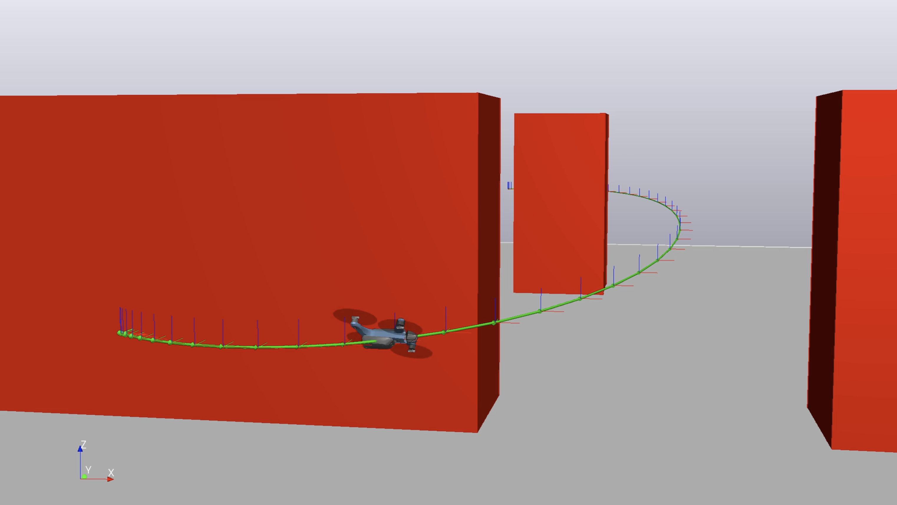
Collision-Free Mixed-Integer Planning for Quadrotors Using Convex Safe Regions
Final Project – 6.832 Underactuated Robotic
Bernhard Paus Græsdal
Massachusetts Institute of Technology
May 2020

Slide 2
Main References

Slide 3
Goal of the project
Generate collision-free polynomial trajectories
Translate these trajectories to full-state trajectories
Stabilize trajectory using TVLQR

Slide 4
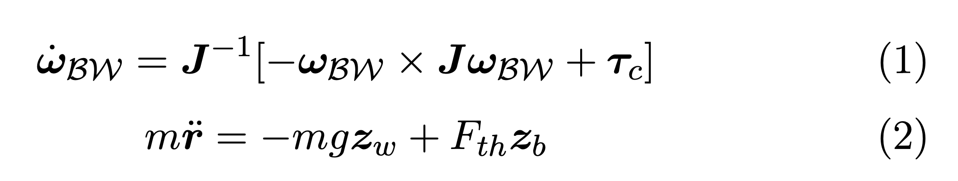
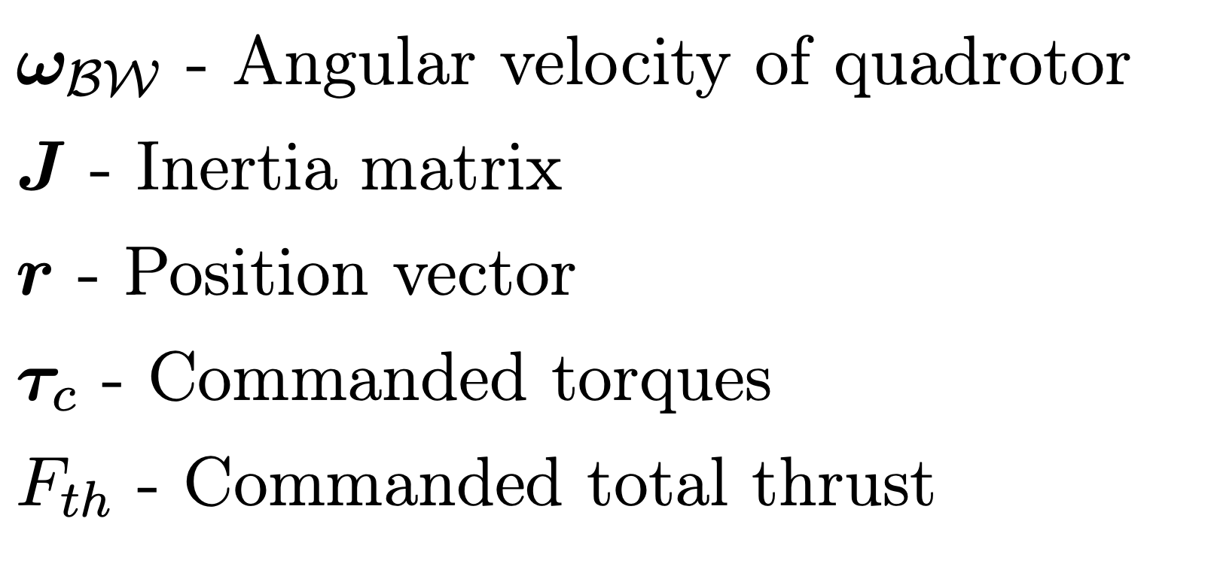
Quadrotor model

Slide 5
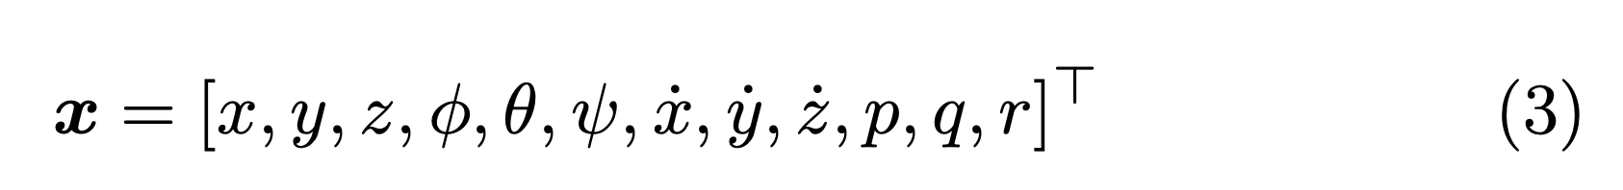


State vector
Flat output space

Slide 6
Trajectory generation
Pre-processing: Generate convex regions of obstacle-free space
Mixer-Integer Optimization: Assign each polynomial segment to a region using binary decision variables
SOS: Use sums-of-squares to ensure that the entire trajectory is collision-free

Slide 7
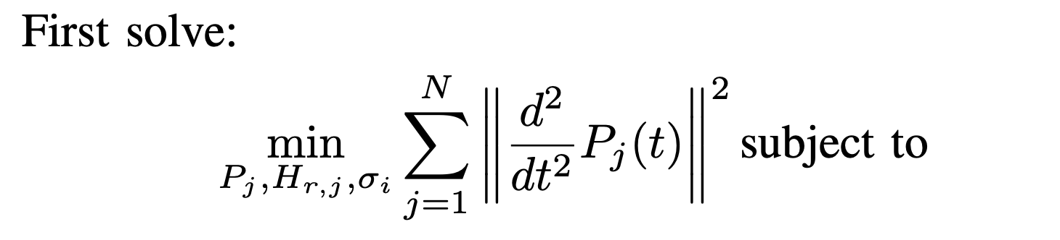
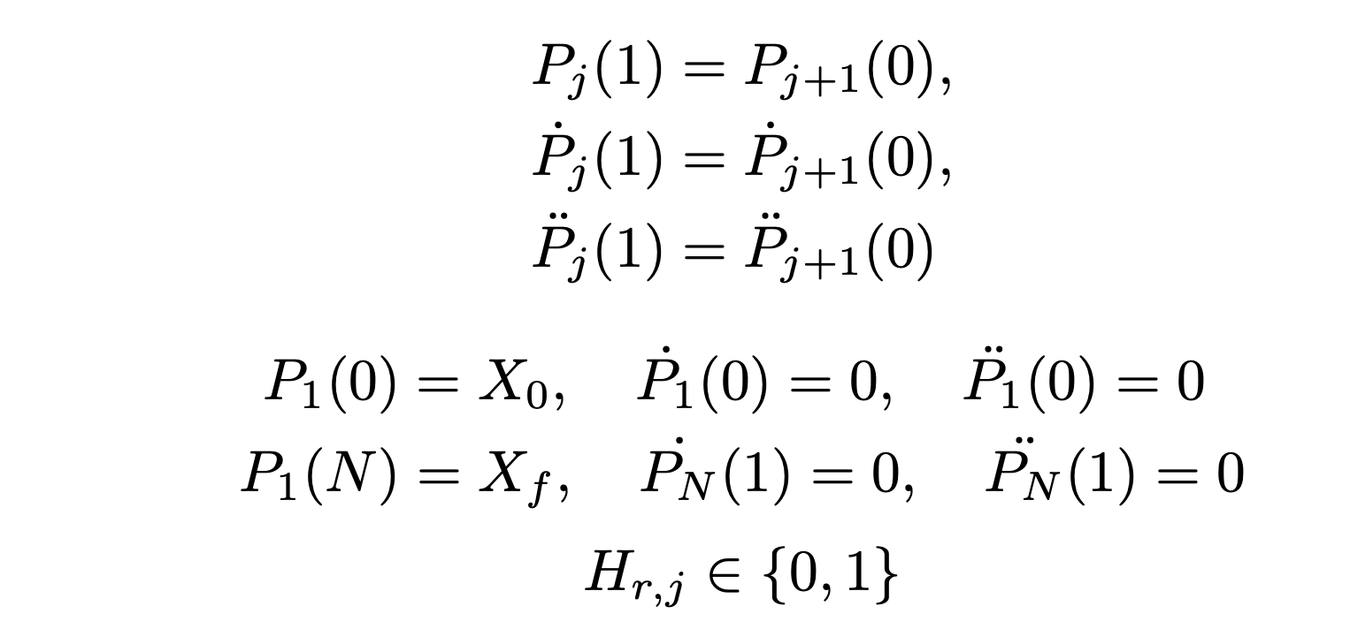
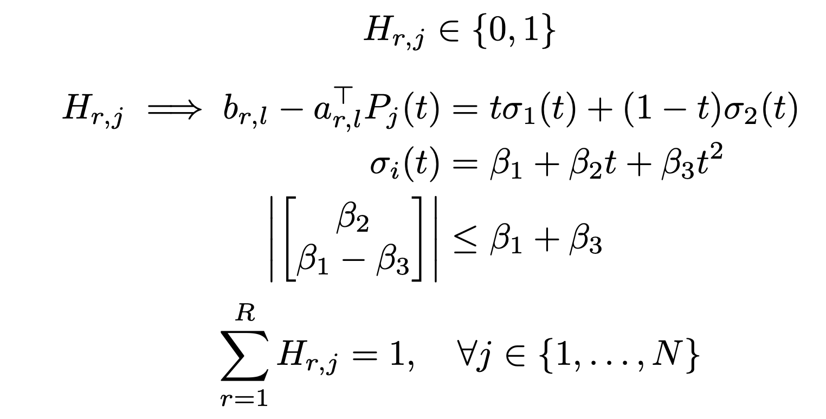
Complete optimization formulation #1

Slide 8
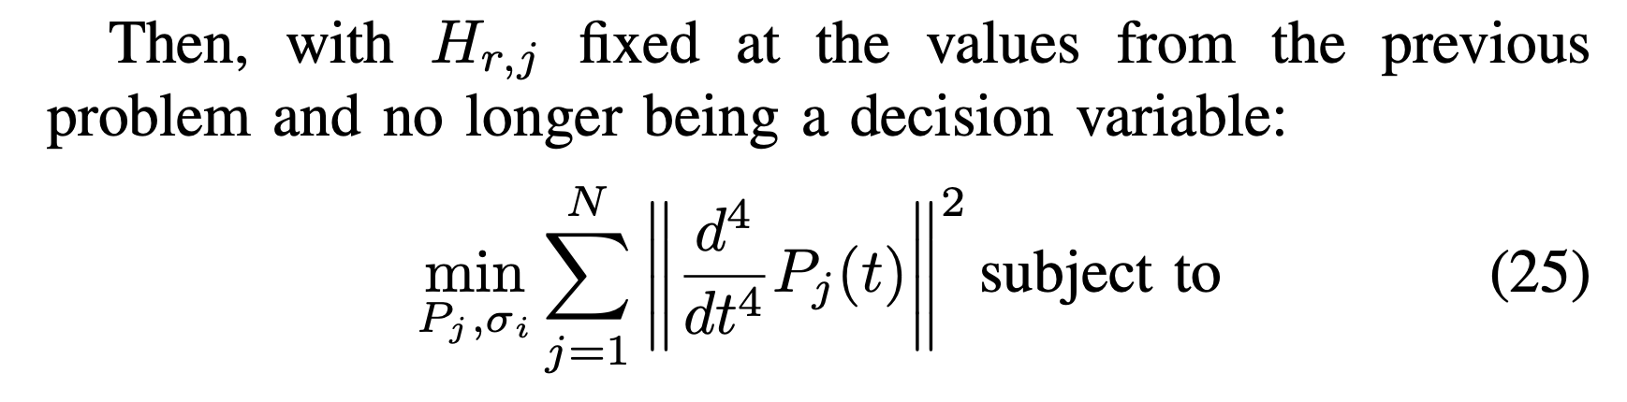
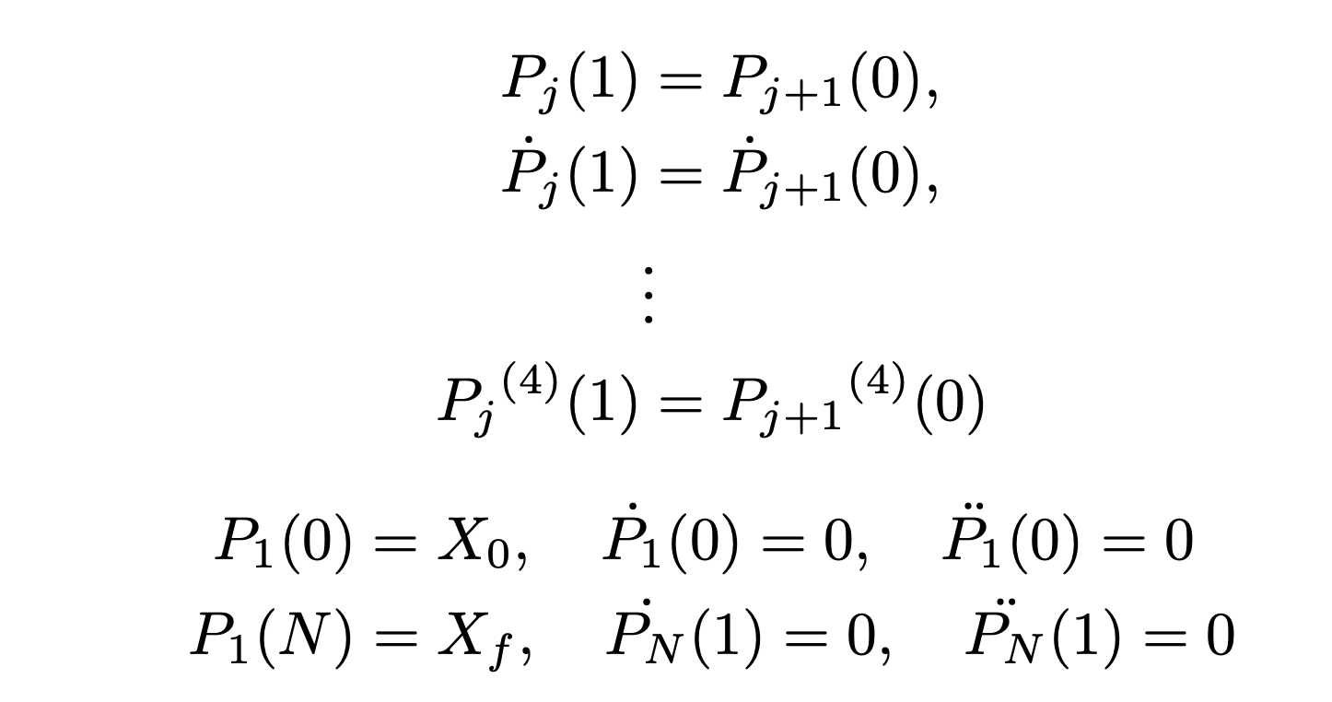
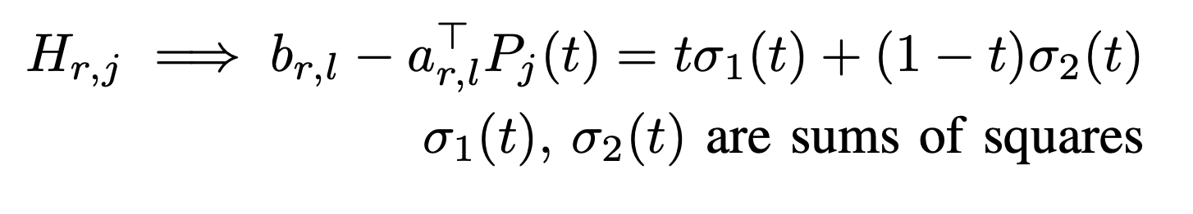
Complete optimization formulation #2

Slide 9
Flight Test #1

Slide 10
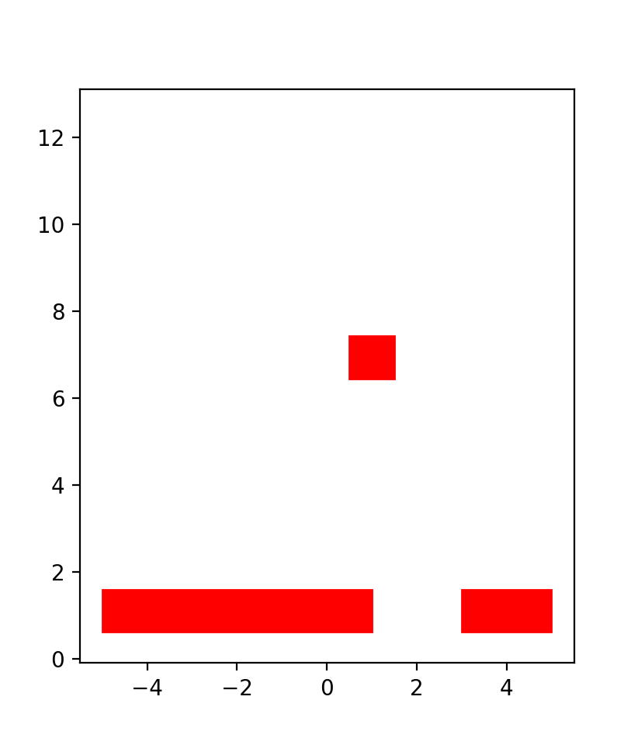
Generating safe convex regions

Slide 11
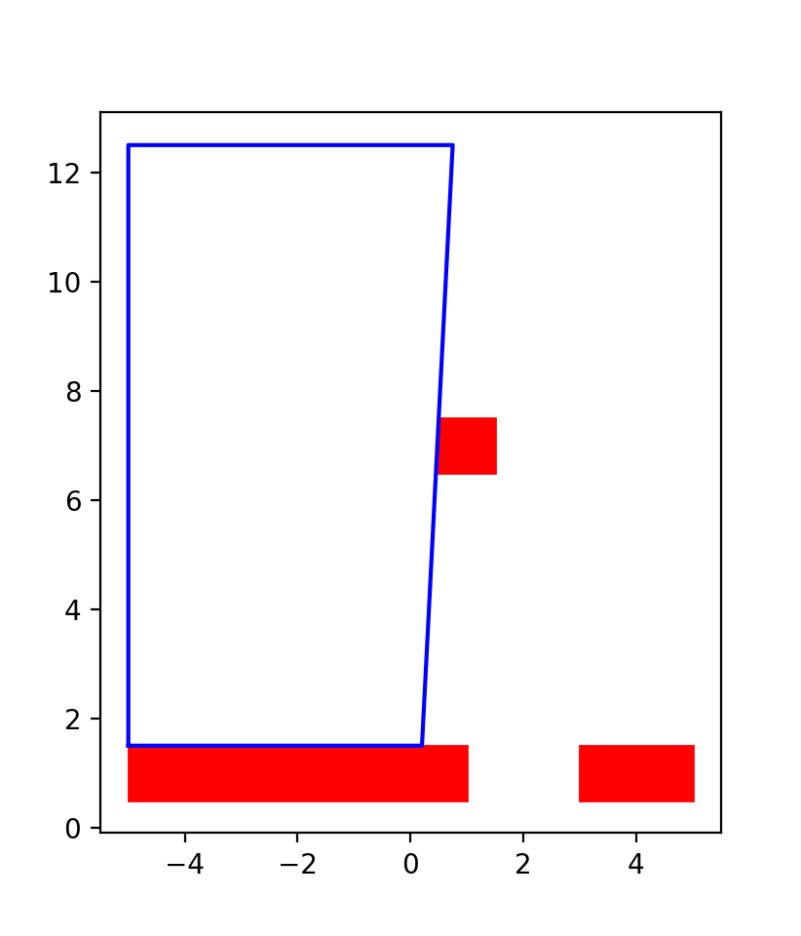
Generating safe convex regions

Slide 12
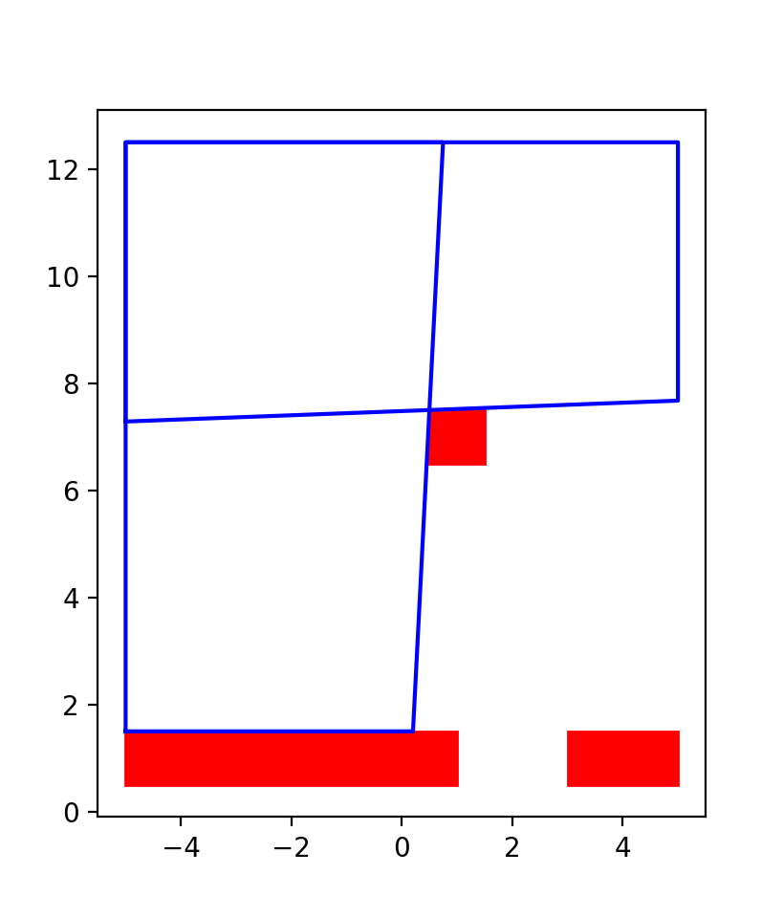
Generating safe convex regions

Slide 13
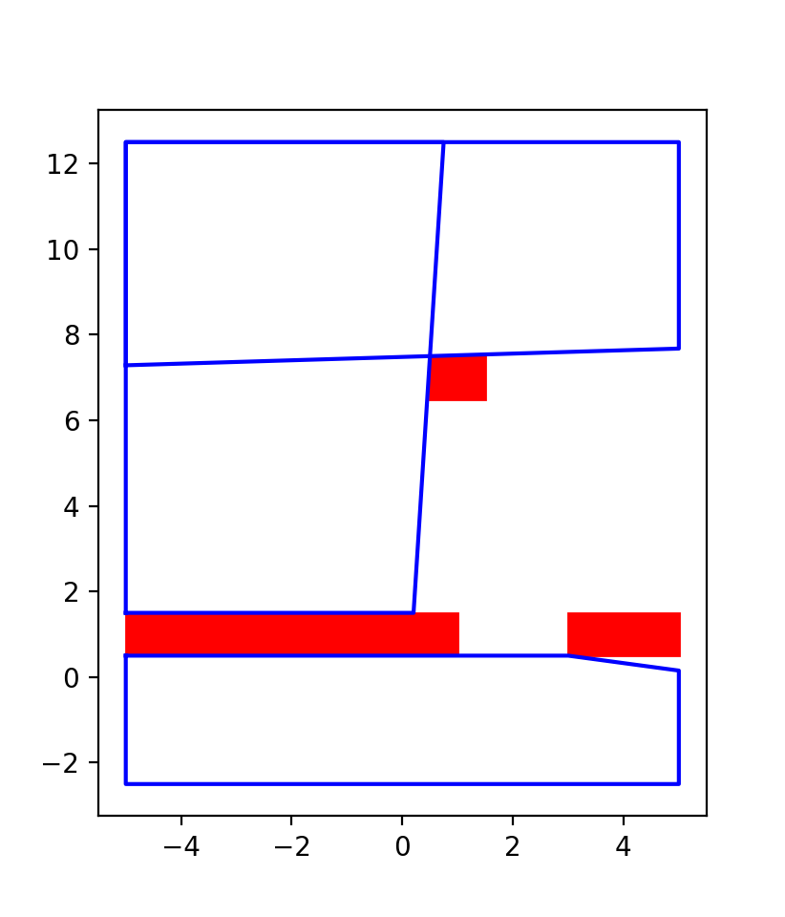
Generating safe convex regions

Slide 14
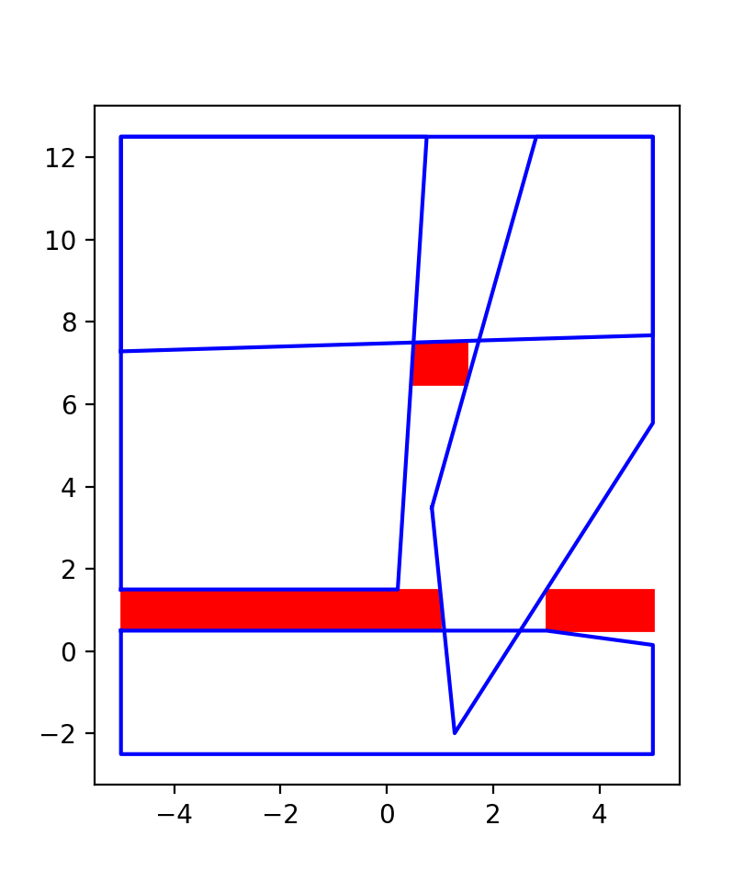
Generating safe convex regions

Slide 15
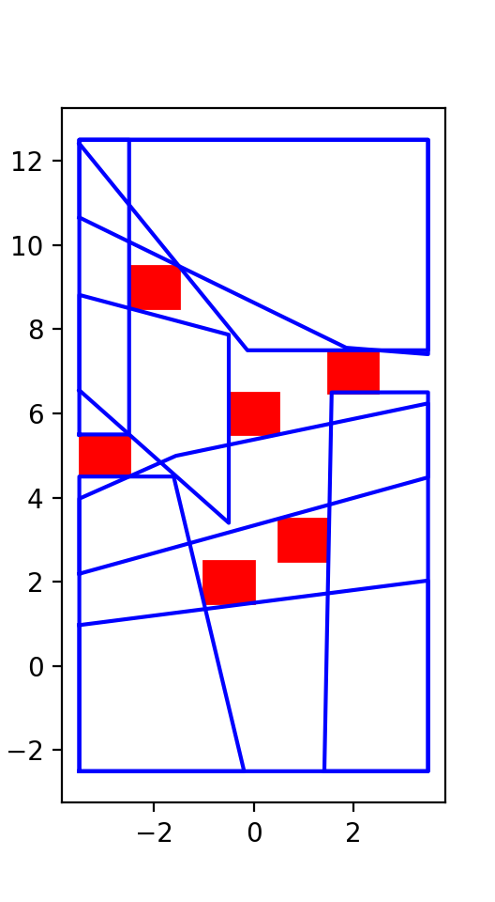
8 convex regions

Slide 16
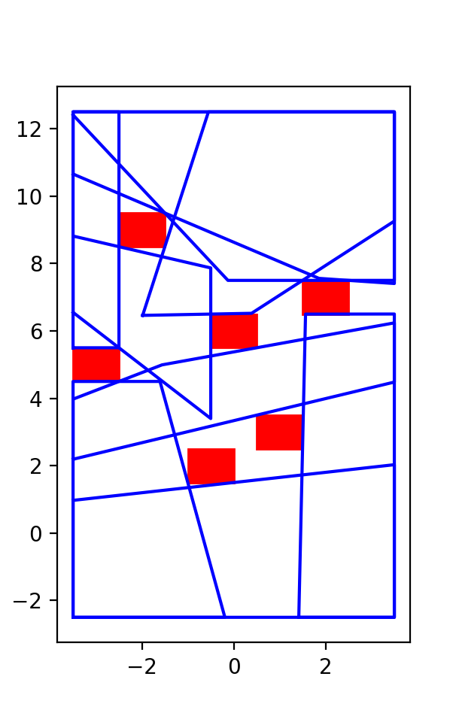
9 convex regions

Slide 17
Flight Test #2

Slide 18
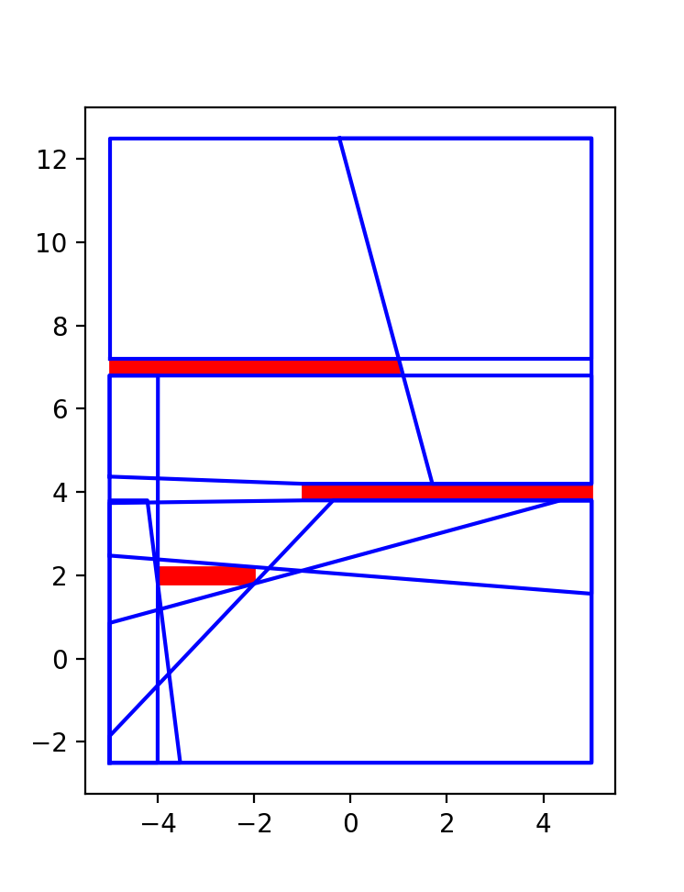
Computed safe regions

Slide 20
Flight Test #3
Comparing different numbers of convex regions

Slide 21
Comparing different numbers of convex regions

Slide 22
Future work
Smarter choice of safe regions using RRT*
Time-scaling of the trajectories
Actuator limits

Slide 23
Thanks for watching!
For the full paper, source code and reference list, please see the description.

