Slide 1
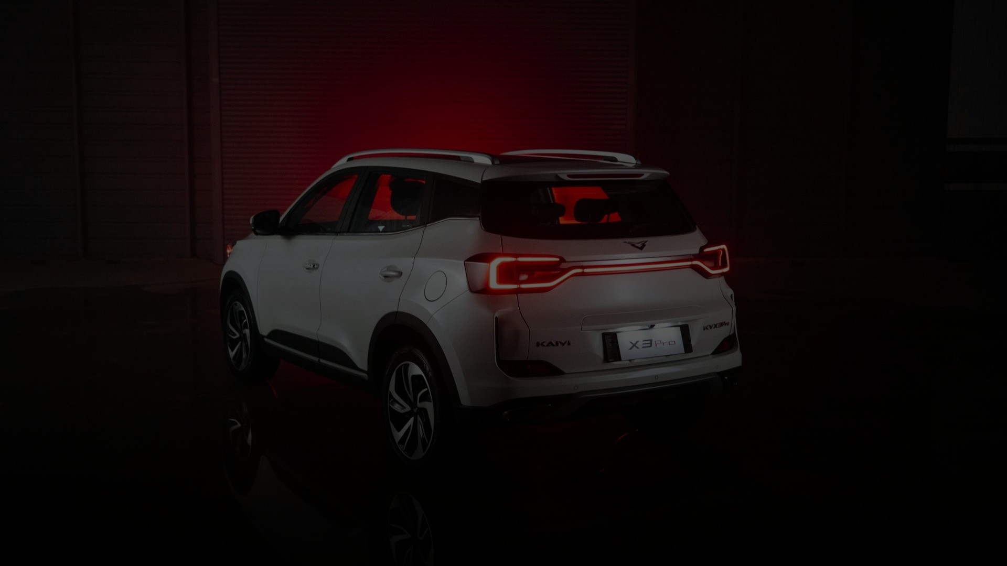


Argentina 2026
Market Analysis & Commercial Performance

Slide 2


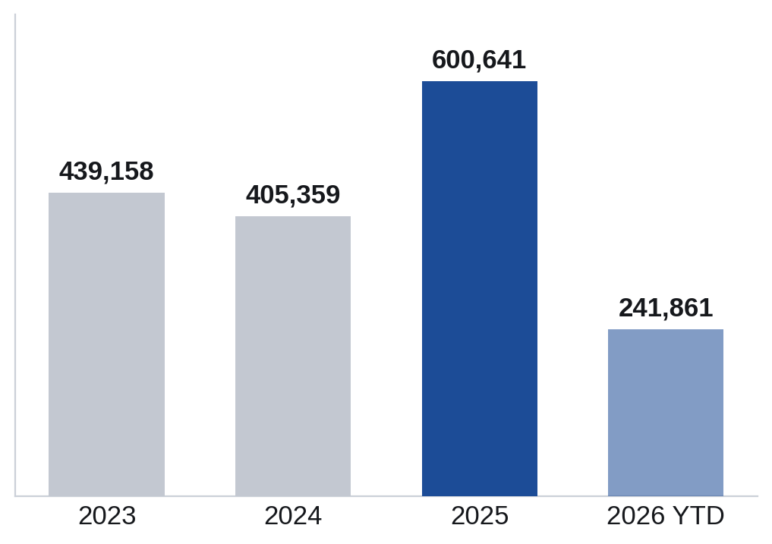
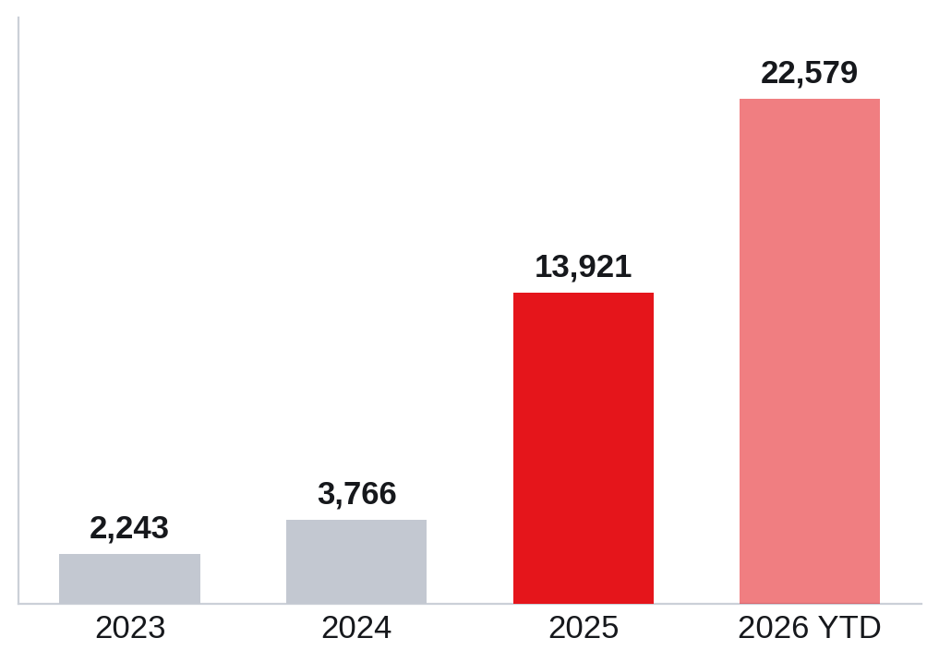
MARKET OVERVIEW
Total Market vs. Chinese Brands
TOTAL MARKET — units patented
CHINESE BRANDS — units patented
–10%
Total market · Jan–May '25 vs '26
+529%
Chinese brands · Jan–May '25 vs '26
The overall market is contracting, yet Chinese brands are scaling exponentially — from 13.9k units in 2025 to 22.6k in the first five months of 2026 alone.
KAIYI · Argentina 2026
01

Slide 3
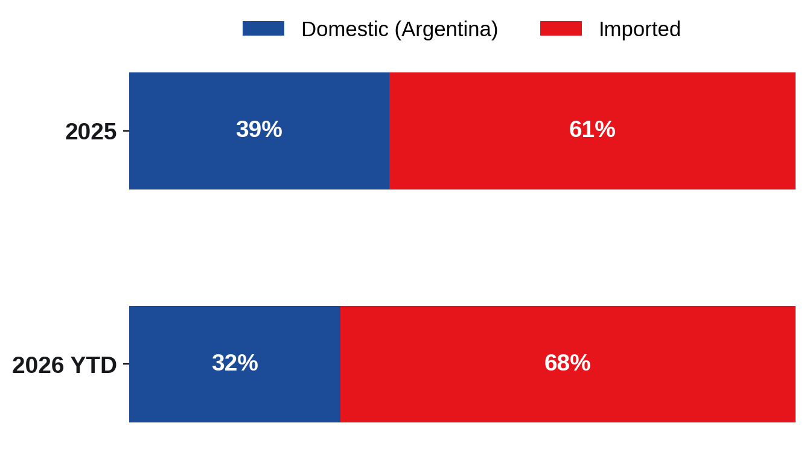
ORIGIN OF SUPPLY
Imported vs. Domestic Production
UNITS PATENTED
2025
Domestic 234,423
Imported 366,212
2026 YTD
Domestic 76,711
Imported 165,147
39% → 32%
Domestic share of market
Argentina is increasingly import-dependent: domestic output is shrinking while China is the only origin growing (+246% YoY), reshaping the supply mix.
KAIYI · Argentina 2026
02

Slide 4
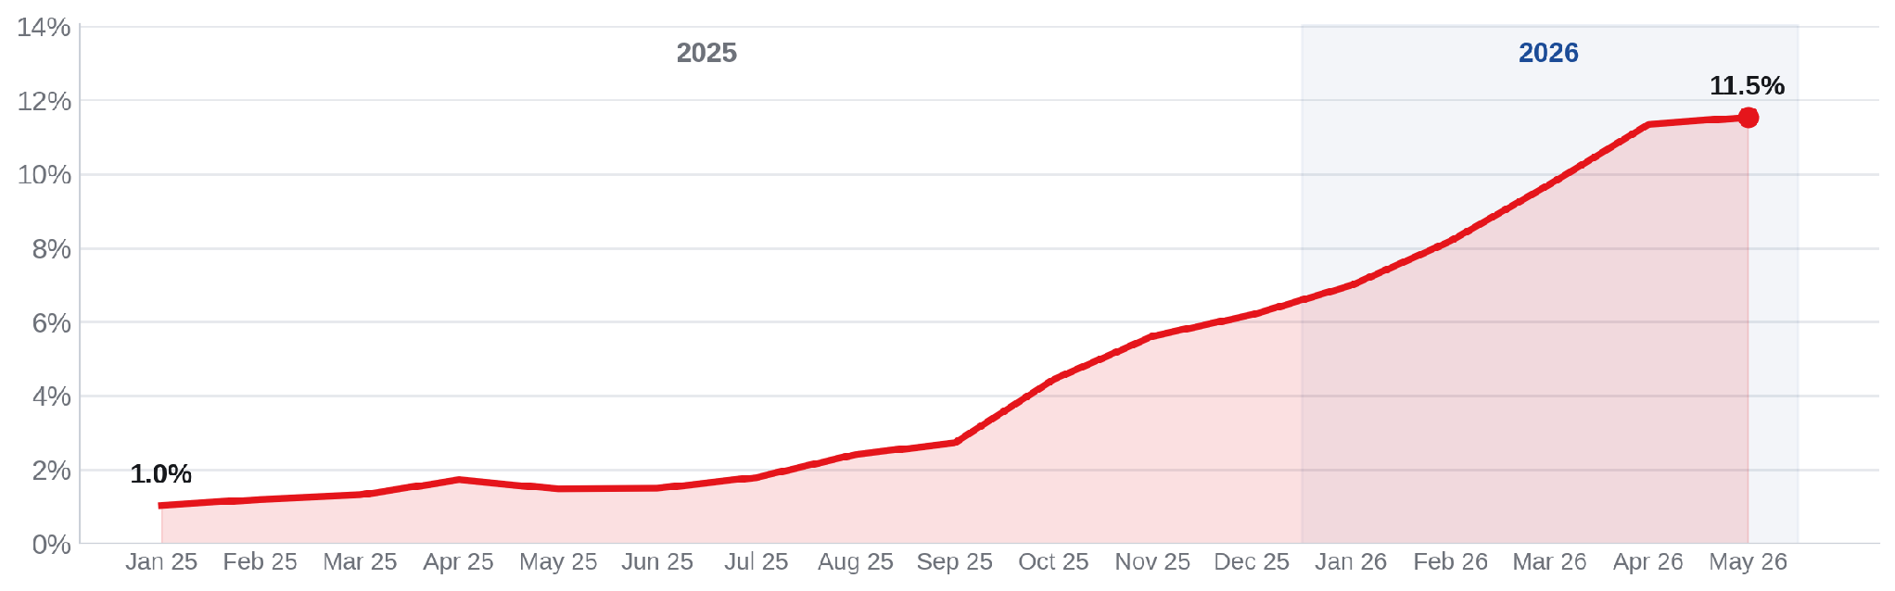
THE CHINA SURGE
Chinese Brands — Market Share Evolution
1.0%
Market share · Jan 2025
11.5%
Market share · May 2026
≈11×
Growth in 16 months
In just 16 months Chinese brands went from a 1% niche to over 11% of the Argentine market — one of the fastest share gains the industry has seen.
KAIYI · Argentina 2026
03

Slide 5
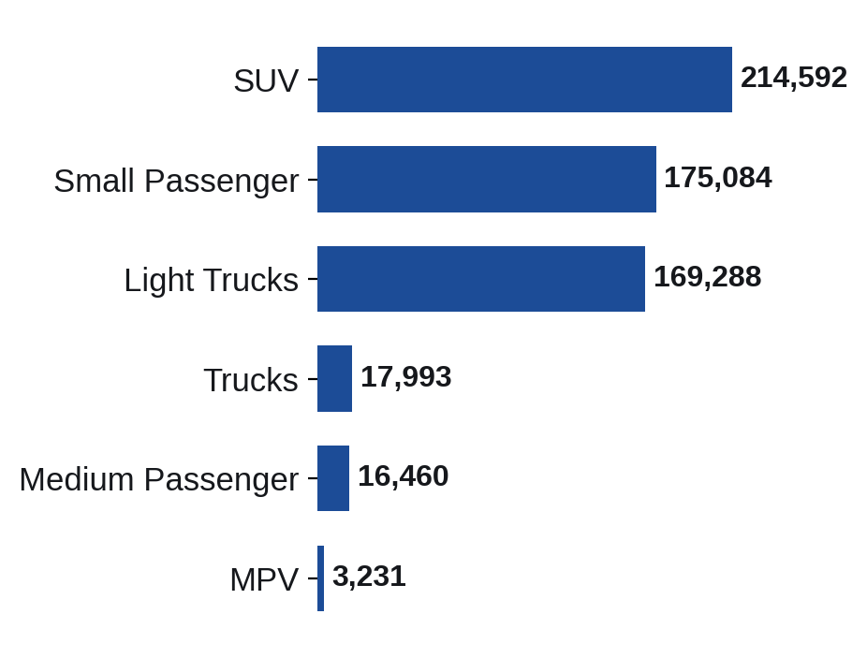
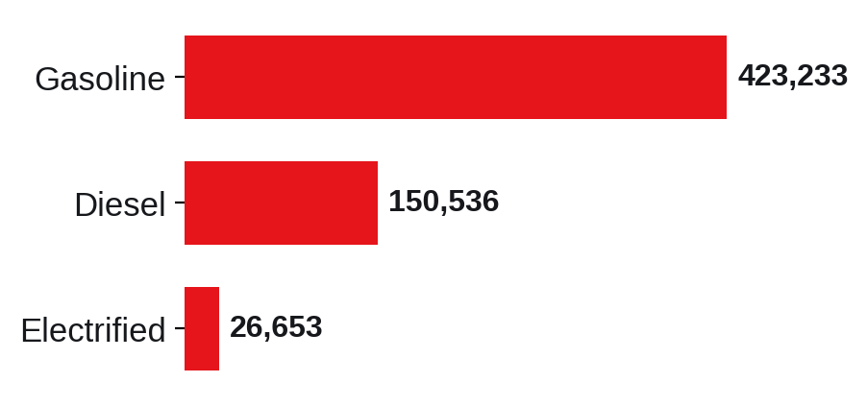
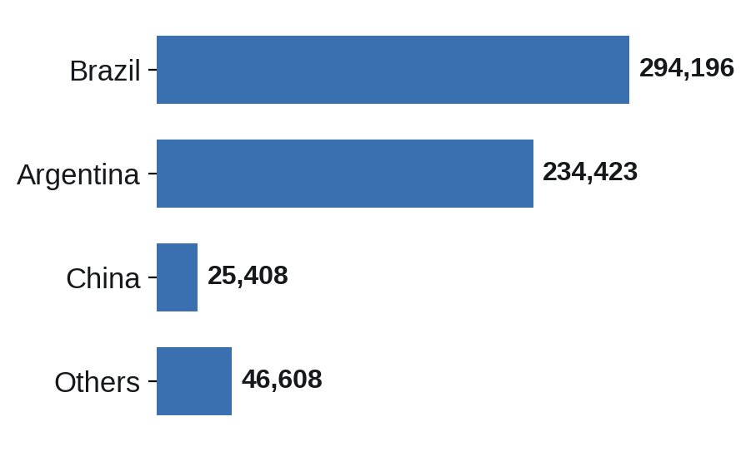
MARKET STRUCTURE
Segments, Fuel & Country of Origin
TOP SEGMENTS · 2025
FUEL TYPE · 2025
COUNTRY OF ORIGIN · 2025
Electrified is the fastest-growing fuel: +333% YoY.
SUVs are now the #1 segment (215k) and the structural growth engine, while gasoline still dominates the powertrain mix and Brazil leads supply.
KAIYI · Argentina 2026
04

Slide 6
BRAND LANDSCAPE
Top 10 Brands — 2025 vs. 2026
# | 2025 | 2026 YTD
1 | TOYOTA | VOLKSWAGEN
2 | VOLKSWAGEN | TOYOTA
3 | FIAT | FIAT
4 | RENAULT | FORD
5 | PEUGEOT | CHEVROLET
6 | FORD | RENAULT
7 | CHEVROLET | PEUGEOT
8 | CITROEN | CITROEN
9 | JEEP | MERCEDES BENZ
10 | MERCEDES BENZ | BYD
BYD breaks into the Top 10 in 2026 — the first Chinese brand to do so, displacing Jeep; Volkswagen overtakes Toyota for the #1 position.
KAIYI · Argentina 2026
05

Slide 7
COMPETITIVE SET — X3 / X3 PRO
KAIYI X3 vs. the SUV B-Segment
KAIYI X3 $22,000 · KAIYI X3 PRO $26,000
Segment 2025: 111,867 | 2026 YTD: 42,103
Model | Price (USD) | Units 2025 | Units 2026 YTD
Volkswagen Tera | $26–33k | 4,779 | 7,065
Chevrolet Tracker | $28–35k | 17,654 | 6,451
Peugeot 2008 | $32–38k | 15,347 | 5,177
Renault Kardian | $26–34k | 11,345 | 3,551
Volkswagen Nivus | $31–38k | 10,855 | 3,174
Volkswagen T-Cross | $36–46k | 9,832 | 2,888
Nissan Kicks | $26–33k | 5,519 | 2,410
Jeep Renegade | $33–41k | 9,753 | 2,385
Citroen Basalt | $23–28k | 6,544 | 2,382
Citroen Aircross | $26–31k | 7,378 | 2,048
Fiat Pulse | $26–32k | 6,073 | 2,040
Honda HR-V | $32–36k | 2,358 | 1,322
Renault Duster | $30–34k | 4,430 | 1,210
KAIYI X3 enters at the accessible end of Argentina's largest growth segment, undercutting most established SUV rivals on price.
KAIYI · Argentina 2026
06

Slide 8
COMPETITIVE SET — X3 / X3 PRO
KAIYI X3 vs. the Passenger-Car Segment
KAIYI X3 $22,000 · KAIYI X3 PRO $26,000
Segment 2025: 144,929 | 2026 YTD: 46,958
Model | Price (USD) | Units 2025 | Units 2026 YTD
Peugeot 208 | $22–31k | 29,093 | 10,185
Fiat Cronos | $22–27k | 29,908 | 10,138
Chevrolet Onix | $22–27k | 13,707 | 6,108
Toyota Yaris | $24–29k | 30,152 | 5,042
Volkswagen Polo | $27–33k | 21,326 | 4,774
Fiat Argo | $21–23k | 4,211 | 2,611
Citroen C3 | $22–24k | 5,458 | 2,554
Hyundai HB20 | $20–25k | 3,311 | 2,042
Kia K3 | $25–28k | 2,011 | 1,508
Honda WR-V | $30k | 1 | 949
MG3 | $24–26k | 132 | 710
Renault Stepway | $25–26k | 3,048 | 187
Renault Sandero | $27–28k | 2,571 | 150
Priced like a hatchback but sized as an SUV, the X3 competes directly against the country's highest-volume passenger cars.
KAIYI · Argentina 2026
07

Slide 9
COMPETITIVE SET — X7 PRO / X7 PHEV
KAIYI X7 vs. the C-SUV Segment
KAIYI X7 PHEV $35,000 · KAIYI X7 PRO $38,000
INTERNATIONAL BRANDS
CHINESE BRANDS
Model | Price | Units '26
Ford Teritory | $34–40k | 8,973
Volkswagen Taos | $41–47k | 4,906
Toyota Corolla Cross | $37–45k | 4,815
Jeep Compass | $39–51k | 3,308
Chevrolet Captiva | $37k | 1,486
Jeep Commander | $48–59k | 458
Peugeot 3008 | $54k | 322
Hyundai Tucson | $48–66k | 130
Model | Price | Units '26
BAIC BJ30 | $36–42k | 3,306
BYD Song Pro | $35–37k | 2,019
Haval H6 | $36–44k | 1,244
Changan CS55 | $32k | 817
BAIC X55 | $37–42k | 682
Jetour Dashing | $38k | 182
JAC JS6 | $34k | 139
GAC Emkoo | $34k | 100
Jetour X70 | $40k | 71
Cherry Tiggo 8 | $47k | 58
JAC JS8 | $39k | 47
DFSK E5 | $34k | 41
DFSK Glory 580 | $28k | 33
KAIYI · Argentina 2026
08

Slide 10
COMMERCIAL PERFORMANCE
KAIYI Pipeline — Orders → Wholesale → Retail
ORDERED FROM CHINA
991
BY MODEL · 2026
Model | Orders | Wholesale | Retail
X3 | 280 | 164 | 121
X3 PRO | 180 | 137 | 97
X7 PRO | 11 | 35 | 35
X7 PHEV | 485 | 376 | 280
X7 PRO AWD | 35 | 20 | 14
TOTAL | 991 | 732 | 547
WHOLESALE TO DEALERS
732
RETAIL (PATENTED)
547
Order → Wholesale: 74% Wholesale → Retail: 75%
2025 was the pipeline-build year (177 units ordered, none yet retailed). 2026 marks full market entry: 991 units ordered, 732 wholesaled and 547 reaching customers.
KAIYI · Argentina 2026
09

Slide 11
Thank you · 谢谢
Argentina 2026

