Slide 1
IEEE BIGDATA CUP 2026 · AI EMULATION CHALLENGE
CarbonGlobe
Physics-guided machine learning for forest ecosystem forecasting
From a single-model baseline to a multi-model optimized pipeline
0.238 RMSE
0.095 RMSE
First submission
Optimized submission
Project presentation

Slide 2
1. Problem statement
Why build an emulator?
The challenge
Our objective
Evaluation focus
Ecosystem Demography (ED) models forest growth and carbon dynamics, but running it globally is computationally expensive.
Train a machine-learning emulator that predicts ecosystem outcomes from climate, site conditions and forest age.
The competition submission predicts year-40 vegetation height and above-ground biomass (AGB), normalized by global means.
Core idea: learn the simulator’s patterns while respecting ecological constraints.
Two climate scenarios are evaluated: SSP126 (lower-warming pathway) and SSP585 (higher-warming pathway). The second scenario is especially challenging because future conditions can differ from the training distribution.
CARBON GLOBE | IEEE BigData Cup 2026
2

Slide 3
2. Dataset and prediction target
Inputs are time-dependent, and forests have different starting ages
Climate drivers
Forest age
Outputs
136 input variables across 40 years and 12 months, including meteorological and environmental drivers.
15 age groups: 1, 10, 20, 30, 50, 70, 100, 150, 200, 250, 300, 350, 400, 450 and 500 years.
Seven ecosystem state variables are available in the data; the competition file requires height and AGB for year 40.
Submission format
Each row uses an ID of the form scenario_site_age. Predictions for height and AGB are divided by their respective global means before submission: 10.90645 and 3.39567.
CARBON GLOBE | IEEE BigData Cup 2026
3

Slide 4
3. Submission 1 — baseline approach
Reported Kaggle RMSE: approximately 0.238
Model used
Baseline workflow
HistGradientBoostingRegressor (tree-based gradient boosting). The notebook trains a model on engineered inputs and uses age-conditioned features for predictions.
Load data → prepare climate/site features → fit a single model per target → predict year-40 height and AGB → clip negative predictions → normalize by global means → write CSV.
What the baseline did well
Main limitations to address
• Established an end-to-end Kaggle submission.
• Used a nonlinear tree model to learn feature interactions.
• Produced the required 185,130-row submission structure.
• One learner has one dominant modeling bias.
• Climate summaries alone may miss long-term trend and site context.
• Unconstrained predictions can violate plausible growth behavior.
CARBON GLOBE | IEEE BigData Cup 2026
4

Slide 5
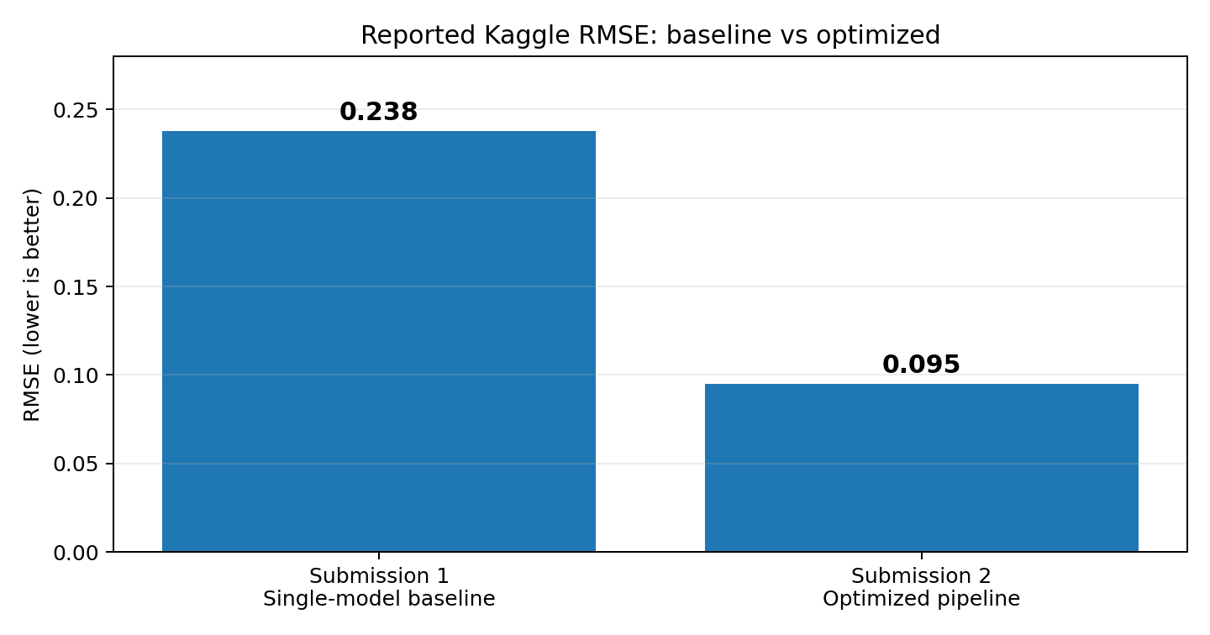
4. Performance improvement
Lower RMSE means predictions are closer to the target
First submission
RMSE ≈ 0.238
Optimized submission
RMSE ≈ 0.095
Approx. 60.1% relative RMSE reduction
Scores are reported from the project team’s Kaggle runs; the CSV files alone do not contain the leaderboard score.
CARBON GLOBE | IEEE BigData Cup 2026
5

Slide 6
5. Optimized methodology — the big picture
A pipeline combining richer features, multiple learners and ecological priors
01 Prepare data
02 Engineer features
03 Fit diverse learners
Load climate arrays, target arrays, site splits and initial state.
Summarize climate trends and add forest age, ecosystem ratios and site profiles.
Train LightGBM, XGBoost and HistGradientBoosting models.
04 Blend predictions
05 Apply constraints
06 Normalize + submit
Combine model outputs and multiple target formulations to reduce model-specific errors.
Use chronosequence/carrying-capacity priors and non-negative output clipping.
Scale height/AGB by global means and align predictions to the sample submission IDs.
CARBON GLOBE | IEEE BigData Cup 2026
6

Slide 7
6. Feature engineering
Turn raw time series into ecological signals
Climate history
Initial ecosystem state
Ecology + age
Mean climate, first-five-year and last-five-year summaries, change, variability, temporal slope and recency-weighted climate.
Year-0 state variables, log-transformed states and normalized height/AGB give the model a starting point.
Ratios such as biomass/height, productivity measures, stand age transforms, growth rates, saturation and remaining growth potential.
Why it helps
The optimized notebook builds a large feature vector (about 1,159 features) to represent not only average climate, but also how climate changes through time and how each forest site is progressing along its age trajectory.
CARBON GLOBE | IEEE BigData Cup 2026
7

Slide 8
7. Three-model ensemble
Different tree learners capture different patterns
LightGBM
XGBoost
HistGradientBoosting
Gradient-boosted decision trees designed for efficient learning on large tabular datasets.
A separate gradient-boosting implementation; its different regularization and tree-building choices provide complementary predictions.
Histogram-based gradient boosting, offering another tree-learning bias and efficient split search.
Voting / blending
The optimized code uses VotingRegressor combinations for model families and several target formulations (for example, predicting a growth delta, a direct value, or a log-ratio). The final prediction combines these signals instead of trusting a single model.
CARBON GLOBE | IEEE BigData Cup 2026
8

Slide 9
8. Physics-guided constraints
Use ecology to keep predictions plausible
Chronosequence profile
Growth headroom
Safe outputs
Compare states across age groups to estimate site-level height, biomass, productivity and likely future capacity.
Features estimate the gap between the current state and a site’s historical maximum / carrying-capacity proxy.
Negative height and biomass predictions are clipped to zero; outputs are normalized with the competition’s required global means.
Why this matters for SSP585
Under stronger warming, climate inputs can be far from familiar historical conditions. Site-state information and growth priors help prevent the model from making implausible jumps based only on climate similarity.
CARBON GLOBE | IEEE BigData Cup 2026
9

Slide 10
9. Before vs after
The improvements target both representation and model robustness
Aspect | Submission 1 | Submission 2
Model design | Single HistGradientBoosting baseline | LightGBM + XGBoost + HistGradientBoosting voting/blending
Feature set | Climate / site features and age-conditioned inputs | Richer climate trends, initial state, ecological ratios, age and chronosequence features
Ecological context | Limited explicit constraints | Carrying-capacity / growth-headroom priors and non-negative predictions
Target strategy | Single main prediction formulation | Delta, direct-value and log-ratio formulations blended
Reported RMSE | ≈ 0.238 | ≈ 0.095
Reported change: 0.143 absolute RMSE points lower (about 60% relative reduction).
CARBON GLOBE | IEEE BigData Cup 2026
10

Slide 11
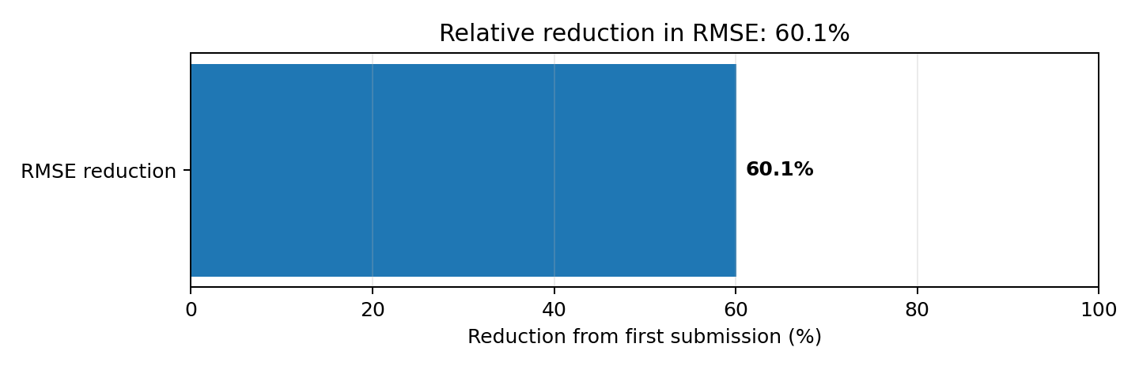
10. What the score change means
Quantifying the improvement
Absolute change
0.238 − 0.095 = 0.143
Relative change
60.1% lower RMSE
Interpretation: the optimized submission substantially reduced prediction error on the reported leaderboard metric. This is evidence of a stronger pipeline, but it does not by itself prove which single feature or model caused the entire gain.
CARBON GLOBE | IEEE BigData Cup 2026
11

Slide 12
11. Final submission workflow
From Kaggle inputs to competition-ready CSV
Kaggle data
Feature builder
Model training
Ensemble + prior
Post-process
submission.csv
train / validation / test + climate arrays
→
climate summaries + state + age + site profile
→
LightGBM · XGBoost · HistGradientBoosting
→
blend target formulations and ecological anchors
→
clip negatives; divide by global means
→
id, height, agb — 185,130 rows
Submission checks: IDs are joined to the official template, row count is preserved, and both target columns are scaled consistently.
CARBON GLOBE | IEEE BigData Cup 2026
12

Slide 13
12. Conclusion and future work
What we learned
Main achievement
Key lesson
Next steps
Reduced reported RMSE from about 0.238 to about 0.095 by improving features, model diversity and ecological guidance.
Strong forecasting needs more than a powerful learner: useful representations and domain constraints matter.
Run repeated validation, perform ablation tests, inspect errors by scenario and age, and verify performance on the full evaluation set.
Thank you
CarbonGlobe — combining machine learning with ecological reasoning for scalable ecosystem forecasting.
CARBON GLOBE | IEEE BigData Cup 2026
13

