Slide 1
CSE 373
Sorting 3: Merge Sort, Quick Sort
reading: Weiss Ch. 7
slides created by Marty Stepp
http://www.cs.washington.edu/373/
© University of Washington, all rights reserved.

Slide 2
Merge sort
merge sort: Repeatedly divides the data in half, sorts each half, and combines the sorted halves into a sorted whole.
  The algorithm:
  Divide the list into two roughly equal halves.
  Sort the left half.
  Sort the right half.
  Merge the two sorted halves into one sorted list.
  Often implemented recursively.
  An example of a "divide and conquer" algorithm.
    Invented by John von Neumann in 1945
  Runtime: O(N log N). Somewhat faster for asc/descending input.

Slide 3
Merge sort example
index | 0 | 1 | 2 | 3 | 4 | 5 | 6 | 7
value | 22 | 18 | 12 | -4 | 58 | 7 | 31 | 42
split
22 | 18 | 12 | -4
58 | 7 | 31 | 42
split
split
22 | 18
12 | -4
58 | 7
31 | 42
split
split
split
split
22
18
12
-4
58
7
31
42
merge
merge
merge
merge
18 | 22
-4 | 12
7 | 58
31 | 42
merge
merge
-4 | 12 | 18 | 22
7 | 31 | 42 | 58
merge
-4 | 7 | 12 | 18 | 22 | 31 | 42 | 58

Slide 4
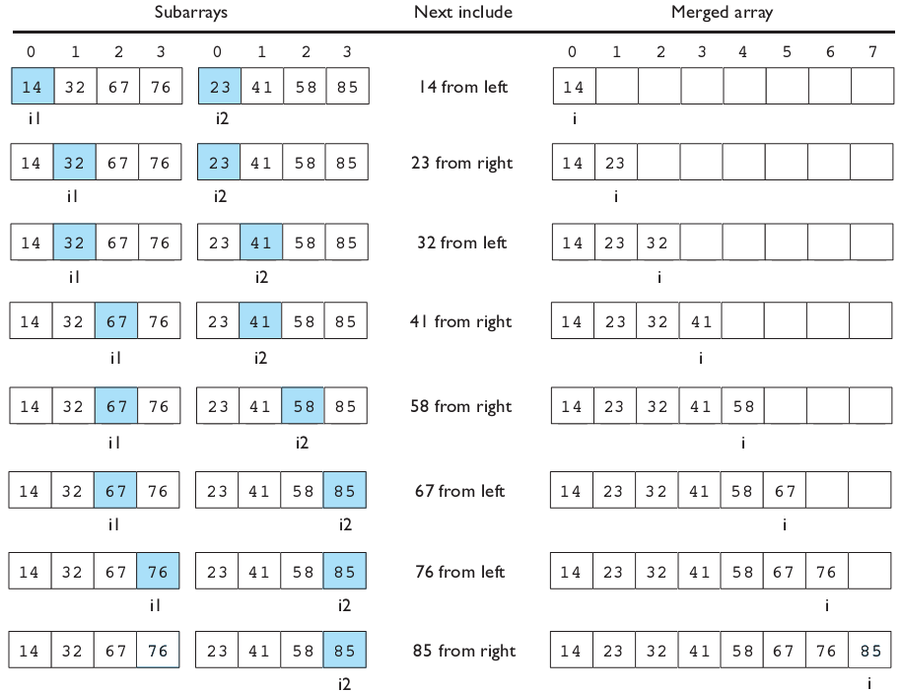
Merging sorted halves

Slide 5
Merge halves code
// Merges the left/right elements into a sorted result.
// Precondition: left/right are sorted
public static void merge(int[] result, int[] left,
int[] right) {
int i1 = 0; // index into left array
int i2 = 0; // index into right array
for (int i = 0; i < result.length; i++) {
if (i2 >= right.length ||
(i1 < left.length && left[i1] <= right[i2])) {
result[i] = left[i1]; // take from left
i1++;
} else {
result[i] = right[i2]; // take from right
i2++;
}
}
}

Slide 6
Merge sort code
// Rearranges the elements of a into sorted order using
// the merge sort algorithm.
public static void mergeSort(int[] a) {
if (a.length >= 2) {
// split array into two halves
int[] left = Arrays.copyOfRange(a, 0, a.length/2);
int[] right = Arrays.copyOfRange(a, a.length/2,
a.length);
// recursively sort the two halves
mergeSort(left);
mergeSort(right);
// merge the sorted halves into a sorted whole
merge(a, left, right);
}
}

Slide 7
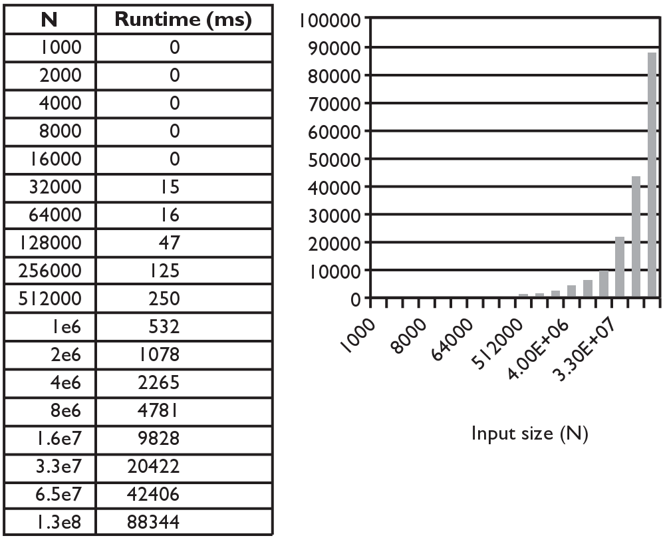
Merge sort runtime
What is the complexity class (Big-Oh) of merge sort?

Slide 8
Recursive code and runtime
It is difficult to look at a recursive method and estimate its runtime.
  Let T(N) = Runtime for merge sort to process an array of size N.
  mergeSort(a, length=N):
  if N ≥ 2:
  left = copyOfRange(0, N/2) // approx. N/2 time
  right = copyOfRange(N/2, N) // approx. N/2 time
  mergeSort(left) // T(N/2)
  mergeSort(right) // T(N/2)
  merge(a, left, right) // approx. N time
    T(N) = N/2 + N/2 + T(N/2) + T(N/2) + N
    T(N) = 2T(N/2) + 2N, when N ≥ 2
    T(1) = 1, when N = 1
recurrence relation: An equation that recursively defines a sequence, specifically the runtime of a recursive algorithm.

Slide 9
Recurrence relations
Intuition about recurrence relations: Use repeated substitution.
T(N) = 2 T(N/2) + 2N
  T(N/2) = 2 T(N/4) + 2(N/2)
T(N) = 2 ( 2 T(N/4) + 2(N/2) ) + 2N
T(N) = 4 T(N/4) + 4N
  T(N/4) = 2 T(N/8) + 2(N/4)
T(N) = 4 ( 2 T(N/8) + 2(N/4) ) + 4N
T(N) = 8 T(N/8) + 6N
T(N) = 16 T(N/16) + 8N
T(N) = 32 T(N/32) + 10N
...
T(N) = 2^{k} T(N/2^{k}) + 2kN
  At what value of k will we hit T(1) ?
Let k = log₂ N.
T(N) = 2^{log2 N} T(N/2^{log2 N}) + 2 (log₂N) N
T(N) = N T(N/N) + 2 N log₂ N
T(N) = N T(1) + 2 N log₂ N
T(N) = 2 N log₂ N + N
T(N) = O(N log N)

Slide 10
More runtime intuition
Merge sort performs O(N) operations on each level. (width)
  Each level splits the array in 2, so there are log₂ N levels. (height)
  Product of these = N * log₂ N = O(N log N). (area)
  Example: N = 32. Performs ~ log₂ 32 = 5 levels of N operations each:
32
16
8
height = log₂ N
4
2
1
width = N

Slide 11
Quick sort
quick sort: Orders a list of values by partitioning the list around one element called a pivot, then sorting each partition.
  invented by British computer scientist C.A.R. Hoare in 1960
Quick sort is another divide and conquer algorithm:
  Choose one element in the list to be the pivot.
  Divide the elements so that all elements less than the pivot are to its left and all greater (or equal) are to its right.
  Conquer by applying quick sort (recursively) to both partitions.
Runtime: O(N log N) average, O(N²) worst case.
  Generally somewhat faster than merge sort.

Slide 12
Choosing a "pivot"
The algorithm will work correctly no matter which element you choose as the pivot.
  A simple implementation can just use the first element.
But for efficiency, it is better if the pivot divides up the array into roughly equal partitions.
  What kind of value would be a good pivot? A bad one?
index | 0 | 1 | 2 | 3 | 4 | 5 | 6 | 7 | 8 | 9 | 10 | 11 | 12 | 13 | 14 | 15 | 16
value | 8 | 18 | 12 | -4 | 27 | 30 | 36 | 50 | 7 | 68 | 91 | 56 | 2 | 85 | 42 | 98 | 25

Slide 13
Partitioning an array
Swap the pivot to the last array slot, temporarily.
Repeat until done partitioning (until i,j meet):
  Starting from i = 0, find an element a[i] ≥ pivot.
  Starting from j = N-1, find an element a[j] ≤ pivot.
  These elements are out of order, so swap a[i] and a[j].
Swap the pivot back to index i to place it between the partitions.
index | 0 | 1 | 2 | 3 | 4 | 5 | 6 | 7 | 8 | 9
value | 6 | 1 | 4 | 9 | 0 | 3 | 5 | 2 | 7 | 8
 | 8 i |  |  |  |  |  |  | ← | j | 6
 | 2 | i | → | → |  |  | j | 8
 |  |  |  | 5 | i | → | 9
 |  |  |  |  |  |  | 6 |  |  | 9
 | 2 | 1 | 4 | 5 | 0 | 3 | 6 | 8 | 7 | 9

Slide 14
Quick sort example
index | 0 | 1 | 2 | 3 | 4 | 5 | 6 | 7 | 8 | 9
value | 65 | 23 | 81 | 43 | 92 | 39 | 57 | 16 | 75 | 32 | choose pivot=65
32 | 23 | 81 | 43 | 92 | 39 | 57 | 16 | 75 | 65 | swap pivot (65) to end
32 | 23 | 16 | 43 | 92 | 39 | 57 | 81 | 75 | 65 | swap 81, 16
32 | 23 | 16 | 43 | 57 | 39 | 92 | 81 | 75 | 65 | swap 57, 92
32 | 23 | 16 | 43 | 57 | 39 | 92 | 81 | 75 | 65
32 | 23 | 16 | 43 | 57 | 39 | 65 | 81 | 75 | 92 | swap pivot back in
recursively quicksort each half
32 | 23 | 16 | 43 | 57 | 39 | pivot=32
39 | 23 | 16 | 43 | 57 | 32 | swap to end
16 | 23 | 39 | 43 | 57 | 32 | swap 39, 16
16 | 23 | 32 | 43 | 57 | 39 | swap 32 back in
81 | 75 | 92 | pivot=81
92 | 75 | 81 | swap to end
75 | 92 | 81 | swap 92, 75
75 | 81 | 92 | swap 81 back in
...
...

Slide 15
Quick sort code
public static void quickSort(int[] a) {
quickSort(a, 0, a.length - 1);
}
private static void quickSort(int[] a, int min, int max) {
if (min >= max) { // base case; no need to sort
return;
}
// choose pivot; we'll use the first element (might be bad!)
int pivot = a[min];
swap(a, min, max); // move pivot to end
// partition the two sides of the array
int middle = partition(a, min, max - 1, pivot);
swap(a, middle, max); // restore pivot to proper location
// recursively sort the left and right partitions
quickSort(a, min, middle - 1);
quickSort(a, middle + 1, max);
}

Slide 16
Partition code
// partitions a with elements < pivot on left and
// elements > pivot on right;
// returns index of element that should be swapped with pivot
private static int partition(int[] a, int i, int j, int pivot) {
while (i <= j) {
// move index markers i,j toward center
// until we find a pair of out-of-order elements
while (i <= j && a[i] < pivot) { i++; }
while (i <= j && a[j] > pivot) { j--; }
if (i <= j) {
swap(a, i, j);
i++;
j--;
}
}
return i;
}

Slide 17
Quick sort runtime
Best-case analysis: If partition divides the array fairly evenly.
  Let T(N) = Runtime for quick sort to process an array of size N.
  quickSort(a, length=N):
  swap pivot to end. // O(1)
  mid = partition(a, pivot). // approx. N time
  swap pivot to mid. // O(1)
  quickSort(min, mid-1). // T(N/2) if left size ≈ N/2
  quickSort(mid+1, max). // T(N/2) if right size ≈ N/2
    T(N) = 2T(N/2) + k₁N + k₂(1) for some constants k₁, k₂
    T(N) = O(N log N)
Worst-case: What if the pivot is chosen poorly?
What is the runtime?
    T(N) = T(N-1) + T(1) + k₁N + k₂(1) = O(N²)

Slide 18
Choosing a better pivot
Choosing the first element as the pivot leads to very poor performance on certain inputs (ascending, descending)
  does not partition the array into roughly-equal size chunks
Alternative methods of picking a pivot:
  random: Pick a random index from [min .. max]
  median-of-3: look at left/middle/right elements and pick the one with the medium value of the three:
    a[min], a[(max+min)/2], and a[max]
    better performance than picking random numbers every time
    provides near-optimal runtime for almost all input orderings
index | 0 | 1 | 2 | 3 | 4 | 5 | 6 | 7 | 8 | 9 | 10 | 11 | 12 | 13 | 14 | 15 | 16
value | 8 | 18 | 91 | -4 | 27 | 30 | 86 | 50 | 65 | 78 | 5 | 56 | 2 | 25 | 42 | 98 | 31

Slide 19
Stable sorting
stable sort: One that maintains relative order of "equal" elements.
  important for secondary sorting, e.g.
    sort by name, then sort again by age, then by salary, ...
All of the N² sorts shown are stable, as is shell sort.
  bubble, selection, insertion, shell
Merge sort is stable.
Quick sort is not stable.
  The partitioning algorithm can reverse the order of "equal" elements.
  For this reason, Java's Arrays/Collections.sort() use merge sort.

Slide 20
Unstable sort example
Suppose you want to sort these points by Y first, then by X:
  [(4, 2), (5, 7), (3, 7), (3, 1)]
A stable sort like merge sort would do it this way:
  [(3, 1), (4, 2), (5, 7), (3, 7)] sort by y
  [(3, 1), (3, 7), (4, 2), (5, 7)] sort by x
  Note that the relative order of (3, 1) and (3, 7) is maintained.
Quick sort might leave them in the following state:
  [(3, 1), (4, 2), (5, 7), (3, 7)] sort by y
  [(3, 7), (3, 1), (4, 2), (5, 7)] sort by x
  Note that the relative order of (3, 1) and (3, 7) has reversed.

