Slide 1
Electronic mail security
-- Pretty Good Privacy

Slide 2
Pretty Good Privacy
https://www.youtube.com/watch?v=P5eMxXaGSVg
https://www.youtube.com/watch?v=l1eKh2omRbo
https://www.youtube.com/watch?v=ERp8420ucGs

Slide 3
Pretty Good Privacy
Philip R. Zimmerman is the creator of PGP.
PGP provides a confidentiality and authentication service that can be used for electronic mail and file storage applications.

Slide 4
Why Is PGP Popular?
It is availiable free on a variety of platforms.
Based on well known algorithms.
Wide range of applicability
Not developed or controlled by governmental or standards organizations

Slide 5
Operational Description
Consist of five services:
  Authentication
  Confidentiality
  Compression
  E-mail compatibility
  Segmentation

Slide 6
PGP Operation – Authentication
1. Sender creates a message
2. SHA1 used to create 160-bit hash of message
3. Hash code is encrypted using the sender's private key, and resulting signature is attached to message
4. Receiver uses sender's public key to decrypt attached signature and recover hash code
5. Receiver generates hash code of message and compares with decrypted hash code.
If match, message is accepted as authentic

Slide 7
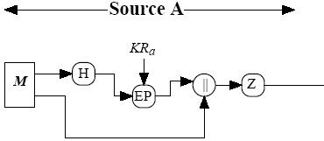
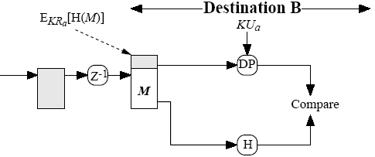
PGP Operation – Authentication
M = original message
H = hash function
| | = concatenation (join)
Z = compression
Z⁻¹ = decompression
EP = public key encryption
DP = public key decryption
KR_{a} = A’s private key
KU_{a} = A’s public key

Slide 8
PGP Operation – Confidentiality
1. Sender generates message and random number to be used as session key for this message only
2. Message is encrypted, using AES, 3DES, IDEA or CAST-128, with session key
3. Session key is encrypted using RSA with recipient's public key, then attached to msg
4. Receiver uses RSA with its private key to decrypt and recover session key
5. Session key is used to decrypt message

Slide 9

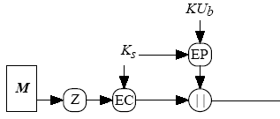

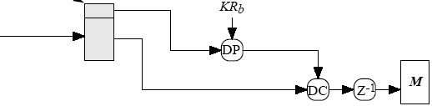
PGP Operation – Confidentiality
(book, fig 5.1b)
EC = symmetric encryption
DC = symmetric decryption
K_{s} = session key

Slide 10
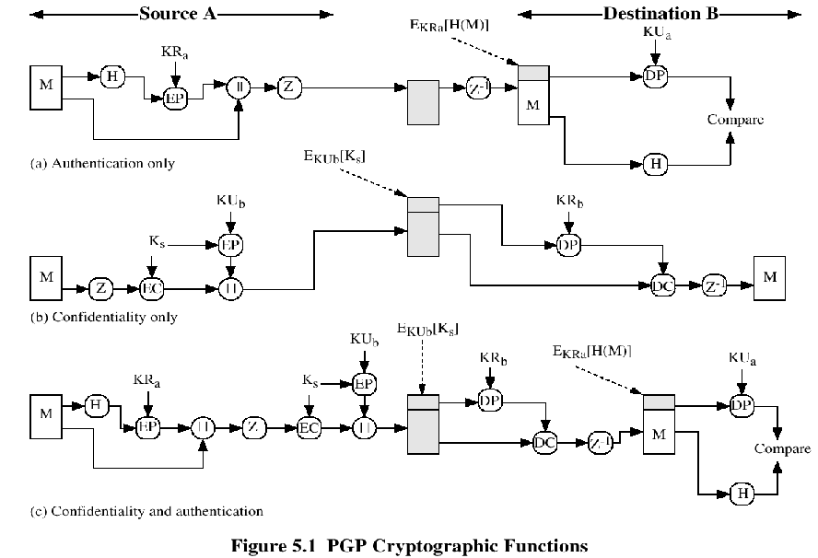

Slide 11
PGP Operation – Compression
PGP compresses the message:
after signing the hash
  to save having to compress document every time you wish to verify its signature
before encryption
  to speed up the process (less data to encrypt)
  for greater security; compressed messages are more difficult to cryptanalyse as they have less redundancy)

Slide 12
PGP Operation – Segmentation/Reassembly
Email protocols often restrict a message to a certain maximum size (e.g. 50KB)
Thus PGP divides messages that are too large into smaller ones
Reassembly at the other end is required before decryption or signature verification

Slide 13
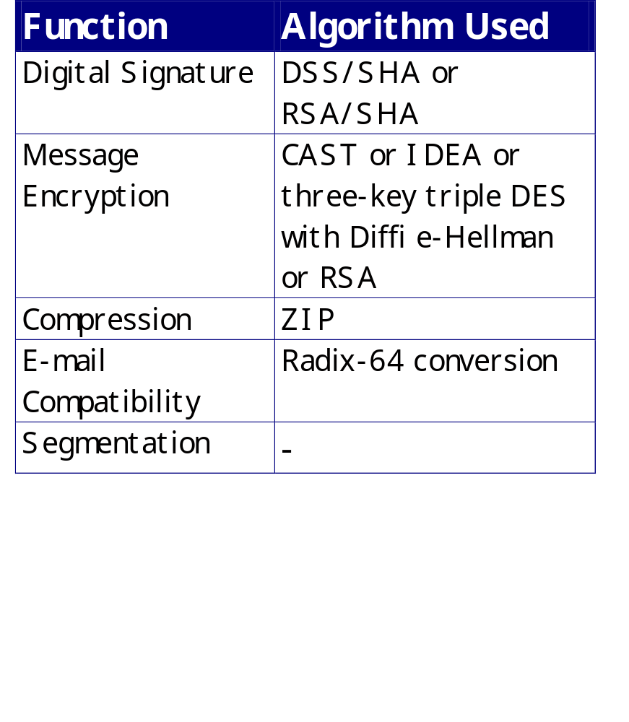
Summary of PGP Services
CS@UTC

Slide 14
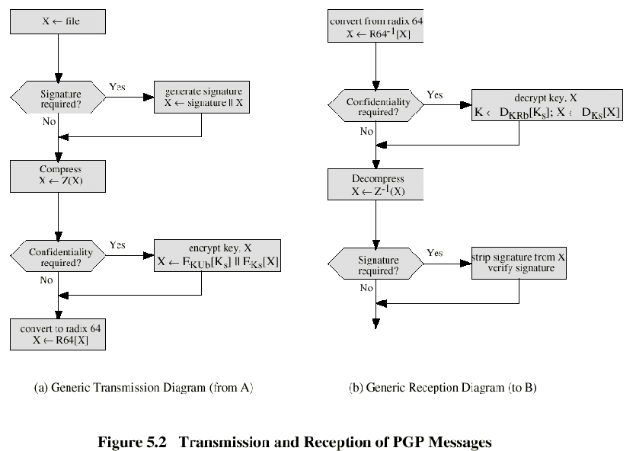

Slide 15
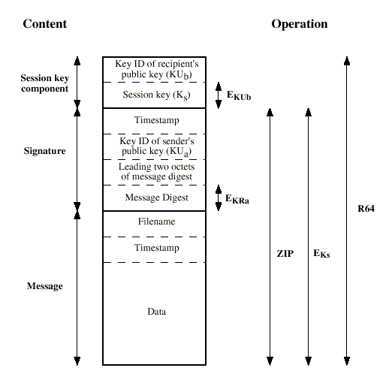
Format of PGP Message
CS@UTC

Slide 16
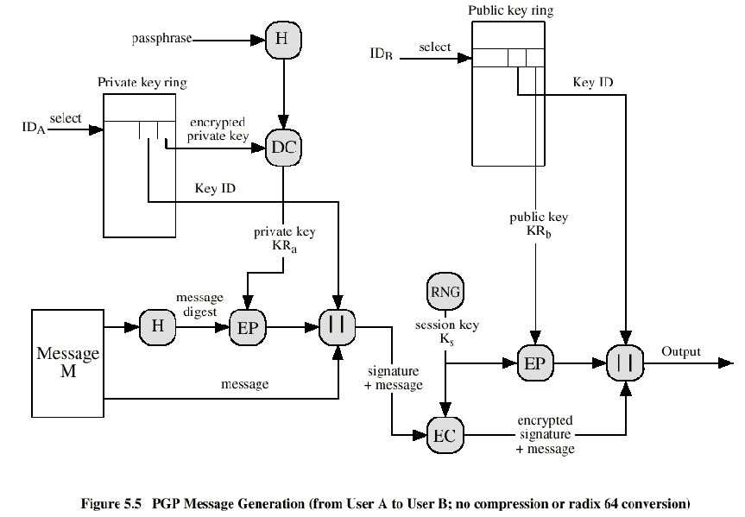

Slide 17
