Slide 1
CIS 5600 Information Security Management
Dr. Jeremy Lanman, Adjunct Professor
jlanman@fit.edu
Office: Virtual
Office Hours: By arrangement

Slide 2
Administrivia: Introductions
Dr Jeremy Lanman
Undergraduate: BS Computer Science & Mathematics – Butler University
MS Software Engineering – Embry Riddle Aeronautical University
Ph.D. Industrial Engineering / M&S - University of Central Florida
Work
Project Manager/Chief Architect – Department of Defense
Adjunct Faculty – FIT, University of Central Florida, Embry Riddle Aeronautical University, Nova Southeastern University
Interests
Service Oriented Architecture
Distributed Computing
Cloud-based Computing, Mobile Computing
Software and Systems Engineering, Modeling & Simulation

Slide 3
Administrivia: Contact Details
Contact Information:
Email: jlanman@fit.edu
Phone: 407-385-0445
Office Hours
By arrangement

Slide 4
Administrivia: Basic Information
Class home page Course Canvas site contains syllabus and schedule, lecture notes, homework, more reading material

Slide 5
Administrivia: Communications
Email
All students are expected to have an FIT email address.
Please make sure it is valid and make sure you can access the course Canvas page.
Course mailing list:
On Canvas
You can subscribe to discussion forums
If necessary, update your spam filter to accept messages from the Canvas system.
Unless your message is personal, send it to the course mailing list!
Last minute information will go to the mailing list on Canvas.

Slide 6
Administrivia: Reading materials
REQUIRED TEXT
Workman, M., Phelps, D. C., & Gathegi, J. N. (2013). Information Security for Managers. Boston, MA: Jones & Bartlett. ISBN-13: 9780763793012
SOFTWARE
The software needed for this class includes:
Word processing software. I accept submissions in MicroSoft Word, PDF and plain text formats.
Spreadsheet and presentation creation software (e.g. Excel, PowerPoint, Google Docs/Slides, OpenOffice, etc.).

Slide 7
Administrivia: Reading materials
Collateral reading: these two books are ones that every practitioner in the field ought to read.
Frederick P. Brooks, The Mythical Man-Month: Essays on Software Engineering, Anniversary Edition (2nd Edition) (Paperback), Addison-Wesley, ISBN-10: 0-201-83595-9.
Gerald M. Weinberg, The Psychology of Computer Programming: Silver Anniversary Edition (Paperback), Dorset House, ISBN-10: 0-932633-42-0

Slide 8
Administrivia: Course structure
10-11 weeks (Aug 19 – Nov 18)
Weekly reading
Graded labs (4)
Term/Team project
Class Participation / Online Journal
Class structure: In-class or Online/Distance Learning via Canvas.
Topics and reading assignments are on the course Canvas page

Slide 9
Administrivia: Miscellany
Communications development:
An essential part of this course is communicating your ideas in prose.
The ability to communicate clearly and effectively is a skill that will pay off both in and out of class.
Motivation from a recent NPR business report:
Robert Half surveyed their corporate customers concerning resumes they had received.
Corporate reviewers spent about 10-15 seconds deciding whether to examine the resume further.
They instantly tossed the resume if they detected any grammatical or spelling errors.
Treat your coursework as if it were being reviewed by the manager who does your performance review and sets your salary.

Slide 10
Administrivia: Miscellany
There will be a lot of ambiguity and lack of firm direction in the assignments and the information.
That is typical of much of project management.
This requires you to provide your own experience. Or to research and discover your information.
Understanding a problem (statement):
An essential part of this course is understanding written material, ideas in prose. The ability to understand a document, to "read between the lines", is a skill that will pay off both in and out of class.

Slide 11
Administrivia: Miscellany
Intellectual property issues:
All material in this course is property of the either the instructor or other authors.
You are permitted to download and print copies of the material.
You are not permitted to redistribute the material in any form.
Plagiarism:
All individual assignments must represent your own work.
It’s a great idea to get together in study groups to discuss the problems, but you should then do the assignments individually.
Plagiarism is to take and use as one’s own, or copy without acknowledgement, the works of another person. The provider of such material can be ruled equally culpable.
If you hand in late homework with prior permission, it must be your own work, not a copy of the solutions presented in class.

Slide 12
Administrivia: Support
Technical questions can be addressed during office hours or by email
Use the mailing list for all technical questions
Provide appropriate support to each other
I do not preview homework, but I will answer questions or make suggestions to generic problems
If you contact me by e-mail
Please include your name and the course number in all correspondence

Slide 13
Administrivia: Feedback/Participation
Feedback/Participation
Share your thoughts
Ask questions – wave your hand forcefully to get my attention
Speak loudly so all can hear
Give me verbal and non-verbal feedback
Don’t just sit there . . . nod, smile, frown, shake your head
Make sure your email address is correct and works

Slide 14
Administrivia: Assessment
Labs (4)
A course Journal
Team Project
Final examination
Each of the above will be weighted as follows
Labs 40%
Project 30%
Class Participation 10%
Final Exam 20%
Grading will be done on the usual 60/70/80/90 bands but will be adjusted to account for clustering and banding of scores. Bands may be adjusted if there seems to be a systemic bias to the scores.

Slide 15
Administrivia: Schedule
Wed Aug 19 (First week)
Wed Aug 26 01
Wed Sep 02 (Lab 1 due)
Wed Sep 09 (No class)
Wed Sep 16 (Lab 2 due)
Wed Sep 23 (Term Paper / Project proposal due)
Wed Sep 30
Wed Oct 07 (Lab 3 due)
Wed Oct 14 (No class – Fall Break)
Wed Oct 21
Wed Oct 28 (Lab 4 due)
Wed Nov 04 (Term Paper / Team Project due)
Wed Nov 11 (No class – Veteran’s Day)
Wed Nov 18 (Last week) (Final Exam)

Slide 16
Homework logistics
Homework must be submitted via Canvas by 11:59 PM Eastern time on the assignment due date.
Submit MS Word or Adobe PDF files only
All figures must be embedded in the file, not bundled in a ‘.zip’ file
No extra credit assignments.

Slide 17
Surviving CIS 5600
Make sure you read things, sometimes more than once. People do not seem to read assignments and web pages (or do not follow instructions).
Read the assignments carefully. Note special requirements, such as formats and use of predefined templates!
Start your assignments right after they are handed out (assigned). They will take some time and starting on the night before it is due is not a good strategy.
Reading list:
Is it required? No.
Is it useful? Yes, especially if you are serious about a career in information security.
The articles are usually short but informative. Most are supplemental – useful for understanding but the notes cover the major points.
Reading should be done in parallel with the lectures.
Pace yourself. Remember: “This too shall pass.”

Slide 18
Introductions
Roll call
Tell everyone about:
Your Background
Day Job (if any)
Major
Project Management Experience
Industry Experience
Expectations & goals from the class

Slide 19
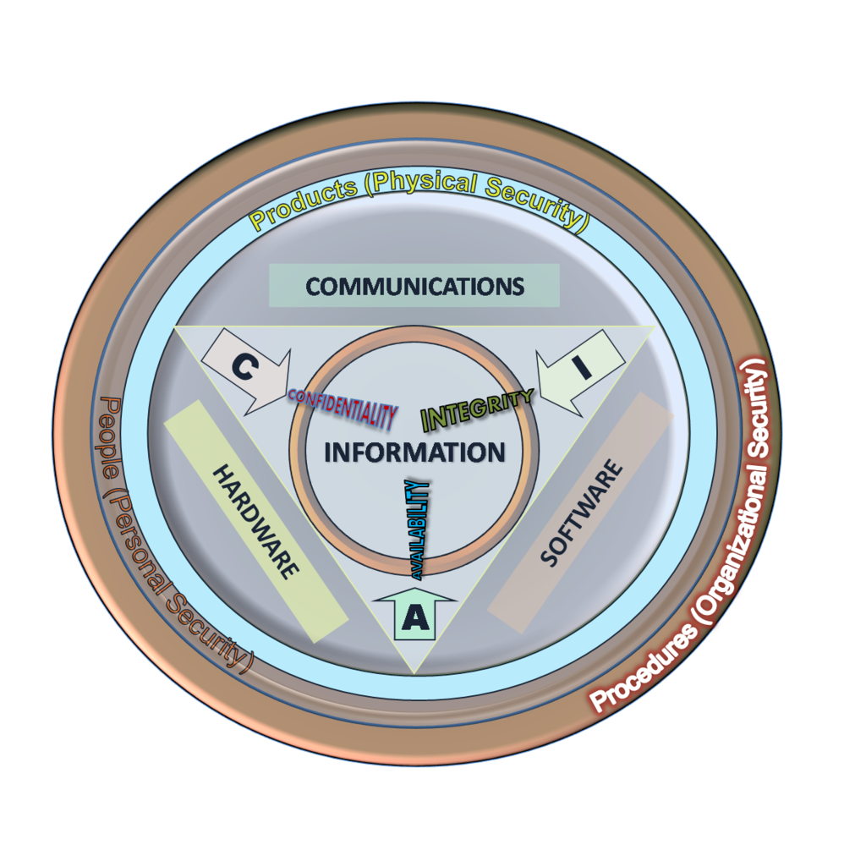
Course Objective
An ability to articulate the Confidentiality, Integrity, & Availability (CIA) elements in information systems security.
Be capable of producing a security policy for a complex information systems implementation, and understand the role of manager in overseeing the security of information resources.
Know how to secure networks, host systems, and other provisioned information resources.
Have the ability to assess the impact of information security on organizations and societies at large.

Slide 20
Topics
Topic | Objectives
Organizations and Security Law
Organizations, security models, security and HR law | Become acquainted with organizational law and issues. Know about regulation and legislations. Know about compliance and criteria.
Introduction to security policies | Know what is contained in a security policy. Understand the relationships between policies and security models.
The Business of security | Know what is comprised in continuity plans, recovery, and secure business practices.
Technologies for Managers
Host Systems | Understand access controls, plans, recovery, and secure business practices.
Operating Systems | Know about OS threats and vulnerabilities.
Networking | Be familiar with networks and security.
Security for Managers
OS Security | Understand security operating systems.
Network Security | Know about network threats and vulnerabilities.
Firewalls | Understand firewalls, and firewall infrastructure, and architecture.
Systems Security | Know how cryptographic algorithms work, public and private key cryptography, and know about certificate authorities and message digests.
Operations and Administration
Scanning for Vulnerabilities | Learn how scanning is done to find vulnerabilities to exploit.
Intrusion Detection | Know about HIDS and NIDS, and learn to detect attempts and intrusions.
Handling Incidents | Know how to handle security incidents, what to do, and how to preserve evidence.
Security Audits | Be able to conduct an audit using one or the many criteria and checklists. Know about C&A.

Slide 21
Assignments
Journal – Due at the end of the term
Students will keep a journal. This will cover collateral reading assigned, questions asked in class (also exercises at the end of each lecture), labs, team/term projects, and your thoughts on course material. The journal entries will comment on the readings and the lessons learned.
While I may suggest topics (or questions) in class (see Exercises), do not restrict yourself to just those items.
If you do not have other entries, you will not receive 100%.

Slide 22
Introduction to the Management of Information Security
If this is the information superhighway, it’s
going through a lot of bad, bad neighborhoods.
-- DORIAN BERGER, 1997

Slide 23
Introduction
Information technology is critical to business and society
Computer security is evolving into information security
Information security is the responsibility of every member of an organization, but managers play a critical role
Notes:
Introduction
Information technology is the vehicle that stores and transports information from one business unit to another. But what happens if the vehicle breaks down, even for a little while?
As businesses have become more fluid, the concept of computer security has been replaced by the concept of information security.
Because this new concept covers a broader range of issues, from the protection of data to the protection of human resources, information security is no longer the sole responsibility of a discrete group of people in the company; rather, it is the responsibility of every employee, and especially managers.

Slide 24
Introduction
Information security involves three distinct communities of interest:
Information security managers and professionals
Information technology managers and professionals
Non-technical business managers and professionals
Notes:
Introduction
Organizations must realize that information security decisions should involve three distinct groups of decision makers, or communities of interest:
Information security managers and professionals
Information technology managers and professionals
Non-technical business managers and professionals
Organizations must realize that information security decisions should involve three distinct groups of decision makers, or communities of interest:
Information security managers and professionals
Information technology managers and professionals
Non-technical business managers and professionals

Slide 25
Communities of Interest
InfoSec community: protect information assets from threats
IT community: support business objectives by supplying appropriate information technology
Business community: policy and resources

Slide 26
What Is Security?
“The quality or state of being secure—to be free from danger”
Security is achieved using several strategies simultaneously
Notes:
What Is Security?
Understanding the technical aspects of information security requires that you know the definitions of certain information technology terms and concepts.
In general, security is defined as “the quality or state of being secure—to be free from danger.”
Security is often achieved by means of several strategies usually undertaken simultaneously or used in combination with one another.

Slide 27
Specialized Areas of Security
Physical security
Personal security
Operations security
Communications security
Network security
Information Security (InfoSec)
Computer Security
Notes:
Specialized areas of security
Physical security
Personal security
Operations security
Communications security
Network security
Information Security
Computer Security

Slide 28
Information Security
InfoSec includes information security management, computer security, data security, and network security
Policy is central to all information security efforts
Notes:
Information Security
Information security includes the broad areas of information security management, computer and data security, and network security.
At the heart of the study of information security is the concept of policy.
Policy, awareness, training, education, and technology are vital concepts for the protection of information and for keeping information systems from danger.

Slide 29
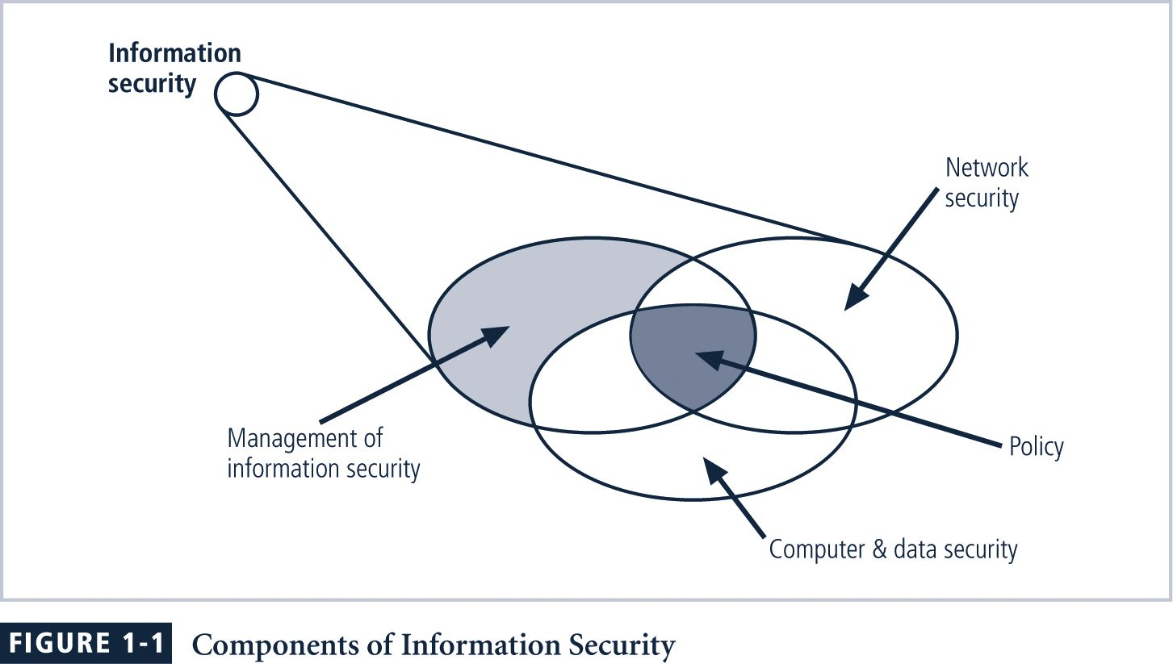
Components of Information Security
Notes:
FIGURE 1-1 Components of Information Security
Information security (InfoSec) is the protection of information and its critical elements, including the systems and hardware that use, store, and transmit that information.
Figure 1-1 shows that information security includes the broad areas of information security management (the topic of this book), computer and data security, and network security. At the heart of the study of information security is the concept of policy (discussed in detail in Chapter 4). Policy, awareness, training, education, and technology
are vital concepts for the protection of information and for keeping information systems from danger.

Slide 30
CIA Triangle
The C.I.A. triangle is made up of:
Confidentiality
Integrity
Availability
Over time the list of characteristics has expanded, but these three remain central
Notes:
CIA Triangle
The C.I.A. triangle - confidentiality, integrity, and availability - has expanded into a more comprehensive list of critical characteristics of information.
The NSTISSC Security Model provides a more detailed perspective on security.
While the NSTISSC model covers the three dimensions of information security, it omits discussion of detailed guidelines and policies that direct the implementation of controls.
Another weakness of using this model with too limited an approach is to view it from a single perspective.

Slide 31
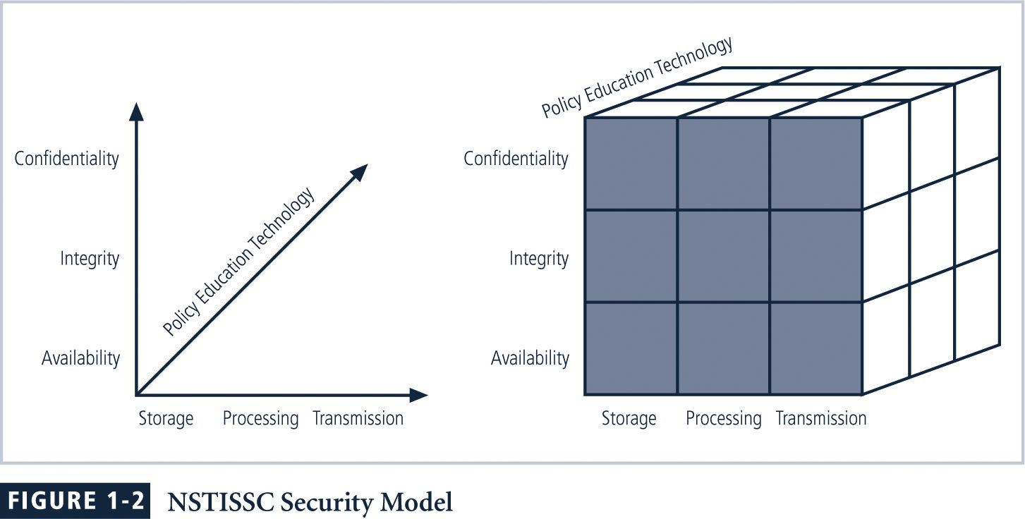
NSTISSC Security Model
Notes:
Figure 1-2 NSTISSC Security Model
The NSTISSC security model, as shown in Figure 1-2, illustrates three dimensions central to the discussion of information security. If we extend the relationship among the three dimensions represented by the axes, we end up with a 3 × 3 × 3 cube with 27 cells. Each of these cells represents an area of intersection among these three dimensions that must be addressed to secure information systems. When using this model to design or review any information security program, you must make sure that each of the 27 cells is properly addressed by each of the three communities of interest.

Slide 32
Key Concepts of Information Security
Confidentiality
Confidentiality of information ensures that only those with sufficient privileges may access certain information
To protect confidentiality of information, a number of measures may be used including:
Information classification
Secure document storage
Application of general security policies
Education of information custodians and end users
Notes:
Confidentiality
Confidentiality of information ensures that only those with sufficient privileges may access certain information.
To protect the confidentiality of information, a number of measures are used:
Information classification
Secure document storage
Application of general security policies
Education of information custodians and end users

Slide 33
Key Concepts of Information Security
Integrity
Integrity is the quality or state of being whole, complete, and uncorrupted
The integrity of information is threatened when it is exposed to corruption, damage, destruction, or other disruption of its authentic state
Corruption can occur while information is being compiled, stored, or transmitted
Notes:
Integrity
Integrity is the quality or state of being whole, complete, and uncorrupted.
The integrity of information is threatened when it is exposed to corruption, damage, destruction, or other disruption of its authentic state.
Corruption can occur while information is being compiled, stored, or transmitted.

Slide 34
Key Concepts of Information Security
Availability
Availability is making information accessible to user access without interference or obstruction in the required format
A user in this definition may be either a person or another computer system
Availability means availability to authorized users
Notes:
Availability
Availability is the characteristic of information that enables user access to information without interference or obstruction and in a required format.
A user in this definition may be either a person or another computer system.
Availability does not imply that the information is accessible to any user; rather, it means availability to authorized users.

Slide 35
Key Concepts of Information Security
Privacy
Information is to be used only for purposes known to the data owner
This does not focus on freedom from observation, but rather that information will be used only in ways known to the owner
Notes:
Privacy
The information that is collected, used, and stored by an organization is to be used only for the purposes stated to the data owner at the time it was collected.
This definition of privacy does focus on freedom from observation, but rather means that information will be used only in ways known to the person providing it.

Slide 36
Key Concepts of Information Security
Identification
Information systems possess the characteristic of identification when they are able to recognize individual users
Identification and authentication are essential to establishing the level of access or authorization that an individual is granted
Notes:
Identification
An information system possesses the characteristic of identification when it is able to recognize individual users.
Identification and authentication are essential to establishing the level of access or authorization that an individual is granted.

Slide 37
Key Concepts of Information Security
Authentication
Authentication occurs when a control provides proof that a user possesses the identity that he or she claims
Notes:
Authentication
Authentication occurs when a control provides proof that a user possesses the identity that he or she claims.

Slide 38
Key Concepts of Information Security
Authorization
After the identity of a user is authenticated, a process called authorization provides assurance that the user (whether a person or a computer) has been specifically and explicitly authorized by the proper authority to access, update, or delete the contents of an information asset
Notes:
Authorization
After the identity of a user is authenticated, a process called authorization provides assurance that the user (whether a person or a computer) has been specifically and explicitly authorized by the proper authority to access, update, or delete the contents of an information asset.

Slide 39
Key Concepts of Information Security
Accountability
The characteristic of accountability exists when a control provides assurance that every activity undertaken can be attributed to a named person or automated process
Notes:
Accountability
The characteristic of accountability exists when a control provides assurance that every activity undertaken can be attributed to a named person or automated process.

Slide 40
What Is Management?
A process of achieving objectives using a given set of resources
To manage the information security process, first understand core principles of management
A manager is “someone who works with and through other people by coordinating their work activities in order to accomplish organizational goals”
Notes:
What Is Management?
Management is the process of achieving objectives using a given set of resources.
To make the information security process more effective, it is important to understand certain core principles of management.
A manager is “someone who works with and through other people by coordinating their work activities in order to accomplish organizational goals.”

Slide 41
Managerial Roles
Informational role: Collecting, processing, and using information to achieve the objective
Interpersonal role: Interacting with superiors, subordinates, outside stakeholders, and other
Decisional role: Selecting from alternative approaches and resolving conflicts, dilemmas, or challenges
Notes:
Management
Managerial roles:
Informational role: Collecting, processing, and using information that can affect the completion of the objective
Interpersonal role: Interacting with superiors, subordinates, outside stakeholders, and other parties that influence or are influenced by the completion of the task
Decisional role: Selecting from among alternative approaches, and resolving conflicts, dilemmas, or challenges.

Slide 42
Differences Between Leadership and Management
The leader influences employees so that they are willing to accomplish objectives
He or she is expected to lead by example and demonstrate personal traits that instill a desire in others to follow
Leadership provides purpose, direction, and motivation to those that follow
Notes:
The Difference Between Leadership and Management
The distinction between a leader and a manager arises in the execution of organizational tasks.
The leader influences employees so that they are willing to accomplish objectives.
He or she is expected to lead by example and demonstrate personal traits that instill a desire in others to follow.
In other words, leadership provides purpose, direction, and motivation to those that follow.
By comparison, a manager administers the resources of the organization.

Slide 43
A Manager administers the resources of the organization by:
Creating budgets
Authorizes expenditures
Hires employees
A Manager can also be a leader.

Slide 44
Characteristics of a Leader
Bearing
Courage
Decisiveness
Dependability
Endurance
Enthusiasm
Initiative
Integrity
Judgment
Justice
Knowledge
Loyalty
Tact
Unselfishness
Notes:
Characteristics of a Leader What makes a good leader?
Bearing
Courage
Decisiveness
Dependability
Endurance
Enthusiasm
Initiative Integrity
Judgment
Justice
Knowledge
Loyalty
Tact
Unselfishness

Slide 45
What Makes a Good Leader?
Action plan for improvement of leadership abilities
Knows and seeks self-improvement
Be technically and tactically proficient
Seek responsibility and take responsibility for your actions
Make sound and timely decisions
Set the example
Knows [subordinates] and looks out for their well-being
Notes:
Action plan for improvement of leadership abilities:
Know yourself and seek self-improvement.
Be technically and tactically proficient.
Seek responsibility and take responsibility for your actions.
Make sound and timely decisions.
Set the example.
Know your [subordinates] and look out for their well-being.
Keep your subordinates informed.
Develop a sense of responsibility in your subordinates.
Ensure the task is understood, supervised, and accomplished.
Build the team.
Employ your [team] in accordance with its capabilities.

Slide 46
What Makes a Good Leader? (Continued)
Action plan for improvement of leadership abilities
Keeps subordinates informed
Develops a sense of responsibility in subordinates
Ensures the task is understood, supervised, and accomplished
Builds the team
Employs a team in accordance with its capabilities
Notes:
Action plan for improvement of leadership abilities:
Know yourself and seek self-improvement.
Be technically and tactically proficient.
Seek responsibility and take responsibility for your actions.
Make sound and timely decisions.
Set the example.
Know your [subordinates] and look out for their well-being.
Keep your subordinates informed.
Develop a sense of responsibility in your subordinates.
Ensure the task is understood, supervised, and accomplished.
Build the team.
Employ your [team] in accordance with its capabilities.

Slide 47
Behavioral Types of Leaders
Three basic behavioral types of leaders:
Autocratic – action-oriented, “Do as I say”
Democratic – action-oriented and likely to be less efficient
Laissez-faire – laid-back
Notes:
Behavioral Types of Leaders
There are three basic behavioral types of leaders:
the autocratic,
the democratic, and
the laissez-faire.

Slide 48
Characteristics of Management
Two well-known approaches to management:
Traditional management theory using principles of planning, organizing, staffing, directing, and controlling (POSDC)
Popular management theory categorizes principles of management into planning, organizing, leading, and controlling (POLC)
Notes:
Characteristics of Management
Two basic approaches to management exist:
Traditional management theory uses the core principles of planning, organizing, staffing, directing, and controlling (POSDC).
Popular management theory categorizes the principles of management into planning, organizing, leading, and controlling (POLC).

Slide 49
Planning
Planning: process that develops, creates, and implements strategies for the accomplishment of objectives
Three levels of planning:
Strategic – occurs at highest level of organization
Tactical – focuses on production planning and integrates organizational resources
Operational – focuses on day-to-day operations of local resources
Notes:
Planning
The process that develops, creates, and implements strategies for the accomplishment of objectives.
There are three levels of planning:
Strategic
Tactical
Operational

Slide 50
Planning (Continued)
In general, planning begins with the strategic plan for the whole organization
To do this successfully, organization must thoroughly define its goals and objectives
Notes:
Planning
The general approach to planning begins with the creation of strategic plans for the entire organization.
To better understand the planning process, an organization must thoroughly define its goals and objectives.

Slide 51
Organization
Organization: is a principle of management dedicated to structuring of resources to support the accomplishment of objectives
Organizing tasks requires determining:
What is to be done
In what order
By whom
By which methods
When
Notes:
Organization
The principle of management dedicated to the structuring of resources to support the accomplishment of objectives.
Organizing tasks requires determining what is to be done, in what order, by whom, by which methods, and according to what timeline.

Slide 52
Leadership
Encourages the implementation of the planning and organizing functions, including supervising employee behavior, performance, attendance, and attitude
Leadership generally addresses the direction and motivation of the human resource
Notes:
Leadership
As noted earlier, leadership encourages the implementation of the planning and organizing functions. It includes supervising employee behavior, performance, attendance, and attitude.
Leadership generally addresses the direction and motivation of the human resource.

Slide 53
Control
Control:
Monitoring progress toward completion
Making necessary adjustments to achieve the desired objectives
Controlling function determines what must be monitored as well using specific control tools to gather and evaluate information
Notes:
Control
Monitoring progress toward completion, and making necessary adjustments to achieve the desired objectives, requires the exercise of control.
In general, the control function serves to assure the organization of the validity of the plan.
The controlling function also determines what must be monitored as well as applies specific control tools to gather and evaluate information.

Slide 54
Solving Problems
All managers face problems that must be solved.
Step 1: Recognize and Define the Problem
Step 2: Gather Facts and Make Assumptions
Step 3: Develop Possible Solutions
Step 4: Analyze and Compare the Possible Solutions
Step 5: Select, Implement, and Evaluate a Solution
Notes:
Solving Problems
Step 1: Recognize and Define the Problem
Step 2: Gather Facts and Make Assumptions
Step 3: Develop Possible Solutions
Step 4: Analyze and Compare the Possible Solutions
Step 5: Select, Implement, and Evaluate a Solution

Slide 55
Principles Of Information Security Management
Information security management is part of the organizational management team.
The extended characteristics of information security are known as the six Ps:
Planning
Policy
Programs
Protection
People
Project Management
Notes:
Principles Of Information Security Management
The extended characteristics of information security are known as the six Ps.
Planning
Policy
Programs
Protection
People
Project Management

Slide 56
InfoSec Planning
Planning as part of InfoSec management is an extension of the basic planning model discussed earlier in this chapter
Included in the InfoSec planning model are activities necessary to support the design, creation, and implementation of information security strategies as they exist within the IT planning environment
Notes:
InfoSec Planning
Planning as part of InfoSec management is an extension of the basic planning model discussed earlier in this chapter.
Included in the InfoSec planning model are activities necessary to support the design, creation, and implementation of information security strategies, as they exist within the IT planning environment

Slide 57
InfoSec Planning Types
Several types of InfoSec plans exist:
Incident response
Business continuity
Disaster recovery
Policy
Personnel
Technology rollout
Risk management and
Security program including education, training and awareness
Notes:
InfoSec Planning
Several types of InfoSec plans exist:
incident response planning
business continuity planning
disaster recovery planning
policy planning
personnel planning
technology rollout planning
risk management planning and
security program planning including education, training and awareness.

Slide 58
Policy
Policy: set of organizational guidelines that dictates certain behavior within the organization
In InfoSec, there are three general categories of policy:
General program policy (Enterprise Security Policy)
An issue-specific security policy (ISSP)
System-specific policies (SSSPs)
Notes:
Policy
The set of organizational guidelines that dictates certain behavior within the organization is called policy.
In InfoSec, there are three general categories of policy:
• General program policy (Enterprise Security Policy)
• An issue-specific security policy (ISSP)
• System-specific policies (SSSPs)

Slide 59
Programs
Programs: specific entities managed in the information security domain
A security education training and awareness (SETA) program is one such entity
Other programs that may emerge include a physical security program, complete with fire, physical access, gates, guards, and so on
Notes:
Programs
Specific entities managed in the information security domain.
A security education training and awareness (SETA) program is one such entity.
Other programs that may emerge include a physical security program, complete with fire, physical access, gates, guards, and so on.

Slide 60
Protection
Risk management activities, including risk assessment and control, as well as protection mechanisms, technologies, and tools
Each of these mechanisms represents some aspect of the management of specific controls in the overall information security plan
Notes:
Protection
The protection function is executed via a set of risk management activities, including risk assessment and control, as well as protection mechanisms, technologies, and tools.
Each of these mechanisms represents some aspect of the management of specific controls in the overall information security plan.

Slide 61
People
People are the most critical link in the information security program
It is imperative that managers continuously recognize the crucial role that people play
Including information security personnel and the security of personnel, as well as aspects of the SETA program
Notes:
People
People are the most critical link in the information security program. As discussed in the Viewpoint section, it is imperative that managers continuously recognize the crucial role that people play in the information security program.
This aspect of InfoSec includes security personnel and the security of personnel, as well as aspects of the SETA program mentioned earlier.

Slide 62
Project Management
Project management discipline should be present throughout all elements of the information security program
Involves
Identifying and controlling the resources applied to the project
Measuring progress and adjusting the process as progress is made toward the goal
Notes:
Project Management
The final component is the application of thorough project management discipline to all elements of the information security program.
This effort involves identifying and controlling the resources applied to the project, as well as measuring progress and adjusting the process as progress is made toward the goal.

