Slide 1
CIS 5600 Information Security Management
Dr. Jeremy Lanman, Adjunct Professor
jlanman@fit.edu
Office: Virtual
Office Hours: By arrangement

Slide 2
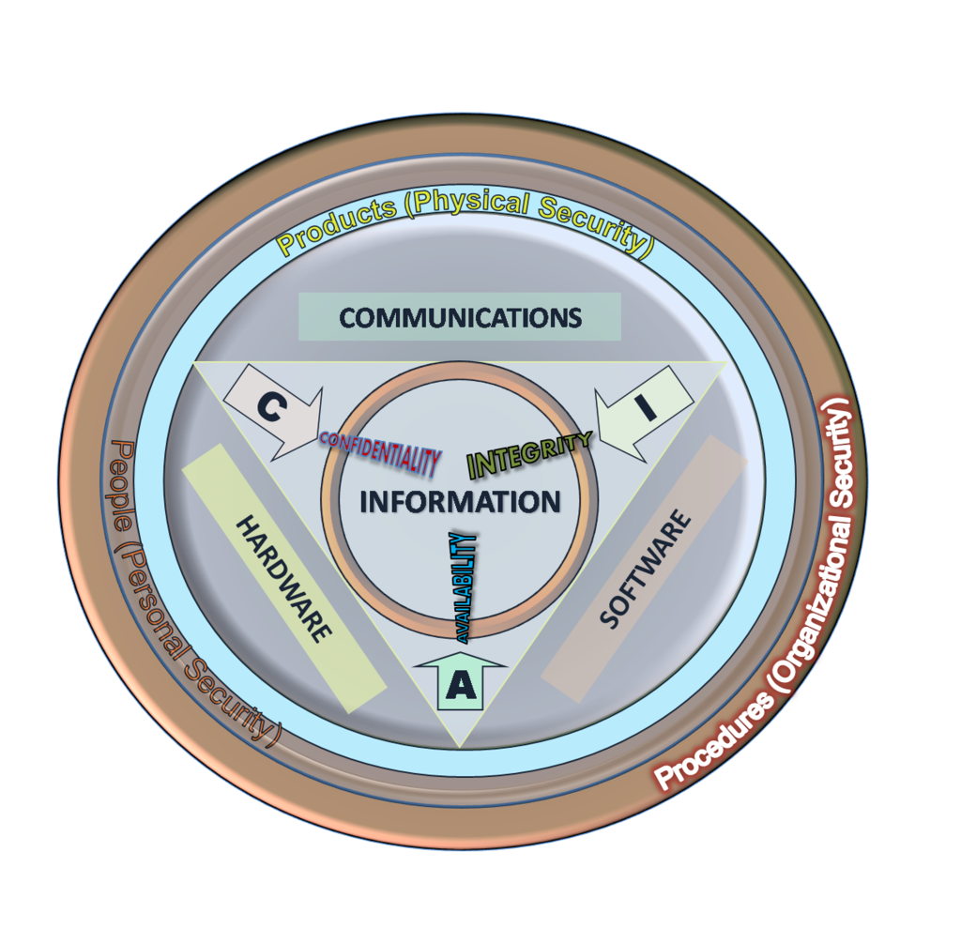
Course Objective
An ability to articulate the Confidentiality, Integrity, & Availability (CIA) elements in information systems security.
Be capable of producing a security policy for a complex information systems implementation, and understand the role of manager in overseeing the security of information resources.
Know how to secure networks, host systems, and other provisioned information resources.
Have the ability to assess the impact of information security on organizations and societies at large.

Slide 3
Security Planning
You got to be careful if you don’t know
where you’re going, because you might not
get there.
-- Yogi Berra

Slide 4
Introduction
Successful organizations utilize planning
Planning involves:
Employees
Management
Stockholders
Other outside stakeholders
Physical environment
Political and legal environment
Competitive environment
Technological environment

Slide 5
Introduction
Strategic planning includes:
Vision statement
Mission statement
Strategy
Coordinated plans for sub units
Knowing how the general organizational planning process works helps in the information security planning process

Slide 6
Introduction
Planning:
Is creating action steps toward goals, and then controlling them
Provides direction for the organization’s future
Top-down method:
Organization’s leaders choose the direction
Planning begins with the general and ends with the specific

Slide 7
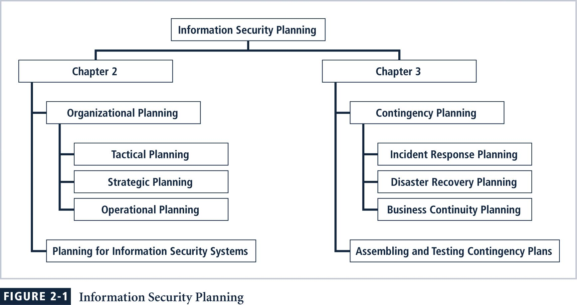
Information Security Planning
InfoSec Management
Notes:
In this textbook, the planning process is broken into two chapters – one on business planning (in general and specific to information security) and one on preparedness planning, also called contingency planning.

Slide 8
Components Of Planning: Mission/Vision Statement
Mission statement:
Declares the business of the organization and its intended areas of operations
Explains what the organization does and for whom
Example: Random Widget Works, Inc. designs and manufactures quality widgets, associated equipment and supplies for use in modern business environments
Vision statement:
Expresses what the organization wants to become
Should be ambitious
Example: Random Widget Works will be the preferred manufacturer of choice for every business’s widget equipment needs, with an RWW widget in every machine they use

Slide 9
Components Of Planning: Values
By establishing organizational principles in a values statement, an organization makes its conduct standards clear
Example: RWW values commitment, honesty, integrity and social responsibility among its employees, and is committed to providing its services in harmony with its corporate, social, legal and natural environments.
The mission, vision, and values statements together provide the foundation for planning

Slide 10
Components Of Planning: Strategy
Strategy is the basis for long-term direction
Strategic planning:
Guides organizational efforts
Focuses resources on clearly defined goals
“… strategic planning is a disciplined effort to produce fundamental decisions and actions that shape and guide what an organization is, what it does, and why it does it, with a focus on the future.”

Slide 11
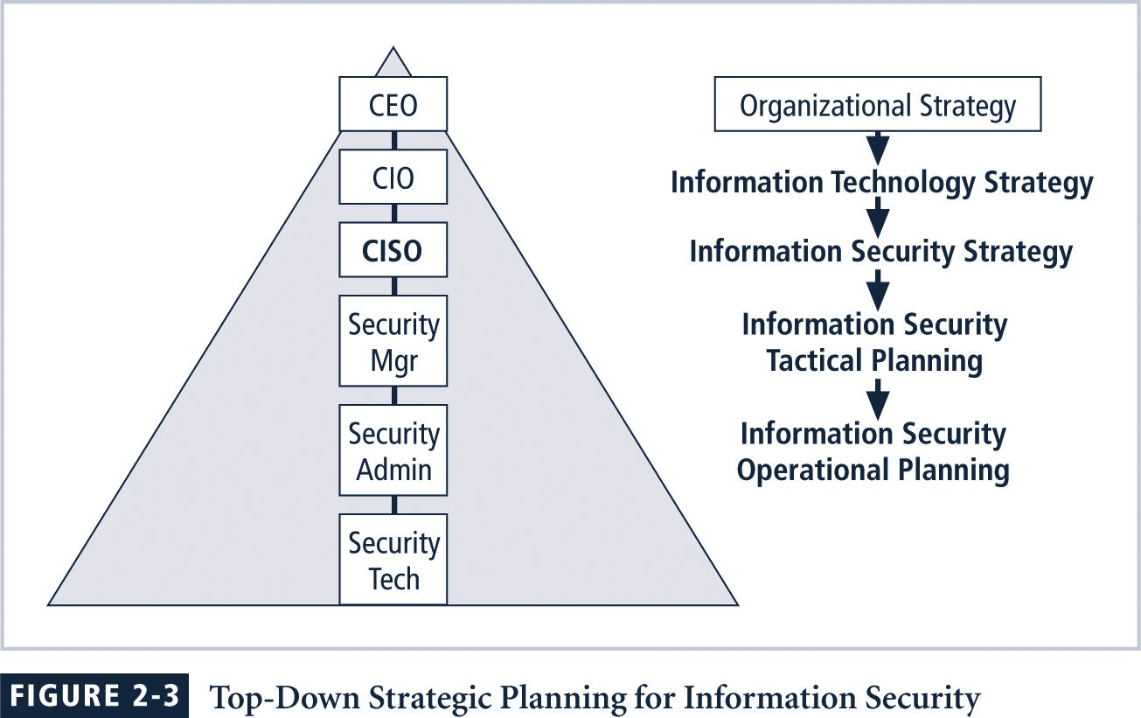
Strategic Planning

Slide 12
Strategic Planning
Organization:
Develops a general strategy
Creates specific strategic plans for major divisions
Each level of division translates those objectives into more specific objectives for the level below
In order to execute this broad strategy, executives must define individual managerial responsibilities

Slide 13
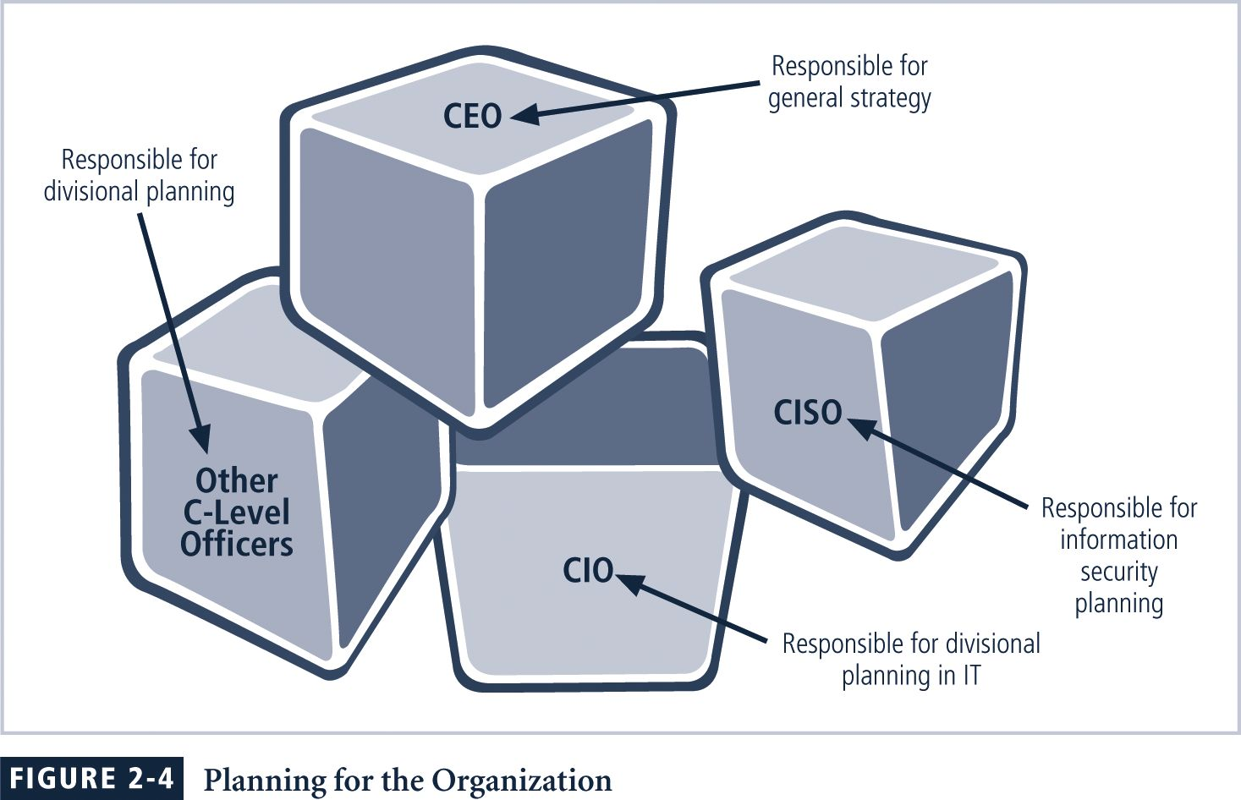
Planning for the Organization

Slide 14
Strategic Planning
Strategic goals are then translated into tasks with specific, measurable, achievable, reasonably high and time-bound objectives (SMART)
Strategic planning then begins a transformation from general to specific objectives

Slide 15
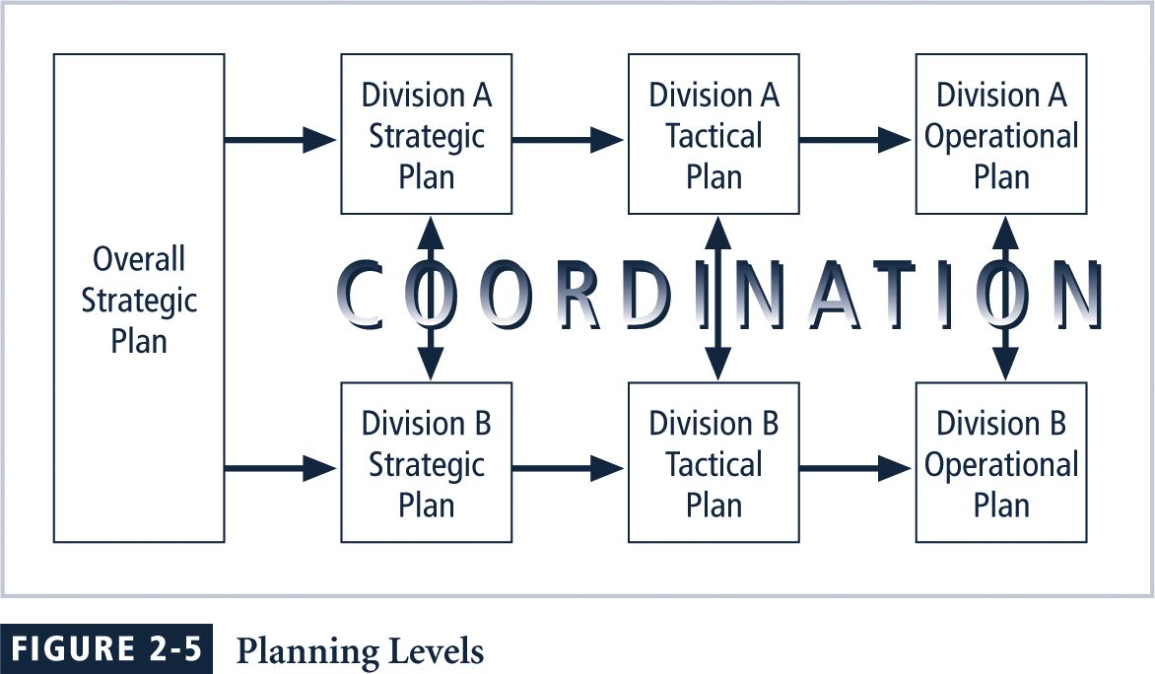
Planning Levels

Slide 16
Planning levels
Tactical Planning
Shorter focus than strategic planning
Usually one to three years
Breaks applicable strategic goals into a series of incremental objectives
Operational Planning
Used by managers and employees to organize the ongoing, day-to-day performance of tasks
Includes clearly identified coordination activities across department boundaries such as:
Communications requirements
Weekly meetings
Summaries
Progress reports

Slide 17
Typical Strategic Plan Elements
Introduction by senior executive
Executive Summary
Mission Statement and Vision Statement
Organizational Profile and History
Strategic Issues and Core Values
Program Goals and Objectives
Management/Operations Goals and Objectives
Appendices (optional)
Strengths, weaknesses, opportunities and threats (SWOT) analyses, surveys, budgets &etc

Slide 18
Tips For Planning
Create a compelling vision statement that frames the evolving plan, and acts as a magnet for people who want to make a difference
Embrace the use of balanced scorecard approach
Deploy a draft high level plan early, and ask for input from stakeholders in the organization
Make the evolving plan visible

Slide 19
Tips For Planning
Make the process invigorating for everyone
Be persistent
Make the process continuous
Provide meaning
Be yourself
Lighten up and have some fun

Slide 20
Planning For Information Security Implementation
The CIO and CISO play important roles in translating overall strategic planning into tactical and operational information security plans/ information security
CISO plays a more active role in the development of the planning details than does the CIO

Slide 21
CISO Job Description
Creates strategic information security plan with a vision for the future of information security at Company X…
Understands fundamental business activities performed by Company X
Based on this understanding, suggests appropriate information security solutions that uniquely protect these activities…
Develops action plans, schedules, budgets, status reports and other top management communications intended to improve the status of information security at Company X…

Slide 22
Planning for InfoSec
Once plan has been translated into IT and information security objectives and tactical and operational plans information security, implementation can begin
Implementation of information security can be accomplished in two ways:
Bottom-up
OR
Top-down

Slide 23
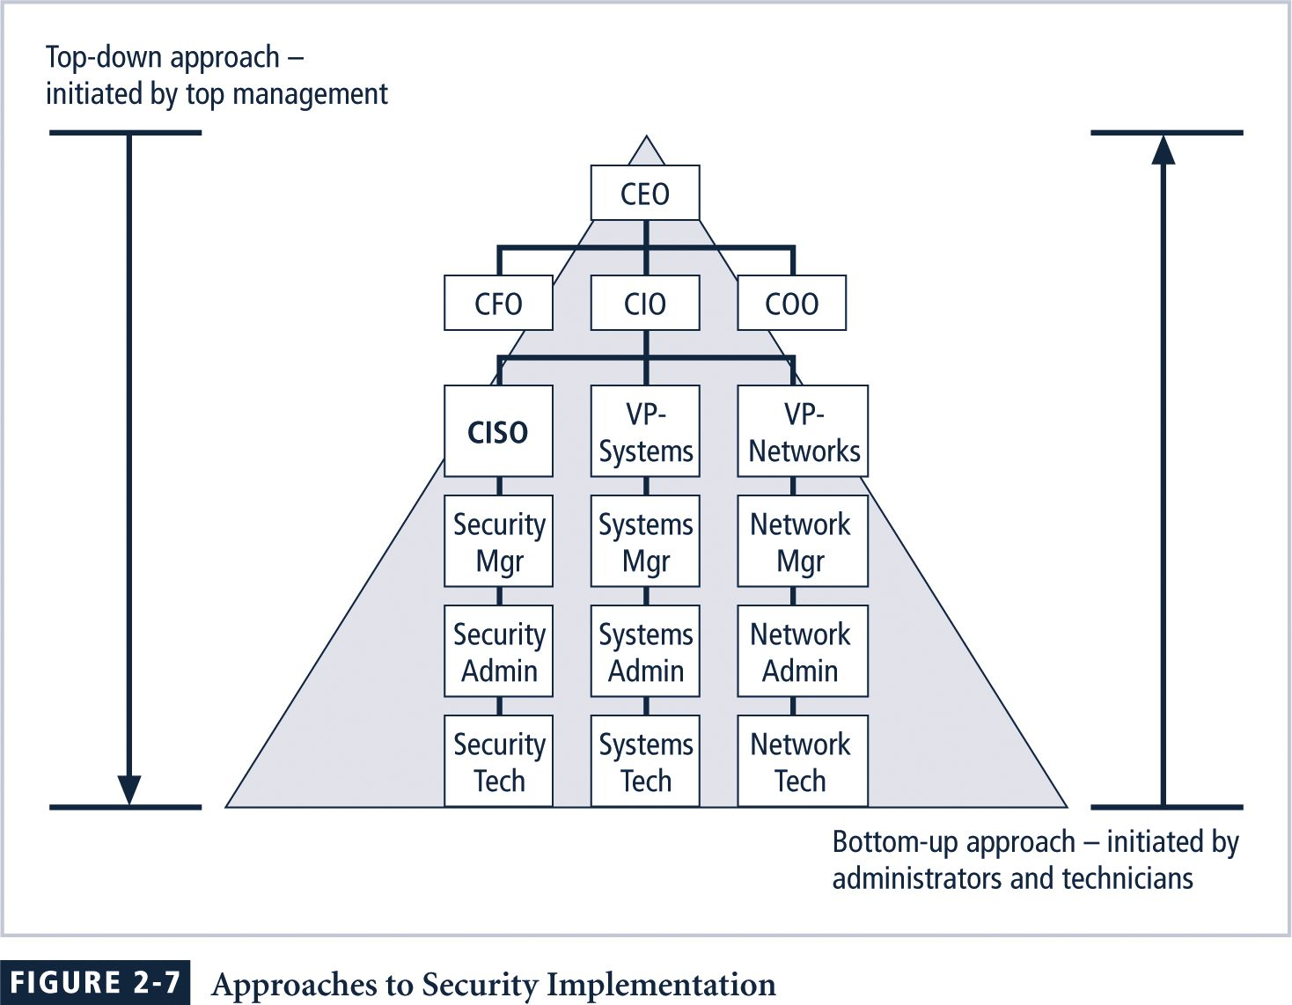
Approaches to Security Implementation
Notes:
Bottom-Up Planning
The bottom-up approach can begin as a grass-roots effort in which systems administrators attempt to improve the security of their systems.
The key advantage to this approach is the technical expertise of the individual administrators, since they work with information systems on a daily basis.
Unfortunately, this approach seldom works, as it lacks a number of critical features, such as coordinated planning from upper management, coordination between departments, and the provision of sufficient resources.
Top-Down Planning
The top-down approach, in contrast, has strong upper management support, a dedicated champion, usually assured funding, a clear planning and implementation process, and the ability to influence organizational culture.
High-level managers provide resources, give direction, issue policies, procedures and processes, dictate the goals and expected outcomes of the project, and determine who is accountable for each of the required actions.
The most successful top-down approach also involves a formal development strategy referred to as the systems development life cycle.
Involvement and support of the end users is also critical to the success of this type of effort.

Slide 24
The Systems Development Life Cycle (SDLC)
SDLC: methodology for the design and implementation of an information system
SDLC-based projects may be initiated by events or planned
At the end of each phase, a review occurs when reviewers determine if the project should be continued, discontinued, outsourced, or postponed

Slide 25
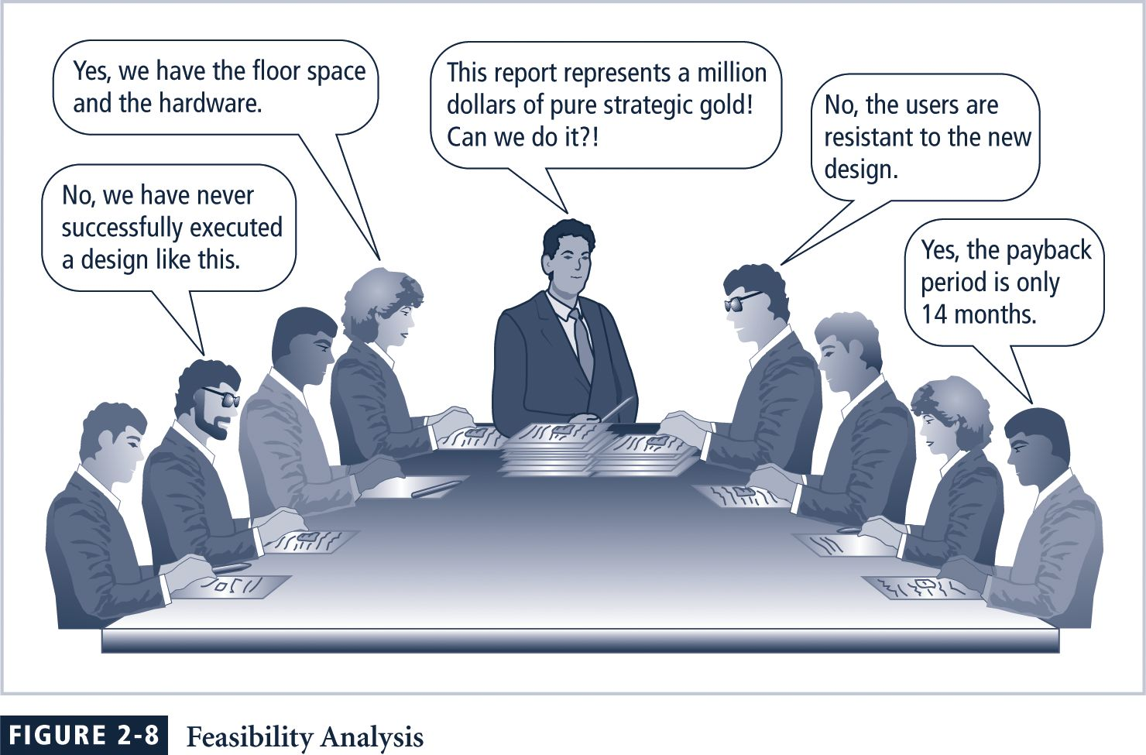
Feasibility

Slide 26
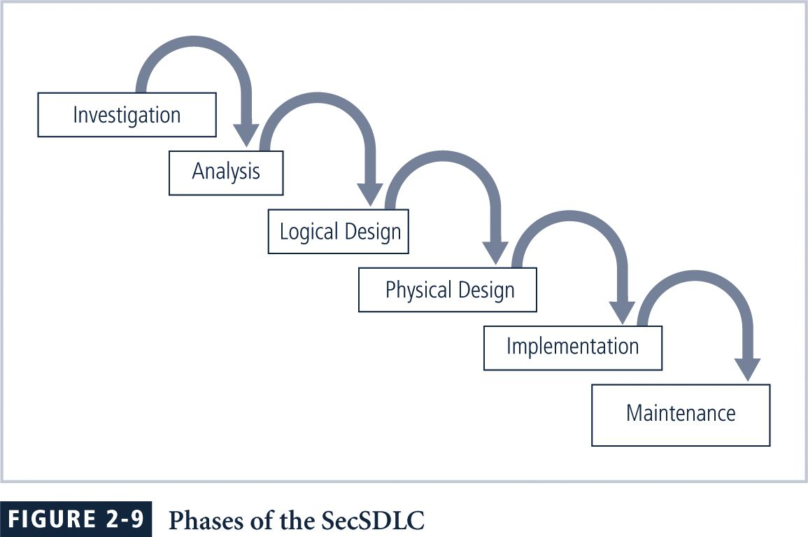
Phases of An SDLC

Slide 27
Investigation
Identifies problem to be solved
Begins with the objectives, constraints, and scope of the project
A preliminary cost/benefit analysis is developed to evaluate the perceived benefits and the appropriate costs for those benefits

Slide 28
Analysis
Begins with information from the Investigation phase
Assesses the organization’s readiness, its current systems status, and its capability to implement and then support the proposed system(s)
Analysts determine what the new system is expected to do, and how it will interact with existing systems

Slide 29
Logical Design
Information obtained from analysis phase is used to create a proposed solution for the problem
A system and/or application is selected based on the business need
The logical design is the implementation independent blueprint for the desired solution

Slide 30
Physical Design
During the physical design phase, the team selects specific technologies
The selected components are evaluated further as a make-or-buy decision
A final design is chosen that optimally integrates required components

Slide 31
Implementation
Develop any software that is not purchased, and create integration capability
Customized elements are tested and documented
Users are trained and supporting documentation is created
Once all components have been tested individually, they are installed and tested as a whole

Slide 32
Maintenance
Tasks necessary to support and modify the system for the remainder of its useful life
System is tested periodically for compliance with specifications
Feasibility of continuance versus discontinuance is evaluated
Upgrades, updates, and patches are managed
When current system can no longer support the mission of the organization, it is terminated and a new systems development project is undertaken

Slide 33
The Security SDLC
May differ in several specifics, but overall methodology is similar to the SDLC
SecSDLC process involves:
Identification of specific threats and the risks that they represent
Subsequent design and implementation of specific controls to counter those threats and assist in the management of the risk those threats pose to the organization

Slide 34
Investigation in the SecSDLC
Often begins as directive from management specifying the process, outcomes, and goals of the project and its budget
Frequently begins with the affirmation or creation of security policies
Teams assembled to analyze problems, define scope, specify goals and identify constraints
Feasibility analysis determines whether the organization has resources and commitment to conduct a successful security analysis and design

Slide 35
Analysis in the SecSDLC
A preliminary analysis of existing security policies or programs is prepared along with known threats and current controls
Includes an analysis of relevant legal issues that could affect the design of the security solution
Risk management begins in this stage

Slide 36
Risk Management
Risk Management: process of identifying, assessing, and evaluating the levels of risk facing the organization
Specifically the threats to the information stored and processed by the organization
To better understand the analysis phase of the SecSDLC, you should know something about the kinds of threats facing organizations
In this context, a threat is an object, person, or other entity that represents a constant danger to an asset

Slide 37
Key Terms
Attack: deliberate act that exploits a vulnerability to achieve the compromise of a controlled system
Accomplished by a threat agent that damages or steals an organization’s information or physical asset
Exploit: technique or mechanism used to compromise a system
Vulnerability: identified weakness of a controlled system in which necessary controls are not present or are no longer effective

Slide 38
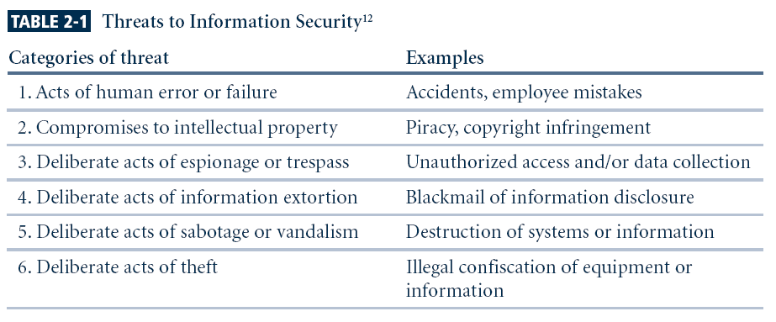
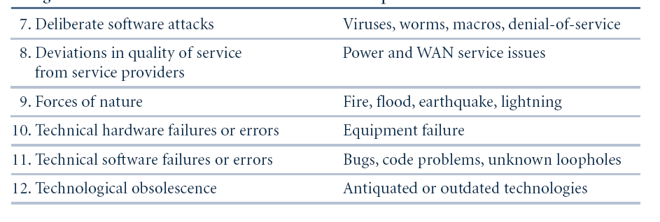
Threats to Information Security

Slide 39
Some Common Attacks
Malicious code
Hoaxes
Back doors
Password crack
Brute force
Dictionary
Denial-of-service (DoS) and distributed denial-of-service (DDoS)
Spoofing
Man-in-the-middle
Spam
Mail bombing
Sniffer
Social engineering
Buffer overflow
Timing

Slide 40
Risk Management
Use some method of prioritizing risk posed by each category of threat and its related methods of attack
To manage risk, you must identify and assess the value of your information assets
Risk assessment assigns comparative risk rating or score to each specific information asset
Risk management identifies vulnerabilities in an organization’s information systems and takes carefully reasoned steps to assure the confidentiality, integrity, and availability of all the components in organization’s information system

Slide 41
Design in the SecSDLC
Design phase actually consists of two distinct phases:
Logical design phase: team members create and develop a blueprint for security, and examine and implement key policies
Physical design phase: team members evaluate the technology needed to support the security blueprint, generate alternative solutions, and agree upon a final design

Slide 42
Security Models
Security managers often use established security models to guide the design process
Security models provide frameworks for ensuring that all areas of security are addressed
Organizations can adapt or adopt a framework to meet their own information security needs

Slide 43
Policy
A critical design element of the information security program is the information security policy
Management must define three types of security policy:
General or security program policy
Issue-specific security policies
Systems-specific security policies

Slide 44
SETA
Another integral part of the InfoSec program is the security education and training program
SETA program consists of three elements: security education, security training, and security awareness
Purpose of SETA is to enhance security by:
Improving awareness
Developing skills and knowledge
Building in-depth knowledge

Slide 45
Design
Attention turns to the design of the controls and safeguards used to protect information from attacks by threats
Three categories of controls:
Managerial
Operational
Technical

Slide 46
Managerial Controls
Address the design and implementation of the security planning process and security program management
Management controls also address:
Risk management
Security control reviews

Slide 47
Operational Controls
Cover management functions and lower level planning including:
Disaster recovery
Incident response planning
Operational controls also address:
Personnel security
Physical security
Protection of production inputs and outputs

Slide 48
Technical Controls
Address those tactical and technical issues related to designing and implementing security in the organization
Technologies necessary to protect information are examined and selected

Slide 49
Contingency Planning
Essential preparedness documents provide contingency planning (CP) to prepare, react and recover from circumstances that threaten the organization:
Incident response planning (IRP)
Disaster recovery planning (DRP)
Business continuity planning (BCP)

Slide 50
Physical Security
Physical Security: addresses the design, implementation, and maintenance of countermeasures that protect the physical resources of an organization
Physical resources include:
People
Hardware
Supporting information system elements

Slide 51
Implementation in the SecSDLC
Security solutions are acquired, tested, implemented, and tested again
Personnel issues are evaluated and specific training and education programs conducted
Perhaps most important element of implementation phase is management of project plan:
Planning the project
Supervising tasks and action steps within the project
Wrapping up the project

Slide 52
InfoSec Project Team
Should consist of individuals experienced in one or multiple technical and non-technical areas including:
Champion
Team leader
Security policy developers
Risk assessment specialists
Security professionals
Systems administrators
End users

Slide 53
Staffing the InfoSec Function
Each organization should examine the options for staffing of the information security function
Decide how to position and name the security function
Plan for proper staffing of information security function
Understand impact of information security across every role in IT
Integrate solid information security concepts into personnel management practices of the organization

Slide 54
InfoSec Professionals
It takes a wide range of professionals to support a diverse information security program:
Chief Information Officer (CIO)
Chief Information Security Officer (CISO)
Security Managers
Security Technicians
Data Owners
Data Custodians
Data Users

Slide 55
Certifications
Many organizations seek professional certification so that they can more easily identify the proficiency of job applicants:
CISSP
SSCP
GIAC
SCP
ICSA
Security +
CISM

Slide 56
Maintenance and Change in the SecSDLC
Once information security program is implemented, it must be operated, properly managed, and kept up to date by means of established procedures
If the program is not adjusting adequately to the changes in the internal or external environment, it may be necessary to begin the cycle again

Slide 57
Maintenance Model
While a systems management model is designed to manage and operate systems, a maintenance model is intended to focus organizational effort on system maintenance:
External monitoring
Internal monitoring
Planning and risk assessment
Vulnerability assessment and remediation
Readiness and review
Vulnerability assessment

Slide 58
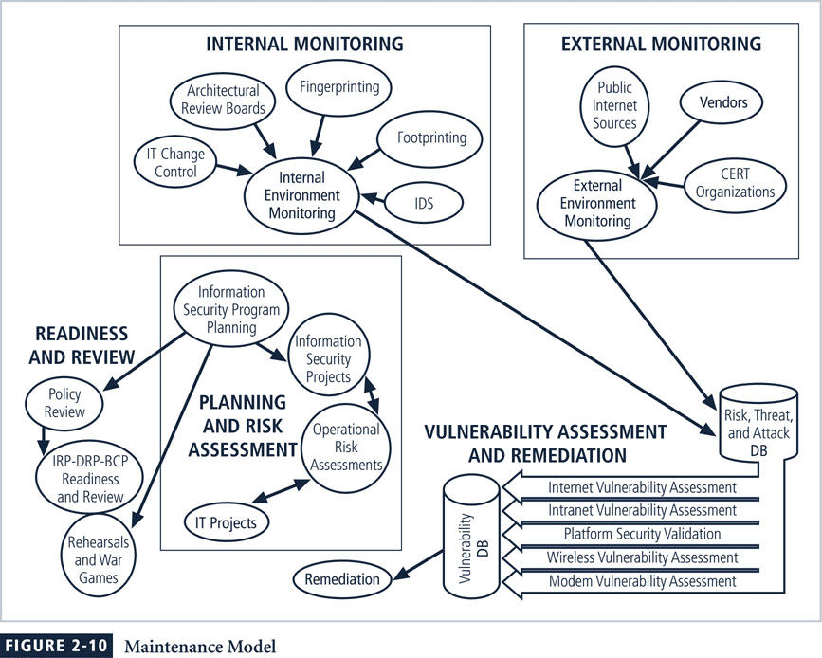

Slide 59
ISO Management Model
One issue planned in the SecSDLC is the systems management model
ISO management model contains five areas:
Fault management
Configuration and name management
Accounting management
Performance management
Security management

Slide 60
Security Management Model
Fault Management involves identifying and addressing faults
Configuration and Change Management involve administration of components involved in the security program and administration of changes
Accounting and Auditing Management involves chargeback accounting and systems monitoring
Performance Management determines if security systems are effectively doing the job for which they were implemented

Slide 61
Security Program Management
Once an information security program is functional, it must be operated and managed
In order to assist in the actual management of information security programs, a formal management standard can provide some insight into the processes and procedures needed
This could be based on the BS7799/ISO17799 model or the NIST models described earlier

