Slide 1
CIS 5600 Information Security Management
Dr. Jeremy Lanman, Adjunct Professor
jlanman@fit.edu
Office: Virtual
Office Hours: By arrangement

Slide 2
Contingency Planning
Things which you do not hope happen more frequently than things which you do hope.
-- PLAUTUS. (C. 254–184 B.C.), MOSTELLARIA, ACT I, SCENE 3, 40 (197)

Slide 3
Introduction
Planning for the unexpected event, when the use of technology is disrupted and business operations come close to a standstill
Procedures are required that will permit the organization to continue essential functions if information technology support is interrupted
Over 40% of businesses that don't have a disaster plan go out of business after a major loss

Slide 4
What Is Contingency Planning?
The overall planning for unexpected events is called contingency planning (CP)
It is how organizational planners position their organizations to prepare for, detect, react to, and recover from events that threaten the security of information resources and assets
Main goal: restoration to normal modes of operation with minimum cost and disruption to normal business activities after an unexpected event

Slide 5
CP Components
Incident response planning (IRP) focuses on immediate response
Disaster recovery planning (DRP) focuses on restoring operations at the primary site after disasters occur
Business continuity planning (BCP) facilitates establishment of operations at an alternate site

Slide 6
CP Components (Continued)
To ensure continuity across all CP processes during planning process, contingency planners should:
Identify the mission- or business-critical functions
Identify resources that support critical functions
Anticipate potential contingencies or disasters
Select contingency planning strategies
Implement selected strategy
Test and revise contingency plans

Slide 7
CP Operations
Four teams are involved in contingency planning and contingency operations:
CP team
Incident recovery (IR) team
Disaster recovery (DR) team
Business continuity plan (BC) team

Slide 8
Contingency Planning
NIST describes the need for this type of planning as
“These procedures (contingency plans, business interruption plans, and continuity of operations plans) should be coordinated with the backup, contingency, and recovery plans of any general support systems, including networks used by the application. The contingency plans should ensure that interfacing systems are identified and contingency/disaster planning coordinated.”

Slide 9
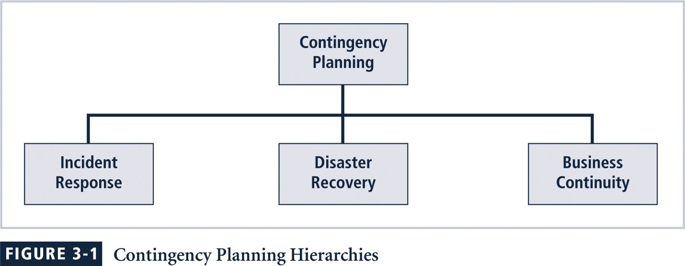
Contingency Planning

Slide 10
Incident Response Plan
IRP:
Detailed set of processes and procedures that anticipate, detect, and mitigate the impact of an unexpected event that might compromise information resources and assets
Incident response (IR):
Set of procedures that commence when an incident is detected

Slide 11
Incident Response Plan (Continued)
When a threat becomes a valid attack, it is classified as an information security incident if:
It is directed against information assets
It has a realistic chance of success
It threatens the confidentiality, integrity, or availability of information assets
It is important to understand that IR is a reactive measure, not a preventive one

Slide 12
During the Incident
Planners develop and document the procedures that must be performed during the incident
These procedures are grouped and assigned to various roles
Planning committee drafts a set of function-specific procedures

Slide 13
After the Incident
Once the procedures for handling an incident are drafted, planners develop and document the procedures that must be performed immediately after the incident has ceased
Separate functional areas may develop different procedures

Slide 14
Before the Incident
Planners draft a third set of procedures, those tasks that must be performed in advance of the incident
Include:
Details of data backup schedules
Disaster recovery preparation
Training schedules
Testing plans
Copies of service agreements
Business continuity plans

Slide 15
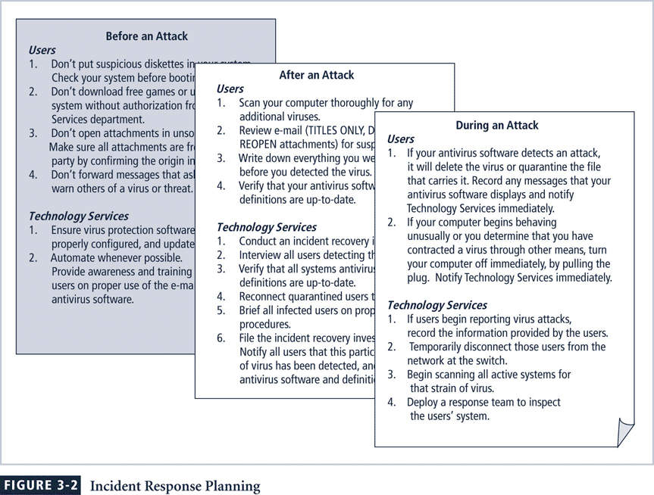

Slide 16
Preparing to Plan
Planning requires detailed understanding of information systems and threats they face
IR planning team seeks to develop pre-defined responses that guide users through steps needed to respond to an incident
Pre-defining incident responses enables rapid reaction without confusion or wasted time and effort

Slide 17
Preparing to Plan (Continued)
IR team consists of professionals capable of handling information systems and functional areas affected by an incident
Each member of the IR team must:
Know his or her specific role
Work in concert with each other
Execute the objectives of the IRP

Slide 18
Incident Detection
Challenge is determining whether an event is routine system use or an actual incident
Incident classification: process of examining a possible incident and determining whether or not it constitutes actual incident
Initial reports from end users, intrusion detection systems, host- and network-based virus detection software, and systems administrators are all ways to track and detect incident candidates
Careful training allows everyone to relay vital information to the IR team

Slide 19
Incident Indicators
Probable Indicators
Presence of unfamiliar files
Presence or execution of unknown programs or processes
Unusual consumption of computing resources
Unusual system crashes
Probable Indicators
Activities at unexpected times
Presence of new accounts
Reported attacks
Notification from IDS
Definite Indicators
Use of dormant accounts
Changes to logs
Presence of hacker tools
Notifications by partner or peer
Notification by hacker

Slide 20
Occurrences of Actual Incidents
Loss of availability
Loss of integrity
Loss of confidentiality
Violation of policy
Violation of law

Slide 21
Incident Response
Once an actual incident has been confirmed and properly classified, the IR team moves from detection phase to reaction phase
In the incident response phase, a number of action steps taken by the IR team and others must occur quickly and may occur concurrently
These steps include notification of key personnel, the assignment of tasks, and documentation of the incident

Slide 22
Notification of Key Personnel
As soon as incident is declared, the right people must be immediately notified in the right order
Alert roster: document containing contact information of individuals to be notified in the event of actual incident either sequentially or hierarchically
Alert message: scripted description of incident
Other key personnel: must also be notified only after incident has been confirmed, but before media or other external sources learn of it

Slide 23
Documenting an Incident
As soon as an incident has been confirmed and the notification process is underway, the team should begin documentation
Should record the who, what, when, where, why and how of each action taken while the incident is occurring
Serves as a case study after the fact to determine if right actions were taken and if they were effective
Can also prove the organization did everything possible to deter the spread of the incident

Slide 24
Incident Containment Strategies
Essential task of IR is to stop the incident or contain its impact
Incident containment strategies focus on two tasks:
Stopping the incident
Recovering control of the systems

Slide 25
Incident Containment Strategies
IR team can stop the incident and attempt to recover control by means of several strategies:
Disconnect affected communication circuits
Dynamically apply filtering rules to limit certain types of network access
Disable compromised user accounts
Reconfigure firewalls to block problem traffic
Temporarily disable compromised process or service
Take down conduit application or server
Stop all computers and network devices

Slide 26
Incident Escalation
An incident may increase in scope or severity to the point that the IRP cannot adequately contain the incident
Each organization will have to determine, during the business impact analysis, the point at which the incident becomes a disaster
The organization must also document when to involve outside response

Slide 27
Initiating Incident Recovery
Once the incident has been contained, and system control regained, incident recovery can begin
IR team must assess full extent of damage in order to determine what must be done to restore systems
Immediate determination of the scope of the breach of confidentiality, integrity, and availability of information and information assets is called incident damage assessment
Those who document the damage must be trained to collect and preserve evidence, in case the incident is part of a crime or results in a civil action

Slide 28
Recovery Process
Once the extent of the damage has been determined, the recovery process begins:
Identify and resolve vulnerabilities that allowed incident to occur and spread
Address, install, and replace/upgrade safeguards that failed to stop or limit the incident, or were missing from system in the first place
Evaluate monitoring capabilities (if present) to improve detection and reporting methods, or install new monitoring capabilities

Slide 29
Recovery Process (Continued)
Restore data from backups as needed
Restore services and processes in use where compromised (and interrupted) services and processes must be examined, cleaned, and then restored
Continuously monitor system
Restore the confidence of the members of the organization’s communities of interest

Slide 30
After Action Review
Before returning to routine duties, the IR team must conduct an after-action review, or AAR
AAR: detailed examination of events that occurred
All team members:
Review their actions during the incident
Identify areas where the IR plan worked, didn’t work, or should improve

Slide 31
Law Enforcement Involvement
When incident violates civil or criminal law, it is organization’s responsibility to notify proper authorities
Selecting appropriate law enforcement agency depends on the type of crime committed: Federal, State, or Local
Involving law enforcement has both advantages and disadvantages:
Usually much better equipped at processing evidence, obtaining statements from witnesses, and building legal cases
However, involvement can result in loss of control of chain of events following an incident

Slide 32
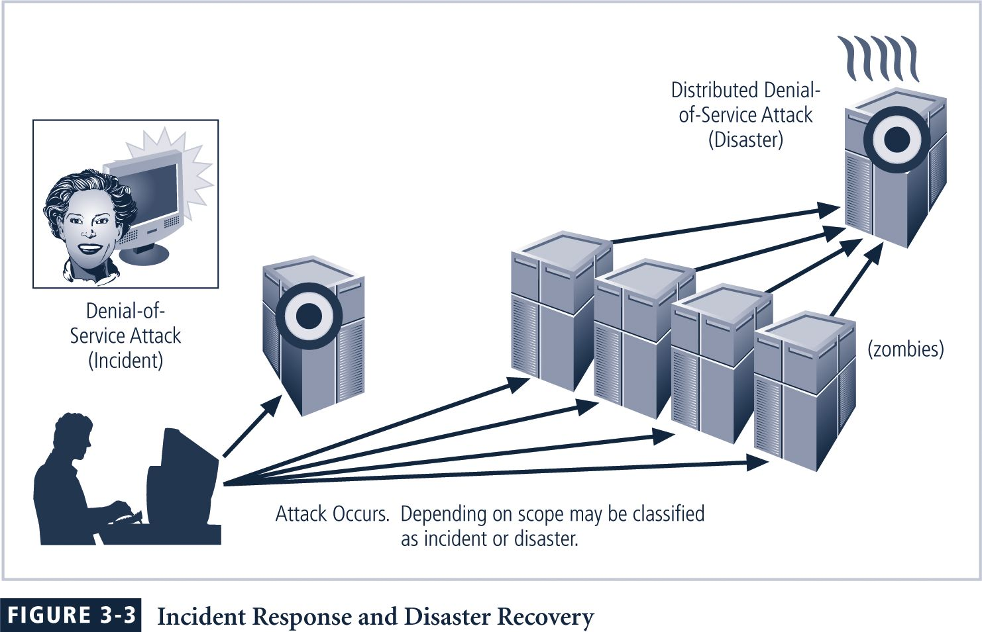
Incident Response and Disaster Recovery

Slide 33
Disaster Recovery
preparation for and recovery from a disaster, whether natural or man made
In general, an incident is a disaster when:
organization is unable to contain or control the impact of an incident
OR
level of damage or destruction from incident is so severe, the organization is unable to quickly recover
Key role of DRP: defining how to reestablish operations at location where organization is usually located

Slide 34
Disaster Classifications
A DRP can classify disasters in a number of ways
Most common method: separate natural disasters from man-made disasters
Another way: by speed of development
Rapid onset disasters
Slow onset disasters

Slide 35
Planning for Disaster
Scenario development and impact analysis are used to categorize the level of threat of each potential disaster
DRP must be tested regularly
Key points in the DRP:
Clear delegation of roles and responsibilities
Execution of alert roster and notification of key personnel
Clear establishment of priorities
Documentation of the disaster
Action steps to mitigate the impact
Alternative implementations for various systems components

Slide 36
Crisis Management
et of focused steps taken during and after a disaster that deal primarily with people involved
Crisis management team manages event:
Supporting personnel and their loved ones during crisis
Determining event's impact on normal business operations
When necessary, making a disaster declaration
Keeping public informed about event
Communicating with outside parties
Two key tasks of crisis management team:
Verifying personnel status
Activating alert roster

Slide 37
Responding to the Disaster
Actual events often outstrip even best of plans
To be prepared, DRP should be flexible
If physical facilities are intact, begin restoration there
If organization’s facilities are unusable, take alternative actions
When disaster threatens organization at the primary site, DRP becomes BCP

Slide 38
Business Continuity Planning (BCP)
Ensures critical business functions can continue in a disaster
Most properly managed by CEO of organization
Activated and executed concurrently with the DRP when needed
Reestablishes critical functions at alternate site (DRP focuses on reestablishment at primary site)
Relies on identification of critical business functions and the resources to support them

Slide 39
Continuity Strategies
Several continuity strategies for business continuity
Determining factor is usually cost
Three exclusive-use options:
Hot sites
Warm sites
Cold sites
Three shared-use options:
Timeshare
Service bureaus
Mutual agreements

Slide 40
Exclusive Use Options
Hot Sites
Fully configured computer facility with all services
Warm Sites
Like hot site, but software applications not kept fully prepared
Cold Sites
Only rudimentary services and facilities kept in readiness

Slide 41
Shared Use Options
Timeshares
Like an exclusive use site but leased
Service Bureaus
Agency that provides physical facilities
Mutual Agreements
Contract between two organizations to assist
Specialized alternatives:
Rolling mobile site
Externally stored resources

Slide 42
Off-Site Disaster Data Storage
To get any BCP site running quickly, organization must be able to recover data
Options include:
Electronic vaulting: bulk batch-transfer of data to an off-site facility
Remote Journaling: transfer of live transactions to an off-site facility
Database shadowing: storage of duplicate online transaction data

Slide 43
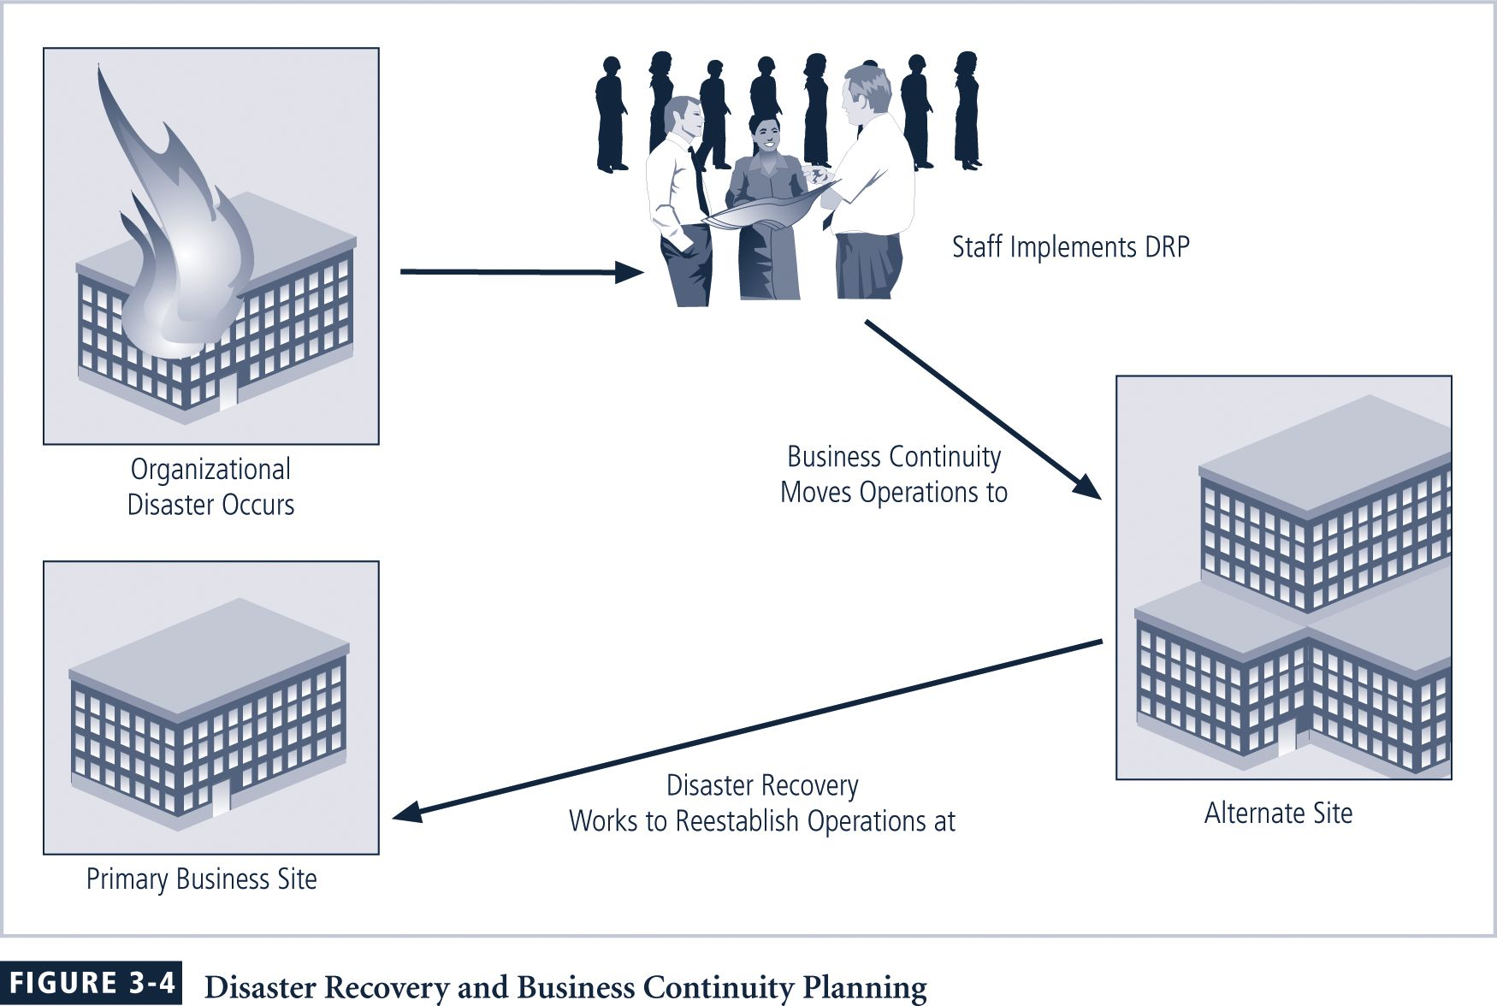
Disaster Recovery and Business Continuity Planning

Slide 44
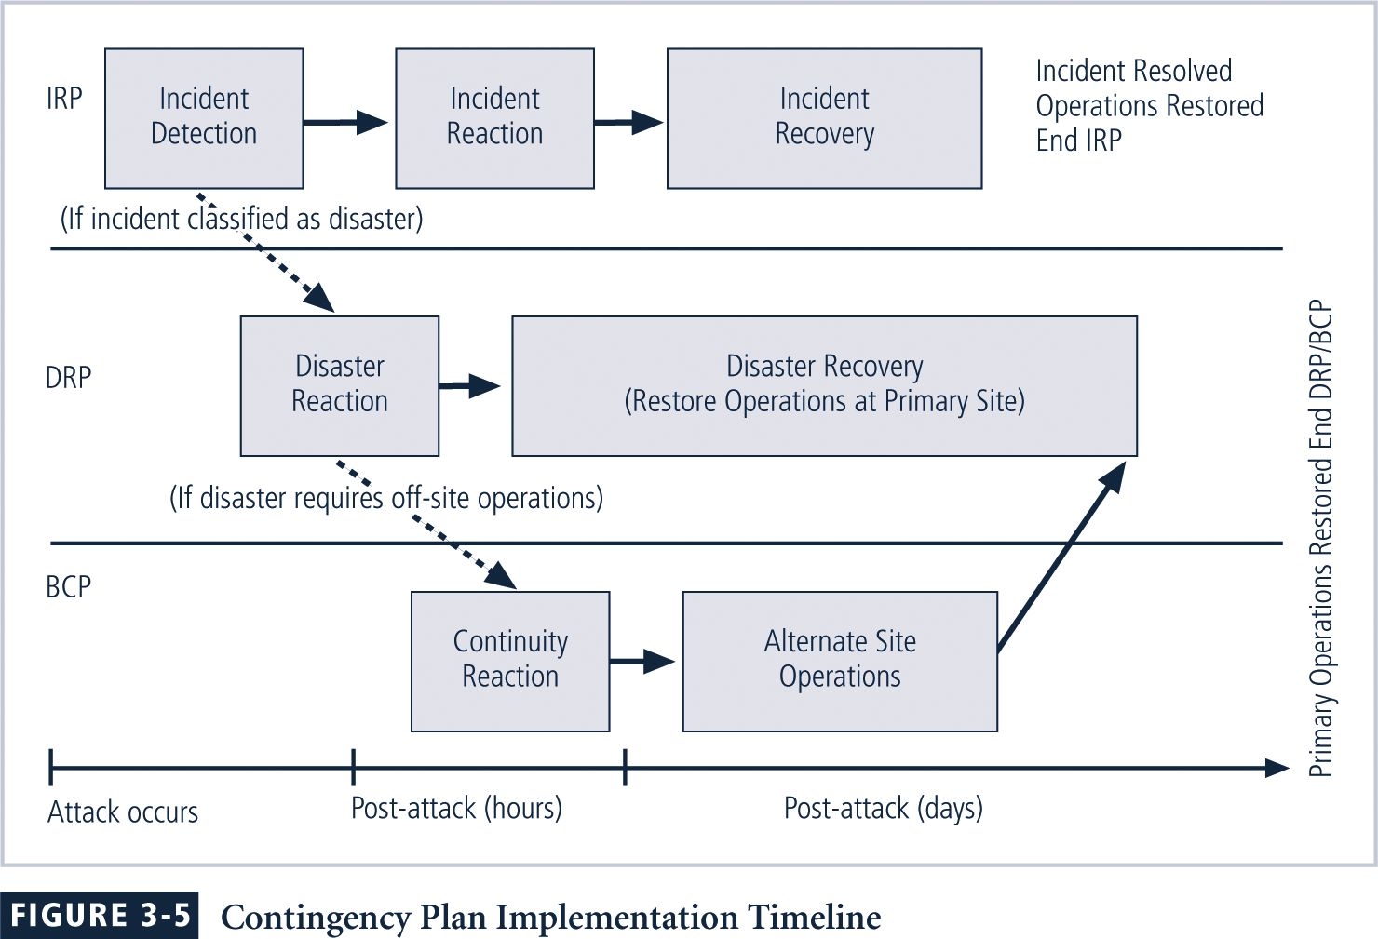
Contingency Plan Implementation Timeline

Slide 45
Putting a Contingency Plan Together
The CP team should include:
Champion
Project Manager
Team Members
Business managers
Information technology managers
Information security managers

Slide 46
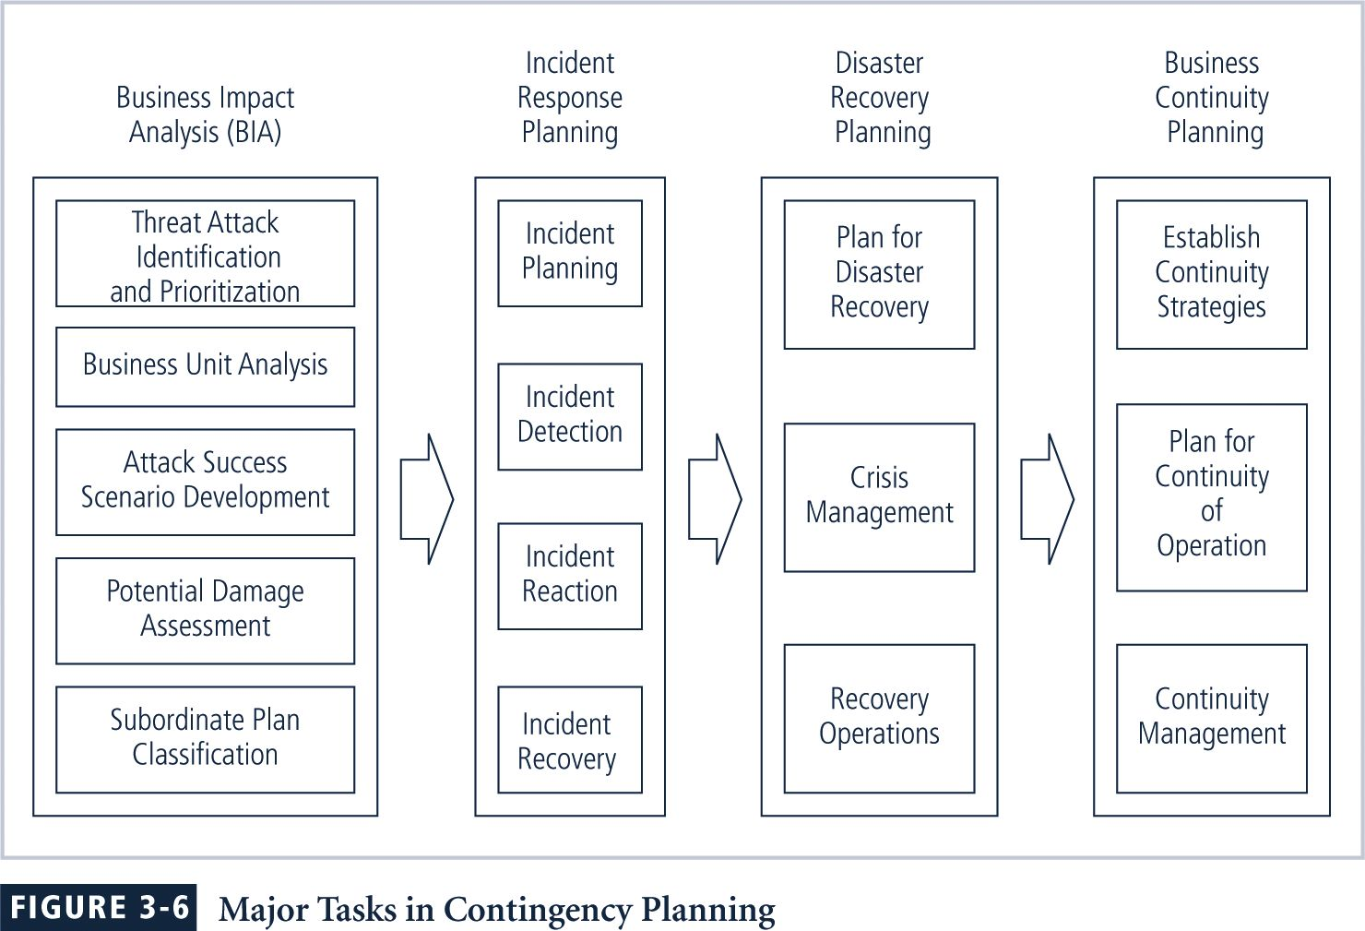
Major Tasks in Contingency Planning

Slide 47
Business Impact Analysis (BIA)
BIA
Provides information about systems/threats and detailed scenarios for each potential attack
Not risk management focusing on identifying threats, vulnerabilities, and attacks to determine controls
Assumes controls have been bypassed or are ineffective and attack was successful
CP team conducts BIA in the following stages:
Threat attack identification
Business unit analysis
Attack success scenarios
Potential damage assessment
Subordinate plan classification

Slide 48
Threat/Attack Identification and Prioritization
An organization that uses risk management process will have identified and prioritized threats
These organizations update threat list and add one additional piece of information -- the attack profile
Attack profile: detailed description of activities that occur during an attack

Slide 49
Business Unit Analysis
Second major BIA task is analysis and prioritization of business functions within the organization
Notes:
Business Unit Analysis
The second major BIA task is the analysis and prioritization of business functions within the organization.

Slide 50
Attack Success Scenario Development
Next create a series of scenarios depicting impact of successful attack on each functional area
Attack profiles should include scenarios depicting typical attack including:
Methodology
Indicators
broad consequences
More details are added including alternate outcomes—best, worst, and most likely

Slide 51
Potential Damage Assessment
From detailed scenarios, the BIA planning team must estimate the cost of the best, worst, and most likely outcomes by preparing an attack scenario end case
This will allow identification of what must be done to recover from each possible case

Slide 52
Subordinate Plan Classification
From existing plans, a related plan must be developed or identified from among existing plans already in place
Each attack scenario case is categorized as disastrous or not
Attack cases that are disastrous find members of the organization waiting out the attack and planning to recover after it is over

Slide 53
Combining the DRP and the BCP
Because DRP and BCP are closely related, most organizations prepare them concurrently and may combine them into a single document
Such a comprehensive plan must be able to support reestablishment of operations at two different locations
Immediately at alternate site
Eventually back at primary site
Therefore, although a single planning team can develop combined DRP/BRP, execution requires separate teams

Slide 54
Sample Disaster Recovery Plan
Name of agency
Date of completion or update of the plan and test date
Agency staff to be called in the event of a disaster
Emergency services to be called (if needed) in event of a disaster
Locations of in-house emergency equipment and supplies
Sources of off-site equipment and supplies
Salvage Priority List
Agency Disaster Recovery Procedures
Follow-up Assessment

Slide 55
Testing Contingency Plans
Once problems are identified during the testing process, improvements can be made, and the resulting plan can be relied on in times of need
There are five testing strategies that can be used to test contingency plans:
Desk Check
Structured walkthrough
Simulation
Parallel testing
Full interruption

Slide 56
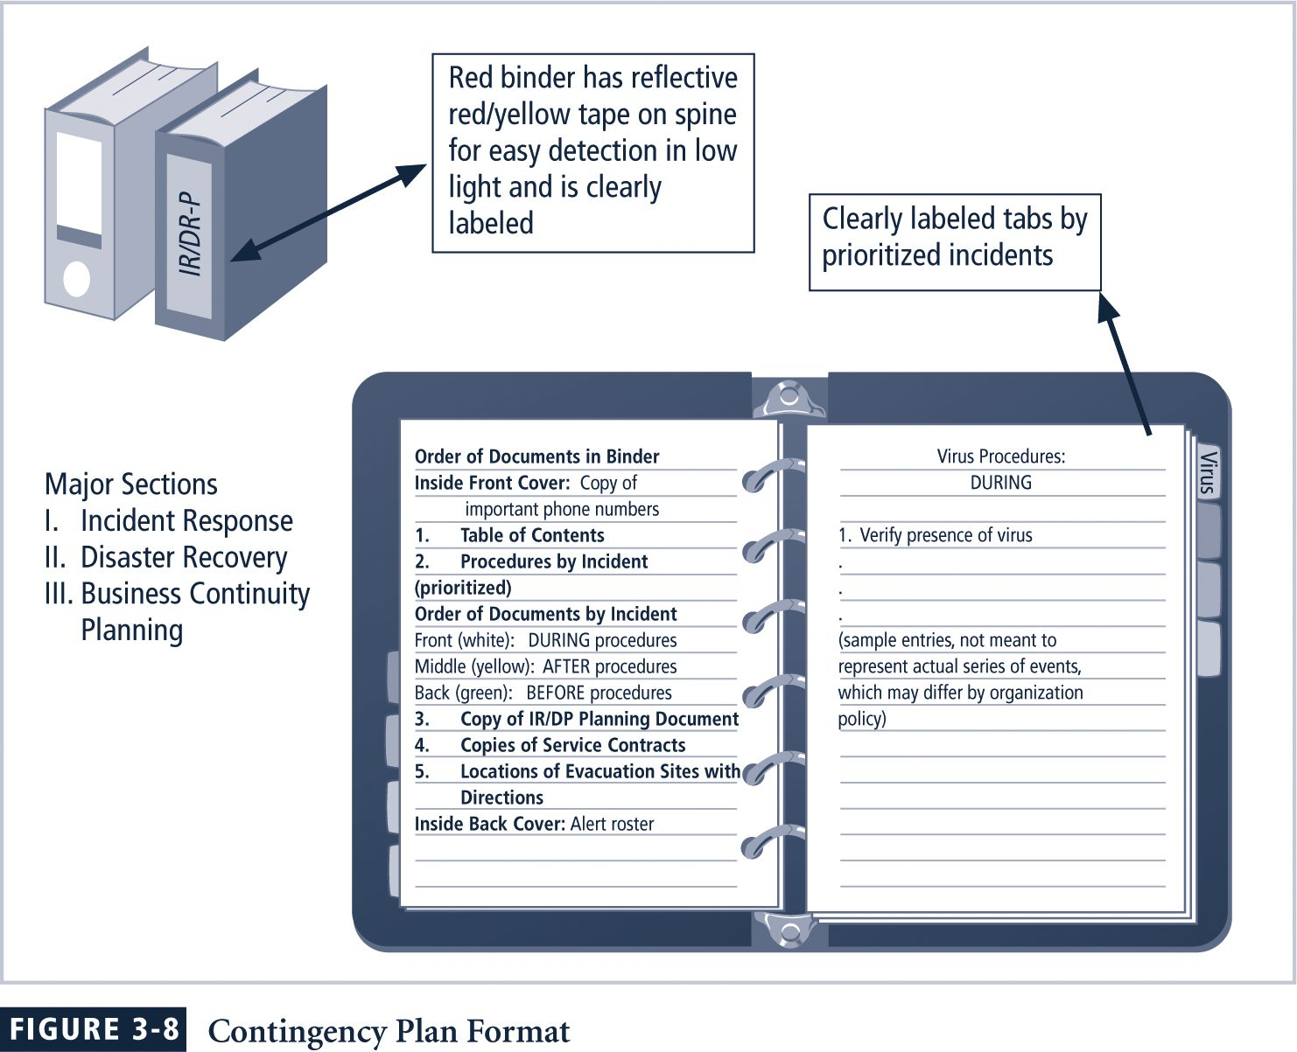
A Single Contingency Plan Format

