Slide 1
CIS 5600 Information Security Management
Dr. Jeremy Lanman, Adjunct Professor
jlanman@fit.edu
Office: Virtual
Office Hours: By arrangement

Slide 2
Risk Management: Identifying and Assessing Risk

Slide 3
Introduction
Information security departments are created primarily to manage IT risk
Managing risk is one of the key responsibilities of every manager within the organization
In any well-developed risk management program, two formal processes are at work:
Risk identification and assessment
Risk control

Slide 4
Knowing Our Environment
Identify, Examine and Understand
information and how it is processed, stored, and transmitted
Initiate an in-depth risk management program
Risk management is a process
means - safeguards and controls that are devised and implemented are not install-and-forget devices

Slide 5
Knowing the Enemy
Identify, examine, and understand
the threats
Managers must be prepared
to fully identify those threats that pose risks to the organization and the security of its information assets
Risk management is the process
of assessing the risks to an organization’s information and determining how those risks can be controlled or mitigated

Slide 6
Risk Management
The process concerned with identification, measurement, control and minimization of security risks in information systems to a level commensurate with the value of the assets protected (NIST)
Identify
the
Risk Areas
Re-evaluate
the Risks
Assess the
Risks
Risk Management
Cycle
Implement Risk
Management
Actions
Risk Assessment
Develop Risk
Management
Plan
Risk Control (Mitigation)

Slide 7
Accountability for Risk Management
All communities of interest must work together:
Evaluating risk controls
Determining which control options are cost-effective
Acquiring or installing appropriate controls
Overseeing processes to ensure that controls remain effective
Identifying risks
Assessing risks
Summarizing findings

Slide 8
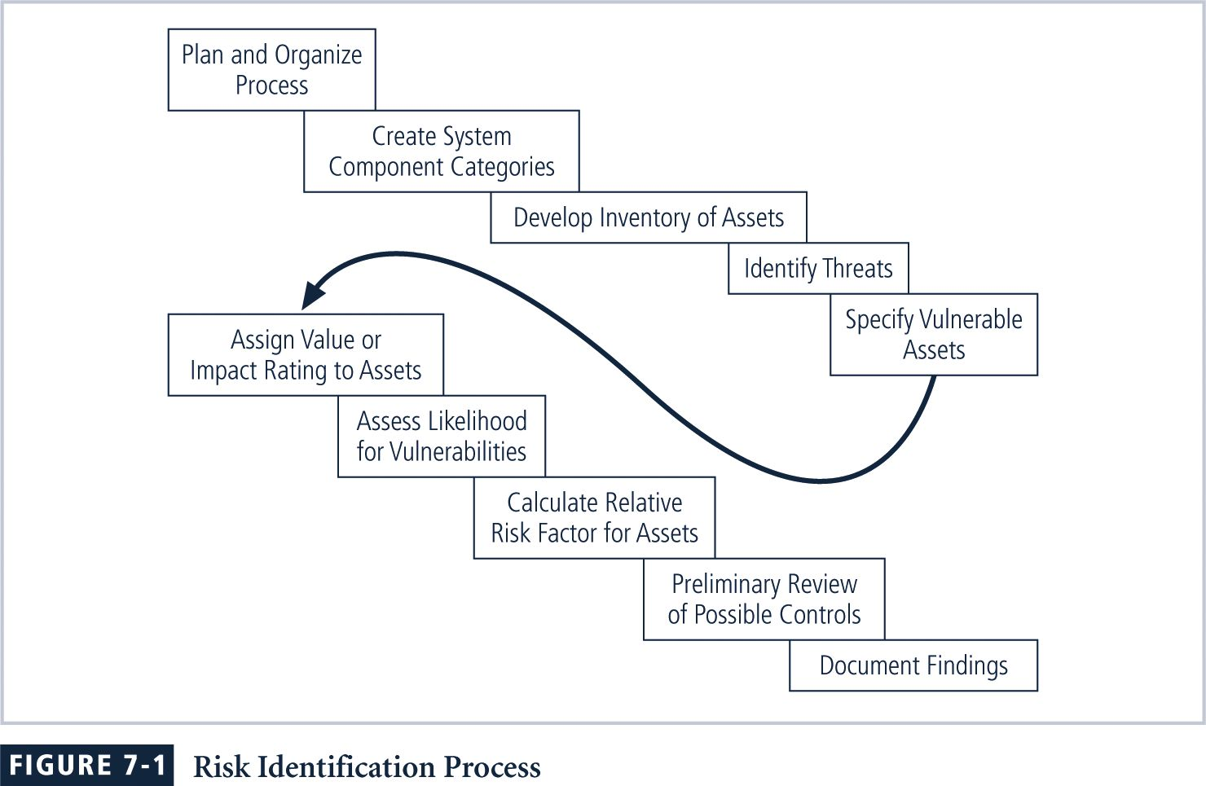
Risk Identification Process

Slide 9
Risk Identification
Risk identification
begins with the process of self-examination
Managers
identify the organization’s information assets,
classify them into useful groups, and
prioritize them by their overall importance

Slide 10
Creating an Inventory of Information Assets
Identify information assets, including
people, procedures, data and information, software, hardware, and networking elements
Should be done without pre-judging value of each asset
Values will be assigned later in the process

Slide 11
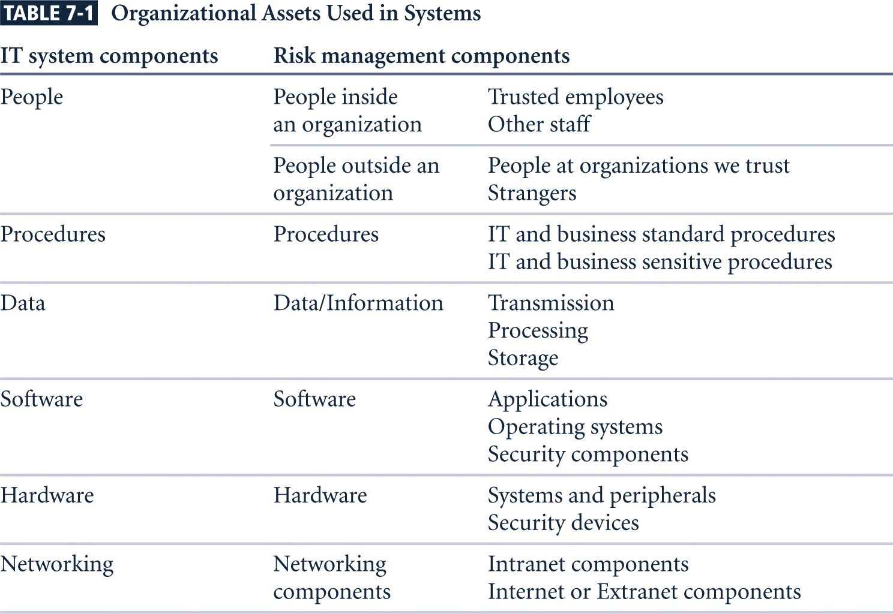
Organizational Assets

Slide 12
Identifying Hardware, Software, and Network Assets
Inventory process requires a certain amount of planning
Determine which attributes of each of these information assets should be tracked
Will depend on the needs of the organization and
its risk management efforts

Slide 13
Attributes for Assets
Potential attributes:
Name
IP address
MAC address
Asset type
Manufacturer name
Manufacturer’s model or part number
Software version, update revision,
Physical location
Logical location
Controlling entity
Notes:
Attributes for Hardware Assets
When deciding which attributes to track for each information asset, consider the following list of potential attributes:
Name:
IP address:
MAC address:
Asset type:
DeviceClass = S (server)
DeviceOS = W2K (Windows 2000)
DeviceCapacity = AS (Advanced Server)
Serial number
Manufacturer name:
Manufacturer’s model or part number:
Software version, update revision, or FCO number:
Physical location:
Logical location:
Controlling entity:

Slide 14
Identifying People, Procedures, and Data Assets
Whose Responsibility ?
managers who possess the necessary knowledge, experience, and judgment
Recording
use reliable data-handling process

Slide 15
Suggested Attributes
People
Position name/number/ID
Supervisor name/number/ID
Security clearance level
Special skills
Procedures
Description
Intended purpose
Software/hardware/networking elements to which it is tied
Location where it is stored for reference
Location where it is stored for update purposes
Notes:
Attributes for People, Procedures, and Data Assets
People
Position name/number/ID
Supervisor name/number/ID
Security clearance level
Special skills
Procedures
Description
Intended purpose
Software/hardware/networking elements to which it is tied
Location where it is stored for reference
Location where it is stored for update purposes
Data
Classification
Owner/creator/manager
Size of data structure
Data structure used
Online or offline
Location
Backup procedures

Slide 16
Suggested Attributes
Data
Classification
Owner/creator/manager
Size of data structure
Data structure used
Online or offline
Location
Backup procedures

Slide 17
Classifying and Categorizing Assets
Determine whether its asset categories are meaningful
After initial inventory is assembled,
Inventory should also reflect sensitivity and security priority assigned to each asset
A classification scheme categorizes these information assets based on their sensitivity and security needs

Slide 18
Classifying and Categorizing Assets (Continued)
Categories
designates level of protection needed for a particular information asset
Classification categories must be comprehensive and mutually exclusive
Some asset types, such as personnel,
may require an alternative classification scheme that would identify the clearance needed to use the asset type

Slide 19
Assessing Values for Information Assets
Assign a relative value
to ensure that the most valuable information assets are given the highest priority, for example:
Which is the most critical to the success of the organization?
Which generates the most revenue?
Which generates the highest profitability?
Which is the most expensive to replace?
Which is the most expensive to protect?
Whose loss or compromise would be the most embarrassing or cause the greatest liability?
Final step in the RI process is to list the assets in order of importance
Can use a weighted factor analysis worksheet
Notes:
Assessing Values for Information Assets
As each information asset is identified, categorized, and classified, a relative value must also be assigned to it.
Relative values are comparative judgments made to ensure that the most valuable information assets are given the highest priority when managing risk.
Which information asset is the most critical to the success of the organization?
Which information asset generates the most revenue?
Which information asset generates the highest profitability?
Which information asset is the most expensive to replace?
Which information asset is the most expensive to protect?
Which information asset’s loss or compromise would be the most embarrassing or cause the greatest liability?

Slide 20
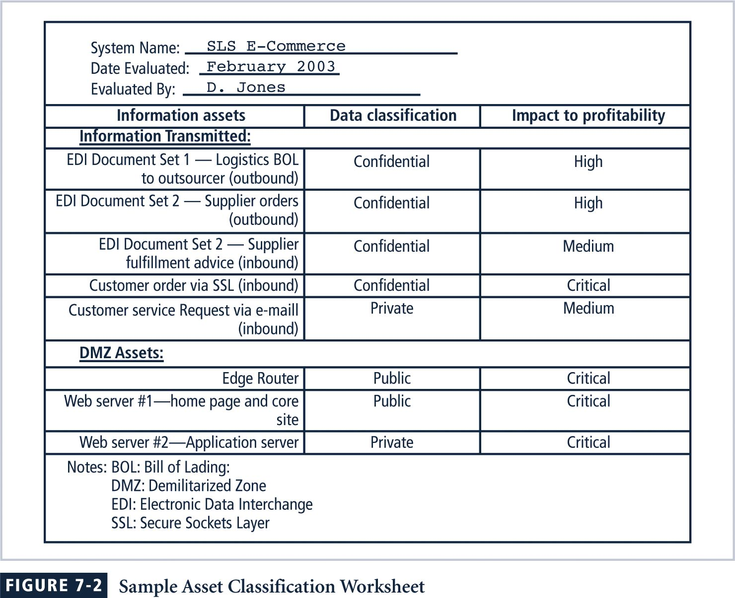
Sample Asset Classification Worksheet

Slide 21
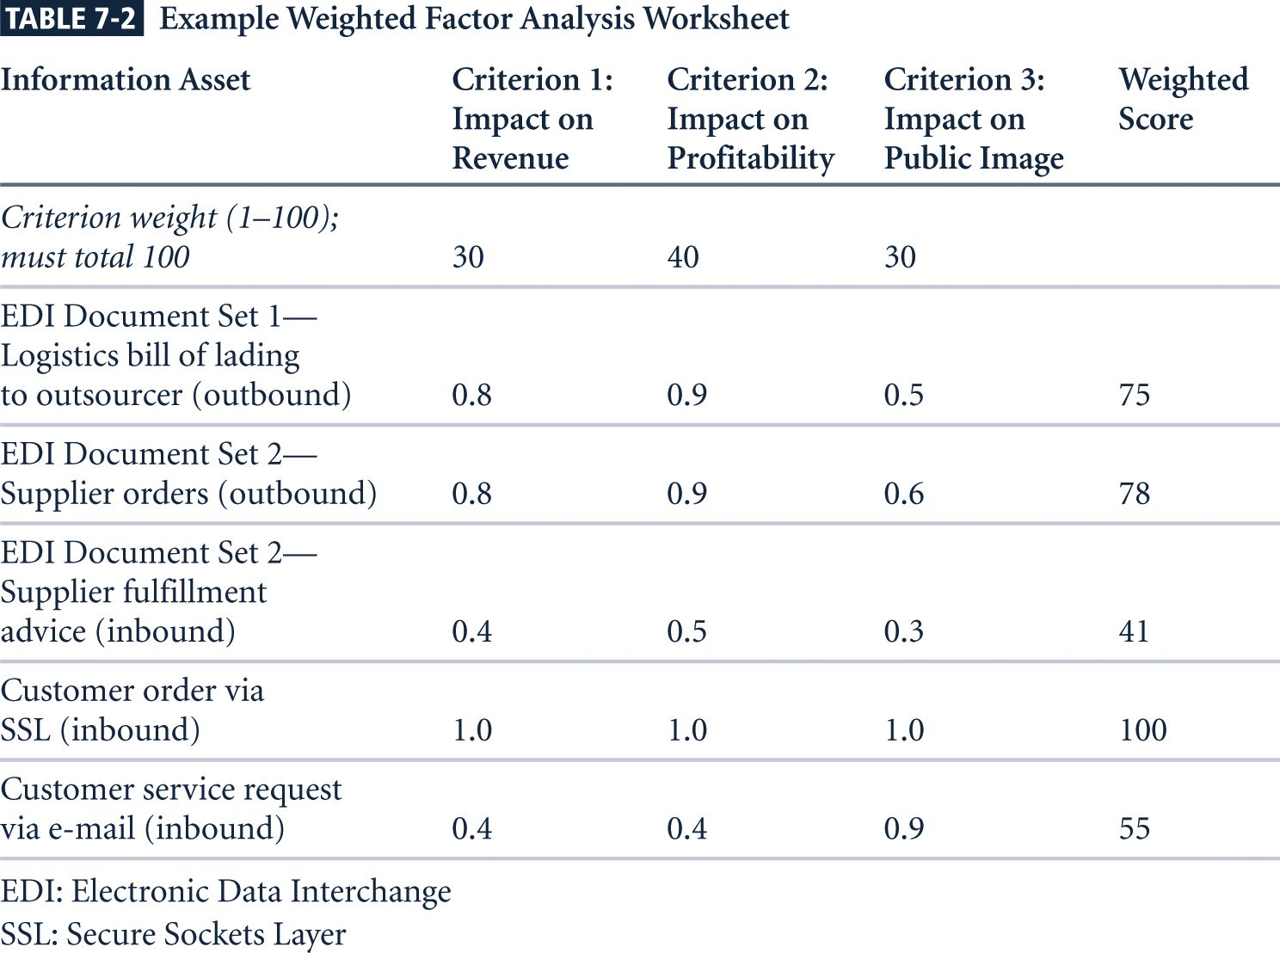
Weighted Factor Analysis Worksheet (NIST SP 800-30)

Slide 22
Data Classification Model
Data owners must classify information assets for which they are responsible and review the classifications periodically
Example:
Public
For official use only
Sensitive
Classified

Slide 23
Data Classification Model
U.S. military classification scheme
more complex categorization system than the schemes of most corporations
Uses a five-level classification scheme as defined in Executive Order 12958:
Unclassified Data
Sensitive But Unclassified (SBU) Data
Confidential Data
Secret Data
Top Secret Data

Slide 24
Security Clearances
Personnel Security Clearance Structure:
Complement to data classification scheme
Each user of information asset is assigned an authorization level that indicates level of information classification he or she can access
Most organizations have developed a set of roles and corresponding security clearances
Individuals are assigned into groups that correlate with classifications of the information assets they need for their work

Slide 25
Security Clearances (Continued)
Need-to-know principle:
Regardless of one’s security clearance, an individual is not allowed to view data simply because it falls within that individual’s level of clearance
Before he or she is allowed access to a specific set of data, that person must also need-to-know the data as well

Slide 26
Management of Classified Information Assets
Managing an information asset includes
considering the storage, distribution, portability, and destruction of that information asset
Information asset that has a classification designation other than unclassified or public:
Must be clearly marked as such
Must be available only to authorized individuals

Slide 27
Management of Classified Information Assets
Clean Desk policy
To maintain confidentiality of classified documents, managers can implement a clean desk policy
Destruction of sensitive material
When copies of classified information are no longer valuable or too many copies exist, care should be taken to destroy them properly to discourage dumpster diving

Slide 28
Threat Identification
Any organization typically faces a wide variety of threats
If you assume that every threat can and will attack every information asset, then the project scope becomes too complex
To make the process less unwieldy, manage separately
each step in the threat identification and
vulnerability identification processes
then coordinate them at the end

Slide 29
Identify And Prioritize Threats and Threat Agents
Each threat presents a unique challenge to information security
Must be handled with specific controls that directly address particular threat and threat agent’s attack strategy
Threat assessment
Before threats can be assessed in risk identification process, each threat must be further examined to determine its potential to affect targeted information asset

Slide 30
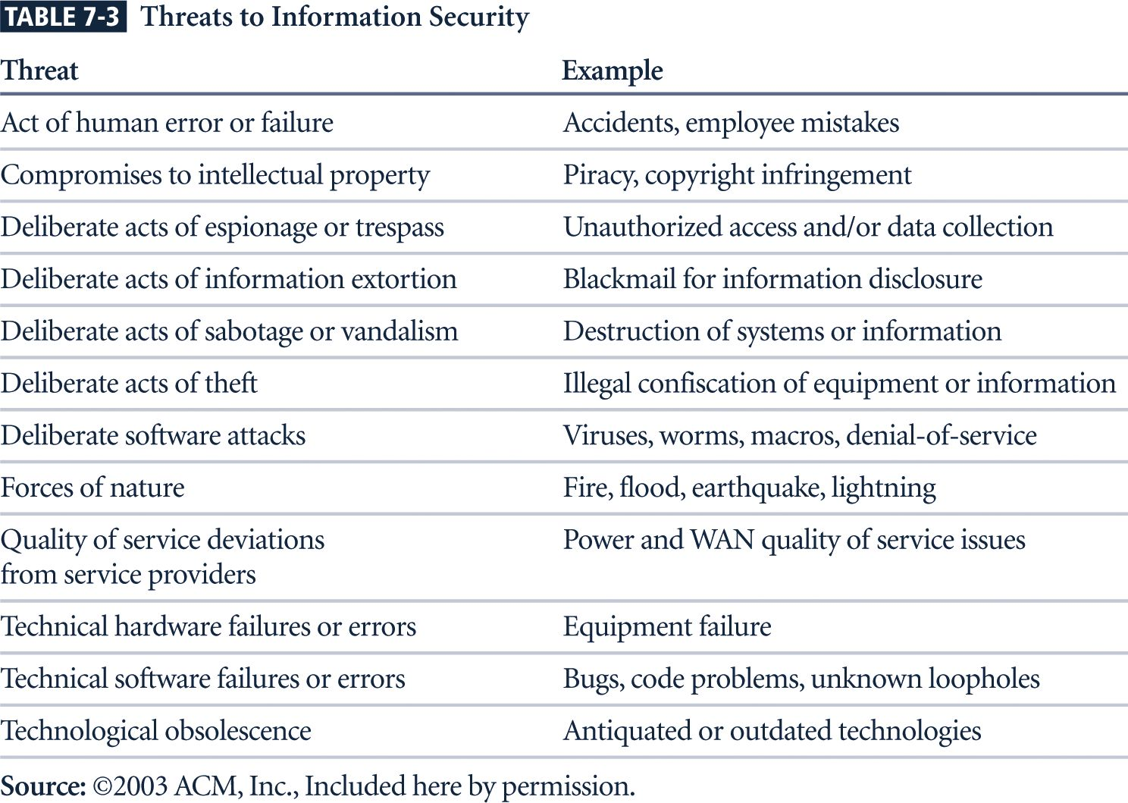
Threats to Information Security

Slide 31
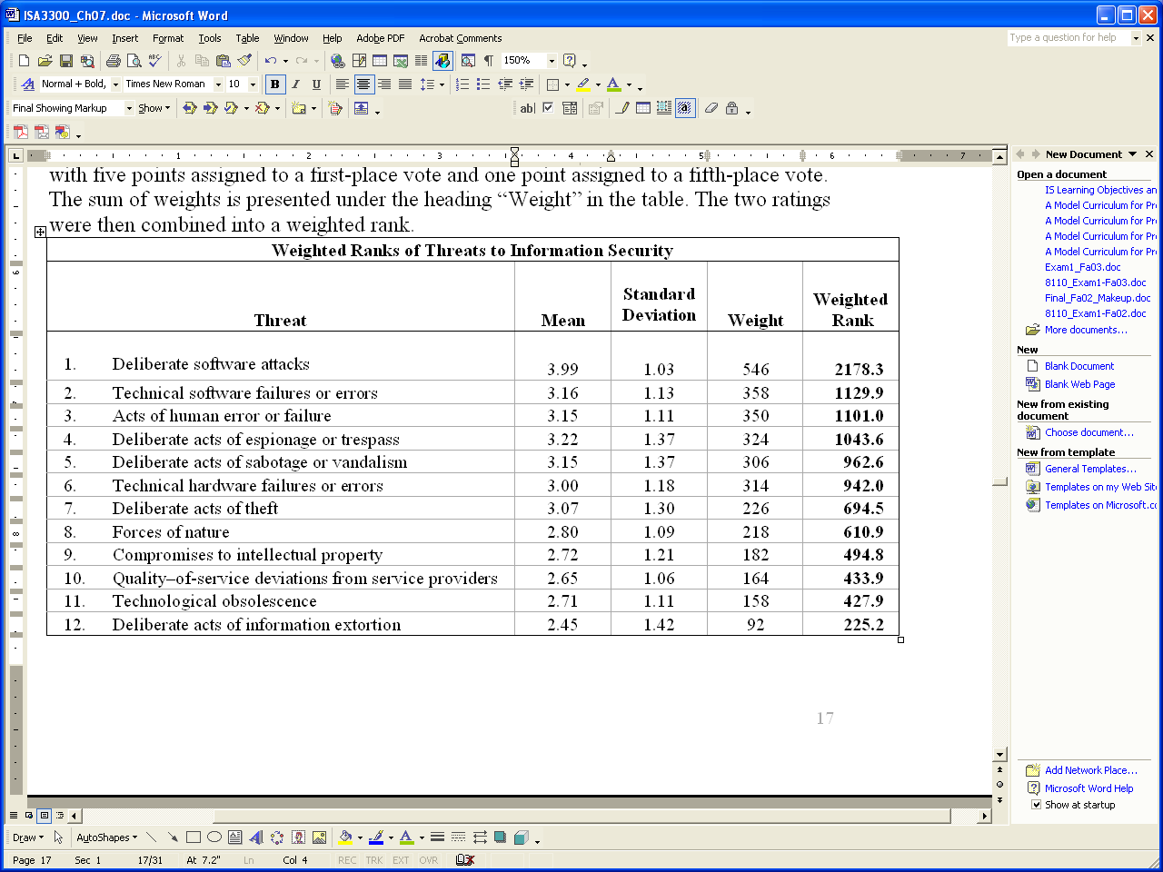
Threats to Information Security

Slide 32
Weighted Ranking of Threat-Driven Expenditures
Top Threat-Driven Expenses Rating
Deliberate software attacks 12.7
Acts of human error or failure 7.6
Technical software failures or errors 7.0
Technical hardware failures or errors 6.0
QoS deviations from service providers 4.9
Deliberate acts of espionage or trespass 4.7
Deliberate acts of theft 4.1
Deliberate acts of sabotage or vandalism 4.0
Technological obsolescence 3.3
Forces of nature 3.0
Compromises to intellectual property 2.2
Deliberate acts of information extortion 1.0
Notes:
This material can be found in the offline feature within chapter 7.

Slide 33
Vulnerability Assessment
Steps revisited
Identify the information assets of the organization and
Document some threat assessment criteria,
Begin to review every information asset for each threat
Leads to creation of list of vulnerabilities that remain potential risks to organization
Vulnerabilities
specific avenues that threat agents can exploit to attack an information asset
At the end of the risk identification process,
a list of assets and their vulnerabilities has been developed

Slide 34
Introduction to Risk Assessment
The goal at this point is to create a method to evaluate relative risk of each listed vulnerability
Notes:
Introduction to Risk Assessment
The goal at this point is to create a method to evaluate the relative risk of each listed vulnerability.

Slide 35
Risk Identification Estimate Factors
Risk is
The likelihood of the occurrence of a vulnerability
Multiplied by
The value of the information asset
Minus
The percentage of risk mitigated by current controls
Plus
The uncertainty of current knowledge of the vulnerability
Notes:
Risk Identification Estimate Factors
Risk is
The likelihood of the occurrence of a vulnerability
Multiplied by
The value of the information asset
Minus
The percentage of risk mitigated by current controls
Plus
The uncertainty of current knowledge of the vulnerability

Slide 36
Likelihood
Likelihood
lof the threat occurring is the estimation of the probability that a threat will succeed in achieving an undesirable event
is the overall rating - often a numerical value on a defined scale (such as 0.1 – 1.0) - of the probability that a specific vulnerability will be exploited
Using the information documented during the risk identification process,
assign weighted scores based on the value of each information asset, i.e. 1-100, low-med-high, etc

Slide 37
Assessing Potential Loss
To be effective, the likelihood values must be assigned by asking:
Which threats present a danger to this organization’s assets in the given environment?
Which threats represent the most danger to the organization’s information?
How much would it cost to recover from a successful attack?
Which threats would require the greatest expenditure to prevent?
Which of the aforementioned questions is the most important to the protection of information from threats within this organization?
Notes:
Assessing Potential Loss
To be effective, the values must be assigned by asking:
Which threats present a danger to this organization’s assets in the given environment?
Which threats represent the most danger to the organization’s information?
How much would it cost to recover from a successful attack?
Which threats would require the greatest expenditure to prevent?
Which of the aforementioned questions is the most important to the protection of information from threats within this organization?

Slide 38
Mitigated Risk / Uncertainty
If it is partially controlled,
Estimate what percentage of the vulnerability has been controlled
Uncertainty
is an estimate made by the manager using judgment and experience
It is not possible to know everything about every vulnerability
The degree to which a current control can reduce risk is also subject to estimation error

Slide 39
Risk Determination Example
Asset A has a value of 50 and has vulnerability #1,
likelihood of 1.0 with no current controls
assumptions and data are 90% accurate
Asset B has a value of 100 and has two vulnerabilities
Vulnerability #2
likelihood of 0.5 with a current control that addresses 50% of its risk
Vulnerability # 3
likelihood of 0.1 with no current controls
assumptions and data are 80% accurate

Slide 40
Risk Determination Example
Resulting ranked list of risk ratings for the three vulnerabilities is as follows:
Asset A: Vulnerability 1 rated as 55 =
(50 × 1.0) – 0% + 10%
Asset B: Vulnerability 2 rated as 35 =
(100 × 0.5) – 50% + 20%
Asset B: Vulnerability 3 rated as 12 =
(100 × 0.1) – 0 % + 20%

Slide 41
Identify Possible Controls
For each threat and its associated vulnerabilities that have residual risk, create a preliminary list of control ideas
Three general categories of controls exist:
Policies
Programs
Technical controls

Slide 42
Access Controls
Access controls specifically
address admission of a user into a trusted area of the organization
These areas can include
information systems,
physically restricted areas such as computer rooms, and
even the organization in its entirety
Access controls usually consist of
a combination of policies, programs, and technologies

Slide 43
Types of Access Controls
Mandatory Access Controls (MACs):
Required
Structured and coordinated with a data classification scheme
When implemented, users and data owners have limited control over their access to information resources
Use data classification scheme that rates each collection of information

Slide 44
Types of Access Controls (Continued)
Access Control Matrix
Access Control List
the column of attributes associated with a particular object is called an access control list (ACL)
Capabilities
The row of attributes associated with a particular subject

Slide 45
Types of Access Controls (Continued)
Nondiscretionary controls are determined by a central authority in the organization
Can be based on roles—called role-based controls—or on a specified set of tasks—called task-based controls
Task-based controls can, in turn, be based on lists maintained on subjects or objects
Role-based controls are tied to the role that a particular user performs in an organization, whereas task-based controls are tied to a particular assignment or responsibility

Slide 46
Types of Access Controls (Continued)
Discretionary Access Controls (DACs) are
implemented at the discretion or option of the data user
The ability to share resources in a peer-to-peer configuration allows
users to control and possibly provide access to information or resources at their disposal
The users can allow
general, unrestricted access, or
specific individuals or sets of individuals to access these resources

Slide 47
Documenting the Results of Risk Assessment
The goal of the risk management process:
Identify information assets and their vulnerabilities
Rank them according to the need for protection
In preparing this list, collect
wealth of factual information about the assets and the threats they face
information about the controls that are already in place
The final summarized document is the ranked vulnerability risk worksheet

Slide 48
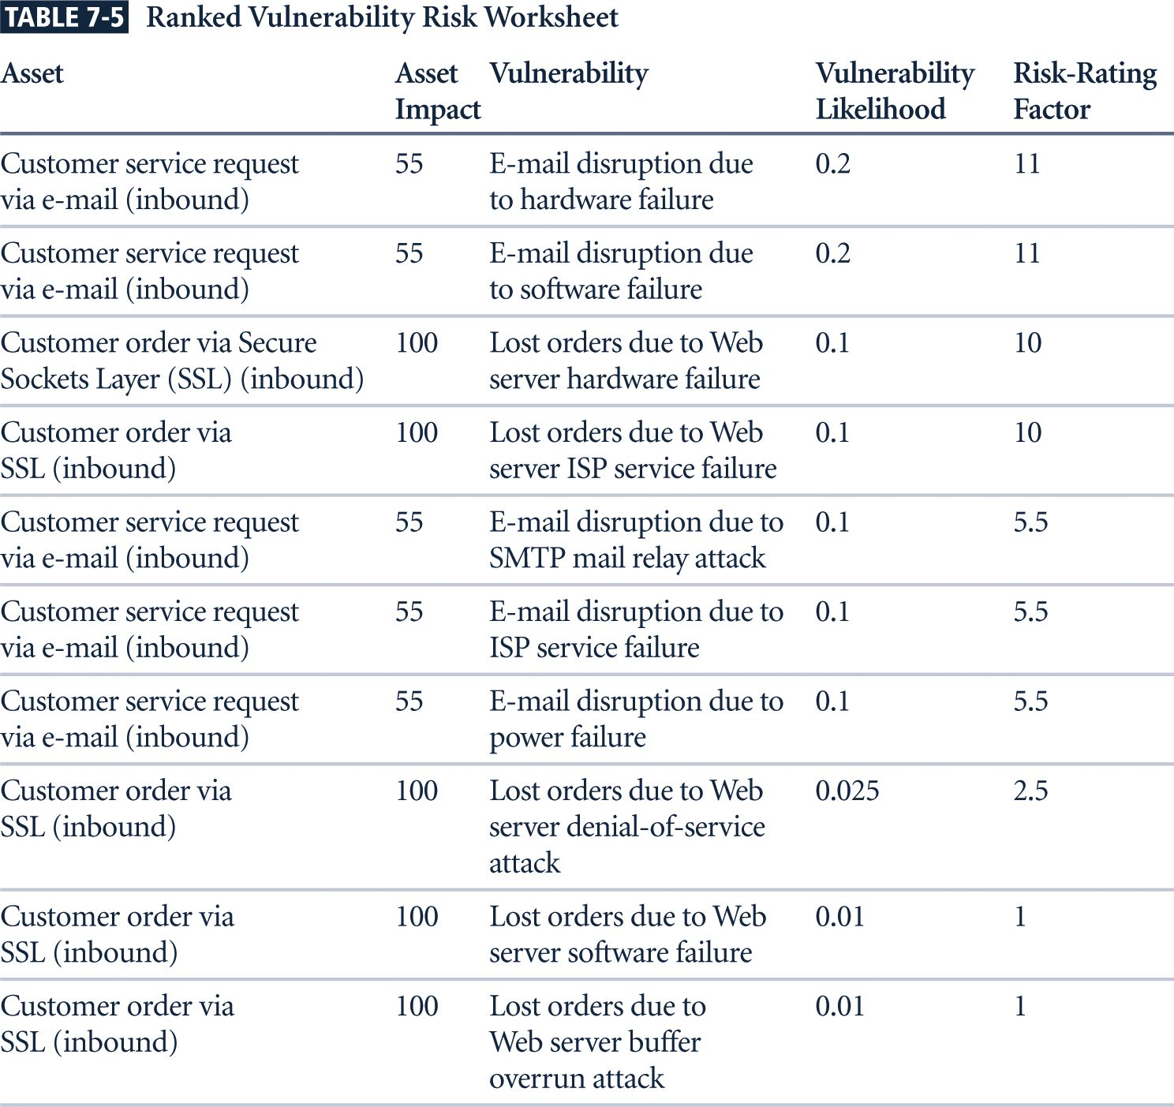
Ranked Vulnerability Risk Worksheet

Slide 49
Documenting the Results of Risk Assessment (Continued)
What are the deliverables from this stage of the risk management project?
The risk identification process should designate
what function the reports serve,
who is responsible for preparing them, and
who reviews them

Slide 50
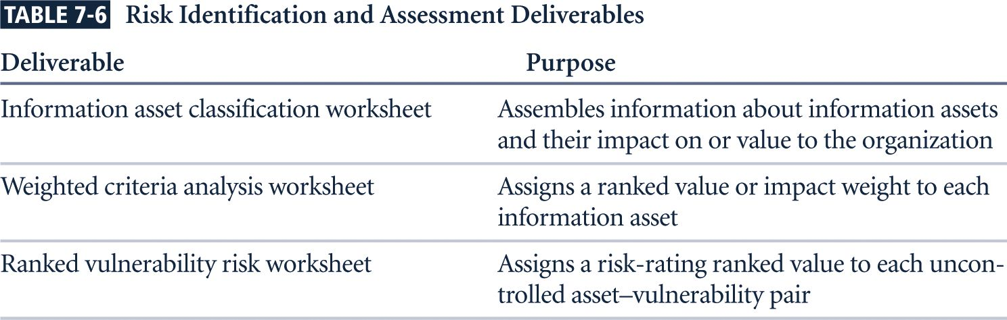
Risk Identification and Assessment Deliverables

