Slide 1
CIS 5600 Information Security Management
Dr. Jeremy Lanman, Adjunct Professor
jlanman@fit.edu
Office: Virtual
Office Hours: By arrangement

Slide 2
Risk Management (Part 2): Assessing and Controlling Risk

Slide 3
Introduction
Competitive Disavantage
To keep up with the competition, organizations must design and create a safe environment in which business processes and procedures can function
This environment must
Maintain confidentiality and privacy
Assure the integrity and availability of organizational data
Use principles of risk management

Slide 4
Risk Control Strategies
Choose basic control risks strategy :
Avoidance:
applying safeguards that eliminate or reduce the remaining uncontrolled risks for the vulnerability
Transference:
shifting the risk to other areas or to outside entities
Mitigation:
reducing the impact should the vulnerability be exploited
Acceptance:
understanding the consequences and accept the risk without control or mitigation

Slide 5
Avoidance
Attempts to prevent the exploitation of the vulnerability
Accomplished through:
Application of policy
Application of training and education
Countering threats
Implementation of technical security controls and safeguards

Slide 6
Transference
Attempts to shift the risk to other assets, other processes, or other organizations
May be accomplished by
Rethinking how services are offered
Revising deployment models
Outsourcing to other organizations
Purchasing insurance
Implementing service contracts with providers

Slide 7
Mitigation
Attempts to reduce the damage caused by the exploitation of vulnerability
by means of planning and preparation,
Includes three types of plans:
Disaster recovery plan (DRP)
Incident response plan (IRP)
Business continuity plan (BCP)
Depends upon
the ability to detect and respond to an attack as quickly as possible

Slide 8
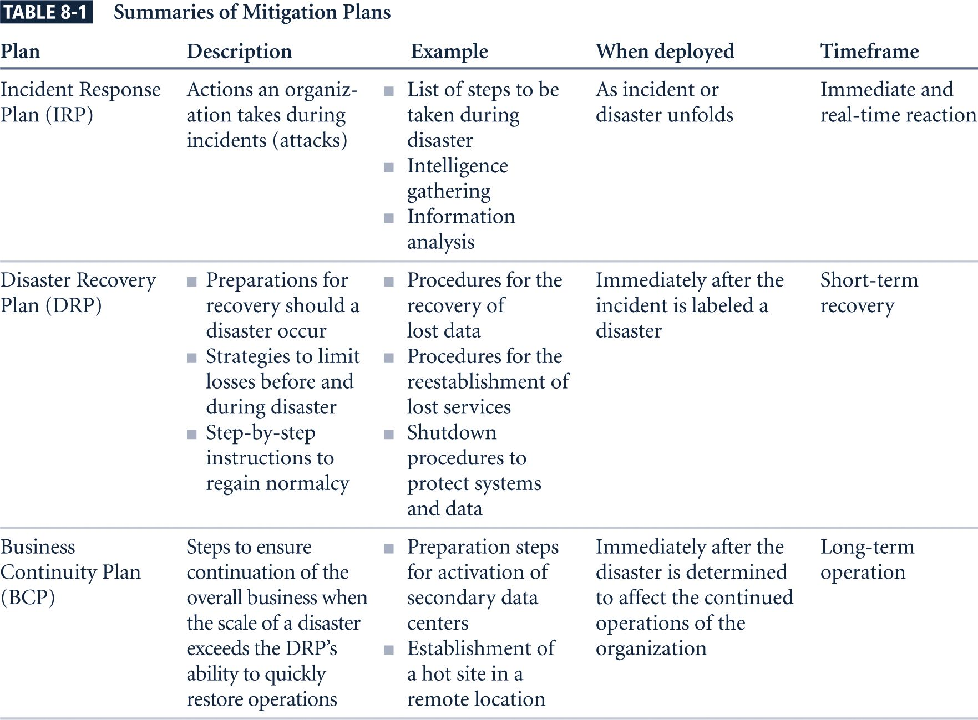
Summaries of Mitigation Plans

Slide 9
Acceptance
Acceptance is the choice to do nothing to protect an information asset and to accept the loss when it occurs
This control, or lack of control, assumes that it may be a prudent business decision to
Examine alternatives
Conclude the cost of protecting an asset does not justify the security expenditure

Slide 10
Acceptance (Continued)
Only valid use of acceptance strategy occurs when organization has:
Determined level of risk to information asset
Assessed probability of attack and likelihood of a successful exploitation of vulnerability
Approximated ARO of the exploit
Estimated potential loss from attacks
Performed a thorough cost benefit analysis
Evaluated controls using each appropriate type of feasibility
Decided that the particular asset did not justify the cost of protection

Slide 11
Risk Control Strategy Selection
Risk control involves
selecting one of the four risk control strategies for the vulnerabilities present within the organization
Acceptance of risk
If the loss is within the range of losses the organization can absorb, or
if the attacker’s gain is less than expected costs of the attack,
Otherwise, one of the other control strategies will have to be selected

Slide 12
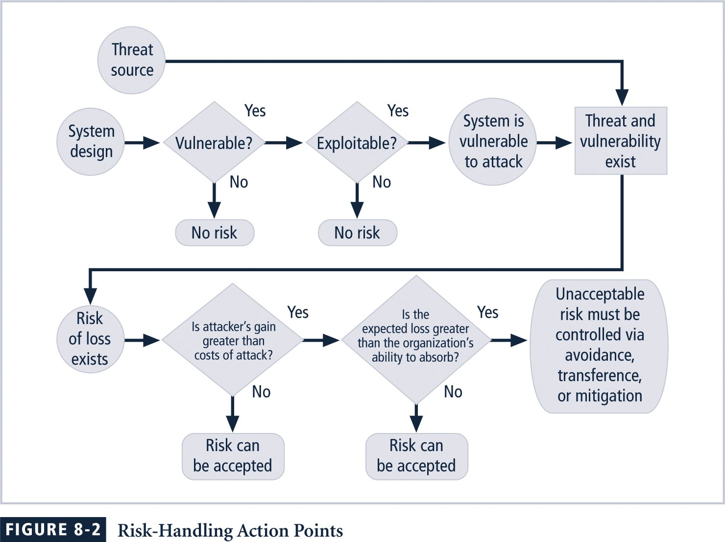
Risk Handling Action Points

Slide 13
Risk Control Strategy Selection Some rules
When a vulnerability exists:
Implement security controls to reduce the likelihood of a vulnerability being exercised
When a vulnerability can be exploited:
Apply layered controls to minimize the risk or prevent occurrence
When the attacker’s potential gain is greater than the costs of attack:
Apply protections to increase the attacker’s cost, or reduce the attacker’s gain, using technical or managerial controls
When potential loss is substantial:
Apply design controls to limit the extent of the attack, thereby reducing the potential for loss

Slide 14
Evaluation, Assessment, And Maintenance Of Risk Controls
Once a control strategy has been selected and implemented
Effectiveness of controls should be monitored and measured on an ongoing basis to determine its effectiveness
Accuracy of estimated risk that will remain after all planned controls are in place

Slide 15
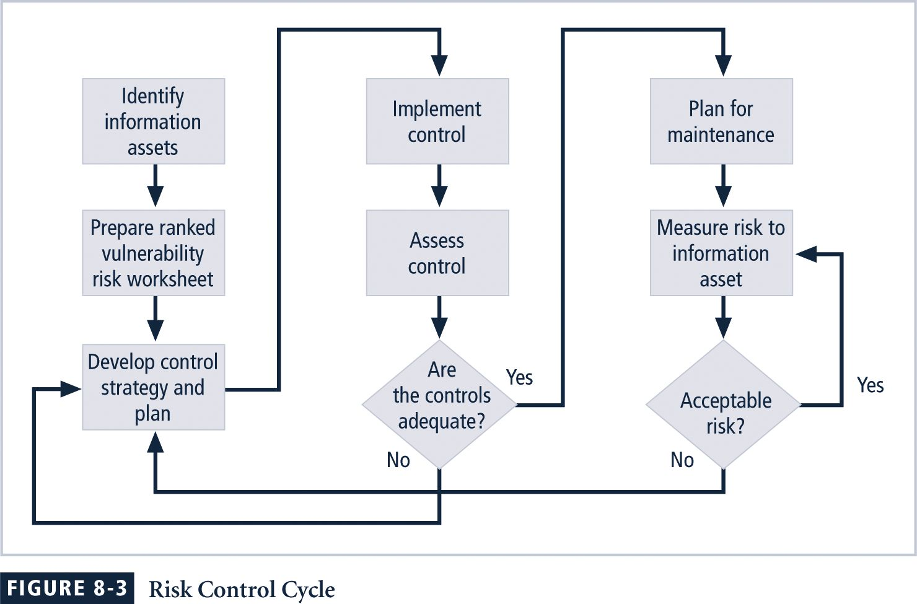
The Risk Control Cycle

Slide 16
Categories of Controls
Implementing controls or safeguards
To control risk by means of
avoidance,
mitigation,
transference
Controls can be one of four categories:
Control function
Architectural layer
Strategy layer
Information security principle

Slide 17
Control Function
Preventive controls
Stop attempts to exploit a vulnerability by implementing enforcement of an organizational policy or a security principle
Use a technical procedure, or some combination of technical means and enforcement methods
Detective controls
Alerts about violations of security principles, organizational policies, or attempts to exploit vulnerabilities
Use techniques such as audit trails, intrusion detection, and configuration monitoring

Slide 18
Architectural Layer
Some controls apply to one or more layers of an organization’s technical architecture
Possible architectural layers include the following:
Organizational policy
External networks & Extranets
Demilitarized zones
Intranets
Network devices that interface network zones
Systems
Applications

Slide 19
Strategy Layer
Controls are sometimes classified by the risk control strategy they operate within:
Avoidance
Mitigation
Transference
Note that the acceptance strategy is not an option since it involves the absence of controls

Slide 20
Information Security Principle
Risk controls operate within one or more of the commonly accepted information security principles:
Confidentiality
Integrity
Availability
Authentication
Authorization
Accountability
Privacy

Slide 21
Feasibility Studies and Cost Benefit Analysis
Information about the consequences of the vulnerability must be explored
Before deciding on the strategy for a specific vulnerability,
Determine advantage or disadvantage of a specific control
Primary means are based on the value of information assets that control is designed to protect

Slide 22
Cost Benefit Analysis (CBA)
Economic Feasibility
criterion most commonly used when evaluating a project that implements information security controls and safeguards
Should begin a CBA by evaluating
Worth of the information assets to be protected
Loss in value if those information assets are compromised
Cost Benefit Analysis or Economic Feasibility Study

Slide 23
Cost
It is difficult
to determine the value of information,
to determine the cost of safeguarding it
Some of the items that affect the cost of a control or safeguard include:
Cost of development or acquisition of hardware, software, and services
Training fees
Cost of implementation
Service costs
Cost of maintenance

Slide 24
Benefit
Benefit is
the value to the organization of using controls to prevent losses associated with a specific vulnerability
Usually determined by
Valuing the information asset or assets exposed by vulnerability
Determining how much of that value is at risk and how much risk there is for the asset
This is expressed as
Annualized Loss Expectancy (ALE)

Slide 25
Asset Valuation
Asset valuation is
a challenging the process of assigning financial value or worth to each information asset
Value of information differs
Within organizations and between organizations
Based on information characteristics and perceived value of that information
Valuation of assets involves:
Estimation of real and perceived costs associated with design,
development, installation, maintenance, protection, recovery, and defense against loss and litigation

Slide 26
Asset Valuation Components
Some of the components of asset valuation include:
Value retained from the cost of creating the information asset
Value retained from past maintenance of the information asset
Value implied by the cost of replacing the information
Value from providing the information
Value acquired from the cost of protecting the information
Value to owners
Value of intellectual property
Value to adversaries
Loss of productivity while the information assets are unavailable
Loss of revenue while information assets are unavailable

Slide 27
Asset Valuation Approaches
Organization must be able to place a dollar value on each information assets it owns, based on:
How much did it cost to create or acquire?
How much would it cost to recreate or recover?
How much does it cost to maintain?
How much is it worth to the organization?
How much is it worth to the competition?

Slide 28
Asset Valuation Approaches (Continued)
Potential loss is that which could occur from the exploitation of vulnerability or a threat occurrence
The questions that must be asked include:
What loss could occur, and what financial impact would it have?
What would it cost to recover from the attack, in addition to the financial impact of damage?
What is the single loss expectancy for each risk?

Slide 29
Asset Valuation Techniques
Single loss expectancy (SLE):
calculation of value associated with most likely loss from an attack
Based on estimated asset value and expected percentage of loss that would occur from attack:
SLE = asset value (AV) x exposure factor (EF)
EF = the percentage loss that would occur from a given vulnerability being exploited
In most cases,
probability of a threat occurring is the probability of an attack within a given time frame
Commonly referred to as the ARO, or annualized rate of occurrence

Slide 30
The Cost Benefit Analysis (CBA) Formula
CBA determines whether or not a control alternative is worth its associated cost
CBAs may be calculated
Before a control or safeguard is implemented to determine if the control is worth implementing OR
After controls have been implemented and have been functioning for a time:
CBA = ALE(prior) – ALE(post) – ACS

Slide 31
The Cost Benefit Analysis (CBA) Formula
ALE(prior to control) is
the annualized loss expectancy of the risk before the implementation of the control
ALE(post control) is
the ALE examined after the control has been in place for a period of time
ACS is
the annual cost of the safeguard

Slide 32
Other Feasibility Approaches
Organizational feasibility analysis
examines how well the proposed information security alternatives will contribute to operation of an organization
Operational feasibility analysis
Addresses user acceptance and support, management acceptance and support, and overall requirements of organization’s stakeholders

Slide 33
Other Feasibility Approaches
Technical feasibility analysis
examines whether or not the organization has or can acquire the technology to implement and support the alternatives
Political feasibility analysis
defines what can and cannot occur based on the consensus and relationships between the communities of interest

Slide 34
Benchmarking
Benchmarking:
Seeking out and studying practices of other organizations that produce desired results
Measuring differences between how organizations conduct business
When benchmarking, an organization typically uses one of two measures to compare practices:
Metrics-based measures
comparisons based on numerical standards
Process-based measures
generally less focused on numbers and are more strategic

Slide 35
Benchmarking (Continued)
In the field of information security, two categories of benchmarks are used:
Standards of due care and due diligence, and
Best practices
Within best practices, the gold standard is a subcategory of practices that are typically viewed as “the best of the best”

Slide 36
Due Care and Due Diligence
For legal reasons, an organization may be forced to adopt a certain minimum level of security
Due Care
adopt levels of security for legal defense,
need to show that they have done what any prudent organization would do in similar circumstances
Due diligence
demonstration that organization is persistent in ensuring implemented standards continue to provide required level of protection

Slide 37
Best Business Practices
Best business practices:
security efforts that seek to provide a superior level of performance
Are among the best in the industry,
balancing access to information with adequate protection, while maintaining a solid degree of fiscal responsibility
Companies with best practices may not be the best in every area

Slide 38
The Gold Standard
Even the best business practices are not sufficient for some organizations
These organizations aspire to set the standard by implementing the most protective, supportive, and yet fiscally responsible standards they can
The gold standard
is a defining level of performance that demonstrates a company’s industrial leadership, quality, and concern for the protection of information

Slide 39
Applying Best Practices
Address the following questions:
Does your organization resemble the organization that is implementing the best practice under consideration?
Is your organization in a similar industry?
Does your organization face similar challenges?
Is your organizational structure similar to the organization from which you are modeling the best practices?
Can your organization expend resources that are in line with the requirements of the best practice?
Is your organization in a similar threat environment as the one cited in the best practice?

Slide 40
Problems with Benchmarking and Best Practices
Organizations don’t talk to each other
No two organizations are identical
Best practices are a moving target
Simply knowing what was going on a few years ago does not necessarily indicate what to do next

Slide 41
Baselining
Baselining is the analysis of measures against established standards
In information security, baselining is the comparison of security activities and events against the organization’s future performance
The information gathered for an organization’s first risk assessment becomes the baseline for future comparisons

Slide 42
Risk Appetite
Risk appetite
defines the quantity and nature of risk that organizations are willing to accept, as they evaluate the trade-offs between perfect security and unlimited accessibility
Reasoned approach to risk is one that
balances expense against possible losses if exploited

Slide 43
Residual Risk
When vulnerabilities have been controlled as much as possible, there is often remaining risk that has not been completely accounted for residual risk
Residual Risk:
Risk from a threat less the effect of threat-reducing safeguards plus
Risk from a vulnerability less the effect of vulnerability-reducing safeguards plus
Risk to an asset less the effect of asset value-reducing safeguards

Slide 44
Residual Risk
The significance of residual risk
must be judged within the context of an organization’s risk appetite
The goal of information security
is not to bring residual risk to zero,
but to bring it in line with an organization’s risk appetite

Slide 45
Documenting Results
When risk management program has been completed, series of proposed controls are prepared
Each justified by one or more feasibility or rationalization approaches
At minimum, each information asset-threat pair should have a documented control strategy that
Clearly identifies any residual risk remaining after the proposed strategy has been executed

Slide 46
Documenting Results
Some organizations document outcome of control strategy for each information asset-threat pair in an action plan
Includes:
Concrete tasks, each with accountability assigned to an organizational unit or to an individual

Slide 47
Qualitative Measures
Quantitative assessment performs asset valuation with actual values or estimates
An organization could determine that it cannot put specific numbers on these values
Organizations could use qualitative assessments instead, using scales instead of specific estimates

Slide 48
The OCTAVE Method
Operationally Critical Threat, Asset, and Vulnerability EvaluationSM (OCTAVESM) Method:
Defines essential components of a comprehensive, systematic, context-driven, self-directed information security risk evaluation
By following OCTAVE Method, organization can
make information-protection decisions based on risks to
confidentiality, integrity, and availability of critical information technology assets
Operational or business units and IT department work together to address information security needs of the organization

Slide 49
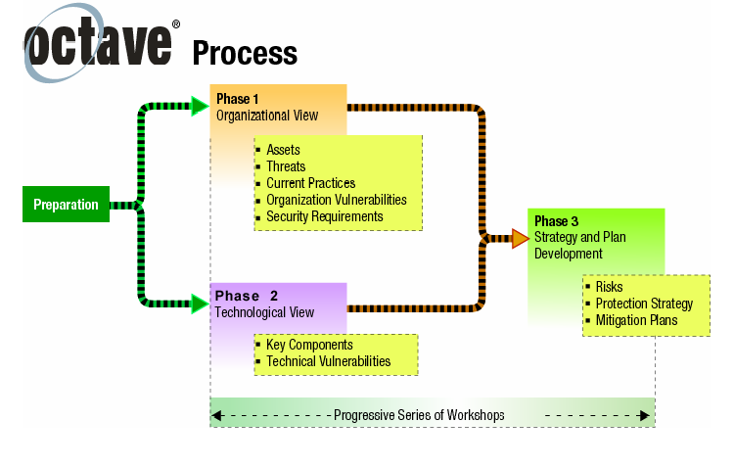

Slide 50
Phases of The OCTAVE Method
Phase 1: Build Asset-Based Threat Profiles
Organizational evaluation
Key areas of expertise within organization are examined to elicit important knowledge about:
Information assets
Threats to those assets
Security requirements of assets
What organization is currently doing to protect its information assets
Weaknesses in organizational policies and practice

Slide 51
Phases of The OCTAVE Method (Continued)
Phase 2: Identify Infrastructure Vulnerabilities
Evaluation of information infrastructure
Key operational components of information technology infrastructure are examined for weaknesses (technology vulnerabilities) that can lead to unauthorized action

Slide 52
Phases of The OCTAVE Method (Continued)
Phase 3: Develop Security Strategy and Plans
Risks are analyzed in this phase
Information generated by organizational and information infrastructure evaluations (Phases 1 and 2) is analyzed to:
Identify risks to organization
Evaluate risks based on their impact to the organization’s mission
Organization protection strategy and risk mitigation plans for the highest priority risks are developed

Slide 53
Important Aspects of the OCTAVE Method
The OCTAVE Method:
Self directed
Requires analysis team to conduct evaluation and analyze information
Basic tasks of the team are to:
Facilitate knowledge elicitation workshops of Phase 1
Gather any necessary supporting data
Analyze threat and risk information
Develop a protection strategy for the organization
Develop mitigation plans to address risks to the organization’s critical assets

Slide 54
Important Aspects of the OCTAVE Method (Continued)
OCTAVE Method:
Uses workshop-based approach for gathering information and making decisions
Relies upon the following major catalogs of information:
Catalog of practices: collection of good strategic and operational security practices
Threat profile: range of major sources of threats that an organization needs to consider
Catalog of vulnerabilities: collection of vulnerabilities based on platform and application

Slide 55
Phases & Processes of the OCTAVE Method
Each phase of the OCTAVE Method contains two or more processes. Each process is made of activities.
Phase 1: Build Asset-Based Threat Profiles
Process 1: Identify Senior Management Knowledge
Process 2: Identify Operational Area Management Knowledge
Process 3: Identify Staff Knowledge
Process 4: Create Threat Profiles

Slide 56
Phases & Processes of the OCTAVE Method (Continued)
Phase 2: Identify Infrastructure Vulnerabilities
Process 5: Identify Key Components
Process 6: Evaluate Selected Components
Phase 3: Develop Security Strategy and Plans
Process 7: Conduct Risk Analysis
Process 8: Develop Protection Strategy

Slide 57
Preparing for the OCTAVE Method
Obtain senior management sponsorship of OCTAVE
Select analysis team members.
Train analysis team
Select operational areas to participate in OCTAVE
Select participants
Coordinate logistics
Brief all participants

Slide 58
The OCTAVE Method
For more information, you can download the OctaveSM method implementation guide from www.cert.org/octave/omig.html

