Slide 1
CIS 5600 Information Security Management
Dr. Jeremy Lanman, Adjunct Professor
jlanman@fit.edu
Office: Virtual
Office Hours: By arrangement

Slide 2
Protection Mechanisms

Slide 3
Introduction (Continued)
Some of the most powerful and widely used technical security mechanisms include:
Access controls
Firewalls
Dial-up protection
Intrusion detection systems
Vulnerability
Auditing Systems

Slide 4
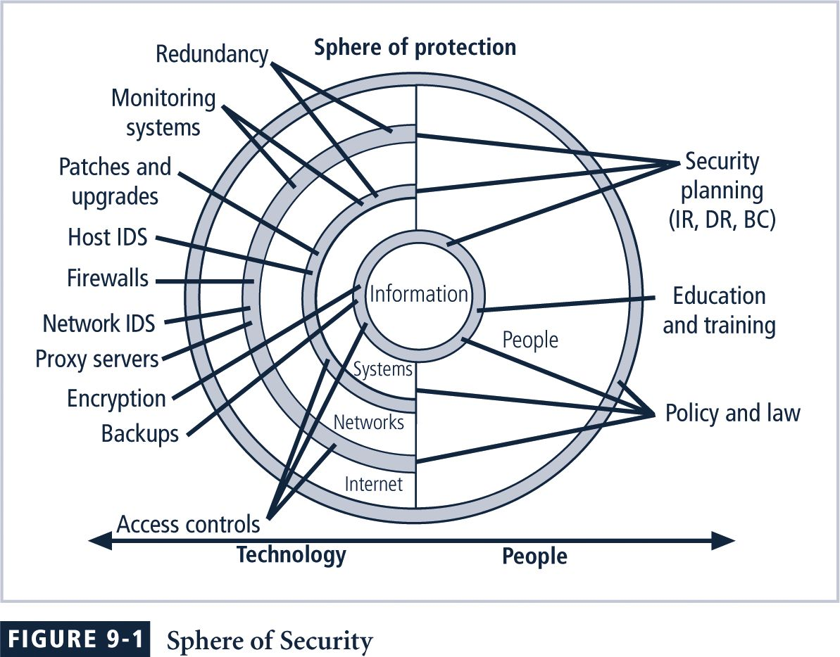
Sphere of Security

Slide 5
Access Control Devices
Access control encompasses two processes:
Confirming identity of entity accessing a logical or physical area (authentication)
Determining which actions that entity can perform in that physical or logical area (authorization)
A successful access control approach (for both physical access or logical access always consists of
authentication and
authorization

Slide 6
Authentication Mechanisms
Mechanism types:
Something you know
Something you have
Something you are
Something you produce
Strong authentication uses at least two different authentication mechanism types
Two factor authentication
Have + Know

Slide 7
Something You Know
Authentication mechanism based on the user’s identity
password, passphrase, or other unique code
A password is a private word or combination of characters that only the user should know
A passphrase is a plain-language phrase, typically longer than a password, from which a virtual password is derived
A good rule of thumb is to require that passwords be at least eight characters long and contain at least one number and one special character
Attack against password
Dictionary, brute force, man-in-the-middle, social engineering; keyboard attack

Slide 8
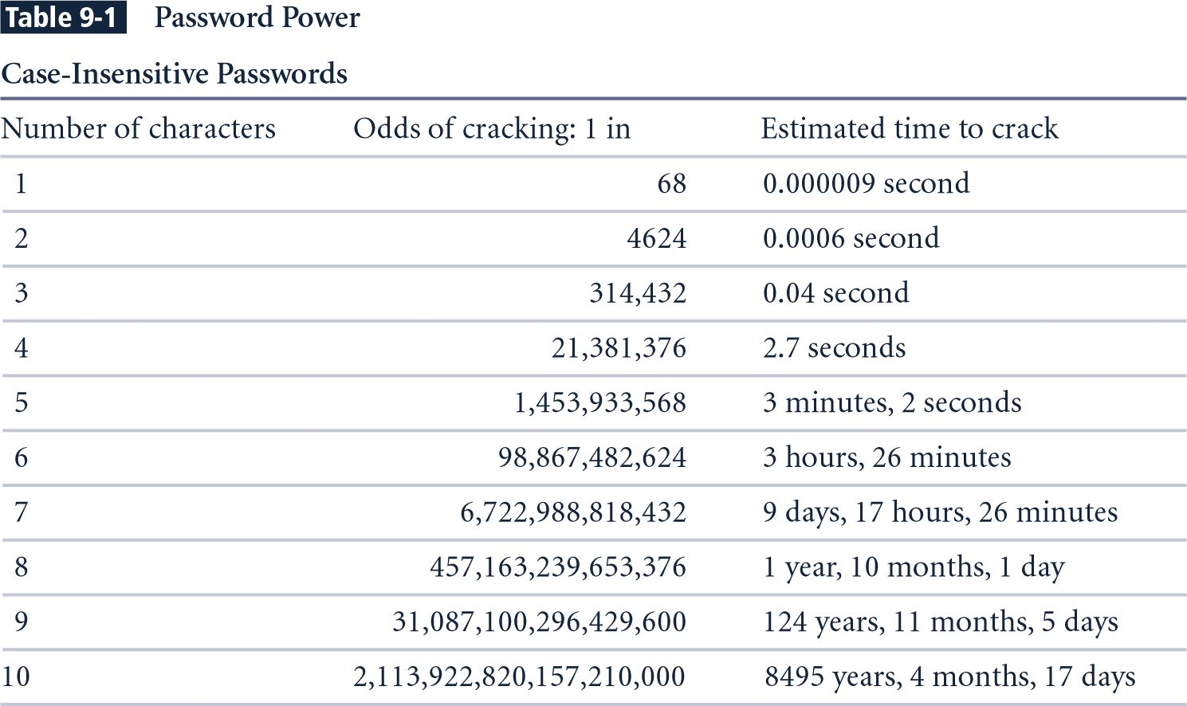
Password Power (1)

Slide 9
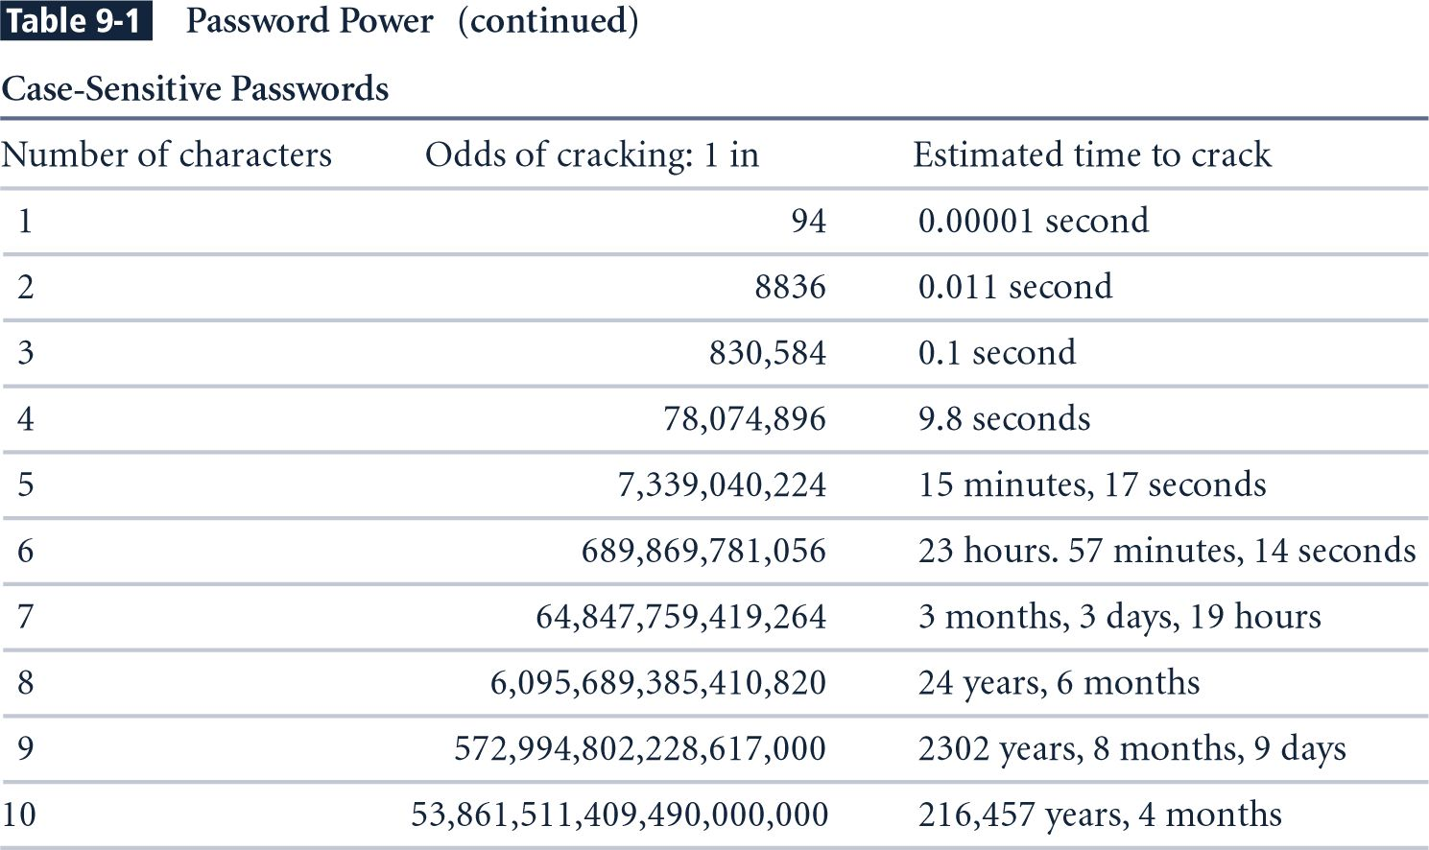
Password Power (2)

Slide 10
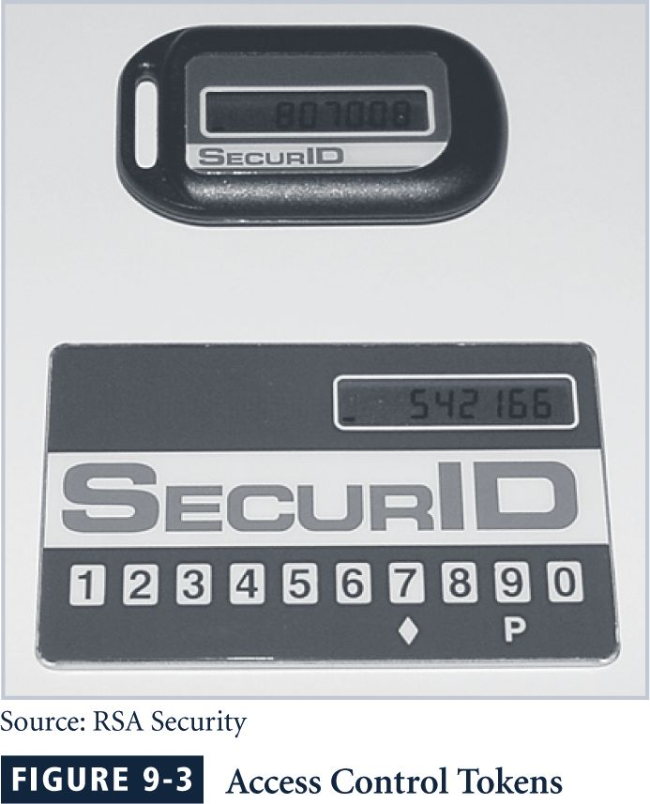
Something You Have
Authentication mechanism based on what user has
a card, key, or token
dumb card (such as an ATM cards) with magnetic stripes
smart card containing a processor
Cryptographic token, a processor in a card that has a display
Tokens may be either
synchronous or
Synchronized with the server
Asynchronous
Challenge response

Slide 11
Something You Are
Biometric
something inherent in the user
Fingerprints, palm scans, hand geometry/topology, facial recognition, retina scan, iris scan
Most of the technologies that scan human characteristics convert these images to obtain some form of minutiae —
unique points of reference that are digitized and stored in an encrypted format

Slide 12
Something You Do
This type of authentication makes use of something the user performs or produces
signature recognition and
voice recognition (voice phrase)
Key stroke pattern
Timing for known sequence of keystrokes

Slide 13
Authorization
Authorization for each authenticated user
System performs authentication process to verify specific entity
Grants access to resources for only that entity
Authorization for members of a group
System matches authenticated entities to a list of group memberships
Grants access to resources based on group’s access rights
Authorization across multiple systems
Central authentication and authorization system verifies entity identity
Grants a set of credentials to verified entity

Slide 14
Evaluating Biometrics
False reject rate:
Percentage of authorized users who are denied access (Type I Error)
False accept rate:
Percentage of unauthorized users who are allowed access (Type II Error)
Crossover error rate:
Point at which the number of false rejections equals the false acceptances

Slide 15
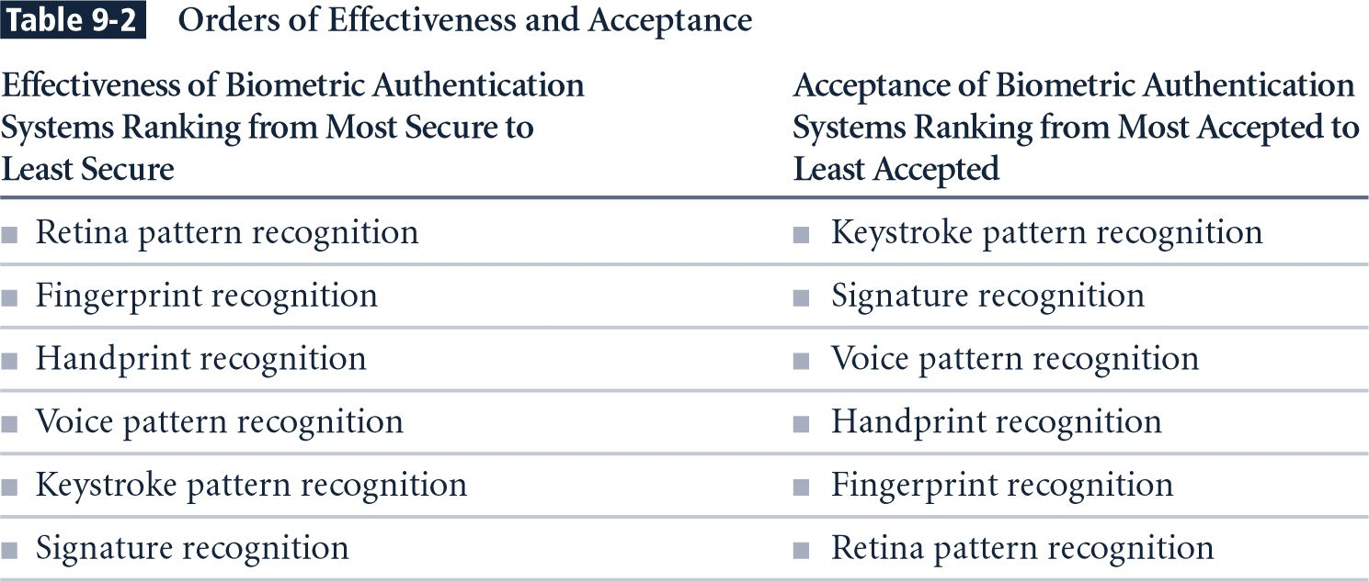
Orders of Effectiveness and Acceptance

Slide 16
Managing Access Controls
To appropriately manage access controls, an organization must have a formal access control policy in place
Determines how access rights are granted to entities and groups
Must include provisions for periodically reviewing all access rights, granting access rights to new employees, changing access rights when job roles change, and revoking access rights as appropriate
All those access control models !!!
ACM, SPM, BLP, Biba, Lipner, Clark-Wilson, RBAC

Slide 17
Perimeter Defense
Organization system consists of a network of many host machines –
the system is as secure as the weakest link
Use perimeter defense
Define a border and use gatekeeper (firewall)
If host machines are scattered and need to use public network, use encryption
Virtual Private Networks (VPNs)

Slide 18
Perimeter Defense
Is it adequate?
Locating and securing all perimeter points is quite difficult
Less effective for large border
Inspecting/ensuring that remote connections are adequately protected is difficult
Insiders attack is often the most damaging

Slide 19
Firewalls
Total isolation of networked systems is undesirable
Use firewalls to achieve selective border control
Firewall
Is a configuration of machines and software
Limits network access
Come “for free” inside many devices: routers, modems, wireless base stations etc.
Alternate:
a firewall is a host that mediates access to a network, allowing and disallowing certain type of access based on a configured security policy

Slide 20
What Firewalls can’t do
They are not a panacea
Only adds to defense in depth
If not managed properly
Can provide false sense of security
Cannot prevent insider attack
Firewalls act a particular layer (or layers)

Slide 21
What is a VPN?
A network that supports a closed community of authorized users
There is traffic isolation
Contents are secure
Services and resources are secure
Use the public Internet as part of the virtual private network
Provide security!
Confidentiality and integrity of data
User authentication
Network access control
IPSec can be used

Slide 22
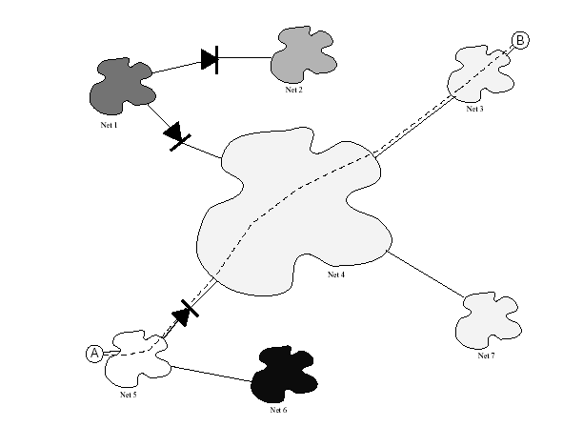
Tunneling in VPN

Slide 23
The Development of Firewalls First Generation
Packet filtering firewalls
are simple networking devices that filter packets by examining every incoming and outgoing packet header
Can selectively filter packets based on values in the packet header, accepting or rejecting packets as needed
Can be configured to filter based on IP address, type of packet, port request, and/or other elements present in the packet

Slide 24
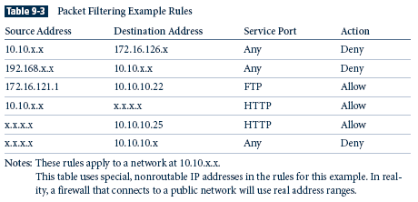
Packet Filtering Example Rules

Slide 25
Second Generation
Application-level firewalls
often consists of dedicated computers kept separate from the first filtering router (edge router)
Commonly used in conjunction with a second or internal filtering router - or proxy server
Proxy server, rather than the Web server, is exposed to outside world from within a network segment called the demilitarized zone (DMZ), an intermediate area between a trusted network and an untrusted network
Application-level firewalls are implemented for specific protocols

Slide 26
Third Generation
Stateful inspection firewalls,
keep track of each network connection established between internal and external systems using a state table
State tables track the state and context of each packet exchanged by recording which station sent which packet and when
can restrict incoming packets by allowing access only to packets that constitute responses to requests from internal hosts
If the stateful inspection firewall receives an incoming packet that it cannot match in its state table, then it uses ACL rights to determine whether to allow the packet to pass

Slide 27
Fourth Generation
A fourth-generation firewall, or dynamic packet filtering firewall, allows only a particular packet with a specific source, destination, and port address to pass through the firewall
Does so by understanding how the protocol functions, and by opening and closing pathways in the firewall
Dynamic packet filters are an intermediate form, between traditional static packet filters and application proxies

Slide 28
Firewall Architectures
Each of the firewall generations can be implemented in a number of architectural configurations
Four architectural implementations of firewalls are especially common:
Packet filtering routers
Screened-host firewalls
Dual-homed host firewalls
Screened-subnet firewalls

Slide 29
Packet Filtering Routers
Most organizations with an Internet connection use some form of router between their internal networks and the external service provider
Many of these routers can be configured to block packets that the organization does not allow into the network
Such an architecture lacks auditing and strong authentication
Complexity of the access control lists used to filter the packets can grow to the point of degrading network performance

Slide 30
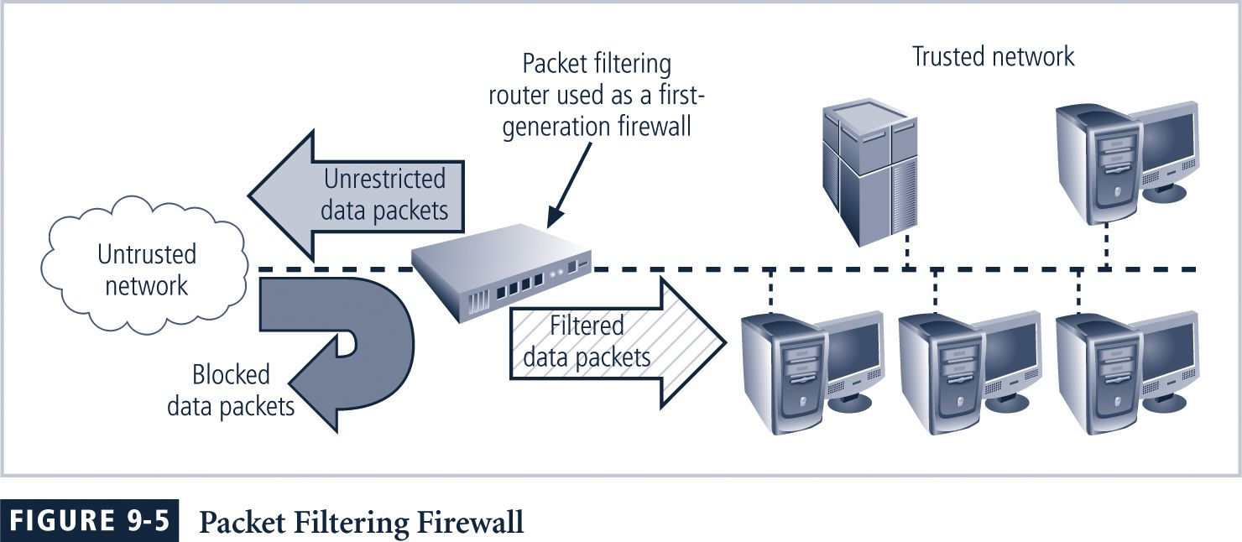
Packet Filtering Router/Firewall

Slide 31
Screened-Host Firewall Systems
Screened-host firewall systems
combine packet filtering router with a separate, dedicated firewall such as an application proxy server
allows the router to screen packets to minimize network traffic and load on the internal proxy
Application proxy examines an application layer protocol, such as HTTP, and performs the proxy services
This separate host, which is often referred to as a bastion host, represents a single, rich target for external attacks, and should be very thoroughly secured

Slide 32
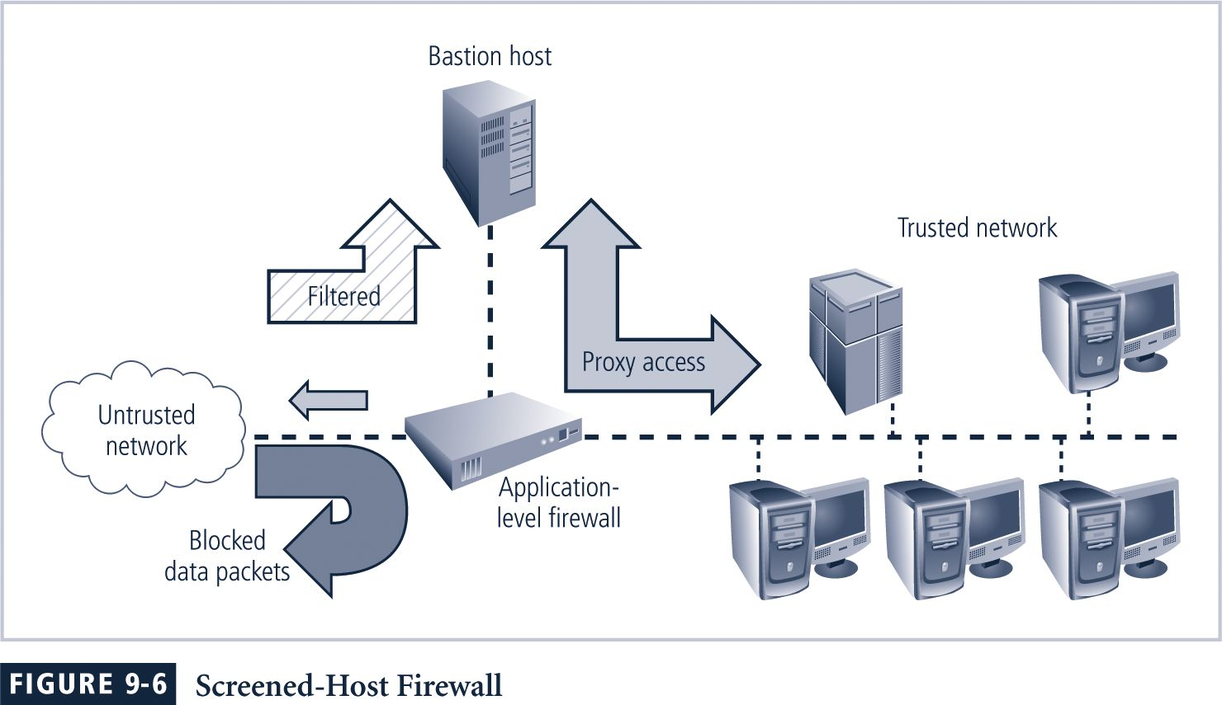
Screened-Host Firewall

Slide 33
Dual-Homed Host Firewalls
In this configuration, the bastion host contains two network interfaces:
One connected to external network
One connected to internal network, requiring all traffic to travel through the firewall to move between the internal and external networks
Network–address translation (NAT) is often implemented with this architecture
Converts external IP addresses to special ranges of internal IP addresses

Slide 34
Dual-Homed Host Firewalls (Continued)
These special, non-routable addresses consist of three different ranges:
10.x.x.x ,> 16.5 million usable addresses
192.168.x.x ,> 65,500 addresses
172.16.0.x - 172.16.15.x ,> 4000 usable addresses

Slide 35
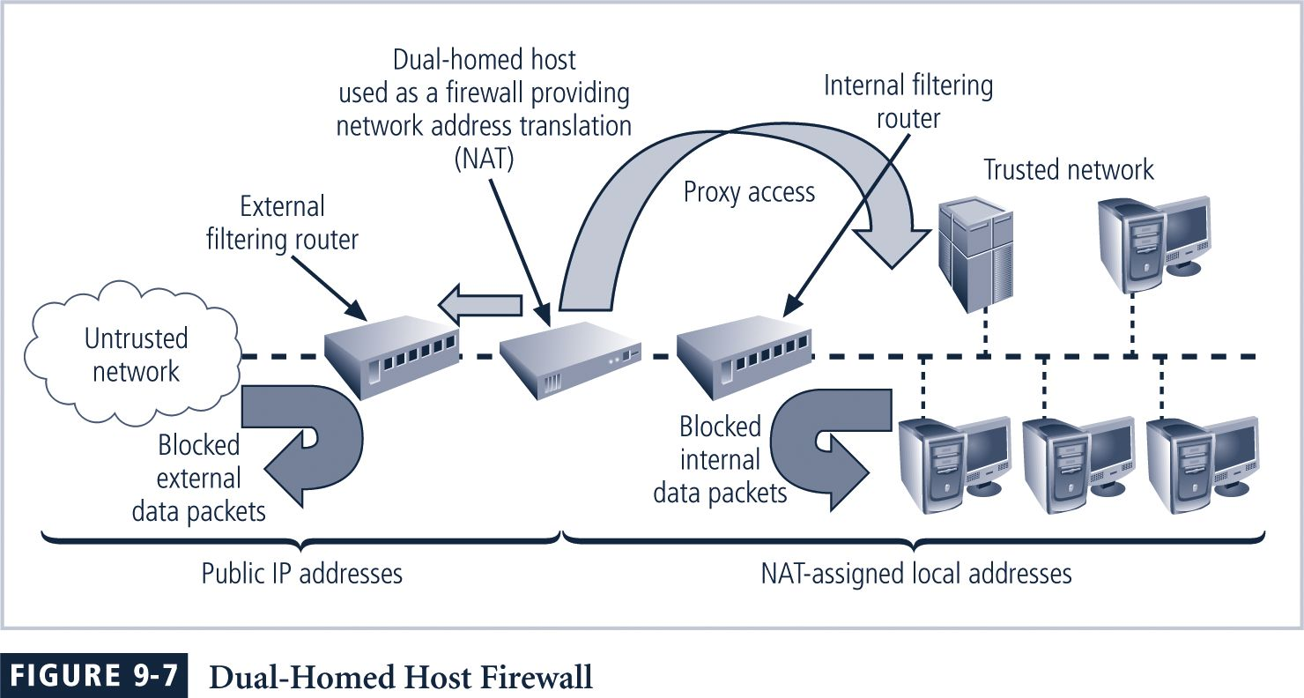
Figure 9-7 Dual-Homed Host Firewall

Slide 36
Screened-Subnet Firewalls (with DMZ)
Screened-subnet firewall
consists of one or more internal bastion hosts located behind a packet filtering router, with each host protecting the trusted network
First general model uses two filtering routers, with one or more dual-homed bastion hosts between them

Slide 37
Screened-Subnet Firewalls (with DMZ)
Second general model (next slide) shows connections are routed as follows:
Connections from the outside or untrusted network are routed through an external filtering router
Connections from the outside or untrusted network are routed into—and then out of—a routing firewall to the separate network segment known as the DMZ
Connections into the trusted internal network are allowed only from the DMZ bastion host servers

Slide 38
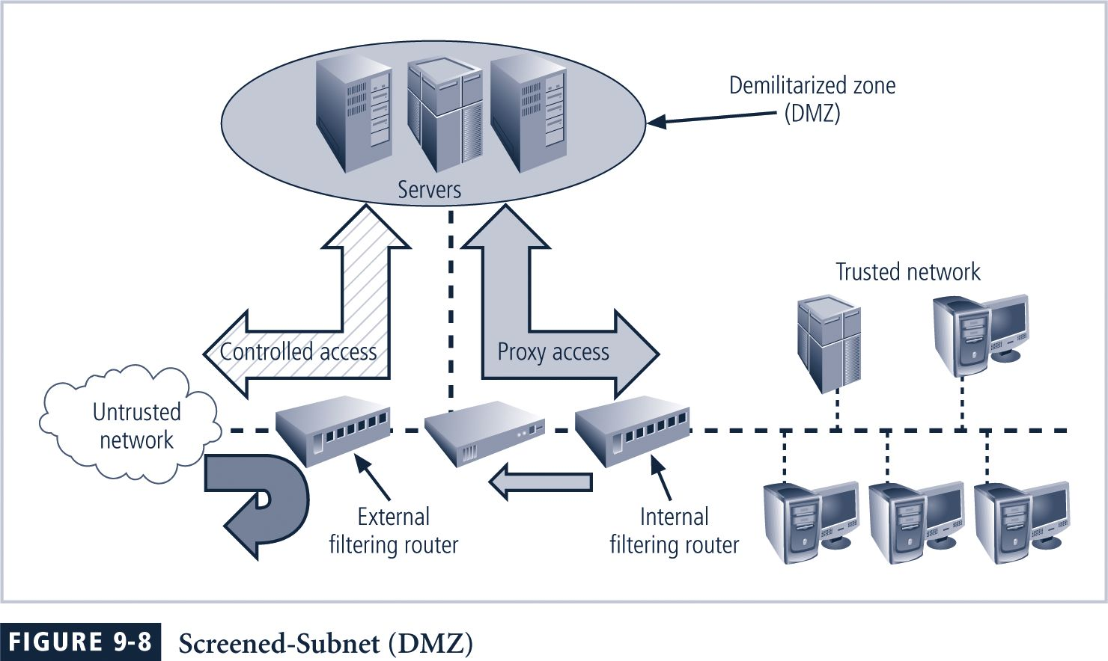
Screened Subnet (DMZ)

Slide 39
Selecting the Right Firewall
When evaluating a firewall, ask the following questions:
What type of firewall technology offers the right balance between protection and cost for the needs of the organization?
What features are included in the base price? What features are available at extra cost? Are all cost factors known?
How easy is it to set up and configure the firewall? How accessible are the staff technicians who can competently configure the firewall?
Can the candidate firewall adapt to the growing network in the target organization?

Slide 40
Managing Firewalls
Any firewall device—
must have its own configuration that regulates its actions
A policy regarding the use of a firewall should be articulated before it is made operable
In practice, configuring firewall rule sets can be something of a nightmare
Each firewall rule must be carefully crafted, placed into the list in the proper sequence, debugged, and tested

Slide 41
Managing Firewalls
Proper rule sequence ensures that the most resource-intensive actions are performed after the most restrictive ones, thereby reducing the number of packets that undergo intense scrutiny
Firewalls:
Deal strictly with defined patterns of measured observation
Are prone to programming errors, flaws in rule sets, and other inherent vulnerabilities
Are designed to function within limits of hardware capacity
Can only respond to patterns of events that happen in an expected and reasonably simultaneous sequence

Slide 42
Firewall Best Practices
All traffic from trusted network is allowed out
Firewall device is never accessible directly from public network
Simple Mail Transport Protocol (SMTP) data is allowed to pass through the firewall, but should be routed to a SMTP gateway
All Internet Control Message Protocol (ICMP) data should be denied
Telnet (terminal emulation) access to all internal servers from the public networks should be blocked
When Web services are offered outside the firewall, HTTP traffic should be handled by some form of proxy access or DMZ architecture

Slide 43
Dial-Up Protection
Attacker who suspects that an organization has dial-up lines can use a device called a war-dialer to locate connection points
Network connectivity using dial-up connections is usually much simpler and less sophisticated than Internet connections
For the most part, simple user name and password schemes are the only means of authentication

Slide 44
RADIUS and TACACS
RADIUS and TACACS:
Systems that authenticate credentials of users trying to access an organization’s network via a dial-up connection
Typical dial-up systems place authentication of users on system connected to modems
Remote Authentication Dial-In User Service (RADIUS) system centralizes the management of user authentication
Places responsibility for authenticating each user in the central RADIUS server

Slide 45
RADIUS and TACACS (Continued)
When a remote access server (RAS) receives a request for a network connection from a dial-up client
It passes the request along with the user’s credentials to the RADIUS server
RADIUS then validates the credentials
Terminal Access Controller Access Control System (TACACS) works similarly
Is based on a client/server configuration

Slide 46
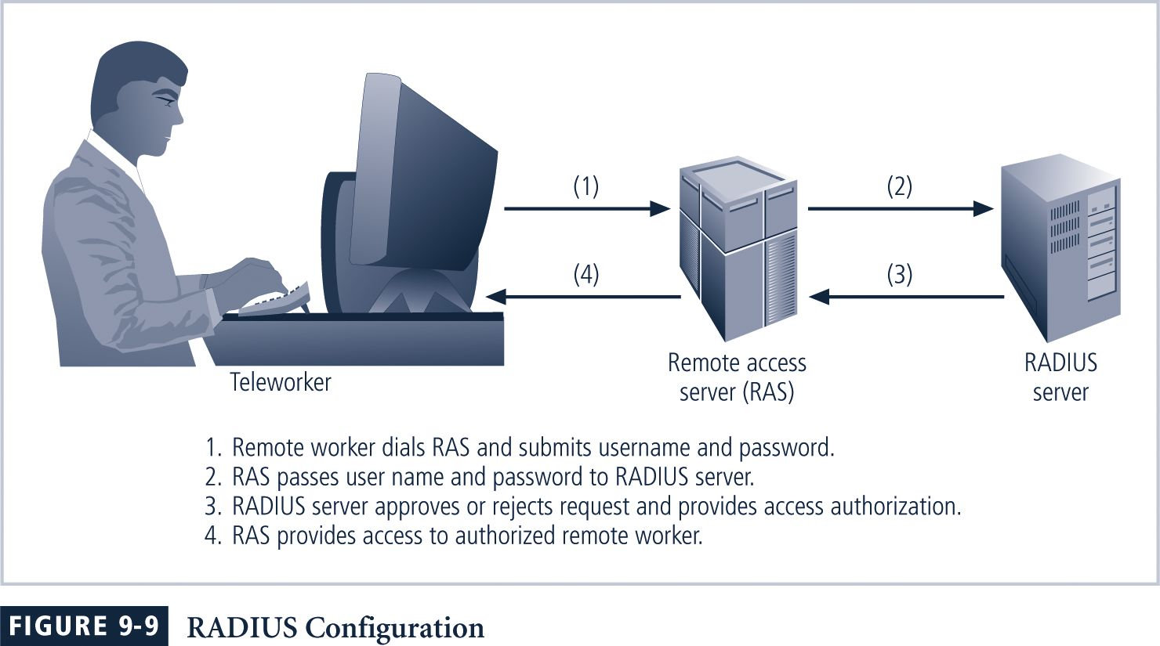
Figure 9-9 RADIUS Configuration

Slide 47
Managing Dial-Up Connections
Organizations that continue to offer dial-up remote access must deal with a number of thorny issues:
Determine how many dial-up connections the organization has
Control access to authorized modem numbers
Use call-back whenever possible
Use token-based authentication if at all possible

Slide 48
Intrusion Detection

Slide 49
Intrusion Detection/Response
Characteristics of systems not under attack:
Actions of users/processes conform to statistically predictable patterns
Actions of users/processes do not include sequences of commands to subvert security policy
Actions of processes conform to specifications describing allowable actions
Denning: Systems under attack fail to meet one or more of the these characteristics

Slide 50
Intrusion Detection
Idea: Attack can be discovered by one of the above being violated
Automated attack tools
Designed to violate security policy
Example: rootkits: sniff passwords and stay hidden
Practical goals of intrusion detection systems:
Detect a wide variety of intrusions (known + unknown)
Detect in a timely fashion
Present analysis in a useful manner
Need to monitor many components; proper interfaces needed
Be (sufficiently) accurate
Minimize false positives and false negatives

Slide 51
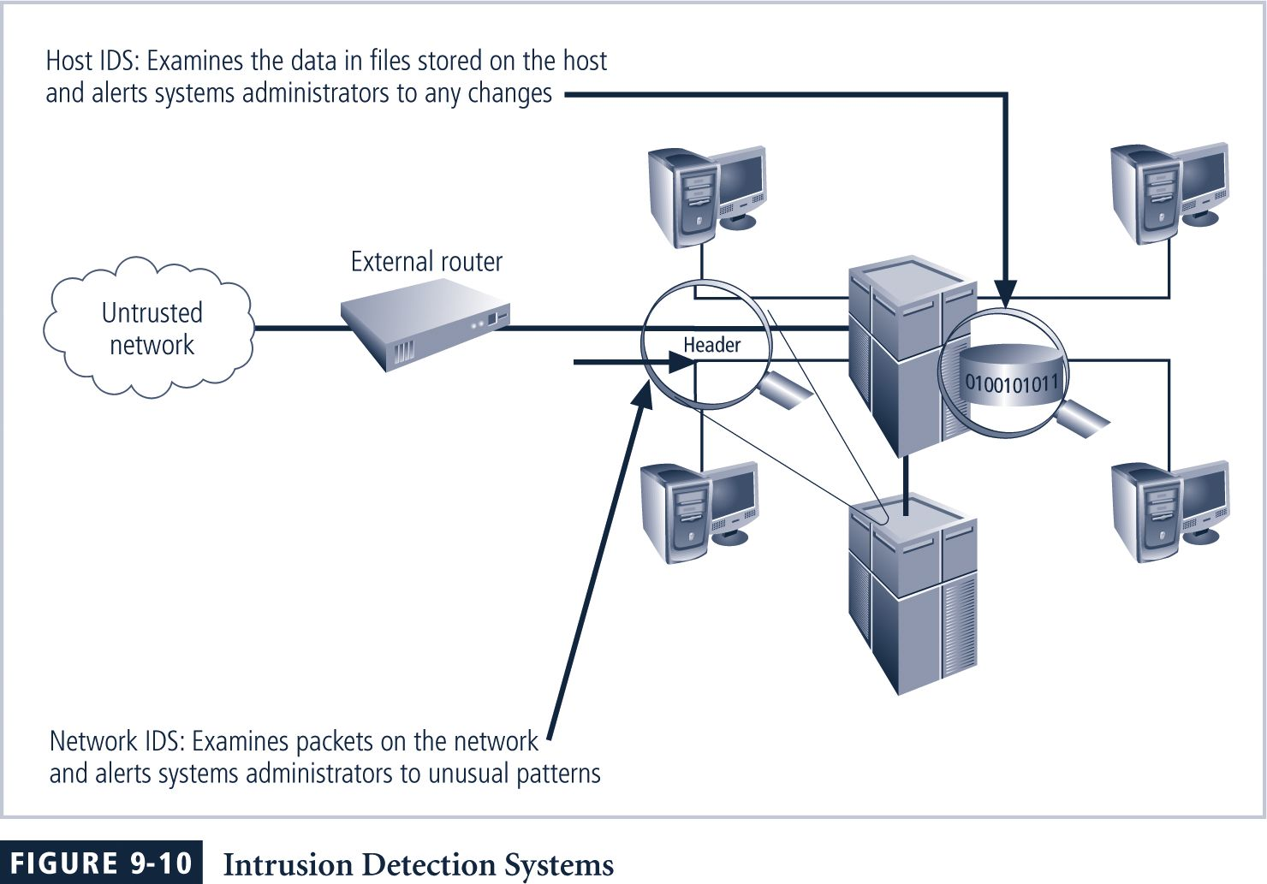
Figure 9-10 Intrusion Detection Systems

Slide 52
Host-Based IDS
Host-based IDS works by configuring and classifying various categories of systems and data files
In many cases, IDSs provide only a few general levels of alert notification
Unless the IDS is very precisely configured, benign actions can generate a large volume of false alarms
Host-based IDSs can monitor multiple computers simultaneously

Slide 53
Network-Based IDS
Network-based IDSs
Monitor network traffic and, when a predefined condition occurs, notify appropriate administrator
Looks for patterns of network traffic
Must match known and unknown attack strategies against their knowledge base to determine whether an attack has occurred
Yield many more false-positive readings than do host-based IDSs
Because attempting to read network activity pattern to determine what is normal and what is not

Slide 54
IDS Types: Anomaly Detection
Compare characteristics of system with expected values
report when statistics do not match
Threshold metric: when statistics deviate from normal by threshold, sound alarm
E.g., Number of failed logins
Statistical moments: based on mean/standard deviation of observations
Number of user events in a system
Time periods of user activity
Resource usages profiles
Markov model: based on state, expected likelihood of transition to new states
If a low probability event occurs then it is considered suspicious

Slide 55
Statistical Anomaly-Based IDS
Statistical anomaly-based IDS (stat IDS) or behavior-based IDS
First collects data from normal traffic and establishes a baseline
Then periodically samples network activity, based on statistical methods
Compares samples to baseline
When activity falls outside baseline parameters (known as the clipping level), IDS notifies the administrator
Advantage is that system is able to detect new types of attacks
Because it looks for abnormal activity of any type

Slide 56
Anomaly Detection: How do we determine normal?
Capture average over time
But system behavior isn’t always average
Correlated events
Events may have dependencies
Machine learning approaches
Training data obtained experimentally
Data should relate to as accurate normal operation as possible

Slide 57
IDS Types: Misuse Modeling
Does sequence of instructions violate security policy?
Problem: How do we know all violating sequences?
Solution: capture known violating sequences
Generate a rule set for an intrusion signature
But won’t the attacker just do something different?
Often, no: kiddie scripts, Rootkit, …
Alternate solution: State-transition approach
Known “bad” state transition from attack (e.g. use petri-nets)
Capture when transition has occurred (user root)

Slide 58
Signature-Based IDS
Signature-based IDS or knowledge-based IDS
Examines data traffic for something that matches signatures which comprise preconfigured, predetermined attack patterns
Problem is that signatures must be continually updated, as new attack strategies emerge
Weakness is time frame over which attacks occur
If attackers are slow and methodical, they may slip undetected through the IDS, as their actions may not match a signature that includes factors based on duration of the events

Slide 59
IDS Systems
Anomaly Detection
Intrusion Detection Expert System (IDES) – successor is NIDES
Network Security Monitor (NSM)
Misuse Detection
Intrusion Detection In Our Time- IDIOT (colored Petri-nets)
USTAT?
ASAX (Rule-based)
Hybrid
NADIR (Los Alamos)
Haystack (Air force, adaptive)
Hyperview (uses neural network)
Distributed IDS (Haystack + NSM)

Slide 60
IDS Architecture
Host 1
Similar to Audit system
Log events
Analyze log
Difference:
happens real-time - timely fashion
(Distributed) IDS idea:
Agent generates log
Director analyzes logs
May be adaptive
Notifier decides how to handle result
GrIDS displays attacks in progress
Agent
Director
Host 1
Agent
Notifier
Host 1
Agent

Slide 61
Where is the Agent?
Host based IDS
watches events on the host
Often uses existing audit logs
Network-based IDS
Packet sniffing
Firewall logs

Slide 62
IDS Problem
IDS useless unless accurate
Significant fraction of intrusions detected
Significant number of alarms correspond to intrusions
Goal is
Reduce false positives
Reports an attack, but no attack underway
Reduce false negatives
An attack occurs but IDS fails to report

Slide 63
Intrusion Response
Incident Prevention
Stop attack before it succeeds
Measures to detect attacker
Example: Jailing (also Honepots)
Make attacker think they are succeeding and confine to an area
Intrusion handling
Preparation for detecting attacks
Identification of an attack
Contain attack
Eradicate attack
Recover to secure state
Follow-up to the attack - Punish attacker

Slide 64
Containment
Passive monitoring
Track intruder actions
Eases recovery and punishment
Constraining access
Downgrade attacker privileges
Protect sensitive information
Why not just pull the plug?
Example: Honepots

Slide 65
Eradication
Terminate network connection
Terminate processes
Block future attacks
Close ports
Disallow specific IP addresses
Wrappers around attacked applications

Slide 66
Follow-Up
Legal action
Trace through network
Cut off resources
Notify ISP of action
Counterattack
Is this a good idea?

Slide 67
Managing Intrusion Detection Systems
IDSs must be configured using technical knowledge and adequate business and security knowledge to differentiate between routine circumstances and low, moderate, or severe threats
Properly configured IDS can translate a security alert into different types of notification
Poorly configured IDS may yield only noise
Most IDSs monitor systems by means of agents, software that resides on a system and reports back to a management server

Slide 68
Managing Intrusion Detection Systems (Continued)
Consolidated enterprise manager
Valuable tool in managing an IDS
Software that allows security professional to collect data from multiple host- and network-based IDSs and look for patterns across systems and subnetworks
Collects responses from all IDSs used to identify cross-system probes and intrusions

