Slide 1
CIS 5600 Information Security Management
Dr. Jeremy Lanman, Adjunct Professor
jlanman@fit.edu
Office: Virtual
Office Hours: By arrangement

Slide 2
Auditing

Slide 3
What is Auditing?
Logging
Recording events or statistics to provide information about system use and performance
Auditing
Analysis of log records to present information about the system in a clear, understandable manner

Slide 4
Auditing goals/uses
User accountability
Damage assessment
Determine causes of security violations
Describe security state for monitoring critical problems
Determine if system enters unauthorized state
Evaluate effectiveness of protection mechanisms
Determine which mechanisms are appropriate and working
Deter attacks because of presence of record

Slide 5
Problems
What to log?
looking for violations of a policy, so record at least what will show such violations
Use of privileges
What do you audit?
Need not audit everything
Key: what is the policy involved?

Slide 6
Audit System Structure
Logger
Records information, usually controlled by parameters
Analyzer
Analyzes logged information looking for something
Notifier
Reports results of analysis

Slide 7
Logger
Type, quantity of information recorded controlled by system or program configuration parameters
May be human readable or not
If not, usually viewing tools supplied
Space available, portability influence storage format

Slide 8
Example: Windows NT
Different logs for different types of events
System event logs record system crashes, component failures, and other system events
Application event logs record events that applications request be recorded
Security event log records security-critical events such as logging in and out, system file accesses, and other events
Logs are binary; use event viewer to see them
If log full, can have system shut down, logging disabled, or logs overwritten

Slide 9
Windows NT Sample Entry
Date: 2/12/2000 Source: Security
Time: 13:03 Category: Detailed Tracking
Type: Success EventID: 592
User: WINDSOR\Administrator
Computer: WINDSOR
Description:
A new process has been created:
New Process ID: 2216594592
Image File Name:
\Program Files\Internet Explorer\IEXPLORE.EXE
Creator Process ID: 2217918496
User Name: Administrator
FDomain: WINDSOR
Logon ID: (0x0,0x14B4c4)
[would be in graphical format]

Slide 10
Analyzer
Analyzes one or more logs
Logs may come from multiple systems, or a single system
May lead to changes in logging
May lead to a report of an event
Using swatch to find instances of telnet from tcpd logs:
/telnet/&!/localhost/&!/*.site.com/
Query set overlap control in databases
If too much overlap between current query and past queries, do not answer
Intrusion detection analysis engine (director)
Takes data from sensors and determines if an intrusion is occurring

Slide 11
Notifier
Informs analyst, other entities of results of analysis
May reconfigure logging and/or analysis on basis of results
May take some action

Slide 12
Designing an Audit System
Essential component of security mechanisms
Goals determine what is logged
Idea: auditors want to detect violations of policy, which provides a set of constraints that the set of possible actions must satisfy
So, audit functions that may violate the constraints
Constraint pi : action condition

Slide 13
Example: Bell-LaPadula
Simple security condition and *-property
S reads O L(S) ≥ L(O)
S writes O L(S) ≤ L(O)
To check for violations, on each read and write, must log L(S), L(O), action (read, write), and result (success, failure)
Note: need not record S, O!
In practice, done to identify the object of the (attempted) violation and the user attempting the violation

Slide 14
Implementation Issues
Show non-security or find violations?
Former requires logging initial state as well as changes
Defining violations
Does “write” include “append” and “create directory”?
Multiple names for one object
Logging goes by object and not name
Representations can affect this (if you read raw disks, you’re reading files; can your auditing system determine which file?)

Slide 15
Syntactic Issues
Data that is logged may be ambiguous
BSM: two optional text fields followed by two mandatory text fields
If three fields, which of the optional fields is omitted?
Solution: use grammar to ensure well-defined syntax of log files

Slide 16
Example Grammar
entry : date host prog [ bad ] user [ “from” host ] “to” user “on” tty
date : daytime
host : string
prog : string “:”
bad : “FAILED”
user : string
tty : “/dev/” string
Log file entry format defined unambiguously
Audit mechanism could scan, interpret entries without confusion

Slide 17
More Syntactic Issues
Context
Unknown user uses anonymous ftp to retrieve file “/etc/passwd”
Logged as such
Problem: which /etc/passwd file?
One in system /etc directory
One in anonymous ftp directory /var/ftp/etc, and as ftp thinks /var/ftp is the root directory, /etc/passwd refers to /var/ftp/etc/passwd

Slide 18
Log Sanitization
U set of users, P policy defining set of information C(U) that U cannot see; log sanitized when all information in C(U) deleted from log
Two types of P
C(U) can’t leave site
People inside site are trusted and information not sensitive to them
C(U) can’t leave system
People inside site not trusted or (more commonly) information sensitive to them
Don’t log this sensitive information

Slide 19
Logging Organization
Top prevents information from leaving site
Users’ privacy not protected from system administrators, other administrative personnel
Bottom prevents information from leaving system
Data simply not recorded, or data scrambled before recording (Cryptography)

Slide 20
Reconstruction
Anonymizing sanitizer cannot be undone
No way to recover data from this
Pseudonymizing sanitizer can be undone
Original log can be reconstructed
Importance
Suppose security analysis requires access to information that was sanitized?

Slide 21
Issue
Key: sanitization must preserve properties needed for security analysis
If new properties added (because analysis changes), may have to resanitize information
This requires pseudonymous sanitization or the original log

Slide 22
Example
Company wants to keep its IP addresses secret, but wants a consultant to analyze logs for an address scanning attack
Connections to port 25 on IP addresses 10.163.5.10, 10.163.5.11, 10.163.5.12, 10.163.5.13, 10.163.5.14,
Sanitize with random IP addresses
Cannot see sweep through consecutive IP addresses
Sanitize with sequential IP addresses
Can see sweep through consecutive IP addresses

Slide 23
Generation of Pseudonyms
Devise set of pseudonyms to replace sensitive information
Replace data with pseudonyms that preserve relationship
Maintain table mapping pseudonyms to data
Use random key to encipher sensitive datum and use secret sharing scheme to share key
Used when insiders cannot see unsanitized data, but outsiders (law enforcement) need to
(t, n) –threshold scheme: requires t out of n people to read data

Slide 24
Application Logging
Applications logs made by applications
Applications control what is logged
Typically use high-level abstractions such as:
su: bishop to root on /dev/ttyp0
Does not include detailed, system call level information such as results, parameters, etc.

Slide 25
System Logging
Log system events such as kernel actions
Typically use low-level events
3876 ktrace CALL execve(0xbfbff0c0,0xbfbff5cc,0xbfbff5d8)
3876 ktrace NAMI "/usr/bin/su"
3876 ktrace NAMI "/usr/libexec/ld-elf.so.1"
3876 su RET xecve 0
3876 su CALL __sysctl(0xbfbff47c,0x2,0x2805c928,0xbfbff478,0,0)
3876 su RET __sysctl 0
3876 su CALL mmap(0,0x8000,0x3,0x1002,0xffffffff,0,0,0)
3876 su RET mmap 671473664/0x2805e000
3876 su CALL geteuid
3876 su RET geteuid 0
Does not include high-level abstractions such as loading libraries (as above)

Slide 26
Contrast
Differ in focus
Application logging focuses on application events, like failure to supply proper password, and the broad operation (what was the reason for the access attempt?)
System logging focuses on system events, like memory mapping or file accesses, and the underlying causes (why did access fail?)
System logs usually much bigger than application logs
Can do both, try to correlate them

Slide 27
Design
A posteriori design
Need to design auditing mechanism for system not built with security in mind
Goal of auditing
Detect any violation of a stated policy
Focus is on policy and actions designed to violate policy; specific actions may not be known
Detect actions known to be part of an attempt to breach security
Focus on specific actions that have been determined to indicate attacks

Slide 28
Detect Violations of Known Policy
Goal: does system enter a disallowed state?
Two forms
State-based auditing
Look at current state of system
Transition-based auditing
Look at actions that transition system from one state to another

Slide 29
State-Based Auditing
Log information about state and determine if state is allowed
Assumption: you can get a snapshot of system state
Snapshot needs to be consistent
Non-distributed system needs to be quiescent

Slide 30
Example
File system auditing tools (e.g. tripwire)
Thought of as analyzing single state (snapshot)
In reality, analyze many slices of different state unless file system quiescent
Potential problem: if test at end depends on result of test at beginning, relevant parts of system state may have changed between the first test and the last
Classic TOCTTOU flaw (time to check to time of use)

Slide 31
Transition-Based Auditing
Log information about action, and examine current state and proposed transition to determine if new state would be disallowed
Note: just analyzing the transition may not be enough; you may need the initial state
Tend to use this when specific transitions always require analysis (for example, change of privilege)

Slide 32
Example
TCP access control mechanism intercepts TCP connections and checks against a list of connections to be blocked
Obtains IP address of source of connection
Logs IP address, port, and result (allowed/blocked) in log file
Purely transition-based (current state not analyzed at all)

Slide 33
Detect Known Violations of Policy
Goal: does a specific action and/or state that is known to violate security policy occur?
Assume that action automatically violates policy
Policy may be implicit, not explicit
Used to look for known attacks

Slide 34
Scanning Tools

Slide 35
Scanning and Analysis Tools
Scanning and analysis tools can find vulnerabilities in systems, holes in security components, and other unsecured aspects of the network
Conscientious administrators
Will have several informational web sites bookmarked
Frequently browse for new vulnerabilities, recent conquests, and favorite assault techniques
Nothing wrong with using tools used by attackers to examine own defenses and search out areas of vulnerability

Slide 36
Scanning and Analysis Tools
Scanning tools collect the information that an attacker needs to succeed
Footprinting
Organized research of the Internet addresses owned or controlled by a target organization
Fingerprinting
Entails the systematic examination of all of the organization’s network addresses
Yields a detailed network analysis that reveals useful information about the targets of the planned attack

Slide 37
Port Scanners
Port
Network channel or connection point in a data communications system
Port scanning utilities (or port scanners)
Can identify (or fingerprint) active computers on a network and active ports and services on those computers, the functions and roles fulfilled by the machines, and other useful information

Slide 38
Port Scanners (Continued)
Well-known ports are those from 0 through 1023
Registered ports are those from 1024 through 49151
Dynamic and private ports are those from 49152 through 65535
Open ports
Can be used to send commands to a computer
Gain access to a server
Exert control over a networking device
Thus must be secured

Slide 39
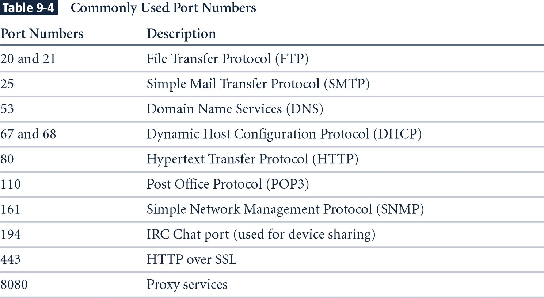
Commonly Used Port Numbers

Slide 40
Vulnerability Scanners
Vulnerability scanners
Variants of port scanners
Capable of scanning networks for very detailed information
Identify exposed user names and groups
Show open network shares
Expose configuration problems and other server vulnerabilities

Slide 41
Packet Sniffers
Packet sniffer
Network tool that collects and analyzes packets on a network
Can be used to eavesdrop on network traffic
Must be connected directly to a local network from an internal location
To use a packet sniffer legally, you must:
Be on a network that the organization owns, not leases
Be under the direct authorization of the network’s owners
Have the knowledge and consent of users
Have a justifiable business reason for doing so

Slide 42
Content Filters
Content filter
Effectively protects organization’s systems from misuse and unintentional denial-of-service conditions
Software program or a hardware/software appliance that allows administrators to restrict content that comes into a network
Most common application is restriction of access to Web sites with non–business-related material, such as pornography
Another application is restriction of spam e-mail
Ensure that employees are using network resources appropriately

Slide 43
Trap and Trace
Trap function
Describes software designed to entice individuals illegally perusing internal areas of a network
Trace function
Process by which the organization attempts to determine the identity of someone discovered in unauthorized areas of the network or systems
If identified individual is outside the security perimeter, then policy will guide the process of escalation to law enforcement or civil authorities

Slide 44
Managing Scanning and Analysis Tools
Vitally important that security manager be able to see organization’s systems and networks from viewpoint of potential attackers
Should develop a program using in-house resources, contractors, or an outsourced service provider to periodically scan his or her own systems and networks for vulnerabilities with the same tools that typical hacker might use

Slide 45
Managing Scanning and Analysis Tools (Continued)
Drawbacks to using scanners and analysis tools, content filters, and trap and trace tools:
Do not have human-level capabilities
Most function by pattern recognition only handle known issues
Most are computer-based prone to errors, flaws, and vulnerabilities of their own
Designed, configured, and operated by humans subject to human errors
Some governments, agencies, institutions, and universities have established policies or laws that protect the individual user’s right to access content
Tool usage and configuration must comply with explicitly articulated policy policy must provide for valid exceptions

