Slide 1
Web Security
Web now widely used by business, government, individuals
but Internet & Web are vulnerable
have a variety of threats
  integrity
  confidentiality
  denial of service
  authentication
need added security mechanisms

Slide 2
YouTube Videos
https://www.youtube.com/watch?v=LRMBZhdFjDI

Slide 3
SSL (Secure Socket Layer)
transport layer security service
originally developed by Netscape
version 3 designed with public input
subsequently became Internet standard known as TLS (Transport Layer Security)
uses TCP to provide a reliable end-to-end service
SSL has two layers of protocols
Notes:
SSL probably most widely used Web security mechanism. Its implemented at the Transport layer; cf IPSec at Network layer; or various Application layer mechanisms eg. S/MIME & SET (later).

Slide 4
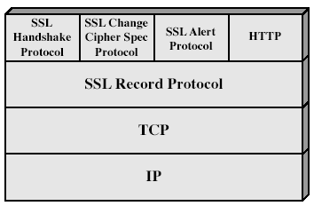
SSL Architecture
Notes:
Stallings Fig 17-2.

Slide 5
SSL Architecture
SSL session
  an association between client & server
  created by the Handshake Protocol
  define a set of cryptographic parameters
  may be shared by multiple SSL connections
SSL connection
  a transient, peer-to-peer, communications link
  associated with 1 SSL session

Slide 6
SSL Record Protocol
confidentiality
  using symmetric encryption with a shared secret key defined by Handshake Protocol
  IDEA, RC2-40, DES-40, DES, 3DES, Fortezza, RC4-40, RC4-128
  message is compressed before encryption
message integrity
  using a Message Authentication Code (MAC) with shared secret key
  similar to keyed-Hashing (HMAC) but with different padding
Notes:
SSL Record Protocol defines these two services for SSL connections.

Slide 7
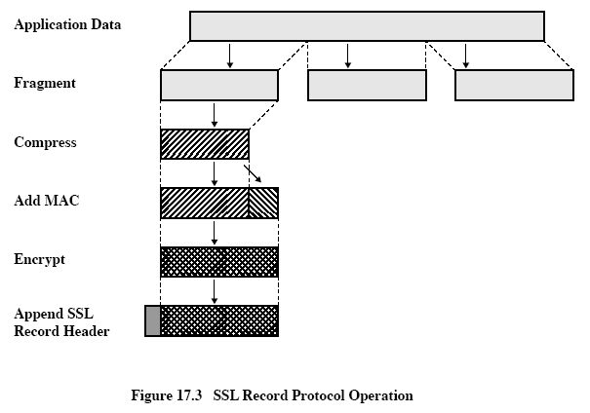

Slide 8
SSL Change Cipher Spec Protocol
one of 3 SSL specific protocols which use the SSL Record protocol
a single message
causes pending state to become current
hence updating the cipher suite in use

Slide 9
SSL Alert Protocol
conveys SSL-related alerts to peer entity
severity
    warning or fatal
specific alert
    unexpected message, bad record mac, decompression failure, handshake failure, illegal parameter
    close notify, no certificate, bad certificate, unsupported certificate, certificate revoked, certificate expired, certificate unknown
compressed & encrypted like all SSL data

Slide 10
SSL Handshake Protocol
allows server & client to:
  authenticate each other
  to negotiate encryption & MAC algorithms
  to negotiate cryptographic keys to be used
comprises a series of messages in phases
  Establish Security Capabilities
  Server Authentication and Key Exchange
  Client Authentication and Key Exchange
  Finish

Slide 11
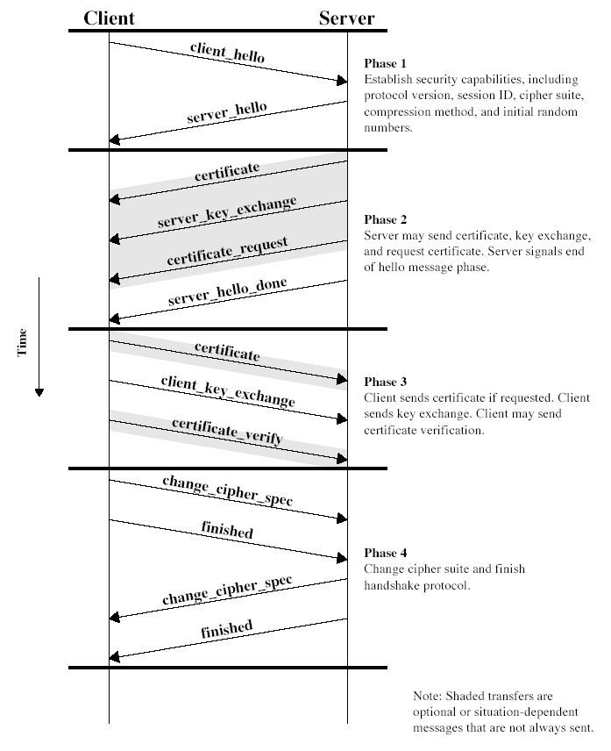
Notes:
Stallings Fig 17-6.

Slide 12
TLS (Transport Layer Security)
IETF standard RFC 2246 similar to SSLv3
with minor differences
  in record format version number
  uses HMAC for MAC
  a pseudo-random function expands secrets
  has additional alert codes
  some changes in supported ciphers
  changes in certificate negotiations
  changes in use of padding

Slide 13
Secure Electronic Transactions (SET)
open encryption & security specification
to protect Internet credit card transactions
developed in 1996 by Mastercard, Visa etc
not a payment system
rather a set of security protocols & formats
  secure communications amongst parties
  trust from use of X.509v3 certificates
  privacy by restricted info to those who need it

Slide 14
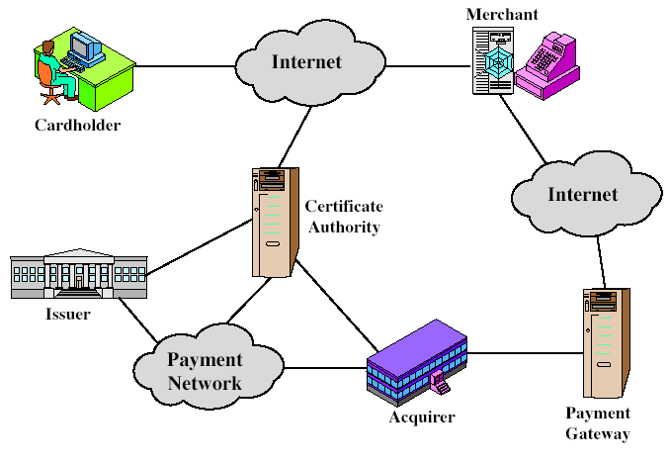
SET Components
Notes:
Stallings Fig 17-8.

Slide 15
SET Transaction
customer opens account
customer receives a certificate
merchants have their own certificates
customer places an order
merchant is verified
order and payment are sent
merchant requests payment authorization
merchant confirms order
merchant provides goods or service
merchant requests payment

Slide 16
Dual Signature
customer creates dual messages
  order information (OI) for merchant
  payment information (PI) for bank
neither party needs details of other
but must know they are linked
use a dual signature for this
  signed concatenated hashes of OI & PI
  DS=E_{KRc}[H (H(PI) || H(OI))]

Slide 17
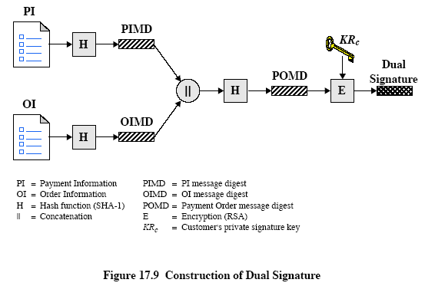

Slide 18
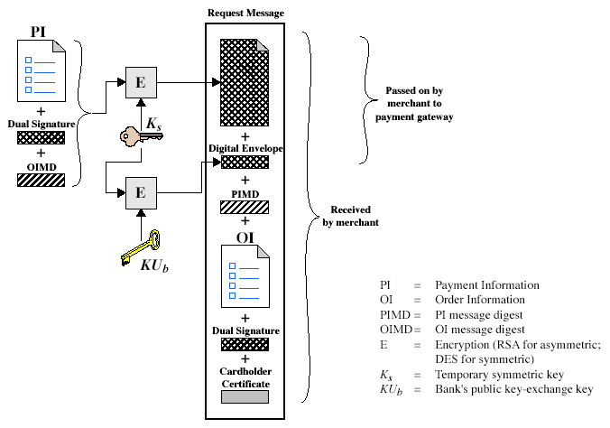
Purchase Request – Customer
Notes:
Stallings Fig 17-10.

Slide 19
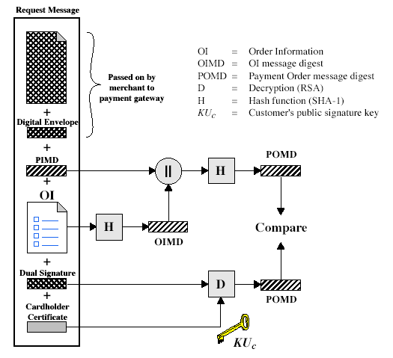
Purchase Request – Merchant
Notes:
Stallings Fig 17-11.

Slide 20
Purchase Request – Merchant
verifies cardholder certificates using CA sigs
verifies dual signature using customer's public signature key to ensure order has not been tampered with in transit & that it was signed using cardholder's private signature key
processes order and forwards the payment information to the payment gateway for authorization (described later)
sends a purchase response to cardholder

Slide 21
Payment Gateway Authorization
verifies all certificates
decrypts digital envelope of authorization block to obtain symmetric key & then decrypts authorization block
verifies merchant's signature on authorization block
decrypts digital envelope of payment block to obtain symmetric key & then decrypts payment block
verifies dual signature on payment block
verifies that transaction ID received from merchant matches that in PI received (indirectly) from customer
requests & receives an authorization from issuer
sends authorization response back to merchant

Slide 22
Payment Capture
merchant sends payment gateway a payment capture request
gateway checks request
then causes funds to be transferred to merchants account
notifies merchant using capture response

Slide 23
Summary
have considered:
  need for web security
  SSL/TLS transport layer security protocols
  SET secure credit card payment protocols

