Slide 1
Data Modeling & Database Design
Chapter 1
Database Systems: Architecture & Components
Module I
Notes:
1

Slide 2
Major Themes
Metadata
Program-Data Independence
  ANSI/SPARC 3-schema architecture
What is a Database System?
Data Modeling: A Roadmap

Slide 3

What is an Information System ?!
Environment
Organization
Business Process
Candidate Key
Information Technology
{IT + Data + Procedures + People}
{Hardware + Software}
Information System

Slide 4
A Taxonomy for Information Systems
Data/Transaction Processing Systems
Information Reporting Systems
  Executive Information Systems
Decision Support Systems
  Expert Systems
Knowledge Management Systems
Business Intelligence
  Decision Analytics
Knowledge Discovery

Slide 5
Data & Information
What is Data?
  Raw material
  Unorganized facts about things, events, activities and transactions
  Lack of organization renders data valueless
What is Information?
  Data in context
  Organized into a specific context, data has,
  as information, value to its recipients

Slide 6
What is Data ?
2357111317
What does the above data tell you ?
Social security number ?! – No, there are 10 digits
Phone number ?! – Perhaps a good guess; just a guess, though – may be right, may be not !!
A bunch of prime numbers – a mathematician talking !!
Any interpretation on your part amounts to
pure and simple
“Hallucination”

Slide 7
What is Information ?
Giving meaning to data !
Data acquires meaning based on
the “lens”
through which the data is viewed
2357111317

Slide 8

The Lens
[No more hallucinations]
2357111317
Lens 1: (Position 1 – 9) Social security # (Position 10) Pay scale code
Lens 2: (Position 1 – 3) Area code (Position 4 -10) Phone #
The lens is called “METADATA”

Slide 9
So What is Metadata ?
It is a precise definition of the context
Data that describes the properties of data
Lens to view data & information
infer

Slide 10
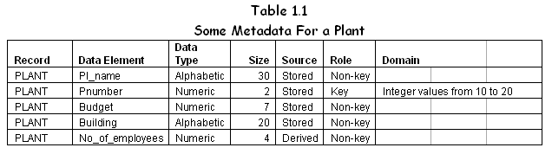
Metadata: A Simplified Example
Record Data Element Data Type
Size Source Role Domain

Slide 11
Metadata: A Textual Expression
There are several colleges in the university. Each college has a Name, Location, and Size. A college offers many courses over four college terms or quarters—Fall, Winter, Spring, and Summer—during which one or more of these courses are offered. Course#, Name, and Credit Hours describe a course. No two courses in any college have the same Course#; likewise no two courses have the same Name. Terms are identified by Year and Quarter, and contain enrollment numbers. Courses are offered during every term. The college also has several instructors. Instructors teach; that is why they are called instructors. Often, not all instructors are scheduled to teach during all terms; but every term has some instructors teaching. Also, the same course is never taught by more than one instructor in a specific term. Further, instructors are capable of teaching a variety of courses offered by the college. Instructors have a unique Employee ID and their Name, Qualification, and Experience are also recorded.

Slide 12
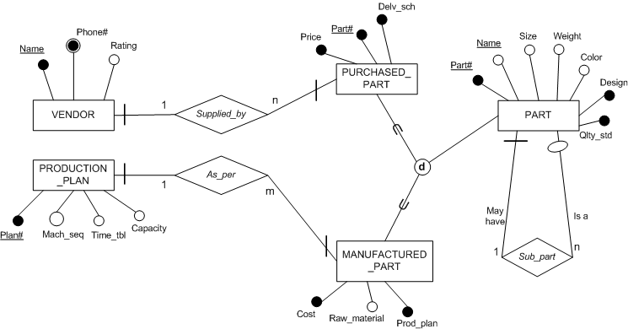
Metadata: A pictorial Expression
A conceptual schema
Data Modeling & Database Design: Chapter 2 {Umanath& Scamell}

Slide 13
Metadata: A Complex pictorial Expression
A conceptual schema

Slide 14
Questions ?!

Slide 15
End of Module

