Slide 1
attendance tracker
Jazz Team

Slide 2
our vision
To integrate management and payroll tasks allowing more effective and efficient utilization of your most important commodity, time.

Slide 3
need for an upgrade
Biometric scanning device is out of close proximity to lab locations
Ensure the labs are open at their appropriate times
Convenient access to payroll
Real-time notifications of clock in/out times of employees

Slide 4
Major Features
A new biometric scanner will be installed and implemented into each lab location for close proximity to work site. This will be purchased from a third party vendor, Acrotime.
Real time notifications of employees arrival and departure
Detailed Compiled reports of payroll hours
Alert notifications of a closed lab after opening hours

Slide 5
Acrotime
Detailed Summary Reports of all employees for specified pay period
Time card reports, document sick and personal leave
Reports are accessible on multiple devices.

Slide 6
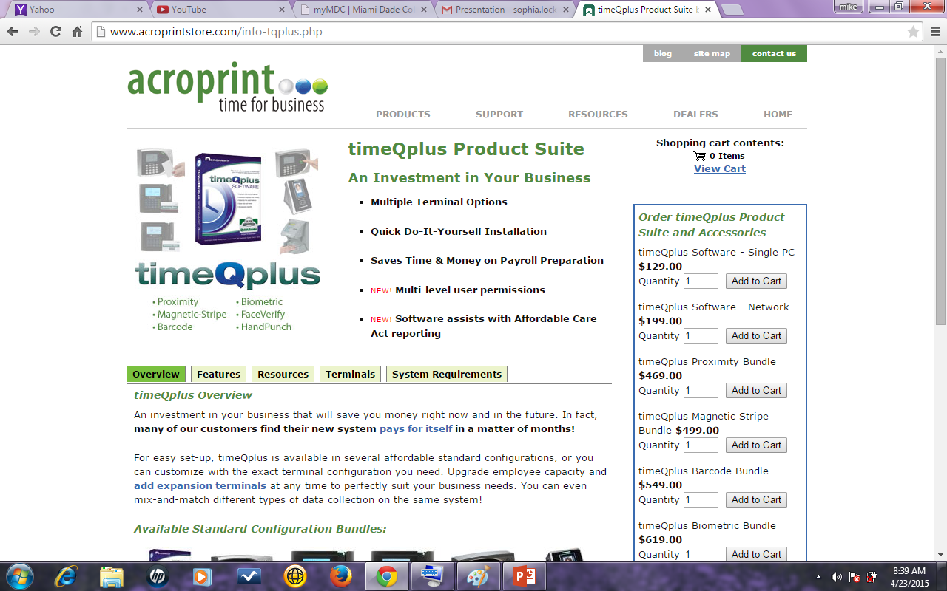
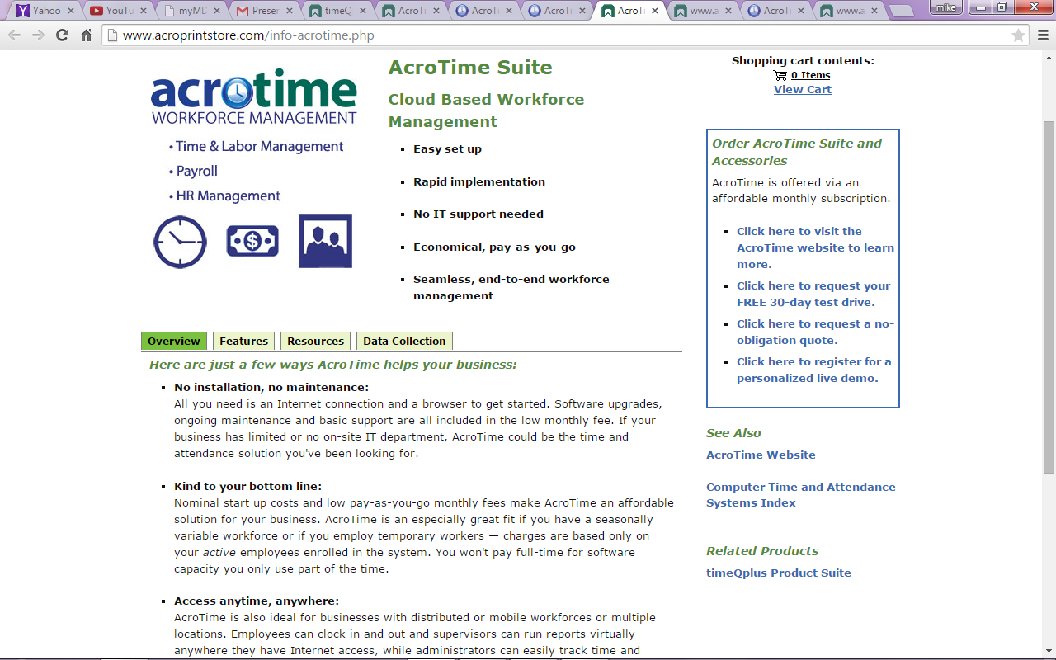

Slide 7
Features of acrotime
No installation, no maintenance
Kind to your bottom line
Access anytime, anywhere

Slide 8
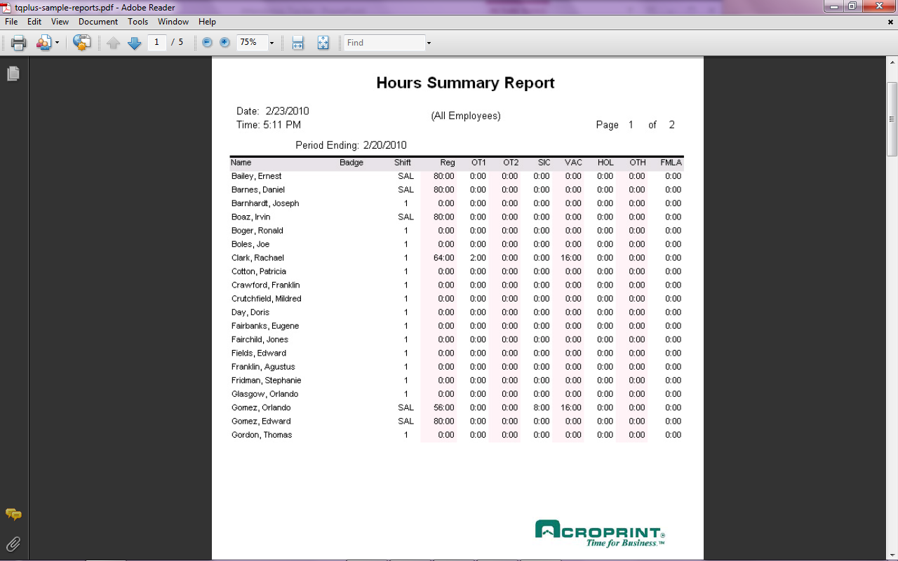

Slide 9
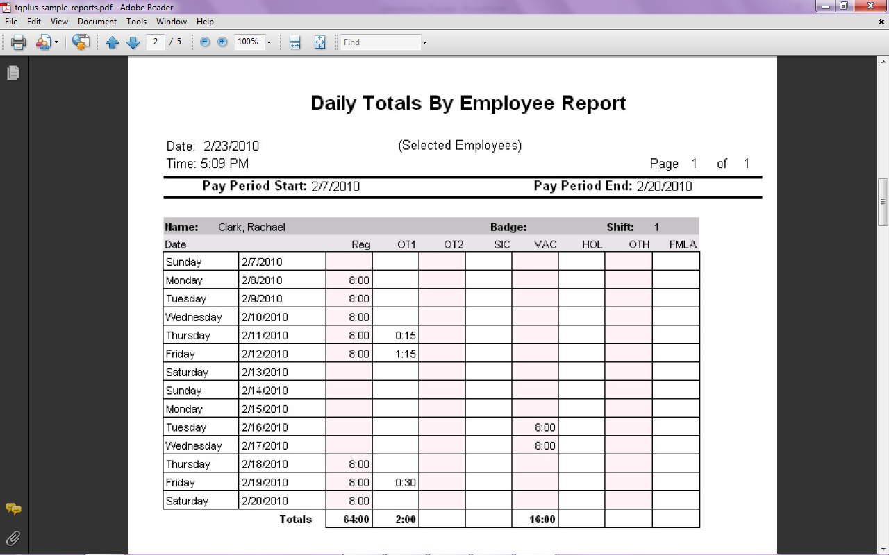

Slide 10
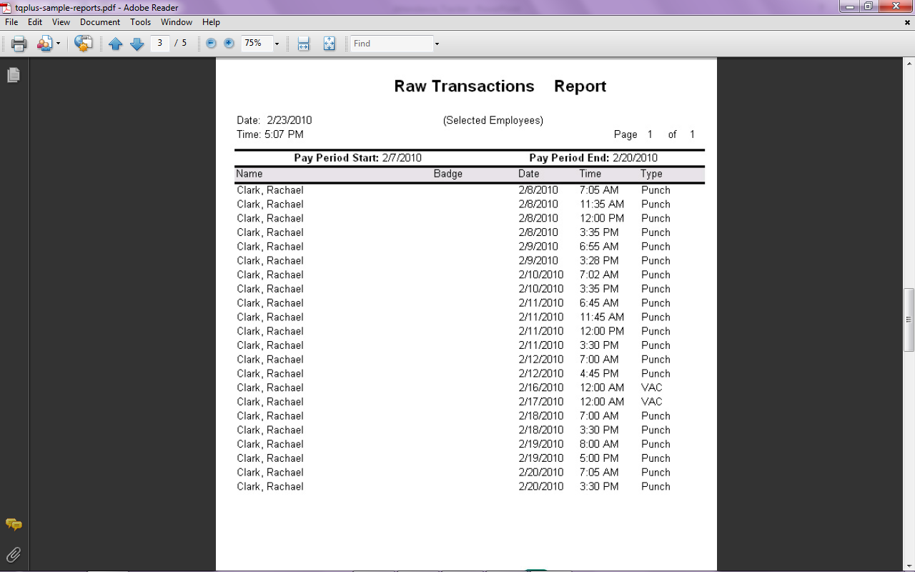
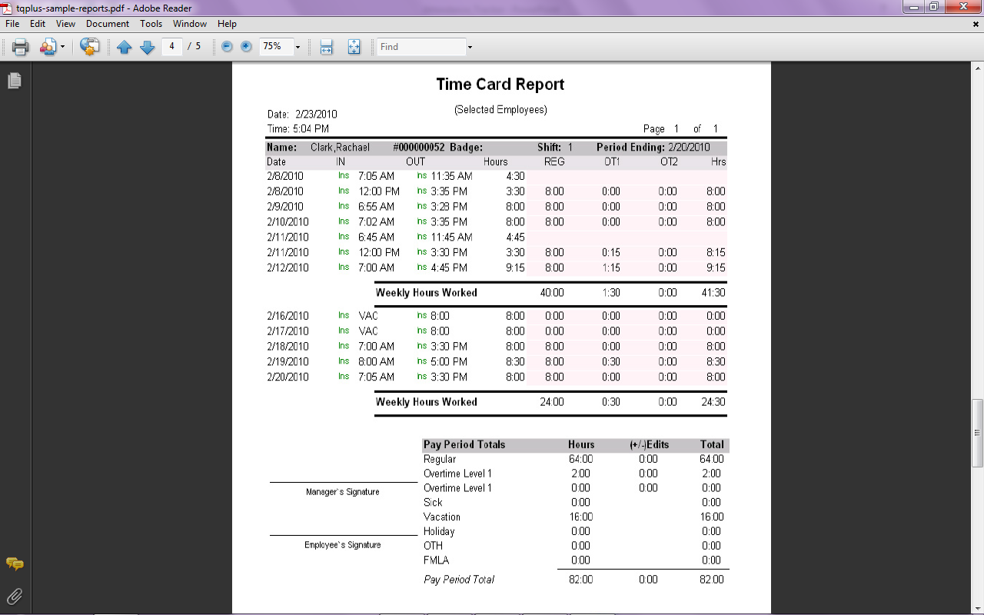

Slide 11
callfire
Notifications
Alerts
Student Satisfaction Survey via SMS text

Slide 12
