Slide 2
Mathematical Library Functions
#include <cmath>
abs(a)
exp(a)
sqrt(a)
pow(a,n) // a is a number and n is the exponent

Slide 3
Mathematical Library Functions

Slide 4
Type Conversion
C++ operator and operands
If operands are of different data type, C++ attempts to convert them to same type
Implicit (automatic) conversion
a.k.a “type coercion”
Promotion
Demotion

Slide 5
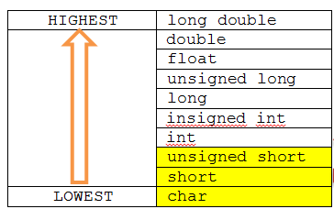

Type Conversion
Data type rankings:
R1: char, short, unsigned short are automatically promoted to an int

Slide 6
Type Conversion
Data type rankings:
int x = 10;
double y = 5.43;
cout << x + y;
R2: when an operator works with two operands of different data types, the
lower ranking operand is promoted to the data type of the high ranking operand

Slide 7
Type Conversion
Data type rankings:
int x;
double y = 5.43;
x = y;
R3: when the final value of an expression is assigned to a variable, it is converted
to the data type of the variable regardless of the data type rank.

Slide 8
Type Conversion
R1: char, short, and unsigned short are automatically promoted to int
R2: when an operator works with two operands of different data types, the lower ranking operand is promoted to the data type of the high-ranking operand.
R3: when the final value of an expression is assigned to a variable, it is converted to the data type of the variable regardless of the data type rank.

Slide 9
Type Casting
double myValue = 1.23456;
How would you convert this to a different data type ?
static_cast<DataType>(value)
1 | int main()
2 | {
3 | const int numTests = 3;
4 | int test1=85, test2=100, test3=87;
5 | double average;
6
7 | average = (test1+test2+test3)/numTests;
8 | cout << "Your average is : " << average << endl;
9 | return 0;
10 | }

Slide 10

Legacy Casts

Slide 11
Expressions
Q: What is an expression?
A: Anything that evaluates to numeric value.
Expression vs. “Expression Statement”

Slide 12
Expressions
Expressions with arithmetic operators:
3 + 5 * 2
3 + (12-4) * ((14/2 -8)*3)
cout << "3 + 5 * 2 is : " << 3 + 5 * 2 << endl;
int result = 3 + 5 * 2;
cout << "3 + 5 * 2 is : "
<< result
<< endl;

Slide 13
Operators
Classification?
Unary
Binary
Ternary

Slide 14
Operators - Unary
Negation (-)
Increment (++)
Decrement (--)

Slide 15
Operators - Increment
x = x + 1;
++x;
x +=1;

Slide 16
Operators - Decrement
x = x - 1;
--x;
x -=1;

Slide 17
Prefix vs. Postfix
Prefix:
operation takes place first, then the operand is used
Postfix:
Operand is first used, then the operation takes place

Slide 18
Binary Operators

Slide 19
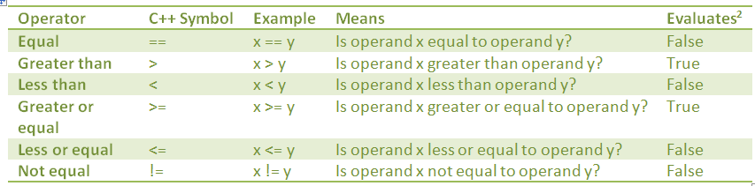
Relational Operators

Slide 20
Conditional Statements
Execute only if certain conditions are met
Designed to mimic real world situations
“if it is raining outside, take an umbrella”
Start with the keyword “if”
if (expr)
statement1;
statement2;
statement3;
Only if expr evaluates to true, then “statement1” will execute

Slide 21
Simple if Statement
1 | int main()
2 | {
3 | int x = 25;
4 | int y = 20;
5 | if (x < y)
6 | cout << x << " is less than " << y << endl;
7
8 | cout << "Have a nice day!" << endl;
9 | return 0;
10 | }

Slide 22
Flowcharts
http://en.wikipedia.org/wiki/Flowchart
http://www.farshadoo.com/ic/tutorials/flowchart-diagrams.php

Slide 23
Block of Code
1 | int main()
2 | {
3 | int x = 5;
4 | int y = 20;
5 | if (x < y)
6 | {
7 | cout << x << " is less than " << y << endl;
8 | cout << "This is a block of code." << endl;
9 | cout << "All the statements in this block execute together." << endl;
10 | }
11
12 | cout << "Have a nice day!" << endl;
13 | return 0;
14 | }

Slide 24
Common Mistakes
Using the assignment (=) operator instead of the equal (==) operator
Semicolon at the end of if statement
1 | int main()
2 | {
3 | int x = 25;
4 | int y = 20;
5 | if (x < y);
6 | {
7 | cout << x << " is less than " << y << endl;
8 | cout << "This is a block of code." << endl;
9 | cout << "All the statements in this block execute together." << endl;
10 | }
11
12 | cout << "Have a nice day!" << endl;
13 | return 0;
14 | }

