Slide 1

The Zen of C++
Chapter 2: Fundamental Data Types
Adnan Zejnilovic

Slide 2
C++ Programming Process
Write the source code
Notepad
IDEs
Compile
Command Line
IDEs
Execute

Slide 3
Compilation
Command Line Compilers
GNU C++ (GCC)
Pros: Free
Cons:
Need to remember commands
Error prone due to typing
IDEs
MS Visual Studio
Code Blocks
DevC++
Pros:
No need to memorize commands – only a few buttons
Cons:
Each IDE is specific
Learning curve

Slide 4
Your 1st C++ Program
1 | // my first C++ program -Hello World
2 | #include <iostream>
3
4 | using namespace std;
5
6 | int main()
7 | {
8 | cout << "Hello world!" << endl;
9 | return 0;
10 | }
1 | /*
2 | Programmer : Adi Zejnilovic
3 | Date : 07/28/2013
4 | Description : This program will display the following message:
5 | Hello world!
6 | */
7 | #include <iostream>
8
9 | using namespace std;
10
11 | int main()
12 | {
13 | cout << "Hello world!" << endl;
14 | return 0;
15 | }

Slide 5
Preprocessor Directive
1 | // my first C++ program -Hello World
2 | #include <iostream>
3
4 | using namespace std;
5
6 | int main()
7 | {
8 | cout << "Hello world!" << endl;
9 | return 0;
10 | }
Sourcecode.cpp
iostream
Sourcecode.cpp
iostream
Modified Source Code File

Slide 6
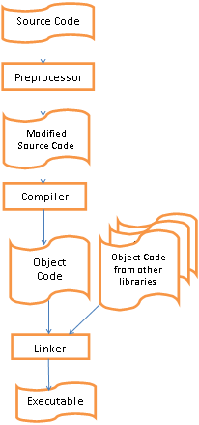

Slide 7

Namespaces
using namespace std;
namespace is like a directory
std::cout << "Hello world!" << std::endl;
cout << "Hello world!" << endl;

Slide 8
Function Definition, Function Header, and Function Body
int main()
{
cout << "Hello World!" << endl;
return 0;
}
Function
Header
Function
Definition
Function
Body

Slide 9
int main cont.
Parameter List
int main()
{
cout << "Hello World!" << endl;
return 0;
}
Beginning
End

Slide 10
endl and Escape Sequences
Escape Sequence | Character | Comments
\’ | Single quote | Prints a single quote
\” | Double quote | Prints a double quote
\\ | Backslash | Prints a backslash
\0 | Null character | Null Character (to terminate char arrays)
\b | Backspace | Moves the cursor back one space
\a | Audible bell | Plays a predetermined sound
\f | Form feed (new page) | Prints a new page
\n | Line feed (new line) | Moves the cursor to the new line
\r | Carriage return | Moves the cursor to the beginning of the existing line
\t | Horizontal tab | Moves the cursor to the next tab stop

Slide 11
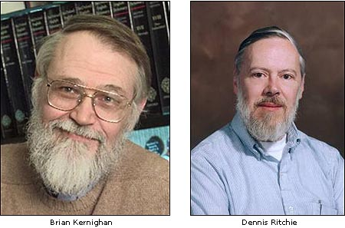
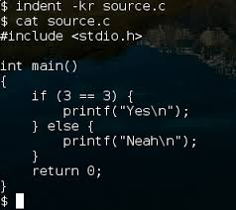
Programming Style – K & R

Slide 12
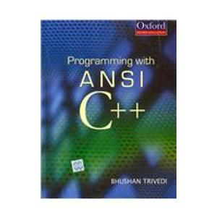
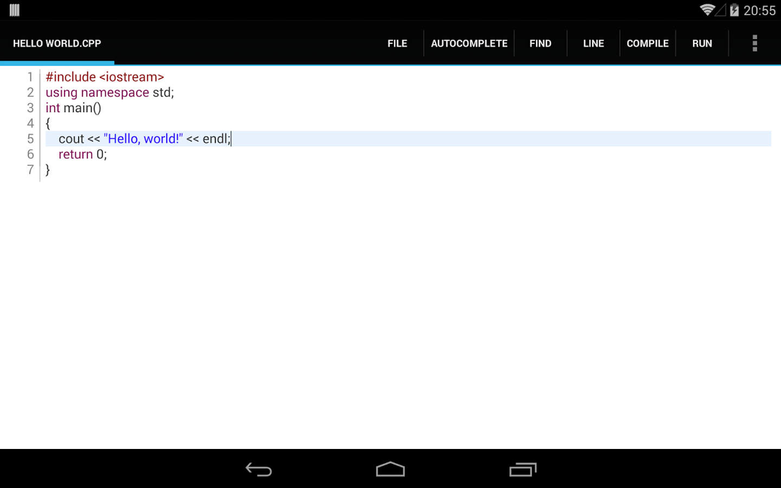
Programming Style

Slide 13

Programming Style - GNU
if (a > 5)
{
// statement(s);
}

Slide 14
Fundamental Data Types
Reserved (“Key Words”)
Identifiers
Operators
Punctuation
Grammar
Bool, int, float, for, if, namespace
constants, variables, types, templates, classes,
functions, and namespaces
Must start with a letter or an underscore
Can contain characters and numbers
Cannot start with a number

Slide 15

Literals
String Literal
cout << "Hello world!" << endl;
cout << "5" << endl;
Integer Literal
cout << 5 << endl;

Slide 16
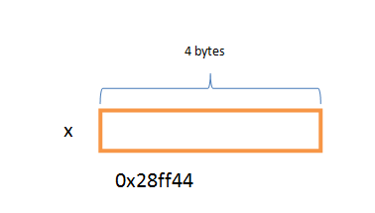
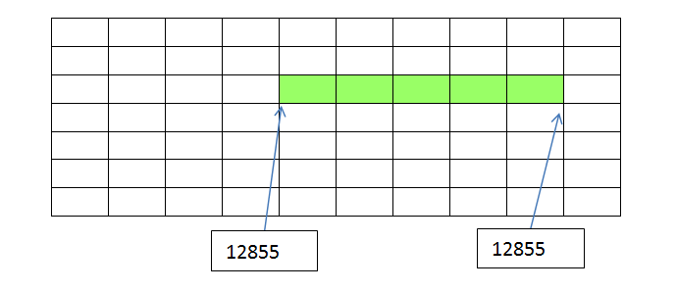
Variables
int x; // variable definition

Slide 17
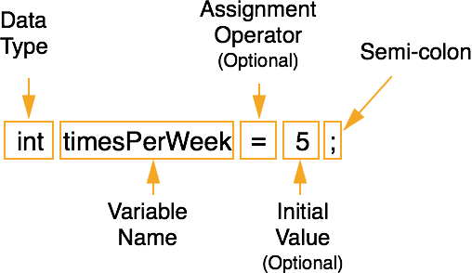
Variables

Slide 18
C++ Data Types
Built-in
Fundamental Data Types
Non Fundamental Data Types
Programmer Defined
Abstract Data Types

Slide 19
Built In Data Types
Integer Data Types
bool
char
short int (also short)
int
long int (also long)
unsigned char
unsigned short int
unsigned int
unsigned long
Floating Point Data Types
Number with decimal point
What is the difference between signed and unsigned?

Slide 20

Bit vs. Byte
bit
byte

Slide 21
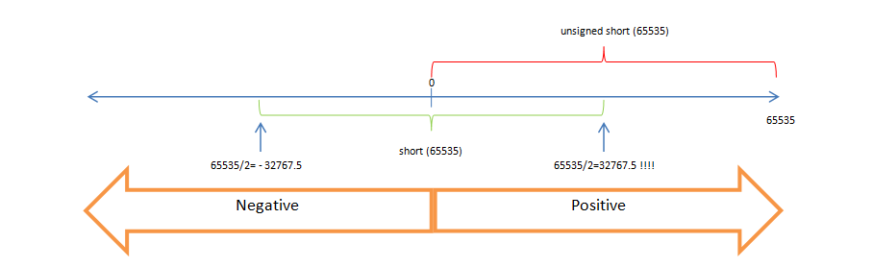
Signed vs. Unsigned

Slide 22
Signed vs. Unsigned
short
unsigned short
0
65535/2
65535/2
65535
-32757.5
32757.5

Slide 23
Source Code
#include <iostream>
#include <climits>
using namespace std;
int main()
{
cout << "sizeof bool: " << sizeof(bool)<< endl;
cout << "bool range: "
<< CHAR_MIN
<< " to "
<< CHAR_MAX << endl;
return 0;
}

Slide 24



short vs. int

Slide 25
Fundamental Data Types cont.
bool
char
Floating Point
float
double
long double

Slide 26
Non-Fundamental Data Types
#include <string>
string bestEver = “Michael Jordan”;
string myAddress = “123 Main Street”;

Slide 27
Arithmetic Operators
Unary
Example: -10
Binary
Ternary
Example: ((x+5) > 0) ? x = x + 1 : x = 10;
Operator | C++ Symbol | Example
Addition | + | 5 + 3
Subtraction | - | 5.4 – 3
Multiplication | * | 5 * 3.14
Division | / | 5.0 / 3.0
Modulus | % | 5 % 3

