Slide 1
INDI Instrument-Neutral Distributed Interface
Defines a protocol to connect instruments to a GUI client. Primarily used for astronomical work.
The protocol reports the properties of the instrument. If the client is adaptable, it can potentially control any instrument if a driver is available.
Similar to a word processor being able to print to any printer if a driver is available.
Project Indi-mr - receives the INDI protocol data and sets it into REDIS for a web client. Provides further functions for transmitting the protocol over MQTT

Slide 2
The usual case:
Various drivers, written to match different instruments
IANA assigned port 7624
Instrument
Driver
GUI client
Indiserver (Available for Linux)
XML protocol
Instrument
Driver
Many GUI client programs are available, often integrated with planetarium applications
Driver
Instrument
Instruments are typically telescopes, guiders, dome controls, CCD cameras, weather sensors. Each with proprietary controls, connected by serial/USB/IP

Slide 3
Indi_mr.inditoredis
Web apps are event driven and multi-process and do not store state, so require a database
IANA assigned port 7624
Python package
indiredis
Instrument
Driver
Indiserver (Available for Linux)
Web app
Web
Redis
Instrument
Driver
Web app
WEB SERVER
Driver
Web app
Instrument
Or any GUI app written to read and write to Redis
Python function
Indi_mr.inditoredis()

Slide 4
Indi_mr.inditoredis()
Communicate on port 7624, parse the XML and shove it into redis key – value storage.
Using a set of Redis keys useful to a GUI holding instrument names and properties.
A ‘tools’ module is available with functions to read/write to Redis and hence to the connected instruments.

Slide 5
The protocol defines Property vectors – each containing a number of elements
NumberVector
TextVector
SwitchVector
LightVector
BLOBVector
Each with XML tags and attributes to define the property and its elements (from the driver), set an element (from client), delete a property, update an element.
End result is any format of data can be transmitted between the instrument and the client.

Slide 6
REDIS KEYS
Note : A prefix string can be specified and added to all keys.
Keys | Stored values
devices | A list of device names
properties:<devicename> | List of property names for the device
attributes:<propertyname>:<devicename> | Dictionary of attributes:values
messages | String of "Timestamp space message"
devicemessages:<devicename> | String of "Timestamp space message"
elements:<propertyname>:<devicename> | List of element names for the device property
elementattributes:<elementname>: <propertyname>:<devicename> | Dictionary of attributes:values for the element
Logdata keys store logs of the above as redis streams of (timestamp, datastring)
logdata:devices | Datastring is a JSON string of device list
logdata:properties:<devicename> | Datastring is a JSON string of property list
logdata:attributes:<propertyname>: <devicename> | Datastring is a JSON string of an attribute dictionary for the given property and device
Etc., - a matching logdata key for each of the above.

Slide 7
Indi_mr.driverstoredis
Python package
indiredis
Instrument
Driver
Web app
Web
Redis
Instrument
Driver
Web app
WEB SERVER
Driver
Web app
Instrument
Or any GUI app written to read and write to Redis
Python function
Indi_mr.driverstoredis()

Slide 8
MQTT
Included functions to transmit XML data
Via an MQTT server.
MQTT Server
Driver
Indiserver (Available for Linux)
Web app
Web
Redis
Driver
Web app
WEB SERVER
Driver
Web app
Python function
Indi_mr.inditomqtt()
Python function
Indi_mr.mqtttoredis()

Slide 9
MQTT
Included functions to transmit XML data
Via an MQTT server.
MQTT Server
Driver
IANA assigned port 7624
Driver
GUI client
XML
protocol
Driver
Python function
Indi_mr.mqtttoport()
Python function
Indi_mr.driverstomqtt()

Slide 10
MQTT
Included functions to transmit XML data
Via an MQTT server.
Driver
MQTT Server
Driver
Driver
IANA assigned port 7624
GUI client
XML protocol
Driver
Driver
Python function
Indi_mr.mqtttoport()
Driver
Python functions
Indi_mr.driverstomqtt()

Slide 11
Indiredis
Web application, served by any wsgi web server.
Reads and writes data to redis keys.
Very general application, ‘learns’ and displays instrument properties from the data stored in redis.
Useful as a general instrument client.

Slide 12
Example web service
With a redis server and indiserver running on localhost, the included web service can be run with:
python3 -m indiredis path/to/blobfolder
where path/to/blobfolder is a path to a folder of your choice where Binary Large Objects, such as images, will be stored if your instruments create them.
The web client can then be viewed from a browser pointing to localhost:8000

Slide 13
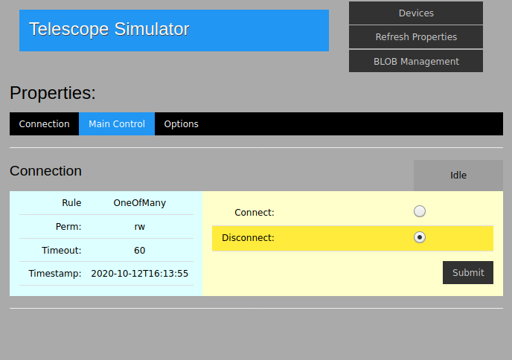
Image from web client

Slide 14
Indi_mr.tools
A set of Python functions which read, and publish to the redis server.
Useful when creating a Python client GUI.
Functions are provided which open a redis connection, and return lists of devices, properties, elements etc.,
Further functions create xml elements and publish them which transmits the values on to the attached instruments.

Slide 15
References
https://github.com/bernie-skipole/indi-mr
https://indi-mr.readthedocs.io
https://pypi.org/project/indi-mr/
https://github.com/bernie-skipole/indi
https://indiredis.readthedocs.io
https://pypi.org/project/indiredis/
https://en.wikipedia.org/wiki/Instrument_Neutral_Distributed_Interface
https://www.clearskyinstitute.com/INDI/INDI.pdf
https://indilib.org/
https://github.com/indilib/indi/releases
https://packages.debian.org/buster/indi-bin
https://github.com/eclipse/paho.mqtt.python
https://github.com/andymccurdy/redis-py

