Slide 1
INDI Instrument-Neutral Distributed Interface
Defines a protocol to connect a GUI client to measurement/control instruments. Primarily used for astronomical work.
The protocol reports the properties of the instrument. If the client is adaptable, it can potentially control any instrument if a driver is available.
Similar to a word processor being able to print to any printer if a driver is available.
My project Indiredis - to take the instrument data and set it into REDIS for a web client.

Slide 2
The usual case:
Various drivers, written to match different instruments
IANA assigned port 7624
Instrument
Driver
GUI client
Indiserver (Available for Linux)
XML protocol
Instrument
Driver
Many GUI client programs are available, often integrated with planetarium applications
Driver
Instrument
Instruments are typically telescopes, guiders, dome controls, CCD cameras, weather sensors. Each with proprietary controls, connected by serial/USB/IP

Slide 3
Indiredis
Web apps are event driven and multi-process and do not store state, so require a database
IANA assigned port 7624
Python module
indiredis.indiwsgi
Instrument
Driver
Indiserver (Available for Linux)
Web app
Web
Redis
Instrument
Driver
Web app
WEB SERVER
Driver
Web app
Instrument
Or any GUI app written to read and write to Redis
Python function
Indiredis.inditoredis()

Slide 4
Indiredis.inditoredis()
Communicate on port 7624, parse the XML and shove it into redis key – value storage.
Devise a list of sensible keys useful to a GUI.
Python has libraries to parse xml, and to communicate to redis, and to create web services.
Main task to understand the XML protocol specification.

Slide 5
Sample from the Indi white paper describing the protocol
<!ELEMENT getProperties EMPTY >
<!ATTLIST getProperties
version %nameValue; #REQUIRED
device %nameValue; #IMPLIED
name %nameValue; #IMPLIED>
<!ELEMENT defNumberVector (defNumber+) >
<!ATTLIST defNumberVector
device %nameValue; #REQUIRED
name %nameValue; #REQUIRED
label %labelValue; #IMPLIED
group %groupTag; #IMPLIED
state %propertyState; #REQUIRED
perm %propertyPerm; #REQUIRED
timeout %numberValue; #IMPLIED
timestamp %timeValue #IMPLIED
message %textValue #IMPLIED>
<!ELEMENT defNumber %numberValue >
<!ATTLIST defNumber
name %nameValue; #REQUIRED
label %labelValue; #IMPLIED
format %numberFormat; #REQUIRED
min %numberValue; #REQUIRED
max %numberValue; #REQUIRED
step %numberValue; #REQUIRED>

Slide 6
Property vectors – each containing a number of elements
NumberVector
TextVector
SwitchVector
LightVector
BlobVector
Each with XML tags and attributes to define the property and its elements (from the driver), set an element (from client), delete a property, update an element.
End result is any format of data can be transmitted between the instrument and the client.
Work so far – all vectors largely implemented except Blobs,
Numbers working but some odd cases not yet done,
i.e. Write only numbers
Working with simulated instruments, but not yet with real instruments.

Slide 7
REDIS KEYS
Note : A prefix string can be specified and added to all keys.
Keys | Stored values
devices | A set of device names
properties:<devicename> | Sets of property names, one key for each device
attributes:<propertyname>:<devicename> | Hash table of attributes:values
messages | String of "Timestamp space message"
devicemessages:<devicename> | String of "Timestamp space message"
elements:<propertyname>:<devicename> | Set of element names for the device property
elementattributes:<elementname>: <propertyname>:<devicename> | Hash table of attributes:values for the element
Logdata keys store a history of the above as a list of received Timestamp and JSON string
logdata:devices | list of "Timestamp space JSON string of device list"
logdata:properties:<devicename> | list of "Timestamp space JSON string of property list”
logdata:attributes:<propertyname>: <devicename> | List of Timestamp space JSON string of an attribute object for the given property and device”
Etc., - a matching logdata key for each of the above.

Slide 8
MQTT
Included functions to transmit XML data
Via an MQTT server.
MQTT Server
Driver
Indiserver (Available for Linux)
Web app
Web
Redis
Driver
Web app
WEB SERVER
Driver
Web app
Python function
Indiredis.inditomqtt()
Python function
Indiredis.mqtttoredis()

Slide 9
Indiredis.indiwsgi
Web application, served by any wsgi web server.
Reads and writes data to redis keys created by inditoredis.
Very general application, knows nothing about the attached instruments, but ‘learns’ and displays properties from the data stored in redis.
Precursor to ‘better looking’ web applications that have some knowledge of the attached instruments.
Useful as a general client when writing drivers.

Slide 10
Example web service
With a redis server and indiserver running on localhost, the sample web service can be run with:
python3 -m indiredis path/to/blobfolder
where path/to/blobfolder is a path to a folder of your choice where Binary Large Objects, such as images, will be stored if your instruments create them.
The web client can then be viewed from a browser pointing to localhost:8000

Slide 11
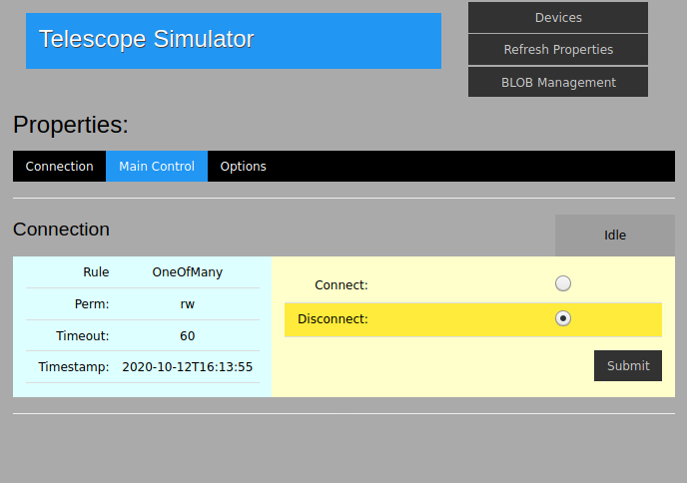
Image from web client

Slide 12
Indiredis.tools
A set of Python functions which read, and publish to the redis server.
Useful when creating a Python client GUI.
Functions are provided which open a redis connection, and return lists of devices, properties, elements etc.,
Further functions create xml elements and publish them which transmits the values on to indiserver and hence the attached instruments.

Slide 13
References
http://www.clearskyinstitute.com/INDI/INDI.pdf
https://github.com/bernie-skipole/indi
https://indiredis.readthedocs.io
https://pypi.org/project/indiredis/
https://indilib.org/
https://github.com/indilib/indi/releases
https://packages.debian.org/buster/indi-bin
https://en.wikipedia.org/wiki/Instrument_Neutral_Distributed_Interface

