Slide 1
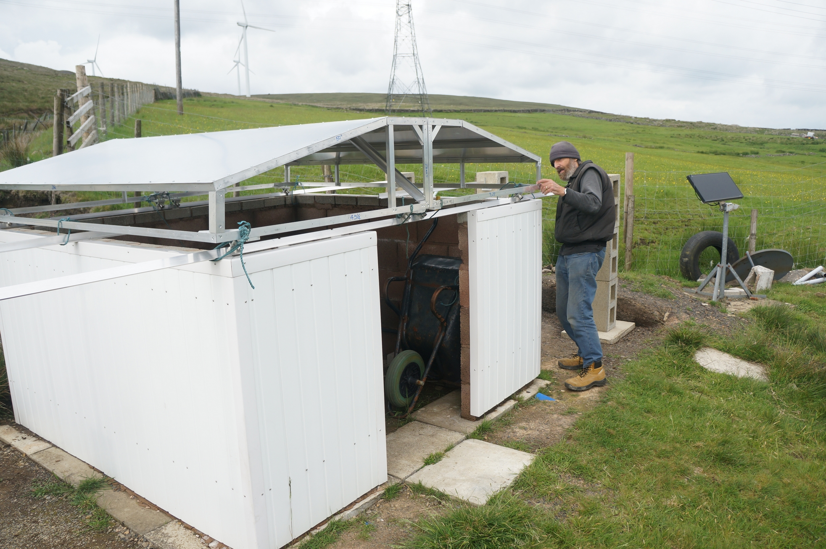
Astronomy Centre Remote Scope

Slide 2


Web control site
Web Server
Internet

Slide 3
Demo the web site
Currently at:
www.webparametrics.co.uk/acremscope

Slide 4
Python – a short diversion
A really nice programming language.
Any programming language is a set of instructions for the computer to undertake.
To write the instructions, you need to know the syntax.
A brief example, what is the volume of a sphere?

Slide 5
Filename : sample.py
def volsphere(radius):
volume = 4*3.141*radius*radius*radius/3
return volume

Slide 6
Import and use the function
from sample import volsphere
volsphere(1)
4.188
volsphere(2)
33.504

Slide 7
Python packages
You can obtain ‘packages’ of functions which other people (with brains the size of a planet) have written.
Your own program can then call these functions.
https://pypi.org/

Slide 8
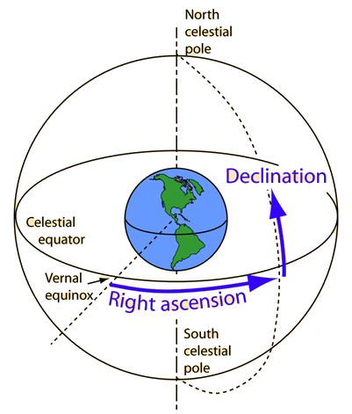
Coordinates

Slide 9
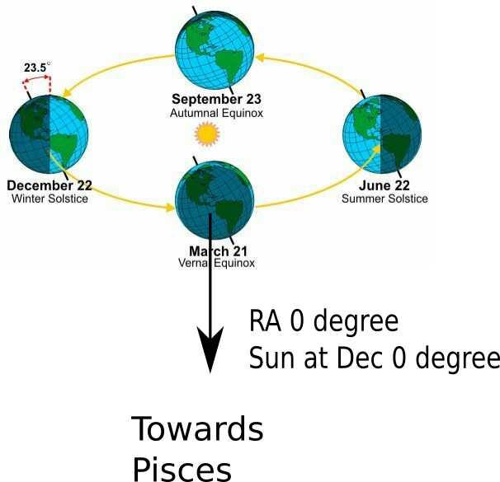
Origin
Coordinates could be in reference to the equinox of any given year, but as standard, the beginning of the year 2000, known as J2000.0 is used.

Slide 10
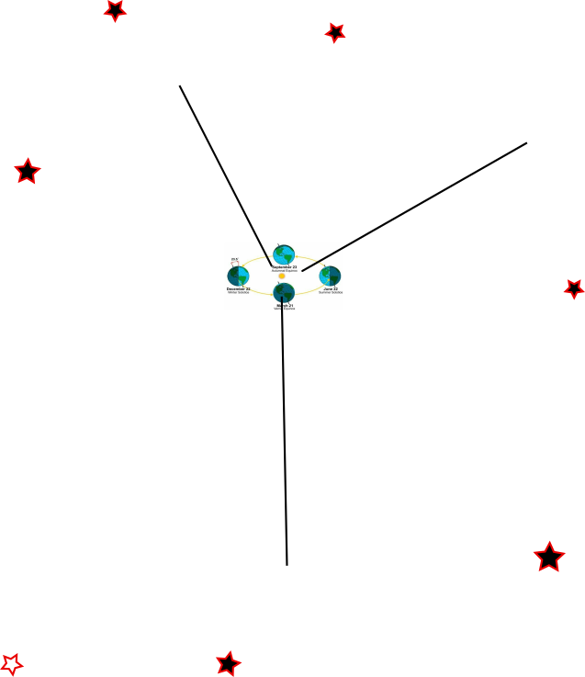
ICRS
International Celestial Reference System
A catalogue of a number of extra galactic distant objects has been compiled, so distant they are essentially ‘fixed’ in position.
And these axis have been defined in
reference to these objects, with origin at the barycentric centre of the solar system.

Slide 11
Alt-Az
Altitude – height in degrees, horizontal 0.
Vertically straight–up 90.
Azimuth – points of a compass

Slide 12
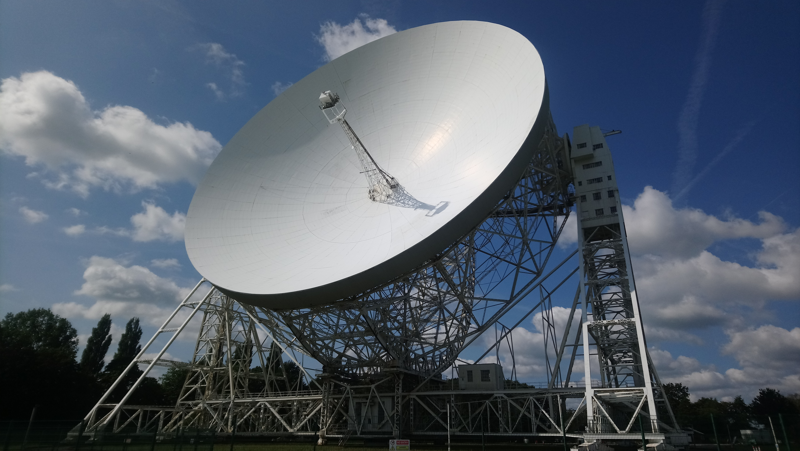

Slide 13
Demo IERS
ICRS coordinates of the target
Time and date of the observation
ALT-AZ
coordinates
Observer’s Longitude and Latitude
Earth wobble
https://www.iers.org/IERS/EN/Home/home_node.html

Slide 14
Astropy
A Python package containing many astronomical functions.
Including converting coordinates from ICRS to Alt-Az.
Resolves object names (such as M45) to ICRS coords
Gets planet and minor planet positions
Gets IERS data

Slide 15
Drawing the finder chart
With a catalogue of star positions and magnitudes.
Given the RA and DEC, and Field of View, pull out the relevant stars and plot them.
As the telescope moves, show its position on the chart.
Problem: There’s a lot of stars!!!!

Slide 16
Guide Star Catalogue
https://heasarc.gsfc.nasa.gov/W3Browse/all/gsc.html
I have a table derived from the above, of around 15 million stars, with columns
GSC_ID RA DEC MAG
Where GSC_ID is the index number from the catalogue, RA and DEC are in degrees, and MAG is the star magnitude.
However picking the stars from this catalogue at a particular RA, DEC and Field of View is difficult, and the algorithm doing it was slow.

Slide 17
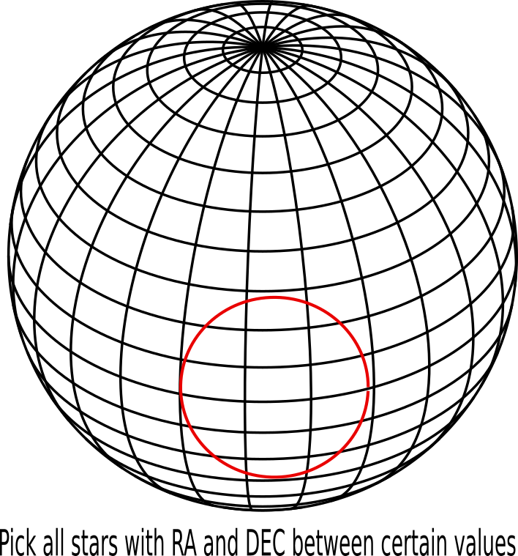
Cone search

Slide 18
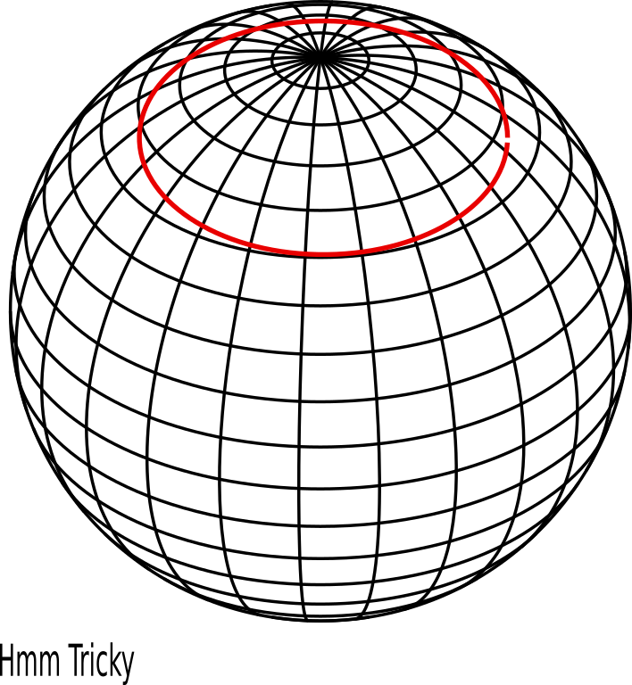
Not Easy!

Slide 19
HEALPix
So if plotting RA and DEC is so difficult, how do others do it?
Hierarchical Equal Area isoLatitude Pixelisation
(One heck of an acronym)

Slide 20
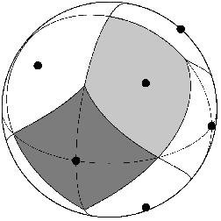
HEALPix 0
Diamonds : 12
Nside : 1

Slide 21
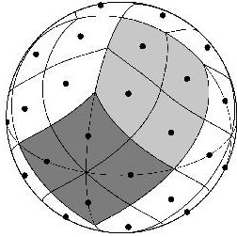
HEALPix 1
Diamonds : 48
Nside : 2

Slide 22
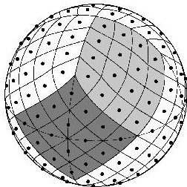
HEALPix 2
Diamonds : 192
Nside : 4

Slide 23
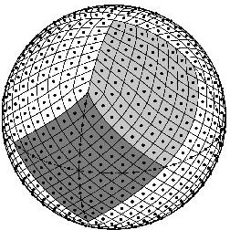
HEALPix 3
Diamonds : 768
Nside : 8

Slide 24
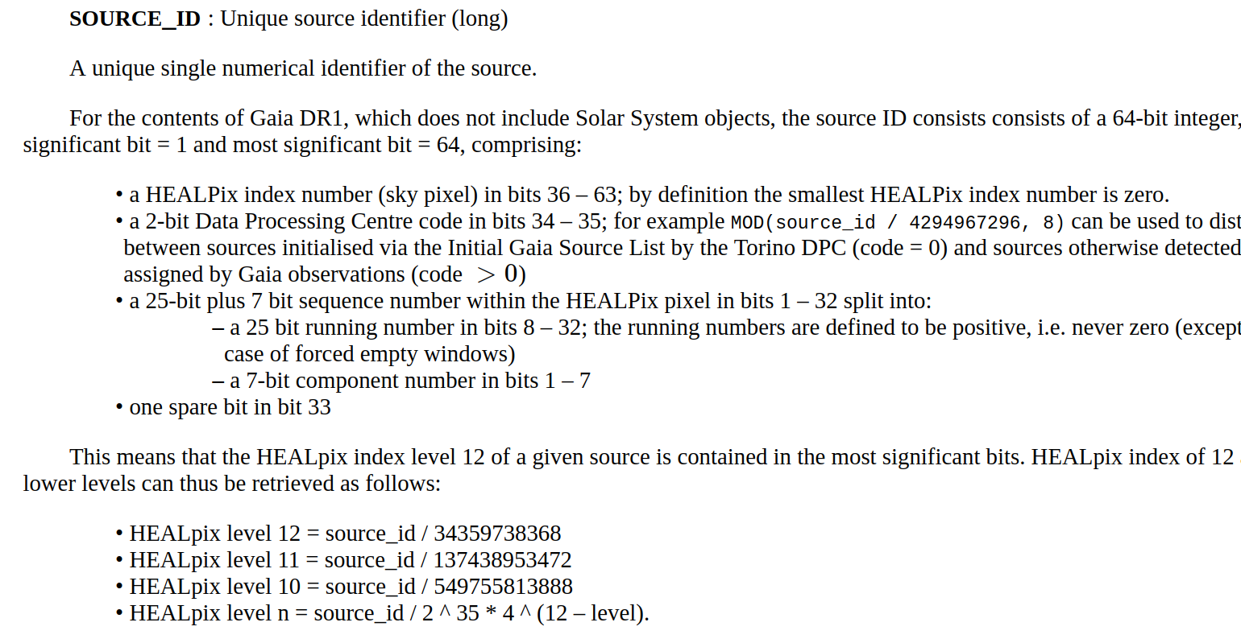
Gaiai ID

Slide 25
HiPS
HiPS - Hierarchical Progressive Surveys
Data and images are available on internet servers sorted into HEALPix diamonds.
Applications can then download the images or data at required areas of the sky.

Slide 26
Demo Aladin client
The Aladin client calls HiPS servers to pull off images.
https://aladin.u-strasbg.fr/

Slide 27
ASTROPY
As well as other functions the astropy Python package has two of interest:
At a given HEALPix resolution:
Cone search:
Given a sky RA, DEC point and Field of View angle, returns the HEALPix diamond numbers in that area of sky.
Point location:
Given the RA, DEC of a star, returns the HEALPix diamond number which contains the star.

Slide 28
Ordered Guide Star Catalog
Created a table, with columns
HP GSC_ID RA DEC MAG
Where HP is the HEALPix number, GSC_ID is the index number from the GSC catalog, RA and DEC are in degrees, and MAG is the star magnitude.
This initially required me to run a program which went through the GSC catalog, getting the RA and DEC of every star, finding the HEALPix number and inserting it into the table – this took several hours.
So now, at a given RA/DEC and Field of View, I use the astropy cone search to find the diamonds, and go down the table picking the stars in those diamonds.

Slide 29
MOC
MOC - HEALPix Multi-Order Coverage map
To refer to the area of sky covered by a particular survey, list the HEALPix diamond numbers that cover the area.
These numbers can then be compared with the MOC numbers of other surveys, to find, for example, where multiple surveys at different wavelengths intersect.

Slide 30
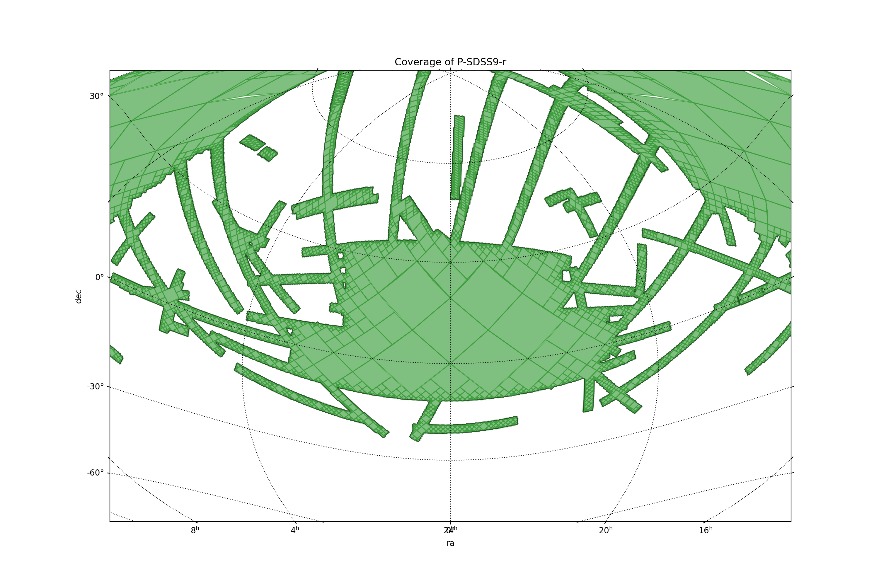
MOC
MOC - HEALPix Multi-Order Coverage map

Slide 31
INDI – our next stage
Instrument-Neutral Distributed Interface
A specification defining a set of commands to control instruments.
Different makes of telescope have different proprietary commands
I send ‘INDI’ commands from the web server to a small computer at the observatory, this runs ‘drivers’ to convert these to the proprietary commands the telescope understands.

Slide 32

At the observatory
Raspberry pi computer
Link to web
server via internet
Driver
Communications
‘INDI’ software drivers are available for many of the common telescopes.

Slide 33
References
ACREMSCOPE software development:
https://github.com/bernie-skipole/acremscope
HealPix illustrations from:
https://healpix.sourceforge.io/
Gaiai source id extract from:
https://gea.esac.esa.int/archive/documentation/GDR1/datamodel/Ch1/gaia_source.html
MOC map
https://cds-astro.github.io/mocpy/
INDI is a specification that converts from a ‘standard’ set of commands to the proprietary commands of different manufacturers:
https://indilib.org
Jodrell Bank photo – Reproduced with the kind permission of my wife Anita.

