Slide 1
Learning Styles
What’s your style?
Notes:
Hello I am Regina Bernier
From Anchorage Alaska
I heard about Bethel Teck at school of the prophets in 2019
I signed up for Data Science because it sounded like a fun profession to have and I enjoy technology, formulas and solving puzzles.
Over the last 6 months I have learned the languages sql - no sql – mon go - R – python.
The technologies I have used is piespark, Amazon web service, waterfall, agile, tablow , Scrum, canban

Slide 2
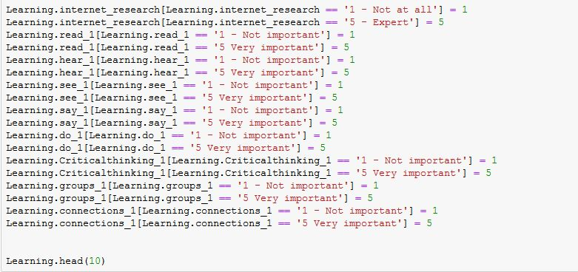
Notes:
This is a snippet of my code,
I needed to have my data cleaned so that each 1 was an integer for running test and each answer would be the same variable type,
a character is anything from a space, letter, symbol or number,
to mine my data was about 10 thousands characters
but to clean my data was over 20 thousands characters

Slide 3
Learning Styles
What’s your style?
Notes:
I am a data scientist.
I take raw data frames and clean them so I can make the information useful to discover conclusions
My project is on learning styles
To help with understanding of my project
I am going to show through explaining p value with the different learning styles

Slide 4

P-Value - Auditory Learner
Notes:
People who prefer learning by hearing : they talk things out by explaining, learning from others, debates, using different voices, being in discussion groups, using voice recorders and self-talk are all ways an Auditory learner takes in information
Here is P value explained
There is a Significance Level which is Alpha
This level is where we are allowed to reject the null hypothesis
The Probability value which is p-value: Is the likelihood of an observed statistic occurring on the basis of the sampling distribution or the default position
Who decides the level: The researcher – by convention alpha is normally set to .05
If p-value is less than alpha which is p is less than .05 we reject the null hypothesis which null is the default position
This is considered Statistically significant therefore learning something
If the p-value is greater than alpha which is p is greater than .05 we fail to reject the null hypothesis we did not learn anything interesting
This is Statistically nonsignificant

Slide 5
P-Value – Reading/Writing Learner
Significance Level(Alpha):
The level in which we are allowed to reject the null hypothesis
Null is the default position
Probability value (p-value):
The like hood of an observed statistic occurring on the basis of the sampling distribution
Who decides the level:
The researcher – by convention alpha is normally set to α =.05
If p-value is less than alpha α (p < .05) reject null hypothesis
This is Statistically significant
If the p-value is greater than alpha α (p > .05) fail to reject the null hypothesis
This is Statistically nonsignificant
Notes:
People with the Reading Writing preference take in information just like it says
using words that have interesting meanings,
list to order things into categories ,
headings that explain what follows,
bullet points, numbered paragraphs
they use dictionaries, glossaries and written notes.

Slide 6
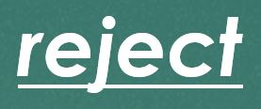
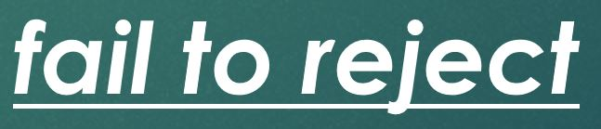
P-Value – Visual Learner
Alpha
Significance Level(Alpha):
The level in which we are allowed to reject the null hypothesis
Null is the default position
Probability value (p-value):
The like hood of an observed statistic occurring on the basis of the sampling distribution
Who decides the level:
The researcher – by convention alpha is normally set to α =.05
If p-value is less than alpha α (p < .05) reject null hypothesis
This is Statistically significant
If the p-value is greater than alpha α (p > .05) fail to reject the null hypothesis
This is Statistically nonsignificant
alpha
α =.05
less than
alpha α
<
.05
greater than
alpha α
>
.05
Notes:
People with a visual preference prefer to draw things out ,
they like plans, charts, maps, diagrams flowcharts, decision trees,
organizational charts, pictures, logos, design, patterns, using symbols, color and space

Slide 7
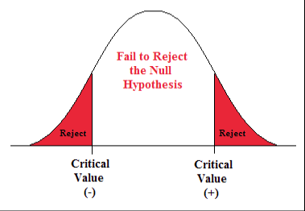
P-Value – Visual Learner
Fail to reject the Null Hypothesis
Reject the Null
Reject the Null
Notes:
When we fail to reject the null, we are saying the possibility of our results happening are not significant
P is greater than null
When we reject the null this is when we change our minds because there is significance to what the null says is true.
P less than null

Slide 8
P-Value – Kinesthetic Learner True story –
Her Brother did it
Instead of the math I will try to explain with a real life example, the Hypothesis:
Null hypothesis: Barbara is innocent Alternative hypothesis: Barbara is not innocent
The chance that Barbara absolutely did not do it, we could accept the null, but we never accept the null since there is a slight chance that she did do it so we fail to reject the null.
So then I imagine in my mind how in the world could Barbara be innocent
A p-value doesn’t *prove* anything. It is a simply basis for making a reasonable decision using collected data, and figuring out the likelihood of it happening.
A p-value asks, “In a scenario what is my default action, is my evidence reasonable to be considered?” The higher the p-value, the more confidant I’ll feel about persisting with my planned action it falls inside of the confidence interval the 95%. If the p-value is low enough falling outside of the confidence interval, I’ll change my mind and do something else.
Notes:
People with the kinesthetic preference prefer autobiographies, documentaries,
demonstrations, they talk about real things in their lives,
doing things with others and making things happen.
They are physical and they like practical problem-solving techniques. they use all their senses and Hands-On approach.
Instead of the math I will try to explain with a real life example,
I found a circle of lovely multi colored dots on my freshly painted wall.
I put daughter on trial in my mind, since she would be more likely out of the my 2 children to do something like this.
The chance that Barbara absolutely did not do it, we could accept the null, which is Barbara is innocent –
but we never accept the null since there is a slight chance that she did do it, so we fail to reject the null.
So then I imagine in my mind how in the world could Barbara be innocent with these scenarios:
Plausible: Kids who came over to play, her brother, my husband all possibly did it. In this scenario we would reject the null.
Possible but not very probable(a small chance): Maybe someone broke in and drew dots on the wall. If someone broke in and that is all they did that seems ridiculous –
So I reject the null because of that ridiculousness
A p-value doesn’t *prove* anything. It is a simply basis for making a reasonable decision using collected data, and figuring out the likelihood of it happening.
A p-value asks, “In a scenario what is my default action, is my evidence reasonable to be considered?” The higher the p-value, the more confidant I’ll feel about persisting with my planned action it falls inside of the confidence interval the 95%. If the p-value is low enough falling outside of the confidence interval, I’ll change my mind and do something else.

Slide 9
Evaluation Questions
What is the demographics of the populations surveyed?
What do people find most important when it comes to learning?
How do the learning styles differ based on:
Age
Gender
Personality styles
Region
Notes:
In this presentation I want to answer questions that relate to learning style

Slide 10
Methods
VARK learning styles
Visual
Auditory
Reading/Writing
Kinesthetic
Survey Questions
City and State
Gender and age
5 questions on introverts and extroverts
Internet search efficiency
Importance of teaching styles
16 questions about the VARK learning styles
Notes:
I researched different learning styles .
I focused mostly on the VARK learning styles.
Which are visual auditory Reading Writing and kinesthetic learners.
There were 28 survey questions

Slide 11
Methods
Survey Distribution:
Facebook
Slack
Email
Asked for all of them to send the survey to their friends
With in 3 weeks
N = 158 results with 141 usable results
Notes:
Once I had my survey done on Survey Monkey
I distributed my survey through
Facebook
slack
email
and people sent it to their friends
within 3 weeks I had my results

Slide 12
Methods
Python
28 columns of strings except for 1 column integers
Eliminated Survey Monkey default columns that were not useful
Renamed columns
Made the information useful by
Changed the appropriate data styles
Recoded and cleaned columns
Statistical Analysis
Value counts
ANOVAs
Chi-square
Tableau
Created graphics
Notes:
I mostly use Python for my data cleaning and data wrangling
I did statistical analyst
by doing value counts Anova and chi squares.
Tableau was how I created my graphics

Slide 13
Statistics from the survey
Age groups represented
18 -80 years old
Gender
104 Female (72%)
40 Males (29%)
Introverts verses Extroverts
86 Extroverts (59%)
60 Introverts (49%)
Notes:
I was studying to see if
Age,
Gender
personality type or
region made a difference in learning styles,
Most of the respondents were female extroverts.

Slide 14
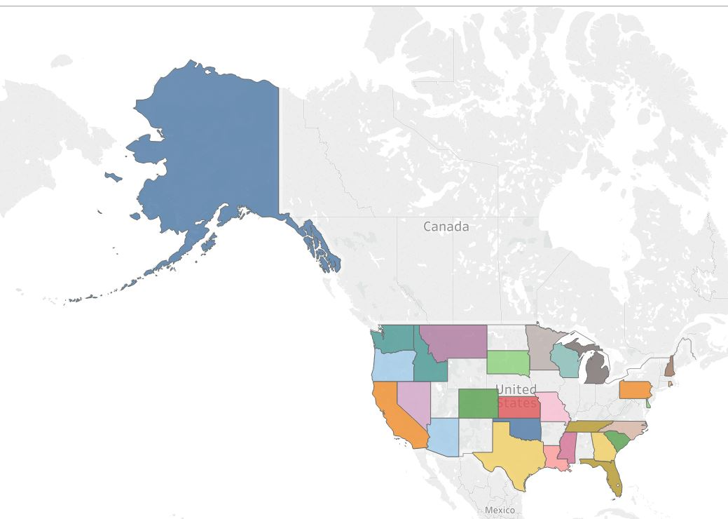
Which regions are represented?
Alaska 59 (40%)
Pacific Coastal 40 (27%)
Rocky Mountain 13 (9%)
Southern Region 12 (8%)
Mid-West 10 (7%)
South-West 8 (5%)
Mid-Atlantic 2 (1%)
New England 1 (1%)
Other Countries 2 (1%)
Notes:
Most of my respondents came from Alaska
and Out of all the other regions,
the Pacific coast had the most respondents

Slide 15
Learning styles represented
Learning Style | Frequency
Kinesthetic | 66 (47%)
Reading/Writing | 48 (34%)
Auditory | 17 (12%)
Visual | 10 (7%)
Notes:
Almost 50% of the respondents were Kinesthetic,
1/3 respondents were learners who like reading and writing,
auditory or visual learners made up a small percentage of the rest

Slide 16
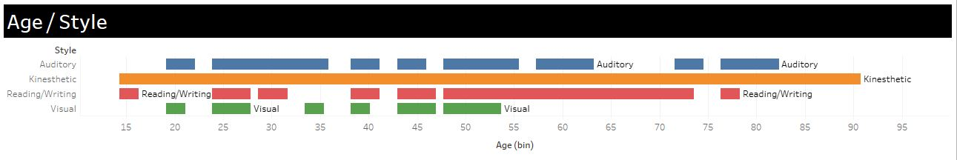
How do the learning styles differ based on:
Age
x² = 1.34, p = .11
p value is greater than the null therefore the result is significantly nonsignificant
Age has no significant importance in determining learning style
Notes:
Although age is not a significant determiner in how someone learns
it was interesting to see that Kinesthetic Learners were a part of all the age groups,
readers and writers were mostly over 50,
and visual respondents were under 50

Slide 17
How do the learning styles differ based on:
Gender
x² = 3.26, p = .35
p value is greater than the null therefore the result is significantly nonsignificant
Gender has no significant importance in determining learning style
Gender | Kinesthetic | Reading/Writing | Auditory | Visual
Female | 43 (42%) | 38(37%) | 13(13%) | 8(8%)
Male | 23(59%) | 10(26%) | 4(10%) | 2(5%)
Notes:
Males and females show no differences in learning styles

Slide 18
How do the learning styles differ based on:
Personality styles
x^2 = 8.56, p = .04
p value is less than the null therefore the result is significant
Personality has significant value in determining learning style
Personality | Kinesthetic | Reading/Writing | Auditory | Visual
Introvert | 26(44%) | 21(36%) | 4(7%) | 8(14%)
Extrovert | 40(49%) | 27(33%) | 13(16%) | 2(2%)
Notes:
extroverts were usually a kinesthetic learner.
What's interesting to note is on the lower scale an introvert was more visual
- being 4 times the amount of a extrovert
- an extrovert was three times more to be a auditory learner then a introvert

Slide 19
How do the learning styles differ based on:
Region
x^2 = 3.06, p = .31
p value is greater than the null therefore the result is significantly nonsignificant
Region has no significant importance to determine learning style
Personality | Kinesthetic | Reading/Writing | Auditory | Visual
Alaska | 24(42%) | 23(40%) | 8(14%) | 2(4%)
All other | 42(50%) | 25(30%) | 9(11%) | 8(10%)
Notes:
As we can see from this data –
the p-value for region does not have an impact on learning styles,
but as we can see from the the data
alaskans are not very visual when it comes to learning -
and maybe that's because we are in the dark half the year

Slide 20
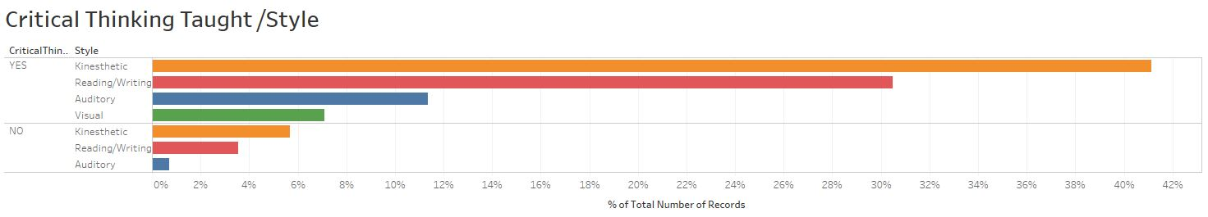
Critical Thinking
How does the belief that critical thinking can be taught differ by learning style?
P value is .619 which is greater than the null
The result is significantly nonsignificant
Learning style has no significance value to determine if critical thinking is believed that it can be taught
Notes:
By looking at the graph kinesthetic Learners show that they believe critical thinking can be taught,
but from the P value of .619 which is greater than the null,
we cannot take this information to determine
whether or not someone thinking critical can be taught
pertains to their learning style

Slide 21
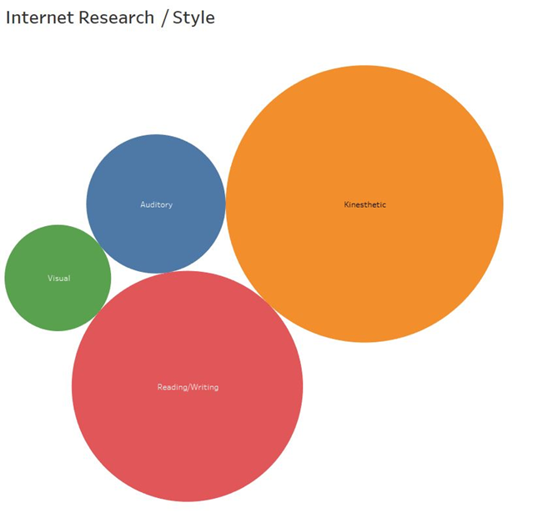
Internet Research
By learning style how skillful do people believe they can search the Internet?
P value is .306 which greater than the null
The result is significantly nonsignificant
Learning style has no significant value with how well people believe they can search the internet
Orange – Kinesthetic
Red – Reading / Writing
Blue – Auditory
Green – Visual
Notes:
Here again kinesthetic learners believe they can do anything,
the chart shows that kinesthetic Learners believe the very most,
that they can search the internet
but with the P value result of .30 which is greater than the null.
we have learned nothing about whether or not
learning styles determine
whether someone believes they can research on the internet efficiently

Slide 22
Interesting Observation
What do people find most import when it comes to taking in information?
Though 4 learning styles have been identified there are many ways to take in information
Speaking to yourself
Hearing it
Having information grouped together
Critically thinking through the information
Seeing the graphs, design, color and etc.…
Reading about the information
Doing what’s being learned
Having connections to other information
Notes:
I also studied about ways of taking in information
4 learning styles have definitely been identified and are used frequently,
but there are ways people take in information…
people speak to themselves,
they'll need to hear it from outside sources,
feel like having information grouped together in chunks or concepts,
some people like to critically think through the information,
others like graphs and designs to draw their attention in,
reading about information is quite common,
doing what's been learned,
or having connections to other information
are all ways people take in information

Slide 23
Interesting Observation
What do people find most import when it comes to taking in information?
Though 4 learning styles have been identified there are many ways to take in information
Speaking to yourself (M = 3.89)
Hearing it mean (M = 3.99)
Having information grouped together mean (M = 4.19)
Critically thinking through the information mean (M = 4.33)
Seeing the graphs, design, color and etc.… (M = 4.36)
Reading about the information mean (M = 4.38)
Doing what’s being learned mean (M = 4.41)
Having connections to other information (M = 4.41)
Notes:
The scale for importance was 1-5,
5 being the most important,
all types of learners thought each of these different ways of taking in information were important,
the mean for 5 is 2.5,
the lowest mean in my research for this data was 3.89
which is 1.39 over the 2.5.
As you can see from the mean of each of these categories all of them were above the mean of 2.5

Slide 24
Interesting Observation
What do people find most import when it comes to learning?
Out of 141 complete responses
Totals for the whole
Mean = 4.26
1st quartile = 4.0
Median = 4.33
3rd quartile = 4.66
Max = 5.0
Notes:
The over all average was a 4.26, with ¼ of the scores being at a 4 .
With using a scale of 1 to 5 and 5 being the most important -
having a mean of 4.26 is quite unusual

Slide 25
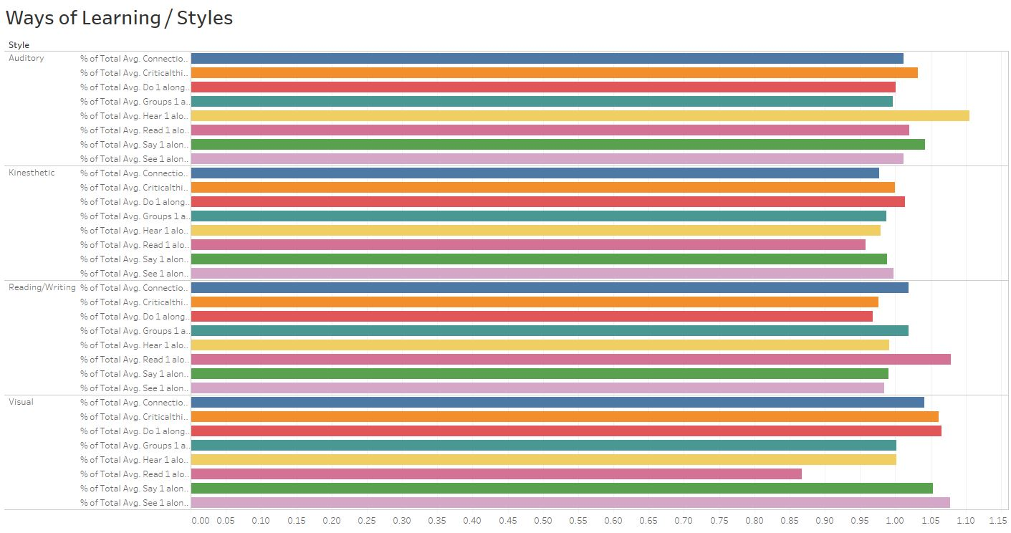
Interesting Observation
What do people find most import when it comes to learning?
The learning style correlates with taking in information
Auditory
Kinesthetic
Reading/
Writing
Visual
Notes:
As you can see
people taking in information correlates with what that group says is their learning style.
So even though each of the learning styles found each type of taking in information important,
it seems they still have a tendency to want information as the their learning style dictates
and that learning style has significance to how someone takes in information

Slide 26
Interesting Observation
What do people find most import when it comes to learning?
Speaking to yourself (p = 0. 91)
Hearing it (p = 0.71)
Having information grouped together (p = 0. 68 )
Critically thinking through the information (p = 0.52 )
Seeing the graphs, design, color and etc.…(p = 0.91 )
Reading about the information (p = 0. 005 )
Doing what’s being learned (p = 0.87 )
Having connections to other information (p = 0. 71 )
Notes:
YET all except 1
are more than the alpha
which means no significance between the two
and the 1 that is significant is Reading…
35% of those who were sampled were readers. Over 80% of the respondents to the taking in information by reading answered at a score of a 4 or 5 - 5 being most important

Slide 27
Summary
Most learners from the sample were kinesthetic and extroverts
Not many factors outside of personality has a bearing on how we learn
Most find that taking in information many ways important
Notes:
Most learners from the sample were kinesthetic and extroverts
Not many factors outside of personality has a bearing on how we learn
Most find that taking in information many ways important

Slide 28
Conclusion
Impact to education
Knowing the different learning types and how they learn can help focus on more creative ways of teaching
Knowing how adults learn can help in teaching
Testing adult learners to see if they are introverts or extroverts
Notes:
In adult Learners
taking an account whether they are an extrovert or introvert
could possibly help with how teaching is done.
As I have done my own studies
Woz-U teaches in all four learning styles
by utilizing videos, graphs, charts, colors, activities, story and of course reading.
Some times I am even told I need a cookie
so Woz-U is activating all senses when teaching.

Slide 29
Learning Styles
What’s your style?
Notes:
Thank you.
BOOM Mic DROP!

