Slide 1
Module 1
Exploring ASP.NET MVC 5

Slide 2
Module Overview
Overview of Microsoft Web Technologies ASP.NET Introduction ASP.NET MVC 5 Introduction

Slide 3
Lesson 1: Overview of Microsoft Web Technologies
Introduction to Microsoft Web Technologies Overview of ASP.NET Client-Side Web Technologies Internet Information Server Microsoft Azure

Slide 4
Introduction to Microsoft Web Technologies
Develop
Host
Execute
Server-Side
Client-Side
Visual Studio
IIS
Microsoft Azure
ASP.NET
JavaScript
jQuery
AJAX

Slide 5
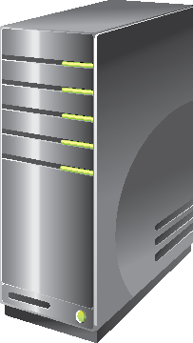
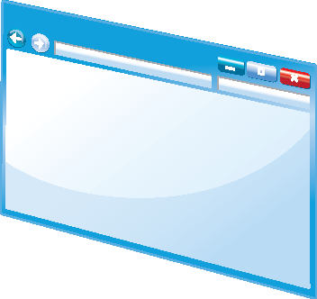


Overview of ASP.NET
Programming Models
Web Pages
Web Forms
MVC
ASP.NET API
Configuration
Authentication and Authorization
Caching
Compiling ASP.NET Code
ASP.NET
HTML
Pages

Slide 6
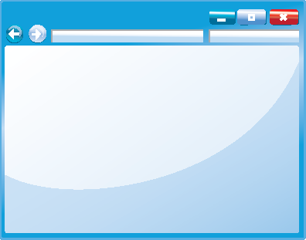

Client-Side Web Technologies
JavaScript
jQuery
jQuery UI
jQuery Mobile
AJAX
<p>
Content
</p>
p {
color: black;
}

Slide 7

Internet Information Server
IIS
Features
Scaling
Perimeter Networks
IIS Express
Other Web Servers

Slide 8

Microsoft Azure
What Is Microsoft Azure?
Web Apps
API Apps
SQL Database
Virtual Servers
Mobile Services
Media Storage

Slide 9
Lesson 2: ASP.NET Introduction
Web Pages Applications Web Forms Applications MVC Applications Shared ASP.NET Features

Slide 10
Web Pages Applications
Code in .CSHTML files
Precise Control of HTML
<h2>Special Offers</h2>
<p>Get the best possible value on Northwind specialty
foods by taking advantage of these offers:</p>
@foreach (var item in offers) {
<div class="offer-card">
<div class="offer-picture">
@if (!String.IsNullOrEmpty(item.PhotoUrl)){
<img src="@Href(item.PhotoUrl) alt="@item.Title" />
}
</div>
</div>
}

Slide 11
Web Forms Applications
Code in .aspx files and code-behind files
Create a UI by dragging controls onto a page
Controls provide rich properties and events
Bind controls to data

Slide 12
MVC Applications
Models encapsulate objects and data
Views generate the user interface
Controllers interact with user actions
Code in .cshtml and .cs files
Precise control of HTML and URLs
Easy to use unit tests

Slide 13
Shared ASP.NET Features
Configuration
Authentication
Membership and Roles
State Management
Caching

Slide 14
Lesson 3: ASP.NET MVC 5 Introduction
Models, Views, and Controllers Demonstration: How to Explore an MVC5 Application Structure

Slide 15

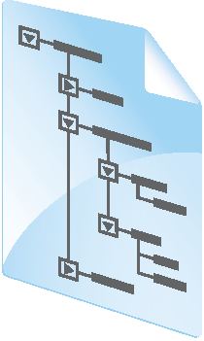


Models, Views, and Controllers
SQL
View
Model
Database
Controller
Web Server
HTTP
Browser

Slide 16
Demonstration: How to Explore an MVC5 Application Structure
In this demonstration, you will see how to:
Examine an MVC application renders the default home page.
Examine the default route that forwards requests to the Controller.
Examine the Photo Model code.
Examine the Photo Controller code.
Examine the Photo Details View code.
Examine the photo details rendered as a result of Models, Controllers, and Views working together.

Slide 17
Lab: Exploring ASP.NET MVC 5
Exercise 1: Exploring a Photo Sharing Application Exercise 2: Exploring an MVC Application
Estimated Time: 45 minutes
Notes:
(More notes on the next slide)

