Slide 1
Module 3 (Cont)
Developing ASP.NET MVC 5 Views

Slide 2
Module Overview
Creating Views with Razor Syntax Using HTML Helpers Re-using Code in Views

Slide 3
Lesson 1: Creating Views with Razor Syntax
Adding Views Differentiating Server Side Code from HTML Features of Razor Syntax Binding Views to Model Classes and Displaying Properties Rendering Accessible HTML

Slide 4
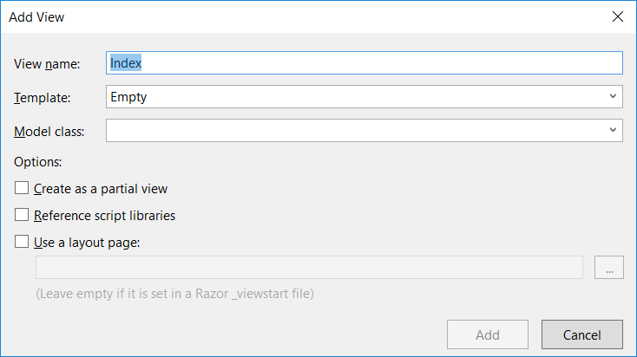
Adding Views

Slide 5
Differentiating Server Side Code from HTML
Razor identifies server-side code by looking for the @ symbol.
In Razor syntax, the @ symbol has various uses. You can:
Use @ to identify server-side C# code.
Use @@ to render an @ symbol in an HTML page.
Use @: to explicitly declare a line of text as content and not code.
Use <text>to explicitly declare several lines of text as content and not code.
To render text without HTML encoding, you can use the Html.Raw() helper.

Slide 6
Features of Razor Syntax
A sample code block displaying the features of Razor.
@* Some more Razor examples *@
<span>
Price including Sale Tax: @Model.Price * 1.2
</span>
<span>
Price including Sale Tax: @(Model.Price * 1.2)
</span>
@if (Model.Count > 5)
{
<ol>
@foreach(var item in Model)
{
<li>@item.Name</li>
}
</ol>
}

Slide 7
Binding Views to Model Classes and Displaying Properties
You can use strongly-typed views and include a declaration of the model class. Visual Studio helps you with additional IntelliSense feedback and error-checking as you write the code.
Binding to Enumerable Lists:
You can use dynamic views to create a view that can display more than one model class.
@model IEnumerable<MyWebSite.Models.Product>
<h1>Product Catalog</h1>
@foreach (var Product in Model)
{
<div>Name: @Product.Name</div>
}

Slide 8
Rendering Accessible HTML
You can ensure that your content is accessible to the broadest range of users by adhering to the following guidelines:
Provide alt attributes for visual and auditory content
Do not rely on color to highlight content
Separate content from structure and presentation code:
Only use tables to present tabular content
Avoid nested tables
Use <div> elements and positional style sheets to lay out elements on the page
Avoid using images that include important text
Put all important text in HTML elements or alt attributes

Slide 9
Lesson 2: Using HTML Helpers
Using Action Helpers Using Display Helpers The Begin Form Helper Using Editor Helpers Using Validation Helpers Demonstration: How to Use HTML Helpers

Slide 10
Using Action Helpers
Html.ActionLink()
Url.Action()
@Html.ActionLink("Click here to view photo 1", "Display", new { id = 1 })
<a href="/photo/display/1">
Click here to view photo 1
</a>
<img alt="This image came from an action" src="@Url.Action("GetImage", new { id = 1 })" />
<img alt="This image came from an action" src="/photo/getimage/1" })"
/>

Slide 11
Using Display Helpers
Html.DisplayNameFor()
Html.DisplayFor()
@Html.DisplayNameFor(model => model.CreatedDate)
Created Date
@Html.DisplayFor(model => model.CreatedDate)
03/12/2012

Slide 12
The Begin Form Helper
Html.BeginForm()
@using (Html.BeginForm("Create", "Photo", FormMethod.Post, new { enctype = "multipart/form-data" }))
{
@* Place input controls here *@
}
<form action="/Photo/Create" method="post“
enctype="multipart/form-data">
</form>

Slide 13
Using Editor Helpers
Html.LabelFor()
Html.EditorFor()
@Html.LabelFor(model => model.ContactMe)
@Html.LabelFor(model => model.ContactMe)
<label for="ContactMe"> Contact Me </label>
<label for="ContactMe"> Contact Me </label>
@Html.EditorFor(model => model.ContactMe)
@Html.EditorFor(model => model.ContactMe)
<input type="checkbox" name="Description">
<input type="checkbox" name="Description">

Slide 14
Using Validation Helpers
Html.ValidationSummary()
Html.ValidationMessageFor ()
@Html.ValidationSummary()
<ul>
<li>Please enter your last name</li> <li>Please enter a valid email address</li> </ul>
@Html.ValidationMessageFor(model => model.Email)
Please enter a valid email address

Slide 15
Demonstration: How to Use HTML Helpers
In this demonstration, you will see how to:
Create a new view.
Use the Html.BeginForm helper to render an HTML form.
Use the Html.LabelFor helper to render a label for a model property.
Use the Html.EditorFor helper to render an editor control for a model property.
Use the Html.ValidationMessageFor helper to render validation errors.
Use the Html.ActionLink helper to render a link to an action.

Slide 16
Lesson 3: Re-using Code in Views
Creating Partial Views Using Partial Views Discussion: Partial View Scenarios

Slide 17
Creating Partial Views
You can use partial views to render the same HTML content in different locations in your web application
Creating and Naming Partial Views:
Create a partial view by using the Add View dialog
Name partial views with an underscore prefix to keep to convention
Strongly-typed and dynamic partial views:
Create strongly-typed partial views if you are certain that the partial view will always display the same model class
Create dynamic partial views if you are not sure if the partial view will always display the same model class

Slide 18
Using Partial Views
Using HTML helpers, you can use partial views within other views in a web application:
To pass the same model object to a partial view from the parent view, use Html.Partial()
To pass a model object to a partial view, which is different from the parent view or of a different model class, use Html.Action()
Use the ViewBag and ViewData collections to share data between the controller action, parent view, and partial view

Slide 19
Lab: Developing ASP.NET MVC 5 Views
Exercise 1: Adding a View for Photo Display Exercise 2: Adding a View for New Photos Exercise 3: Creating and Using a Partial View Exercise 4: Adding a Home View and Testing the Views
Estimated Time: 60 minutes
Notes:
(More notes on the next slide)

