Slide 1
User Engagement Archetypes and Cross-Platform Integration on FriendFeed
Final presentation — Data Mining I (1DL360)
Elias Kassie
Data: FriendFeed v2, monitored 1 Aug – 30 Sep 2010 · 14 October 2026

Slide 2
What I want to find out
Two questions, stated without data-mining terms
Q1
Who are FriendFeed's users?
Q2
Which services are used together?
Are there distinct types of users — automated broadcasters, conversationalists, casual users — based on how they publish, interact and connect?
Which external platforms (Twitter, blogs, Flickr, Digg, …) do users link together, beyond what their popularity alone would explain?
Why it matters: Bot detection and moderation; feed curation
Method: Clustering (k-means, validated with Ward)
Why it matters: Which integrations to prioritise; cross-platform marketing
Method: Association rules (Apriori / FP-Growth)
Scope: done as a one-person project (group members withdrew). The planned sub-question on which content types trigger discussions was dropped; no text content is analysed (agreed with the teacher).

Slide 3
The data: 7.5 GB of raw FriendFeed activity
Seven files, no headers, three different separators — loaded with DuckDB (SQL), stored as Parquet
12.45 M
3.75 M
0.80 M
posts
comments
likes
25.9 M
651,870
1.21 M
follow relationships
accounts (606,918 users)
user–service links
Study window: 1 Aug – 30 Sep 2010 for posts, comments, likes. Users, services and follows are snapshots from 15–16 Oct 2010.
Representations: Q1 → a table with one row per user (aggregated features). Q2 → transactions: one basket of linked services per user.
Tools: Python, DuckDB, pandas, scikit-learn, mlxtend, matplotlib.

Slide 4
Data quality issues found — and how they were handled
File | Issue found | Action
users | 19,970 duplicate rows; 44,952 groups; missing description stored as text 'null' | Deduplicated; groups excluded; description → has_description flag
services | 72 malformed lines ('|' inside names); 380,599 duplicate user–service rows | Skipped (0.005%); each user–service pair kept once
entries | GeoX/GeoY 100% empty; 13,282 posts dated before the window (incl. 1970-01-01) | Columns dropped; restricted to study window
comments | 9 columns, not 13 as in README; 130,995 before window; 217 orphans | Columns mapped from the data; window; orphans not counted as received
likes | 822 duplicates; dates 2008 – Oct 2010; 17.4% orphans (98% of Oct likes) | Dedup (earliest); window → 540,332 likes, 0.1% orphans
subscriptions | Not in README; column order opposite to README; 1.95 M duplicate edges | Direction proven via famous accounts; duplicates removed
followingAugSept | Timestamps = crawl time (57% in week 1); 98% overlap with snapshot | Not used

Slide 5
Preprocessing: from events to one row per user
1
2
3
4
5
Clean
Window
Population
Aggregate
Transform
Parsing, types, duplicates, malformed lines → Parquet
Keep 1 Aug – 30 Sep 2010 so all activity covers the same period
Individual users with ≥ 1 post: 201,335
Per-user counts, shares, degrees; no activity → 0
log(1 + x) on counts, merge correlated features, z-score
Feature | Type | Captures
n_posts, n_sources | ratio (count) | publishing volume; number of posting channels
pct_native, pct_image, pct_video | ratio, 0–1 | share typed on FriendFeed vs automated; media
n_interaction (comments/likes given + received) | ratio (count) | interaction with other people
n_comments_on_own | ratio (count) | notes on own posts (half of all comments!)
n_followers, n_following | ratio (count) | influence vs follow-spam
n_services | ratio (count) | external platforms linked

Slide 6
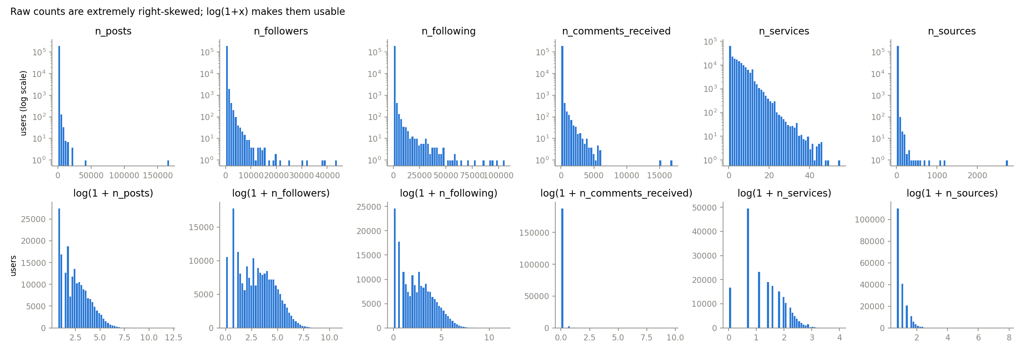
Exploration 1: extremely skewed, zero-inflated features
• Median user: 10 posts, 19 followers — one account posted 166,965 times in two months (≈ 2,700 per day).
• ~94% of users never comment on others, receive no comments and give no likes; 81% of posters only post.
• Euclidean distance squares differences → without log(1 + x) a handful of extreme accounts would dominate the clustering. Outliers are kept (they are the phenomenon of interest).

Slide 7
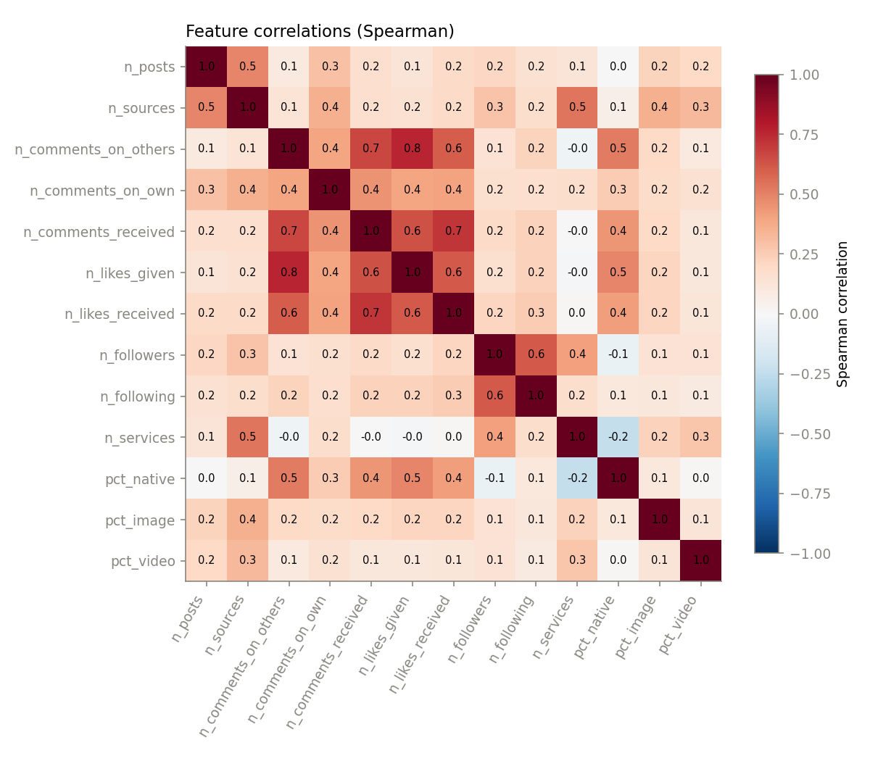
Exploration 2: correlated features would distort the distances
Spearman (rank-based) — robust to extreme values.
Four interaction features are strongly correlated: comments on others ↔ likes given 0.76, comments received ↔ likes received 0.72, …
PCA confirms it: PC1 (35% of variance) loads ≈ 0.43 on exactly these four — like the Maths + Physics example.
In Euclidean distance they give 'interaction' four votes → it dominated the first clustering (silhouette 0.67 for a trivial k = 2).
Fix: merged into one constructed feature n_interaction. Followers ↔ following (0.62) kept separate: influence vs follow-spam.

Slide 8
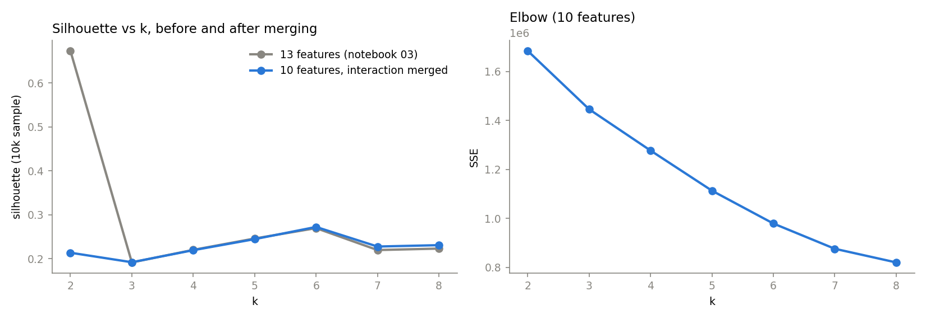
Q1: choosing k with three independent criteria
k-means on 10 features (log counts + shares), z-scored, Euclidean; 10 restarts per run
k | Silhouette | Stability (ARI, 5 seeds) | Agreement with Ward (ARI)
4 | 0.219 | 0.97 | 0.41
5 | 0.245 | 0.99 | 0.44
6 | 0.272 | 0.99 | 0.54
• After merging, the misleading k = 2 peak disappears (0.67 → 0.21).
• k = 6 is best on all three: silhouette, stability across random starts, and agreement with Ward hierarchical clustering (5,000-user sample).
• Silhouettes ≈ 0.27 are modest → real groups, but soft boundaries.
Silhouette s = (b − a) / max(a, b): a = mean distance to own cluster, b = to the nearest other cluster. ARI = chance-corrected Rand index: 1 = identical clusterings, 0 = random agreement.

Slide 9
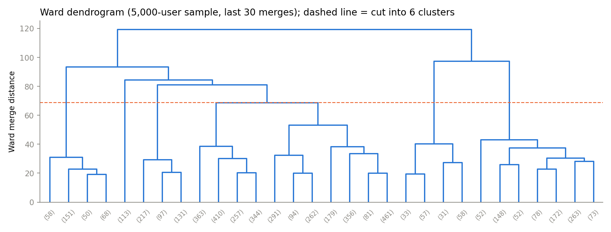
Q1: validation with Ward hierarchical clustering
• Ward merges the two clusters whose union increases the within-cluster SSE least — same objective as k-means, but bottom-up and deterministic. Needs all pairwise distances (O(n²)) → run on a 5,000-user sample.
• Agreement with k-means is moderate (ARI 0.54 at k = 6): the distinct groups are found by both; boundaries between the large automated groups depend on the algorithm.

Slide 10
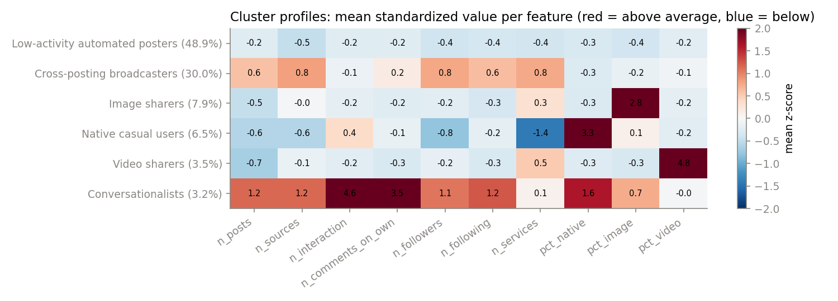
Q1 result: six user archetypes
Archetype | Users | Silh.
Low-activity automated posters | 48.9% | 0.33
Cross-posting broadcasters | 30.0% | 0.12
Image sharers | 7.9% | 0.32
Native casual users | 6.5% | 0.35
Video sharers | 3.5% | 0.45
Conversationalists | 3.2% | 0.29
• Heatmap: mean z-score per feature (red = above average). Each archetype has a clear signature.
• Broadcasters: 26 posts, 6 services, 83 followers, never interact — automated content with reach.
• Media sharers: 92% image posts / 100% video posts, automated feeds (Flickr, YouTube).
• Conversationalists: the only interacting group (median 148 comments/likes), most followed.
Silhouette per cluster: video sharers best separated (0.45); broadcasters weakest (0.12) — they overlap with neighbouring groups.

Slide 11
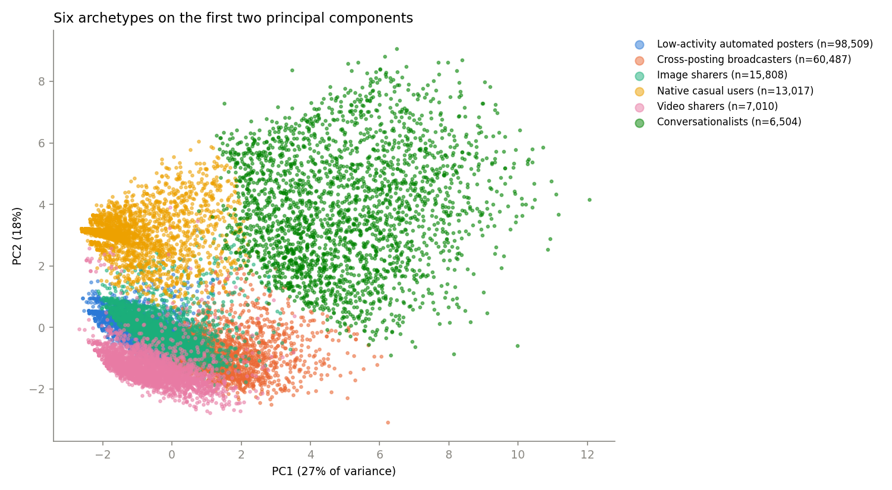
Q1: the archetypes in two dimensions
• PCA projection: PC1 27% + PC2 18% = 45% of the variance (55% not shown).
• Conversationalists separate clearly.
• Automated groups lie close together and overlap in 2D — consistent with the modest silhouettes.
• Used for visualisation only; clustering used all 10 features.

Slide 12
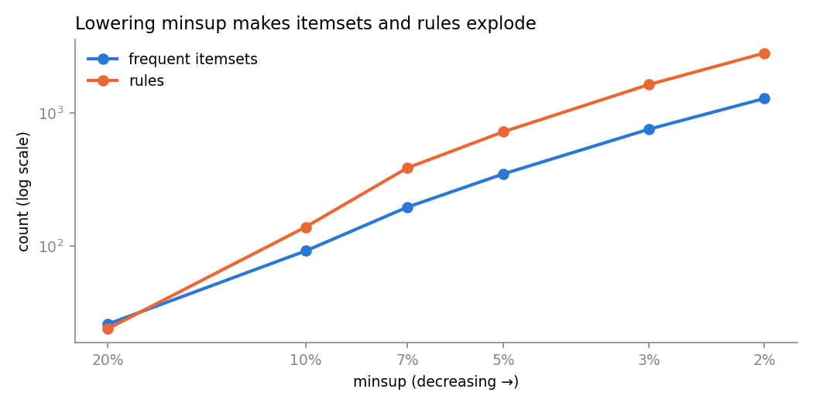
Q2: transactions and the choice of minimum support
305,991
35%
198,824
85%
users with ≥ 1 linked service
link only one → excluded
baskets mined (median 4 services)
of baskets contain Twitter
minsup | min. users | itemsets | rules
20% | 39,764 | 26 | 24
10% | 19,882 | 92 | 139
5% | 9,941 | 348 | 721
3% | 5,964 | 754 | 1,631
2% | 3,976 | 1,283 | 2,813
• minsup = 5%: every rule backed by ≥ 9,941 users; includes the bookmarking services; itemsets and rules roughly double with each halving of minsup.
• Limitation: 42 of 60 services are below 5% and can never appear (rare-item problem).

Slide 13
Q2: frequent, closed and maximal itemsets
348
348
139
frequent itemsets (Apriori = FP-Growth)
closed — no compression here
maximal — 60% fewer
Most frequent maximal itemsets | Support | Users
{YouTube, blog, Twitter, Flickr} | 13.7% | 27,285
{Delicious, blog, Twitter, Flickr} | 12.5% | 24,947
{Delicious, YouTube, Twitter, Flickr} | 11.5% | 22,909
{Delicious, YouTube, blog, Twitter} | 10.9% | 21,625
• Apriori and FP-Growth return the same 348 itemsets (both exact). With 60 items and short baskets Apriori was even faster here (0.35 s vs 1.5 s).
• Closed (no superset with equal support): all 348 — with ~200k baskets supports never tie exactly.
• Maximal (no frequent superset): 139 — the border of the frequent itemsets; shows a broad content-sharing bundle: blog + Flickr + YouTube + Delicious + Twitter.

Slide 14
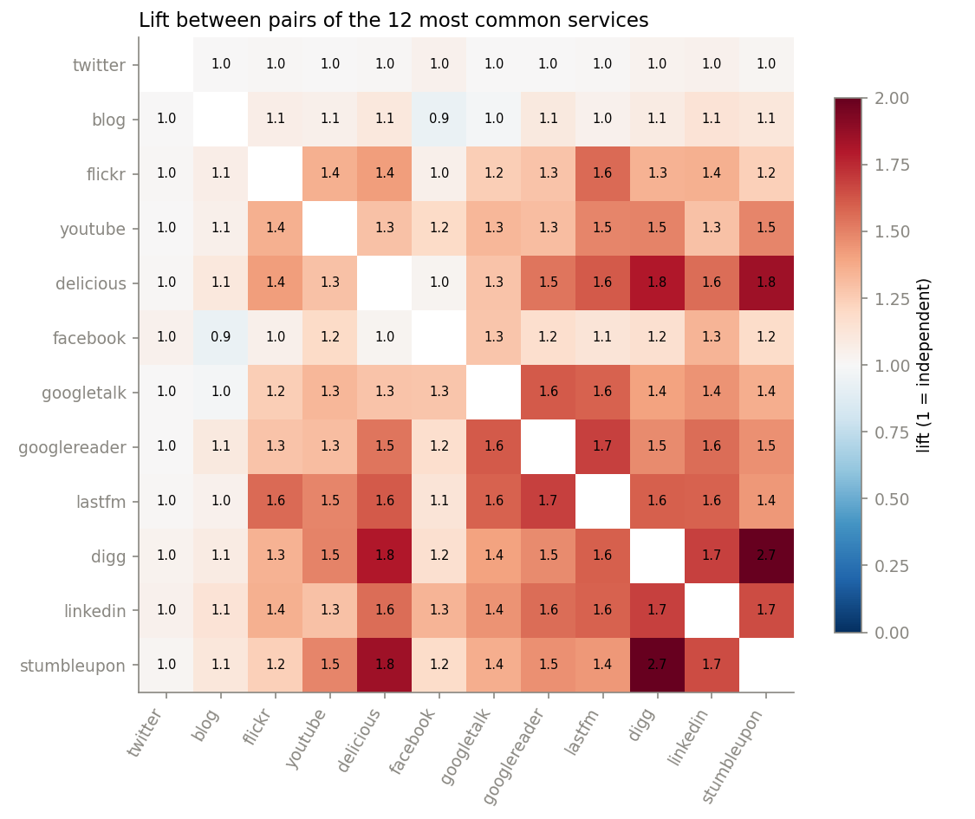
Q2 result: a social-bookmarking bundle
721 rules with confidence ≥ 0.5 and lift > 1, ranked by lift
Rule | Support | Users | Conf. | Lift
{digg, delicious} → {stumbleupon} | 0.069 | 13,810 | 0.53 | 3.26
{delicious, stumbleupon} → {digg} | 0.069 | 13,810 | 0.69 | 3.18
{stumbleupon, flickr} → {digg} | 0.055 | 10,883 | 0.64 | 2.94
{digg, flickr} → {youtube, delicious} | 0.064 | 12,823 | 0.52 | 2.93
• Reading the top rule: 13,810 users link all three; 53% of Digg + Delicious users also link StumbleUpon, whose baseline is only 16% → 3.26× more likely.
• Interpretation: Digg, Delicious and StumbleUpon — all link-sharing services — form the strongest bundle (pairwise lift up to 2.7).
• Twitter has lift ≈ 1.0 with everything: it is everywhere, so it carries no association information.

Slide 15
Q2: why lift, not confidence — and are the rules stable?
The Twitter trap
Stability on two random halves
{digg, facebook} → {twitter}
confidence 0.93 — looks strong
but support(twitter) = 0.85 → lift = 0.93 / 0.85 ≈ 1.09
Knowing Digg + Facebook raises the chance of Twitter only from 85% to 93%.
Confidence = P(Y | X) ignores how common Y is; lift = P(Y | X) / P(Y) compares with that baseline → rules are ranked by lift.
Baskets split at random into two halves (~99,400 each), rules mined separately.
722 vs 720 rules — 706 found in both (95.9%); the others sit at the support/confidence thresholds.
Lift values agree almost perfectly: correlation 0.999, max. difference 0.08.
All top-10 rules appear in both halves.
→ the rules are reproducible, not artefacts of particular users.

Slide 16
Conclusions
Q1 — Who are the users?
Q2 — Which services go together?
New hypotheses
• Six archetypes; ~90% of posting users publish through external tools and never interact.
• Genuine conversation is concentrated in ~3% of users, who are also the most followed.
• Media feeds (images, videos) form their own automated groups.
• Use: flag automated broadcasters/media feeds for moderation; prioritise the conversationalist core in feed curation.
• A social-bookmarking bundle: Digg, Delicious, StumbleUpon (lift ≈ 3).
• A broad content-sharing bundle: blog, Flickr, YouTube, Delicious with Twitter.
• Twitter is universal (85%) — no information (lift ≈ 1).
• Use: offer integrations as bundles; target bookmarking users with the related services.
• Are the cross-posting broadcasters and media feeds bots or humans using tools? (needs labels)
• Do conversationalists' posts get discussions because of who they are or what they post?
• Do bookmarking-bundle users belong mainly to the broadcaster archetype?

Slide 17
Limitations
Soft clusters
No ground truth
Silhouettes 0.12–0.45 and moderate agreement with Ward: archetypes are tendencies, not sharp classes.
'Automated' is inferred from posting channels; no labelled bots to validate against.
Snapshot timing
Missing accounts
Followers, services and users are from mid-October, two weeks after the activity window.
48,695 active accounts are absent from users.csv (type unknown) and were excluded.
Rare services
Scope
With minsup 5%, 42 of 60 services cannot appear in any rule.
Text content not analysed; the content → discussion question was dropped (one-person project).

Slide 18
Examination checklist — where each item is addressed
Checklist item | Where / how
Problem in non-technical terms; requires data mining | Slide 2 — two questions; latent groups and combinatorial dependencies
Data representation; attribute types | Slides 3, 5 — user × feature table (ratio, binary); transactions for Q2
Pre-processing motivated | Slides 4–5 — each cleaning step tied to an observed issue
Proximity function; scaling | Euclidean on log(1 + x) + z-score (slide 6); binary baskets for rules
Correlation; dimensionality | Slide 7 — Spearman + PCA diagnostic → merged features; PCA for 2D view
Noise / outliers | Outliers kept as phenomenon of interest; log limits their influence
Hyperparameters tuned | k: silhouette + stability + Ward (slide 8); minsup sensitivity (slide 12)
Train/test | Not applicable (unsupervised); replaced by split-half stability of rules (slide 15)
Sufficient evidence | Rules ≥ 9,941 users; clusters ≥ 6,504 users; stability checks
Results interpreted | Slides 10, 14, 16; limitations slide 17

