Slide 1
User Engagement Archetypes and Cross-Platform Integration on FriendFeed
Preliminary report — Data Mining I (1DL360)
Elias Kassie · Ludvig Smit Sahlstrand
Data: FriendFeed v2, monitored 1 Aug – 30 Sep 2010
Notes:
Preliminary report: data understanding, data quality, preprocessing, first models, remaining tasks.

Slide 2
What we want to find out
Two questions, stated without data-mining terms
Q1
Who are FriendFeed's users?
Q2
Which services go together — and what sparks discussion?
Can we discover distinct types of users — e.g. automated broadcast accounts, influential conversationalists, low-activity users — from how they publish, interact and connect?
Which external platforms (Twitter, blogs, Flickr, …) are adopted together, and which kinds of content trigger comment threads rather than just likes?
Why it matters: Bot detection and moderation; feed curation
Why it matters: Which integrations to prioritise; content strategy
Notes:
Q1 -> clustering; Q2 -> association rule mining. Scope agreed with teacher: no text mining, comments aggregated by counts; follower network summarised by degree only.

Slide 3
The data: 7.5 GB of raw FriendFeed activity
Seven files, no headers, three different separators — loaded with DuckDB, stored as Parquet
12.45 M
3.75 M
0.80 M
posts (entries)
comments
likes
25.9 M
651,870
1.21 M
follow relationships
accounts (606,918 users)
user–service links
Study window: 1 Aug – 30 Sep 2010 (posts, comments, likes). Users, services and follows are snapshots from 15–16 Oct 2010.
Scope: no text content is analysed — text replaced by its length and a has-link flag; follower network used only through in/out-degree.
Tools: Python, DuckDB (SQL on the raw files), pandas, scikit-learn, mlxtend.

Slide 4
Data quality issues found — and how we handled them
File | Issue found | Action
users | 19,970 duplicate rows (accounts listed 2–3×); 44,952 groups; missing description stored as text 'null' | Deduplicated by user_id; groups excluded; description → has_description flag
services | 72 malformed lines ('|' inside account names, line breaks); 380,599 duplicate user–service rows | Skipped (0.005%); kept each user–service pair once
entries | GeoX/GeoY 100% empty; 13,282 posts dated before the window (incl. 1970-01-01) | Columns dropped; restricted to study window
comments | 9 columns, not 13 as in README; 130,995 before window; 217 orphans | Columns mapped from data; window; orphans not counted as 'received'
likes | 822 duplicates; dates 2008 – Oct 2010; 17.4% orphans (98% of Oct likes) | Dedup (earliest ts); window → 540,332 likes, 0.1% orphans
subscriptions | Not in README; column order opposite to README; 1.95 M duplicate edges | Direction proven via famous accounts; duplicates removed
followingAugSept | Timestamps = crawl time (57% in week 1), 98% overlap with snapshot | Not used
Notes:
Lesson: documentation did not match the data in several places; every decision was checked against the data itself.

Slide 5
Preprocessing pipeline
From event-level records to one row per user
1
2
3
4
5
Load & clean
Study window
Population
Aggregate
Transform
Per-file parsing, types, duplicates, malformed lines → Parquet
Keep 1 Aug – 30 Sep 2010 so every activity feature covers the same period
Individual users with ≥ 1 post in window: 201,335 users
15 features per user (counts, shares, degrees); no activity → 0
log(1 + x) on counts, then z-score; Euclidean distance
Population choice: 203,824 individual users were active; 98.8% posted. Posting-style features are undefined without posts, so non-posters (2,489) are left out. Excluded: 9,930 groups and 48,695 active accounts missing from users.csv (type unknown — limitation).
Comments split: half of all comments (1.81 M) are on the commenter's own post — so 'comments on others' (conversation) and 'comments received from others' are separate features.

Slide 6
The user feature table: 201,335 users × 15 features
Group | Features | Type | Captures
Posting | n_posts, n_sources | ratio (count) | volume; number of channels used
Posting style | pct_native, pct_image, pct_video | ratio, 0–1 | share typed on FriendFeed vs cross-posted; media
Conversation | n_comments_on_others, n_comments_on_own, n_comments_received | ratio (count) | talking with others vs annotating own posts
Appreciation | n_likes_given, n_likes_received | ratio (count) | lightweight interaction
Network | n_followers (in-degree), n_following (out-degree) | ratio (count) | influence; follow-spam
Integration | n_services | ratio (count) | external platforms linked
Profile | has_description | binary | profile effort (22.4% of users)
Counts and shares come from posts, comments and likes in the study window; network and services from the October snapshots (≈ 2 weeks later — limitation).

Slide 7
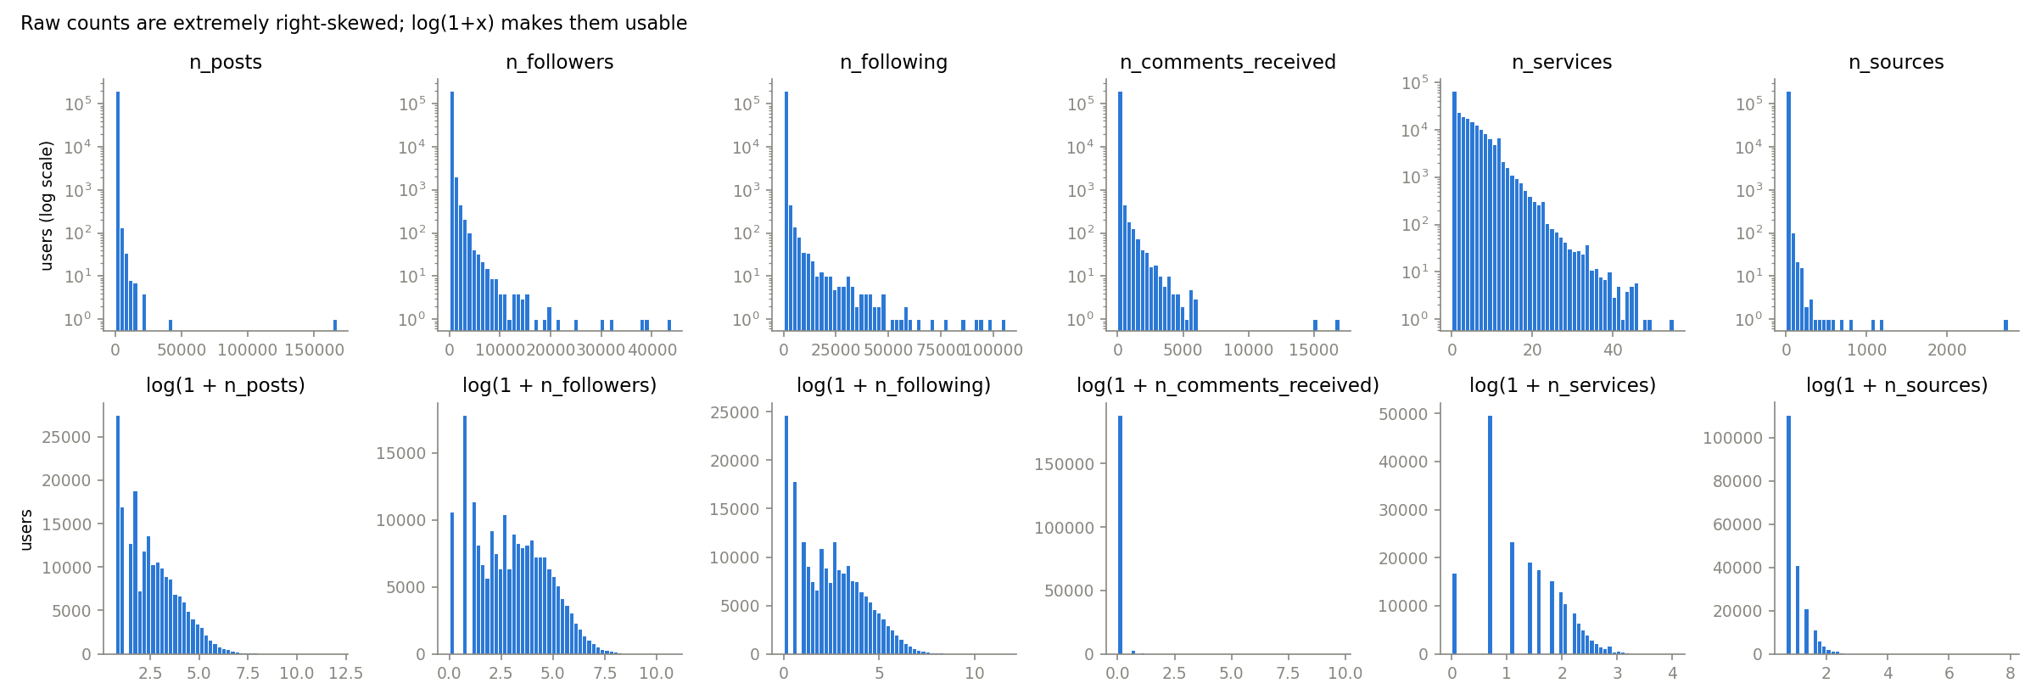
Distributions are extremely skewed
• Median user: 10 posts, 19 followers — but one account posted 166,965 times in two months (≈ 2,700 per day): automated.
• Mean ≫ median for every count feature → raw Euclidean distances would be dominated by a handful of accounts.
• log(1 + x) spreads the distributions out; it is applied to all counts before clustering.

Slide 8
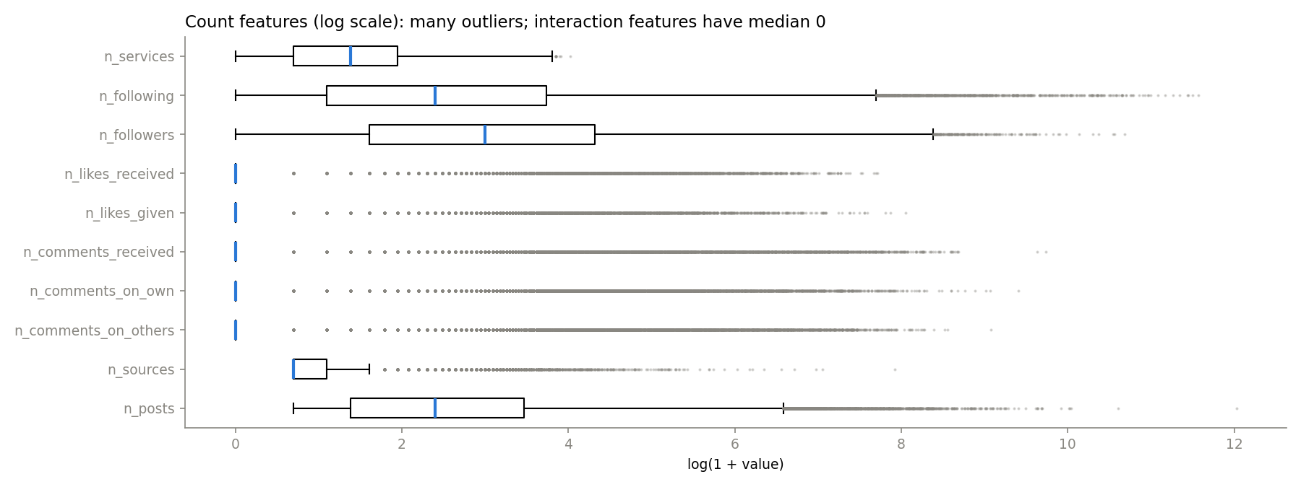
Most users never interact
Share of users with 0
likes given
94.7%
comments on others
93.8%
comments received
93.6%
likes received
92.2%
comments on own
83.6%
following
12.3%
services
8.4%
• 81% of posting users only post — they never comment or like (163,218 users).
• Interaction features are zero-inflated: a spike at 0 plus a long tail; many points lie beyond the whiskers (outliers).

Slide 9
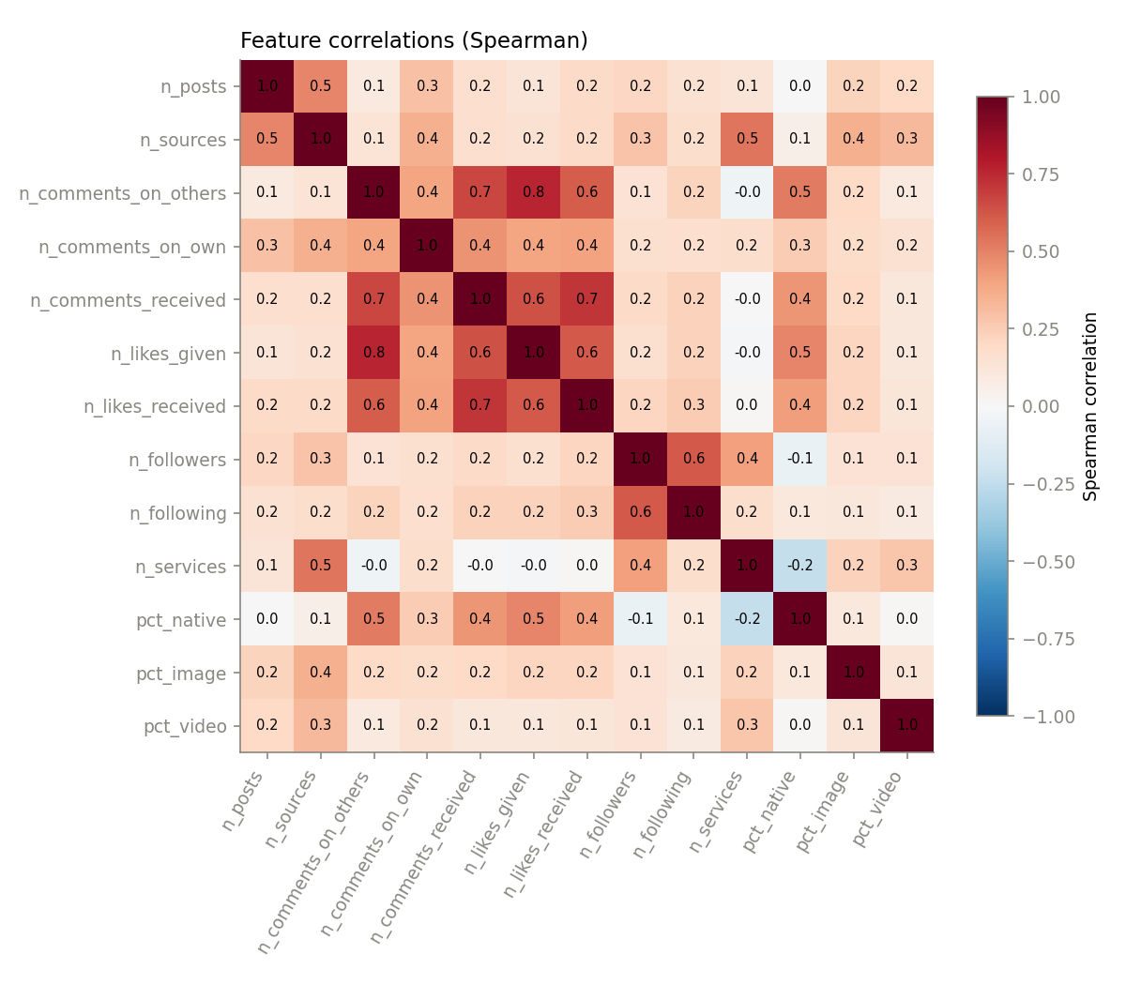
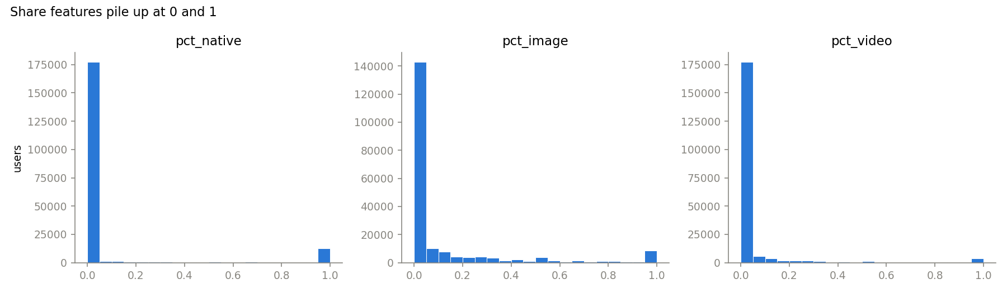
Correlated interaction features; most posting is automated
Strongest correlations (Spearman):
comments on others ↔ likes given: 0.76
comments received ↔ likes received: 0.72
comments on others ↔ comments received: 0.67
followers ↔ following: 0.62
→ five interaction features measure much the same thing and get extra weight in k-means — to address (PCA / feature selection).
Median pct_native = 0: the typical user publishes only through external tools.

Slide 10
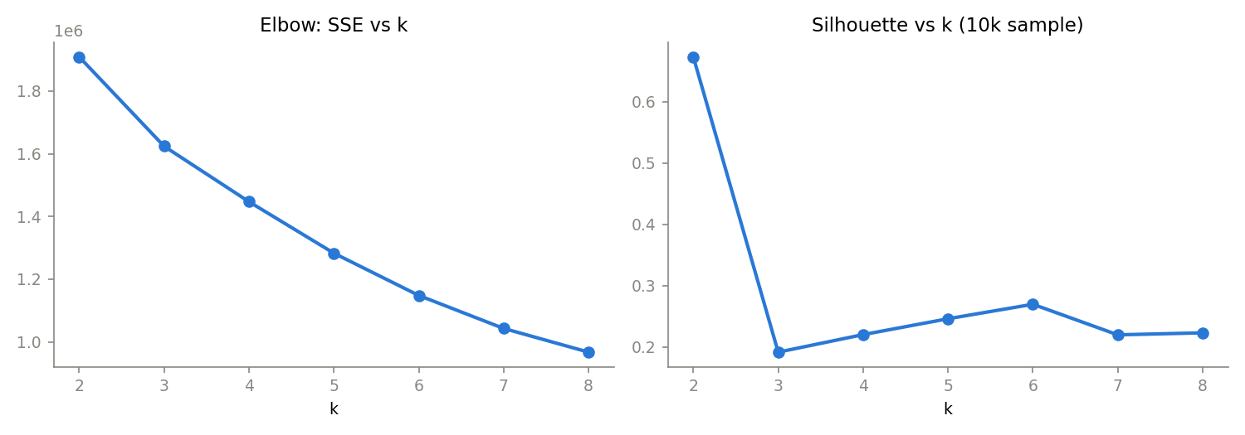
First model (Q1): k-means clustering
13 features (log counts + shares), z-scored, Euclidean distance; k = 2…8, 10 restarts each
k | Silhouette
2 | 0.67
3 | 0.19
4 | 0.22
5 | 0.25
6 | 0.27
7 | 0.22
8 | 0.22
• k = 2 has the highest silhouette, but it only separates the small interactive group from everyone else — not informative.
• No clear elbow in the SSE curve; silhouette is modest (0.2–0.27) for k ≥ 3 → cluster boundaries are soft.
• k = 4 chosen as a preliminary, interpretable solution; silhouette computed on a 10,000-user sample (full computation is O(n²)).

Slide 11
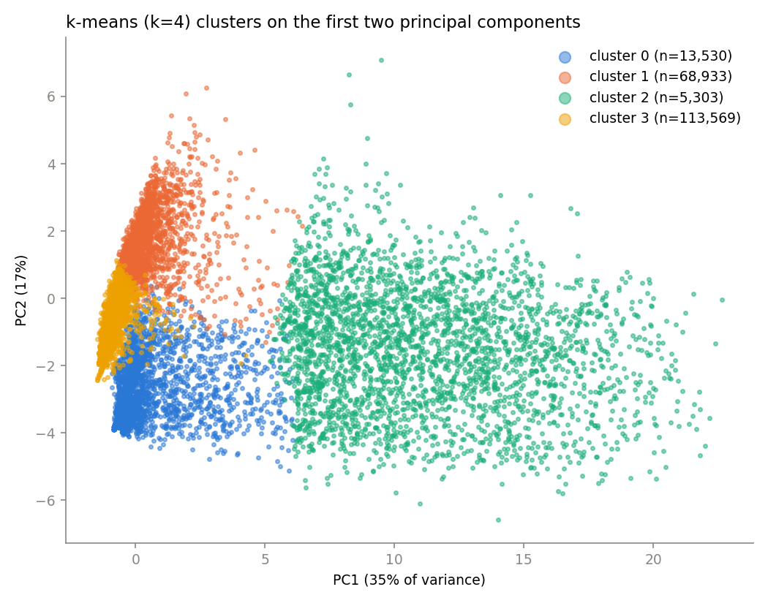
Four preliminary user archetypes (k = 4)
Cluster (medians) | Users | Posts | Native | Services | Followers | Talk*
0 · Native casual users | 13,530 | 3 | 100% | 0 | 3 | 0
1 · Cross-posting broadcasters | 68,933 | 24 | 0% | 6 | 80 | 0
2 · Conversationalists | 5,303 | 59 | 61% | 3 | 151 | 77
3 · Low-activity automated | 113,569 | 5 | 0% | 2 | 8 | 0
* Talk = comments written on other people's posts
• Conversation is concentrated in 2.6% of users (cluster 2).
• Two automated groups differ in reach: many services and followers (1) vs low activity (3).
• In the PCA plot (52% of variance) cluster 2 separates clearly; clusters 0, 1 and 3 overlap — to verify with other methods.

Slide 12
First model (Q2): association rules on linked services
One basket per user = set of linked services · Apriori, minsup 5%, minconf 0.5, lift > 1
305,991
35%
80.5%
721
users with ≥ 1 service
link only 1 service
link Twitter
rules (348 frequent itemsets)
Rule | Support | Confidence | Lift
{digg, delicious} → {stumbleupon} | 0.069 | 0.53 | 3.26
{delicious, stumbleupon} → {digg} | 0.069 | 0.69 | 3.18
{flickr, stumbleupon} → {digg} | 0.055 | 0.64 | 2.94
{digg, facebook} → {twitter} | 0.067 | 0.93 | 1.09
Social-bookmarking bundle: users of two of Digg / Delicious / StumbleUpon are ≈ 3× more likely than average to use the third.
Twitter trap: rules into Twitter reach 93% confidence but lift ≈ 1.09 — Twitter is linked by ~85% of these users anyway, so the rule says almost nothing. Rules are ranked by lift.
Single-service users (35%) cannot form rules and were excluded from mining (198,824 baskets).

Slide 13
Remaining tasks
Clustering (Q1)
Association rules (Q2)
Presentation
• Tune k properly (elbow, silhouette, stability across seeds)
• Handle correlated interaction features (PCA or feature selection)
• Compare with hierarchical clustering (sample) and DBSCAN; Rand index
• Outlier/bot detection with LOF / Isolation Forest
• Validate archetypes, e.g. a suspected-bot flag vs clusters
• Justify minsup with absolute counts; rare-item issue
• Closed and maximal frequent itemsets; compare FP-Growth
• Q2b: post-level baskets (image / video / source / author cluster) → rules with 'discussion' vs 'likes only'
• Check rule stability: August vs September
• Interpret results w.r.t. the questions
• Limitations (snapshot timing, missing accounts)
• Split parts for the individual oral exam

