Slide 1
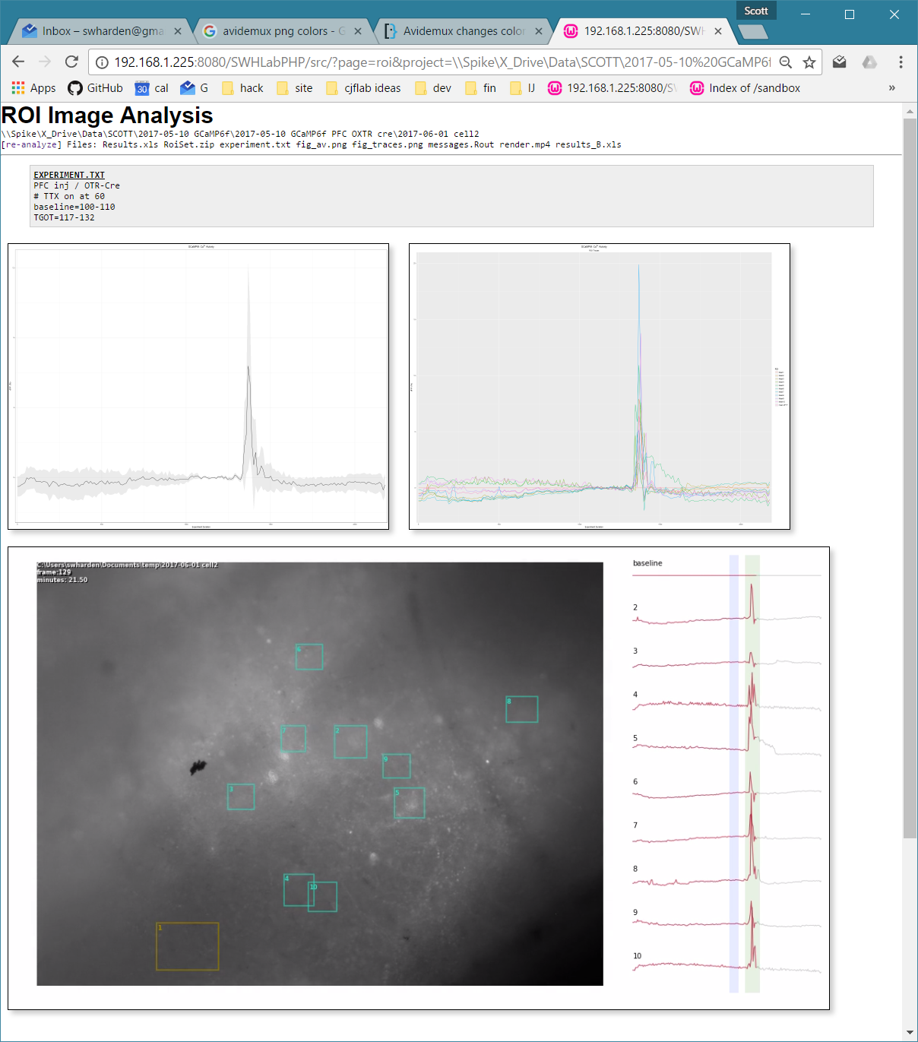
GCaMP6f
2D Acquisition/Analysis Workflow
Original Image
A time-series stack of TIF images
region of interest (ROI)
ROIs are hand-drawn around cells of interest
ROI Value
Each ROI is converted to a single number per frame
There could be multiple user-defined methods for this (i.e., maximum pixel intensity, average pixel intensity, average intensity of brightest 10% of pixels, etc.)
Time Series Acquisition
The camera is configured to turn on the light source, take a high resolution image image, save it as a TIF (with the timestamp as its filename), turn off the light source, and wait 10 seconds before repeating.
Typically a 10m baseline period is used, 3m of 200µM TGOT, then 10m of washout. While increasing the frame rate would increase the number of data points, it also increases accumulated light exposure (photobleaching) and data storage requirements.
Information about the experiment (baseline, drug times, etc.) is stored in experiment.txt
Early experiments analyzed ~1hr of data consisting of high resolution TIFs acquired every 500ms. This is approximately 8GB of data. These frames make excellent video, but have far more data points than are required to draw an experimental conclusion.
Manual Selection of ROIs
Although dozens of fluorescent cells are visible, not all visible cells respond to the drug of interest.
ROIs are outlined by hand with FIJI/ImageJ.
The first ROI is of a region of tissue which contains no cells. It is used as a baseline to subtract-out photobleaching in subsequent ROIs.
The ROI file is always saved as RoiSet.zip
The multi-measure command is used to analyze every ROI of every frame (reported as average pixel intensity) an saved as Results.xls
Not every fluorescent cell is a healthy cell. Dead and dying cells become fluorescent due to a loss of calcium regulation capability. Typically the best responding cells are dark initially and become fluorescent upon activation. Healthy quiescent cells will exhibit low fluorescence.
Automated Analysis
If these steps were followed as written, a single experiment will result in a single folder containing 100s of TIFs, experiment.txt, RoiSet.zip, and Results.xls. Analysis is automatic and occurs when the user goes to the web page for this folder.
Invisible steps that occur when you load the web page:
An R script creates results_B.xls which contains ROI data in baseline-subtracted ΔF/F units.
An R script creates graphs of ROI data in ΔF/F units.
A Python script combines these results with the series of TIFs to create a HTML5-compatible video (render.mp4)

Slide 2
Original Image
A time-series stack of TIF images
GCaMP6f
region of interest (ROI)
ROIs are hand-drawn around cells of interest
Fluorescence Quantification Method
ROI Value
Each ROI is converted to a single number per frame
There could be multiple user-defined methods for this (i.e., maximum pixel intensity, average pixel intensity, average intensity of brightest 10% of pixels, etc.)
f
Raw Intensity Value
When a ROI is converted to a single value per frame, we refer to it as the raw value (f).
When these values are strung together, it graphs of a single ROI with respect to time.
f=
b1
b2
f
f
f
f
f
f
f
f
f
f
f
f
f
f
f
f
f
f
f
f
f
f
f
f
f
f
b
Baseline Intensity Value
calculated as the average or all intensity values between frame b1 and b2.
The user defines b1 and b2.
f/f=
Each ROI has these 3 arrays
r
r
r
r
r
r
r
r
r
r
r
r
r
r
r
r
r
r
r
r
r
r
r
r
r
r
r=f/b this is the instantaneous fluorescence intensity normalized to the average of the baseline period
Δ(f/f)=
d
d
d
d
d
d
d
d
d
d
d
d
d
d
d
d
d
d
d
d
d
d
d
d
d
d
d=(r-1)*100% this comes out to the relative change in normalized fluorescence intensity with respect to the baseline period
scale bar
ROI graph
10% ΔF/F

