Slide 1

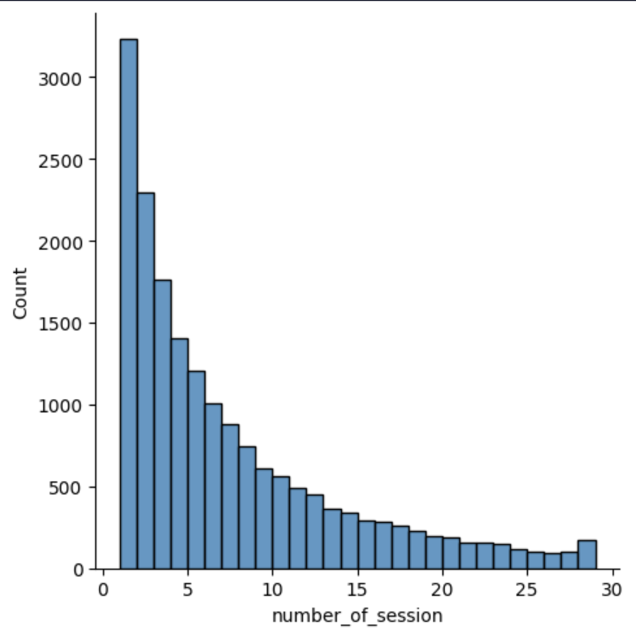
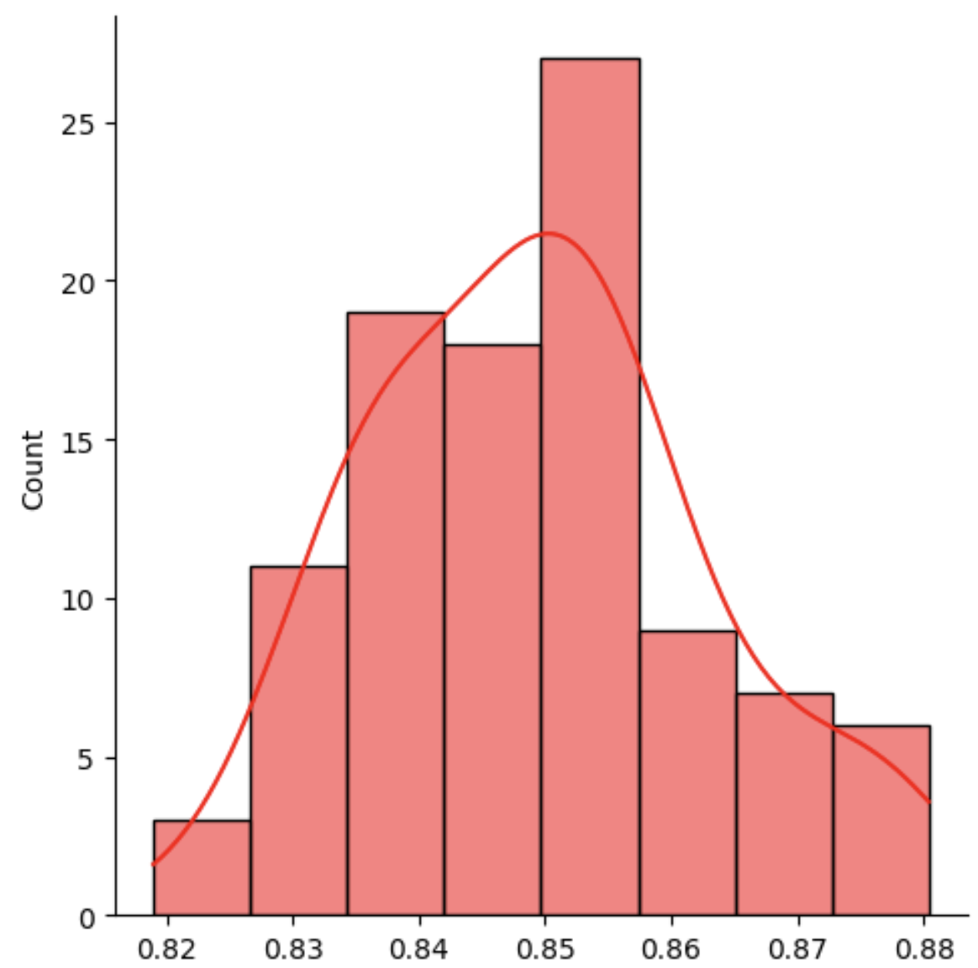
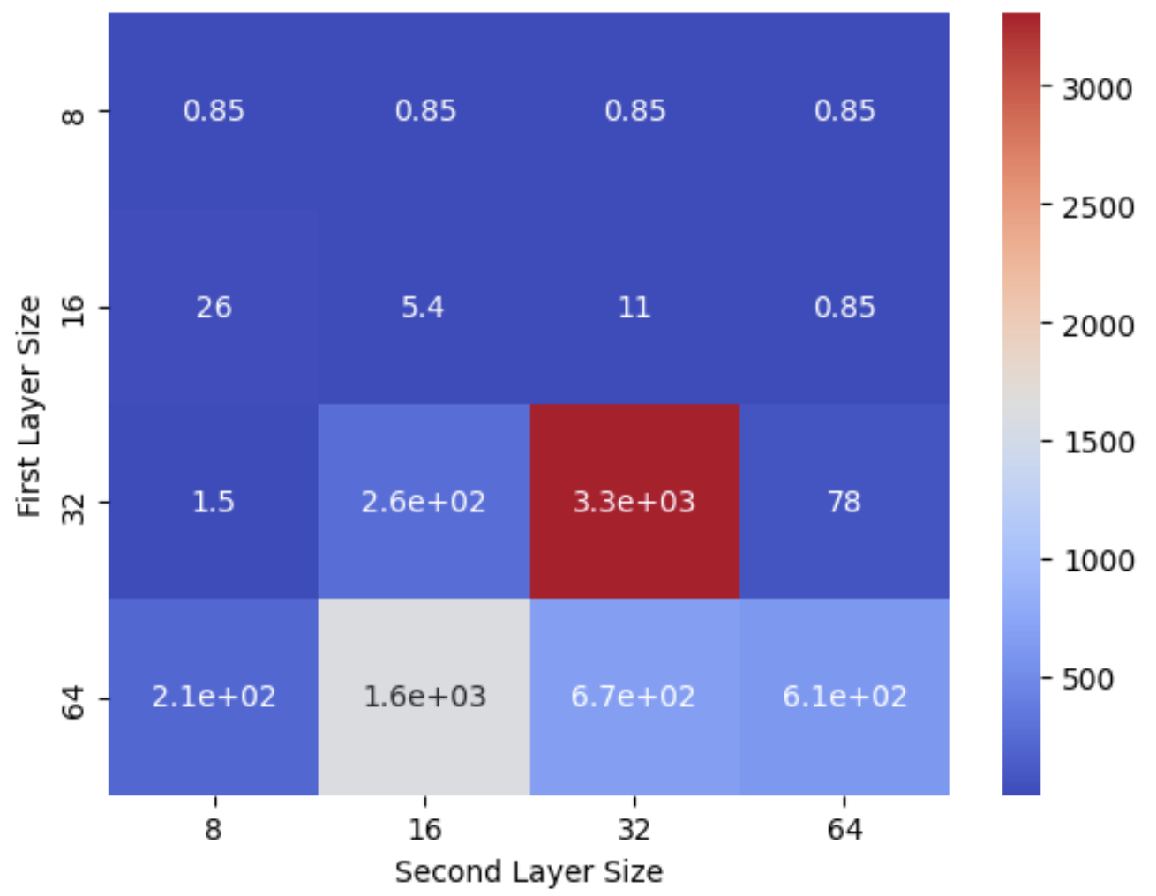
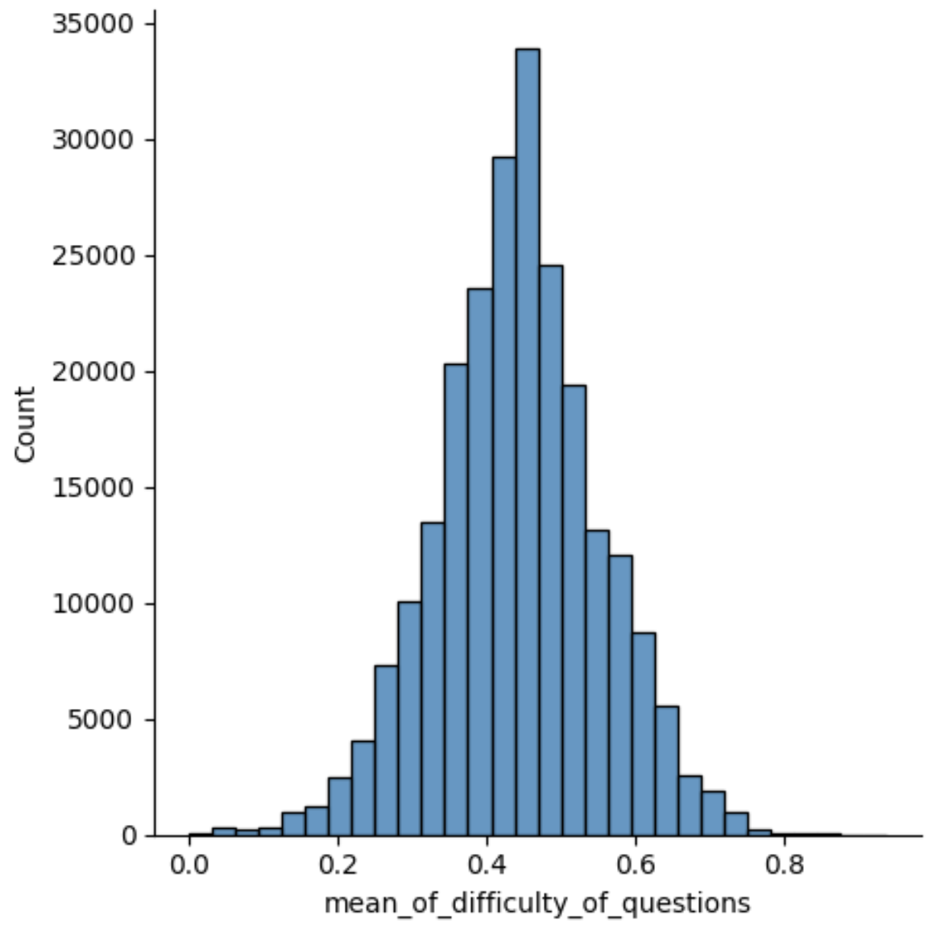
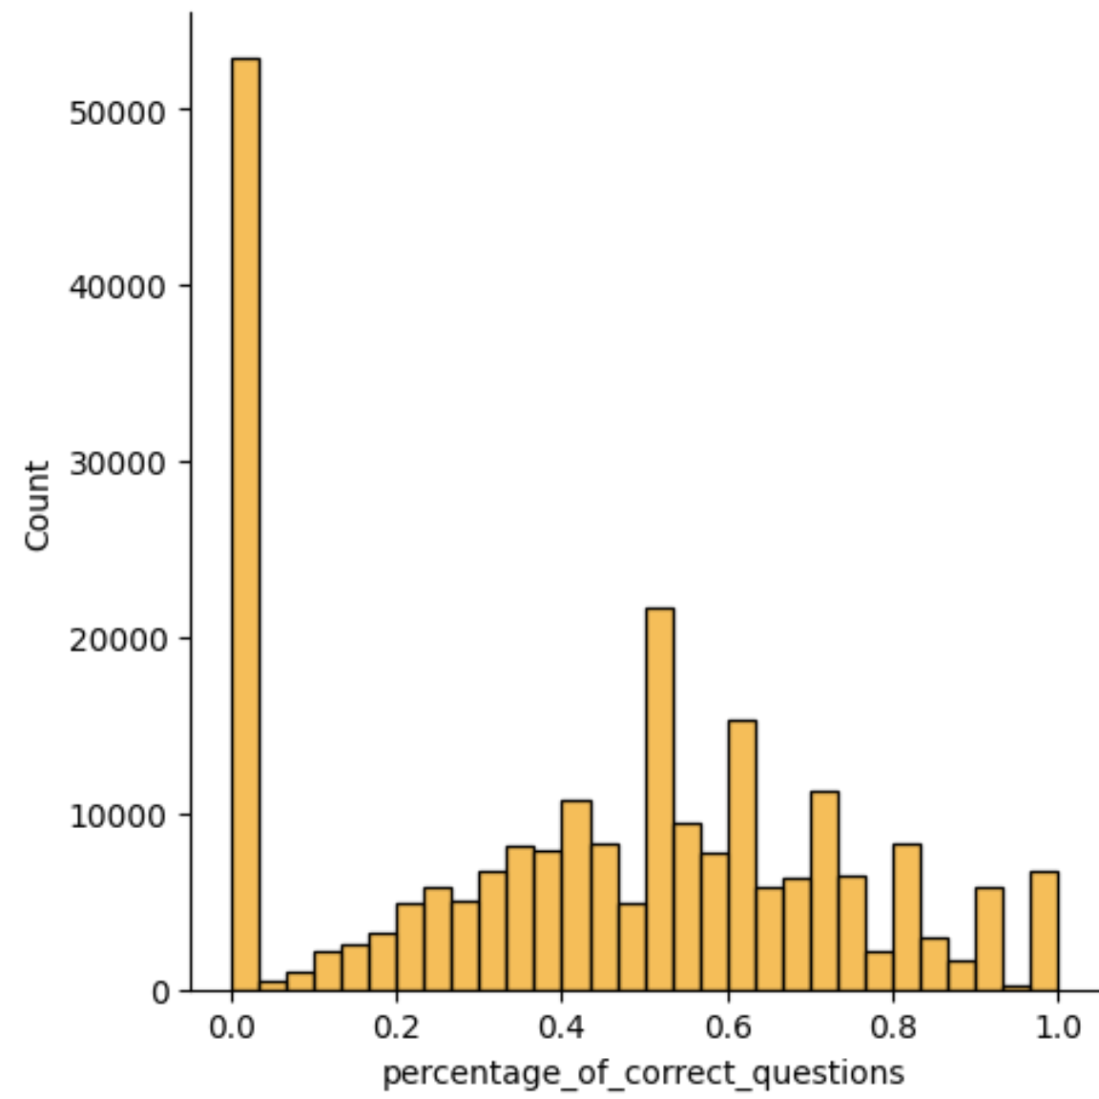
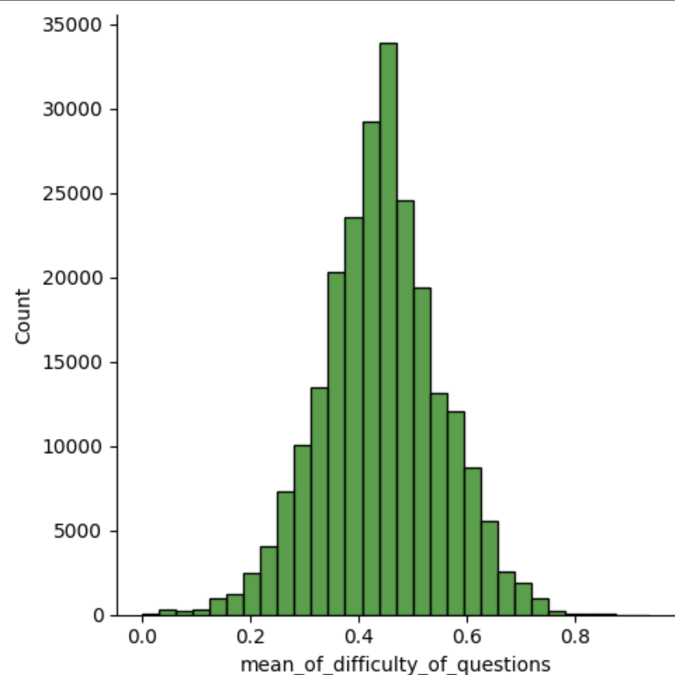
Predict user future experiences on the app
BRAM : Romain Berquet and Antoine Munier
Machine Learning for Behavioral Data (MLBD) Course, EPFL, 2022
1 INTRODUCTION + RESEARCH QUESTION
3 RESULTS
Research Question : Quantifying User Catchability: Predicting the Probability of User Retention in an Application after their Initial 10 Sessions.
We train the two models with different hyperparameters to try to predict the number of sessions the users will do and also see what are the important features.
We run a first linear regression that gives us the following important features (We look at the p-values of each features) :
[‘CLOSE’, ‘GO_TO_BUG_REPORT’,‘ GO_TO_THEORY’, ‘NEXT’,‘VIEW_QUESTION’, ‘mean_of_difficulty_of_questions’, ‘session_closed’,‘duration_of_session’,‘math_session’]
The first 5 ones represent the number of each action per session.
Otherwise, we would like to know how many consecutive sessions would best help for predicting the next one, but noting very obvious appear.
Actually, we try to see which of the two models is the more performant but in both case we can obtain a mean square error of 0.85.
Introduction : Lernavi stands as a platform where students can engage with math and German questions, providing an interactive and immersive learning environment. However, despite its promising features, the application has experienced a notable trend of user attrition, with a significant number of users leaving after only a few sessions. Understanding the underlying factors contributing to this phenomenon will be a part of our work
Fig 1. Number of session per user
2 METHODOLOGY
^{MODEL ARCHITECTURE}
We try to find the best model between a linear regression and a CNN to predict the number of session a user will do after his first 10 ones.
Linear regression : This the simple yet powerful model that establishes a linear relationship between the dependent variable (user catchability) and independent variables (features extracted from user session data).
CNN : CNNs are deep learning models widely used for their ability to capture spatial and temporal patterns in data. Leveraging this strength, we employed CNNs to analyze sequential user session data in order to uncover patterns and relationships that impact user catchability.
Fig .4 Number of MSE we obtain in running 100 linear regression
Fig .5 MSE of the CNN depending of the size of his layers
^{DATASET}
We only take the user that have at least 10 sessions on the application, we take a lot of features on each session and create time series of these features per session.
In the feature created we can name : the mean difficulty of the questions / the duration of the session / the number of correct questions or the number of SKIP question he/she did. [1]
4 CONCLUSION
It is very difficult to predict exactly the future of a user but we get some features that have some good impact for the number of future sessions of a user. We can name, the number of session finished, the number of NEXT action and a mean difficulty of questions high implies that the user will stay longer.
Otherwise for the model we have the same efficiency for the linear regression and the CNN.
REFERENCES
Fig .2 Percentage of correct questions per sessions
Fig .3 Mean of the difficulty of the questions per sessions
[1] Prediction of students’early dropout based on their interactionlogs in online learning environmentAhmed A. Mubaraka,b, Han Caoaand Weizhen Zhang

