Slide 1
A distributed version control system
GIT
Notes:
https://docs.github.com/en/github/importing-your-projects-to-github/importing-source-code-to-github/adding-an-existing-project-to-github-using-the-command-line

Slide 2
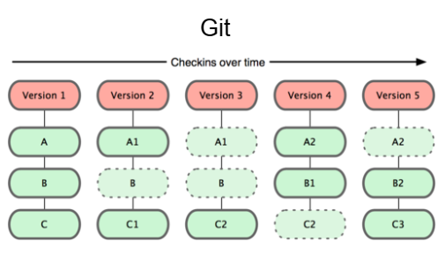
Version control systems
Version control:
  Managing multiple versions of documents, programs, etc.
  For working by yourself:
    “time machine” for going back to earlier versions
    Support for different versions (standalone, web app, etc.) of the same basic project
  For working with others:
    Greatly simplifies concurrent work, merging changes
  For getting an internship or job:
    Any company with a clue uses some kind of version control
    Companies without a clue are bad places to work
Notes:
Well-known version control systems: CVS, Subversion, Mercurial, and Git
“central” repositories: CVS and Subversion use a “central” repository; users “check out” files, work on them, and “check them in”
“distributed” repositories: Mercurial and Git treat all repositories as equal

Slide 3
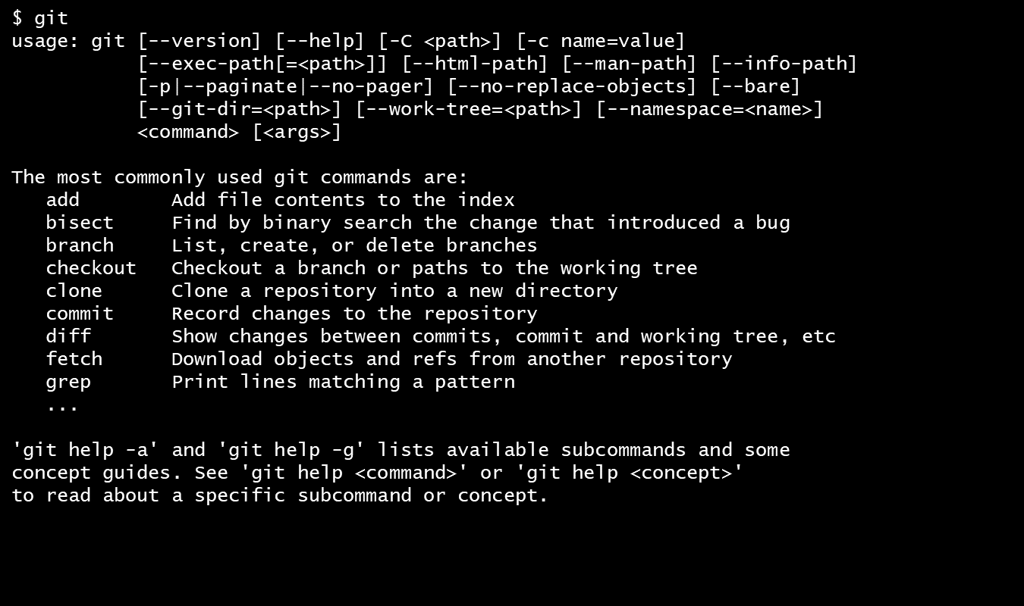
Why Git?
Git was created by Linus Torvalds in 2005
You don't "checkout“ from a central repo:
  you "clone" it and "pull" changes from it
Your local repo is a complete copy of everything on the remote server
  yours is "just as good" as theirs
Many operations are local:
  check in/out from local repo
  commit changes to local repo
  local repo keeps version history
When you're ready, you can "push" changes back to server
  Git is primarily a command-line tool
  The Git GUIs are more trouble than they are worth

Slide 4
Download and install Git
Online materials
  Mac OS X
    http://sourceforge.net/projects/git-osx-installer
    brew install git
  Linux
    apt-get install git (debian/ubuntu)
    yum install git (fedora/redhat)
  Standard one:
    http://git-scm.com/downloads
  SackExchange:
    http://stackoverflow.com/questions/315911/git-for-beginners-the-definitive-practical-guide#323764

Slide 5
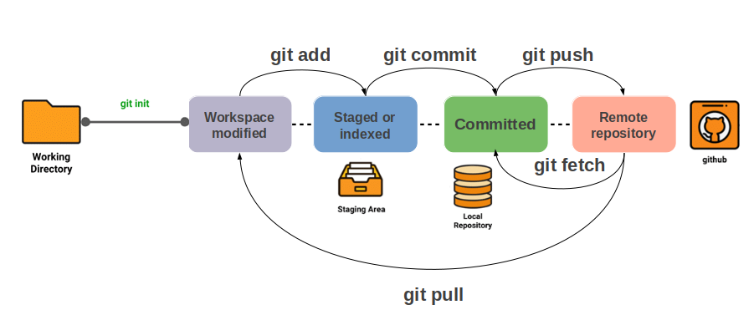
Git cycle life
Cycle life

Slide 6
Let’s create your first GIT
Step 1 : Configure git
Global configuration
  git config -l
  git config --global user.name “Ismail Berrada“
  git config --global user.email ismail.berrada@um6p.ma
  git config --global core.editor nano
Working project configuration
  cd to the project directory
  Leave out the –global
git config --list to verify the config
Step 2 : Create a local repository
  cd to the project directory
  Type in git init
    Create the repository .git containing various files (a “hidden” directory)
    You do not work directly with the contents of that directory; various git commands do that for you
    You do need a basic understanding of what is in the repository
Notes:
You can use a different name/email address for a particular project, you can change it for just that project
Set the editor that is used for writing commit messages:

Slide 7
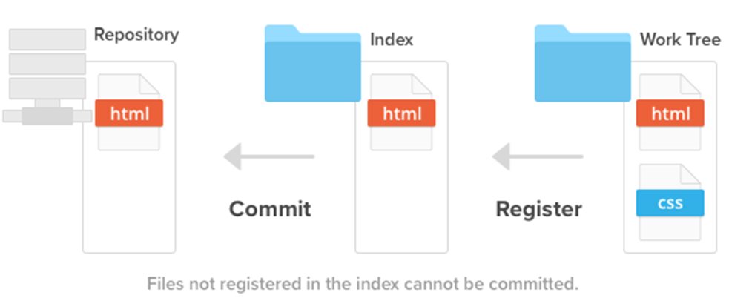
Let’s create your first GIT
Step 3: Fill the local Index
  Do the work as usual coding. If you create new files and/or folders, they are not tracked by Git unless you ask it to do so
    git add newFile1 newFolder1 newFolder2 newFile2
    Or type in git add .
      dot means “this directory”: track all your current files.
      We said that the files are staged.

Slide 8
Let’s create your first GIT
Step 4 : Commit to the local repository
  Make a “snapshot” of everything being tracked into your repository. A message telling what you have done is required
    Type in git commit –m "Initial commit“
    Or type git commit
      It opens an editor, enter the message, save and quit.
    In git, “Commits are cheap”, do them often.

Slide 9
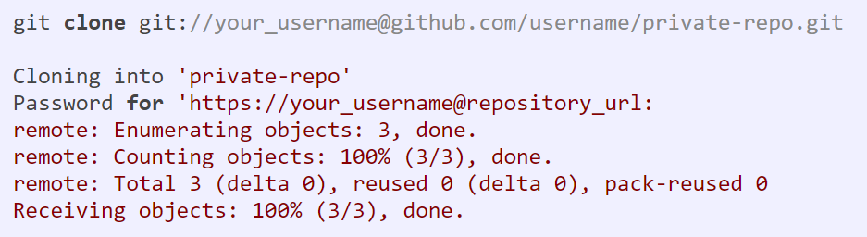
Let’s create your first GIT
Step 5 : Clone a remote repository
  You can clone a remote repo to your current directory:
    git clone https:// github.com/username/mygit.git
      This will create the given local directory, containing a working copy of the files from the repo, and a .git directory (used to hold the staging area and your actual local repo)
    git clone git://your_username@github.com/username/private-repo.git

Slide 10
Recapitulation
Cycle life
“snapshot” of your project directory, and put it in your repository is called a commit object that contains
(1) a set of files, (2) references to the “parents” of the commit object, and (3) a unique “SHA1” name
Top-level working directory:
One of these subdirectories, named .git, is your repository: a (key = object) database
Work as much as you like, but the working repository isn’t updated until you commit
release is the distribution of a given changest of repository.. version of release corresponding to a given commit
Notes:
A release is the distribution of a given changest of repository. It may be either public or private and generally constitutes the initial generation of a new or upgraded application.
Version of release corresponding to a given commit

Slide 11
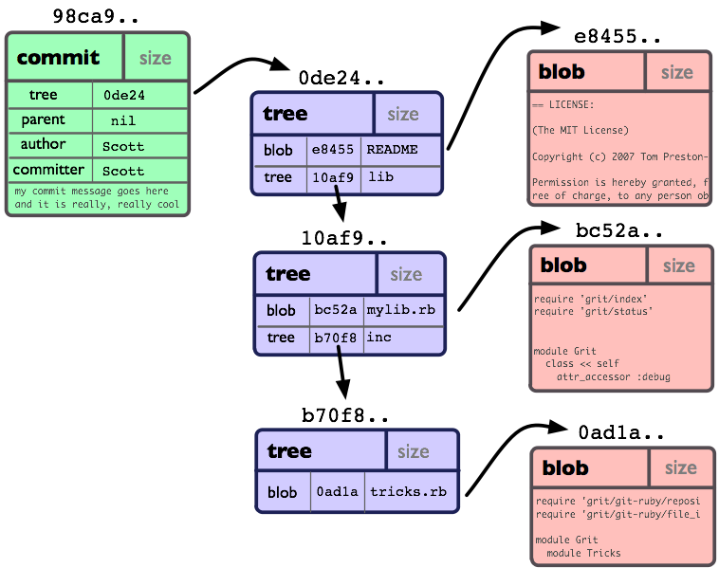
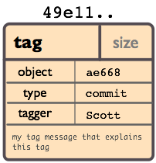
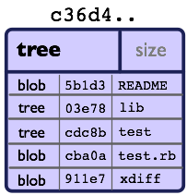
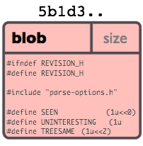
Git internal storage
Object model
  A commit object represents the complete state of the project
All the information needed to represent the history of a project is stored in files referenced by a SHA1 40-digit: "object name"
Object: a type, a size and content.
  "blob": to store file data
  "tree“: like a directory - it references a bunch of other trees and/or blobs (i.e. files and sub-directories)
  "commit": a single tree, the project looked like at a certain point in time.
  "tag": mark a specific commit as special in some way (special version, ..).
Notes:
http://shafiul.github.io/gitbook/1_the_git_object_model.html
All the information needed to represent the history of a project is stored in files referenced by a 40-digit "object name" SHA1
Every object consists of three things: a type, a size and content.
Four different types of objects:
A "blob" is used to store file data - it is generally a file.
A "tree" is basically like a directory - it references a bunch of other trees and/or blobs (i.e. files and sub-directories)
A "commit" points to a single tree, marking it as what the project looked like at a certain point in time.
A "tag" is a way to mark a specific commit as special in some way. It is normally used to tag certain commits as specific releases or something along those lines.<

Slide 12
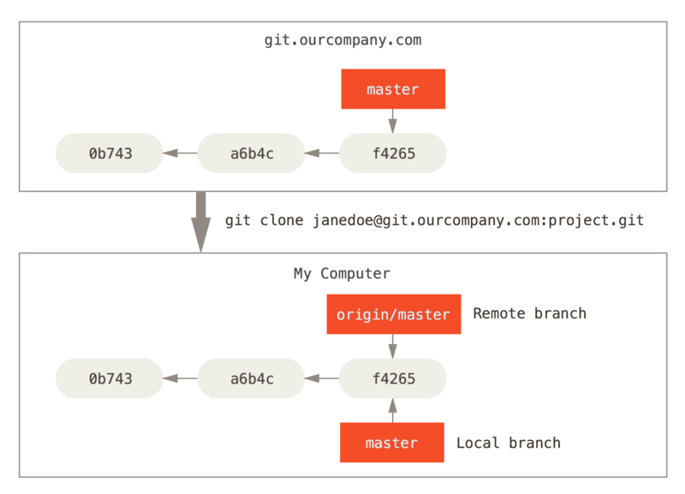
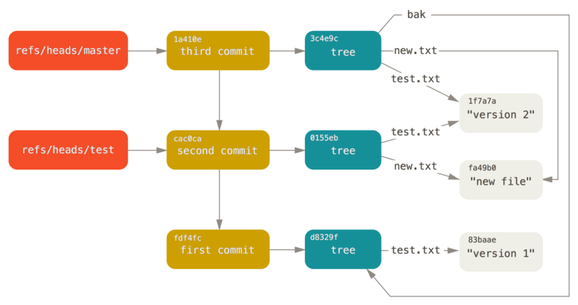
Git internal storage
Git references
  Git keeps the history of your repository reachable from commit, in files called “references” or “refs”.
  You can find the files that contain those SHA-1 values (40 character string of hex digits) in the .git/refs directory. Often we only see the first 7 characters: 0e52da7 Initial commit
Notes:
https://git-scm.com/book/en/v2/Git-Internals-Git-References
Got to .get/refs/headers
Type: ls
Type: « cat file_name »
Type: git cat-file –p content_file_name_hash

Slide 13
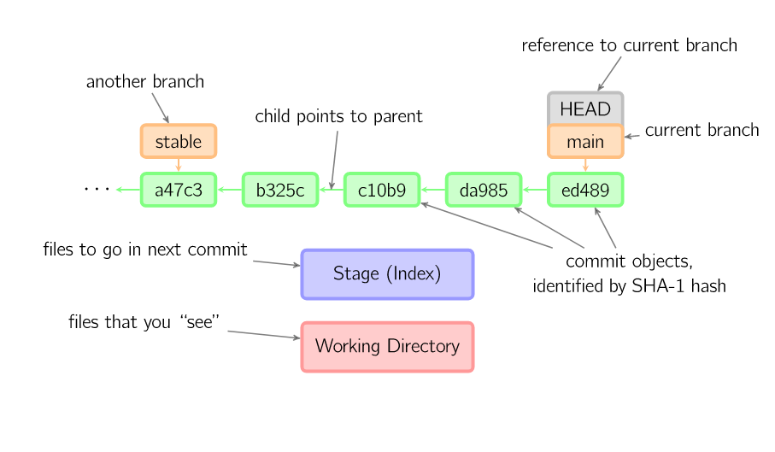
Local git area
Git commit graph
Commit objects form a directed graph
A head is a reference to a commit object. The “current head” is called HEAD. Usually, you will take HEAD (the current commit object), make some changes to it, and commit the changes, creating a new current commit object.
Each user has their own copy of the repo, and commits changes to their local copy of the repo before pushing to the server.

Slide 14
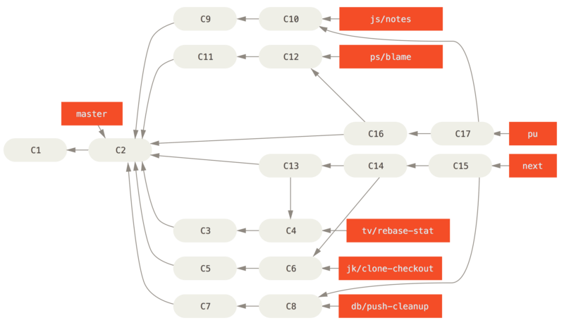
Local git area
Git commit graph (more complex)
The very first commit object has no “parents”
Usually, you take some commit object, make some changes, and create a new commit object; the original commit object is the parent of the new commit object
You can also merge two commit objects to form a new one
  The new commit object has two parents

Slide 15
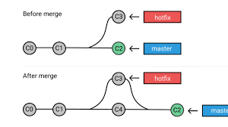
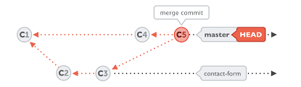
Local git area
merge
You can also take any previous commit object, make changes to it, and commit those changes
  This creates a branch in the graph of commit objects
You can merge any previous commit objects
  This joins branches in the commit graph
Notes:
https://developers.sap.com/tutorials/webide-github-merge-pull-request.html

Slide 16
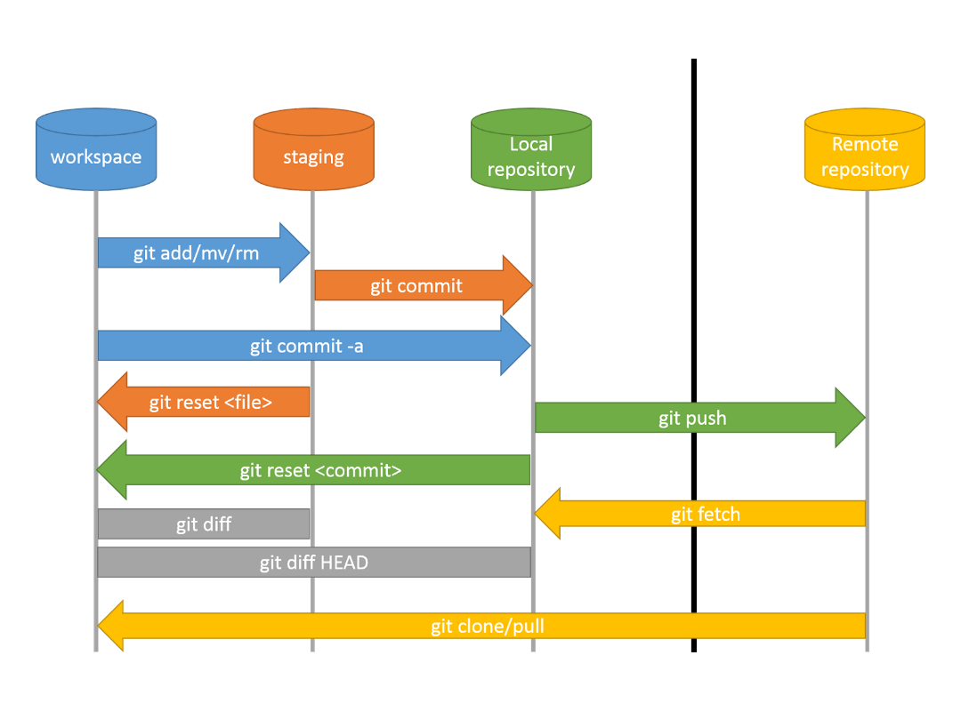
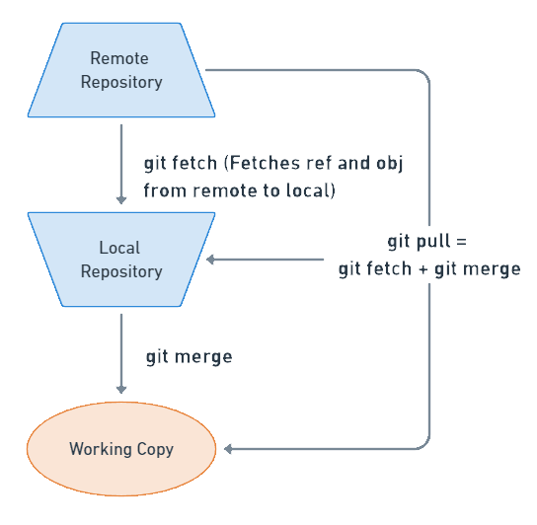
Git workflow
Local vs remote
  Git is all about using and manipulating the commit graph
Notes:
https://git-scm.com/book/en/v2/Git-Internals-Git-Objects

Slide 17
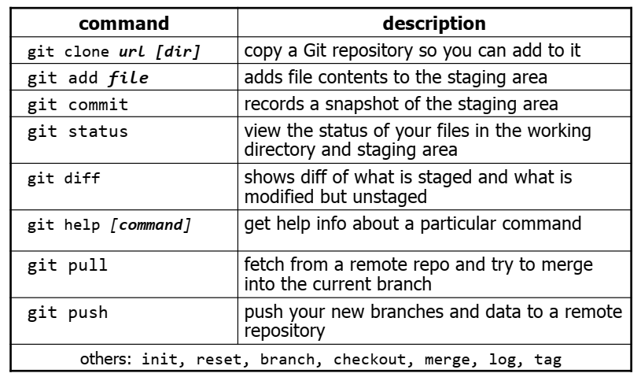
Local git area
Git commands
Notes:
https://git-scm.com/docs/git-merge-file

Slide 18

Working with others
Cycle
Git server
burgers
burgers
burgers
fetch
+
merge
push
fetch
+
merge
My Git repo
push
Git repo
burgers
burgers
burgers
burgers
clone
burgers
A
C
B

Slide 19

Working with others
Cycle
Working directory
merge
commit
pull
Git repo
.git
fetch
push
Git serve
.git shared

Slide 20
Working with others
Clone a repository from elsewhere
  git clone URL
  git clone URL mypath
    These make an exact copy of the repository at the given URL
  git clone git://github.com/rest_of_path/file.git
    Github is the most popular (free) public repository
All repositories are equal
  But you can treat some particular repository (such as one on Github) as the “master” directory
Typically, each team member works in his/her own repository, and “merges” with other repositories as appropriate

Slide 21
Working with others
All repositories are equal, but it is convenient to have one central repository in the cloud
Here’s what you normally do:
  Download the current HEAD from the central repository
  Make your changes
  Commit your changes to your local repository
  Check to make sure someone else on your team hasn’t updated the central repository since you got it
  Upload your changes to the central repository
If the central repository has changed since you got it:
  It is your responsibility to merge your two versions
    This is a strong incentive to commit and upload often!
  Git can often do this for you, if there aren’t incompatible changes

Slide 22
Working with others
Typical workflow
  git pull remote_repository
    Get changes from a remote repository and merge them into your own repository
  git status
    See what Git thinks is going on
    Use this frequently!
  Work on your files (remember to add any new ones)
  git commit –m “What I did”
  git push

Slide 23
Branches and merging
Typical workflow
r1
r2
r3
r5
r8
master
r4
r6
r7
branchname

Slide 24
Branches and merging
Git uses branching heavily to switch between multiple tasks.
  To create a new local branch:
    git branch name
  To list all local branches: (* = current branch)
    git branch
  To switch to a given local branch:
    git checkout branchname
  To merge changes from a branch into the local master:
    git checkout master
    git merge branchname

Slide 25
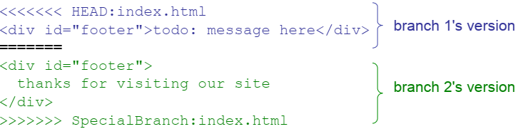
Merging conflict
The conflicting file will contain <<< and >>> sections to
indicate where Git was unable to resolve a conflict:
Find all such sections, and edit them to the proper state (whichever of the two versions is newer / better / more correct)

Slide 26
Some advises
If you:
  Make sure you are current with the central repository
  Make some improvements to your code
  Update the central repository before anyone else does
Then you don’t have to worry about resolving conflicts or working with multiple branches
  All the complexity in git comes from dealing with these
Therefore:
  Make sure you are up-to-date before starting to work
  Commit and update the central repository frequently
If you need help: https://help.github.com/
Notes:
https://developers.sap.com/tutorials/webide-github-merge-pull-request.html

Slide 27
Backup

Slide 28
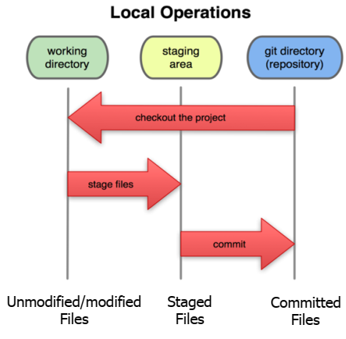
Local git area
In your local copy on git, files can be:
  In your local repo (committed)
  Checked out and modified, but not yet committed (working copy)
  Or, in-between, in a "staging" area
Staged files are ready to be committed.
A commit saves a snapshot of all staged state.

Slide 29
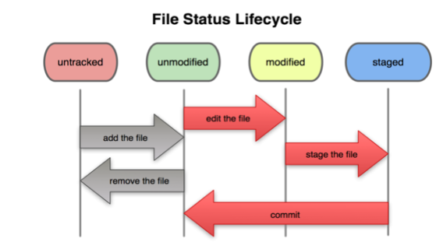
Local git area
Basic git workflow
  Modify files in your working directory.
  Stage files, adding snapshots of them to your staging area.
  Commit, which takes the files in the staging area and stores that snapshot permanently to your Git directory.

Slide 30
Local git area
When you commit your change to git, it creates a commit object:
  A commit object represents the complete state of the project, including all the files in the project
  The very first commit object has no “parents”
  Usually, you take some commit object, make some changes, and create a new commit object; the original commit object is the parent of the new commit object
    Hence, most commit objects have a single parent
  You can also merge two commit objects to form a new one
    The new commit object has two parents
Commit objects form a directed graph
  Git is all about using and manipulating this graph
Notes:
https://developers.sap.com/tutorials/webide-github-merge-pull-request.html

Slide 31
Local git area
Working with your repository
A head is a reference to a commit object
The “current head” is called HEAD (all caps)
Usually, you will take HEAD (the current commit object), make some changes to it, and commit the changes, creating a new current commit object
  This results in a linear graph: A → B → C → …→ HEAD
You can also take any previous commit object, make changes to it, and commit those changes
  This creates a branch in the graph of commit objects
You can merge any previous commit objects
  This joins branches in the commit graph
Notes:
https://developers.sap.com/tutorials/webide-github-merge-pull-request.html

Slide 32
Recapitulation
Cycle life
“snapshot” of everything (or selected things) in your project directory, and put it in your repository is called a commit object that contains
(1) a set of files, (2) references to the “parents” of the commit object, and (3) a unique “SHA1” name
Top-level working directory probably contains many subdirectories, files …:
One of these subdirectories, named .git, is your repository: a (key = object) database
Work as much as you like in your working directory, but the repository isn’t updated until you commit
release is the distribution of a given changest of repository. Version of release corresponding to a given commit,
Notes:
A release is the distribution of a given changest of repository. It may be either public or private and generally constitutes the initial generation of a new or upgraded application.
Version of release corresponding to a given commit

