Slide 1
Python Crash Course
For Data Scientist

Slide 2
Notice
Please note, this is not meant to be a comprehensive overview of Python or programming in general.

Slide 3
Outline – Part 1
Introduction
Data types
  Numbers
  String
  Printing
  Lists
  Dictionaries
  Booleans
  Tuples
  Sets
Python Comparison Operators
Python statements
  if, elif, else Statements
  for Loops
  while Loops
Methods and functions
  lambda expressions
  map and filter
Error handling
Modules and Packages
Object Oriented Programming

Slide 4
Outline – Part 2
Most popular data Python Data Science Libraries
  NumPy
  SciPy
  Pandas
  MatplotLib
  Seaborn
  Scikit-learn
  And much more (Dask, …)
Notes:
SciPy is a free and open-source Python library used for scientific computing and technical ... SciPy builds on the NumPy array object and is part of the NumPy stack which includes tools like Matplotlib, pandas and SymPy, and an expanding set ...
Dask : https://towardsdatascience.com/why-every-data-scientist-should-use-dask-81b2b850e15b

Slide 5
Outline – Part 3
Data Science project
  Cross-industry standard process for data mining
  Exploratory data analysis
  Data preparation
    Missing data imputation
    Data Encoding and scaling
    Feature selection
  Model construction
    Cross-validation
    Grid-search
    Ensemble methods
  Model deployment
Notes:
SciPy is a free and open-source Python library used for scientific computing and technical ... SciPy builds on the NumPy array object and is part of the NumPy stack which includes tools like Matplotlib, pandas and SymPy, and an expanding set ...
Dask : https://towardsdatascience.com/why-every-data-scientist-should-use-dask-81b2b850e15b

Slide 6
Python version
Python 2 or Python 3 ? Definitely 3
https://www.python.org/
https://pythonclock.org/

Slide 7




Python version
Why Python ?
The rich ecosystem of libraries and tooling, and the convenience of the language itself, make Python an excellent choice.
Many distributions of Python, such as
  WinPython,
  ActivePython,
  Anaconda,
  Enthought Canopy,
  Python(x,y),
  Pyzo

Slide 8
Python version
Why Python ?
For this course, let’s install Anaconda for python 3
  https://www.anaconda.com/products/individual
Notes:
Make some examples using python anaconda

Slide 9
Python version
Virtual Environment
  Virtual Environments allow you to set up virtual installations of Python and libraries on your computer
  You can have multiple versions of Python or libraries and easily activate or deactivate these environments
  Virtual environment = a self-contained directory tree that contains a Python installation for a particular version of Python, plus a number of additional packages
Notes:
Make some examples using python anaconda

Slide 10
Python version
Why Virtual Environment?
  Sometimes you’ll want to program in different versions of a library
  For example:
    You develop a program with SciKit-Learn 0.17
    SciKit-Learn 0.18 is released
    You want to explore 0.18 but don’t want you old code to break
Notes:
Make some examples using python anaconda

Slide 11
Python version
Virtual Environment
Several ways to create a virtual environment
  Using venv module of python (default)
    python3 -m venv tutorial-env
    source tutorial-env/bin/activate
    pip3 search astronomy
    pip3 install novas or pip install novas=2.1.0
    source deactivate
    Virtual Environments allow you to set up virtual installations of Python and libraries on your computer
  Using Virtualenv Environment
  Using Pipenv Environment
Notes:
Make some examples using python anaconda

Slide 12
Python version
Virtual Environment
Several ways to create a virtual environment
  Using Anaconda (Conda) a Environment
  https://conda.io/docs/user-guide/tasks/manage-environments.html
    conda create --name myenv
    conda install numpy
    conda install anaconda
    conda activate myvenv
    conda deactivate
Notes:
Make demo

Slide 13
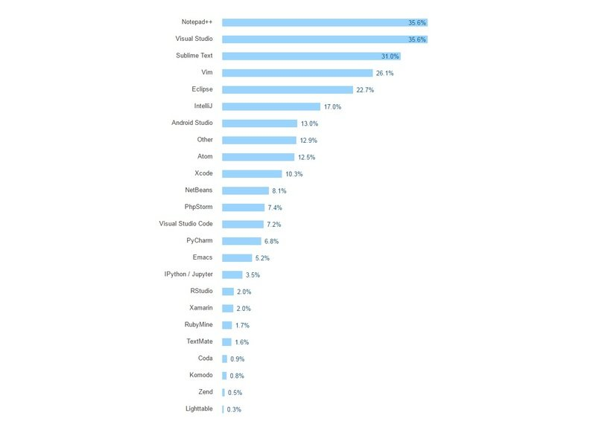
Python IDE
IDEs versus Text Editors
Notes:
https://www.datacamp.com/community/tutorials/data-science-python-ide

Slide 14
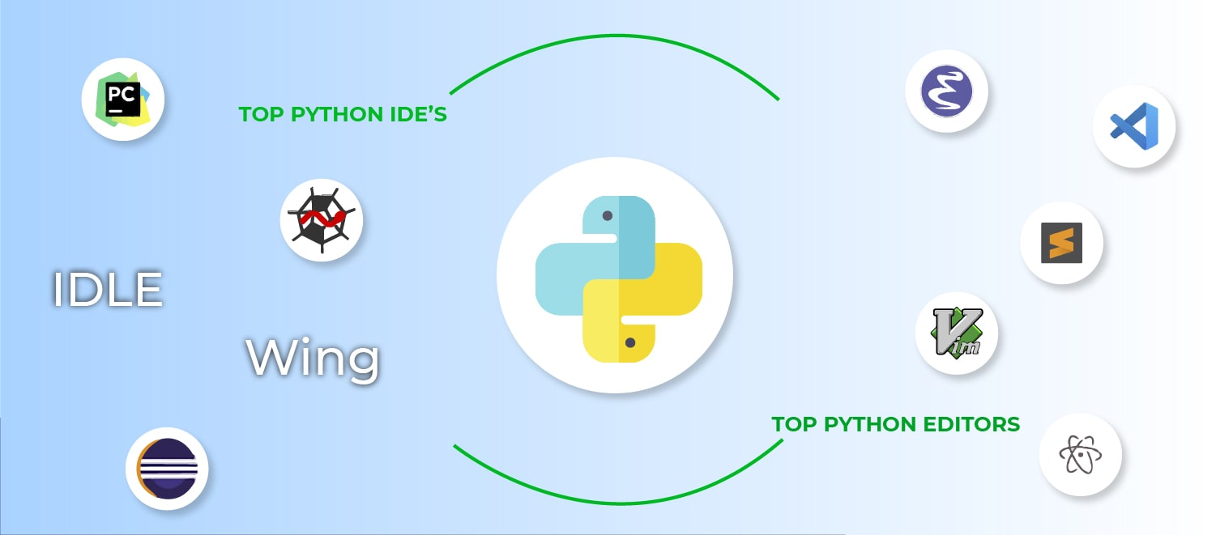
Python IDE
Python IDEs for python
Notes:
https://www.datacamp.com/community/tutorials/data-science-python-ide

Slide 15
Python IDE
Python IDEs for Data Science
  Spyder
  PyCharm
  Rodeo
  Atom
  Jupyter Notebook
  Jupyter Lab
  Visual Studio Code
  PyDev
Notes:
https://www.datacamp.com/community/tutorials/data-science-python-ide

Slide 16
Python IDE
Python IDEs for Data Science
  http://www.jupyter.org/
  and
  try it with python in http://jupyter.org/try
    Code Cell
    Markdaown Cell
Notes:
Make instalation and demo for jupyter

Slide 17
Python IDE
Python IDEs for Data Science
Now, let’s launch Jupyter Notebook in your PC
  Open a terminal window or anaconda prompt
  Enter the startup folder with cd
  Create and/or activate your virtual environment
  Type jupyter notebook to launch the Jupyter Notebook App
    If note installed, use conda install -c conda-forge jupyterlab (or using pip3 or mamba)
    The notebook interface will appear in a new browser window or tab.
  Ask for help if needed
Notes:
Make instalation and demo for jupyter

Slide 18
Python IDE
Python IDEs for Data Science
  Now, Let’s install PyCharm
  Education edition
  https://www.jetbrains.com/pycharm-edu/download/#section=mac
  Or the community edition
  See plugins (ideavim …)
  See packages
  Run jupyter

