Slide 1
Problems with dirty data
ID | Name | Street | City | State | Zip | Hours
1 | N Aldroubi | 123 University Ave | Providence | RI | 98106 | 42
2 | Natalie Delworth | 245 3rd St | Pawtucket | RI | 98052-1234 | 30
3 | Nam Do | 345 Broadway | PVD | Rhode Island | 98101 | 19
4 | N Dellworth | 245 Third Street | Pawtucket | NULL | 98052 | 299
5 | Do Nam | 345 Broadway St | Providnce | Rhode Island | 98101 | 19
6 | Nazem Aldroubi | 123 Univ Ave | PVD | Rhode Island | NULL | 41
7 | Minna Kimura-T | 123 University Ave | Providence | Guyana | 94305 | NULL
…

Slide 2
Problems?
ID | Name | Street | City | State | Zip | Hours
1 | N Aldroubi | 123 University Ave | Providence | RI | 98106 | 42
2 | Natalie Delworth | 245 3rd St | Pawtucket | RI | 98052-1234 | 30
3 | Nam Do | 345 Broadway | PVD | Rhode Island | 98101 | 19
4 | N Dellworth | 245 Third Street | Pawtucket | NULL | 98052 | 299
5 | Do Nam | 345 Broadway St | Providnce | Rhode Island | 98101 | 19
6 | Nazem Aldroubi | 123 Univ Ave | PVD | Rhode Island | NULL | 41
7 | Minna Kimura-T | 123 University Ave | Providence | Guyana | 94305 | NULL
…

Slide 3


Inconsistent Representations
Problems?
ID | Name | Street | City | State | Zip | Hours
1 | N Aldroubi | 123 University Ave | Providence | RI | 98106 | 42
2 | Natalie Delworth | 245 3rd St | Pawtucket | RI | 98052-1234 | 30
3 | Nam Do | 345 Broadway | PVD | Rhode Island | 98101 | 19
4 | N Dellworth | 245 Third Street | Pawtucket | NULL | 98052 | 299
5 | Do Nam | 345 Broadway St | Providnce | Rhode Island | 98101 | 19
6 | Nazem Aldroubi | 123 Univ Ave | PVD | Rhode Island | NULL | 41
7 | Minna Kimura-T | 123 University Ave | Providence | Guyana | 94305 | NULL
…

Slide 4

Inconsistent Representations
Problems?
ID | Name | Street | City | State | Zip | Hours
1 | N Aldroubi | 123 University Ave | Providence | RI | 98106 | 42
2 | Natalie Delworth | 245 3rd St | Pawtucket | RI | 98052-1234 | 30
3 | Nam Do | 345 Broadway | PVD | Rhode Island | 98101 | 19
4 | N Dellworth | 245 Third Street | Pawtucket | NULL | 98052 | 299
5 | Do Nam | 345 Broadway St | Providnce | Rhode Island | 98101 | 19
6 | Nazem Aldroubi | 123 Univ Ave | PVD | Rhode Island | NULL | 41
7 | Minna Kimura-T | 123 University Ave | Providence | Guyana | 94305 | NULL
…
Missing Values

Slide 5

Inconsistent Representations
Problems?
ID | Name | Street | City | State | Zip | Hours
1 | N Aldroubi | 123 University Ave | Providence | RI | 98106 | 42
2 | Natalie Delworth | 245 3rd St | Pawtucket | RI | 98052-1234 | 30
3 | Nam Do | 345 Broadway | PVD | Rhode Island | 98101 | 19
4 | N Dellworth | 245 Third Street | Pawtucket | NULL | 98052 | 299
5 | Do Nam | 345 Broadway St | Providnce | Rhode Island | 98101 | 19
6 | Nazem Aldroubi | 123 Univ Ave | PVD | Rhode Island | NULL | 41
7 | Minna Kimura-T | 123 University Ave | Providence | Guyana | 94305 | NULL
…
Typos
Missing Values

Slide 6

Inconsistent Representations
Duplicates
Problems?
ID | Name | Street | City | State | Zip | Hours
1 | N Aldroubi | 123 University Ave | Providence | RI | 98106 | 42
2 | Natalie Delworth | 245 3rd St | Pawtucket | RI | 98052-1234 | 30
3 | Nam Do | 345 Broadway | PVD | Rhode Island | 98101 | 19
4 | N Dellworth | 245 Third Street | Pawtucket | NULL | 98052 | 299
5 | Do Nam | 345 Broadway St | Providnce | Rhode Island | 98101 | 19
6 | Nazem Aldroubi | 123 Univ Ave | PVD | Rhode Island | NULL | 41
7 | Minna Kimura-T | 123 University Ave | Providence | Guyana | 94305 | NULL
…
Typos
Missing Values

Slide 7
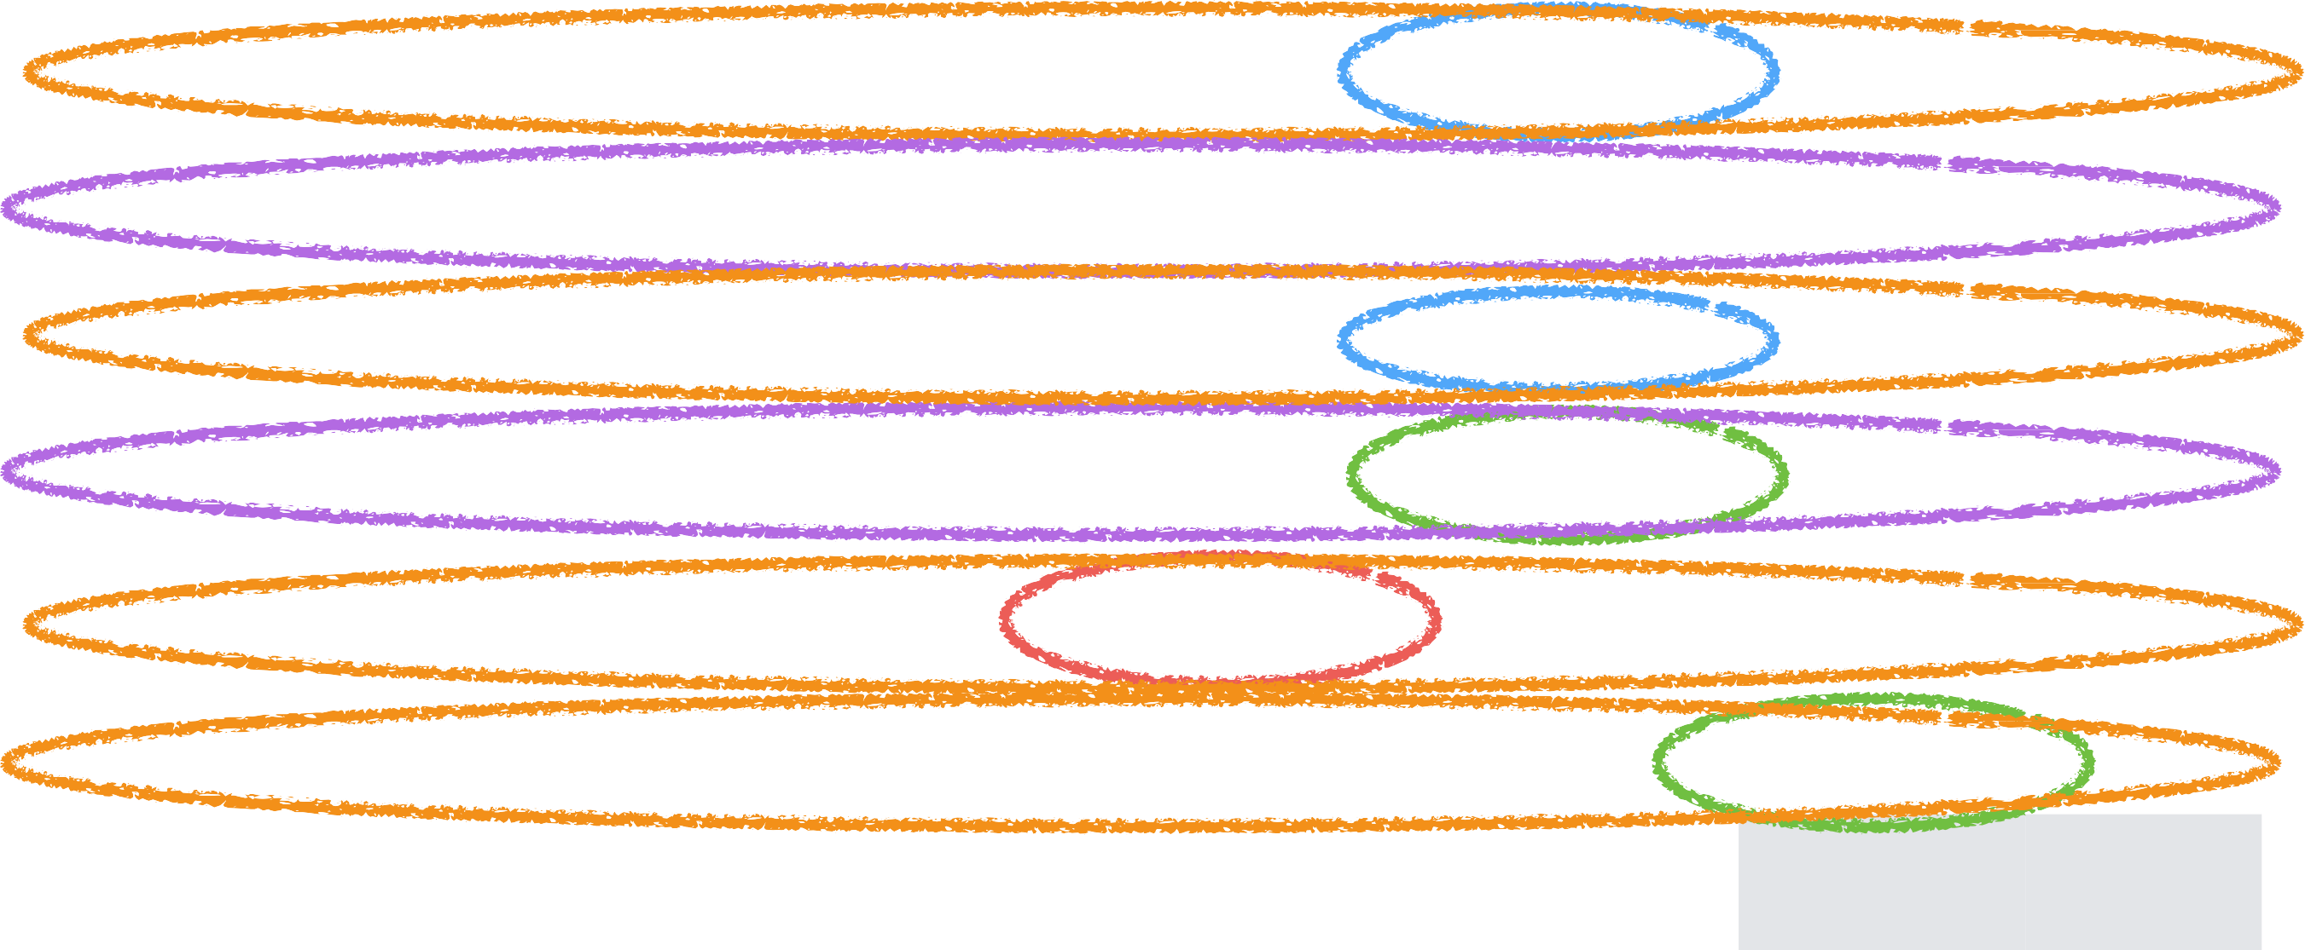
Inconsistent Representations
Duplicates
Problems?
ID | Name | Street | City | State | Zip | Hours
1 | N Aldroubi | 123 University Ave | Providence | RI | 98106 | 42
2 | Natalie Delworth | 245 3rd St | Pawtucket | RI | 98052-1234 | 30
3 | Nam Do | 345 Broadway | PVD | Rhode Island | 98101 | 19
4 | N Dellworth | 245 Third Street | Pawtucket | NULL | 98052 | 299
5 | Do Nam | 345 Broadway St | Providnce | Rhode Island | 98101 | 19
6 | Nazem Aldroubi | 123 Univ Ave | PVD | Rhode Island | NULL | 41
7 | Minna Kimura-T | 123 University Ave | Providence | Guyana | 94305 | NULL
…
Typos Maybe Duplicates?
Missing Values

Slide 8
Dirty Data…

Slide 9
Dirty Data…
•
Data is dirty on its own

Slide 10
Dirty Data…
•
Data is dirty on its own
•
Data sets are clean on their own but combining them introduces errors (e.g. duplicates, different naming conventions)

Slide 11
Dirty Data…
•
Data is dirty on its own
•
Data sets are clean on their own but combining them introduces errors (e.g. duplicates, different naming conventions)
•
Data doesn’t “age well” (inflation, redistricting)

Slide 12
Dirty Data…
•
Data is dirty on its own
•
Data sets are clean on their own but combining them introduces errors (e.g. duplicates, different naming conventions)
•
Data doesn’t “age well” (inflation, redistricting)
•
Any combination of the above

Slide 13
Dirty Data…

Slide 14
Dirty Data…
•
Parsing input data (e.g., separator issues)

Slide 15
Dirty Data…
•
Parsing input data (e.g., separator issues)
•
Naming conventions: NYC vs New York

Slide 16
Dirty Data…
•
Parsing input data (e.g., separator issues)
•
Naming conventions: NYC vs New York
•
Formatting issues – esp. dates

Slide 17
Dirty Data…
•
Parsing input data (e.g., separator issues)
•
Naming conventions: NYC vs New York
•
Formatting issues – esp. dates
•
Missing values and required fields (e.g., always use 0)

Slide 18
Dirty Data…
•
Parsing input data (e.g., separator issues)
•
Naming conventions: NYC vs New York
•
Formatting issues – esp. dates
•
Missing values and required fields (e.g., always use 0)
•
Different representations (2 vs Two)

Slide 19
Dirty Data…
•
Parsing input data (e.g., separator issues)
•
Naming conventions: NYC vs New York
•
Formatting issues – esp. dates
•
Missing values and required fields (e.g., always use 0)
•
Different representations (2 vs Two)
•
Fields too long (get truncated)

Slide 20
Dirty Data…
•
Parsing input data (e.g., separator issues)
•
Naming conventions: NYC vs New York
•
Formatting issues – esp. dates
•
Missing values and required fields (e.g., always use 0)
•
Different representations (2 vs Two)
•
Fields too long (get truncated)
•
Primary key violations (from data merging)

Slide 21
Dirty Data…
•
Parsing input data (e.g., separator issues)
•
Naming conventions: NYC vs New York
•
Formatting issues – esp. dates
•
Missing values and required fields (e.g., always use 0)
•
Different representations (2 vs Two)
•
Fields too long (get truncated)
•
Primary key violations (from data merging)
•
Redundant Records (from data merging)

Slide 22
Clicker Questions!

Slide 23
Clicker Lightening Round!
TAS
ID | Name | City | State | Hours
1 | N Aldroubi | Providence | RI | 42
2 | Natalie Delworth | Pawtucket | RI | 30
3 | Nam Do | PVD | Rhode Island | 19
4 | N Dellworth | Pawtucket | NULL | 300
5 | Do Nam | Providence | Rhode Island | 19
6 | Nazem Aldroubi | PVD | Rhode Island | 42
7 | Minna Kimura-T | Warwick | RI | NULL
ID | Name | City | State | Hours
1 | Nazem Aldroubi | Providence | Rhode Island | 42
2 | Natalie Delworth | Pawtucket | Rhode Island | 30
3 | Nam Do | Providence | Rhode Island | 38
7 | Minna Kimura-T | Warwick | Rhode Island | 0

Slide 24

Clicker Lightening Round!
💩
TAS
City State Hours Providence RI 42
ID 💩
Name
1
N Aldroubi
2 | Natalie Delworth | Pawtucket | RI | 30
3 | Nam Do | PVD | Rhode Island | 19
4 | N Dellworth | Pawtucket | NULL | 300
5 | Do Nam | Providence | Rhode Island | 19
42 💩
6
Nazem Aldroubi
PVD
Rhode Island
💩
7
Minna Kimura-T
Warwick
RI
NULL
ID | Name | City | State | Hours
1 | Nazem Aldroubi | Providence | Rhode Island | 42
2 | Natalie Delworth | Pawtucket | Rhode Island | 30
3 | Nam Do | Providence | Rhode Island | 38
7 | Minna Kimura-T | Warwick | Rhode Island | 0

Slide 25

Clicker Lightening Round!
💩
TAS
City State Hours Providence RI 42
ID 💩
Name
1
N Aldroubi
2 | Natalie Delworth | Pawtucket | RI | 30
3 | Nam Do | PVD | Rhode Island | 19
4 | N Dellworth | Pawtucket | NULL | 300
5 | Do Nam | Providence | Rhode Island | 19
42 💩
6
Nazem Aldroubi
PVD
Rhode Island
💩
7
Minna Kimura-T
Warwick
RI
NULL
ID
🌟
Name
City
State
Hours
🌟1
Nazem Aldroubi
Providence
Rhode Island
42
2 🌟Natalie Delworth
Pawtucket
Rhode Island
30
3 Nam Do
7 Minna Kimura-T
Providence
Rhode Island
🌟
38
🌟
Warwick
Rhode Island
0
🌟

Slide 26
Clicker Lightening Round!
💩
TAS
ID 💩
Name
City State Hours Providence RI 42
1
N Aldroubi
How will the dirty data affect the results of this query?
2 | Natalie Delworth | Pawtucket | RI | 30
3 | Nam Do | PVD | Rhode Island | 19
4 | N Dellworth | Pawtucket | NULL | 300
5 | Do Nam | Providence | Rhode Island | 19
Nazem Aldroubi PVD Rhode Island 42 Minna Kimura-T Warwick RI 💩NULL
💩
Too high
Too low
Unaffected
ID
🌟
Name
City
State
Hours
🌟1
Nazem Aldroubi
Providence
Rhode Island
42
2 🌟Natalie Delworth
Pawtucket
Rhode Island
30
3 Nam Do
7 Minna Kimura-T
Providence
Rhode Island
🌟
38
🌟
Warwick
Rhode Island
0
🌟

Slide 27
Clicker Lightening Round!
💩
TAS
ID 💩
Name
City State Hours Providence RI 42
1
N Aldroubi
How will the dirty data affect the results of this query?
2 | Natalie Delworth | Pawtucket | RI | 30
3 | Nam Do | PVD | Rhode Island | 19
4 | N Dellworth | Pawtucket | NULL | 300
5 | Do Nam | Providence | Rhode Island | 19
42 💩
Too high
Too low
Unaffected
6
Nazem Aldroubi
PVD
Rhode Island
💩
7
Minna Kimura-T
Warwick
RI
NULL
ID
🌟
Name
City
State
Hours
🌟1
Nazem Aldroubi
Providence
Rhode Island
42
2 🌟Natalie Delworth
Pawtucket
Rhode Island
30
3 Nam Do Providence
7 Minna Kimura-T Warwick
Rhode Island
🌟
38
🌟
Rhode Island
0
🌟
How many TAs are there?
SELECT
COUNT(*)
FROM
TAS

Slide 28


Clicker Lightening Round!
💩
TAS
ID 💩
Name
City State Hours Providence RI 42
1
N Aldroubi
How will the dirty data affect the results of this query?
2 | Natalie Delworth | Pawtucket | RI | 30
3 | Nam Do | PVD | Rhode Island | 19
4 | N Dellworth | Pawtucket | NULL | 300
5 | Do Nam | Providence | Rhode Island | 19
Nazem Aldroubi PVD Rhode Island 42 Minna Kimura-T Warwick RI 💩NULL
💩
Too high
Too low
Unaffected
ID
🌟
Name
City
State
Hours
🌟1
Nazem Aldroubi
Providence
Rhode Island
42
2 🌟Natalie Delworth
Pawtucket
Rhode Island
30
3 Nam Do Providence
7 Minna Kimura-T Warwick
Rhode Island
🌟
38
🌟
Rhode Island
0
🌟
🌟
🌟
Duplicates -> Double Counting
How many TAs are there?
SELECT
COUNT(*)
FROM
TAS

Slide 29
Clicker Lightening Round!
💩
TAS
ID 💩
Name
City State Hours Providence RI 42
1
N Aldroubi
How will the dirty data affect the results of this query?
2 | Natalie Delworth | Pawtucket | RI | 30
3 | Nam Do | PVD | Rhode Island | 19
4 | N Dellworth | Pawtucket | NULL | 300
5 | Do Nam | Providence | Rhode Island | 19
42 💩
Too high
Too low
Unaffected
6
Nazem Aldroubi
PVD
Rhode Island
💩
7
Minna Kimura-T
Warwick
RI
NULL
ID
🌟
Name
City
State
Hours
🌟1
Nazem Aldroubi
Providence
Rhode Island
42
2 🌟Natalie Delworth
Pawtucket
Rhode Island
30
3 Nam Do Providence
7 Minna Kimura-T Warwick
Rhode Island
🌟
38
🌟
Rhode Island
0
🌟
🌟
How many TAs have worked zero hours?
SELECT COUNT(*) FROM TAS
WHERE Hours = 0
32

Slide 30
Clicker Lightening Round!
💩
TAS
ID 💩
Name
City State Hours Providence RI 42
1
N Aldroubi
How will the dirty data affect the results of this query?
2 | Natalie Delworth | Pawtucket | RI | 30
3 | Nam Do | PVD | Rhode Island | 19
4 | N Dellworth | Pawtucket | NULL | 300
5 | Do Nam | Providence | Rhode Island | 19
Nazem Aldroubi PVD Rhode Island 42 Minna Kimura-T Warwick RI 💩NULL
💩
Too high
Too low
Unaffected
ID
🌟
Name
City
State
Hours
🌟1
Nazem Aldroubi
Providence
Rhode Island
42
2 🌟Natalie Delworth
Pawtucket
Rhode Island
30
3 Nam Do Providence
7 Minna Kimura-T Warwick
Rhode Island
🌟
38
🌟
Rhode Island
0
🌟
How many TAs have worked zero hours?
SELECT COUNT(*) FROM TAS
WHERE Hours = 0
NULLS aren’t included in the where clause

Slide 31
Clicker Lightening Round!
💩
TAS
ID 💩
Name
City State Hours Providence RI 42
1
N Aldroubi
How will the dirty data affect the results of this query?
2 | Natalie Delworth | Pawtucket | RI | 30
3 | Nam Do | PVD | Rhode Island | 19
4 | N Dellworth | Pawtucket | NULL | 300
5 | Do Nam | Providence | Rhode Island | 19
42 💩
Too high
Too low
Unaffected
6
Nazem Aldroubi
PVD
Rhode Island
💩
7
Minna Kimura-T
Warwick
RI
NULL
ID
🌟
Name
City
State
Hours
🌟1
Nazem Aldroubi
Providence
Rhode Island
42
2 🌟Natalie Delworth
Pawtucket
Rhode Island
30
3 Nam Do Providence
7 Minna Kimura-T Warwick
Rhode Island
🌟
38
🌟
Rhode Island
0
🌟
🌟
How many hours do my commuter TAs work?
SELECT SUM(Hours) FROM TAS
WHERE City != “Providence”

Slide 32
Clicker Lightening Round!
💩
TAS
ID 💩
Name
City State Hours Providence RI 42
1
N Aldroubi
How will the dirty data affect the results of this query?
2 | Natalie Delworth | Pawtucket | RI | 30
3 | Nam Do | PVD | Rhode Island | 19
4 | N Dellworth | Pawtucket | NULL | 300
5 | Do Nam | Providence | Rhode Island | 19
42 💩
Too high
Too low
Unaffected
6
Nazem Aldroubi
PVD
Rhode Island
💩
7
Minna Kimura-T
Warwick
RI
NULL
ID
🌟
Name
City
State
Hours
🌟1
Nazem Aldroubi
Providence
Rhode Island
42
2 🌟Natalie Delworth
Pawtucket
Rhode Island
30
Inconsistent names, typos,
3 Nam Do Providence
7 Minna Kimura-T Warwick
Rhode Island
🌟
38
🌟
Rhode Island
0
🌟
How many hours do my commuter TAs work?
and
SELECT SUM(Hours) FROM TAS
duplicates…
WHERE City != “Providence”

Slide 33
What’s to be done?

Slide 34
What’s to be done?
•
Look at your data!

Slide 35
What’s to be done?
•
Look at your data!
•
Maybe set (sensible) defaults

Slide 36
What’s to be done?
•
Look at your data!
•
Maybe set (sensible) defaults
•
Maybe remove outliers

Slide 37
What’s to be done?
•
Look at your data!
•
Maybe set (sensible) defaults
•
Maybe remove outliers
•
Look at your data

Slide 38
What’s to be done?
•
Look at your data!
•
Maybe set (sensible) defaults
•
Maybe remove outliers
•
Look at your data
•
Maybe machine learn some of the things

Slide 39
What’s to be done?
•
Look at your data!
•
Maybe set (sensible) defaults
•
Maybe remove outliers
•
Look at your data
•
Maybe machine learn some of the things
•
Look at your data

Slide 40
What’s to be done?
•
Look at your data!
•
Maybe set (sensible) defaults
•
Maybe remove outliers
•
Look at your data
•
Maybe machine learn some of the things
•
Look at your data
•
When you issue a query, don’t take the answer as gospel.

Slide 41
What’s to be done?
•
Look at your data!
•
Maybe set (sensible) defaults
•
Maybe remove outliers
•
Look at your data
•
Maybe machine learn some of the things
•
Look at your data
•
When you issue a query, don’t take the answer as gospel. Instead…

Slide 42
What’s to be done?
•
Look at your data!
•
Maybe set (sensible) defaults
•
Maybe remove outliers
•
Look at your data
•
Maybe machine learn some of the things
•
Look at your data
•
When you issue a query, don’t take the answer as gospel. Instead…wait for it…

Slide 43
What’s to be done?
•
Look at your data!
•
Maybe set (sensible) defaults
•
Maybe remove outliers
•
Look at your data
•
Maybe machine learn some of the things
•
Look at your data
•
When you issue a query, don’t take the answer as gospel. Instead…wait for it…look at your data!

Slide 44
Look at your data

Slide 45
Look at your data
SELECT City, COUNT(*) as pop FROM PEOPLE
GROUP BY Zip_Code ORDER BY pop

Slide 46
Look at your data
SELECT City, COUNT(*) as pop FROM PEOPLE
GROUP BY Zip_Code ORDER BY pop
City Count(*)
Schenectady 2,500
New York City
Los Angeles
2,200
1,900
Dallas
1,400

Slide 47

Look at your data
SELECT City, COUNT(*) as pop FROM PEOPLE
GROUP BY Zip_Code ORDER BY pop
City Count(*)
Schenectady 2,500
?!?!
New York City
Los Angeles
2,200
1,900
Dallas
1,400

Slide 48
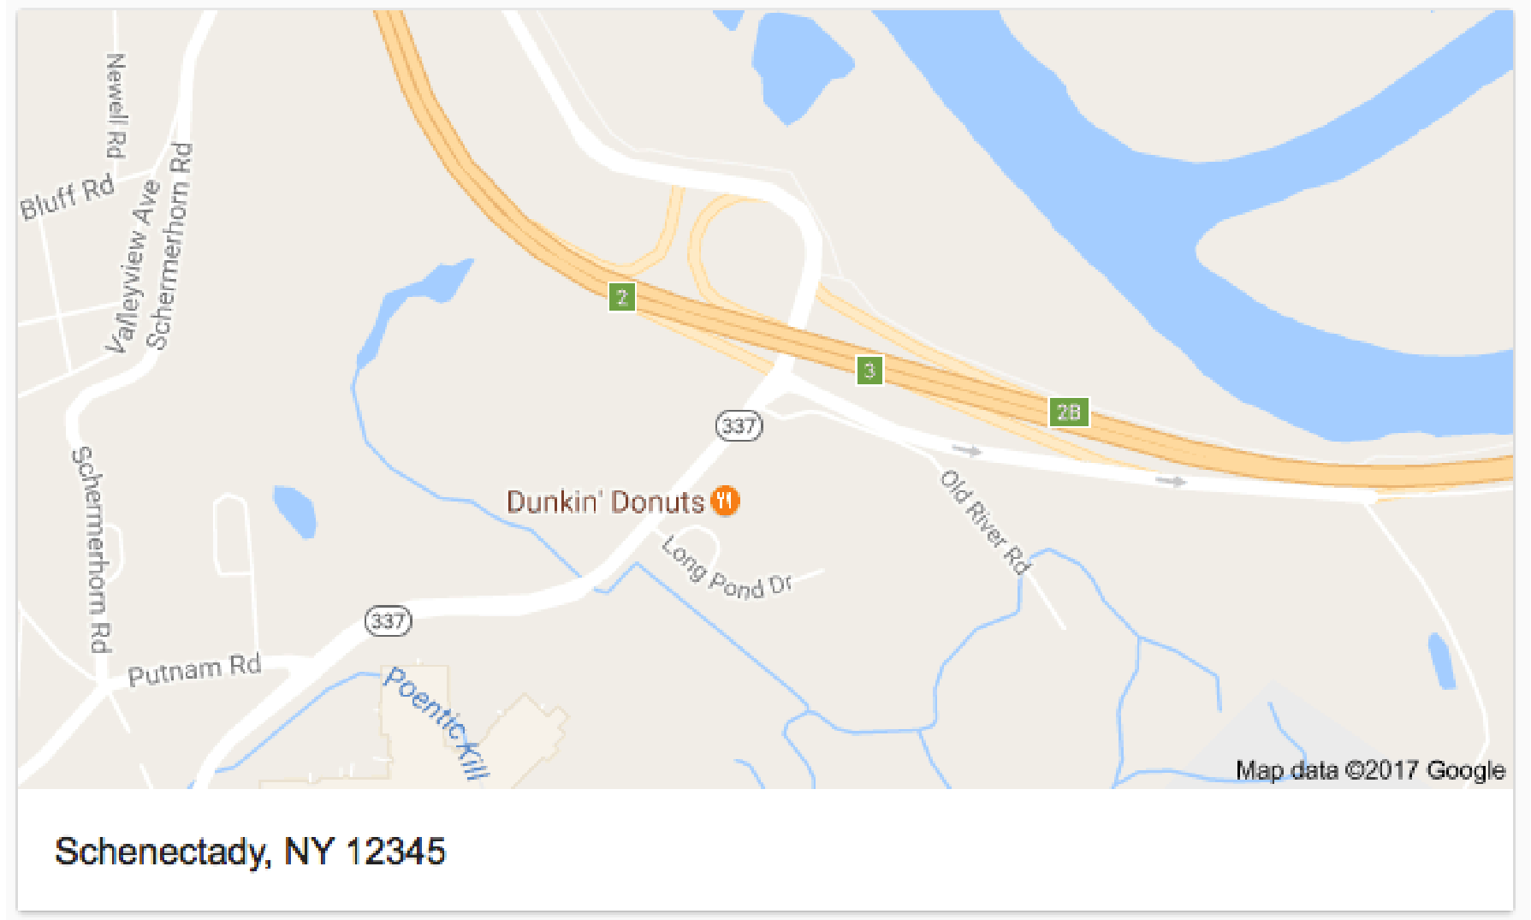

Lo
ok at your data
ity, COUNT(*) as pop OPLE
Y Zip_Code Y pop
SELECT FROM PE GROUP B ORDER B
C
City
Count(*)
City
Count(*)
12345
2,500
Schenectady
?
2,500
!?!
2,200
10001 2,2000
New York City
90001 1,900
Los Angeles
1,900
75001 1,400
Dallas
1,400
51

Slide 49
Set Defaults/Remove Outliers
50
37.5
25
12.5
0
40 50 60
Hours Worked
0
10
20
30
70
80
90 100

Slide 50
Set Defaults/Remove Outliers
50
37.5
25
?!?!
12.5
0
40 50 60
Hours Worked
0
10
20
30
70
80
90 100

Slide 51
Set Defaults/Remove Outliers
50
37.5
25
Assume 0?
12.5
0
40 50 60
Hours Worked
0
10
20
30
70
80
90 100

Slide 52
Set Defaults/Remove Outliers
50
37.5
25
Assume 40?
12.5
0
40 50 60
Hours Worked
0
10
20
30
70
80
90 100

Slide 53
Set Defaults/Remove Outliers
50
37.5
25
Delete?
12.5
0
40 50 60
Hours Worked
0
10
20
30
70
80
90 100

Slide 54
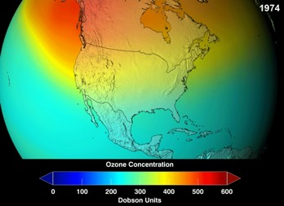
Set Defaults/Remove Outliers
The discovery of the Antarctic "ozone hole" by British Antarctic Survey scientists Farman, Gardiner and Shanklin…came as a shock to the scientific community…[The data] were initially rejected as unreasonable by data quality control algorithms (they were filtered out as errors since the values were unexpectedly low); the ozone hole was detected only in satellite data when the raw data was reprocessed following evidence of ozone depletion in in situ observations. When the software was rerun without the flags, the ozone hole was seen as far back as 1976.
https://en.wikipedia.org/wiki/ Ozone_depletion#Antarctic_ozone_hole

Slide 55
Set Defaults/Remove Outliers
The discovery of the Antarctic "ozone hole" by British Antarctic Survey scientists Farman, Gardiner and Shanklin…came as a shock to the scientific community…[The data] were initially rejected as unreasonable by data quality control algorithms (they were filtered out as errors since the values were unexpectedly low); the ozone hole was detected only in satellite data when the raw data was reprocessed following evidence of ozone depletion in in situ observations. When the software was rerun without the flags, the ozone hole was seen as far back as 1976.
https://en.wikipedia.org/wiki/
Ozone_depletion#Antarctic_ozone_hole

Slide 56
Set Defaults/Remove Outliers
The discovery of the Antarctic "ozone hole" by British Antarctic Survey scientists Farman, Gardiner and Shanklin…came as a shock to the scientific community…[The data] were initially rejected as unreasonable by data quality control algorithms (they were filtered out as errors since the values were unexpectedly low); the ozone hole was detected only in satellite data when the raw data was reprocessed following evidence of ozone depletion in in situ observations. When the
Always always
always! Look at the data!
software was rerun without the flags, the ozone hole was seen as far back as 1976.
https://en.wikipedia.org/wiki/
Ozone_depletion#Antarctic_ozone_hole

Slide 57
String Similarity

Slide 58
String Similarity: Edit Distance
Minimal number of edits (inserts, deletes, substitutions) needed to transform A into B.
https://en.wikipedia.org/wiki/Levenshtein_distance
58

Slide 59
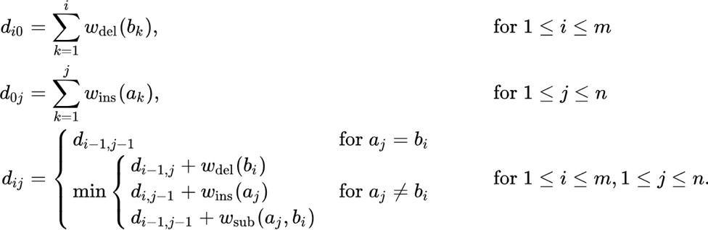
String Similarity: Edit Distance
Minimal number of edits (inserts, deletes,
substitutions) needed to transform A into B.
https://en.wikipedia.org/wiki/Levenshtein_distance
59

Slide 60
String Similarity: Edit Distance
115th Waterman St., Providence, RI 110th Waterman St., Providence, RI
EditDistance = 1

Slide 61
String Similarity: Edit Distance
Waterman Street, Providence, RI Waterman St, Providence, RI
EditDistance = 4

Slide 62
String Similarity: Edit Distance
Problems?

Slide 63
String Similarity: Edit Distance
148th Ave NE, Redmond, WA 148th Ave NE, Redmond, WA

Slide 64

String Similarity: Edit Distance
Edit Distance = o
148th Ave NE, Redmond, WA 148th Ave NE, Redmond, WA

Slide 65
String Similarity: Edit Distance
Edit Distance = o
148th Ave NE, Redmond, WA 148th Ave NE, Redmond, WA
148th Ave NE, Redmond, WA NE 148th Ave, Redmond, WA

Slide 66

String Similarity: Edit Distance
Edit Distance = o
148th Ave NE, Redmond, WA 148th Ave NE, Redmond, WA
148th Ave NE, Redmond, WA NE 148th Ave, Redmond, WA
Edit Distance = 4
69

Slide 67

String Similarity: Jaccard Similarity
https://en.wi₇k₀ipedia.org/wiki/Jaccard_index

Slide 68
String Similarity: Jaccard Similarity
148th Ave NE, Redmond, WA 140th Ave NE, Redmond, WA
https://en.wi₇k₁ipedia.org/wiki/Jaccard_index

Slide 69
String Similarity: Jaccard Similarity
148th Ave NE, Redmond, WA 140th Ave NE, Redmond, WA
https://en.wi₇k₂ipedia.org/wiki/Jaccard_index

Slide 70
String Similarity: Jaccard Similarity
148th Ave NE, Redmond, WA 140th Ave NE, Redmond, WA
Jaccard = 4 / 6 = .67
https://en.wi₇k₃ipedia.org/wiki/Jaccard_index

Slide 71
String Similarity: Jaccard Similarity
148th Ave NE, Redmond, WA NE 148th Ave, Redmond, WA
Jaccard = ???
https://en.wi₇k₄ipedia.org/wiki/Jaccard_index

Slide 72
String Similarity: Jaccard Similarity
148th Ave NE, Redmond, WA NE 148th Ave, Redmond, WA
Jaccard = 1
https://en.wi₇k₅ipedia.org/wiki/Jaccard_index

Slide 73
Clicker Question!

Slide 74
Clicker Question!
iPad Two 16GB WiFi White
iPad 2nd generation 16GB WiFi White
What’s the Jaccard Similarity?
(a) 3/8 (b) 4/11
(c) 4/7

Slide 75

Clicker Question!
iPad Two 16GB WiFi White
iPad 2nd generation 16GB WiFi White
What’s the Jaccard Similarity?
(a) 3/8 (b) 4/11
(c) 4/7
#(iPad, 16GB, Wifi, White)
#(iPad, Two, 2nd, generation, 16GB, Wifi, White)

Slide 76
String Similarity: Jaccard Similarity
Michigan State University Michigan State Univ.
Michigan State University Ohio State University
https://en.wi₇k₉ipedia.org/wiki/Jaccard_index

Slide 77


String Similarity: Jaccard Similarity
Jaccard = 0.5
Michigan State University Michigan State Univ.
Jaccard = 0.5
Michigan State University Ohio State University
https://en.wi₈k₉ipedia.org/wiki/Jaccard_index

Slide 78
String Similarity: (Weighted) Jaccard Similarity
Jaccard = 0.5
1 1
State University
3
Michigan
Michigan
Jaccard = 0.25
Michigan State University
Ohio State University
State Univ.
https://en.wi₈k₁ipedia.org/wiki/Jaccard_index

Slide 79
String Similarity: (Weighted) Jaccard Similarity
Jaccard = 0.5
1 1
State University
3
Michigan
Michigan
Jaccard = 0.5
Michigan State University
University of Michigan
State Univ.
https://en.wi₈k₂ipedia.org/wiki/Jaccard_index

Slide 80
String Similarity: Cosine Similarity
Senator
Washington
announced
party
primary
chairman
GOP
Republican
1002 | 41 | 502 | 700 | 400 | 3
800 | 35 | 521 | 698 | 423 | 10

Slide 81
String Similarity: Cosine Similarity
GOP
Republican
θ

Slide 82
Clicker Question!

Slide 83
Clicker Question!
Brown Brown Uni.
Which metric would (likely) consider the above words more similar?
Jaccard
Cosine

Slide 84
Clicker Question!
Brown Brown Uni.
Which metric would (likely) consider the above words more similar?
Jaccard
Cosine

Slide 85
Clicker Question!
Motown Detroit
Which metric would (likely) consider the above words more similar?
Jaccard
Cosine

Slide 86

Clicker Question!
Motown Detroit
Which metric would (likely) consider the above words more similar?
Jaccard
Cosine

Slide 87

String Similarity: Machine Learn It!!!!

Slide 88

String Similarity: Machine Learn It!!!!
Customer
Id | Name | Street | City | State | P-Code | Age
1 | J Smith | 123 University Ave | Seattle | Washington | 98106 | 42
2 | Mary Jones | 245 3rd St | Redmond | WA | 98052-1234 | 30
3 | Bob Wilson | 345 Broadway | Seattle | Washington | 98101 | 19
4 | M Jones | 245 Third Street | Redmond | NULL | 98052 | 299
5 | Robert Wilson | 345 Broadway St | Seattle | WA | 98101 | 19
6 | James Smith | 123 Univ Ave | Seatle | WA | NULL | 41
7 | J Widom | 123 University Ave | Palo Alto | CA | 94305 | NULL
… | … | … | … | … | … | …
𝑊𝑡𝐽𝑎𝑐𝑐𝑎𝑟𝑑 =
0.57
0.91
1.0
0.0
1.0
1.0

Slide 89

String Similarity: Machine Learn It!!!!
Vector of similarity scores
Jacc(Name)
Jacc(Street)
Edit(City)
Edit(State)
Edit(PostalCode)
Equality(Age)
Fn
Record Pair
Match/Non-Match
Features
Binary Classification

Slide 90
String Similarity: Machine Learn It!!!!
Bob Wilson | 345 Broadway | Seattle | Washington | 98101 | 19
Robert Wilson | 345 Broadway St | Seattle | WA | 98101 | 19
Match
B Wilson | 123 Broadway | Boise | Idaho | 83712 | 19
Robert Wilson | 345 Broadway St | Seattle | WA | 98101 | 19
Non-Match
Mary Jones | 245 3rd St | Redmond | WA | 98052-1234 | 30
M Jones | 245 Third Street | Redmond | NULL | 98052 | 299
Match
Mary Jones | 245 3rd St | Redmond | WA | 98052-1234 | 30
Robert Wilson | 345 Broadway St | Seattle | WA | 98101 | 19
Non-Match

Slide 91














String Similarity: Machine Learn It!!!!
1.0
+
+ +
+
+ +
+
+
+
+
+
+
+
+
+
Jaccard(Street)
+
+
+
+
0.0
Jaccard(Name)
91
1.0

Slide 92
String Similarity: Machine Learn It!!!!
1.0
+
+ +
+
+ +
+
+
+
+
+
+
+
+
+
Jaccard(Street)
+
+
+
+
0.0
Jaccard(Name)
92
1.0

Slide 93
And now….a word from your HTAs
(Meanwhile: I HAVE TO GO I’M GONNA MISS MY TRAIN EMAIL ME YOUR QUESTIONS HAVE A GOOD WEEKEND BYEEEEE)
96

