Slide 1
CLASSIFICATION

Slide 2

Introduction
WHAT IS DATA MINING ?
Process of sifting through large datasets to identify and describe patterns, discover and establish relationships with an intent to predict future trends.

Slide 3
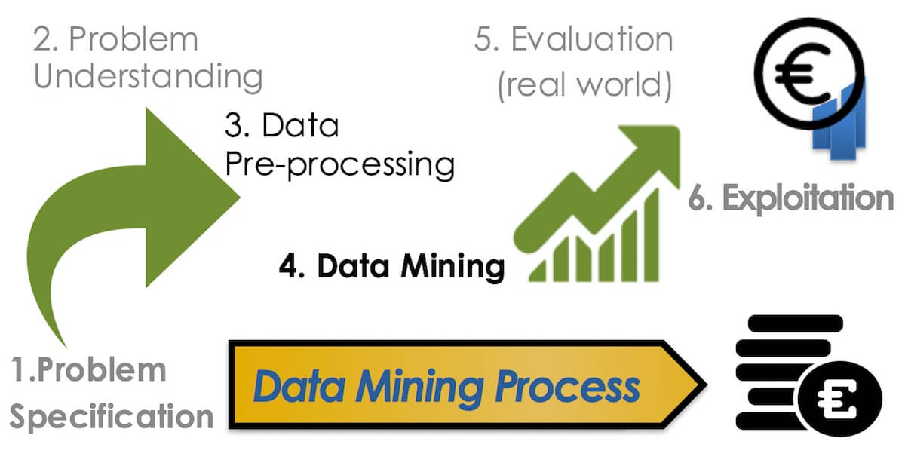
Introduction

Slide 4
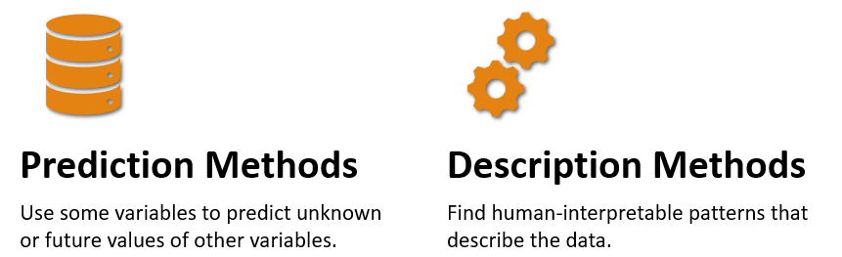
Introduction
Classification
Regression
Prediction
Time series analysis
Clustering
Association rules
Summarization
Sequence discovery

Slide 5
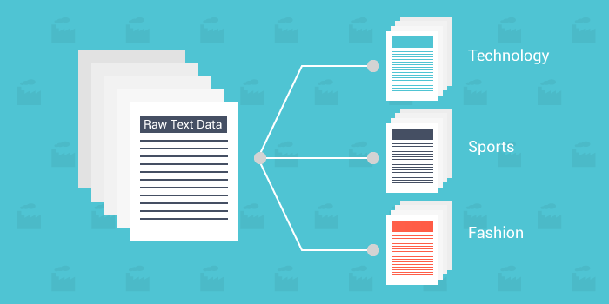

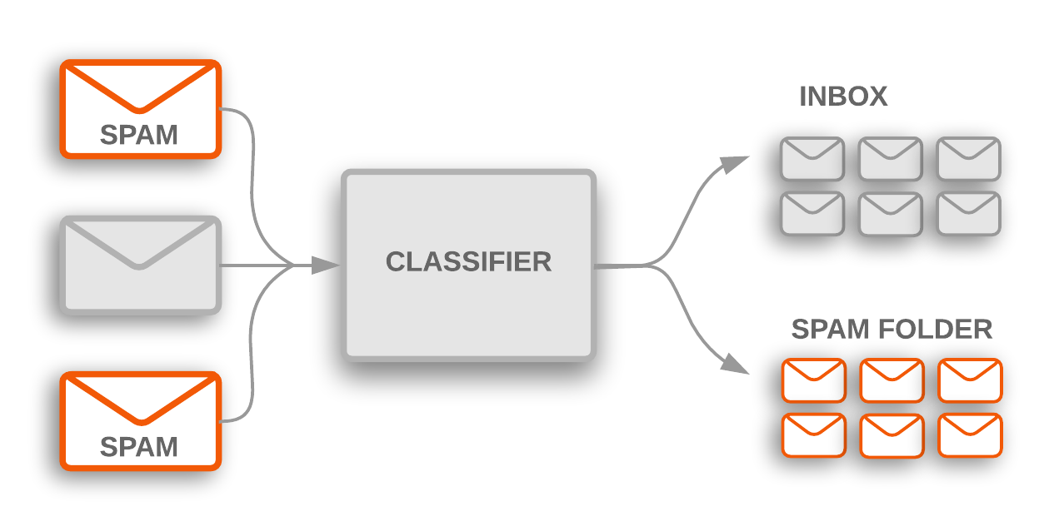
Classification
Text Categorization
Patient data
Yes
Is sick?
No
Medical Diagnosis
Spam detection
Classification assigns data items to target categories or classes

Slide 6
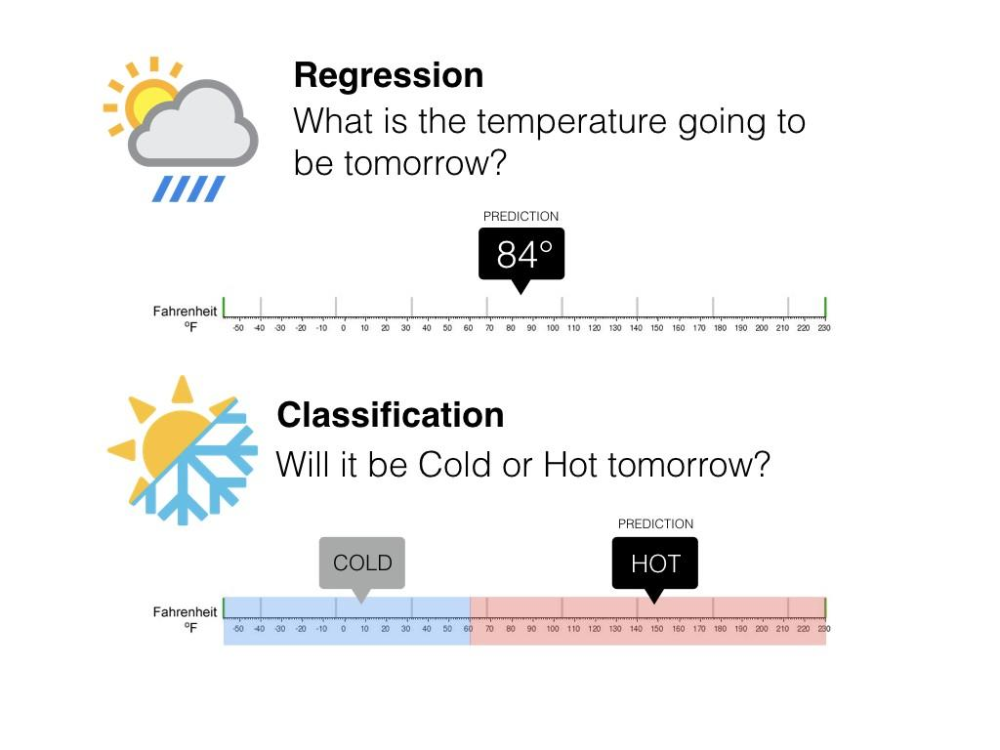
Classification vs regression
Regression is the task of predicting a continuous quantity
Classification is the task of predicting a discrete class label

Slide 7
Classification
Example of application
Fraudulent credit card transactions detection
Approach:
Data used: credit card transactions and information of account holders
When does a customer buy, the products he buy and how often he pays on time…
Data labeling: label past transactions as “fraud” or “fair” (the class attribute)
Modeling: analyze the data to learn a model for the class of the transactions
Usage: use the learned model to detect fraud on credit card transactions

Slide 8
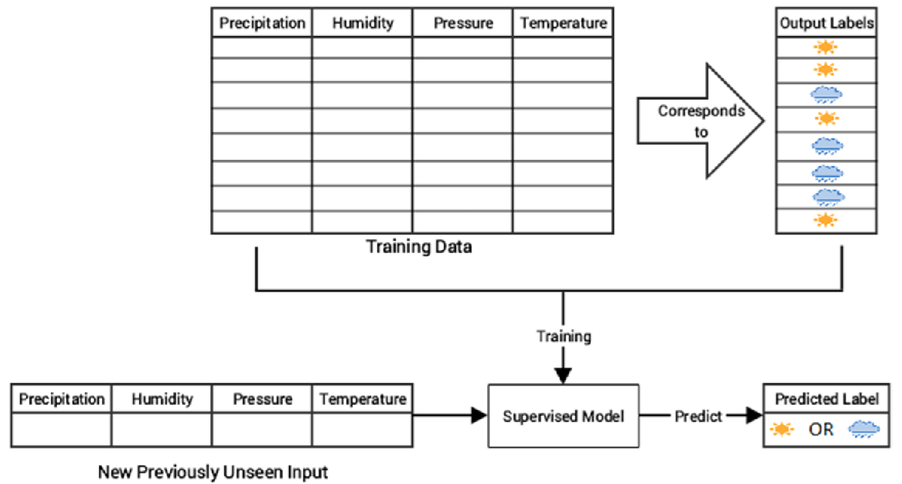
Classification
Classification uses an algorithm (classifier):
To automatically predict the label or class for any new data point
On the basis of a set of labeled data
Classification is a supervised learning method
The quality of classification is evaluated through common metrics.

Slide 9
Classification methods
Approaches to learn classifiers:
Linear classifiers: Logistic Regression, Bayesian classifier
Support Vector Machines (SVM)
Decision trees
Random Forest
K-Nearest Neighbor
Neural networks
…

Slide 10
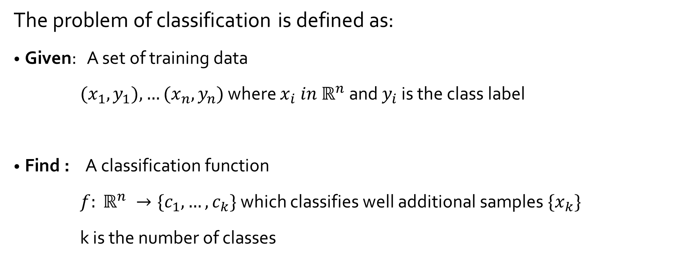
The Classification problem

Slide 11
Classification- A two-step process
Step 1: Building the classification model
Each data point is associated to a class label
Data used for model construction is known as the training set
The model is represented as classification rules, decision trees or mathematical formula
Train and test paradigm!

Slide 12
Classification- A two-step process
Step 2: Using the classifier for classification
Testing the classifier on test data to estimate the accuracy of classification.
If the accuracy is acceptable, the classifier can be used to classify new unlabeled data
Train and test paradigm!

Slide 13
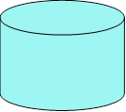
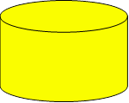
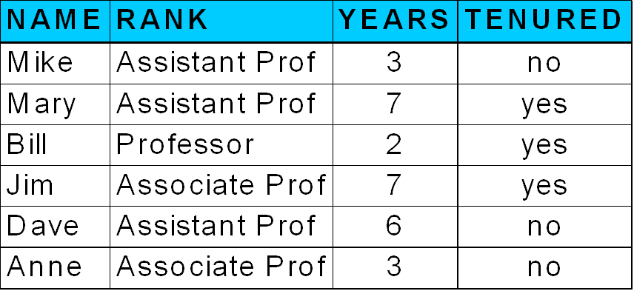
Classifier building
Learning phase
Classification Algorithms
The classification algorithm analyzes the training data to learn the classification function
Training Data
Classifier
(Model)
y=f(x)
IF rank = ‘professor’
OR years > 6
THEN tenured = ‘yes’

Slide 14
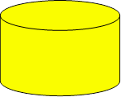

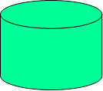
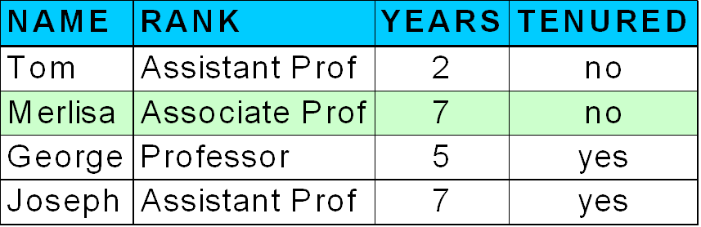

Classifier usage
The classifier is used to classify unseen data
Test data is used to estimate the classifier accuracy
Classifier
Unseen Data
Testing Data
(Jeff, Professor, 4)
Tenured ?

Slide 15
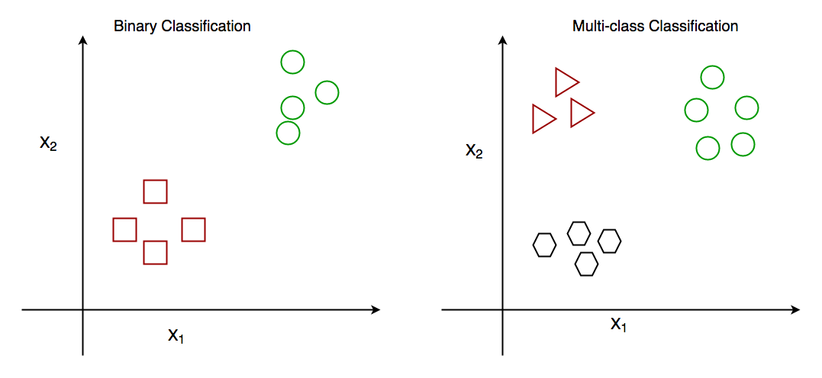
Types of classification
Binary vs multiclass classification
2 target classes
🡪 Samples belong to one of the two classes
n target classes
🡪 Samples belong to one of the n classes

Slide 16
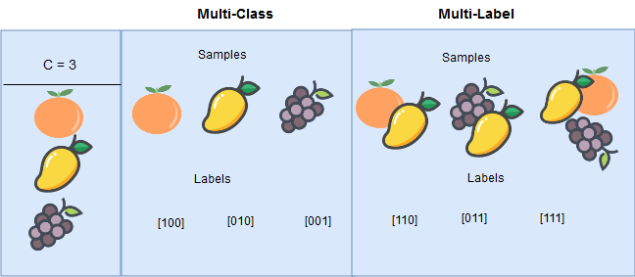
Types of classification
Multiclass vs multilabel classification
To one sample, multiple labels may be assigned
Classes are mutually exclusive
🡪 A sample can be assigned to one label only

Slide 17
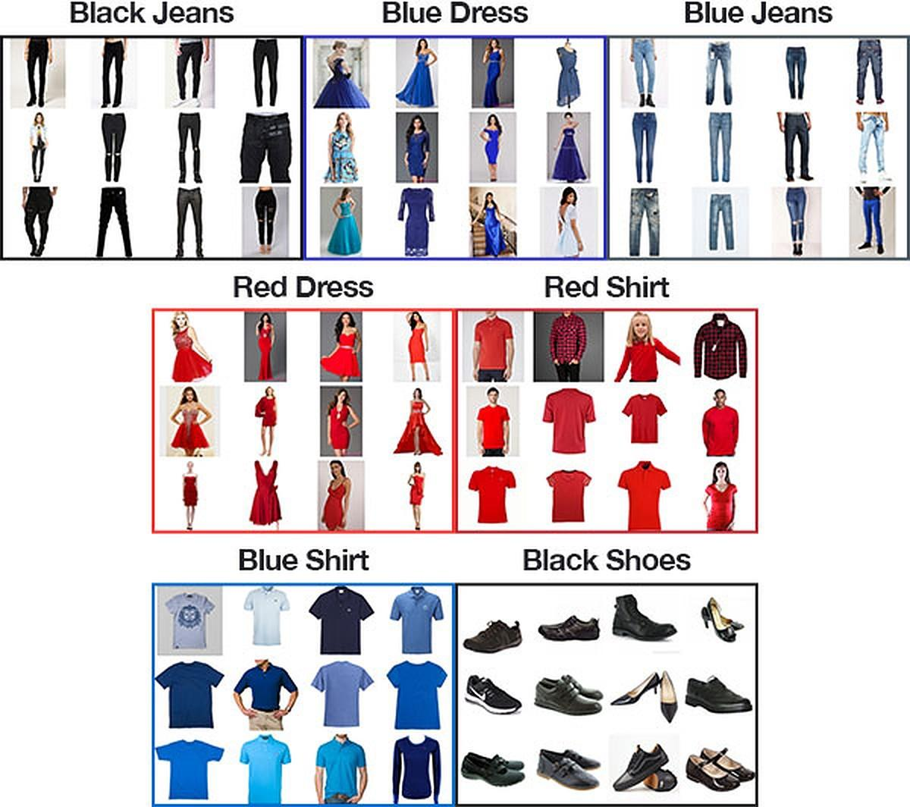
Types of classification
Multioutput-multiclass classification
Simultaneously outputs a set of labels
A label is output for each property and each label is one of the possible classes of the corresponding property.
The goal is to predict for a given image two properties: the category (jeans, dress, shirt, …) + color (Black, blue, … )

Slide 18
Classifier evaluation
Goals of evaluation
Measure the classifier performance
Evaluate the ability of a classifier to generalize what it was learned from training on the new unseen instances
Choose the most appropriate learning scheme for a specific problem

Slide 19
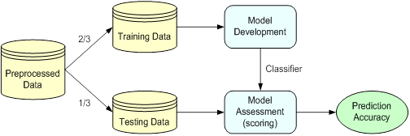
Evaluation strategies
Holdout method
Split data into 2 independent sets, one third for testing and the rest for training
Repeated holdout method: a variation of holdout
Multiple iterations of holdout, the overall accuracy is the average the accuracies obtained at each iteration

Slide 20
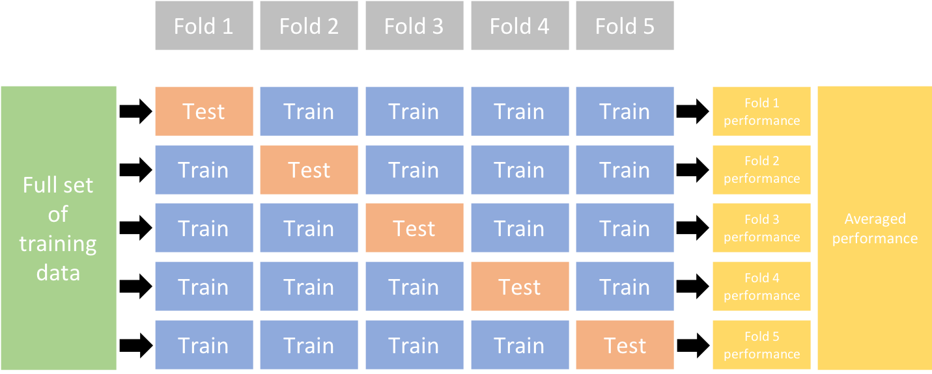
Evaluation strategies
k-fold cross-validation
Randomly split data into k disjoint subsets (folds) of approximately equal size
Use k-1 subsets as training data and one subset as testing data
Repeat k times
Aggregate the results to estimate the overall accuracy

Slide 21
Evaluation strategies
Stratified k-fold cross-validation
Stratification ensures that each class is equally represented across each fold
Useful for imbalanced datasets
Another variation:
Repeated stratified cross
validation

Slide 22
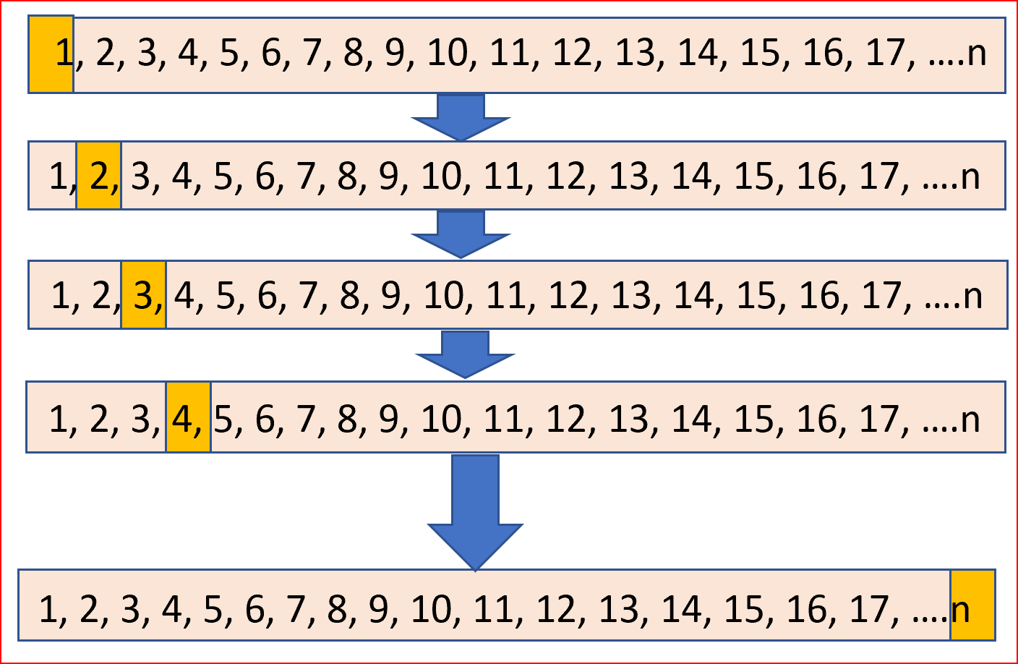
Evaluation strategies
Leave one out
A particular form of k-fold cross-validation
Number of folds = number of training samples
Mainly used for small datasets

Slide 23
Classification outputs
Class output : Algorithms like SVM and KNN create a class output. For instance, in a binary classification problem, the outputs will be either 0 or 1.
Probability output : Algorithms like Logistic Regression, Random Forest, Gradient Boosting, Adaboost etc. give probability outputs. Probability outputs can be converted to class output by creating a threshold probability.

Slide 24
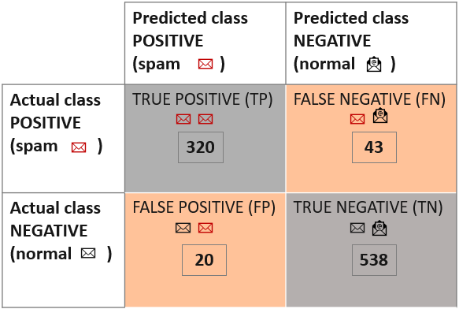

Measures of performance
Confusion matrix
A summary of prediction results
Given k classes, an entry, CM_{i,j} in a confusion matrix indicates the number of tuples in class i that were labeled by the classifier as class j
Total predictions
363
558
340 | 581

Slide 25

Measures of performance
Sample S is
Positive if predicted as spam
True Positive if it is actually spam (correct)
False Positive if is actually not spam (error)
Negative if predicted as not spam
True Negative if it is actually not spam (correct)
False Negative if it is actually a spam (error)
Total predictions
Incorrect predictions
363
558
340 | 581
Correct predictions

Slide 26


Measures of performance
Accuracy: % of samples that are correctly classified
Classification error: % of samples that are incorrectly classified (1- accuracy)
Incorrect predictions
363
558
340 | 581
Correct predictions

Slide 27
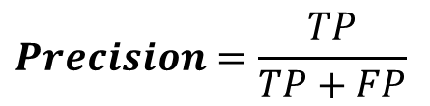
Measures of performance
Precision : a measure of exactness
Number of items correctly identified as positive out of total items identified as positive
Precision = P(Positive sample| sample is classified as positive)
363
558
340 | 581
Precision

Slide 28

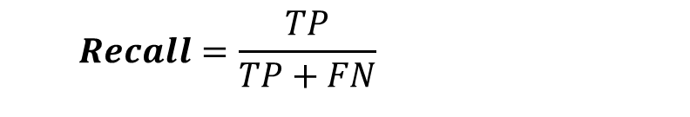
Measures of performance
Recall: a measure of completeness
Number of items correctly identified as positive out of total actual positives
Recall = P(correctly classified | positive sample)
363
558
340 | 581
Precision

Slide 29
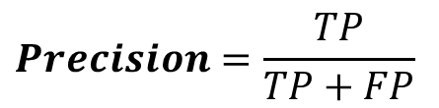
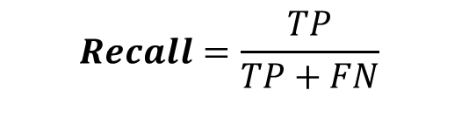
Measures of performance
Recall / Precision
Classifier with better precision and recall is a better model
Inverse relationship
As FP decrease, FN increase (recall decreases) and vice versa
High recall, low precision: Most of the positive examples are correctly recognized (low FN) but there are a lot of false positives.
Low recall, high precision: We miss a lot of positive examples (high FN) but those we predict as positive are indeed positive (low FP).

Slide 30
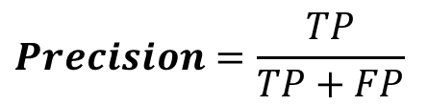
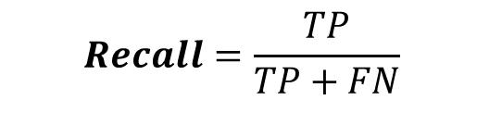
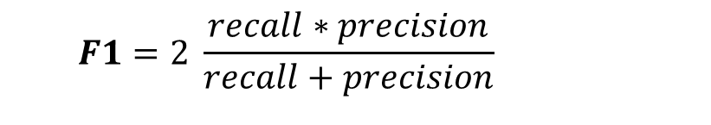
Measures of performance
F1 score
F1 score relies on both recall and precision
The mean harmonic of recall and precision
Will always be nearer to the smaller value.

Slide 31
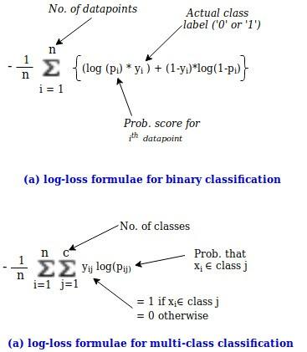
Measures of performance
Logarithmic loss
To be used with probability outputs
Log Loss takes into account the uncertainty of prediction based on how much it varies from the actual label.
It gives a more nuanced view into the performance of the model.

Slide 32
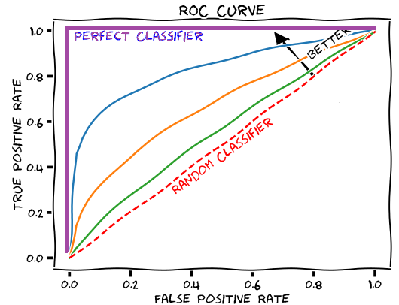
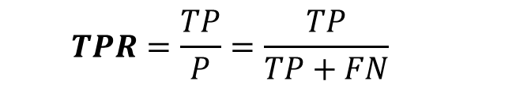
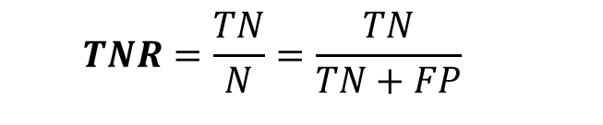
Measures of performance
Receiver Operating Characteristic (ROC) curve
True Positive Rate, recall or sensitivity
True Negative Rate or specificity

Slide 33
Measures of performance
Receiver Operating Characteristic (ROC) curve
Performance measured by AUC: area under curve
Represent the model’s ability to discriminate between positives and negatives
Higher the AUC, better the model is at predicting positives as positives and negatives as negatives.

Slide 34
Comparing metrics
samples |  | 1 | 2 | 3 | 4 | 5 | 6 | 7 | 8 | 9 | 10 | 11 | 12 | 13 | 14 | 15 | 16
Actual class |  | 0 | 0 | 0 | 0 | 0 | 0 | 0 | 0 | 1 | 1 | 1 | 1 | 1 | 1 | 1 | 1
Model 1 | Predicted probability | 0.1 | 0.1 | 0.1 | 0.1 | 0.1 | 0.1 | 0.6 | 0.6 | 0.5 | 0.5 | 0.9 | 0.9 | 0.9 | 0.9 | 0.9 | 0.9
 | Predicted class (threshold=0.5) | 0 | 0 | 0 | 0 | 0 | 0 | 1 | 1 | 1 | 1 | 1 | 1 | 1 | 1 | 1 | 1
 | Predicted class (threshold=0.7) | 0 | 0 | 0 | 0 | 0 | 0 | 0 | 0 | 0 | 0 | 1 | 1 | 1 | 1 | 1 | 1
Model 2 | Predicted probability | 0.6 | 0.6 | 0.6 | 0.6 | 0.6 | 0.6 | 0.6 | 0.6 | 0.7 | 0.7 | 0.7 | 0.7 | 0.7 | 0.8 | 0.8 | 0.8
 | Predicted class (threshold=0.5) | 1 | 1 | 1 | 1 | 1 | 1 | 1 | 1 | 1 | 1 | 1 | 1 | 1 | 1 | 1 | 1
 | Predicted class (threshold=0.7) | 0 | 0 | 0 | 0 | 0 | 0 | 0 | 0 | 1 | 1 | 1 | 1 | 1 | 1 | 1 | 1
Model 2 performs better than Model 1

Slide 35
Compring metrics
Model 1 (threshold=0.5) | Predicted positives | Predicted negatives
Actual positives | 8 | 0
Actual negatives | 2 | 6
Model 1 (threshold=0.7) | Predicted positives | Predicted negatives
Actual positives | 6 | 2
Actual negatives | 0 | 8
14 correct predictions from a total of 16
2 incorrect predictions
Accuracy = 0.875
Precision = 0.8
Recall = 1
F1 = 0.88
14 correct predictions from a total of 16
2 incorrect predictions
Accuracy = 0.875
Precision = 1
Recall = 0.75
F1 = 0.86

Slide 36
Compring metrics
Model 2 (threshold=0.5) | Predicted positives | Predicted negatives
Actual positives | 8 | 0
Actual negatives | 8 | 0
Model 2 (threshold=0.7) | Predicted positives | Predicted negatives
Actual positives | 8 | 0
Actual negatives | 0 | 8
8 correct predictions from a total of 16
8 incorrect prediction
Accuracy = 0.5
Precision = 0.5
Recall = 1
F1 = 0.66
16 correct predictions from a total of 16
0 incorrect prediction
Accuracy = 1
Precision = 1
Recall = 1
F1 = 1

Slide 37
Compring metrics
 | F1 (threshold=0.5) | F1 (threshold=0.7) | ROC-AUC | Log-Loss
Model 1 | 0.88 | 0.86 | 0.94 | 0.28
Model 2 | 0.66 | 1 | 1 | 0.60
Is better in predicting class probabilities
Very big difference from actual labels
Log-Loss is useful to compare models in terms of probabilistic outcome
F1 score and ROC-AUC are useful if we care only about final class predictions.
F1 score is sensitive to threshold and should be tuned first before comparing the models
AUC score can be used if we don’t want to tune threshold.

Slide 38
Comparing metrics
Example
 |  | Predicted class |  | Total
 |  | POSITIVE (cancer = yes) | NEGATIVE (cancer = no)
Actual class | POSITIVE (cancer = yes) | 90 | 210 | 300
 | NEGATIVE (cancer = no) | 140 | 9560 | 9700
Total |  | 230 | 9770 | 10000
Accuracy = 96,5%
Precision = 39,13%
Recall = 30%
F1-score = 33,96%
Class distribution
3%
97%
Accuracy is a misleading metric
The class imbalance problem !!
Notes:
Positive class = 3%
Negative class=97%

Slide 39
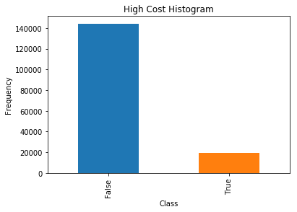
Imbalanced classification
Majority Class
A classification problem where the distribution of examples across the classes is not equal
Slight imbalance: distribution uneven by a small amount
Severe imbalance: distribution uneven by a large amount
Minority Class
Ex: Anomaly detection, fraud detection, outlier detection, …

Slide 40
Imbalanced classification
Causes of class imbalance
A property of the problem domain (some events are naturally of low occurrence )
Biased sampling
Measurement errors
The learning process of most classification algorithms is often biased toward the majority class examples, so that minority ones are not well modeled into the final system.
Approaches to deal with class imbalance
Sampling based (oversampling/undersampling)
Cost based (redefine cost function such as to penalize FN more that FP)
Notes:
Often in cases where the imbalance is caused by a sampling bias or measurement error, the imbalance can be corrected by improved sampling methods, and/or correcting the measurement error. This is because the training dataset is not a fair representation of the problem domain that is being addressed.

Slide 41
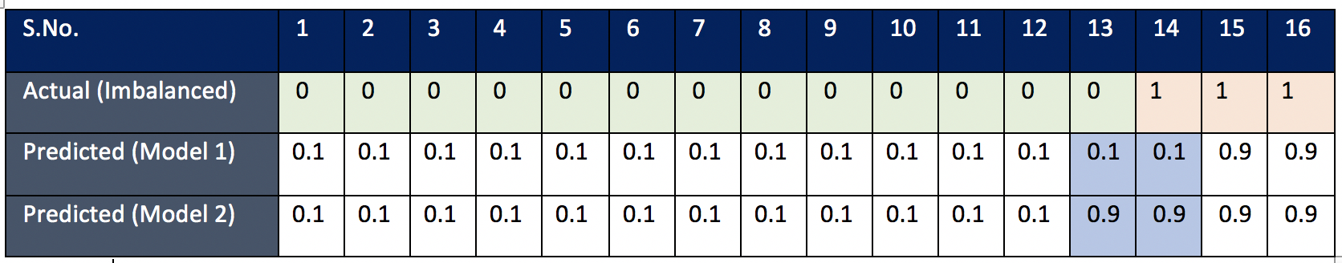
Metrics and class imbalance
Model 1 | Predicted positives | Predicted negatives
Actual positives | 2 | 1
Actual negatives | 0 | 13
We care more about the positive class so Model 2 is better that Model 1
Model 2 | Predicted positives | Predicted negatives
Actual positives | 3 | 0
Actual negatives | 1 | 12

Slide 42
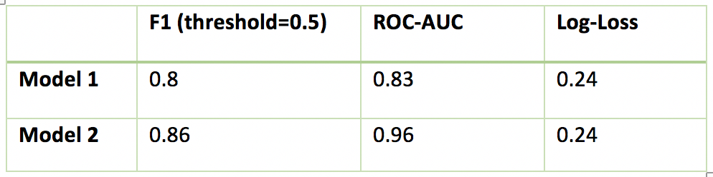
Metrics and class imbalance
Log-Loss does not differentiate between the two models. Treats both errors equally
Log-Loss is not a good metric if classes are imbalanced

Slide 43
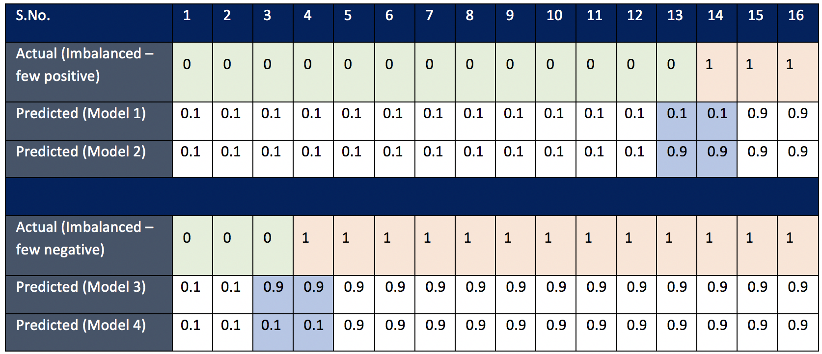
Metrics and class imbalance

Slide 44
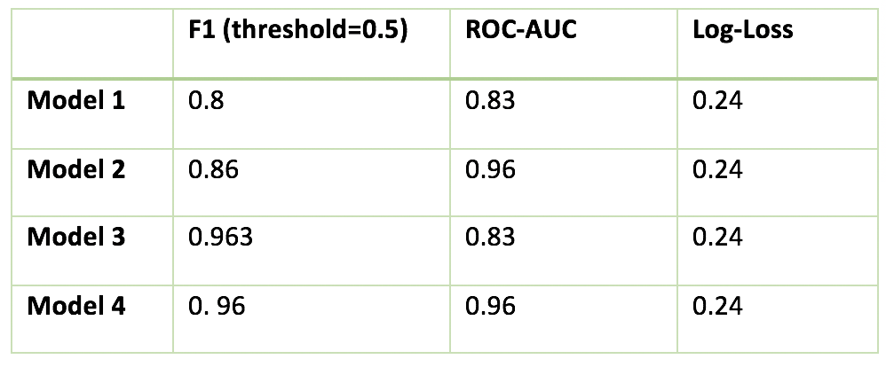
Metrics and class imbalance
No difference between the two cases (few negatives vs few positives)
Not much difference because of the large number of positives
ROC-AUC is a good metric for imbalance classification if you care about the minority class
F1 gives more importance to the positive class

Slide 45
Metrics and class imbalance
Model 1 performs very much better at detecting the positive class (predicts 90% out of 300)
Model 2 is a very bad predictor
POSITIVE (cancer = yes)
NEGATIVE (cancer = no)
Model 1 | Predicted POSITIVE | Predicted NEGATIVE
Actual POSITIVE | 270 | 30
Actual NEGATIVE | 100 | 9600
 | F1 | ROC-AUC
Model 1 | 0.80 | 0.94
Model 2 | 0.07 | 0.51
Model 2 | Predicted POSITIVE | Predicted NEGATIVE
Actual POSITIVE | 15 | 285
Actual NEGATIVE | 100 | 9600
ROC-AUC does not reflect the bad performance of Model 2
F1 is the appropriate metric if you care about the positive class

Slide 46
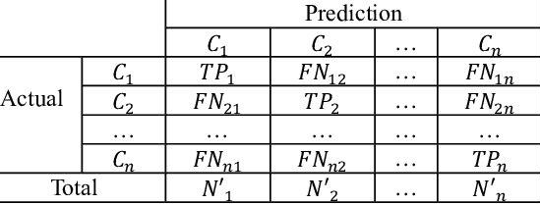
Measures of performance
Confusion matrix : case multiclass classification
One class is defined as positive and the others as negative.
The performance measures are computed in exactly the same way.
Recall and precision and F1 are computed for each class

Slide 47
Measures of performance
Confusion matrix : case of multiclass classification
Overall performance of the classifier is calculated using the weighted averages
Macro average: Equal weight is given to all classes
Weighted average: classes are given different weights
Micro average: Equal weight is given to samples regardless of their class

Slide 48
Classifier performance
Accuracy is not EVERYTHING
Other evaluation criteria
Speed: refers to the computation costs involved in generating and using the classifier
Robustness: refers to the ability of the classifier to make correct predictions given noisy data or data with missing values
Scalability: refers to the ability to construct the classifier efficiently given large amount of data
Interpretability: refers to the level of understanding and insight that is provided by the classifier

