Slide 1
REGULARIZATION

Slide 2
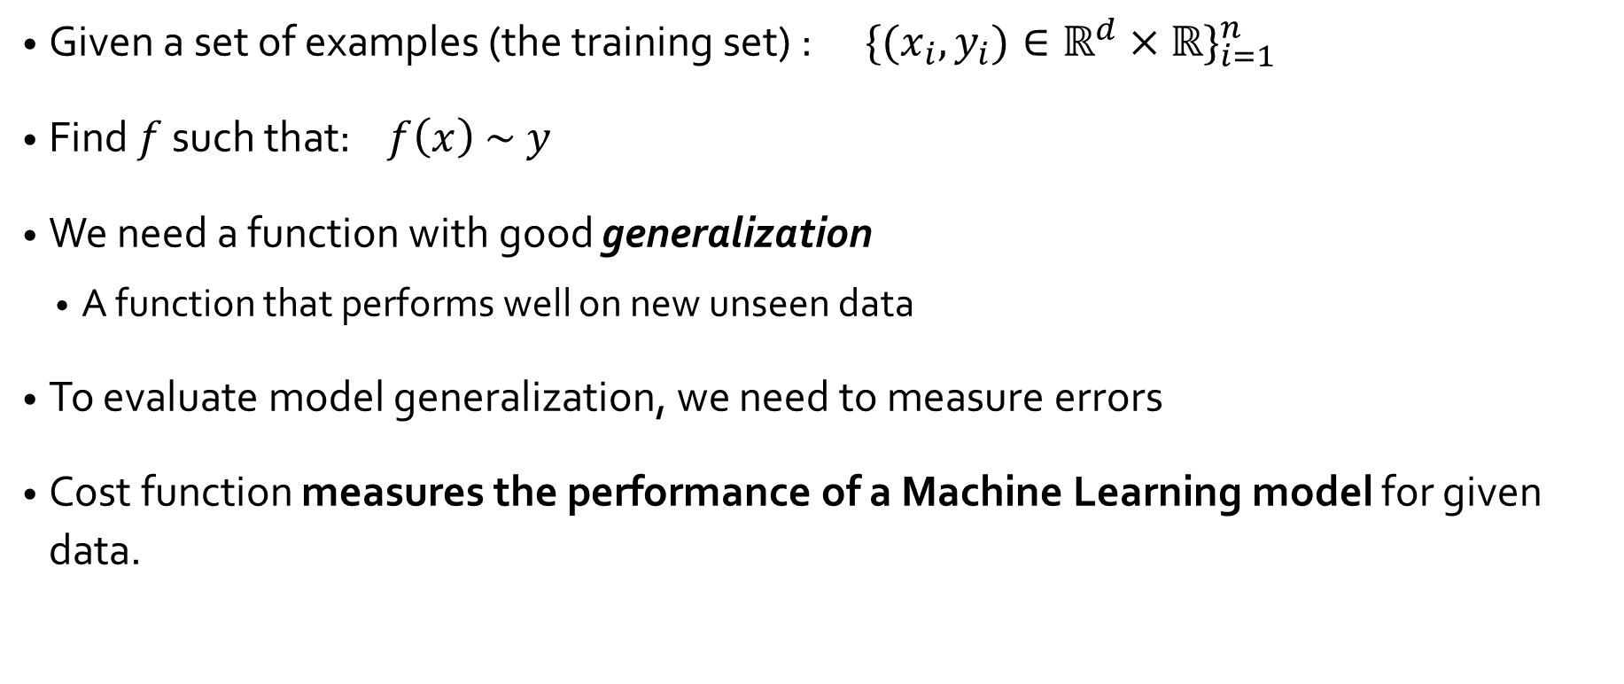
The learning problem

Slide 3
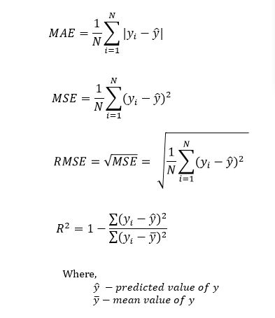
Cost functions
Cost function quantifies the error between predicted values and expected values and presents it in the form of a single real number.
We have various measures of model error
Mean Absolute Error (MAE)
Mean Square Error (MSE)
Root Mean Square Error (RMSE)

Slide 4
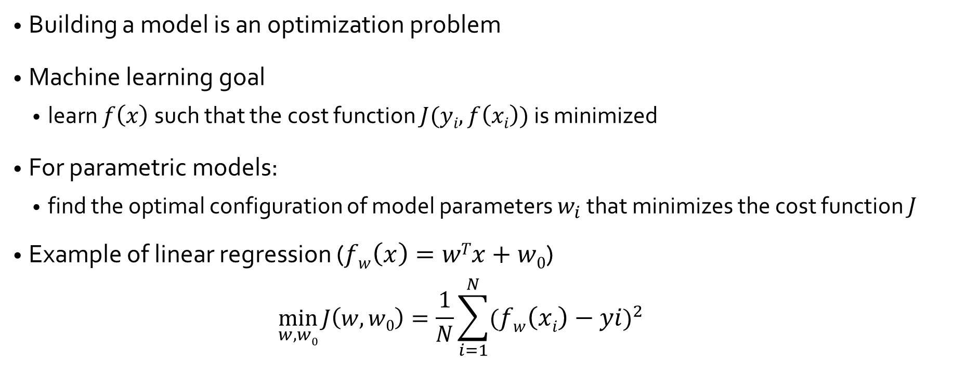
An optimization problem

Slide 5
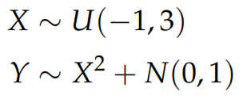
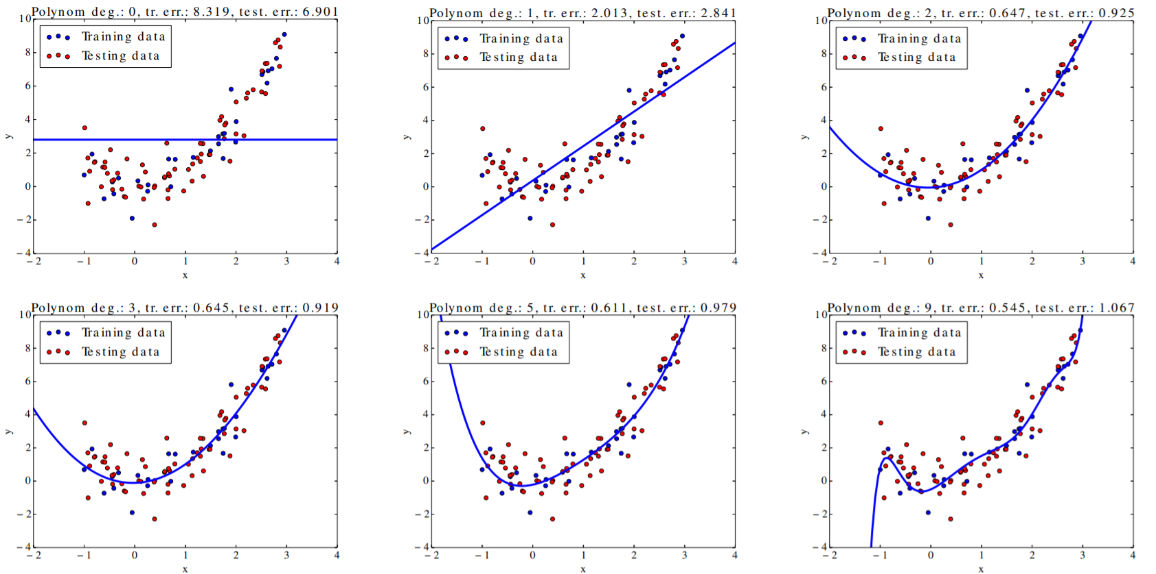
Training and testing error
Example: Polynomial regression with varying degree

Slide 6
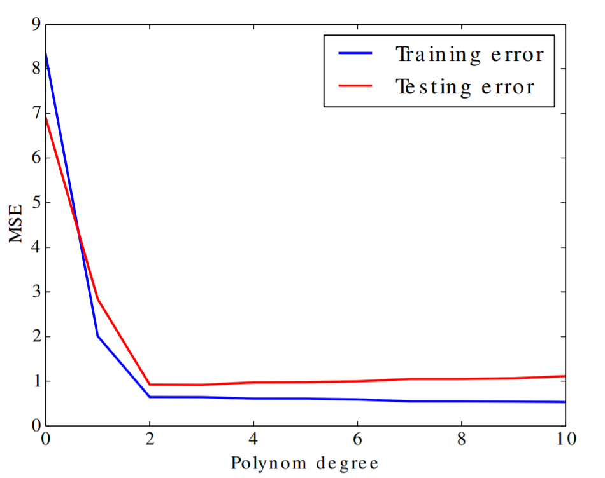
Training and Testing Errors
The training error decreases with increasing model flexibility (the curviness).
The testing error is minimal for certain degree of model flexibility.

Slide 7
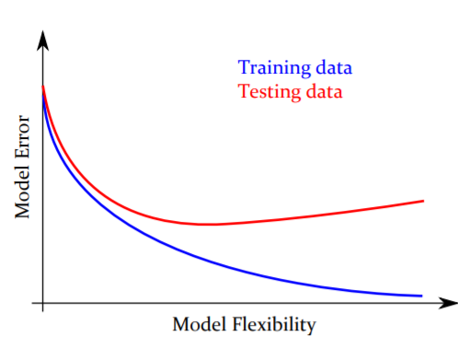
Overfitting
Overfitting is a general phenomenon affecting all kinds of inductive learning.
When overfitted, the model works well for the training data, but fails for new (testing) data.

Slide 8
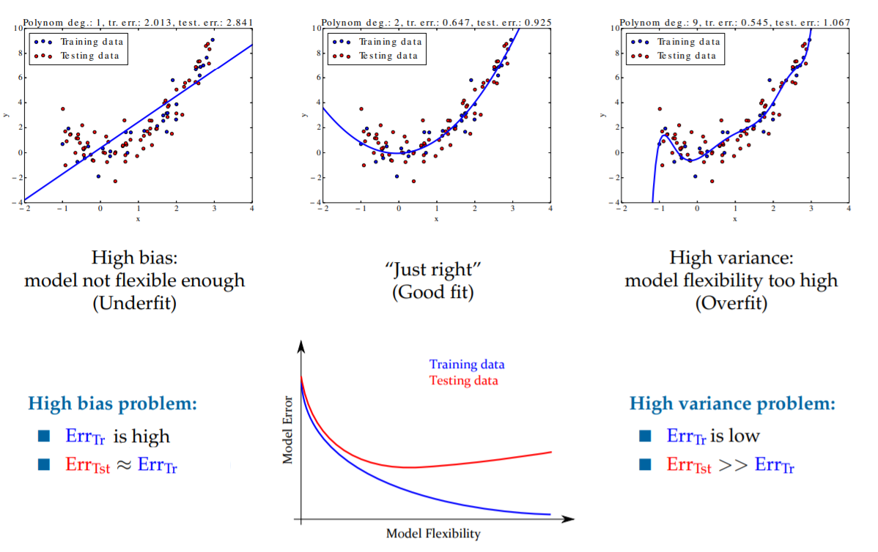
Bias vs Variance

Slide 9
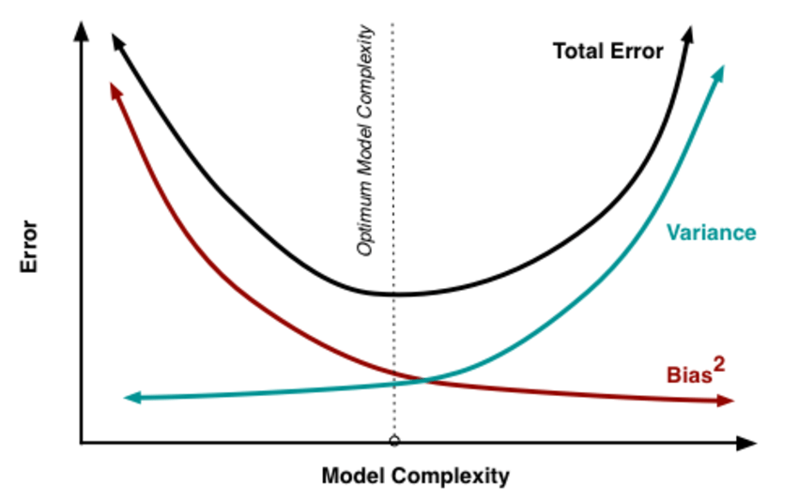
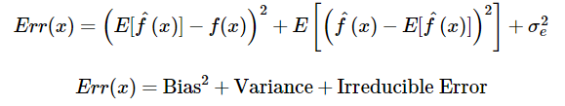
Bias-Variance Tradeoff
To get good predictions, we need to find a balance of Bias and Variance that minimizes total error
Notes:
For error decomposition proof: https://robjhyndman.com/files/2-biasvardecomp.pdf

Slide 10
Regularization
Reduce model variance at the cost of introducing some bias.
A regularization technique is a penalty mechanism which applies shrinkage (driving them closer to zero) of coefficient to build a more robust and parsimonious model.
Reduce model complexity

Slide 11
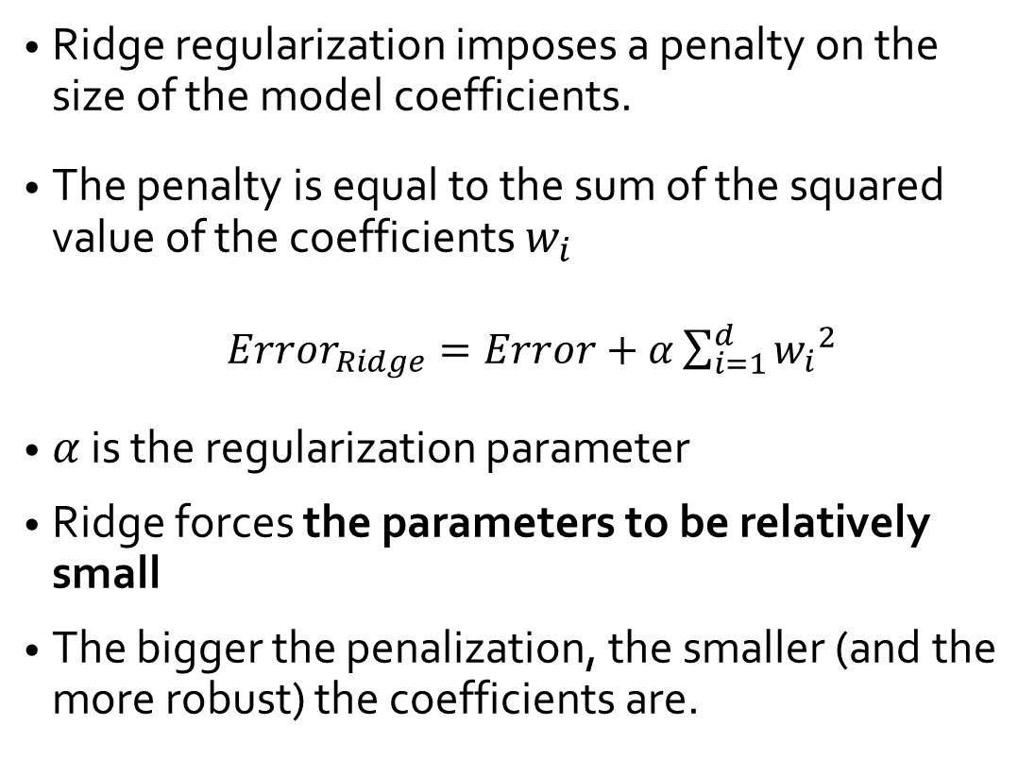
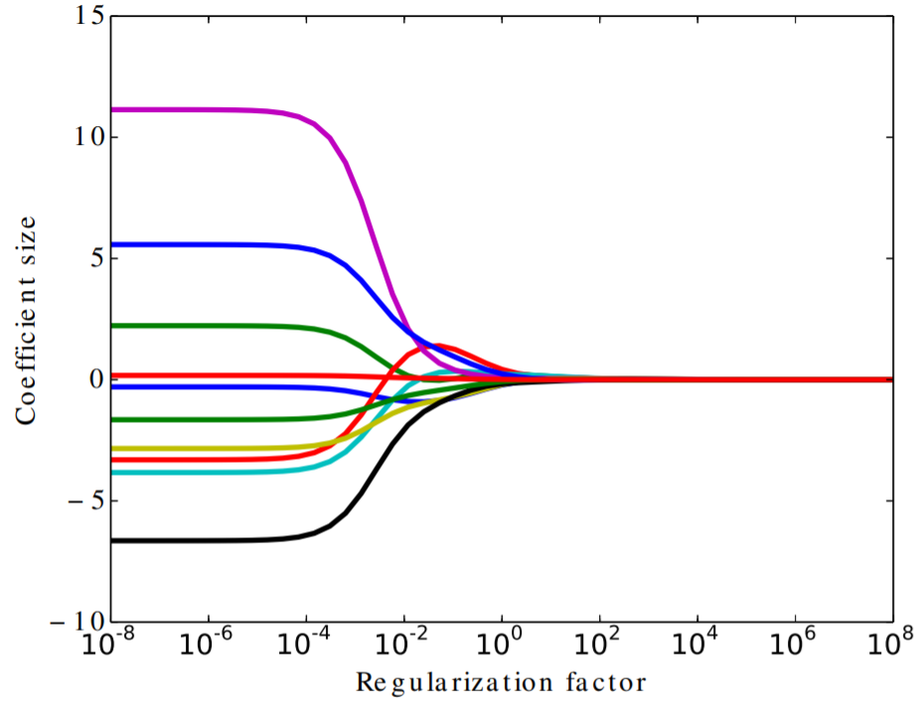
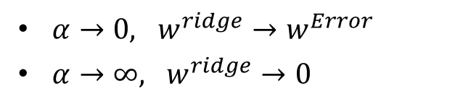
Ridge regularization (L2 regularization)

Slide 12
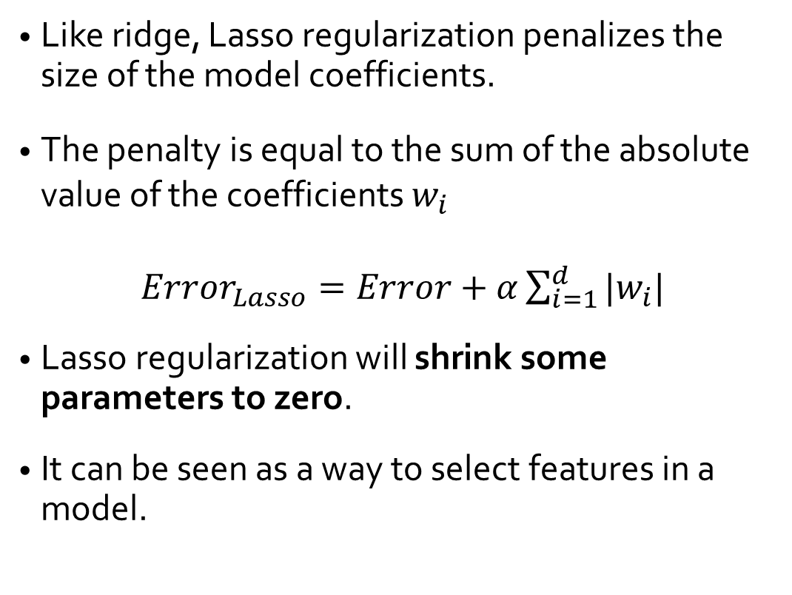
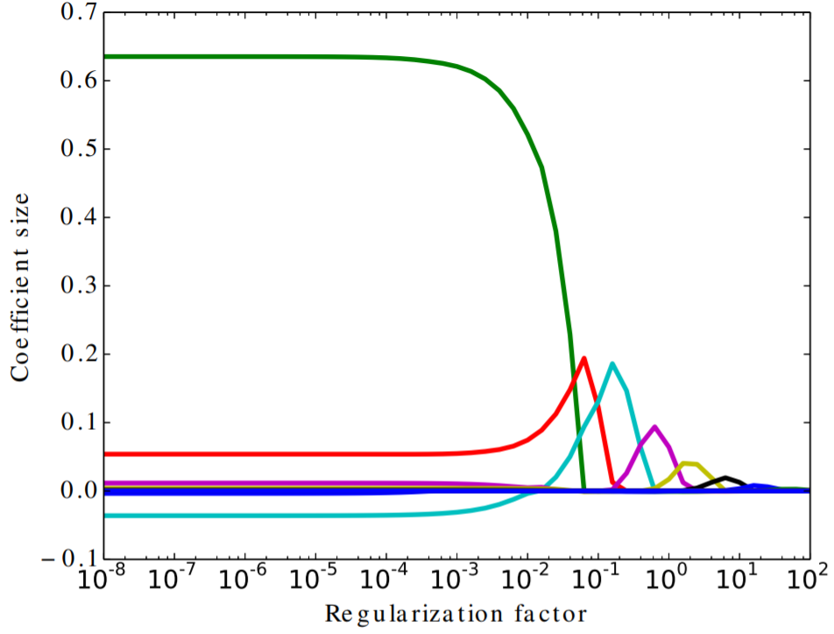
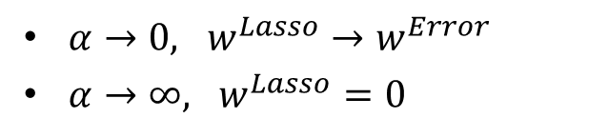
Lasso regularization (L1 regularization)

Slide 13
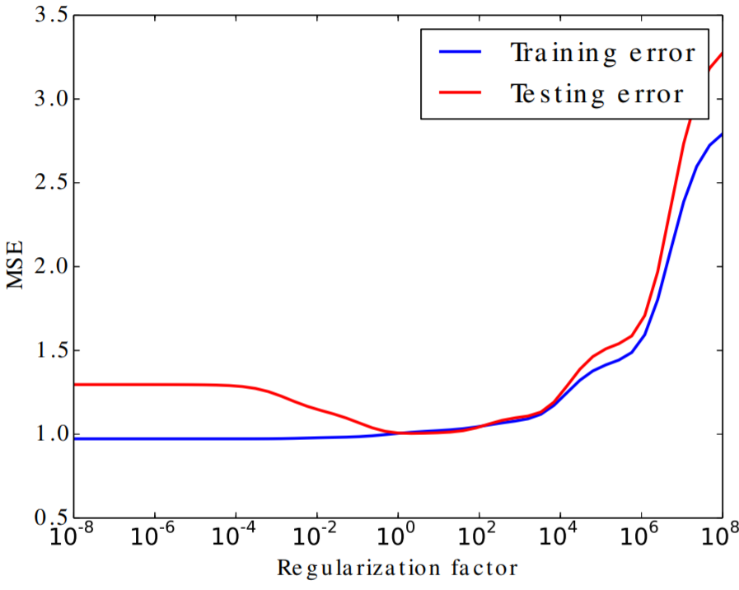
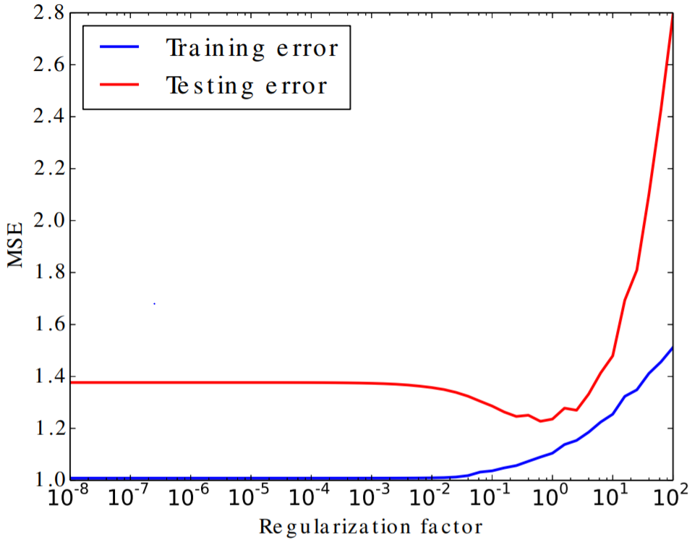
Ridge vs Lasso
Evolution of error vs regularization factor
Ridge (L2 regularization)
Lasso (L1 regularization)

Slide 14
When the LASSO fails?
In the p > n case, the lasso can select at most n variables before it saturates
If there is a group of variables with very high pairwise correlations, the lasso tends to select only one variable from the group, not caring which one
For usual n > p situations, if there are high correlations between predictors, the prediction performance of lasso is poor with respect to ridge.

Slide 15
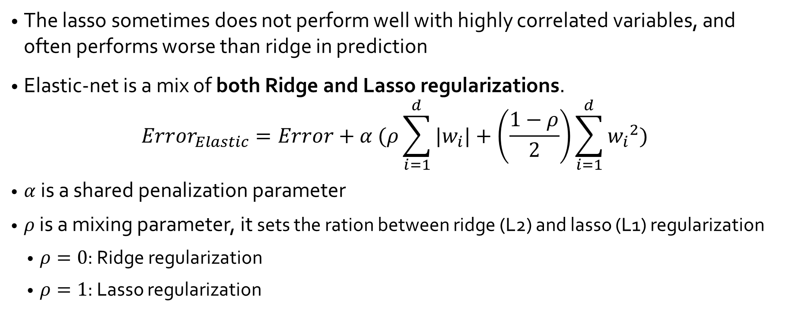
Elastic-net

Slide 16
Summary
Ridge: regularization
Shrink coefficients to zero but can not produce a parsimonious model
Similar estimated coefficient for highly correlated predictors
Exactly identical variables will have same coefficients
LASSO: regularization + variable selection
Unlike Ridge, can set variables exactly to zero
If p>>n, select n variables only
Can not do grouped selection; select one variable if highly correlated variables
Elastic-net: regularization + variable selection
Overcomes LASSO limitations by borrowing strength from Ridge
Allow selecting more than n variables
Allow selection of groups of correlated variables

