Slide 1
MACHINE LEARNING MODELS
SVM and KNN

Slide 2
SUPPORT VECTOR MACHINES (SVM)

Slide 3
Introduction
SVM is one of the most efficient machine learning algorithms
A method used for regression and classification (mostly used in classification problems)
SVM is fundamentally a binary classifier, but can be extended for multiclass problems
Classification performed by learning a linear separator of the data

Slide 4
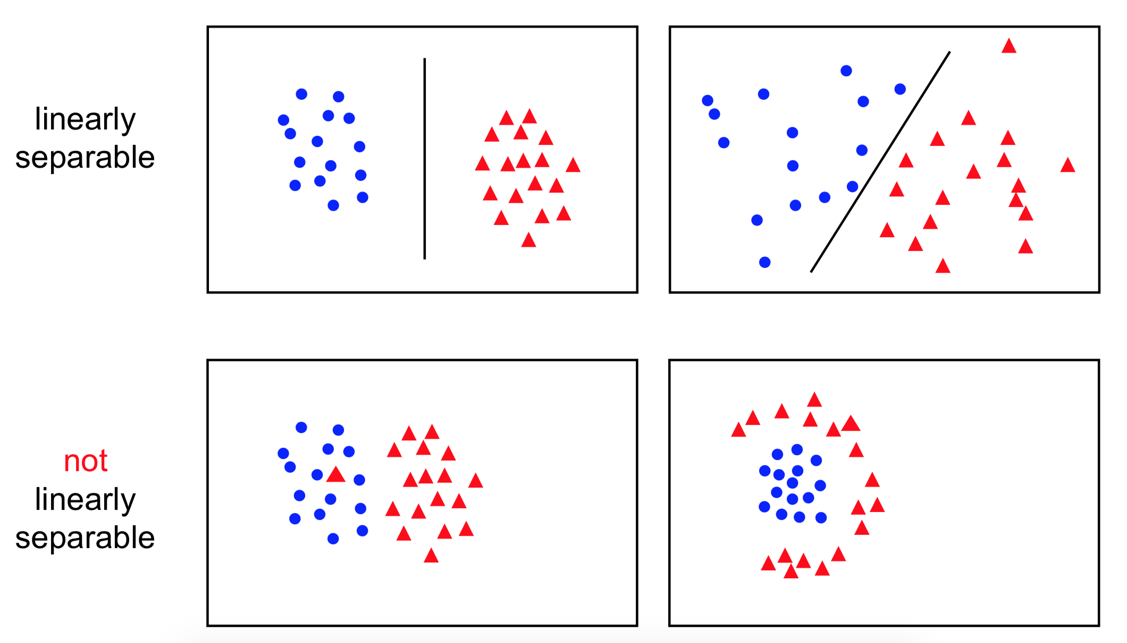
Linear Separability

Slide 5

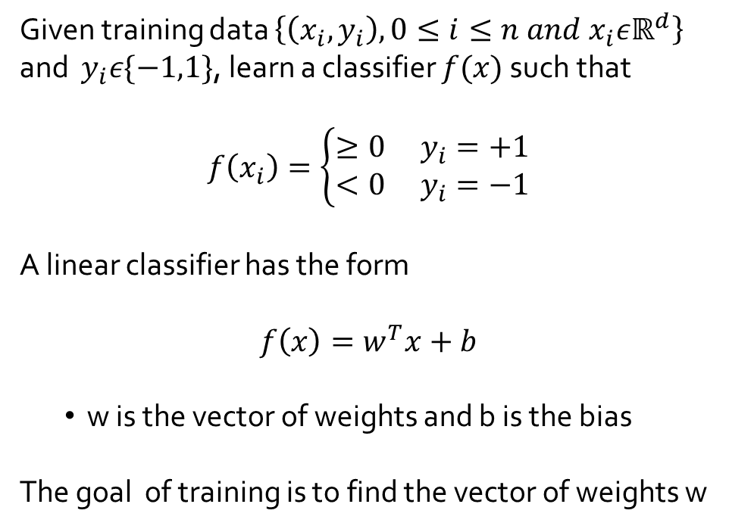

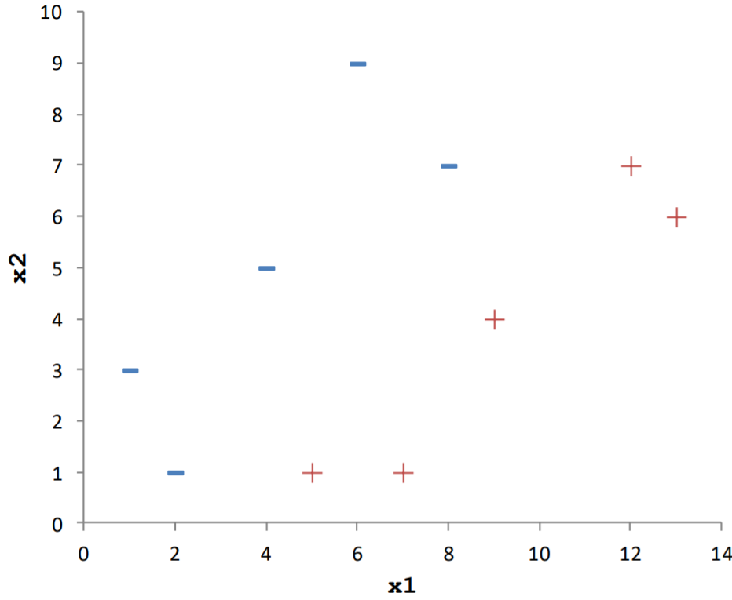

Linear Classifier
Class -1
Class +1

Slide 6



Linear Classifier
There exists an infinite number of linear separators which one is optimal?

Slide 7

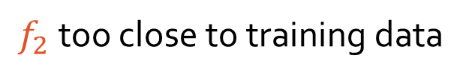
Linear Classifier
There exists an infinite number of linear separators which one is optimal?
New data point

Slide 8

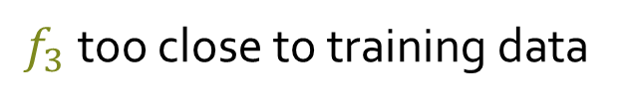
Linear Classifier
There exists an infinite number of linear separators which one is optimal?
New data point

Slide 9

Linear Classifier
There exists an infinite number of linear separators which one is optimal?
margin
Larger margin is preferred for generalization

Slide 10
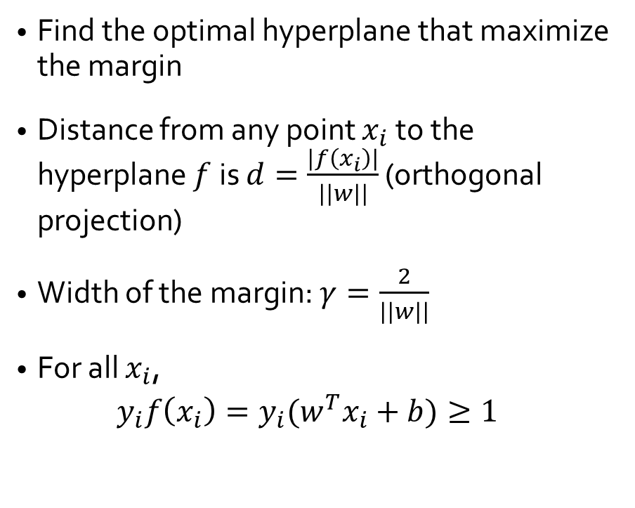



Support Vector Machines
Support Vectors

Slide 11
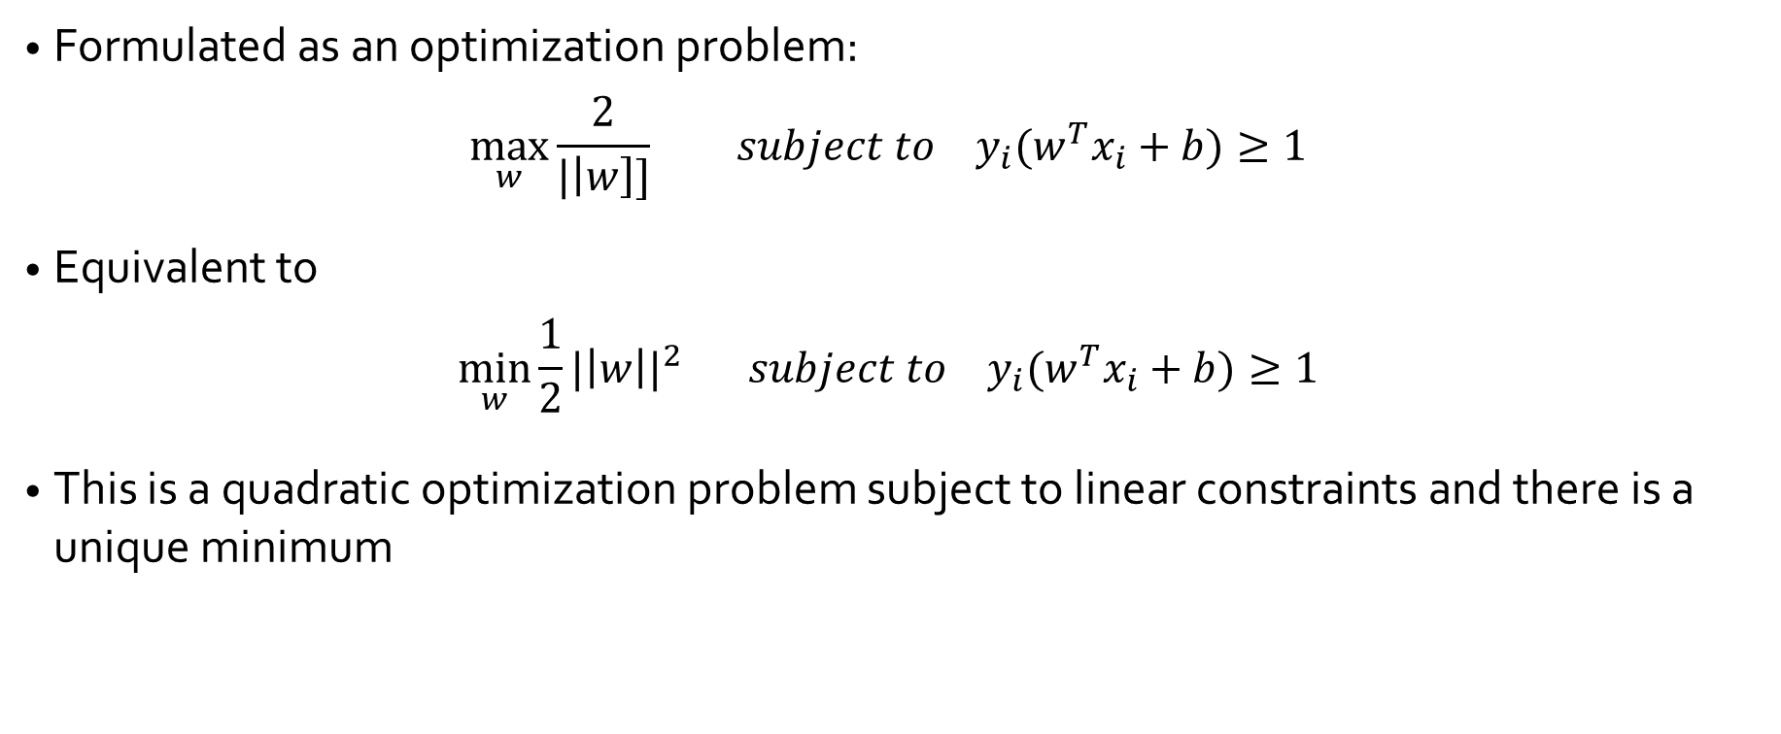
Learning SVM

Slide 12
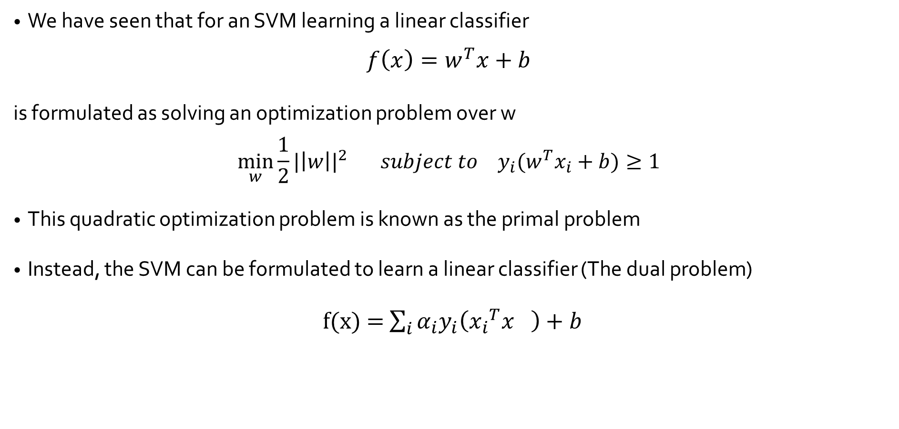
Learning SVM

Slide 13
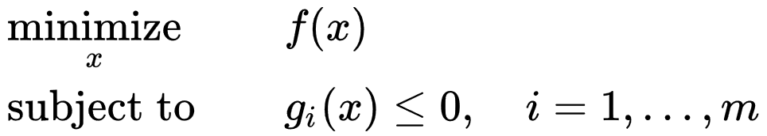
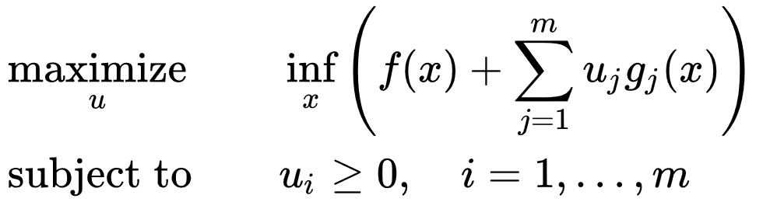
Learning SVM
For a convex minimization problem with inequality constraints,
The Lagrangian dual problem is
where the objective function is the Lagrange dual function.

Slide 14
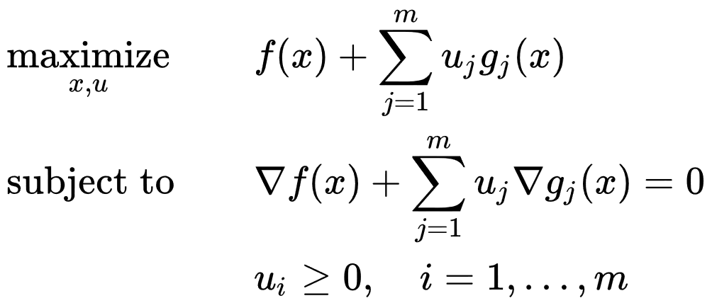
Learning SVM
Provided that the functions ff and g ₁ , … , g_{m} are continuously differentiable, the infimum occurs where the gradient is equal to zero. The problem
is called the Wolfe dual problem. This problem may be difficult to deal with computationally, because the objective function is not concave in the joint variables ( u , x ).

Slide 15
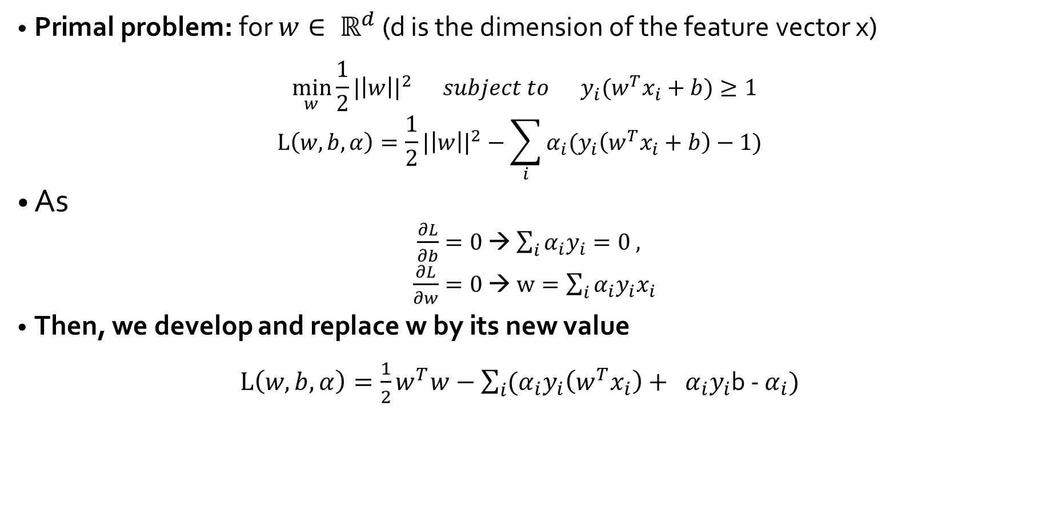
Solving SVM

Slide 16
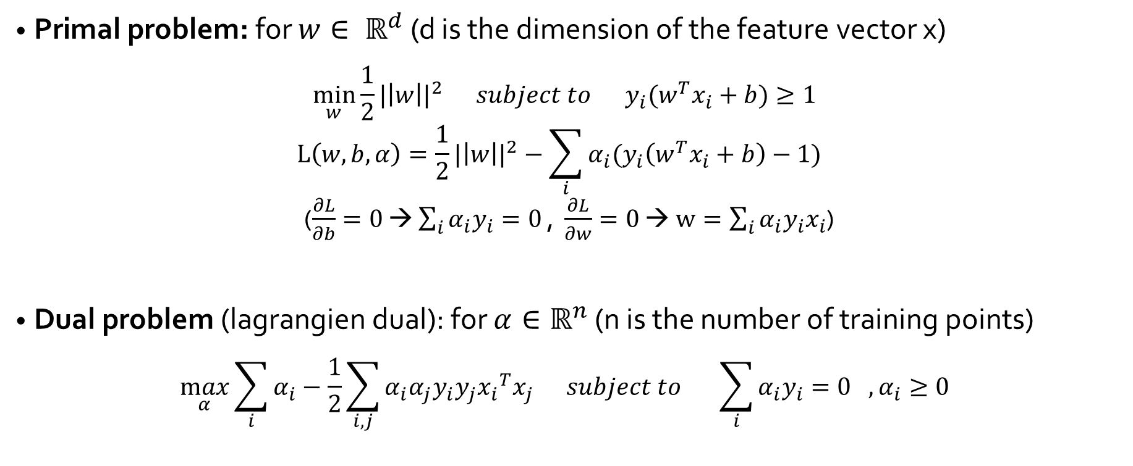
Solving SVM

Slide 17
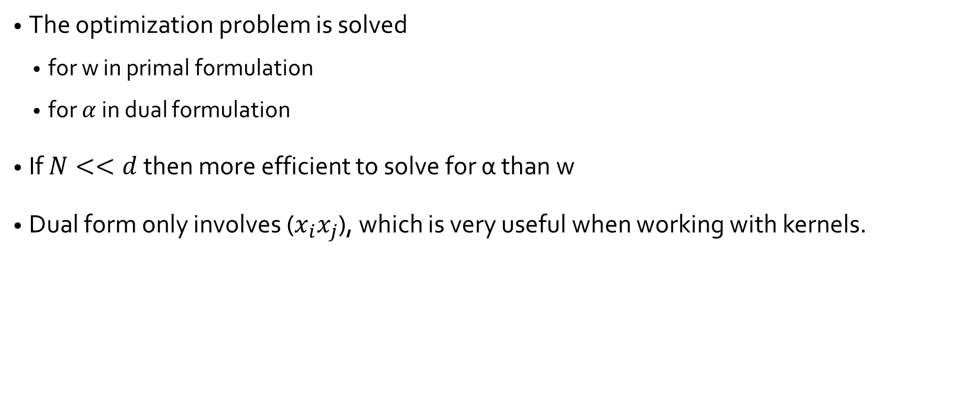
Solving SVM

Slide 18
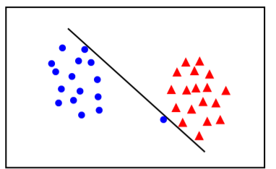
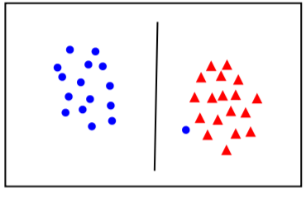
Linear separability
What about mislabelled data and outliers?
Linearly separable but narrow margin
A large margin may be preffered even though some points are misclassified (the constraint is not satisfied)
Solution: Loosen some of the constraints by introducing slack variables (soft margin)
Notes:
Slack variables are introduced to allow certain constraints to be violated. That is, certain training points will be allowed to be within the margin. We want the number of points within the margin to be as small as possible, and of course we want their penetration of the margin to be as small as possible.

Slide 19
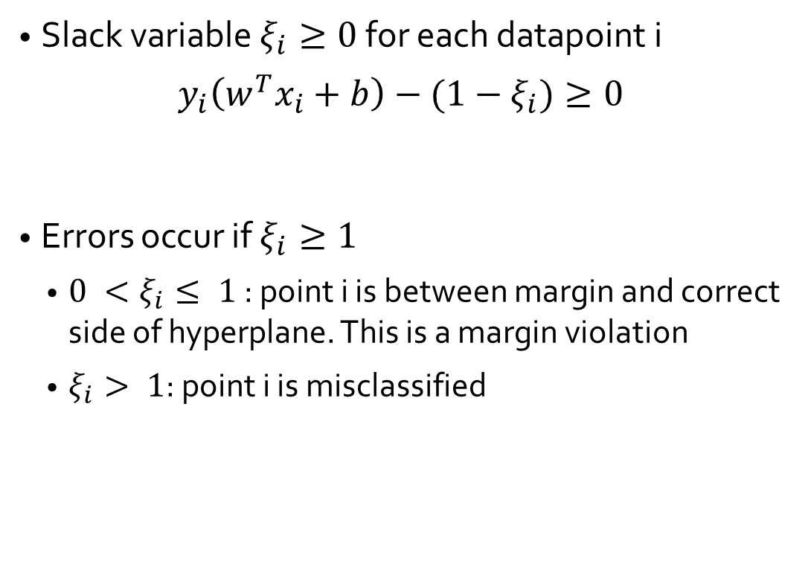
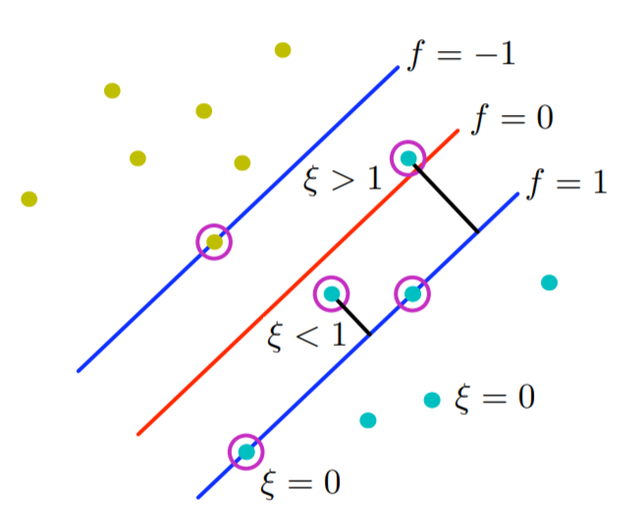
Soft-margin classification

Slide 20
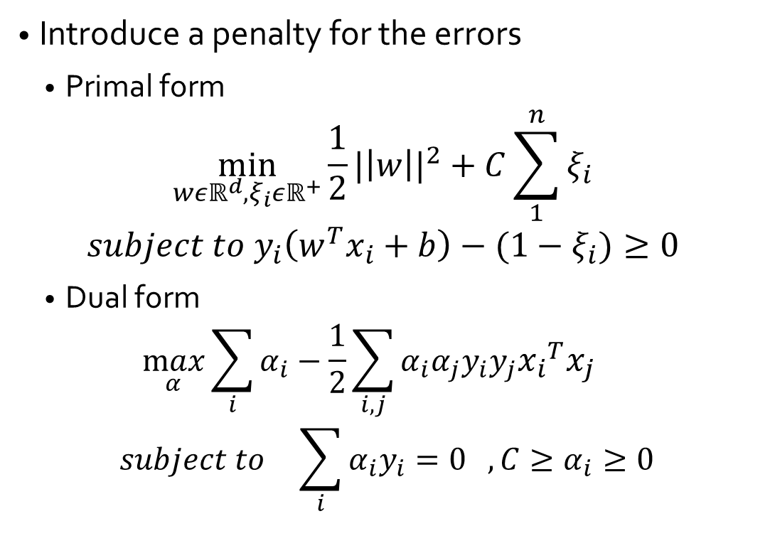
Soft-margin classification

Slide 21
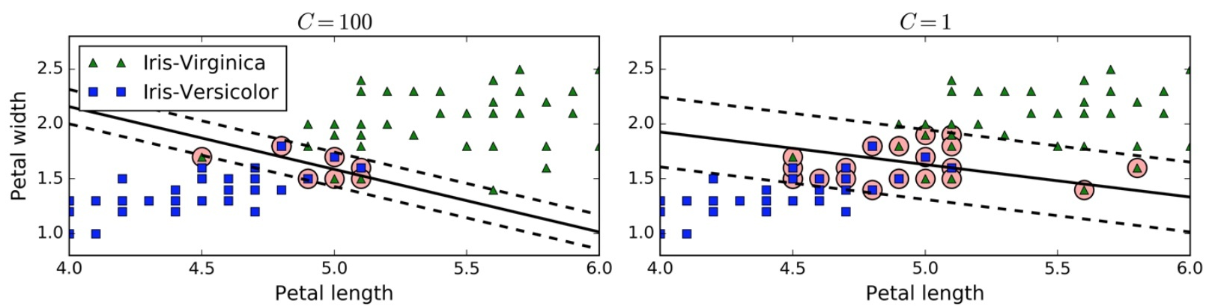
The hyperparameter C
C is the penality parameter
Small margins for higher values of C: better classification but may overfit
Large margins for lower values of C: makes some prediction error but generalize well

Slide 22
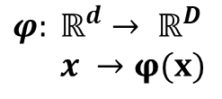


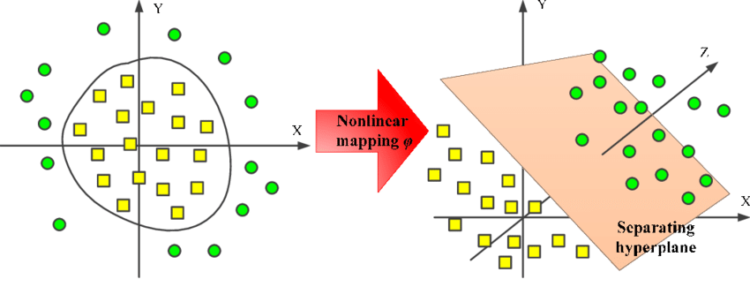
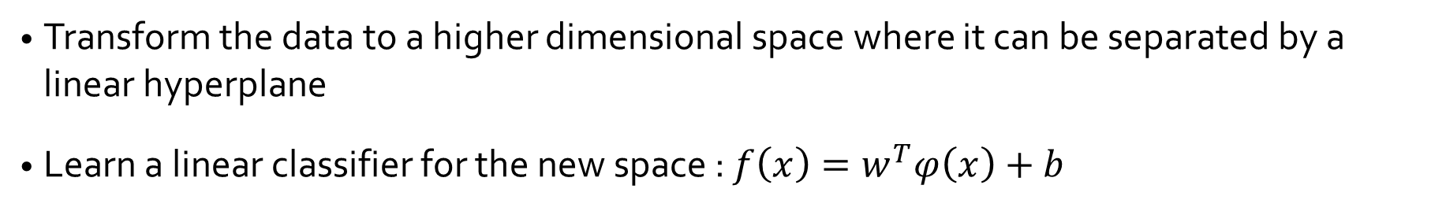
Nonlinear problems

Slide 23


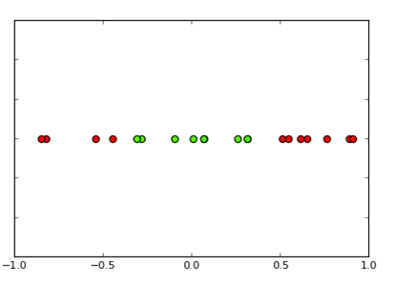
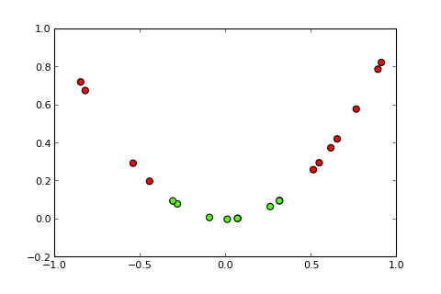
Nonlinear problems
x₂
x₁
x₁
Add a feature x₂=(x₁)² to make the dataset linearly separable

Slide 24
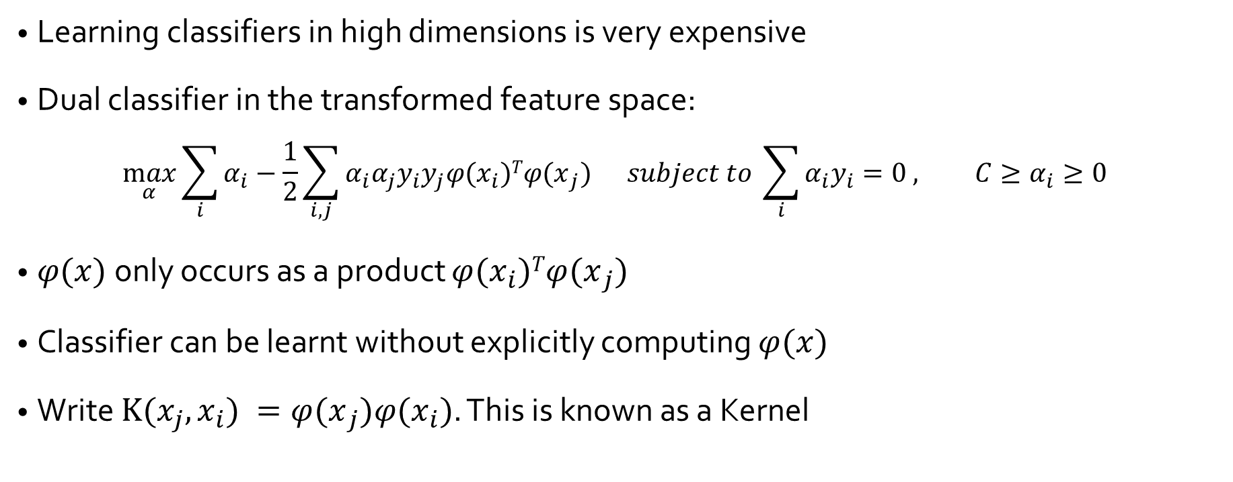
The kernel trick

Slide 25
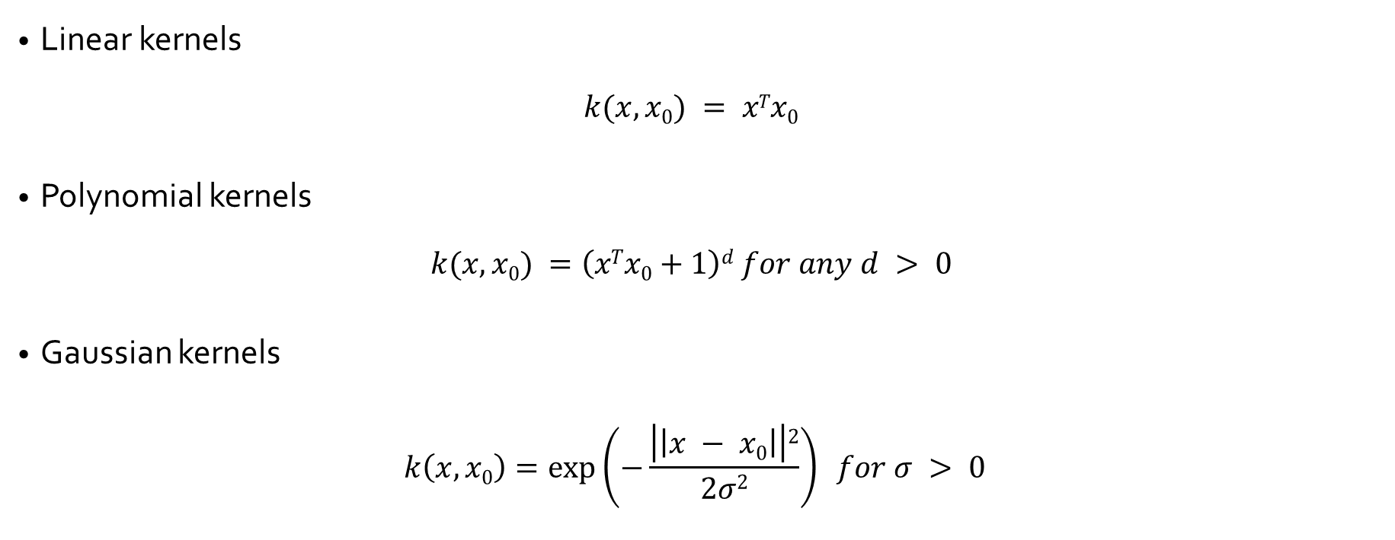
Common kernels

Slide 26
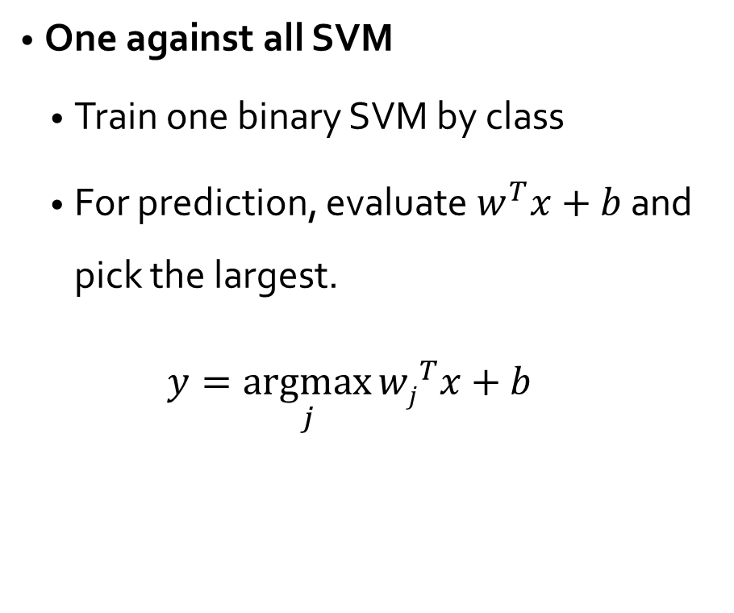
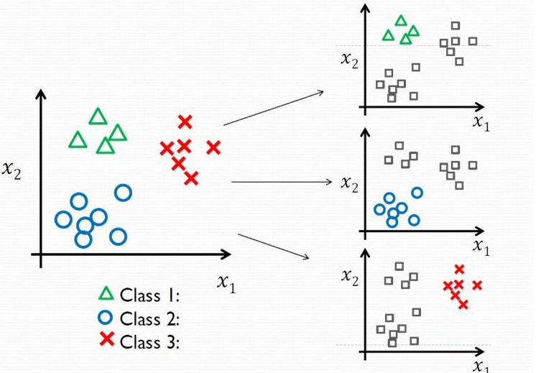
Multiclass Classification

Slide 27
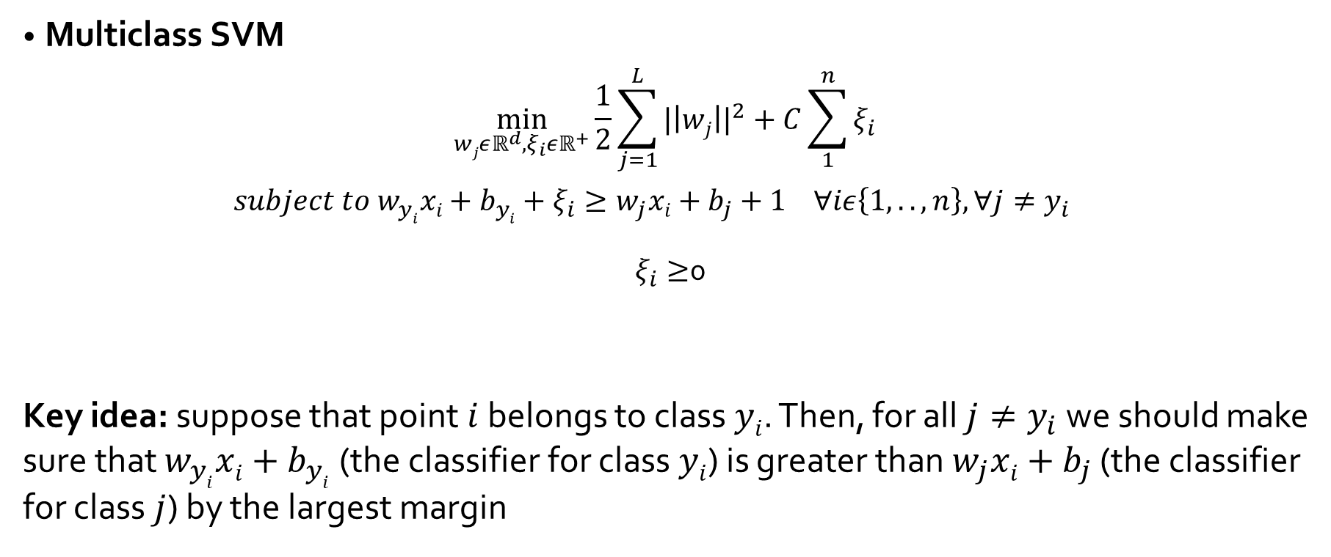
Multiclass Classification

Slide 28
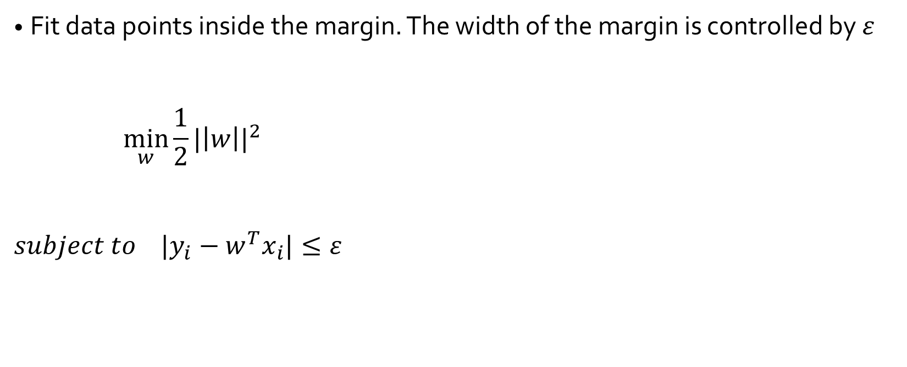
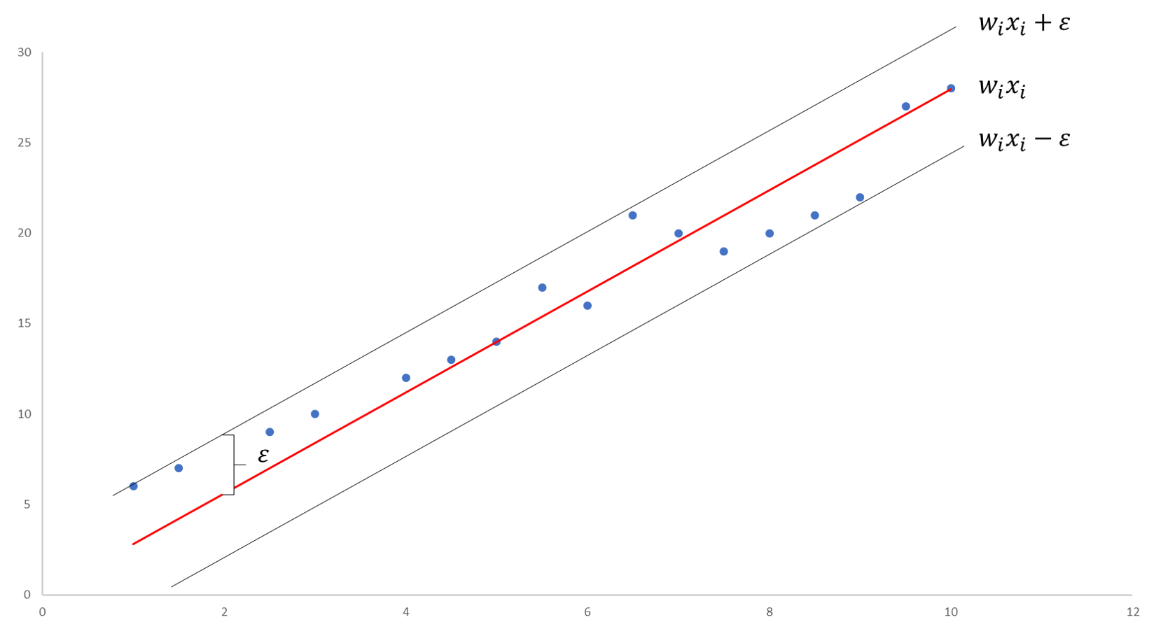
SVM regression

Slide 29
Conclusions
Two key points of SVM:
Maximize the margin between classes using actual data points
Project the data into a higher dimensional space in which the data is linearly separable
Hard margin vs soft margin
Soft margin makes SVM more robust to outliers
SVM is model for classification and for regression
In classification, find an hyperplan that separate the classes with the largest margin
In regression, find an hyperplan that fit the data within a margin of a given width
SVM is inherently a two class model but can be extended for multiclass problems
one vs all
Multiclass SVM

Slide 30
K-NEAREST NEIGHBOR (KNN)

Slide 31
What is K-NN?
A simple, easy to implement supervised machine learning model
Can used for classification and regression problems
Unlike previous learning methods, it does not build a model from the training data.
Classification is based on similarity with neighbors.
K stands for number of data items that are considered for the classification
A non parametric lazy learning model (instance-based)
K is the only parameter

Slide 32
Eager vs lazy learning
Eager learners use training data to construct a generalization model before receiving new data to classify
Lazy learners simply store data and waits until it is given test data
No training is needed for lazy learners. Classification time is linear in training set size for each test case
Lazy learners: less time in training but more in predicting
Lazy learners are also referred to as instance-based learners

Slide 33
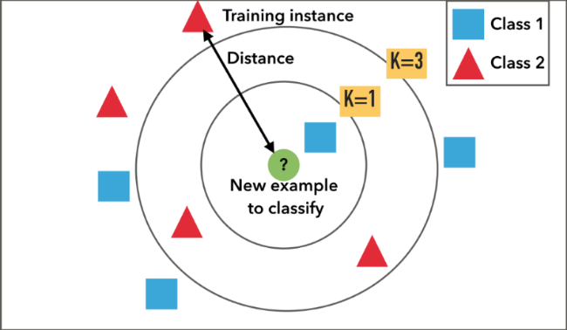
KNN: Basic Idea
For a new instance to be classified. Identify nearby instances (neighbors)
Neighbors are instances with similar predictor values, measured by a distance function
The new instance is assigned to the most common class amongst its K nearest neighbors

Slide 34
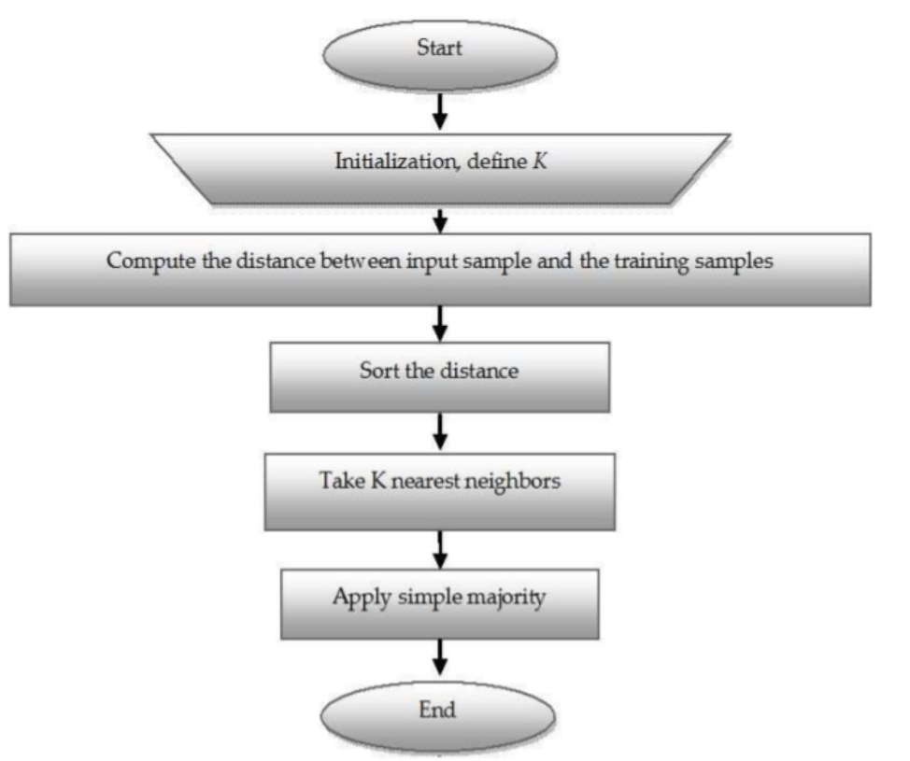
KNN Algorithm
Requires:
The set of stored training instances
A distance metric to compute distance between instances
The value of K, the number of nearest neighbors to retrieve

Slide 35
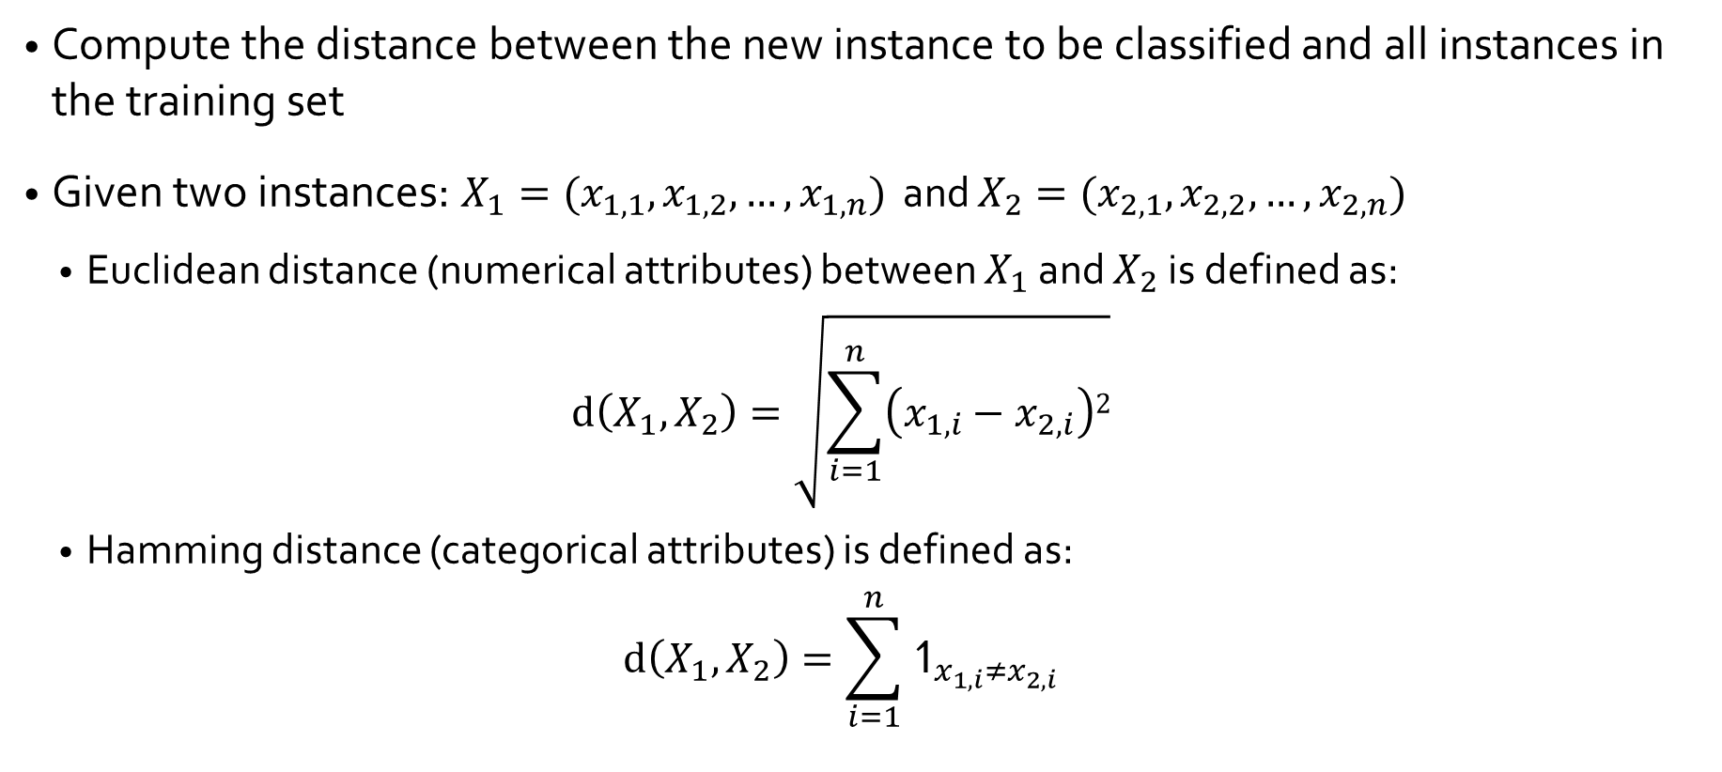
Distance between Instances

Slide 36
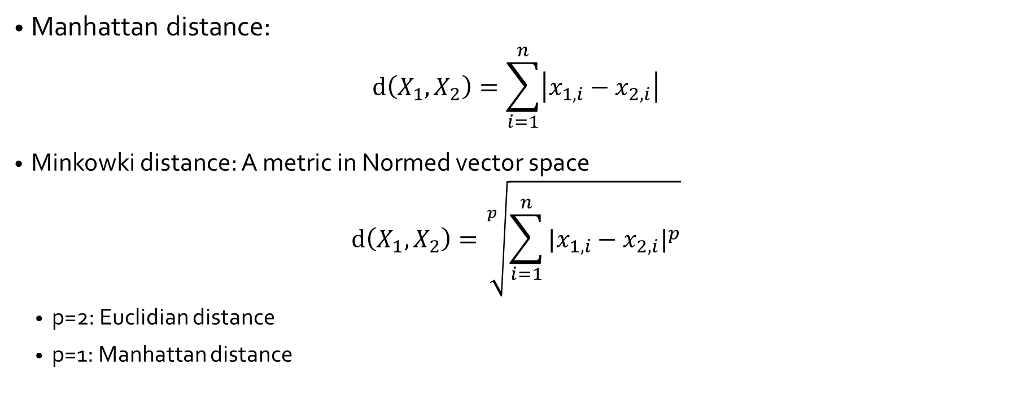
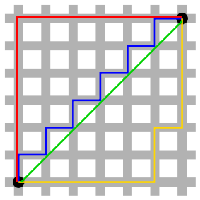
Other Distance metrics

Slide 37
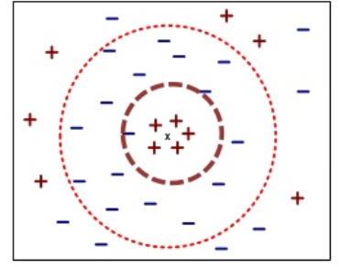
The choice of K
Value of K has strong effect of the performance of KNN
Small value 🡪 sensitive to noisy data
Large value 🡪 neighborhood may include majority data points from other classes

Slide 38
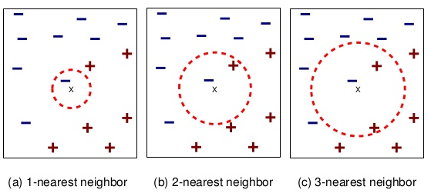
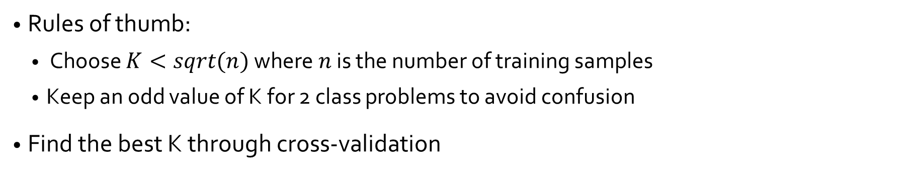
The choice of K

Slide 39
Conclusion
Pros of KNN:
Very simple and intuitive
No assumption about data distribution
Can do well in practice with enough representative data
Cons of KNN:
Requires a large training set for accuracy
Computationally expensive for large training set
Calculate distance from a new instance to all other instances
Performance depends on the distance measure
Finding a meaningful distance measure can be difficult

