Slide 1
Introduction to Python Programming

Slide 2
Ismail BERRADA
Graduated from ENSEIRB-MATMECA, INP Bordeaux
Post-graduate diploma (DEA) in Parallel Computing (HPC) from the U. of Bordeaux
PhD at Labri – University of Bordeaux
Maître de Conférences at the University of La Rochelle
Associate Professor at FSDM-USMBA
Now: Associate professor at UM6P-CS

Slide 3
Outline for Learning lab
Introduction
History
Characteristics
Environment
Anaconda
IDE
Virtual Environnment
Jupyter Lab or Notebook
Data types
Numbers
String
Printing
Lists
Dictionaries
Booleans
Tuples
Sets
Python Comparison Operators
Python statements
if, elif, else Statements
for Loops
while Loops
Methods and functions
lambda expressions
map and filter
Error handling
Modules and Packages

Slide 4
Notice
Please note, this is not meant to be a comprehensive overview of Python or programming in general.

Slide 5
Python characteristics
Started by Guido Van Rossum as a hobby project in 1991
concentrate on the problem rather than the language
Interpreted, high-level, general-purpose programming language, dynamically typed and garbage-collected.
Free & Open source
Simple
Easy to Learn
Extensive libraries
Portable – (c compiler)
Object-Oriented
Support procedural programming
Extensible
Embeddable

Slide 6
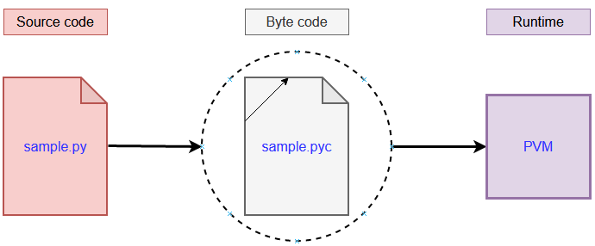
Python characteristics
Compilation = translating your human understandable code to machine understandable code.
Interpretation = executing a program by reading the source code a line at a time and doing what it says.
Python is an interpreted language and not a compiled one, although compilation is a step.
Python code, written in .py file is first compiled to what is called bytecode which is stored with a .pyc or .pyo format.

Slide 7
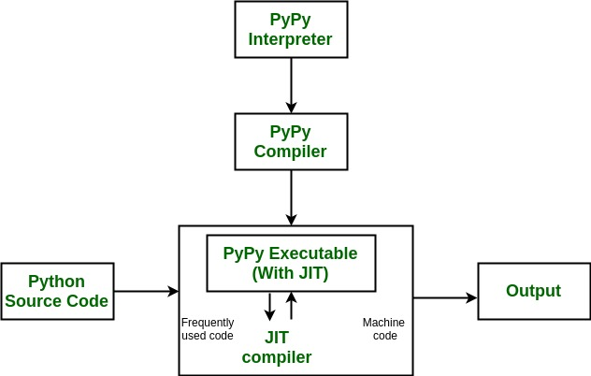
Python characteristics
Several Python Interpreter Implementations:
CPython
Jython
IronPython
Several just-in-time (JIT) compiler implementations:
PyPy
Numba translates a subset of Python and NumPy code into fast machine code

Slide 8
Outline
Environment
Data types
Numbers
String
Printing
Lists
Dictionaries
Booleans
Tuples
Sets
Python Comparison Operators
Python statements
if, elif, else Statements
for Loops
while Loops
Methods and functions
lambda expressions
map and filter
Error handling
Modules and Packages

