Slide 1
Python Environnement

Slide 2
Python version
Python 2 or Python 3 ? Definitely 3
https://www.python.org/
https://pythonclock.org/

Slide 3




Python distributions
Why Python ?
The rich ecosystem of libraries and tooling, and the convenience of the language itself, make Python an excellent choice.
Many distributions of Python, such as:
WinPython,
ActivePython,
Anaconda,
Enthought Canopy,
Python(x,y),
Pyzo

Slide 4
Python distributions
Why Python ?
For this course, let’s install Anaconda for python 3
https://www.anaconda.com/products/individual

Slide 5
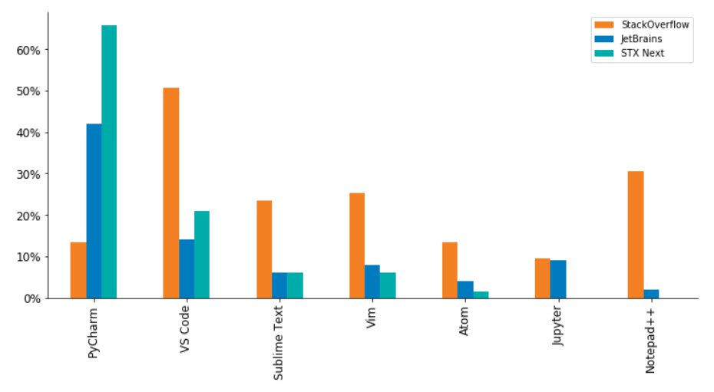
Python IDE
Which Python IDE?
An IDE (Integrated Development Environment) is a software application used by developers for creating programs.
Python IDEs for Data Science
Spyder
PyCharm
Atom
Jupyter Notebook
Jupyter Lab
Visual Studio Code
PyDev
Source: https://www.stxnext.com/blog/best-python-ides-code-editors/
Notes:
https://www.datacamp.com/community/tutorials/data-science-python-ide

Slide 6
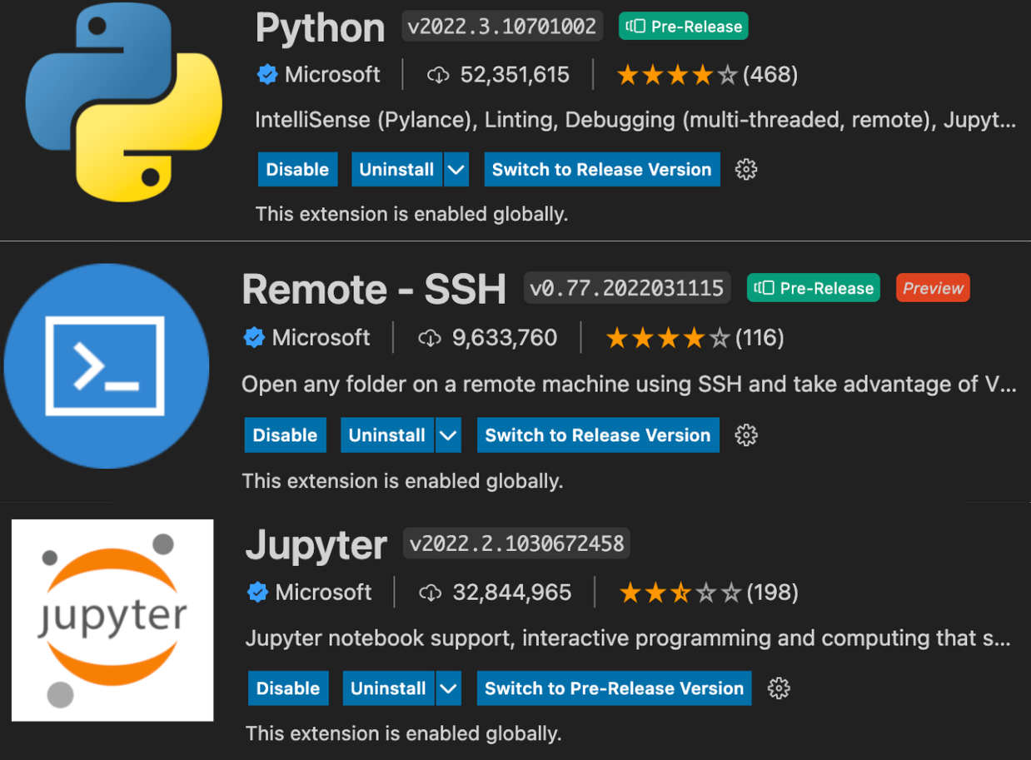
Python IDE
Python IDEs for Data Science
http://www.jupyter.org/
and
try it with python in http://jupyter.org/try
Code Cell
Markdaown Cell
Next, we will user Jupyter Notebooks Extension for Visual Studio Code
Notes:
https://www.datacamp.com/community/tutorials/data-science-python-ide

Slide 7
Python Virtual Environment
Why Virtual Environment?
Virtual environment = a self-contained directory tree that contains a Python installation for a particular version of Python, plus a number of additional packages
Allows virtual installations of Python and libraries on your computer
Multiple versions of Python or libraries and easily activate or deactivate these environments
Sometimes you’ll want to program in different versions of a library. For example:
You develop a program with SciKit-Learn 0.17
SciKit-Learn 0.18 is released
You want to explore 0.18 but don’t want you old code to break

Slide 8
Python Virtual Environment
Why Virtual Environment?
Several ways to create a virtual environment
Using venv module of python (default)
python3 -m venv tutorial-env
source tutorial-env/bin/activate
pip3 search astronomy
pip3 install novas or pip install novas=2.1.0
source deactivate
Using Virtualenv Environment
Using Pipenv Environment

Slide 9
Python Virtual Environment
Why Virtual Environment?
Several ways to create a virtual environment
Using Anaconda (Conda) a Environment
https://conda.io/docs/user-guide/tasks/manage-environments.html
conda create --name myenv
conda install numpy
conda install anaconda
conda activate myvenv
conda deactivate

Slide 10
Jupyter Notebooks and Lab

Slide 11
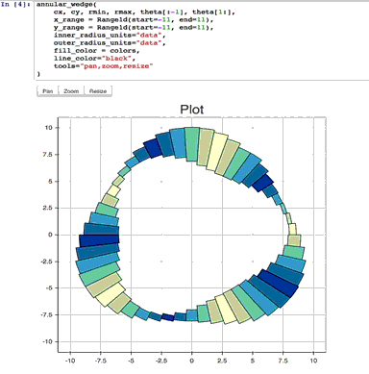

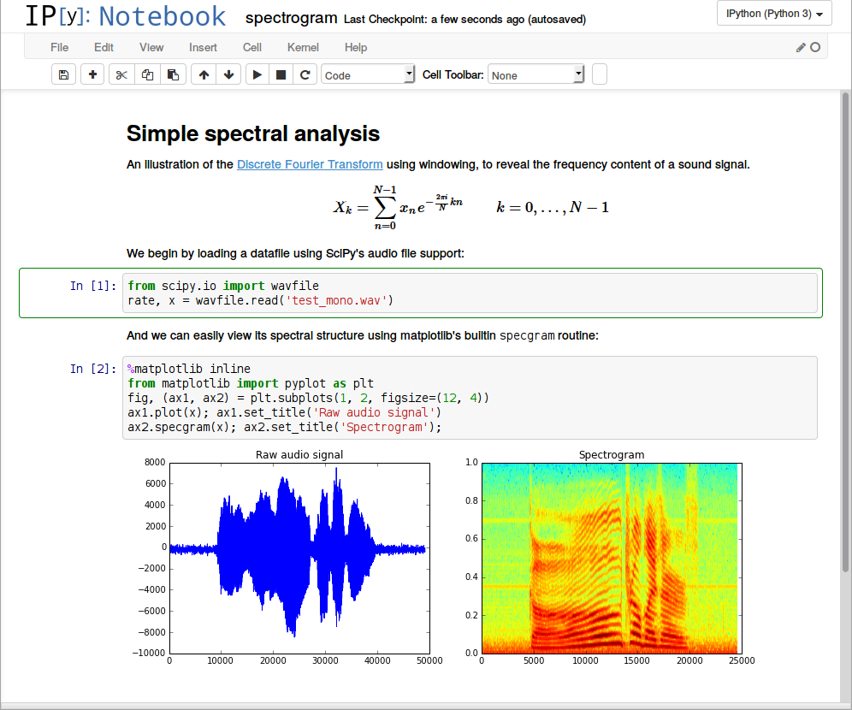
Jupyter Notebooks
Notebooks are an excellent way to document an engineering process because they allow you to combine nicely formatted text with code and results.
Jupyter notebooks use a serialized data storage format, JSON, to store the document.
Integrate many different text processing formats (HTML, Markdown, LaTex, …).
Jupyter notebook use a browser-like interface and is integrated into Anaconda

Slide 12
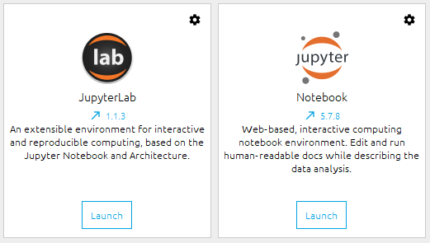
JupyterLab
pip install jupyterlab
JupyterLab runs in a single tab, with sub-tabs displayed within that one tab, while Jupyter Notebook opens new notebooks in new tabs.
JupyterLab feels more like an IDE
Jupyter Notebook feels more standalone

Slide 13
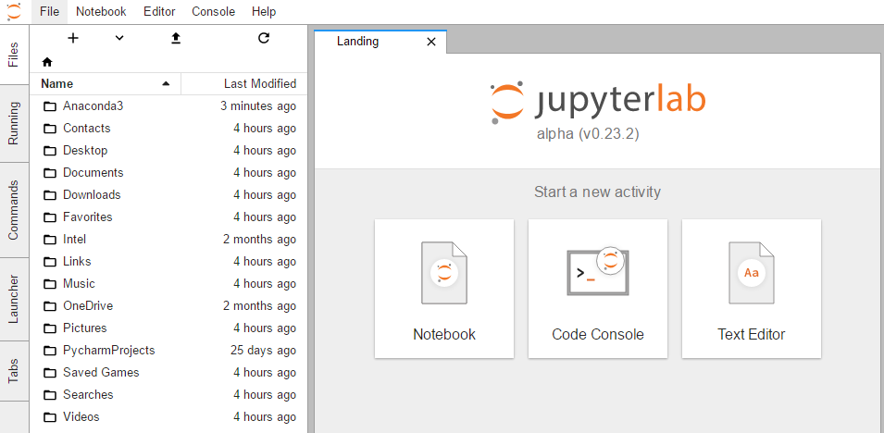
JupyterLab
pip install jupyterlab
Installation
Jupyter Notebook comes with Anaconda
conda install -c conda-forge jupyterlab
Running
jupyter-lab
jupyter notebook

Slide 14
JupyterLab
pip install jupyterlab
Jupyter cells
Code
Markdown/Text
See Demo

