Slide 1
GIT
A distributed version control system

Slide 2
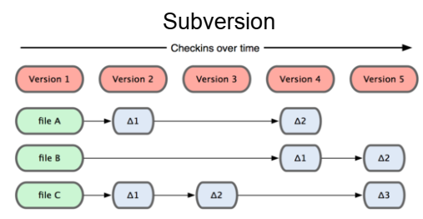
Version control systems
Version control (or revision control, or source control):
  managing multiple versions of documents,
  programs,
  web sites,
  etc.

Slide 3
Why version control?
For working by yourself:
  Gives you a “time machine” for going back to earlier versions
  Gives you great support for different versions (standalone, web app, etc.) of the same basic project
For working with others:
  Greatly simplifies concurrent work, merging changes
For getting an internship or job:
  Any company with a clue uses some kind of version control
  Companies without a clue are bad places to work

Slide 4
Version control systems
Well-known version control systems: CVS, Subversion, Mercurial, and Git
  “central” repositories: CVS and Subversion use a “central” repository; users “check out” files, work on them, and “check them in”
  “distributed” repositories: Mercurial and Git treat all repositories as equal

Slide 5
Version control systems
In git, mercurial, etc., you don't "checkout“ from a central repo
  you "clone" it and "pull" changes from it
Your local repo is a complete copy of everything on the remote server
  yours is "just as good" as theirs
Many operations are local:
  check in/out from local repo
  commit changes to local repo
  local repo keeps version history
When you're ready, you can "push" changes back to server

Slide 6
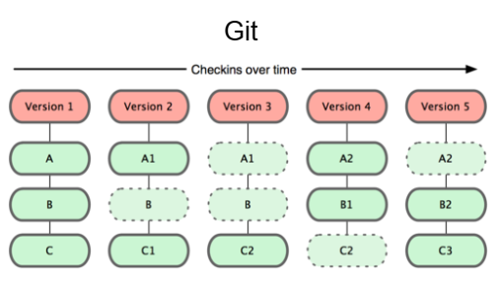
Why Git?
Git has many advantages over earlier systems such as CVS and Subversion
  More efficient, better workflow, etc.
  Git keeps "snapshots" of the entire state of the project.

Slide 7
Download and install Git
Online materials
  Sous Mac OS X
    http://sourceforge.net/projects/git-osx-installer
    brew install git
  Sous Linux
    apt-get install git (debian/ubuntu)
    yum install git (fedora/redhat)
  Standard one:
    http://git-scm.com/downloads
  SackExchange:
    http://stackoverflow.com/questions/315911/git-for-beginners-the-definitive-practical-guide#323764

Slide 8
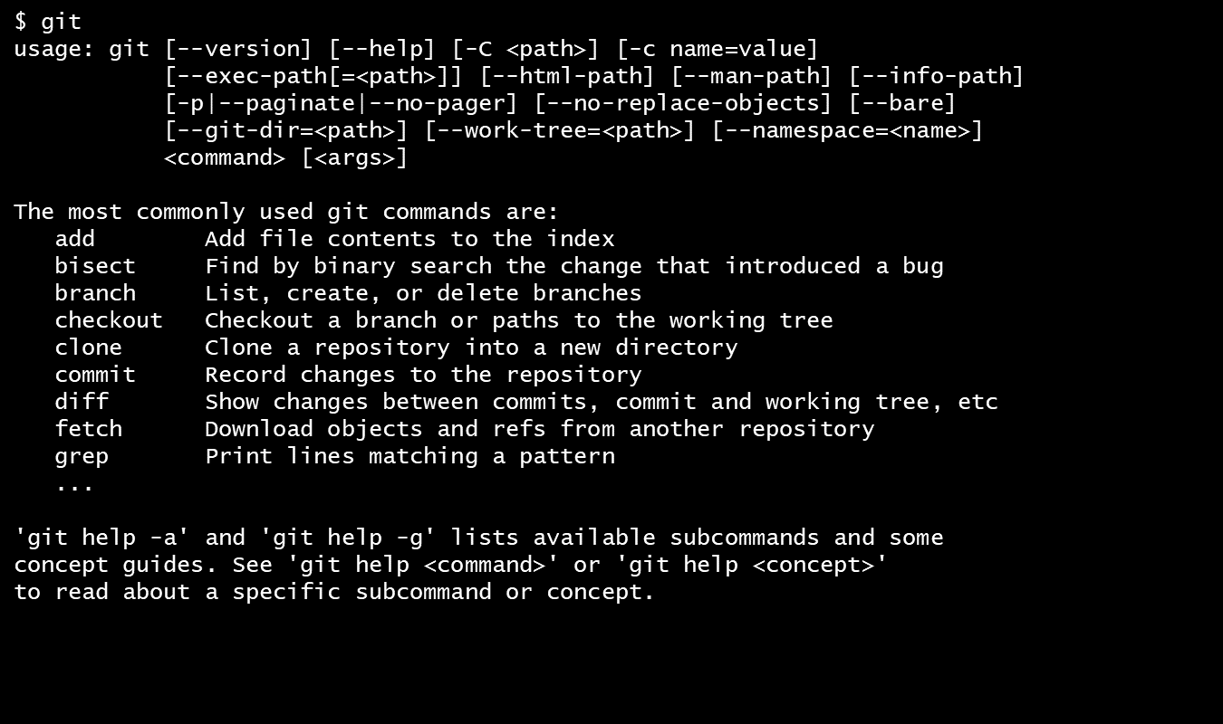
Download and install Git
Online materials
  Git is primarily a command-line tool
  The GIT GUIs are more trouble than they are worth

Slide 9
Let’s create your first GIT
Step 1 : Make global configuration (once)
  Enter these lines (with appropriate changes):
    git config --global user.name “Ismail Berrada"
    git config --global user.email ismail.berrada@um6p.ma
    You can call git config –list to verify these are set.
  You can use a different name/email address for a particular project, you can change it for just that project
    cd to the project directory
    Use the above commands, but leave out the –global
  Set the editor that is used for writing commit messages:
    git config --global core.editor nano

Slide 10
Let’s create your first GIT
Step 2 : Create a local repository
  cd to the project directory you want to use (burgers)
  Type in git init
    This creates the repository (a directory named .git) containing various files (a “hidden” directory)
    You do not work directly with the contents of that directory; various git commands do that for you
    You do need a basic understanding of what is in the repository

Slide 11
Let’s create your first GIT
Step 3 : Fill the local repository
  You do your work in your project directory, as usual
  If you create new files and/or folders, they are not tracked by Git unless you ask it to do so
    git add newFile1 newFolder1 newFolder2 newFile2
    Or type in git add .
    The dot at the end is part of this command!
      do means “this directory”
      This adds all your current files to the repository

Slide 12
Let’s create your first GIT
Step 4 : Commit to the local repository
  Committing makes a “snapshot” of everything being tracked into your repository. A message telling what you have done is required
    Type in git commit –m "Initial commit"
    Or type git commit
      This version opens an editor for you the enter the message
      To finish, save and quit the editor
    In git, “Commits are cheap”, do them often.

Slide 13
Let’s create your first GIT
Step 5 : Clone a remote repository
  You can clone a remote repo to your current directory:
    git clone url localDirectoryName
    This will create the given local directory, containing a working copy of the files from the repo, and a .git directory (used to hold the staging area and your actual local repo)

Slide 14
Git vocabulary
Repository
Your top-level working directory contains everything about your project
  The working directory probably contains many subdirectories—source code, binaries, documentation, data files, etc.
  One of these subdirectories, named .git, is your repository
  Git database is a (key = object) database
    Content are stored in blob (object)
    Filename are stored in tree

Slide 15
Git vocabulary
Changeset/commit
At any time, you can take a “snapshot” of everything (or selected things) in your project directory, and put it in your repository
  This “snapshot” is called a commit object
  The commit object contains (1) a set of files, (2) references to the “parents” of the commit object, and (3) a unique “SHA1” name
  Commit objects do not require huge amounts of memory
You can work as much as you like in your working directory, but the repository isn’t updated until you commit something

Slide 16
Git vocabulary
release:
  A release is the distribution of a given changest of repository. It may be either public or private and generally constitutes the initial generation of a new or upgraded application.
version:
  version of release corresponding to a given commit

Slide 17
Git internal storage
Object model
All the information needed to represent the history of a project is stored in files referenced by a 40-digit "object name" SHA1
Every object consists of three things: a type, a size and content.
Four different types of objects:
  A "blob" is used to store file data - it is generally a file.
  A "tree" is basically like a directory - it references a bunch of other trees and/or blobs (i.e. files and sub-directories)
  A "commit" points to a single tree, marking it as what the project looked like at a certain point in time.
  A "tag" is a way to mark a specific commit as special in some way. It is normally used to tag certain commits as specific releases or something along those lines.<
Notes:
http://shafiul.github.io/gitbook/1_the_git_object_model.html

Slide 18
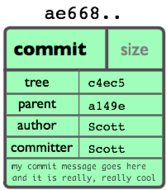
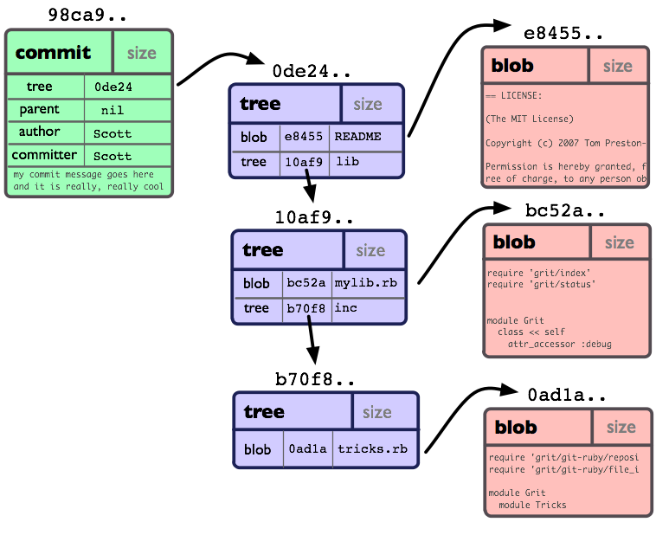
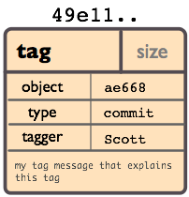
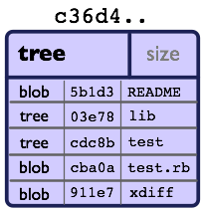
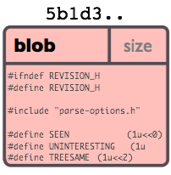
Git internal storage
Object model

Slide 19
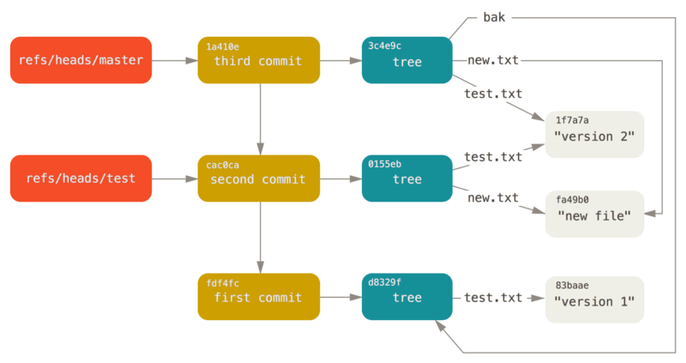
Git internal storage
Git references
  Git keeps the history of your repository reachable from commit, in files called “references” or “refs”.
  You can find the files that contain those SHA-1 values in the .git/refs directory.
Notes:
https://git-scm.com/book/en/v2/Git-Internals-Git-References
Got to .get/refs/headers
Type: ls
Type: « cat file_name »
Type: git cat-file –p content_file_name_hash

Slide 20
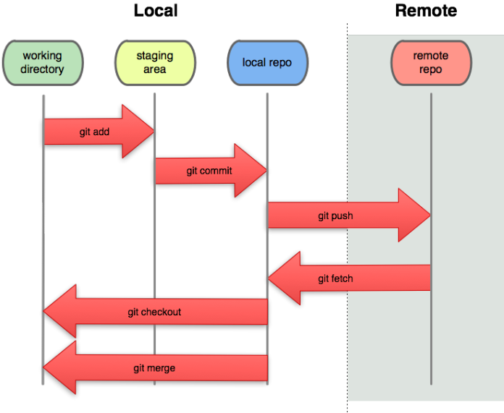
Git workflow
Local vs Remote
Notes:
https://git-scm.com/book/en/v2/Git-Internals-Git-Objects

Slide 21
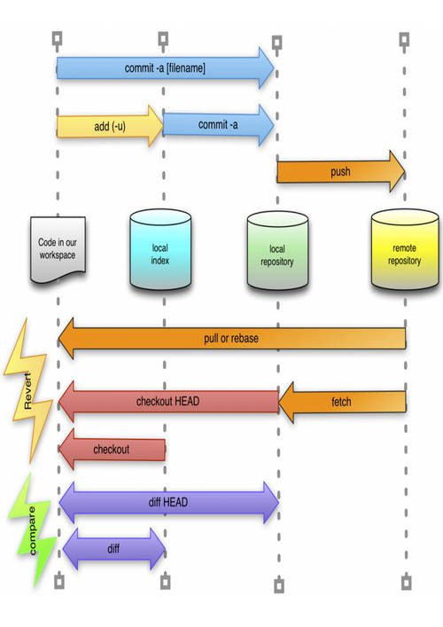
Git workflow
Local vs remote
Notes:
https://git-scm.com/book/en/v2/Git-Internals-Git-Objects

Slide 22
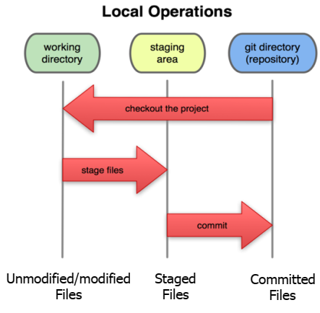
Local git area
In your local copy on git, files can be:
  In your local repo (committed)
  Checked out and modified, but not yet committed (working copy)
  Or, in-between, in a "staging" area
Staged files are ready to be committed.
A commit saves a snapshot of all staged state.

Slide 23
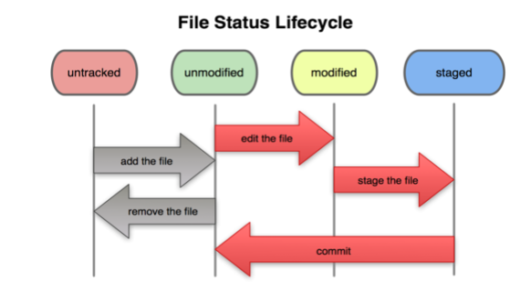
Local git area
Basic git workflow
  Modify files in your working directory.
  Stage files, adding snapshots of them to your staging area.
  Commit, which takes the files in the staging area and stores that snapshot permanently to your Git directory.

Slide 24
Local git area
Git commit checksums
  In Subversion each modification to the central repo increments the version # of the overall repo.
  In Git, each user has their own copy of the repo, and commits changes to their local copy of the repo before pushing to the central server.
  So Git generates a unique SHA-1 hash (40 character string of hex digits) for every commit. Refers to commits by this ID rather than a version number.
  Often we only see the first 7 characters:
    1677b2d Edited first line of readme
    258efa7 Added line to readme
    0e52da7 Initial commit

Slide 25
Local git area
When you commit your change to git, it creates a commit object
  A commit object represents the complete state of the project, including all the files in the project
  The very first commit object has no “parents”
  Usually, you take some commit object, make some changes, and create a new commit object; the original commit object is the parent of the new commit object
    Hence, most commit objects have a single parent
  You can also merge two commit objects to form a new one
    The new commit object has two parents
Commit objects form a directed graph
  Git is all about using and manipulating this graph
Notes:
https://developers.sap.com/tutorials/webide-github-merge-pull-request.html

Slide 26
Local git area
Working with your repository
A head is a reference to a commit object
The “current head” is called HEAD (all caps)
Usually, you will take HEAD (the current commit object), make some changes to it, and commit the changes, creating a new current commit object
  This results in a linear graph: A → B → C → …→ HEAD
You can also take any previous commit object, make changes to it, and commit those changes
  This creates a branch in the graph of commit objects
You can merge any previous commit objects
  This joins branches in the commit graph
Notes:
https://developers.sap.com/tutorials/webide-github-merge-pull-request.html

Slide 27
Local git area
merge
Initial commit
Second commit
Third commit
Bob gets a copy
Fourth commit
Bob’s commit
Merge
Notes:
https://developers.sap.com/tutorials/webide-github-merge-pull-request.html

Slide 28
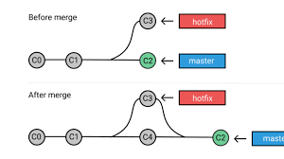
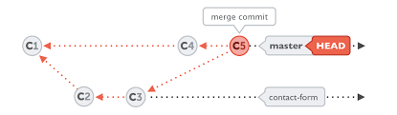
Local git area
merge
Notes:
https://developers.sap.com/tutorials/webide-github-merge-pull-request.html

Slide 29
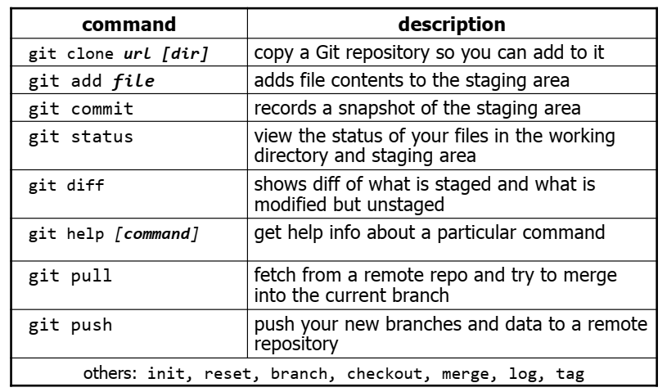
Local git area
Git commands
Notes:
https://git-scm.com/docs/git-merge-file

Slide 30

Working with others
Cycle
Git server
burgers
burgers
burgers
fetch
+
merge
push
fetch
+
merge
My Git repo
push
Git repo
burgers
burgers
burgers
burgers
clone
burgers
Julien
Bob
Steve

Slide 31

Working with others
Cycle
Working directory
merge
commit
pull
Git repo
.git
fetch
push
Git serve
.git shared

Slide 32
Working with others
Clone a repository from elsewhere
  git clone URL
  git clone URL mypath
    These make an exact copy of the repository at the given URL
  git clone git://github.com/rest_of_path/file.git
    Github is the most popular (free) public repository
All repositories are equal
  But you can treat some particular repository (such as one on Github) as the “master” directory
Typically, each team member works in his/her own repository, and “merges” with other repositories as appropriate

Slide 33
Working with others
All repositories are equal, but it is convenient to have one central repository in the cloud
Here’s what you normally do:
  Download the current HEAD from the central repository
  Make your changes
  Commit your changes to your local repository
  Check to make sure someone else on your team hasn’t updated the central repository since you got it
  Upload your changes to the central repository
If the central repository has changed since you got it:
  It is your responsibility to merge your two versions
    This is a strong incentive to commit and upload often!
  Git can often do this for you, if there aren’t incompatible changes

Slide 34
Working with others
Typical workflow
  git pull remote_repository
    Get changes from a remote repository and merge them into your own repository
  git status
    See what Git thinks is going on
    Use this frequently!
  Work on your files (remember to add any new ones)
  git commit –m “What I did”
  git push

Slide 35
Branches and merging
Typical workflow
r1
r2
r3
r5
r8
master
r4
r6
r7
branchname

Slide 36
Branches and merging
Git uses branching heavily to switch between multiple tasks.
  To create a new local branch:
    git branch name
  To list all local branches: (* = current branch)
    git branch
  To switch to a given local branch:
    git checkout branchname
  To merge changes from a branch into the local master:
    git checkout master
    git merge branchname

Slide 37
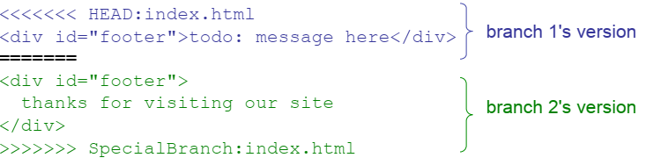
Merging conflict
The conflicting file will contain <<< and >>> sections to
indicate where Git was unable to resolve a conflict:
Find all such sections, and edit them to the proper state (whichever of the two versions is newer / better / more correct)

Slide 38
Some advises
If you:
  Make sure you are current with the central repository
  Make some improvements to your code
  Update the central repository before anyone else does
Then you don’t have to worry about resolving conflicts or working with multiple branches
  All the complexity in git comes from dealing with these
Therefore:
  Make sure you are up-to-date before starting to work
  Commit and update the central repository frequently
If you need help: https://help.github.com/
Notes:
https://developers.sap.com/tutorials/webide-github-merge-pull-request.html

